Slide 2
What does Asian American Pacific Islander mean?
Asian American: people whose ancestors are originally from Asia
Pacific Islander: people whose ancestors are originally from the Pacific Islands
The acronym AAPI is often used to mean Asian American Pacific Islander.
Another common acronym is API- Asian Pacific Islander.
Many people refer to themselves based on family country of origin
Examples: Chinese American, Samoan American, Thai American, Indian American…

Slide 3
Asian and Pacific Islander Identities are Wildly Diverse
There are 28 countries in the continent of Asia.
The continent is wildly diverse in terms of language, culture, religion, and so on...
There are over 2,300 different languages spoken.
The Pacific Islands are comprised of around 30,000 islands across a total of 15 countries.

Slide 4
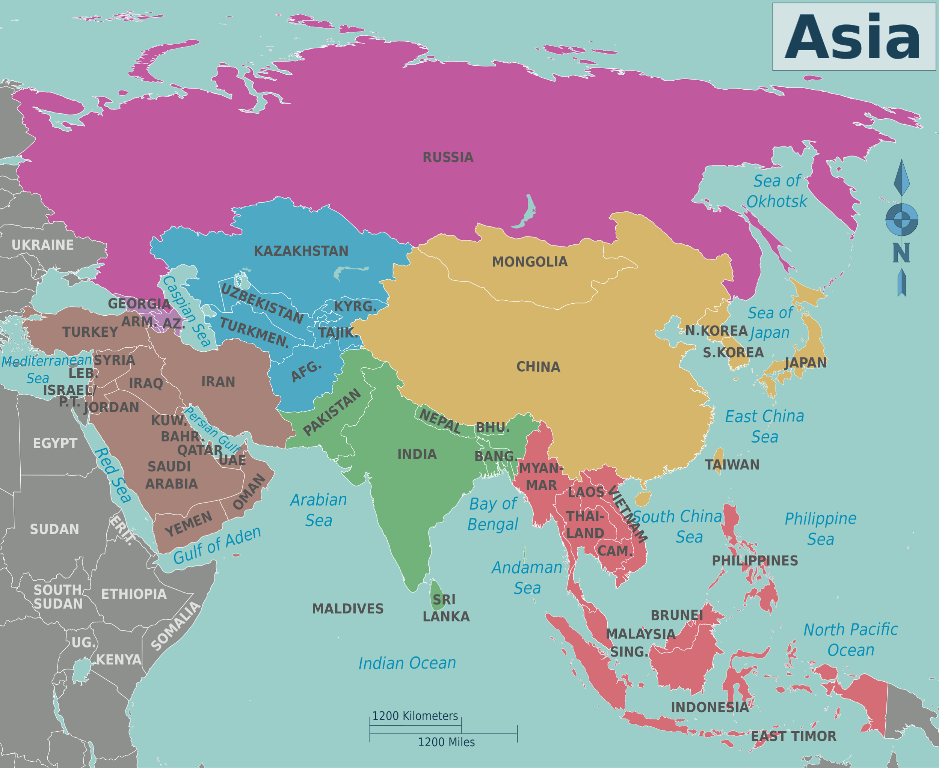

Slide 5
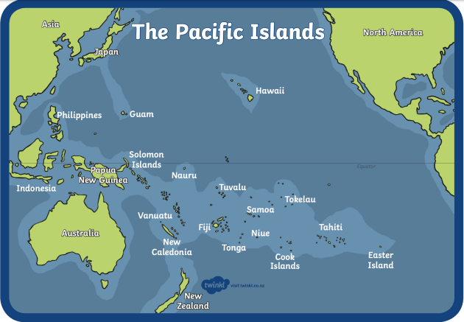

Slide 6
What are some other common AAPI terms?
East Asian: A person of Chinese, Koreas, Japanese, Taiwanese, or Mongolian descent.
South Asian: A person from Afghanistan, Pakistan, India, Bangladesh, Nepal, Bhutan, Sri Lanka or Maldives.
Southeast Asian: A person from Thailand, Vietnam, Malaysia, Singapore, the Philippines, Laos, Indonesia, Brunei, Burma (Myanmar), Cambodia and Timor-Leste.
Central Asian: A person with origins in the original peoples of Kazakhstan, Kyrgyz Republic, Tajikistan, Turkmenistan and Uzbekistan.
West Asian: A person with origins in the original peoples of Armenia, Azerbaijan, Bahrain, Cyprus, Georgia, Iraq, Israel, Jordan, Kuwait, Lebanon, Oman, Palestine, Qatar, Saudi Arabia, Syria, Turkey, United Arab Emirates and Yemen.

Slide 7
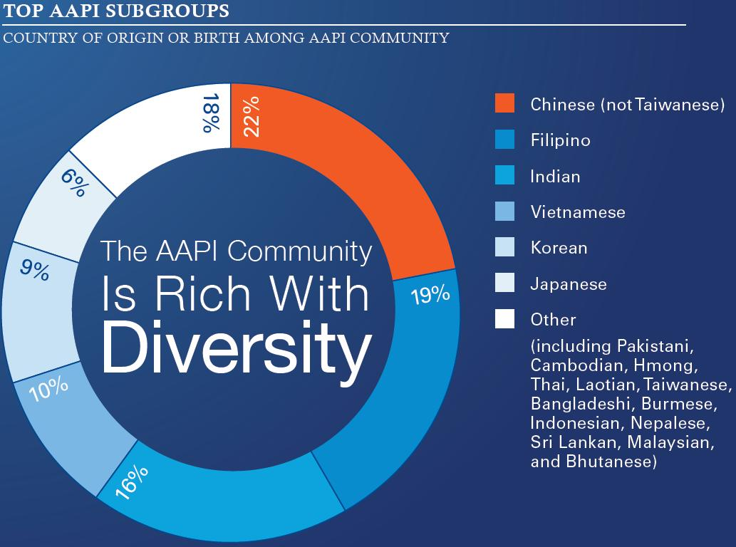
Approximately 16.6 million AAPIs reside in the U.S. (Approximately 5.4% of U.S. population). ^{I}
AAPIs represent over 30 countries^{iii} and ethnic groups that speak over 100 different languages.^{iv}
Notes:
From: https://obamawhitehouse.archives.gov/administration/eop/aapi/data/critical-issues

Slide 8
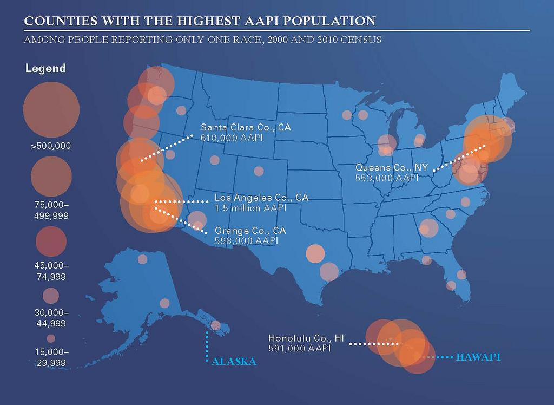
By 2050, AAPIs will make up 9.7% of the total United States population -- over 40 million people.^{ii}
AAPIs make up one of the fastest growing racial groups in the U.S.,^{xvii} constituting about one-third of the one million legal immigrants who enter the U.S. annually.^{xviii}
Notes:
From: https://obamawhitehouse.archives.gov/administration/eop/aapi/data/critical-issues

Slide 9
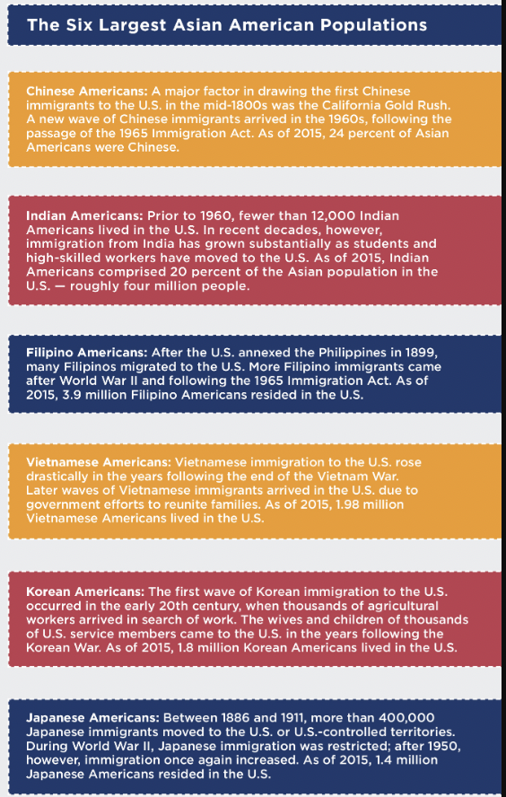
Notes:
From: https://www.insightintodiversity.com/wp-content/uploads/2017/05/Celebrating_Asian_American_Pacific_Islander_Heritage_Month_2018-copy.jpg

Slide 10
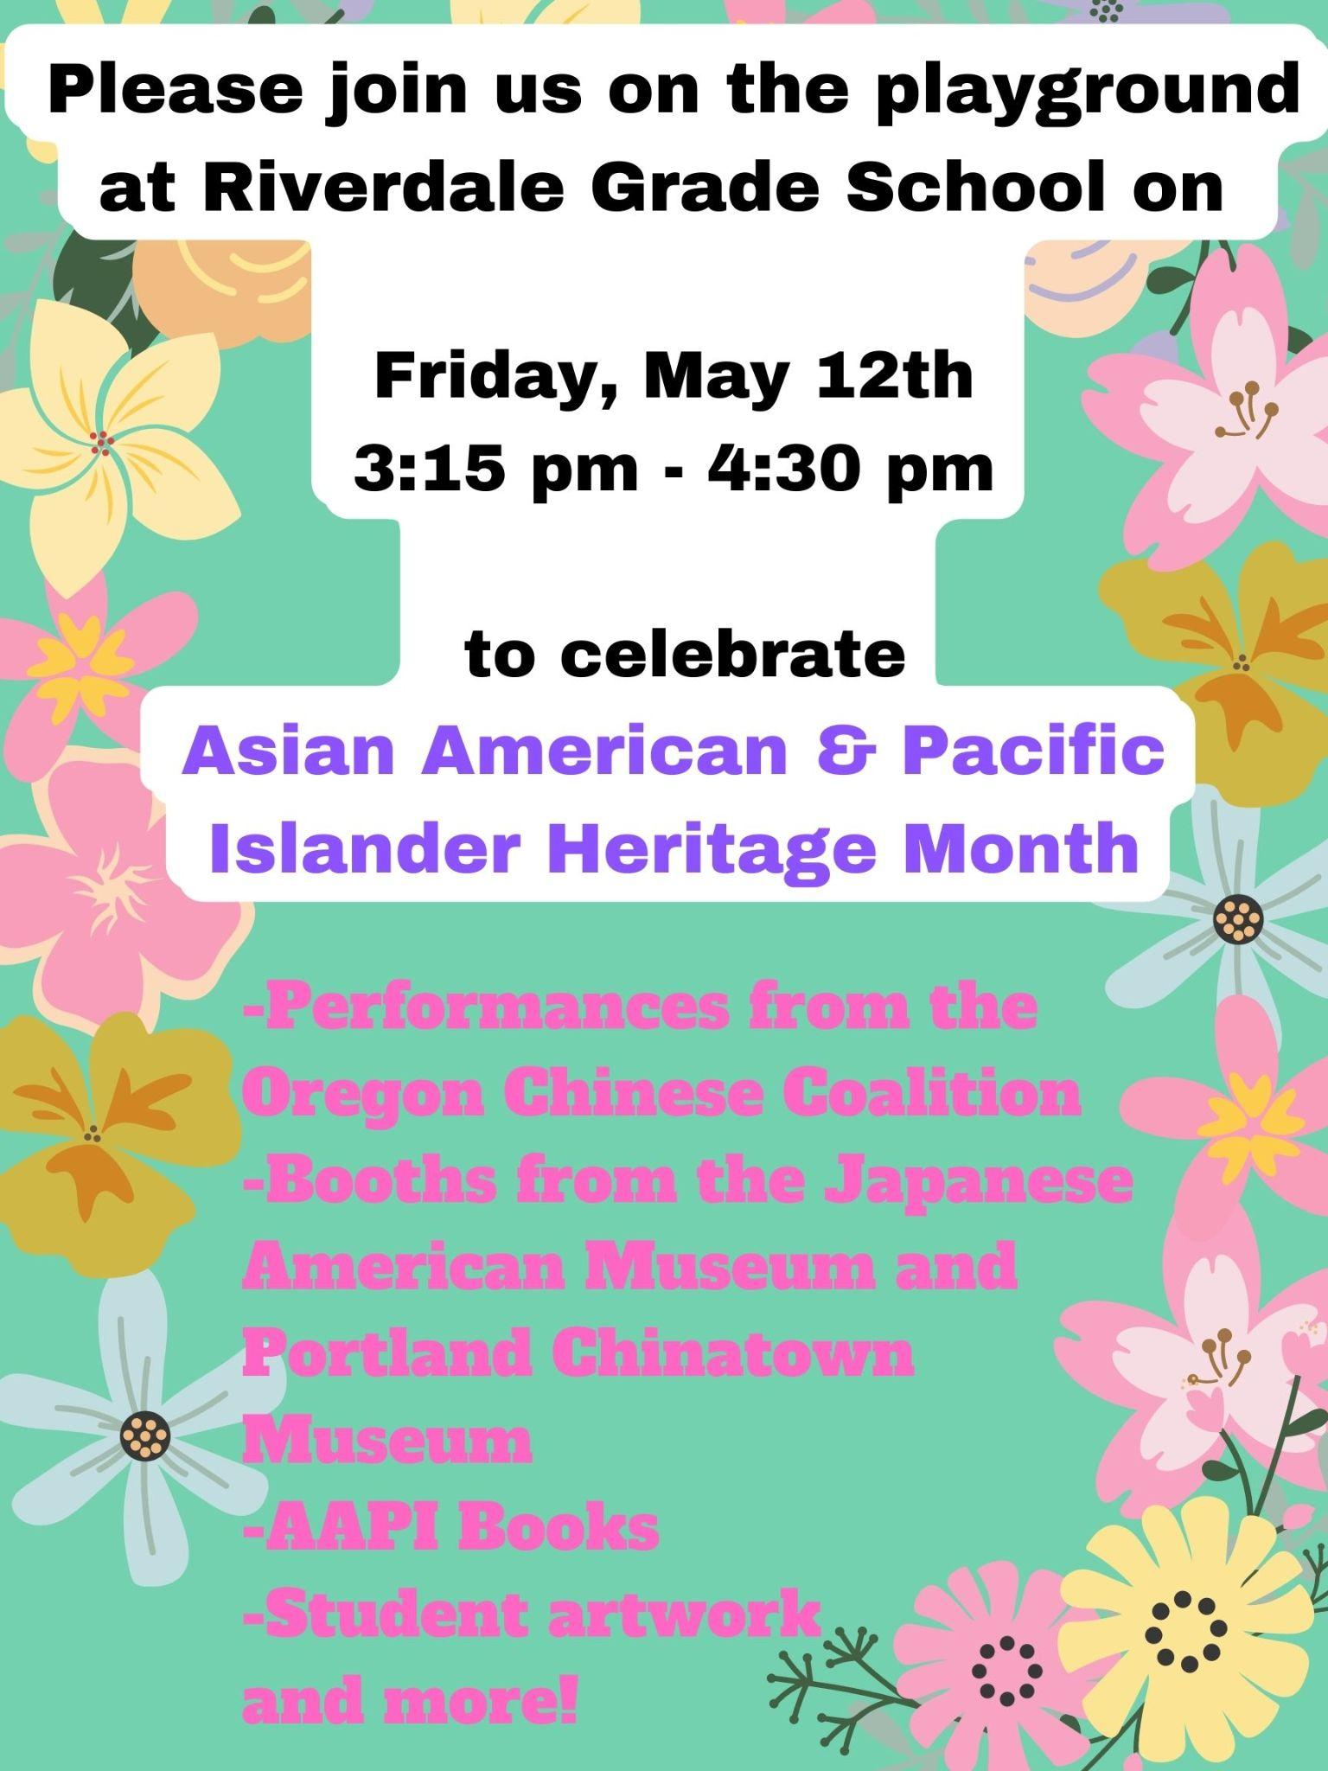
We are having a special event at Riverdale Grade School on May 12th to celebrate AAPI Heritage Month!
During the school day, every class will have a chance to check out booths, art, books, and historic artifacts from AAPI organizations.
After school, there will be dancing and drumming performances on the playground for families. We hope you will come!

Slide 11
Additional Classroom Resources
Smithsonian Care Package is the Asian Pacific American Center's online exhibition. It includes short films, poems, music, and a plethora of resources.
Asian American Books is a compilation of books organized by age group, from early childhood to adult. It includes additional book lists specific to South Asian Americans, Chinese Americans, and Japanese Americans.
Facing History and Ourselves has links to a number of museums with online exhibits and lesson plans.
AAPI Lesson Plans are available specific to grade levels from the National Educator Association.

