Slide 1
Ed Plan & MPS Course Catalog
Micah Willeford
Moore Public Schools
micahwilleford@mooreschools.com

Slide 2
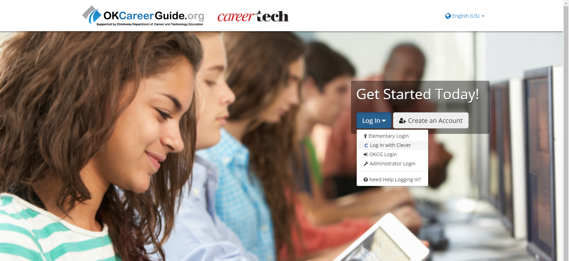
Go to OKCareerGuide.org & Login with Clever

Slide 3
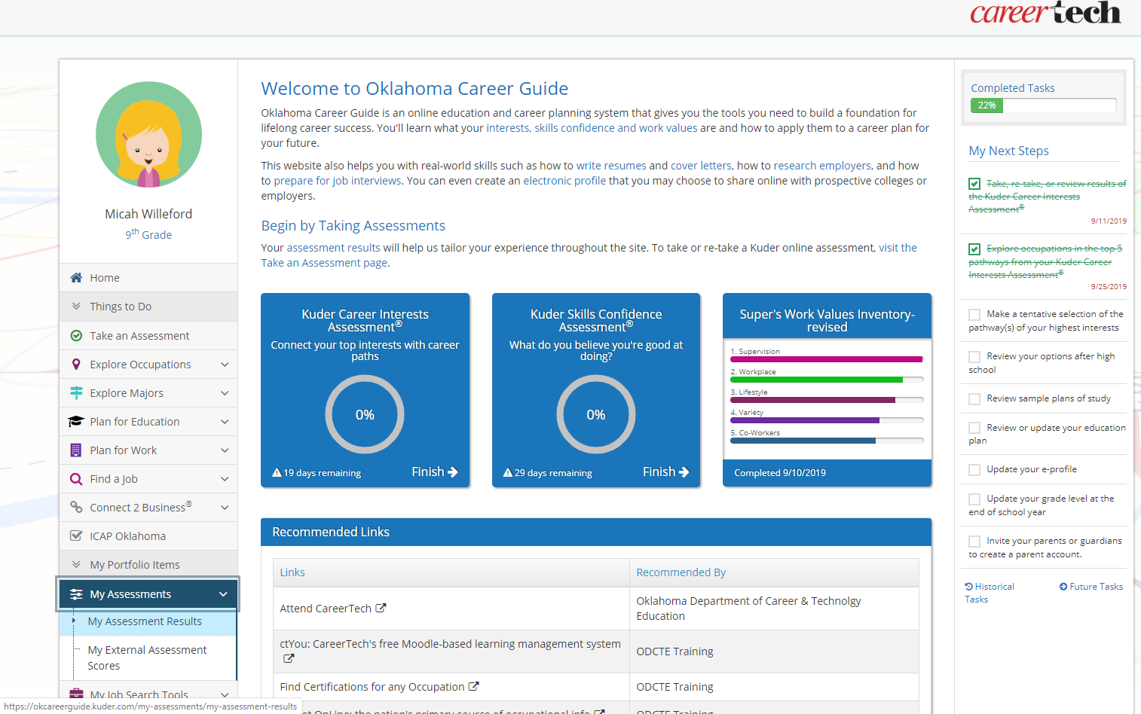

Slide 4
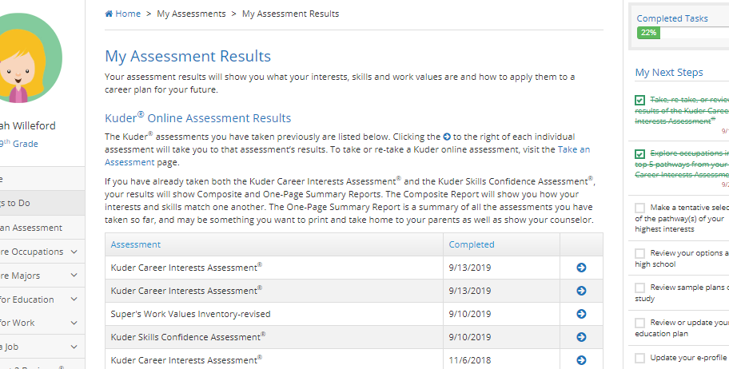

Slide 5
What colors are on YOUR interest assessment results?
EXAMPLE

Slide 6
The Course Catalog
On Moore Public School’s webpage you will find this link:
Notes:
To get to the course catalog, you go to your school’s webpage and click the blue ‘Course Catalog’ Link
Then click HIGH SCHOOL Course Catalog

Slide 7
Notes:
When you do that it will take you to the table of contents. At the top you’ll find…
One really important section is the ‘Moore Public Schools Diploma Requirements’
Click that…

Slide 8
Moore Public Schools’
Diploma Requirements
In other words…
What YOU need to graduate!

Slide 9
Notes:
When you do that it will take you to the table of contents. At the top you’ll find…
One really important section is the ‘Moore Public Schools Diploma Requirements’
Click that…

Slide 11
Related Areas of Interest
Watch for Symbols!
# course may be repeated for credit
^ Course may be counted as a computer credit
$ fee is associated with the course
Notes:
Columns
Symbols:

Slide 12
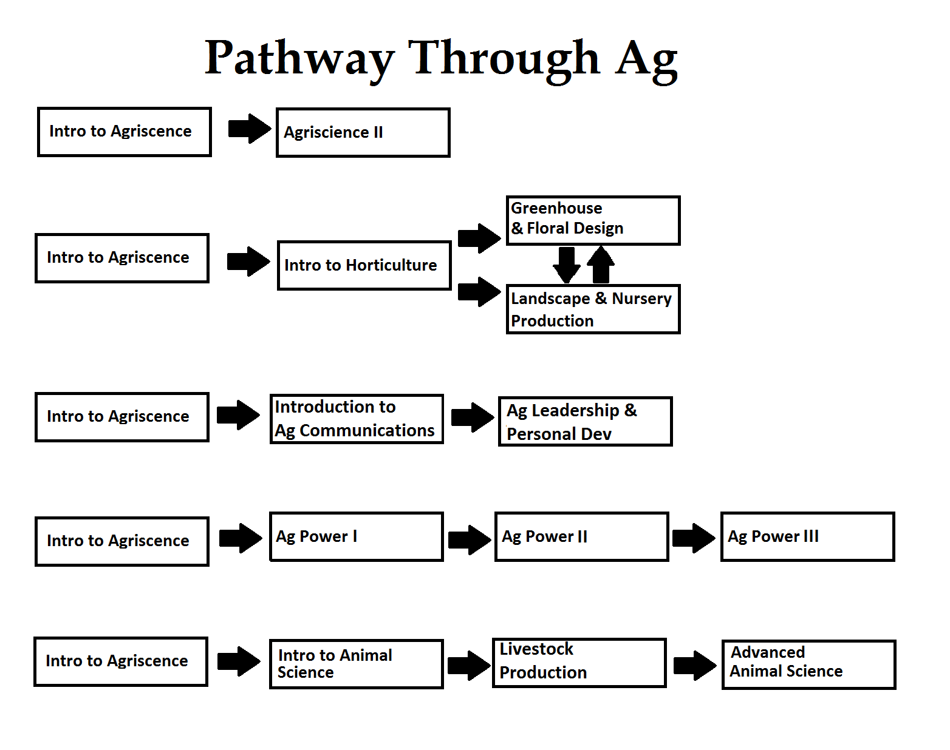

Slide 13
Ed Plan Use the Course Catalog to help complete your plan
Micah Willeford
Moore Public Schools
micahwilleford@mooreschools.com

Slide 14
Go to OKCareerGuide.org & Login with Clever

Slide 15
Click
My Ed Plans
Click
+Add a New Plan
Name your plan your grade level (8th, 9th, 10th, 11th, 12th)
If this is your 2nd or 3rd time reviewing this click the copy icon, rename to grade level, and update.
Choose an Area of Study
-otherwise it won’t work-
Click
Create Plan

Slide 16
Starting with 7th grade…
Click the + next to the categories and select the courses you took, are taking, or that you wish to take.

Slide 17
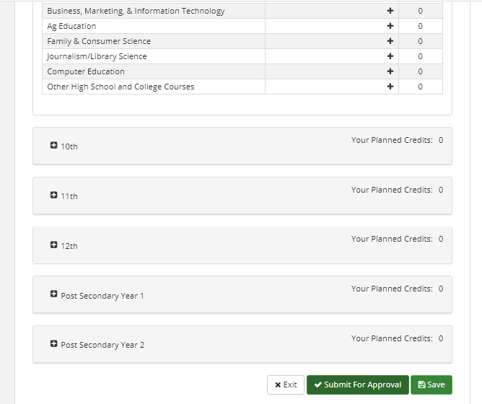
At the end of the hour
‘Submit for Approval’

