Slide 1
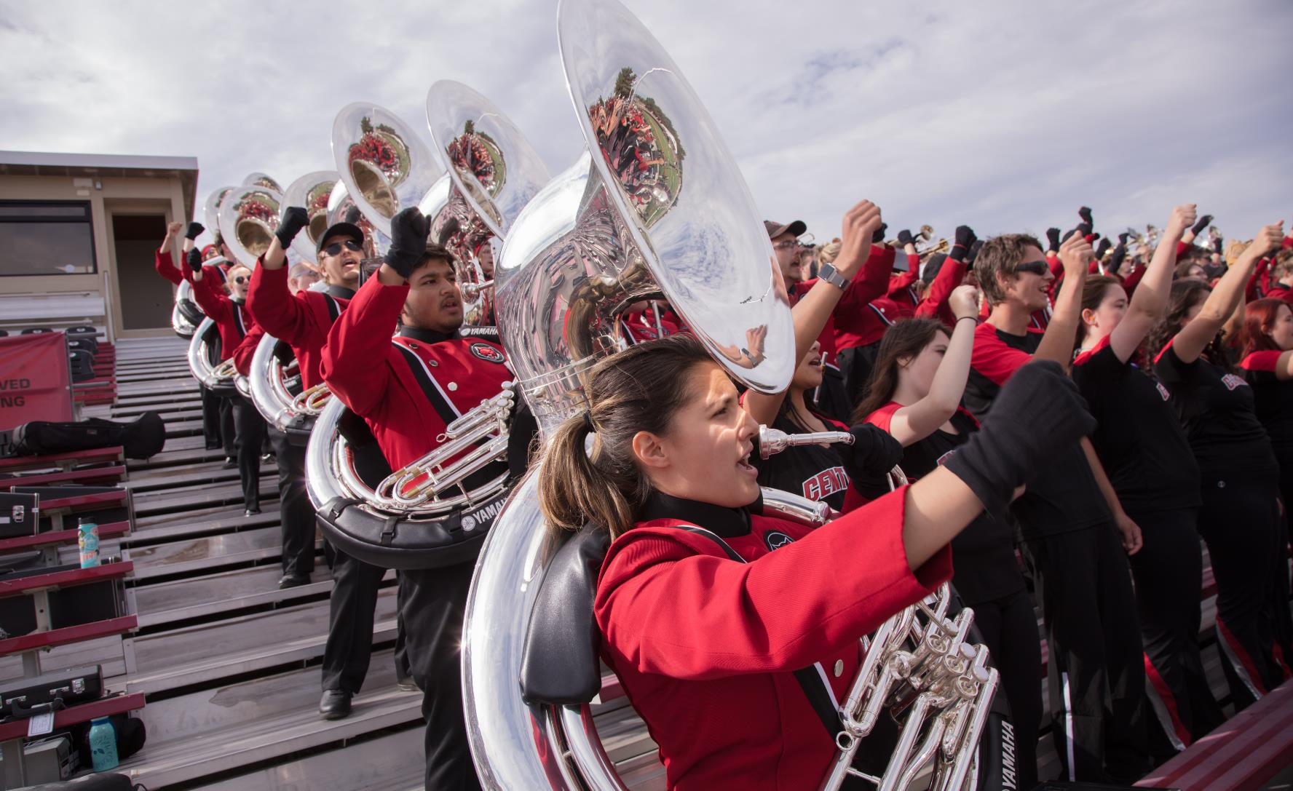
Teacher Education

Slide 2
Introductions Bachelors Degrees Pathways Masters Degree Pathways

Slide 3
Bachelors degrees pathways in Puget Sound
Elementary Education, BAEd offered in Des Moines, WA (at Highline College) and Pierce (at Pierce college)
K-8 Teacher Certificate
Minor options (online):
Teaching English as a Second Language
Early Childhood
Literacy
Special Education

Slide 4
Elementary Education continued…
Fall Evening Cohort
7 quarters, including 1 summer
Practicum in area schools during the day
Must have AA-DTA with certain courses completed to enter the program.
2022-23 Tuition/fees were approximately $12,000 total

Slide 5
Contact: cwu_desmoines@cwu.edu cwu_piercecounty@cwu.edu
There are also many more bachelors degrees options in Ellensburg; contact soe@cwu.edu for more info

Slide 6
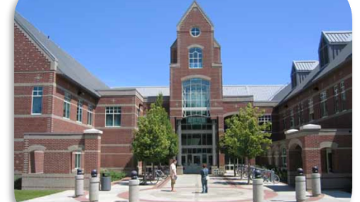
Master of Arts in Teaching
Online and Accelerated
Alternative Pathways to Teaching Programs

Slide 7
Elementary Ed with ELL or SpEd
Elementary Education with English Language Learners or Special Education Endorsements
For School District staff (e.g., paraeducators) with Bachelor’s degree
School District must have agreement with CWU
4-quarter long (summer – spring), Master degree option
Contact Program Coordinator, Yukari Amos (Yukari.Amos@cwu.edu) for more information

Slide 8
CWU Offers Two Master of Arts in Teaching Programs
Program Two: K-12 MAT
For people with a bachelor’s degree or higher who want to become teachers
You do not have to be currently employed by a district for this option
This program is for those not endorsing in Elementary Education-Special Education or Elementary-Education ELL
Four or five-quarter program delivered online
Includes a year-long internship experience in a school in your choice area

Slide 9
Master of Arts in Teaching, K-12 Endorsement Areas For more information on the MAT K-12 program, visit our MAT K-12 website at: http://www.cwu.edu/csel/master-arts-teaching Contact Maria Hays (MATprogram@cwu.edu) for more details about this program

Slide 10
Questions

