Slide 1

School Year 2023-2024
Proposed Budget
April 20,2023

Slide 2
Presentation Sections
Vision and Mission – Page 3
Our Schools – Pages 4 - 10
  Demographic and Enrollment Data
Budget Development Process – Pages 11 - 12
District Development Plan – Pages 13 - 20
  Focus Areas
Proposed 2023-2024 Magnet School Spending – Pages 21 - 36
  Spending Categories
  Spending Changes: FY 23 vs. FY 24
  Budget Rationale
  Headcount & New Positions
  Benefit Expenses & Changes
  GU Contracted Services
  Grant Funding
  Tuition and Program Funding
Final Analysis – Pages 39 - 41
  Funding vs. Expenses
  Tuition Changes
Capital Expenses – Pages 41 - 42

Slide 3
Vision Statement
All members of the Goodwin University Magnet School System are empowered to advocate for a just and sustainable world while developing competencies for future success within a transformative PreK-early college system.
Mission Statement
The Goodwin University Magnet School System breaks down barriers while celebrating the many talents within our community. Partnering with families, educators, and the community, we challenge our scholars to take ownership of their learning through authentic, innovative pathways.

Slide 4
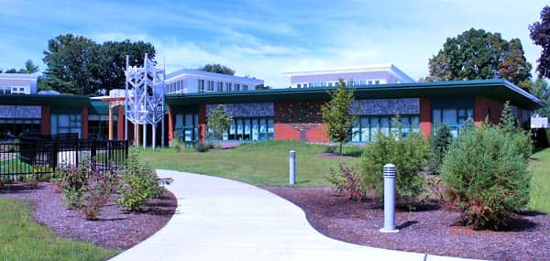
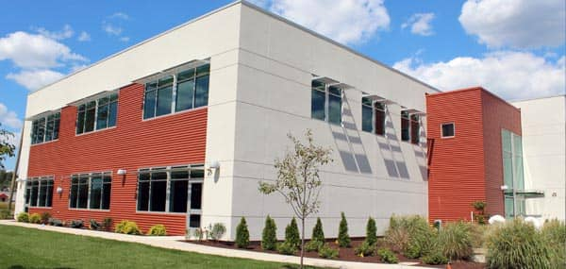
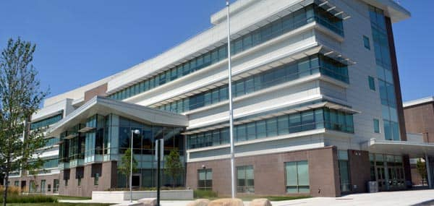
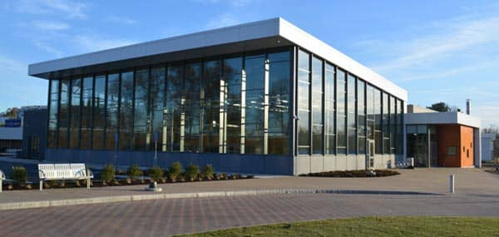
Goodwin University Magnet Schools
Riverside Magnet School
CTRA Middle Level
CTRA High School
Early College Advanced Manufacturing Pathway (ECAMP)

Slide 5
School | Student Enrollment as of October 1, 2022 | Projected Student Enrollment 2023-2024 | Year to Year Difference
Riverside Magnet | 476 | 480 | +4
CTRA Middle Level | 193 | 231 | +38
CTRA High School | 471 | 508 | +37
ECAMP | 12 | 30 | +18
Total Enrollment | 1,152 | 1,249 | +97
Notes:
Update

Slide 6

Demographics
 | RMS %
American Indian or Alaska Native | 0.2%
Asian | 2.5%
Black or African American | 28.6%
White | 13.9%
Hispanic/ Latino of any race | 48.5%
Native Hawaiian or Other Pacific Islander | 0.6%
Two or More Races | 5.7%
October 1, 2022 Student Reporting
Socioeconomic Status of 2022-2023 Incoming Class
 | Tier A % | Tier B % | Tier C %
RMS | 38.3% | 26.3% | 35.3%
Riverside Magnet School - Reduced Isolation
Grade | Total Students | Total Hartford Students | Total Suburban Students | Total RI Students | Total Hartford RI Students | Total Suburban RI Students | % RI Total School
PreK3 | 38 | 11 | 27 | 12 | 0 | 12 | 31.6%
PreK4 | 51 | 12 | 39 | 11 | 0 | 11 | 21.6%
K | 66 | 22 | 44 | 10 | 0 | 10 | 15.2%
1 | 63 | 20 | 44 | 10 | 1 | 9 | 15.9%
2 | 63 | 23 | 39 | 14 | 0 | 14 | 22.2%
3 | 61 | 21 | 40 | 9 | 1 | 8 | 14.8%
4 | 63 | 29 | 34 | 8 | 0 | 8 | 12.7%
5 | 71 | 23 | 48 | 13 | 1 | 12 | 18.3%
Total | 476 | 161 | 315 | 87 | 3 | 84 | 18.3%
Notes:
Update
3 Tiers of Support:
Tier 1: Core Classroom Instruction
Tier 2: Targeted Small Group Instruction
Tier 3: Intensive Individual Instruction

Slide 7
October 1, 2022 Student Reporting
Total District Population | 1,152
RMS | 476 | 41%
# Sending Towns (LEA) + Hartford
RMS | 27
English Language
RMS | 72 | 15%
Special Ed
RMS | 75 | 16%
Free Lunch
RMS | 266 | 56%
Reduced Lunch
RMS | 64 | 13%
Notes:
Update

Slide 8

Demographics
 | CTRA/M %
American Indian or Alaska Native | 0%
Asian | 2.5%
Black or African American | 31.3%
White | 12.7%
Hispanic/ Latino of any race | 48%
Native Hawaiian or Other Pacific Islander | 0%
Two or More Races | 5.5%
October 1, 2022 Student Reporting
Socioeconomic Status of 2022-2023 Incoming Class
 | Tier A % | Tier B % | Tier C %
CTRA HS/Middle | 46.6% | 26.9% | 26.5%
Connecticut River Academy - Reduced Isolation
Grade | Total Students | Total Hartford Students | Total Suburban Students | Total RI Students | Total Hartford RI Students | Total Suburban RI Students | % RI Total School
6 | 74 | 22 | 52 | 7 | 0 | 7 | 9.5%
7 | 61 | 18 | 43 | 6 | 1 | 5 | 8.2%
8 | 58 | 22 | 36 | 8 | 1 | 7 | 12.1%
9 | 127 | 68 | 51 | 21 | 3 | 18 | 14.2%
10 | 116 | 58 | 65 | 18 | 4 | 14 | 12.1%
11 | 115 | 52 | 63 | 26 | 4 | 22 | 19.1%
12 | 113 | 49 | 65 | 21 | 4 | 17 | 15.0%
Total | 664 | 289 | 375 | 107 | 17 | 90 | 13.6%
Notes:
Update

Slide 9
October 1, 2022 Student Reporting
Total District Population | 1,152
CTRA HS/Middle | 664 | 58%
# Sending Towns (LEA) + Hartford
CTRA HS/Middle | 35
English Language
CTRA HS/Middle | 75 | 11%
Special Ed
CTRA HS/Middle | 107 | 16%
Free Lunch
CTRA HS/Middle | 370 | 56%
Reduced Lunch
CTRA HS/Middle | 78 | 12%
Notes:
Update

Slide 10

Socioeconomic Tiers Status
Tier A: Intensive Individual Intervention (Low SES status)
Tier B: Targeted Small Group Instruction (Medium SES status)
Tier C: Core Classroom Instruction (High status)
Tiers | RMS | CTRA/CTRM | Sheff Objective
Tier A | 38.3% | 46.6% | Up to 60%
Tier B | 26.3% | 26.9%
Tier C | 35.3% | 26.5% | Min of 30%
Notes:
David to update

Slide 11

Budget Development Process

Slide 12
Budget Development Process
Surveys
Staff Surveys
Families Surveys
Building Level
Meet with Principals to Review New Process
Review Budget Requests with Building Staff
District Level
Budget Review with Central Office Staff
University Level
Budget Review with GU Business Department
Prepare Final Budget for GU Magnet School Board

Slide 13
District Development Plan

Slide 14
District Development Plan
2022 - 2025
Focus Area: Engagement
Goal: Goodwin University Magnet School System will foster relationships amongst scholars, families, and staff ensuring understanding, respect and trust for future success.
Focus Area: Teaching and Learning
Goal 1: Goodwin University Magnet School System will provide rigorous high quality instructional opportunities for all scholars and staff while supporting their social and emotional well-being.
Goal 2: Goodwin University Magnet School System will continue to foster innovation and creativity in its scholars, families, and staff.
Focus Area: Partnerships
Goal: The Goodwin University Magnet School System will develop strategies to promote enrollment of scholars and will develop partnerships with the community and businesses to extend learning for all.
Focus Area: Resources
Goal: The Goodwin University Magnet School System will appropriately resource all programs and initiatives to meet the needs of scholars, families, and staff while complying with state and federal responsibilities.
Focus Area: Innovation
Goal: Goodwin University Magnet School System will continue to foster innovation and creativity in meeting the needs of its students, families, and staff.

Slide 15
Key Outcomes of Proposed FY 2024 Budget
Focus Area: Engagement
Website Redesign
Stream-lined Methods of Communication to Families
Additional Activities
New Marketing Opportunities
Notes:
Need to update

Slide 16
Key Outcomes of Proposed FY 2024 Budget
Focus Area: Teaching and Learning
Curriculum Consultants
  Math Consultants
    Elementary and Secondary Level
  English Language Arts Consultants
    Elementary Level
  Health and Physical Education
    Elementary and Secondary Level
  Great Schools Partnerships
    Elementary and Secondary Level
Notes:
Need to update

Slide 17
Key Outcomes of Proposed FY 2024 Budget
Focus Area: Teaching and Learning
Curriculum Resources
  Math Resources
    Secondary Level – Texts and Online Resources
  Science Resources
    Secondary Level – Online Resources and Kits
Notes:
Need to update

Slide 18
Key Outcomes of Proposed FY 2024 Budget
Focus Area: Partnerships
Consulting Services
  Curriculum and Instruction
  Diversity, Equity and Inclusion
  Social and Emotional
Notes:
Need to update

Slide 19
Key Outcomes of Proposed FY 2024 Budget
Focus Area: Resources
Increased Staffing
  Middle Level
    Assistant Director
    1 FTE English Language Arts
    1 FTE Mathematics
    1 FTE Science
    1 FTE Social Studies
  High School Level
    1 FTE Certified Nursing Assistant Teacher
    2 FTE Career Technical Education Teachers
  Executive Assistants for Central Office
  Central Office Staff
    Assistant Superintendent Curriculum
    Assistant Superintendent Special Education
    Assistant Superintendent Personnel
    CTE/STEM Coordinator
Notes:
Need to update

Slide 20
Key Outcomes of Proposed FY 2024 Budget
Focus Area: Innovation
New staff positions support the following areas of innovation:
  Pathway development and expansion
  Parent Engagement
  Climate and Culture
  External partnerships
Notes:
Need to update

Slide 21
Proposed FY 2024 Magnet Schools Spending

Slide 22
Proposed FY 2024 Magnet Schools Spending

Slide 23
FY 2024 Spending by Category
Notes:
Need to update

Slide 24

FY 2023 vs. FY 2024 Budget

Slide 25
FY 2024 Magnet Schools Budget Rationale
Personnel
  Headcount by School/Department
  FY 2024 New Positions
  Contracted Obligations
Benefits
  Expenses
  Benefit Changes
Other Budget Drivers
Goodwin University Contracted Services
Notes:
Need to update

Slide 26
Personell: Headcount by School/Department
Position | CTRA | CTRM | RMS | Central | ECAMP | Total
Admin | 2 | 2 | 2 | 5 | 0 | 11
Teachers | 48 | 26 | 43 | 2 | 2 | 121
Non-certified | 11 | 4 | 22 | 4 | 0 | 42
Total | 61 | 32 | 67 | 11 | 2 | 173
Non-certified = Managers, Support Staff, and Instructional Assistants
Notes:
Need to update

Slide 27
Personnel: FY 2024 New Positions
Central Office
  Assistant Superintendent of Curriculum
  Assistant Superintendent of Pupil Services
  Assistant Superintendent of Personnel
  Admin Assistants: Superintendent Admin, Pupil Services Admin, Technology support (3)
  Teacher: STEM Support
CTRA
  Teachers: CTE, Medical Careers
CTRM
  Assistant Director
  Teachers: ELA, Math, Science, Social Studies

Slide 28
Personnel: Salary Changes
Changes to LEARN compensation structure
  3% to 6.15% increase for non-union wages
    Secretaries, Office Managers
  Administrators: 2.4% increase
  Teachers: 3.1% increase
Notes:
Need to update

Slide 29
Benefits – Expenses
Benefits | FY 2024 | FY 2023 | Difference
Health Insurance | 1,825,938 | 1,556,001 | 269,937
FICA | 95,103 | 92,183 | 2,920
Medicare | 175,712 | 139,632 | 36,080
Workers Comp | 121,181 | 98,456 | 22,725
Unemployment | 60,590 | 59,398 | 1,192
403 B contribute | 81,347 | 62,317 | 18,980
Total | 2,359,822 | 2,007,987 | 351,835
Notes:
Includes benefits paid with grants for both FYs

Slide 30
Benefits – Benefit Changes
Health Insurance 5% increase over last year
LEARN 403B contributions for non-TRB employees and new administrators is now 3% for all (costs are passed along to GUMMS)

Slide 31
Other Budget Drivers
Indirect Costs Total Decrease: 460,412
  Goodwin University Contracted Services: 317,390 increase
  LEARN Contracted Services: 777,802 decrease
    New LEARN rate: 380,938 (flat rate, no longer per pupil charge)
Utilities Increase: 54,382
Legal: 61,100
  New labor contracts: teachers, administrators
  Special Ed attorney fees

Slide 32
Goodwin University Contracted Services
Category | FY 2024 | FY 2023 | Difference
Salaries & Benefits | 978,416 | 639,974 | 338,442
Instruction | 565,000 | 564,353 | 647
Computer/IT | 307,412 | 142,630 | 164,781
Administrative | 0 | 627,963 | (627,963)
Repairs/Maintenance | 808,820 | 589,340 | 219,480
Security | 769,807 | 546,804 | 222,003
Marketing | 50,000 | 50,000 | 0
Total | 3,478,454 | 3,161,064 | 317,390
FY 2024 – Admin Costs are absorbed by costs of services
Notes:
Remove admin fees and pass along to other departments

Slide 33
Perennial Grant Funds
Grants | FY 2024 | FY 2023 | Difference | Usage
Title I | 328,935 | 312,757 | 16,178 | Salaries & Benefits for Reading
Title II | 64,618 | 61,541 | 3,077 | Prof Development
Title III | 20,856 | 19,863 | 993 | Bilingual Ed Support
Title IV | 19,231 | 18,315 | 916 | Tech Support
Bilingual | 17,177 | 16,359 | 818 | Bilingual Ed Support
Pre-K Grant | 264,000 | 264,000 | 0 | Salaries for Pre-K Staff
Total | 714,817 | 692,835 | 21,982

Slide 34
Other Grant Funds
Grants | FY 2024 Balance | Usage
ARP | 827,538 | Tech Equipment, Curriculum Development, Professional Development, Music Instruments: String and Keyboards
ESSER | 106,333 | Tech Equipment, Curriculum Development
Sheff Marketing | 65,000 | Marketing Support
Sheff Extracurricular | 150,000 | District-wide Sports and Clubs
New Horizon | 65,000 | Medical Programming
Total | 1,213,871

Slide 35

FY 2024 District Tuition and Program Funding

Slide 36
District Tuition Changes
Increases:
  State Operating Grant Funding: 935,302
    Due to increase in enrollment
    Per pupil reimbursement remained flat
  Increase in Local Tuition Funding: 872,947
    Due to increases in enrollment and tuition. Local tuition increase 5.5% per pupil
Net Tuition Funding Increase: 1,808,249

Slide 37
Final Analysis
Funding vs. Expenses

Slide 38
District Tuition
 | FY 2023 |  | FY 2024
Tuition Rates | Elementary | Secondary | Elementary | Secondary
CREC | 5,535 | 6,153 | TBD | TBD
GUMSS | 6,068 | 6,068 | 6,402 | 6,402
Notes:
Need CREC tuition numbers

Slide 39
Program Funding v. Expenses
 | CTRA | CTRM | RMS | Central O | ECAMP | Total
Funding | (8,663,300) | (3,939,414) | (8,202,639) | (110,000) | (399,766) | (21,315,119)
Expenses | 8,349,144 | 3,536,433 | 6,694,152 | 2,243,620 | 311,770 | 21,315,119
Net | (314,155) | (402,981) | (1,508,847) | 2,313,620 | (87,997) | -

Slide 40

Rationale for Increased Expenditures
Needed staffing to address growth and student need
Increased mental health needs
Increased focus on curriculum and instruction to improve student outcomes
Needed staffing as we continue to continue to evolve as an independent LEA

Slide 41
Capital Expenses
CTRA
  Furniture Replacement in Lecture Hall, Learning Center, conference room, and Main Office: $27,000
  Music Room risers: $20,000
  Weight Room: $49,000
  TV Studio: $50,000
  CNA Program Room: $20,000
  Bus: $150,000
RMS
  Conversion of Pods: up to $150,000

Slide 42
Capital Expenses
Tech
  Chromebooks: $105,000
  Staff Devices: $25,000
  Promethean Boards: $27,000

