Slide 1
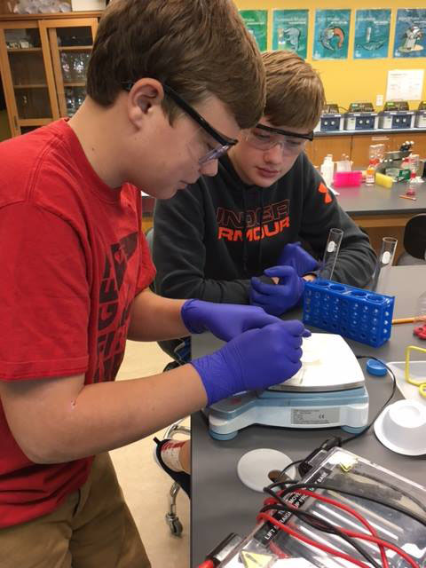
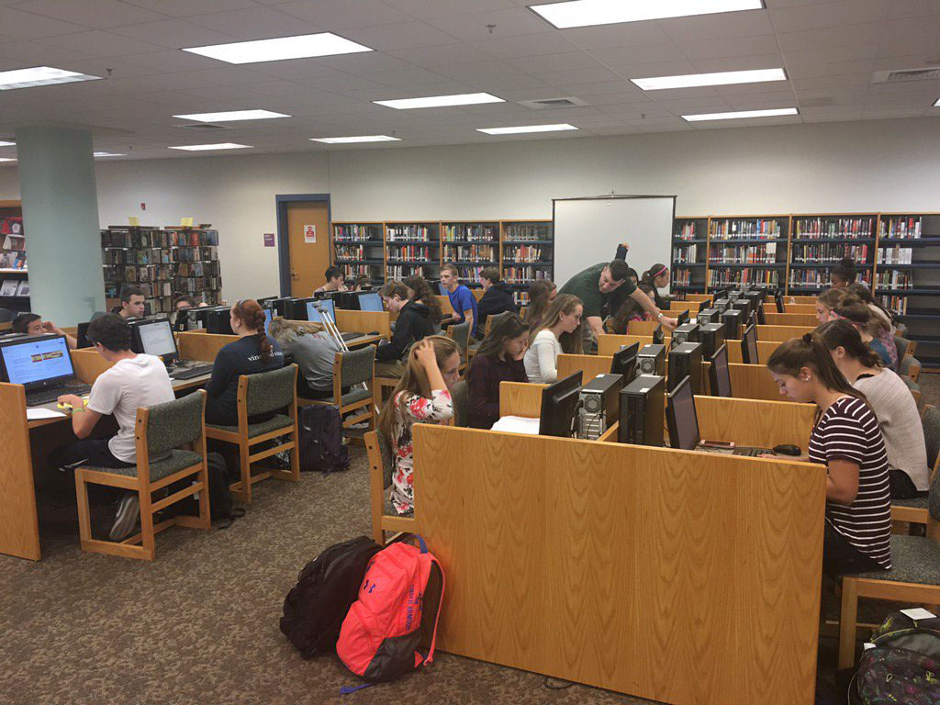
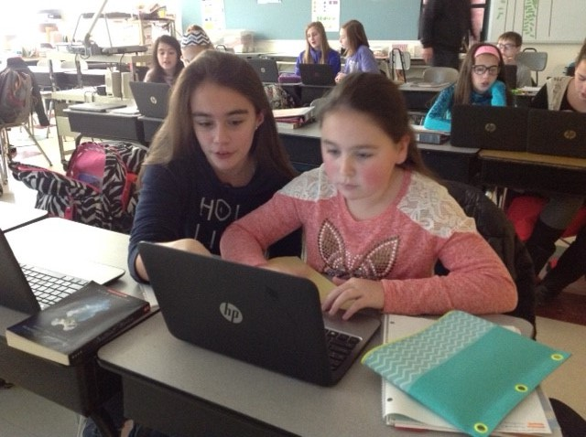
PEMBROKE PUBLIC SCHOOLS
FY19 Budget Presentation
Public Budget Hearing
May 1, 2018
OUR MISSION:
To ensure student achievement through excellence in teaching and learning.
72 Pilgrim Road, Pembroke, Massachusetts 02359

Slide 2
Overview of Tonight
Recap of FY18/19 focus areas & FY19 budget development
Presentation of School Committee balanced FY19 Budget
Public Question and Answer Session
Consideration of FY19 Recommended Budget Approval

Slide 3
FY19 Budget Philosophy & Process
Guiding Philosophies-
Make enrollment driven adjustments
Preserve restorations made possible by override
Continue to develop programs for Social Emotional Learners
Realign infrastructure/resources to better support teachers in their work and align with focus areas
Process-
Continue to increase budget transparency
Create a comprehensive list of district priorities

Slide 4
Priorities in the FY19 Budget
Achievement – Offering free Full Day Kindergarten for SY18-19
Achievement/Technology – Restructuring Math Apps at PCMS to have a STEM focus with project based learning
Technology – Restructuring of current staff to delineate between Instructional and Informational Technology
Social Emotional Health & Wellness – Investigating various schedule options at the secondary level that would allow for more opportunities for students

Slide 5
10 Year Historical Picture
 | Town Budget | School Budget | Chapter 70 | % Increase in Chapter 70 | School Budget as a % of Town Budget | Town Contribution to School Budget
2010 | $50,934,238 | $26,074,372 | $12,200,192 | -2.11% | 51.19% | $13,874,180
2011 | $52,375,683 | $26,564,969 | $12,726,668 | 4.32% | 50.72% | $13,838,301
2012 | $53,185,158 | $26,564,969 | $12,794,990 | 0.54% | 49.95% | $13,769,979
2013 | $54,182,693 | $27,795,729 | $12,925,750 | 1.02% | 51.30% | $14,869,979
2014 | $55,641,151 | $28,289,729 | $13,013,732 | 0.68% | 50.84% | $15,275,997
2015 | $52,777,626 | $28,971,029 | $13,095,032 | 0.62% | 54.89% | $15,875,997
2016 | $56,925,849 | $30,832,029 | $13,174,507 | 0.61% | 54.16% | $17,657,522
2017 | $58,875,321 | $31,332,029 | $13,344,512 | 1.29% | 53.21% | $17,987,517
2018 | $60,556,047 | $32,338,670 | $13,434,662 | 0.68% | 53.40% | $18,904,008
2019 (est) | $62,471,460 | $33,259,352 | $13,521,752 | 0.65% | 53.23% | $19,737,600

Slide 6
FY19 MOE Budget
Description | Amount
FY18 Budget | $32,338,680
FY19 MOE Budget (12/17) | $34,574,302
Adjustments
Retirements | ($23,000)
Transportation Revolving Offset | ($105,000)
Extended Day Revolving Offset | ($65,000)
Circuit Breaker Offset | ($150,000)
Solar Farm Utility Offset | ($180,844)
FY19 MOE Budget After Adjustments | $34,050,459
Resulting Budget Gap | $1,711,779
Additional Revenues
Increase in Chapter 70 ($30/student) | $87,090
Increase in Town Contribution (Town Admin Prelim Budget 1/29) | $833,592
Total | $920,682
Remaining Budget Gap | $791,097
Key Gap Drivers:
Vocational tuition $250,000
Special Ed Increases $383,424
Transportation $131,324
Collective Bargaining $972,903
(2% COLA for Teachers)

Slide 7
FY19 Budget Balancing…
Description | Amount | Notes
Remaining Budget Gap | $791,097
Staff Reductions
6.4 Teaching Positions | ($469,453) | Enrollment driven (5 elem 1.4 sec)
7-12 Guidance Restructure | ($161,144) | 1.0 Counselor at PCMS, 7-12 Guidance Director
3.0 Support Staff | ($72,000) | Enrollment Driven(shift in preschool)
Staff Reductions Subtotal | $702,597
Remaining Gap | $88,500
Additional Reductions
Transportation Reduction | ($25,000) | Kindergarten Buses/SPED
Reduction in Districtwide Curriculum Line | ($50,000)
Reduction in Athletics | ($10,000)
Reduction in Extracurricular Activities | ($3,500) | 2 clubs
Additional Reductions Subtotal | $88,500
Remaining Gap | $0

Slide 8
Elementary Enrollment Projection Detail
FY19 Bryantville | K | 1 | 2 | 3 | 4 | 5 | 6 | Total
Students | 66 | 68 | 55 | 75 | 80 | 67 | 83 | 494
Teachers | 3 | 4 | 3 | 4 | 4 | 3 | 4 | 25
Avg. Class Size |  | 17 | 18 | 20 | 20 | 23 | 21
FY19 Hobomock | K | 1 | 2 | 3 | 4 | 5 | 6 | Total
Students | 58 | 56 | 56 | 69 | 49 | 53 | 78 | 419
Teachers | 3 | 3 | 3 | 3 | 2 | 3 | 4 | 21
Avg. Class Size |  | 19 | 19 | 23 | 25 | 18 | 20
FY19 North | K | 1 | 2 | 3 | 4 | 5 | 6 | Total
Students | 65 | 57 | 55 | 67 | 78 | 75 | 70 | 467
Teachers | 3 | 3 | 3 | 3 | 4 | 4 | 3 | 23
Avg. Class Size |  | 19 | 19 | 23 | 20 | 19 | 23

Slide 9
FY19 Recommended Budget
Description | Amount
FY19 MOE Budget | $34,574,302
Adjustments (revolving + solar farm) | -$523,853
Staff Reductions | -$702,597
Non-Staff Reductions | -$88,500
Total | -$1,314,941
FY19 School Committee Recommended Budget | $33,259,352

