Slide 1
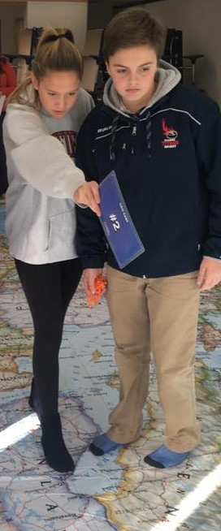
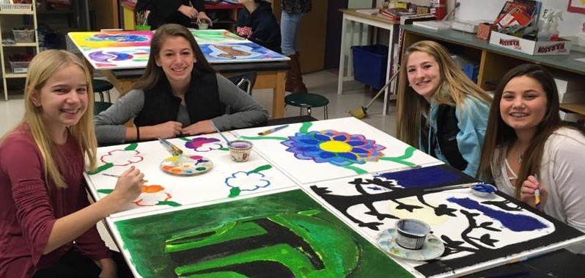
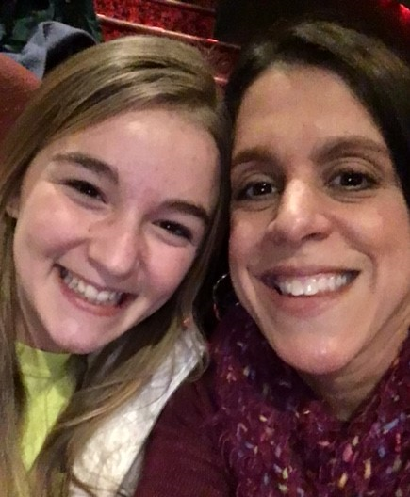
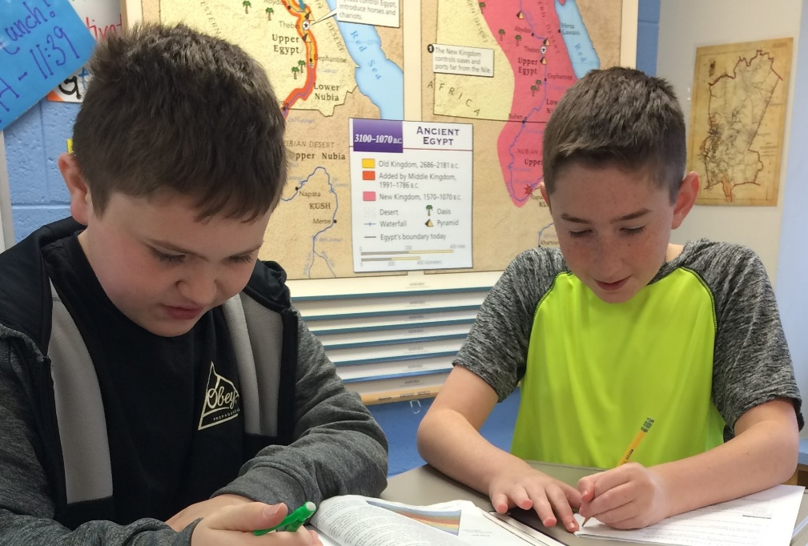
PEMBROKE PUBLIC SCHOOLS
PCMS FY21 Budget Presentation
February 4, 2020
OUR MISSION:
To ensure student achievement through excellence in teaching and learning.
72 Pilgrim Road, Pembroke, Massachusetts 02359

Slide 2
Overview
PCMS Enrollment
Academic Needs
General Education Supports
World Languages
SEL Supports
FY21 Budget Priorities

Slide 3
PCMS Enrollment
School | 2011-12 | 2012-13 | 2013-14 | 2014-15 | 2015-16 | 2016-17 | 2017-18 | 2018-19 | 2019-20 | 2020-21
PCMS | 534 | 584 | 588 | 521 | 494 | 505 | 496 | 463 | 451 | 430

Slide 4
Class Sizes
Grade 7
Hobomock
Grade 8
World Languages
FY20 | ELA | Accel ELA | Math | Accel Math | Social Studies | Science | STEM Lab | PE
Class size average | 19 | 31 | 18 | 29 | 22 | 23 | 19 | 22
# sections | 7 | 3 | 6 | 4 | 10 | 10 | 11 | 11
Class size range | 8-24 | 29-32 | 10-22 | 27-31 | 19-29 | 15-29 | 17-25 | 16-26
FY21 (projected) | Looking at potential areas for reductions
FY20 | ELA | Accel ELA | Math | Accel Math | Social Studies | Science | STEM Lab | PE
Class size average | 20 | 26 | 18 | 28 | 22 | 22 | 18 | 25
# sections | 7 | 3 | 6 | 4 | 10 | 10 | 12 | 9
Class size range | 17-26 | 24-29 | 13-24 | 24-29 | 11-29 | 15-30 | 12-24 | 12-35
FY21 (projected) | Looking at potential areas for reductions
World Language | French 7 | French 8 | Spanish 7 | Spanish 8 | Latin 7 | Latin 8
Avg. Class size | 29 | 30 | 28 | 25 | 15 | 12
# sections | 1 | 2 | 5 | 5 | 1 | 1
Class size range | n/a | 15 | 26-30 | 23-30 | n/a | n/a
FY21 (projected) | Student registration requests drive distribution of sections.

Slide 5
The Story Behind the Numbers: Academic Needs
Number of Students with IEPs (Individual Education Plans):
65 students (14.4%)
Number of Students with 504 plans (Accommodations):
28 students (6%)
Number of Students enrolled in Title I classes:
Literacy Enrichment: 74 students (16%)
Math Foundations: 65 students (14%)

Slide 6
General Education Supports: Title I
Literacy Enrichment:
74 students (16%)
Average class size= 12
6 sections (3/3)

Slide 7
General Education Supports: Title I
Math Foundations:
65 students (14%)
Average class size= 13
5 sections (2/3)

Slide 8
World Languages
Current offerings: Spanish, French, & Latin
Student Enrollment
Spanish= 258 (10 sections)
French= 58 (3 sections)
Latin= 27 (2 sections)

Slide 9
World Languages: Latin
Decreasing student enrollment
Majority of middle schools only offer 2 languages*
Decreasing offerings provides more flexibility in scheduling
*https://docs.google.com/spreadsheets/d/19rbYKOA_bXtVaHE87ljbgho54KvAq895cFtTonH-Sbc/edit?usp=sharing

Slide 10
SEL Needs: Attendance
Students with chronic attendance patterns
(absent 10% or more)
n= 47
1st letter 2nd letter Pre-CRA CRA
(n= 114) (n= 17) (n= 5) (n= 3)
Students with chronic tardy patterns
(tardy 10% or more)
n= 38
~ Absences and tardies are reviewed biweekly

Slide 11
SEL Supports: Guidance
Grade Level Guidance Counselors
Teach 8 class sections/week (full time staff= 15 sections)
Student caseloads
Grade 7: n= 228
Grade 8: n= 223
Individual student conferences/goal setting 4x/year (~1000 annual student meetings per counselor)
2 weekly Kid Day meetings to track student functioning
1 weekly administrative meeting
Manage all aspects of 504 plans
Support grade level transitions
Elementary Middle
Middle High School
Notes:
We have covered the following so far this year:
Course Introduction: What is 21st Century Skills
Communication: Getting to know your classmates
Teamwork: Majority vs. Consensus activities
Study Skills: Time Management, Organization, Learning Styles
Stress Management
Digital Literacy: Your Online Identity, How to Avoid Schemes, Safe Online Talk, Email Etiquette
Gratitude
Diversity: Harrassment vs. Bullying, Learning Disabilities, Physical Disabilities, Gender, Culture
Academic Check-Ins Term 1 and Term 2: Individual meetings with each 7th grade student to discuss academic progress
Goal Setting: Terms 1 and 2 each student sets 2 academic goals for the following term which we discuss at the next check-in
Upcoming:
Small group organization boot camp during Titan Time
Growth Mindset
Test-taking strategies
Decision Making: Drug and Alcohol Resistance
College and Career Readiness: Interest inventories/job matching
Reflection: Reflect on 7th grade in order to give advice to current 6th graders
Letters to Future Self
Other Tasks:
Weekly team meetings with each team to discuss student needs and provide supports
Weekly SUMS meetings with admin team
Coordinate 504 Plans for 7th Grade: Distribute, run meetings, monitor progress
2 lunch duties 1x per week
G8: Since the school year started we have covered the following units in 21st Century Skills:
Class Expectations/What is 21st Century Skills for grade v8
Getting to Know each other activity
Student Handbook
Executive Functioning Skills
Goal Setting
Goal Setting & Perseverance Project
Multiple Intelligences/ Personality Profiles
Personal Goal Setting/Term 1 Academic Check-in’s
Digital Literacy
Flexible Thinking
Gratitude
Stress Management
Review Personal Goals/ Term 2 Academic Check-in’s
Stereotypes/Prejudice/Discrimination
Pyramid of Hate
Boundaries/Sexual Harassment
After the February break we will be doing some team building activities before the high school counselors come to do a presentation prior to the 8th graders registering for their classes. We will then be going into Vaping & Substance Abuse. I will be scheduling the SBRIT interviews and combining them with Term 3 Academic Check-in’s. As the year winds down I will introduce Naviance to them and we will go into Career Exploration.

Slide 12
SEL Needs: Counseling Staff
School Psychologist:
Chair special education team meetings
Complete psychological & cognitive testing
38 completed evaluations 18-19
4 Kid Day meetings/ per week
1 co-led substance prevention session/week (KOP)
25 counseling students/week per IEPs & 504s
Follow up meetings for student attendance/tardy concerns
2 -5 daily student check-ins
1-5 unplanned student ‘drop-ins’ daily (average)
Crisis assessment and response, as needed

Slide 13
Social Emotional Needs: Nurse
Social/Emotional/Behavioral (SEB) Visits to Health Office:
Total SEB visits = 1004 (total visits 3576)
Monthly Average = 167 visits
To date, 36% of health office visits are to address SEB needs.
Last year, SEB visits accounted for 25% of nurse visits.
These students are often then referred to counseling staff for additional, follow-up support.

Slide 14
PCMS Budget Priorities for FY21
Category | Description | Notes
Social Emotional | 1.0 Social Worker | Increase surround care social emotional supports at PCMS from .5 to 1.0 to keep pace with rising needs
Academic | General education support (due to significant decrease in Title I funding) | Maintain current level of supports for Literacy Enrichment & Math Foundations
Academic | Phase out Latin as a middle school world language offering | Latin 8 would continue to be supported in 2020-2021
Schedule | Continue to explore schedule for potential savings

