Slide 1
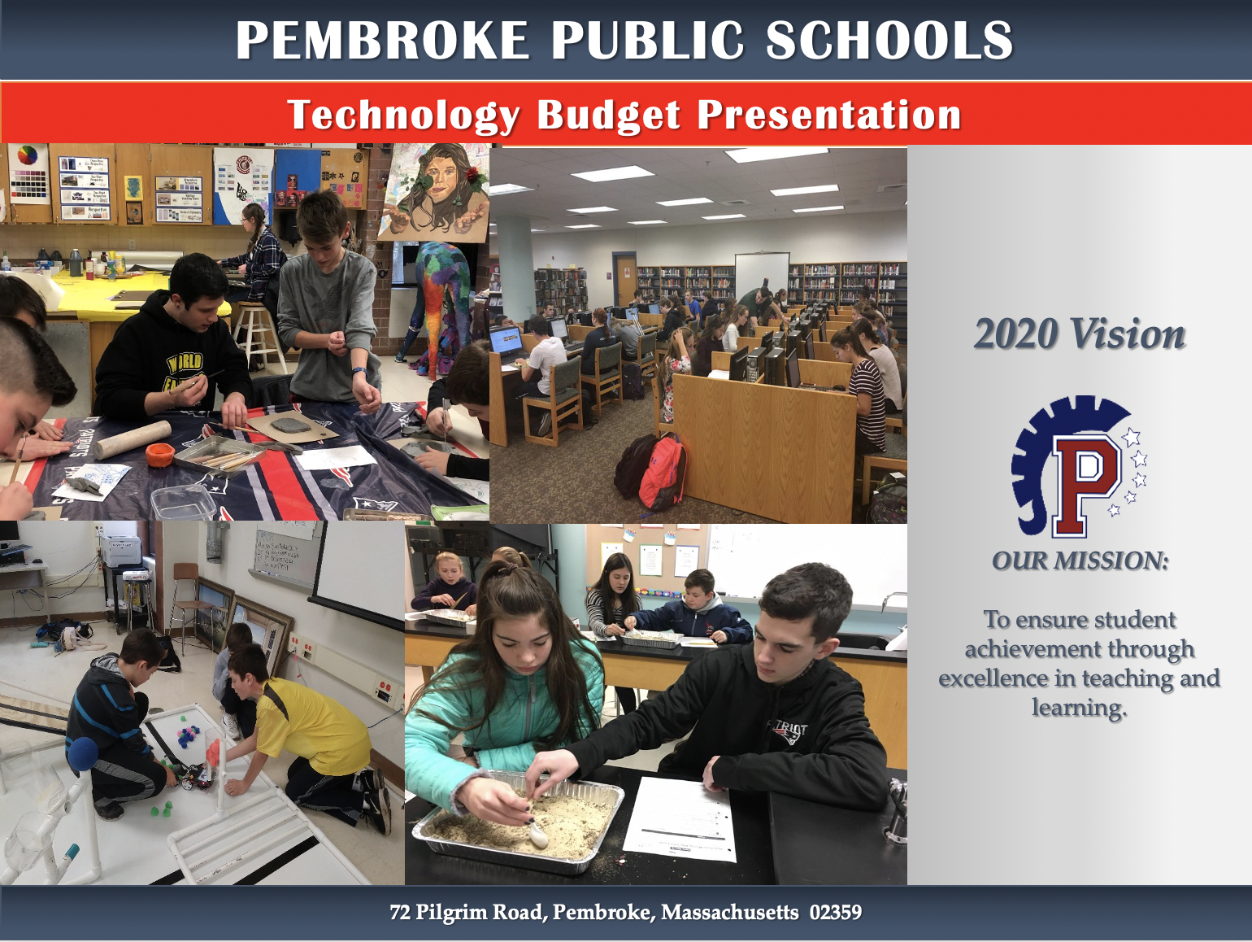

Slide 2
Overview
Historical Information
Update on FY2020 Goals
FY21 Goals
FY21 Budget Priorities

Slide 3
FY2020 Successes
Multiple staff members presenting at state, regional, and international educational technology conferences
Successful implementation of the PLTW Curriculum at PCMS
Addition of 150 new HP Chromebooks per building and five new computer labs at PHS from lease agreement with the town, a total of nearly 900 new devices
Expansion of STEAM-based makerspaces at all three elementary schools
Creation of PHS Innovation Lab
Multiple dates of in-district technology professional development presented by tech integrators and other PPS Staff

Slide 4
Goals and Expected Outcomes
Ensure our staff are using best practices in educational technology with frequent professional development on cutting edge curriculum plans
Ensure device equity amongst all learners across the district
Ensure our students are learning the using latest methods and materials while practicing good digital citizenship and safety.
Create official three-year replacement cycles for devices, ensuring faculty and staff are using the best devices available
Create official replacement cycles for network hardware based on life expectancy and e-Rate funding availability
Expand makerspaces district wide with instructional technology budget line to include more robotics, drones, media creation and ensure all buildings have equal assets.

Slide 5
Current Costs
Yearly Recurring Expenses | Cost
Staffing | $355,626.10
Software, Licensing, and Support | $243,000.00
Internet (our portion through Erate)* | $17,593.32
Supplies and Materials | $50,000.00

Slide 6
Current Staffing
1.0 Director of Instructional Technology
1.0 Software and Data Manager
1.0 Network Manager
1.0 Media Technician
5 Building-based Technology Integrators - classroom teachers with stipend

Slide 7
Staffing Additions - Needs
Description | Cost | Notes
1.0 FT Media Technician | $55,000 | Additional support technician districtwide to assist with growing device numbers
1.0 FTE Tech Integrator | $65,000 | A full time tech integrator to further develop lesson plans and coach teachers, and assist in classrooms based on number of requests
Subtotal | $120,000

Slide 8
Current Device Levels
Building | Devices
Bryantville | K-1 eight iPads per class; Grades 2-6 Chromebooks in a 2:1 student to device ratio
Hobomock | K-2 ten iPads per class; Grades 3-6 ten Chromebooks and eight to ten Windows devices per class
North Pembroke | PreK-2 four iPads per class; Grades 3-6 ten to twelve Chromebooks per class plus old Windows devices
PCMS | Library and Language computer labs with 28 computers each, 5 new carts of 30 Chromebooks, 5 old carts with mixed Windows and Chrome devices
PHS | 7 shared desktop labs with 28 computers and 5 carts of 30 Chromebooks

Slide 9
Device Needs
Priority 1 | Justification | Est Purchase | Est Yearly Lease
Desktop Replacement for Office Staff | 8+ years old (main offices, central office, custodians, librarians, cafeterias) | $30,000.00
Paraprofessional laptops for PCMS (6) and PHS (10) | Travelling with students. Need laptops to help students. | $13,600.00
District wide Point Of Sale registers in cafeterias | 5+ years old. Running Windows 7.
Chromebooks to replace PHS (48) and PCMS (32) special ed student devices, and PACE (15) | Old devices. Mixed device types in each room. Devices needed to support learners. |  | $8,000.00
Three PCMS Classroom Labs - Chrome Devices | Originally purchased FY2013-2014 |  | $12,333.33
Library Computer Labs District Wide - Desktops | Originally purchased FY2015 |  | $20,000.00

Slide 10
Hardware and Equipment Needs
Priority 1 | Quantity | Justification | Est Purchase | Est Yearly Lease
PHS Classroom Sound Systems | 53 Rooms | 10+ Years Old and Failing | TBD
Add Air Conditioning PHS Library IDF and Art Wing IDF | 2 | No AC can cause equipment failure | TBD
BYOD Login and SSID refinement project |  | Reduce and rename wireless networks and improve and BYOD login process | TBD
Add doorway to PHS Innovation Lab | 1 | Innovation lab only has an entrance through the back area of the library | TBD
(Erate) AP New High Capacity in large rooms district-wide and Replacements at PCMS | 47 | Higher capacity for large rooms. Begin Replacement Cycle by Building. | $40,000.00
Projector Cycle 1 Replacement - oldest models in all buildings. Replace with wall mount short-throw projectors. | 73 | Projectors old and failing. Carts are a tripping hazard. | $193,377 | $55,000

Slide 11
Summary FY 2021 Requests
Additional Staffing
Device Replacement Cycle
Hardware Replacement Cycle
Continued Use of Software

Slide 12
Summary FY 2021 Priorities
Preserve Existing Staff and Programs - $667,000.00
Addition of Staff - $120,000
Device Replacement Cycle - $TBD based on lease pricing
Hardware Replacement Cycle - $TBD based on eRate pricing

Slide 13
Next Steps
Develop STEAM specialist program at elementary level
Continued expansion of PLTW
Further build out of makerspaces at all levels
Technology integrator in each building
1:1 Chromebook program at PCMS and PHS

