Slide 1

8th Grade
Parent
Night
Welcome Class of 2027

Slide 2


Slide 3
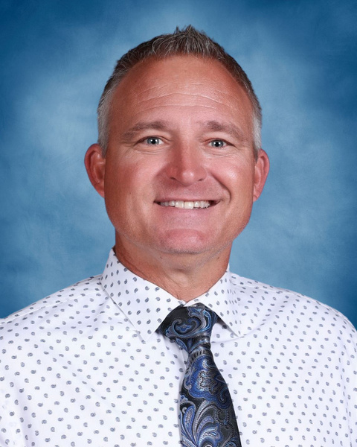
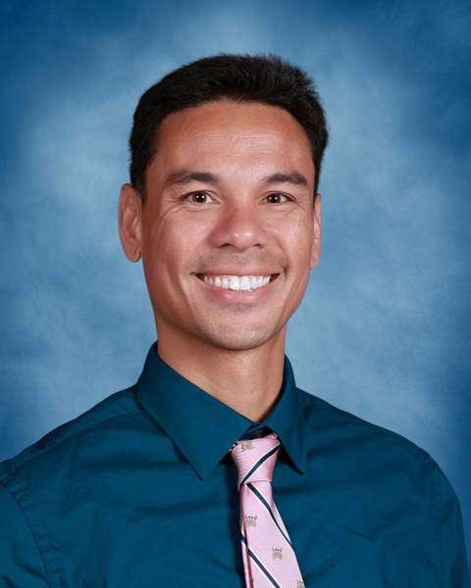
East Union Administrators
Assistant Principal
Andrew Lee
Principal
Eric simoni
Assistant Principal
Andrew Lee

Slide 4
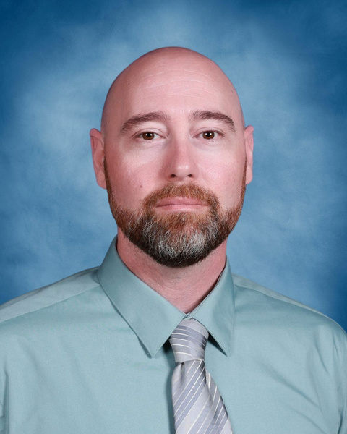
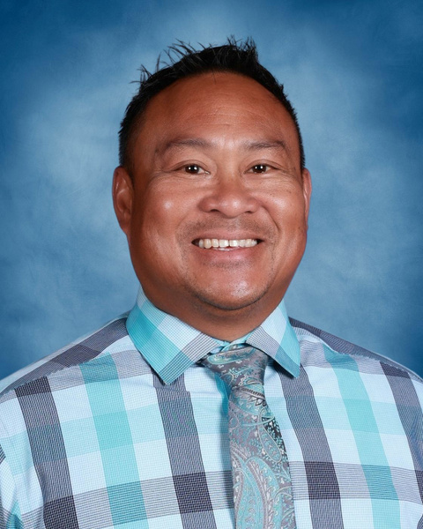
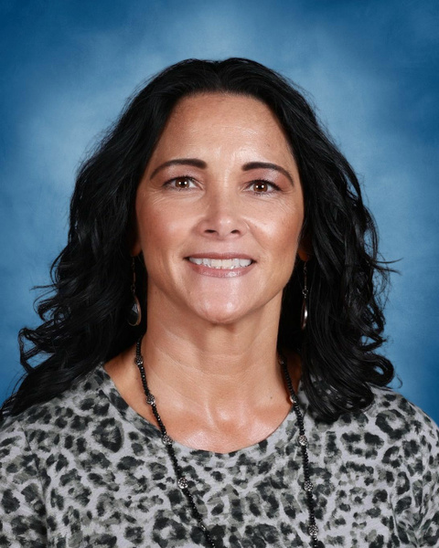
East Union Administrators
Vice Principal
Michael Cipponeri
Vice Principal
Athletic Director
JJ Ramirez
Assistant Principal
Andrew Lee
Activities Director
Jenaia Cano

Slide 5

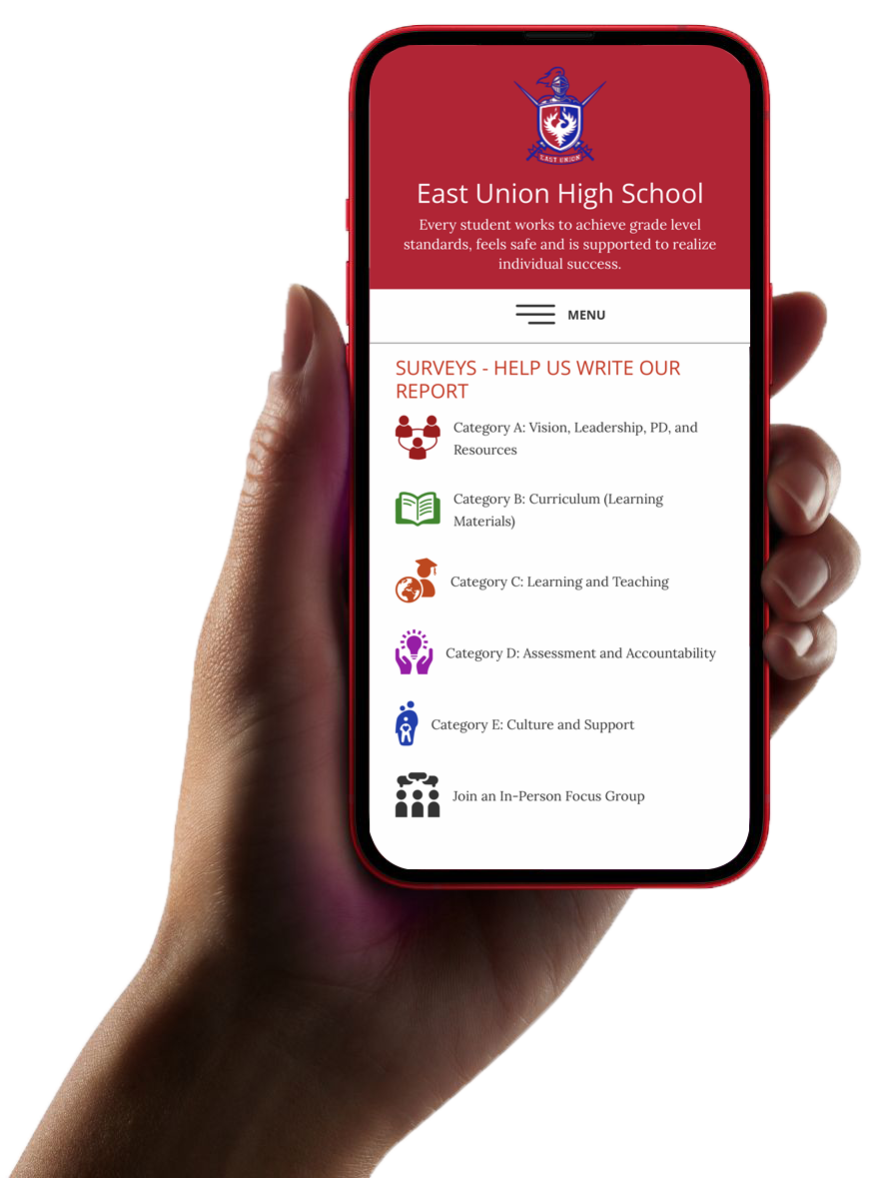
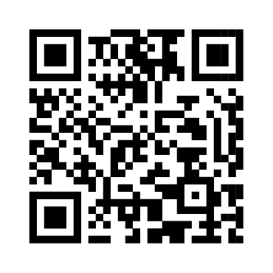
Share Your Voice!
Use the surveys
to rate us.
Sign up for
a committee.

Slide 6
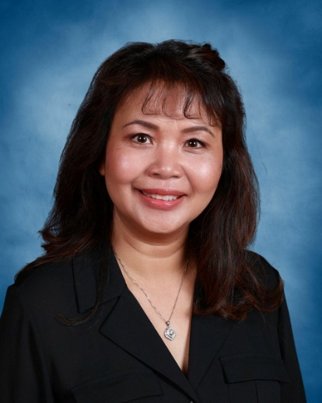
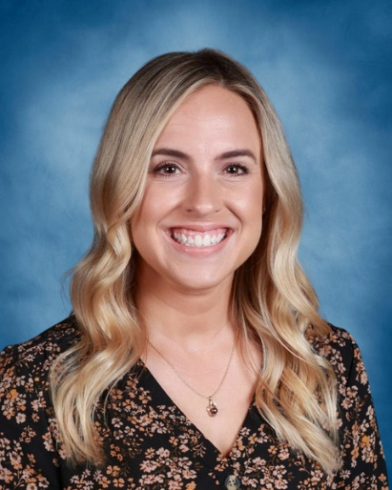
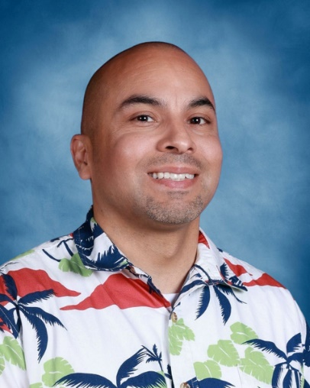
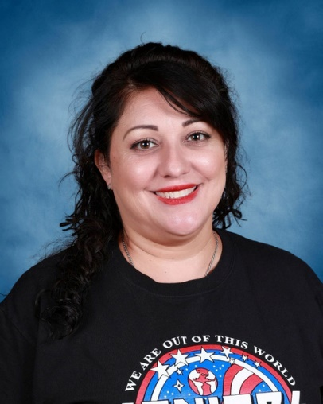
East Union Counselors
Ms. Sim
A - Gom
asim@musd.net
Mrs. Taiariol
Gon - O
staiariol@musd.net
Mr. Gonzalez
P - Z
jjgonzalez@musd.net
Ms. Muñoz
AVID, CARE, EL, Migrant, Foster
jmunoz@musd.net

Slide 7
What are your goals for the future?
How do you get there?

Slide 8


Great Resources!

Slide 9
Fast forward to after
High school!
Career
Major or Specialty
Education or Training

Slide 10
Post High School Options
4 year College or University
Community College
Trade or Technical School
Military
Workforce

Slide 11
Freshmen Course Selection
Letters are being mailed out to parents. Appointments cannot be rescheduled.
Counselors will be visiting Jr Highs in March for 1-1 course selection meetings.

Slide 12

Open Enrollment
If your open enrollment is approved, your home high school will send your course selection form to the high school you were approved to attend.

Slide 13
NON MUSD Students
Pre-Enrollment in available on the MUSD Website. After approval of pre-enrollment Trini Medrano will contact you for an appointment.
Course selection instructions will be provided at appointment with Trini.

Slide 14
C.A.R.E.
Community Active
Response to Education
Small Class Size (Max 22 Students)
Tutoring Opportunities
Study Skills and Organization
Frequent Parent/Guardian Contact
Involvement on Traditional Campus
Core Instruction from One Teacher
Career Exploration

Slide 15

Interested in C.A.R.E.?
Lonnie Cox
lcox@sjcoe.net
Jessica Munoz
jmunoz@musd.net

Slide 16

East Union Athletics
Athletic Director
JJ Ramirez

Slide 17
Fall Sports
Football
Girls’ Golf
Cross Country
Girls’ Tennis
Girls’ Volleyball

Slide 18
Winter Sports
Boys’
Basketball
Girls’
Basketball
Cross Country
Wrestling
Boys’ Soccer
Girls’ Soccer

Slide 19
Spring Sports
Baseball
Softball
Swimming
Track
Boys’ Tennis
Boys’ Golf
Boys’ Volleyball

Slide 20
Red Card
Information
Call the administration office for information on obtaining your red card or HomeCampus.com to download red card.
Visit EU website for updated info about athletics.

Slide 21
Eligibility
Minimum GPA 2.0
No more than 1 F
No more than 1 U

Slide 22
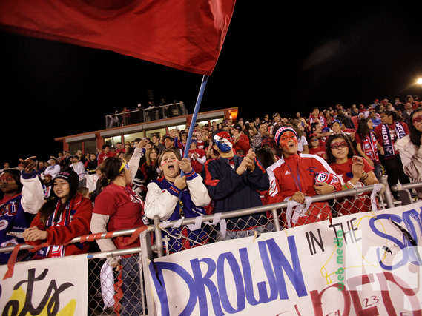
East Union Activities
Activities Director
Jenaia Cano

Slide 23

High School Life
We want you to GET INVOLVED!
Participate, find clubs, take a class you love, play sports, play music, sing, and cheer!

Slide 24

Clubs & Organizations
ASB (Leadership)
API (Asian Pacific Islander) Club
Art-N-Soul
AVID
BAND
BSU
Choir Club
Club Hope
Community First
Creative Writing
CSF
Environmental Science Club
FCA (Fellowship of Christian Athletes)
FCCLA (Family Career Community Leaders of America)
FIDM Fashion
French Club
FFA
Future Teacher Club
Girls Empowerment Leaders
GSA
JROTC
Journalism Honor Society
Key Club
Link Crew
Mecha
No Paing No Gain Weightlifting Club
Playbox Company
Programming/Robotic
Science Olympiad
Spirit Squad
Tabletop Gaming Club
Thespians
Volleyball Club
World Travelers Club
Yearbook
Young Ambassadors Club

Slide 25

EAST UNION LEADERSHIP
The Leadership program is a way to become involved in many of the activities on campus!
You get to create an amazing high school experience for yourself and fellow classmates!

Slide 26
ALL ABOUT LEADERSHIP
Leadership is an application-only class
Once the application is completed, each student will be interviewed
Positions Available for Incoming Freshman
Freshman President
Freshman Vice President
Freshman Secretary
Freshman Treasurer
Elections Commissioner
Rally Commissioner
Publicity/Club Commissioner
Audio Visual Commissioner
Service Commissioner
Student Store Commissioner

Slide 27
Interested in any activities, clubs, or programs?
Please contact Mrs. Cano for more information. jcano@musd.net

Slide 28
Thank you for coming tonight!
The gym will close at 7:00.

Slide 29
Share Your Voice!
Use the surveys
to rate us.
Sign up for
a committee.

