Slide 1
Technology Advisory Board
January 25, 2022
4:00-6:00pm

Slide 2
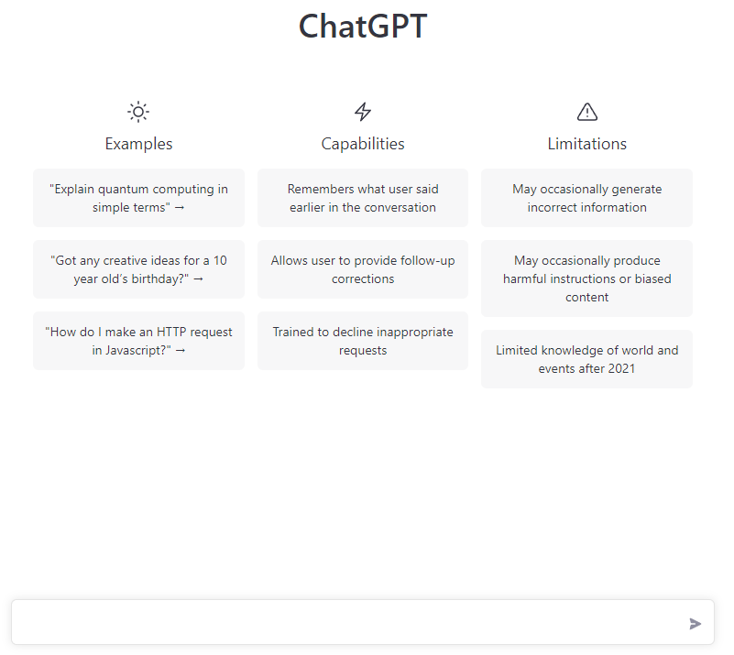
Do Now: Create Artwork or Haiku using AI
Go to openai.com
Sign up for DALLE • 2 or ChatGPT
Use one of the AI tools to create either a piece of art (DALLE 2) or a haiku (ChatGPT) that includes some form of technology as the subject

Slide 3
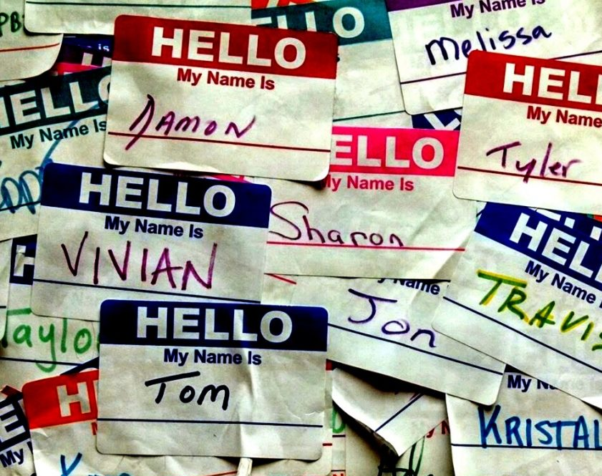
Introductions
Please share the following:
Name
Connection to SVSD
Share your AI Art or Haiku
This Photo by Unknown Author is licensed under CC BY-NC

Slide 4
Agenda
Welcome/Introductions/Opening Activty-10 min
Review of Purpose/Norms/Minutes-5 min
Student Spotlight-10 min
Technology Report-10 min
Strategic Planning -60 mi
Wrap-up/Next Steps-10 min

Slide 5
Meeting Norms
Start and end on time
1
Be fully present
2
Ask questions to understand
3
Participate by listening and speaking
4

Slide 6
Our charge…
The SVSD Technology Advisory Board is comprised of community members, staff and students who volunteer their time to:
Support the development of a technology vision and strategic plan
Research current educational technology best practices and future trends
Provide input on levy funding priorities and ongoing technology projects
Review budgets and other data points

Slide 7
We are not…
A day-to-day technology operations decision making body
A place to advocate for personal pet projects or air individual grievances
A vehicle for promoting specific technology platforms

Slide 8
Student Spotlight
Anjuli and Jaime

Slide 9
Technology Projects
Fletcher and Justin

Slide 10
Strategic Planning
Fletcher and Justin

Slide 11
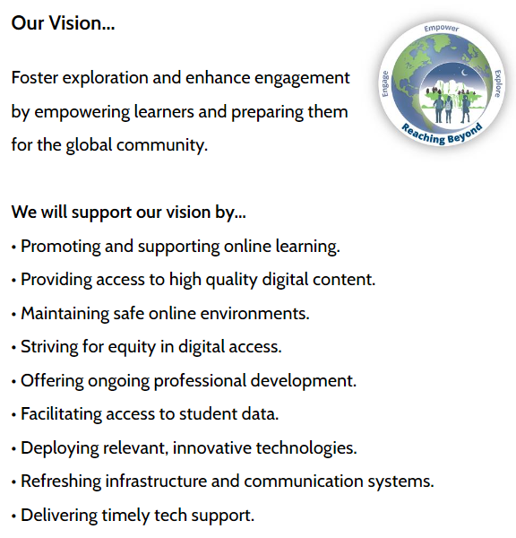
Current SVSD Technology Vision

Slide 13
Example District Technology Plans
Seattle
Nortshore
Peninsula
Renton
Fairfax County

Slide 14
Strategic Planning Activity
Individually develop a list of ways that technology can support the SVSD Strategic Plan Goal 1 objectives (1a, 1b, 1c, etc).
Working in teams place similar ideas together by moving the sticky notes.
Circle the grouping that you think is “best.”
Be prepared to share why
Materials Needed: Each person needs a sharpie and set of stickies
Part 1: Individual Brainstorming (10 min)
Part 2: Small Group Work (15 min)
Part 3: Whole Group Share and Discuss (20)
Part 4: Individual Brainstorming (10 min)
Group 1 1A,1B | Group 2 1B1,1B2 | Group 3 1B3,1C | Group 4 1D,1D1,12
Michelle Ram Jessica Joe Ian | Ginger Jaime Kristin Neil Janelle C | Stephanie Anjuli Courtney Duane Fletcher | Nicole Andre Brian Janelle W Siri

Slide 15
1 to 1 Device Program Overview
2018 Pilot
Device Selection
Device Distribution
Refresh Cycle Planning
Possible 5th Grade Take Home 1 to 1
Notes:
Fletcher

Slide 16
By the Numbers…
60% Yes on Tech Levy
5338 Windows Laptops
3529 Chromebooks
1345 Windows Desktops
317 Flat Panel Displays
17 Miles of Fiberoptic Cabling
627 Wireless Access Points
1047 Security Cameras
900 Digital Clock/Intercoms
6738 Support Tickets Last Year
3 Days Average Time to Resolution

Slide 17
1 to 1 Device Refresh Proposal

Slide 18
Expedited Refresh Budget Implications
22-23: ~1.1 million for 10th/11th Graders in Spring of 2023
23-24: ~2.1 million for 6th/7th/8th/9th Graders in Fall of 2023

Slide 19
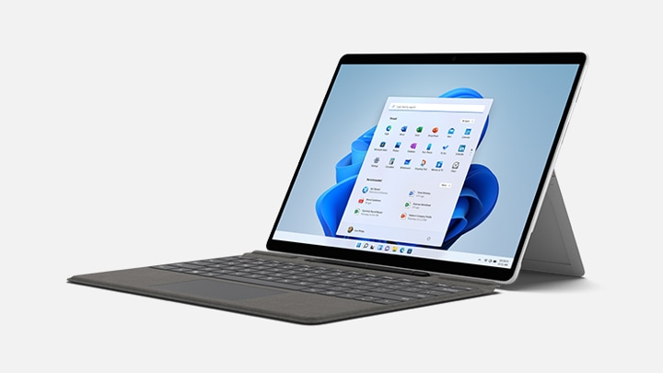
Surface Go 3
8gb RAM
128gb storage
Core i3 10th Gen
10.5 inch screen
Unit Price: $598.00
Typecover Price: $82.00
Stylus Price: 17.00
Total= $697.00

Slide 20
Surface Pro 7+
8 gb ram
128 gb storage
Core i5 11th Gen
12.3 inch screen
Unit Price: $792.00
Type Cover: $106.00
Stylus: $17.00
Total = $915.00

Slide 21
HP Pro X360
8 gb
128 gb
12th Gen Core i3
11.6 inch screen
Rechargeable Pen
Total = 789.00

Slide 22
Feedback Form
svsd.tech/tab1

Slide 23
Wrap-Up/Next Steps
Next Meeting: End of January/Early February
Does this time work for everyone?
Possible Agenda Items:
1 to 1 Device Update
Budget Overview
Technology Use/Needs Survey

Slide 24
Highlights

Slide 26
Committee Makeup
1-School Board Rep
1-Assistant Superintendent
1-Director of Technology
1-Assistant Director of Technology
1-Technology Staff Member
1-Student Services Rep
3-School Principals
2-Digital Learning Coaches
3-Instructional Staff
1- Digital Learning Leader
3-Parents/Community Members
2-Student Reps
1 CTE Director
TOTAL = 21 Members

Slide 27
Classroom Technology Integration Stories
High School: Siri
Middle School: Kristen
Elementary: Janelle

Slide 28
Small Group Discussion
Group 1 | Group 2 | Group 3 | Group 4
Ram Stephanie Bryan Janelle C | Fletcher Andre Kristin Ian | Ginger Jessica Joe Neil | Nicole Jaime Janelle W Siri
Instructions: From your experience as students, parents and staff members, discuss technology program areas of strength and growth with your group.
Choose a notetaker
List ideas on poster
10 minutes (~5 minutes per column).
If you have time left over, discuss what you’d like to see the advisory board accomplish
Choose a presenter to share with the larger group

