Slide 1
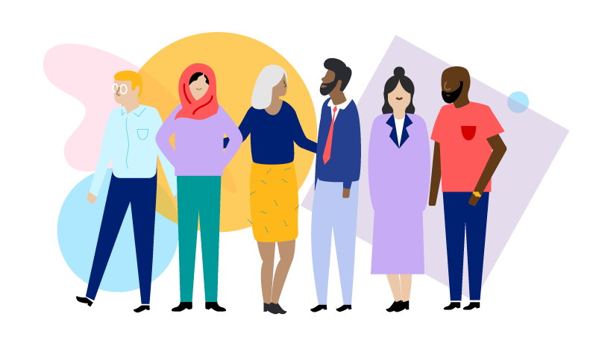
Presented By:
Ms. April Francis-Taylor
Director of Diversity, Equity, and Inclusivity
ESBOCES DEI Agency Council
Understanding Culture, Identity, Bias, and its Impacts
Notes:
Welcome, My Name is April Francis-Taylor and I am the Director of Diversity, Equity, and Inclusion.

Slide 2
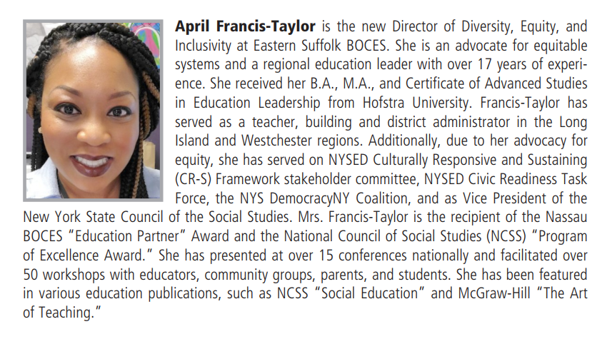

Slide 3
Setting Virtual Norms
Protocols and Strategies to Support Courageous Conversations in Virtual Meetings:
Please use the “rename” function and share your full name and building
Please mute when you are not speaking
When others are speaking, use the “chat” room to share any thoughts
Stay engaged and be “present” as much as possible using your camera/video option
Share your appreciation for colleagues who BRAVE through our conversation
As always, let’s be kind, courteous, and civil in our conversations.
Notes:
Link to Brene Brown’s “BRAVING” norms
https://daretolead.brenebrown.com/wp-content/uploads/2018/10/BRAVING.pdf

Slide 4
Today’s Objectives
Diversity Training: Understanding Culture, Identity, and Bias
Developing norms and protocols using the Courageous Conversations model
Unpacking culture, identity, implicit bias, microaggressions, and their impacts
Learning strategies to combat bias
Develop teamwork skills

Slide 5
Don’t Be Afraid To Have Courageous Conversation
Stay Engaged
Experience Discomfort
Speak Your Truth
Expect and Accept Non Closure
In the chat box, please list a norm you need to have a courageous conversation.
Notes:
Link to Glenn Singleton’s Courageous Conversation norms (hyper link)
https://iel.org/sites/default/files/G10-courageous-conversation-protocol-overview.pdf

Slide 6
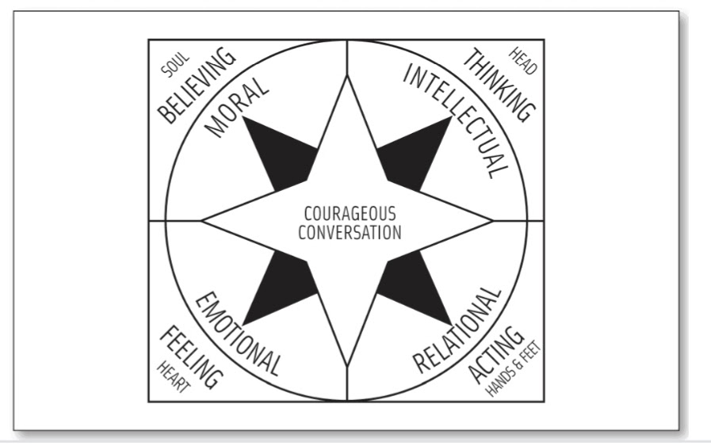
Courageous Conversation Compass
The 4 Points are:
EMOTIONAL: responding to information through feelings (when difficult issues strike us at a physical level and causes sensations such as anger, sadness, joy, or embarrassment).
INTELLECTUAL: response to a difficult issue or information may be to personally disconnect or to search for more information or data. Our intellectual response is often verbal and based in our thinking.
MORAL: responding from a deep-seated belief that relates to difficult issues information or event. Moral views are from the “gut” and may not be verbally articulated.
SOCIAL: connecting and responding to difficult topics and information through actions and behaviors.
In the chat box: please write where you presently are in this moment.

Slide 7
Grounding our group!

Slide 8
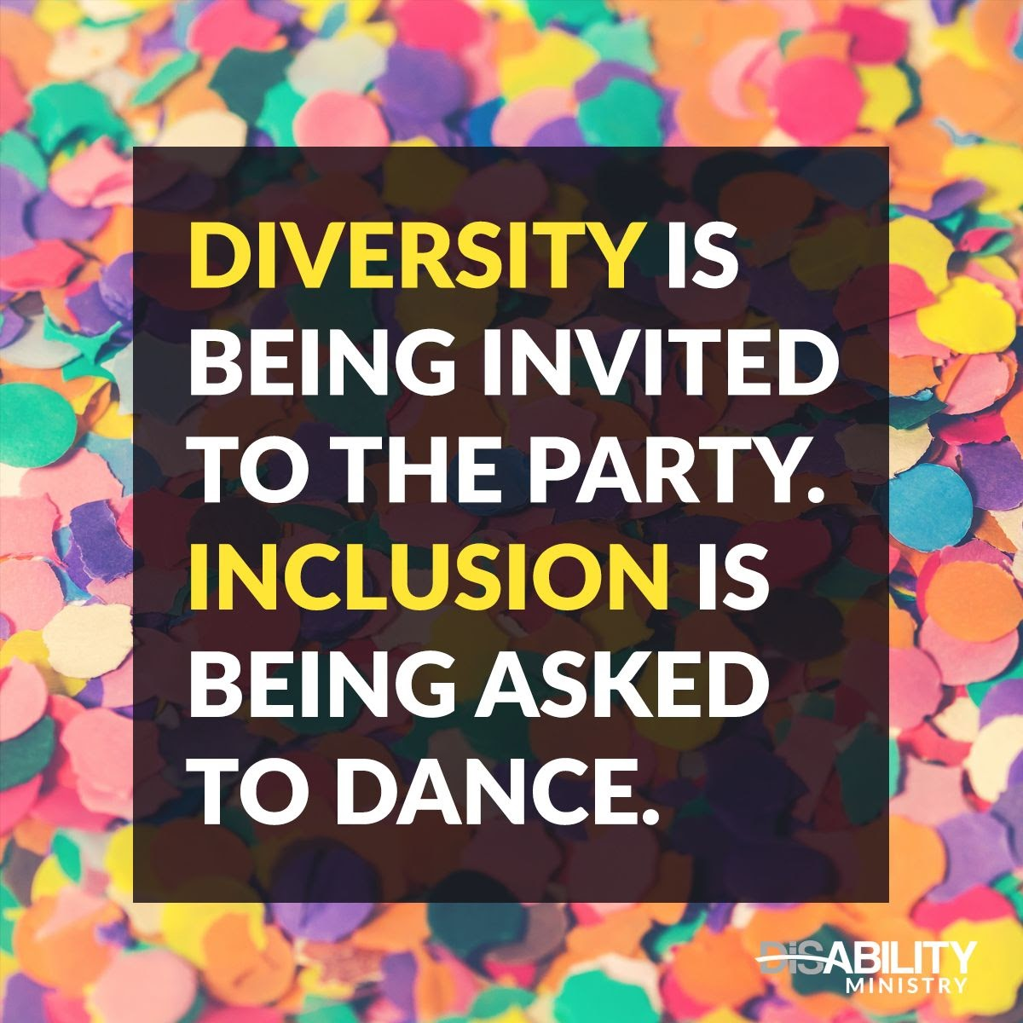
Diversity, Equity, & Inclusivity
Diversity- is the presence of difference within a giving setting. The differences typically refer to identity like race and gender, and sometimes ethnicity, religion, nationality, or sexual orientation. A person isn’t diverse. They’re unique. They can bring diversity to a group though. You’re not looking for a diverse candidate. Diversity is about a collective or a group.
Inclusion- has to do with people with different identities feeling and/or being valued, leveraged, and welcomed within a given setting (whether that’s a team, workplace, or industry): “Diversity is being asked to the party. Inclusion is being asked to dance.”
Equity- is an approach that ensures everyone has access to the same opportunities. Equity recognizes that we don’t all start from the same place because advantages and barriers exist. It’s a process that acknowledges uneven starting places and seeks to correct the imbalance.
Notes:
Link to DEI Agency Council Schedule for 20-21 hyperlink (Inclusivity)

Slide 9
How can we define “Culture”?
The New York State Education Department understands culture as the multiple components of one’s identity, including but not limited to: race, economic background, gender, language, sexual orientation, nationality, religion, and ability. Culture far transcends practices such as cuisines, art, music, and celebrations to also include ways of thinking, values, and forms of expression….

Slide 10
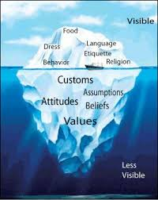
How does your culture impact your identity, personality?
Self-Reflection and Share (breakout rooms)
Notes:
journal, then in groups (after count off) share what you wrote
break

Slide 11
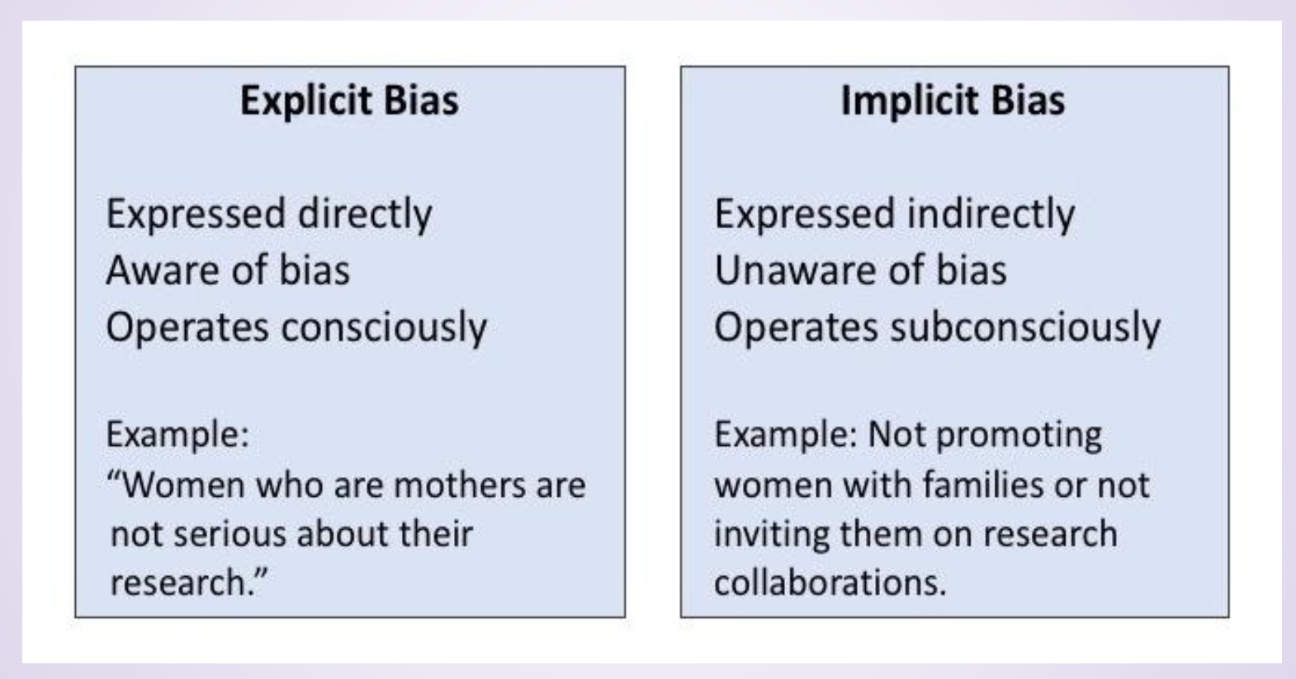
Explicit vs. Implicit Bias
Notes:
Link to “Implicit Bias” video in hyper link (Implicit)
https://www.youtube.com/watch?v=cPqVit6TJjw

Slide 12
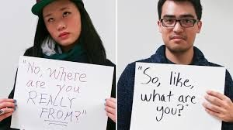
Microaggressions
Microaggressions- are the everyday verbal, nonverbal, and environmental slights, snubs, or insults, whether intentional or unintentional, which communicate negative messages to persons based solely on group membership.
Notes:
Link to TED talk video in hyperlink (microaggressions)
https://www.youtube.com/watch?v=cPqVit6TJjw

Slide 13
Impact of Bias/Stereotypes/Microaggressions
For the person targeted, the impact of the biased action is what really matters, not necessarily the intent of the aggressor.
While It is important to understand the many complexities of bias, it is more important to consider the impacts of bias, whether implicit or explicit, and microaggressions on targets or others in that identity group.

Slide 14
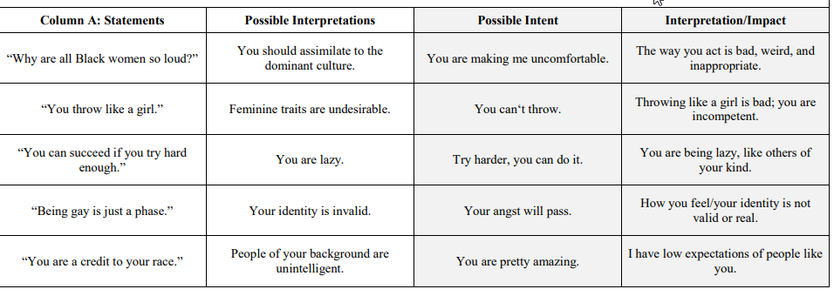
Intent vs. Impact

Slide 15
Mid-point check-in
In break out rooms, share:
How have bias or microaggressions impacted your life?
How did this share of these definitions connect or extend your previous thinking?

Slide 16
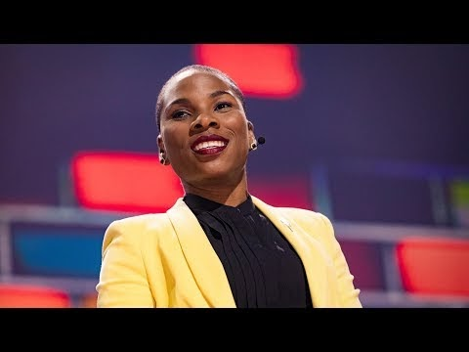
Get Comfortable Being Uncomfortable

Slide 17
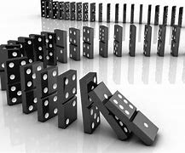
How can YOU continue to be a domino against bias and microaggressions?

Slide 18
Ways we can respond to bias and microaggressions
Inquire, Paraphrase, Reflect, Revisit
Separate the person from the action or behavior. Instead of saying “you’re racist” try saying “that could be perceived as a racist remark.”
Avoid starting questions with “Why”- it puts people on the defense. Instead try “how” and “what made you…”
Try to avoid using the pronoun “you” too often. Use “I” statements describing the impact on you instead or refer to the action indirectly (i.e. “when ____was said, or when ____happened)
Be mindful of your tone, body language, etc… the message has to be said with respect.
Notes:
Link to Interrupting Microaggressions in hyperlink (Ways we can respond)
https://academicaffairs.ucsc.edu/events/documents/Microaggressions_InterruptHO_2014_11_182v5.pdf

Slide 19
REFLECTING
How how has the workshop pushed your thinking?
What is one concept you will commit to sharing with your others after today?
HW: Harvard Implicit Bias Exam
Next Workshop: Developing Anti-racist Mindsets for Action

