Slide 2
What does Arab American mean?
Arab Americans are people who live in the United States and are of Arab descent.
Arab is a cultural and linguistic term. It is not a racial term and does not refer to people based solely on country of origin.
“Arab Americans include many faiths, races and ethnicities, and ancestry in any one of 22 Arab countries that span northern Africa to Western Asia. What these diverse countries share most in common is the Arabic language.” -New York Public Library Website

Slide 3
How many Arab American people live
in the United States?
There are nearly 4 million people of Arab descent living in the United States.
There are over 30,000 people of Arab descent living in Oregon.
In Portland, there are around 10,000 people of Arab descent.

Slide 4
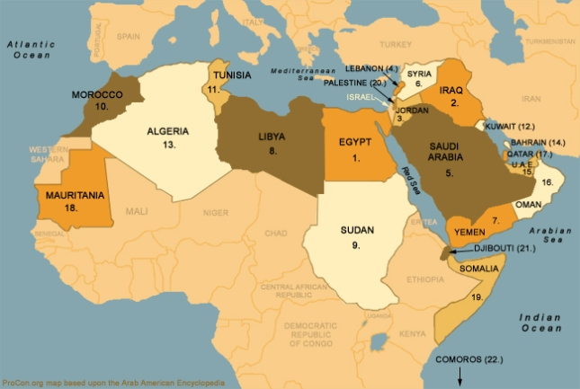
What countries are in the Arab World ?
The Arab World consists of 22 countries in the Middle East and North Africa. On the map, they are orange, white, brown, and dark tan.
While Israel, Iran, and Turkey are in the same region as the countries listed above and have Arab citizens, they are not considered part of the Arab World because of their primary languages (Hebrew, Farsi, and Turkish).

Slide 5
Arab American Heritage Month celebrates the contributions and achievements of Arab Americans people. Let’s learn more about the culture and history.

Slide 6
K-4th Read Aloud: The Arabic Quilt

Slide 7
5th - 8th Video from the Arab American National Museum

Slide 8
Additional Classroom Resources:
National Arab American Heritage Month 2021: Classroom Resources and Activities
Rethinking Schools - “Facts About Arabs”
26 Books for Kids about the Arab World
20 Children’s Books Set in the Middle East & North Africa

