Slide 1
Albemarle County Public Schools Substitute School Nurse Orientation
School Year 2022-2023

Slide 2
General ACPS Information
HR Required Training: Will be sent after employee’s first day
HR Intranet
Kronos Time System
General Information for ACPS Staff

Slide 3
General Information for School Nurses Overview
School nursing is a unique field of nursing, expectations and standards of care are somewhat different than that of other nurse practice settings
One key difference is the school nurse practices autonomously
School nurses function as public health nurses, sometimes as a primary care provider for some students, and advocates for the health and safety of the entire school community
See Position Description

Slide 4
Legal Issues
Federal Laws
- Individuals with Disabilities Education Act (IDEA)
- Family Educational Rights and Privacy Act (FERPA)
- Health Insurance Portability and Accountability Act (HIPAA)

Slide 5
Individuals with Disabilities Education Act
Enacted in 1990 to combine several laws to ensure that all children had available to them a free and appropriate education (FAPE) in the least restrictive environment, regardless of disability
No student can be denied participation in any school-related activity based on disability (including diabetes and other health conditions)

Slide 6
Federal Educational Rights and Privacy Act (1974)- FERPA
Federal Law protecting the privacy of educational records
Parents can access ALL educational records, including health records which may contain referral for confidential services under HIPAA
Provides parents and eligible students with privacy protections and rights
Education records are “any record containing personally identifiable information about a student that is maintained by the school, its staff members or contracting employees”. Health records are educational records in a school setting.
Limits who can see what’s in the record without parental permission and assures their right to view the record

Slide 7
FERPA Continued
Parental permission is not needed when the health information is disclosed for educational purposes within the school division.
Written parental consent is required if providing any outside agency, including the health department and medical offices, with student information.

Slide 8
Health Insurance Portability and Accountability Act (1996)- HIPAA
Law to protect the privacy of personal health data
Applies to: Any personally identifiable information about a student’s past or present health and development status, whether physical, psychological, or behavioral, and whether oral, printed, electronic, or in any other format. Includes family information, health assessment data, individualized health care plans, screening results
Also applies to: Injury reports, incident reports of alcohol or drug use in schools, evaluation reports related to special education eligibility, referral for suspected child abuse, notes from visits to the health office, medication logs, doctor’s orders for medication, parental consent forms
Defers to state laws regarding minor’s consent to treatment statues

Slide 9
Exceptions to the Release of Confidential Information Without Parental Consent
Immunization records shared between the health department and school as well as between a physician’s office and school
Information to child protective services workers
Contracted employees that provide educational services to or on behalf of the school district
Another school division where the child seeks to enroll
In response to a judicial order
Health and safety emergencies
Juvenile justice system

Slide 10
Minor’s Right to Consent to Medical Treatment
Access to contraceptive services- all minors can consent to services
Access to prenatal care- can consent under the law to prenatal care
Access to STD services and HIV testing/treatment- all minors

Slide 11
State Regulations
Physical Exam requirements: https://law.lis.virginia.gov/vacode/title22.1/chapter14/section22.1-270/
Immunization requirements: https://law.lis.virginia.gov/vacode/title22.1/chapter14/section22.1-271.2/
Vision and hearing screening: https://law.lis.virginia.gov/vacode/title22.1/chapter14/section22.1-273/
Diabetes: Any public school with one or more students diagnosed with diabetes is required to have at least 2 employees trained in the administration of insulin and glucagon: https://law.lis.virginia.gov/vacode/title22.1/chapter14/section22.1-274/

Slide 12
State Regulations Continued
Epinephrine: Each school is required to stock undesignated epinephrine to be used on any student believed to be experiencing anaphylaxis https://law.lis.virginia.gov/admincode/title8/agency20/chapter671/section710/
Albuterol inhalers: Each school is required to stock undesignated albuterol inhalers to be used by any student believed to be experiencing an asthma attack: https://legiscan.com/VA/bill/HB2019/2021/X1
Possession and self-administration of inhaled asthma medications and epinephrine by certain students or school board employees https://law.lis.virginia.gov/vacode/title22.1/chapter14/article2/section22.1-274.2/

Slide 13
Mandated Report of Suspected Child Abuse
Albemarle County Department of Social Services / Child Protective Services
(434) 972-4010, Monday-Friday between the hours of 8am-5pm

Slide 14
ACPS School Board Policy
School Board Policy See the bottom of section J for policies related to health and students

Slide 15
General Reference Information for School Nurses
School Health Services Website: https://www.k12albemarle.org/our-departments/school-health-services
School Nurse Manual: https://www.k12albemarle.org/our-departments/school-health-services/school-nurse-manual
Virginia Department of Education School Health Webpage: https://www.doe.virginia.gov/support/health_medical/index.shtml
Virginia Department of Health School-aged and Family Health: https://www.vdh.virginia.gov/school-age-health-and-forms/

Slide 16
School Nurse Tasks and Responsibilities
Review of Records (long-term subs only)
Reviews health records for pertinent health information: makes lists by grade and teacher of information staff needs to know that parents included in health history: asthma, severe allergies, seizure disorder, diabetes etc. Share with administrators and others with supervisory authority over student, enters health alerts and health conditions into Power School
Ensures students are compliant with school health entrance requirements
Ensures parents submit proper forms and care plans: medication form for all medication, care plans for students with conditions that require treatment at school or could necessitate emergency treatment at school, doctor’s orders for prescription medication and medical treatments such as tube feedings

Slide 17
School Health Entrance Requirements
(long-term sub only)
Physical exams Required for all student admitted for the first time to any public kindergarten or elementary school: must contain a report from a qualified licensed physician, or a licensed nurse practitioner of licensed physician assistant acting under the supervision of a licensed physician, of a comprehensive physical examination within the 12 months prior to the student’s start date
Check the date, note whether screenings were preformed and if the doctor reports unusual findings that might require accommodations or modifications. Example of spreadsheet
Parent’s Report of Health History: Parents/guardians of students entering school shall complete a health information form as required by state law.

Slide 18
School Health Entrance Requirements: Immunizations (long-term sub only)
Immunizations, (supplemental guidance): Parents must submit documentary proof of required immunizations prior to admission unless the student is exempted from immunization or is homeless
Conditional enrollment: Students whose immunizations are incomplete may be admitted conditionally with documentary of having received at least one dose of the required immunizations with a schedule for completion of the required doses within 90 calendar days. If the student requires more than two doses of hepatitis B vaccine, the conditional enrollment period will be 180 days. Students will be excluded from school if the parent fails to comply with the schedule for completion until immunizations are resumed.
Exemptions: Medical (requires physician signature) or Religious (requires notarized form)

Slide 19
Minimum Requirements (Cheat Sheet)
Immunization | Minimum number required
DTaP, DTP, DT or Tdap Tdap Booster | 4 w/ 1 dose on or after 4th birthday > 7 years need only 3 doses if 1st dose > 12 months (1 can be Tdap) 1 dose required prior to entry into 7th, 8th ,9th 10th 11th or 12th grade (Only 1 dose necessary)
Polio (OPV or IPV) | 3 w/ 1 dose on or after 4th birthday (only 3 doses if 3rd on/after 4th birthday and at least 6 months after previous dose)
Hepatitis A (HAV) | Effective July 1, 2021, 2 doses w/ first dose at age 12 months or older
Hepatitis B | 3 with at least 4 months spacing between 1st and 3rd doses
Human Papillomavirus (HPV) Vaccine | Effective July 1, 2021, a complete series of 2 doses w/ first dose before entering 7th grade. After reviewing educational materials approved by the Board of Health, the parent or guardian, at their sole discretion, may elect for the child not to receive the HPV vaccine.
Measles, Mumps, Rubella (MMR)** | 2 MMRs or 2 each Measles and Mumps and 1 Rubella First dose on or after first birthday Second MMR may be administered at pre-K physical.
Varicella (chicken pox)** | 2, none required if history of disease
Meningitis MenACWY | Effective July 1, 2021, 2 doses. The first dose prior to entering 7th grade and the final dose prior to entering 12th grade

Slide 20
Immunizations of Special Note (long-term sub only)
There are certain immunizations required for grade level entry:
Kindergarten: All required series of immunizations
Seventh Grade: One dose of Tdap, one dose of meningitis (MenACWY) , two dose of HPV (although parents can opt out at their sole discretion – no documentation necessary)
Twelfth Grade: One dose on meningitis (MenACWY) on or after the 16th birthday
Entering students at all grade levels need to have all the age-level requirements

Slide 21
Substitute School Nurse Tasks and Responsibilities
Provides first aid for students and staff experiencing injury or illness
Excludes from school individuals with communicable conditions per established guidelines (see VDH, AAP)
Uses only approved treatments (see Clinical Guidelines for School Nurses)
Documents services appropriately
Performs prescribed medical procedures including administration of medication, tube feedings, catherization, etc.

Slide 22

American Academy Of Pediatrics
Managing Infectious Diseases in Child Care and Schools In School Clinics

Slide 23
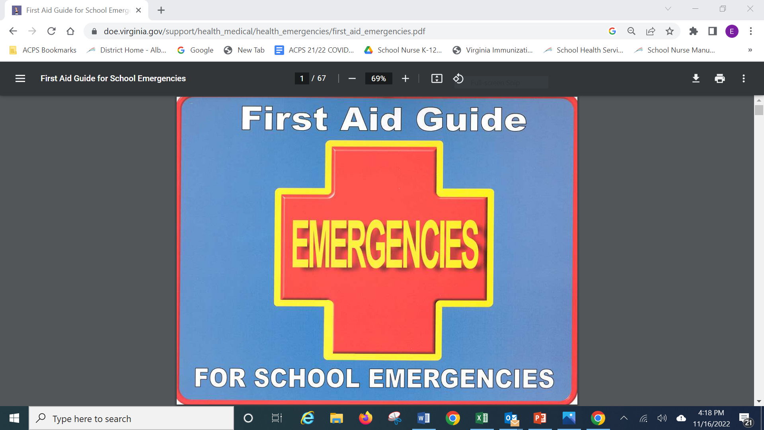
Look for VHD VDOE Flip Chart in School Clinic

Slide 24
English Language Learners
Substitute nurses can access interpretation services at the link below:
Interpretation and Translation
Step-by-step instructions for using Interpretalk translation by phone

Slide 25
Care Plan Templates
Seizure
Asthma
Food allergy
Diabetes

Slide 26
Medication Administration JHCD
Form required for all medication (except in emergency)
Parents provide all medication in original container
Physician signature required for all prescription medication
All medication administered must be documented
School personnel cannot recommend psychotropic medication (JHCDD)
Controlled substances (including Ritalin and Adderall) need to be counted and signed in and out when given back to parents or destroyed
Students may not self-carry medication except inhalers, epi-pens and diabetes supplies (if contract to do so signed by doctor and parent)

Slide 27
Standing Orders for Emergency Medication
School clinics have undesignated medication for emergency use per legislation requiring such floor-stock.
Epinephrine: for any student believed to be having an anaphylactic reaction
< 66 lbs: junior strength 0.15 mg
> 66 lbs: full strength 0.3mg
Albuterol Inhalers: with deposable spacer for any student believed to be having an asthma attack

Slide 28
Medication for Field Trips
The school nurse must prepare medication for field trips
Give teacher daily medication and emergency PRN medication with instructions and first aid kit

Slide 29
Field Trip Medication
Name | Medication | Dose | When to Give | Special Instructions
XX | Benadryl | 25 mg/ 2 tabs | Mild allergic reaction
XX | Epi-Pen* | 1 injection | Severe allergic reaction
YYY | Albuterol inhaler | 2 puffs | As needed
ZZ | Albuterol Inhaler | 2 puffs | As needed
YY | Benadryl | 2 tabs | Mild allergic reaction: few hives rash, nausea | Peanut and walnut allergy
YY | Epi-Pen Jr.** | 1 injection | Severe allergic reaction | See below* call 9-1-1 and parents
ZZ | Ritalin | 7.5 mg/1.5 tabs | Right before lunch | Give with water

Slide 30
Accident Reports
An accident report should be completed and sent to Kimberly Rhodes in the Department of Building Services when a student sustains an injury that the nurse believes needs medical attention or some other follow-up or the injury or could have occurred as the result of an unsafe condition.
https://resources.finalsite.net/images/v1628634103/k12albemarleorg/wp03md28cgopwpzijums/Accidentreport.pdf
Employees injured in an accident at school are required to submit a report through Worker’s Compensation. HR is in the process of updating that procedure. There it usually someone at the school other than the school nurse who is assigned to assisting employees with that process.

Slide 31
Power School for Substitute Nurses
One-Day Power School Credentials:
Eileen learns of the sub assignment and reports to SIS
Substitute signs in to the school for the day
Sub contacts SIS contact for the school
SIS contact tells sub how to get into Power School including assigning her log-in credentials for the day

Slide 32
Substitute Use of Power School
Short-Term Subs Will Have Read-Only Access
Go to SIS Start Page
Enter student’s last name
Select student (by first name if list appears
Pull up student’s screen
Click on medical alert symbol if one appears for acute conditions
Go to Emergency/Medical for additional medical considerations
Go to Health – first screen is immunizations, click Office Visits to see visit history, click Edit to see visit details, but do not edit or delete
Go to Contacts to get parent/guardian contact information. Note any pertinent custody information before calling parent.

Slide 33
Calling Parents
Whether or not to call parents is a judgment call
You may be able to tell from the clinic visit history if a student complains a lot and you might be more inclined to call a parent if a student is not a frequent complainer
If in doubt, err on the side of calling, even if just to let them know about an injury

Slide 34
If EMS is Activated. . .
If you need to call 9-1-1, click on Custom Screens from left menu
Scroll down to ACPS Stu Em Med Summary
Hit the Print icon and ask offer staff to obtain sheet to give to EMS personnel

Slide 35
Paper Documentation
Only Albemarle County Public School Employees can have access to Power School. Agency personnel and other subs may not have access
Document clinic visit information on paper Clinic Visit form
Document medication administered in paper Medication Log
Document medical procedures in Procedure Log

Slide 36
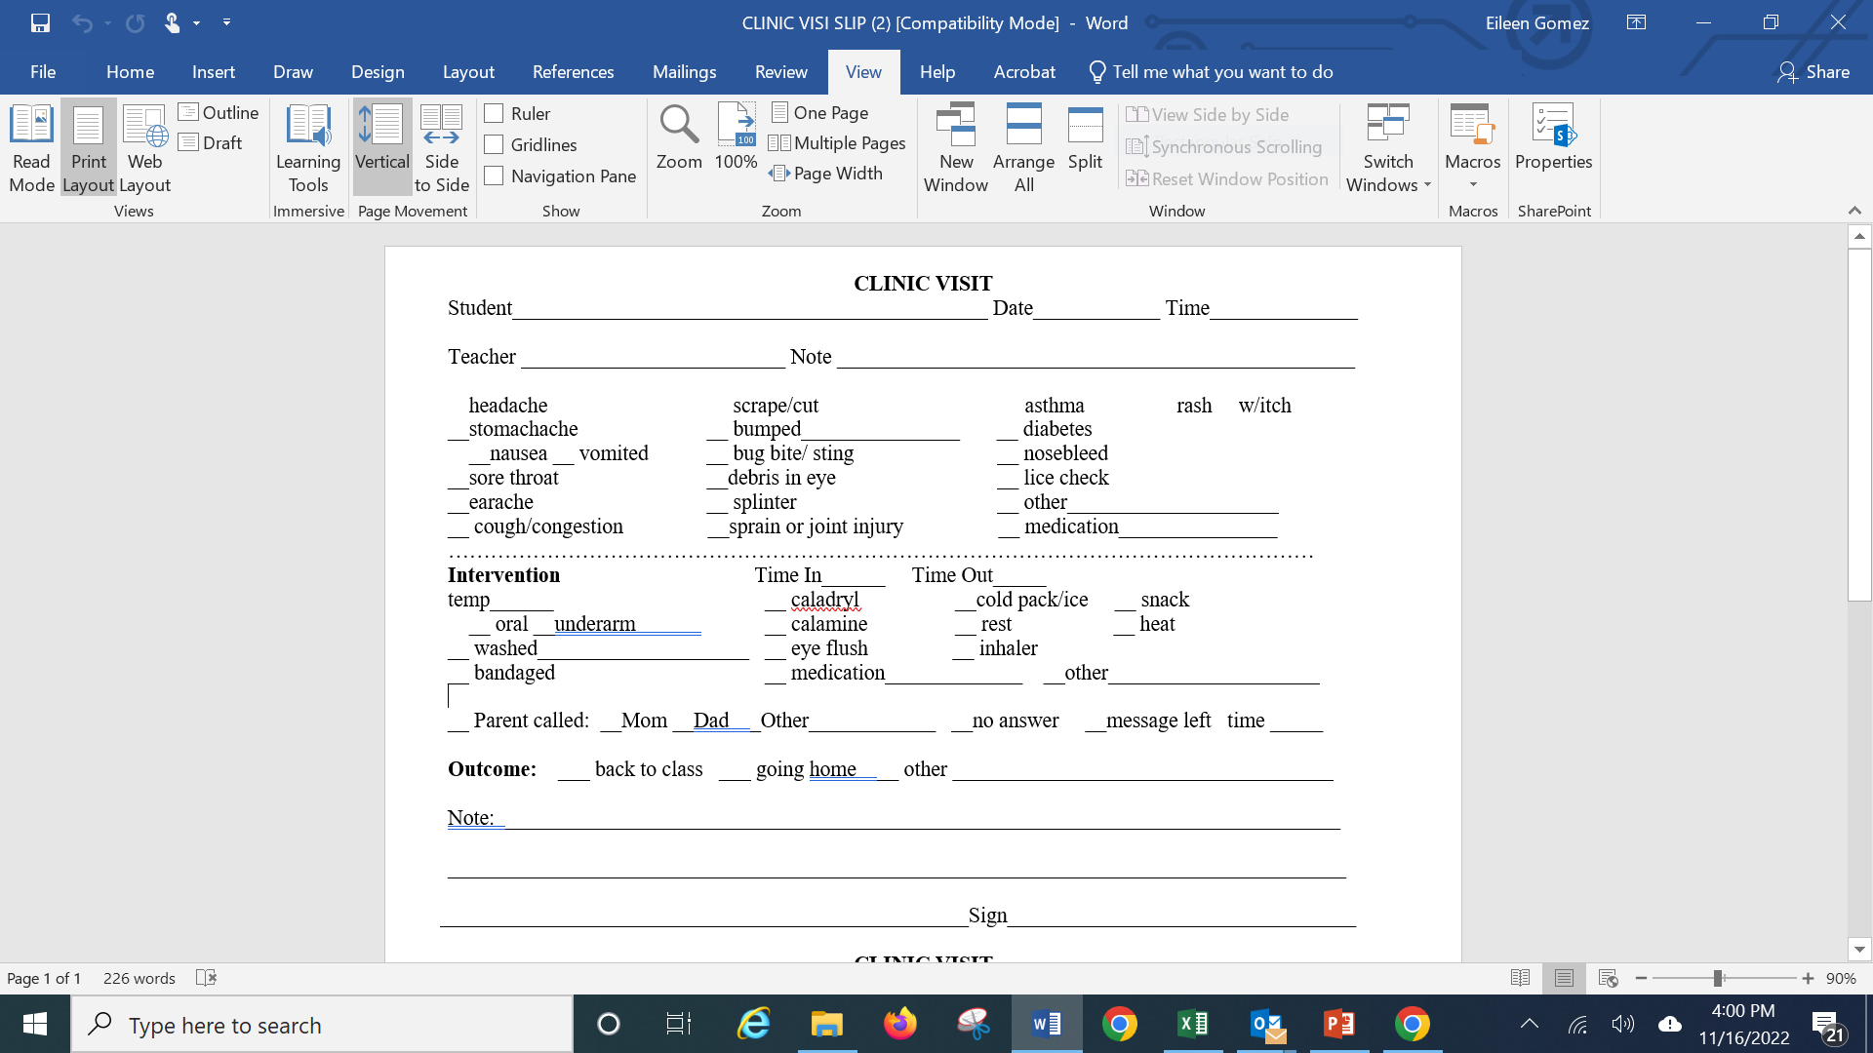
Clinic Form

Slide 37
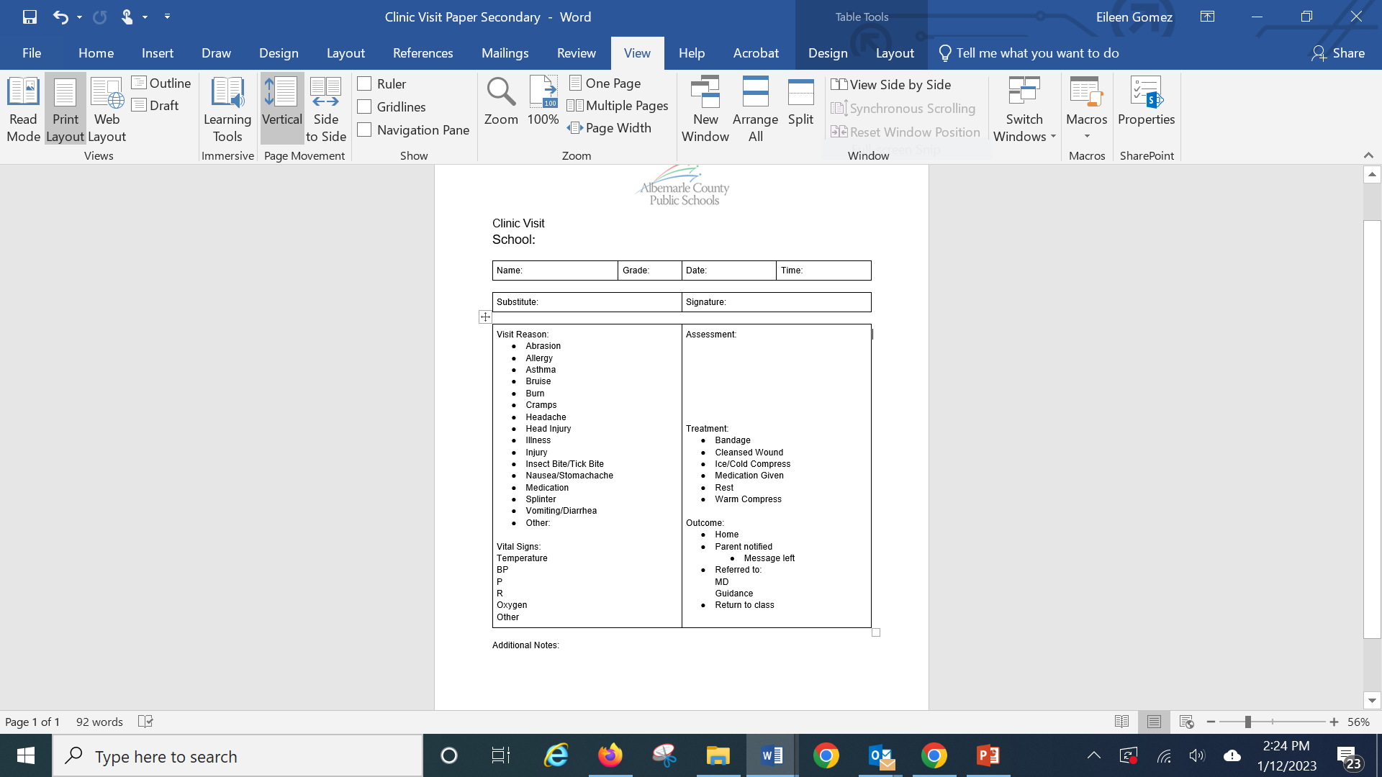

Slide 38
COVID Management 2022 – 2023
Please see ACPS’s COVID management at the website
You can see specific information at the Mitigation Strategies tab
All COVID forms are available at the bottom of the Mitigation Strategies page
See flowchart for triage of students who present with symptoms at school
We are only referring students for PCR testing if they have illness symptoms and a known exposure.See Return to School form
Testing for students at their PCP or at community sites
Schools have BinaxNOW antigen test kits that nurses can distribute to those who ask for them.

Slide 39
Return to School/Work After Testing Positive for COVID
Students and staff may return on Day 6 from the first day of symptoms if symptoms (or positive test result if no symptoms) have improved and individual has a negative antigen test, otherwise they may return on day 11.
No documentation is needed for returning staff
Parents must submit Declaration form

Slide 40
Questions?
Please call Eileen Gomez, School Health Coordinator at:
434-249-4625
This Photo by Unknown Author is licensed under CC BY-NC

