Slide 1
Fremont Elementary
Safe Schools Presentation
Safe Schools Presentation
K-2
Fremont Elementary

Slide 2
Safe Schools for Everyone

Slide 3
Safe School Violations
Arson ▪ Graffiti ▪ Vandalism
Assault ▪ Hazing ▪ Harassment
Controlled Substances
Robbery ▪ Extortion
Weapons
Gang Activity
Sexual Misconduct
Threats
Continued Disruption of School
Discrimination

Slide 4
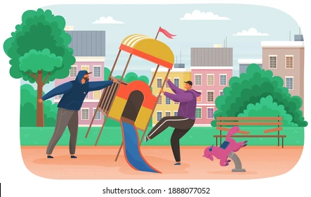
Burning, marking, or damaging property
Arson • Graffiti • Vandalism
Notes:
Examples:
Making messes in the restroom
Writing on walls or desks
Ruining another student’s work

Slide 5
real or pretend physical aggression or intimidation
Fighting • Hazing • Harassment
Notes:
No overt aggression that may include physical fighting such as punching, shoving, kicking, and verbal threatening behavior, such as name calling, or both physical and verbal aggression or threatening behavior;
No relational aggression or indirect, covert, or social aggression, including rumor spreading, intimidation, enlisting a friend to assault a child, and social isolation;

Slide 6
Sometimes…
Kids are bullied
Kids are bullies
Kids see bullying
Bullying: An on-going imbalance of power between students or people intended to do harm.
Physical: Hitting, pushing, shoving, kicking, etc.
Verbal/ Non-Verbal: Teasing, name-calling, gestures, threatening, spreading rumors, being mean, using racial slurs
Cyber Bullying: Text messages, emails, social media posts, websites

Slide 7
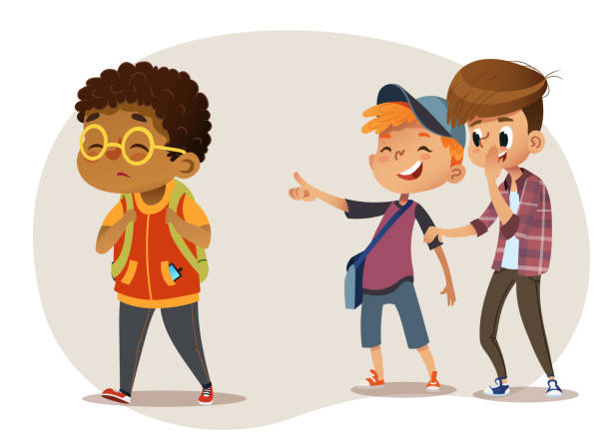
Harassment is
Repeatedly making someone feel uncomfortable using words or actions
Words—jokes, rumors, name calling, pictures
Actions—touching
Can be in person or “cyber”
It makes people scared or worried to come to school.
Makes people feel unsafe
Notes:
No sexual aggression or acts of a sexual nature or with sexual overtones;

Slide 8
No drugs, tobacco, or alcohol
No real or pretend drugs or drug tools

Slide 9
Stealing or making someone give you something or do something for them
Robbery • Extortion
Notes:
Examples:
Taking a classmate’s water bottle.
Stealing candy from a teacher’s desk.
Making a student feel like they must buy you a sticker to be your friend

Slide 10
No real or pretend weapons
this includes using other items as weapons

Slide 11
No gang activity

Slide 12
Saying that you are going to hurt everyone or someone or yourself
terroristic threats • threat to others • threat to harm oneself
Real or Hoax

Slide 13
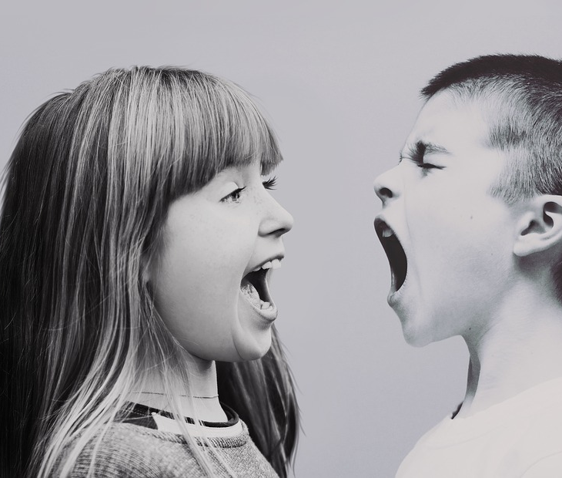
Repeated problems that make it so others can’t learn or be safe
Continued Disruption

Slide 14
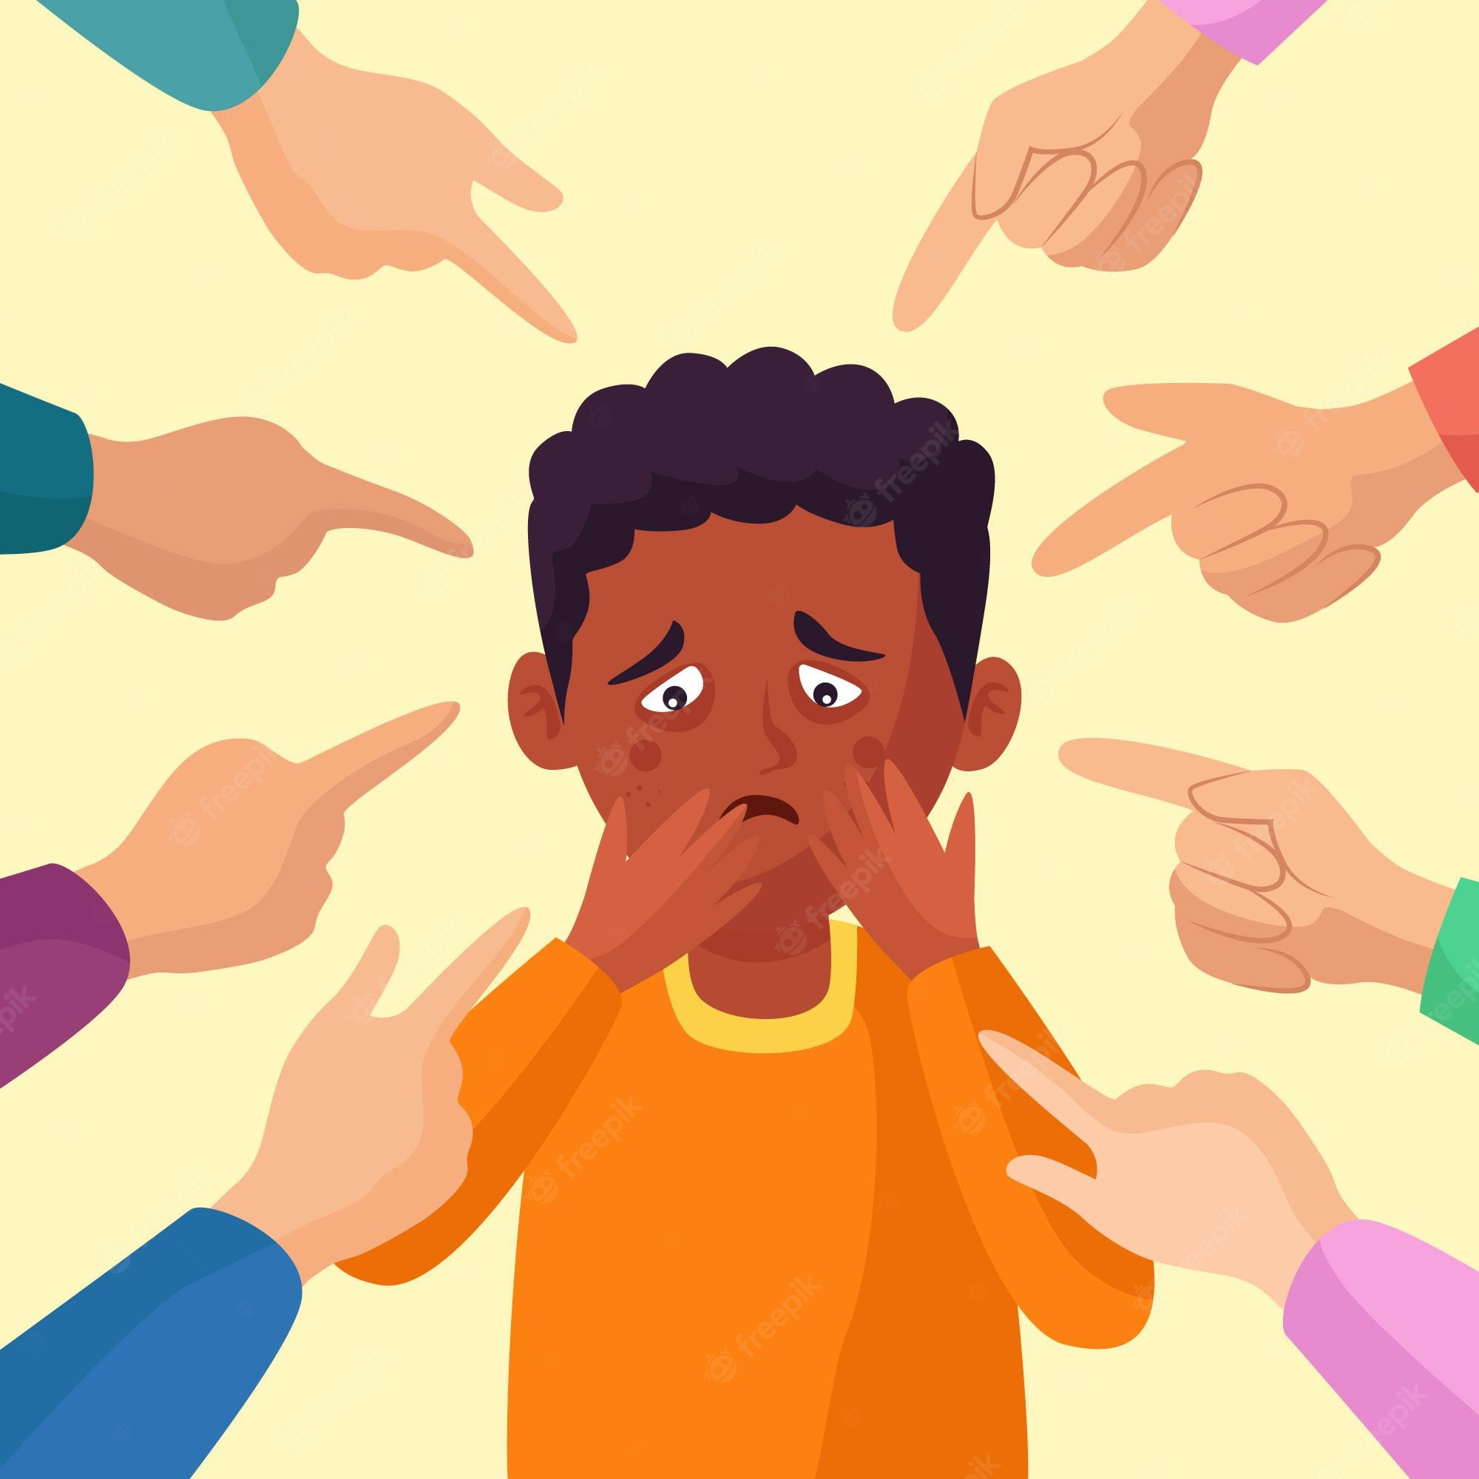
Treat people differently based on race, color, national origin, sex, disability, gender, orientation, religion, physical or mental attributes
Discrimination
Notes:
civil rights violations, including bullying, cyber-bullying, hazing, and retaliation based upon the students’ or employee’s actual or perceived characteristics, including race, color, national origin, sex, disability, religion, gender identify, sexual orientation, or other physical or mental attributes or conformance or failure to conform with stereotypes.

Slide 15
Where do I have to keep these rules?
On school grounds/property
On school buses
During the school day
School activities
Technology/Cyber where it affects another's safety

Slide 16
Possible Consequences
Suspended
Moved to another school
Expelled
Referred to the police
Other school-based outcomes

Slide 17
REPORTING
Reporting means getting help from adults who can help solve the problem.

Slide 18
Dress Code
Come prepared to participate in PE and recess.
Closed toed shoes are best!
Clothing should be appropriate for daily activities and weather.
Shorts and skirts must measure at least 3 inches above the knee.
No shirts or clothing that displays disrespectful slogans or messages about things that are illegal for children.

Slide 19
Electronic Devices * any privately owned electronic device may not be used on during school hours. This includes recesses and lunch. These devices must be kept in backpacks or given to the classroom teacher. * Electronic devices shall not be used in a way that threatens, humiliates, harasses, or intimidates school-related individuals. Do not email other students in your class/school and be mean to them EVER!
Notes:
Teachers can make an exception for specific activities or lessons
If a device is seen, it’s taken and brought to principal
Parent must pick it up
Repeat offenders may have other consequences

Slide 20
other school rules to address

