Slide 1
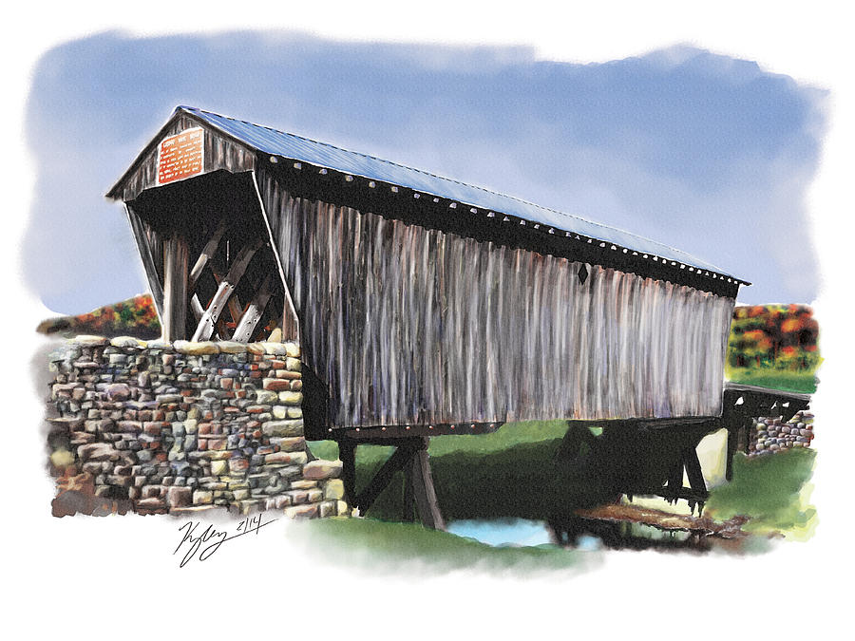
School Name
FLEMING COUNTY SCHOOLS
Teaching & Learning Update
Date

Slide 2
Focus on Student Growth
Fleming County Schools
How is the school focused on student growth this year?
The vision of Fleming County Schools is to become a District of Distinction.

Slide 3
Individual Student Growth
Fleming County Schools
How is the school ensuring that each individual student is growing?
The vision of Fleming County Schools is to become a District of Distinction.

Slide 4
Growth Goals
Fleming County Schools
How are students involved in setting growth goals?
The vision of Fleming County Schools is to become a District of Distinction.

Slide 5
Measuring Growth
Fleming County Schools
What metrics are being used to determine if a student is growing? What happens when a student is not growing?
The vision of Fleming County Schools is to become a District of Distinction.

Slide 6
Growth Examples
Fleming County Schools
How are ALL grades and subjects involved in measuring growth? Provide effective examples.
The vision of Fleming County Schools is to become a District of Distinction.

Slide 7
BRIDGE Performance Indicators
Fleming County Schools
How are BPIs promoting student growth academically, socially, and emotionally?
The vision of Fleming County Schools is to become a District of Distinction.

