Slide 1
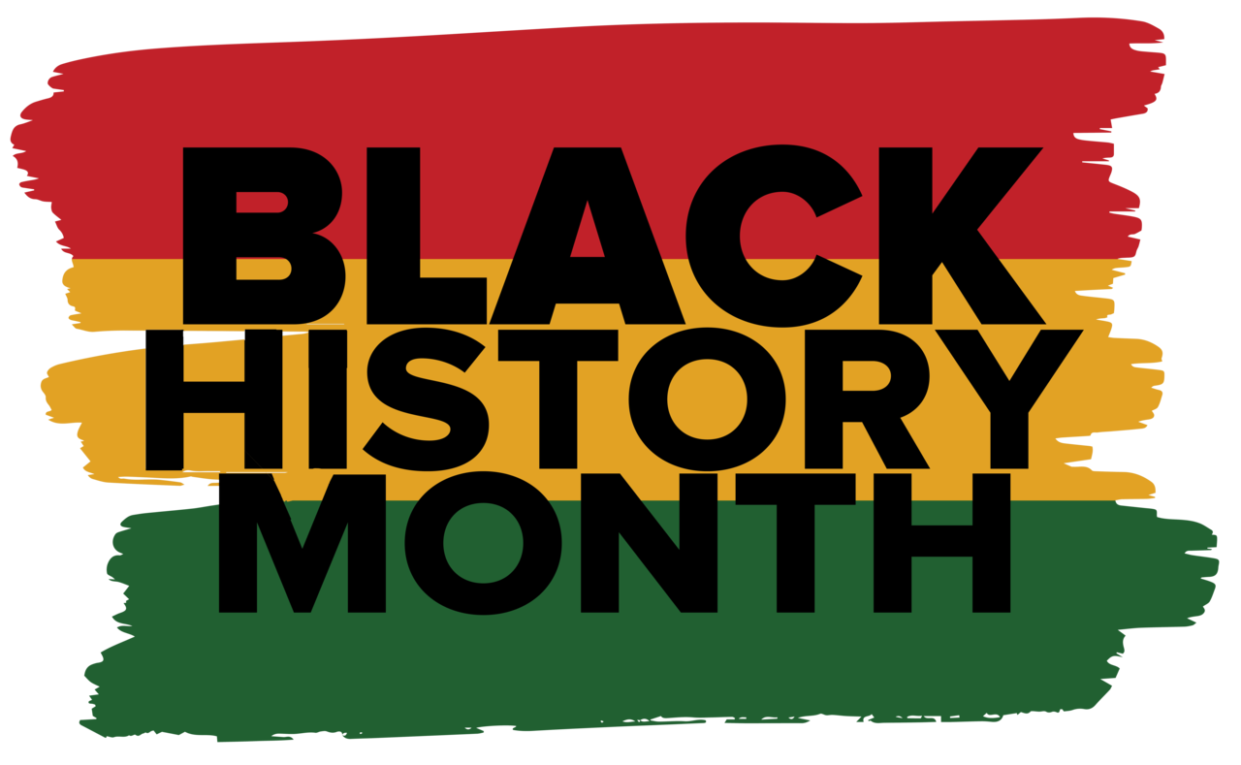
February is
Notes:
Lesson Plans and Activities for Black History Month from NEA
Black History Month Resources and Activities from Scholastic

Slide 2
What does Black American mean?
Black people: people whose ancestors are originally of African descent, in the United States, this could mean a number of things
African American people: people whose ancestors were enslaved
American African or Black African: people whose ancestors came to the USA of their own free will
People in this group often identify based on family country of origin, such as Nigerian American, Somali American, Congolese American…
Caribbean American: people whose ancestors are from the Caribbean
People in this group often identify based on family country of origin, such as Haitian American, Jamaican American, Dominican American
Some people from the Caribbean are Black people, some are not

Slide 3
What do the terms: Mixed Race person, Multiracial person, and Biracial person mean?
Mixed Race person: a person with two or more racial identities
Multiracial person: a person with two or more racial identities
Biracial person: a person with two racial identities
Some people of mixed identity only refer to themselves by one of their racial identities
We cannot determine a person’s racial identity only by the way they look.
People who are mixed race get to choose how they want to identify

Slide 4
Let’s learn about some Black Americans who have made a big impact.

Slide 5
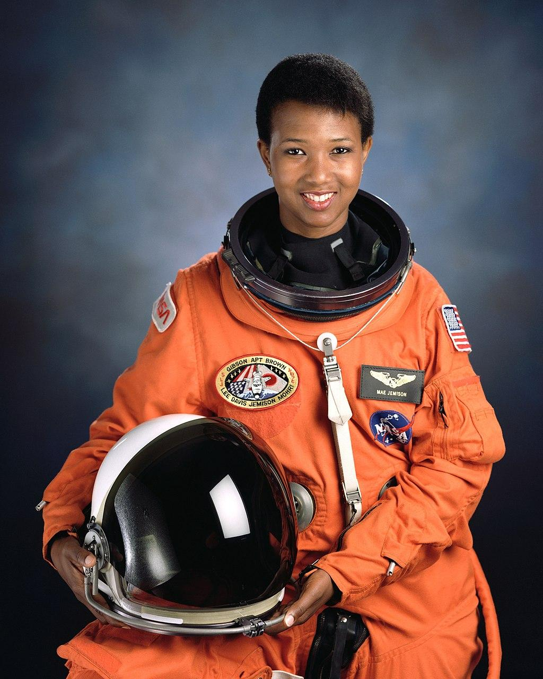
Mae Jemison
Mae is a doctor and engineer who studied at Stanford University and Cornell University
In 1992, she spent 8 days in space as part of the NASA STS-47 mission
After NASA, she worked as a professor and for the Peace Corps
She also founded an organization to support young people of color in the sciences
“Don't let anyone rob you of your imagination, your creativity, or your curiosity. It's your place in the world; it's your life. Go on and do all you can with it, and make it the life you want to live.” -Mae Jemison

Slide 6
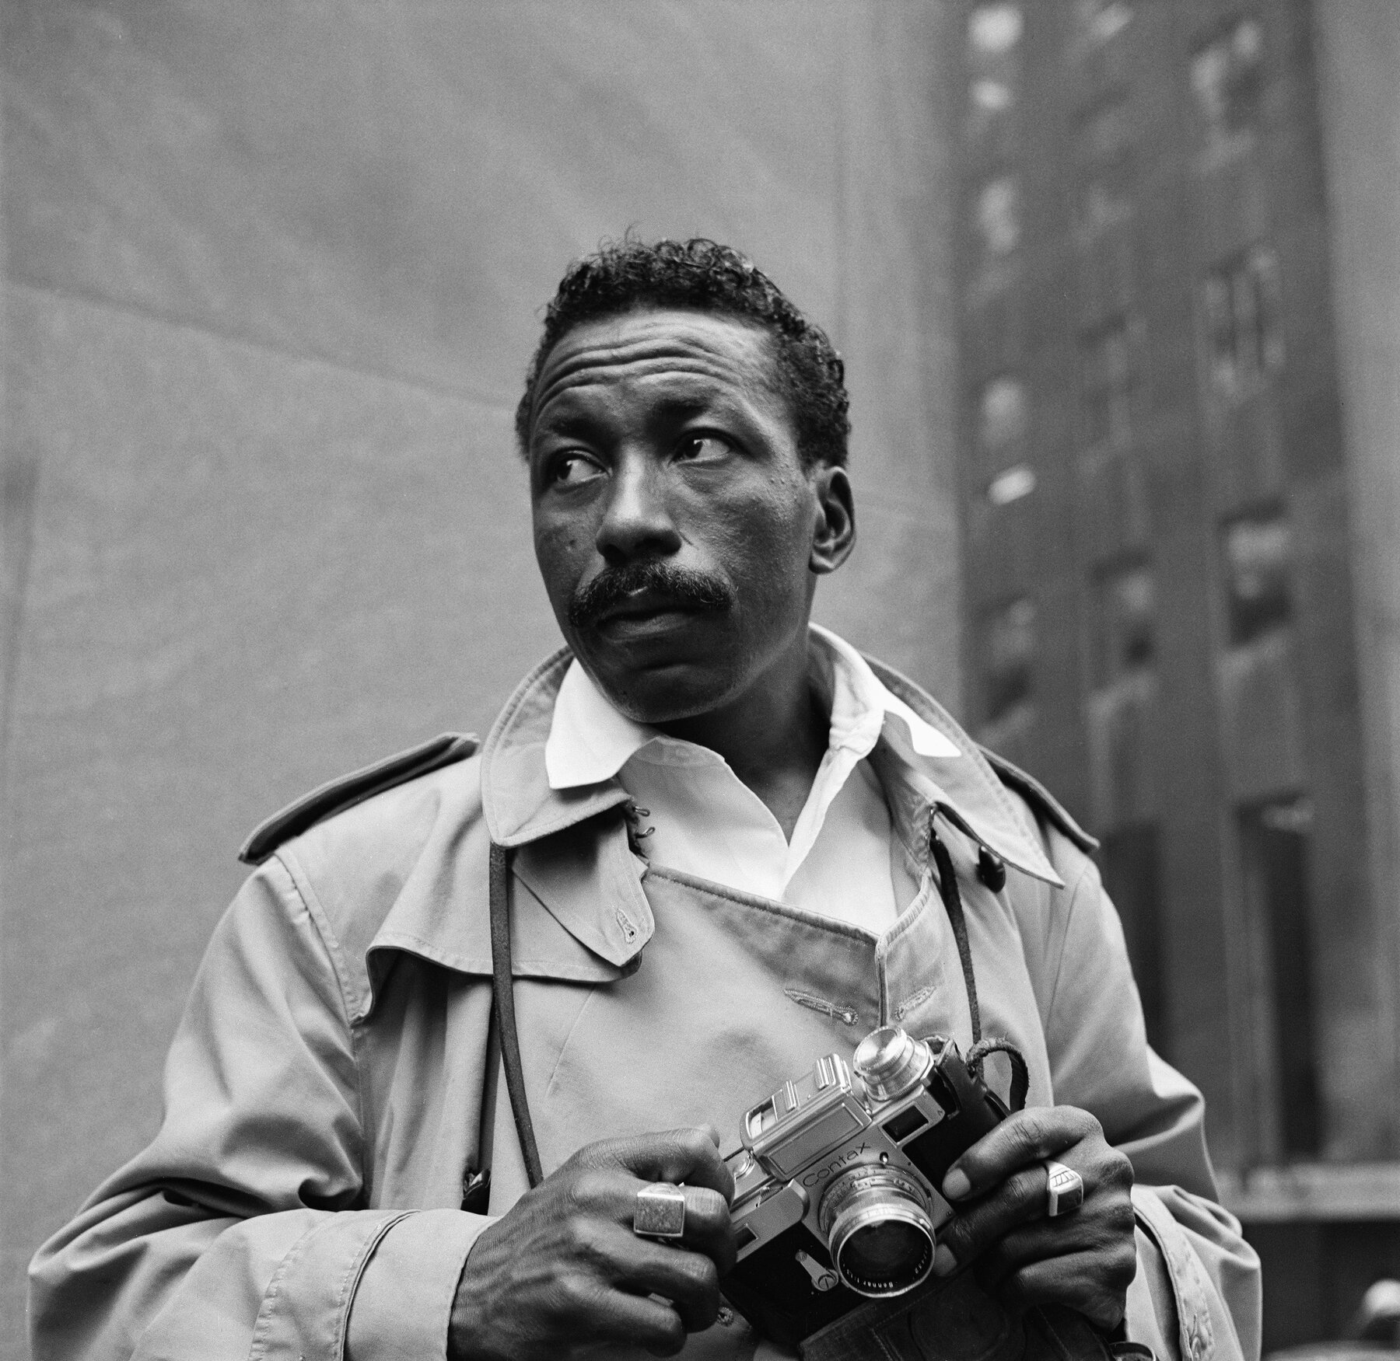
Gordon Parks
Gordon was a famous photographer, writer, film producer, and musician
He worked for Life Magazine and Vogue Magazine as a photographer
He took many well-known photos featuring Black Americans in their daily lives
He won hundreds of awards in his lifetime and published 15 books
“I saw that the camera could be a weapon against poverty, against racism, against all sorts of social wrongs. I knew at that point I had to have a camera.” -Gordon Parks

Slide 7
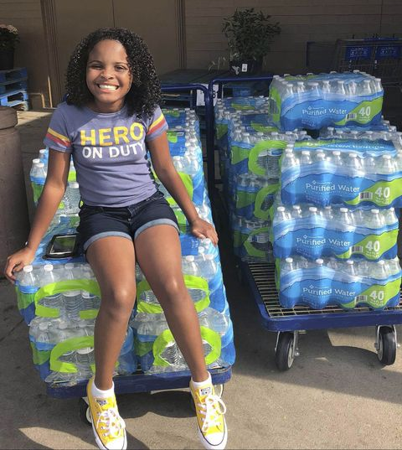
Mari Copeny, “Little Miss Flint”
Mari Copeny lives in Flint, Michigan
In 2014, people in Flint found out that their tap water had lead in it, which is poisonous and can cause serious health problems
She began protesting the unsafe water when she was only 8-years-old and she has raised over $500,000 to help provide clean water for her community
She even ended up meeting President Obama after writing him a letter asking him to help with the water crisis
“Your voice can be heard, even if you’re big, old, young, small, it doesn’t really matter. You can still make a change in the world.” -Mari Copeny

Slide 8
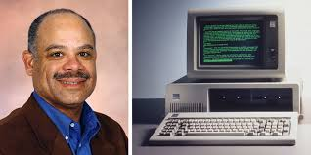
Mark Dean
Mark is a computer scientist and inventor
He co-invented the personal computer (computers for regular use, rather than just for companies)
He also invented the first computer with color showing on the display (they were black and white before that)
In 1997, he was inducted into the National Inventors Hall of Fame
“A lot of kids growing up today aren't told that you can be whatever you want to be. There may be obstacles, but there are no limits.” -Mark Dean

Slide 9
Laverne Cox
Laverne is an actress, model, producer, and activist for transgender rights
She has been in a number of TV shows and movies
She won an Emmy award for her show “Laverne Cox Presents”
She has also won numerous awards for her activism
“There are lessons in everything. The bad, the good. Our job is to listen, and to continue to learn, so that maybe we get better at this.”
-Laverne Cox

Slide 10
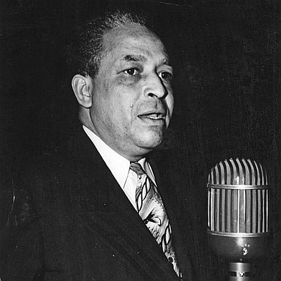
DeNorval Unthank
DeNorval was one of the only Black doctors in Portland when he moved here in 1929
He faced a great deal of racism in Portland and became a civil rights leader
He co-founded the Portland Urban League and was President of the Portland NAACP- both organizations worked towards equality for Black people
He won numerous awards and there is a street and a park named after him in North Portland
“I have always felt in my life that a person should set his own goals and then head toward them. You may have some bad experiences along the way, but if you’re determined you can make it.” -DeNorval Unthank

Slide 11
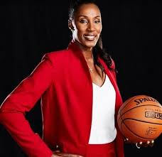
Lisa Leslie
Lisa Leslie is considered one of the greatest basketball players of all time
She won MVP of the WNBA 3 times and has won 4 gold medals with representing the USA at the Olympics
She is in the Basketball Hall of Fame
She currently coaches basketball and is a sports commentator
“Well, the first quality of being a good leader is you have to be able to follow. See, a good leader can’t just be the leader all the time, I have to be able to follow.” -Lisa Leslie

Slide 12
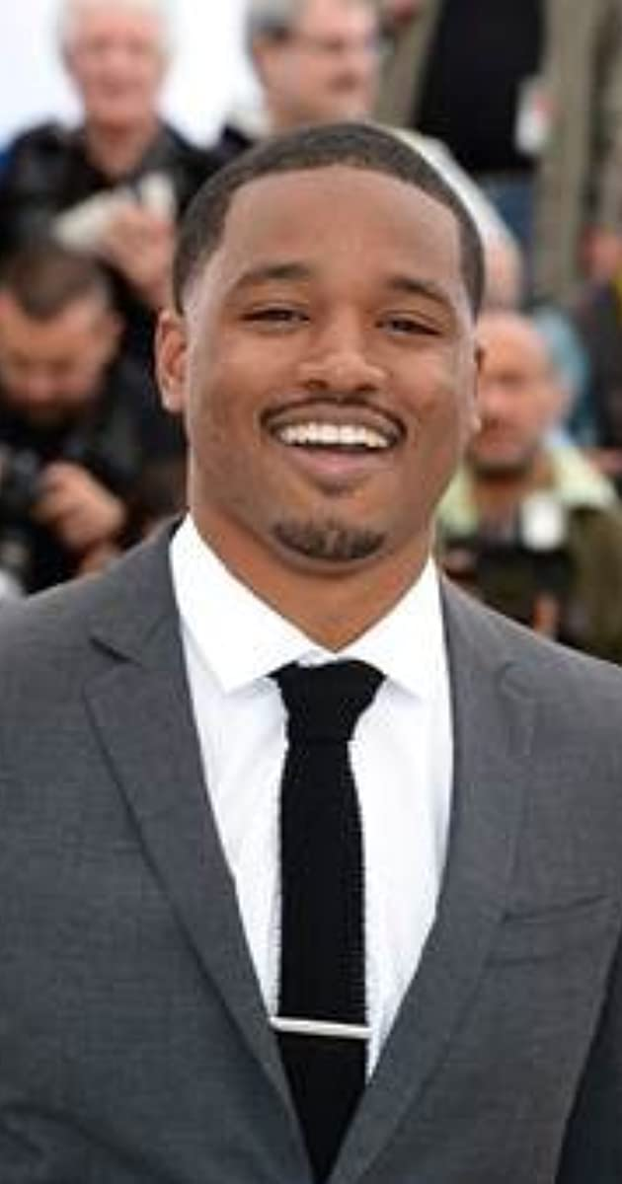
Ryan Coogler
Ryan is a filmmaker, director, and writer
He co-wrote the Marvel movie Black Panther, which broke a number of box-office records
He also produced Space Jam: A New Legacy
He has won a number of awards, including being runner up to Time Magazine’s “Person of the Year” in 2018
“What's important to me is offering perspectives into worlds that people don't often get to see. Do you know what I mean? From angles they don't often get to see.” -Ryan Coogler

Slide 13
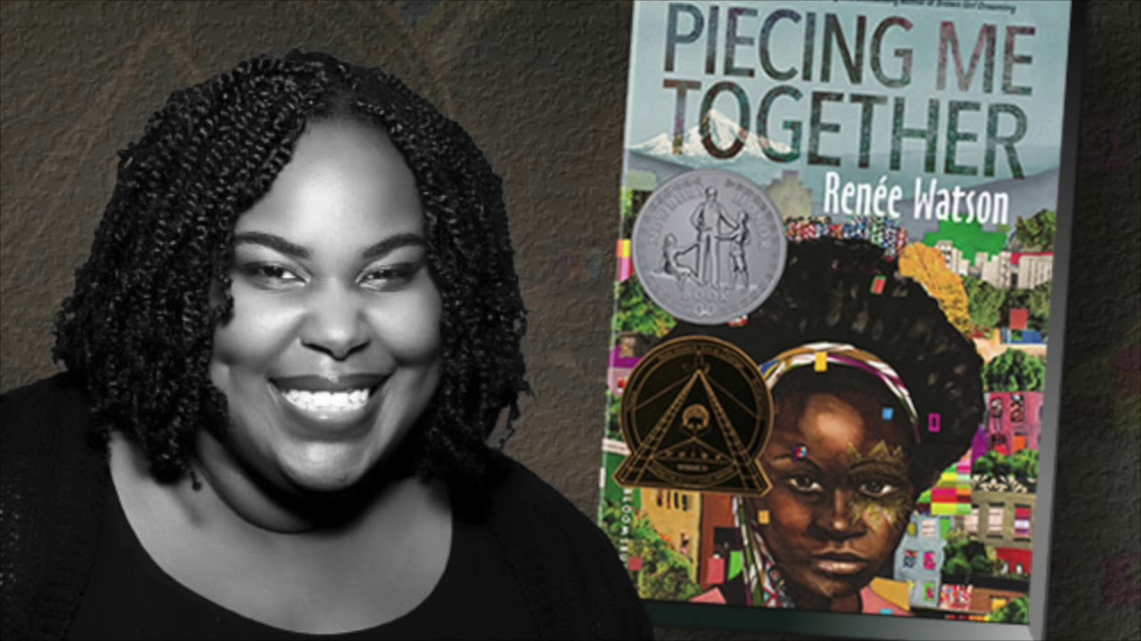
Renée Watson
Renée is an award-winning author and teacher
She grew up in Portland and loved writing from a young age
Many of her books are based in Portland
A number of her books have been #1 New York Times bestsellers
She writes books for kids and young adults- check them out!
“I push my students to read widely, to take in stories they relate to and stories they don’t relate to. I encourage my students to write their world. As it is, as it can be. I invite students to speak their truths.”
-Renée Watson

