Slide 1

Hiawatha Valley Education District (HVED)
2023
Exceptional Teams Empowering Exceptional Students
HVED at https://www.hved6013.org/
MDE at https://education.mn.gov/mde/dse/sped/

Slide 2
Hiawatha Valley Education District Exceptional Teams Empowering Exceptional Students
Structure
Programs
Services
Board of Directors
Superintendents' Advisory
Principals' Advisory
Cabinet
Staff
Area Learning Center
Early Intervention (Birth to 3)
PAES Labs
SAIL
SPECTRUM
Low incidence special education
School Psychologists
MNMTSS
Third Party Billing
Software
SpEd Forms
Edgenuity

Slide 3
HVED Board of Directors
Plainview-Elgin-Millville: Ron Springer
Mabel-Canton: Diane Wilder
Rushford-Peterson: Amy Woxland
St. Charles: Peter Snyder
Spring Grove: Aaron Solum
Wabasha-Kellogg: Phil Rosendale
Charters: Sherry Lohmeyer
Caledonia: Spencer Yohe
Chatfield: Tom Keefe
Dover-Eyota: Ron Pagel
Houston: Mark Swenson
La Crescent-Hokah: Eric Morken
Lanesboro: Christine Troendle
Lewiston-Altura: Jenny Koverman
The Board of Directors has the responsibility to provide programs and services for all general and special education students served by HVED through collaborative team building.

Slide 4
Structure of HVED
Board of Directors
Board Member Committees:
Buildings and Grounds, Curriculum, Program Planning and Policy, Finance, Insurance, Personnel, Special Education Advisory Council, Technology
Superintendents’ Advisory Council
Executive Director
Principals’ Advisory Council
Cabinet
Business Manager, Directors of Special Education (4), Executive Director, Human Resources Manager, IT Manager
Licensed Staff (HVEA)
Support Staff (ESP)
Area Learning Center (ALC)
River Valley Academy – Winona, Spring Grove, Caledonia
Early Intervention (Birth to Age 3)
Federal Setting IV Educational Programs
SAIL – Behavior at Kellogg, MN
SPECTRUM – Autism at Hokah, MN
Children's’ Therapeutic Services and Supports (CTSS)
Itinerant Staff – Assigned to districts and travel to serve students in your schools in person or virtually.
Administrative Assistants
Certified Occupational Therapist Assistants (COTAs), Physical Therapy Assistants (PTAs), Registered Behavior Assistants (RBTs), Speech Language Pathologist Assistants (SLPAs)
Drivers, Custodial, Maintenance
Paraprofessionals
Payroll/Benefits Coordinator

Slide 5
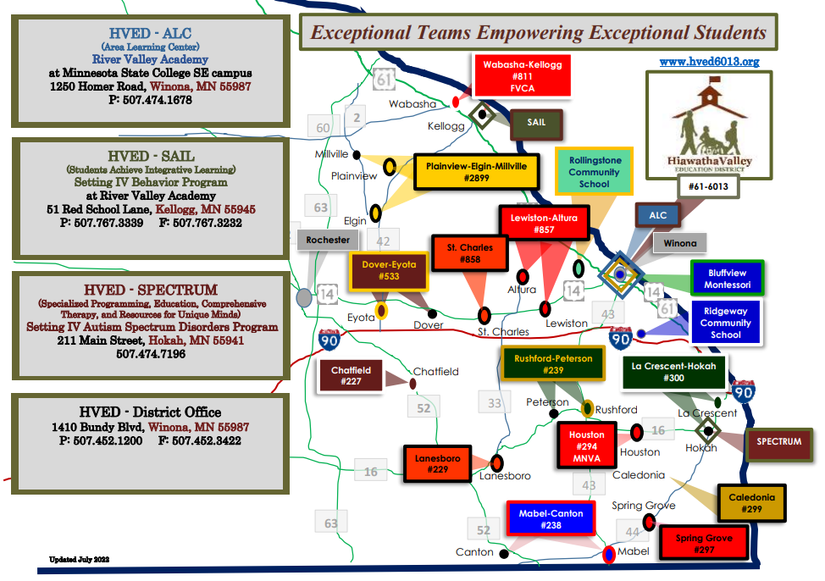

Slide 6
District Enrollment (Fall Seat Count, October 1, 2021) and Special Education Designation Percentage
Mabel-Canton: 265 and 16.6%
Rushford-Peterson: 639 and 14.1%
St. Charles: 1,027 and 12.2%
Spring Grove: 345 and 13.6%
Wabasha-Kellogg & FVCA: 899 and 16.4%
Wabasha-Kellogg ES: 205 and 22.9%
Wabasha-Kellogg HS: 263 and 12.5%
Bluffview Montessori Charter: 213 and 9.9%
Ridgeway Community Charter: 103 and 4.9%
Rollingstone Community Charter: new in 22-23
Caledonia: 732 and 16.7%
Chatfield: 897 and 12.2%
Dover-Eyota: 1,082 and 12.8%
Houston & MNVA: 1,906 and 18.5%
Houston ES: 218 and 23.9%
Houston HS: 209 and 18.7%
La Crescent-Hokah: 1,069 and 18.2%
Lanesboro: 417 and 15.1%
Lewiston-Altura: 692 and 19.4%
Plainview-Elgin-Millville: 1,484 and 14.6%
Data current as of February 3, 2022 from Minnesota Report Card https://rc.education.mn.gov/#demographics/orgId--999999000000__groupType--state__p--1d

Slide 7
Three Main Sources FUND HVED
FEDERAL DOLLARS (32%)
Member districts send their federal special education dollars to HVED.
HVED utilizes the federal dollars for various employees, programs and services.
Remaining federal dollars are returned to the member districts for their special education expenses.
STATE AID (40%)
HVED is careful to capture as much reimbursement from the state of Minnesota as possible.
Many SpEd positions are reimbursed at approximately 68%.
Transportation is reimbursed at 100%.
LOCAL (28%)
Member districts, charter schools or other schools within southeast Minnesota may request to use our services. All are responsible to pay for the maintenance of the programs above the federal and state dollars.
Funding HVED

Slide 8
SPECIAL EDUCATION for qualifying students from birth to age 21
Individualized Education Program (IEP) is a written, legal statement for a student with a disability that is developed, reviewed, and revised by a team of people, including the student's family, that outlines an educational plan for the student.
IEP Team: student, parent, special education teacher, general education teachers, administrator, specialists, related service providers.
IEP Purpose: to provide the accommodations, modifications, and supplementary aids and services necessary to ensure that the student receives a Free and Appropriate Public Education (FAPE), and that their educational program meets that student’s unique needs.
GENERAL EDUCATION
River Valley Academy an Alternative Learning Center (ALC) for qualifying students in MS and HS
Winona (main campus) with satellite sites in Caledonia and Spring Grove
Targeted Services at any school for K-8 students to focus on reading, math, and social skills
MNMTSS – Minnesota Multi-Tiered System of Supports developing systems within each district
Providing a continuum of support up to and including special education.

Slide 9

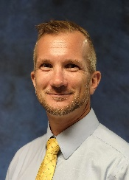
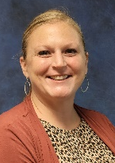
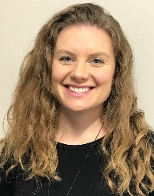
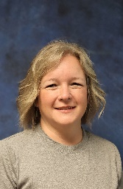
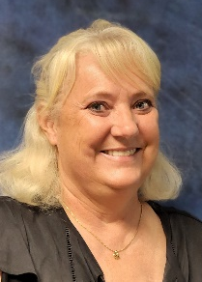
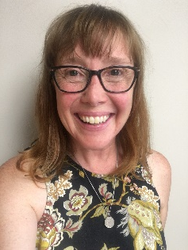
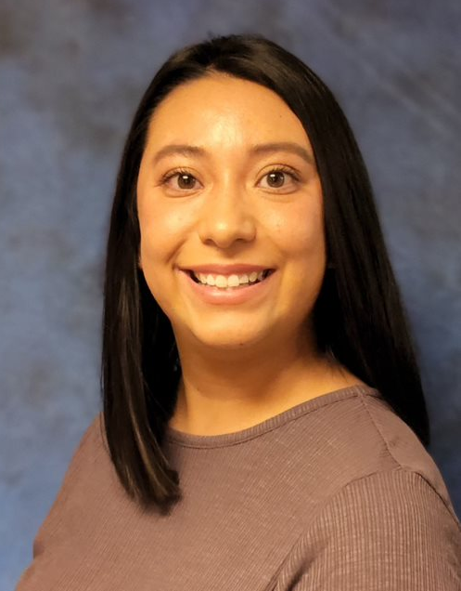
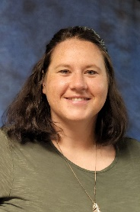
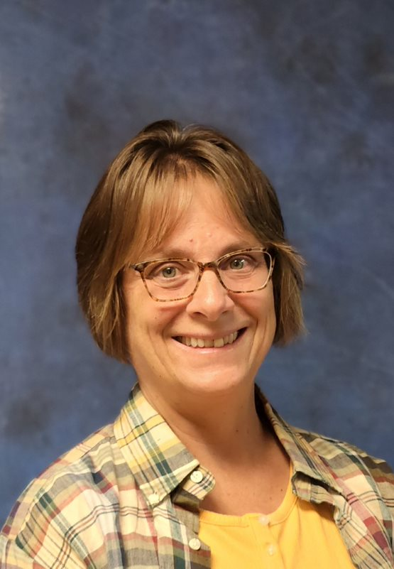
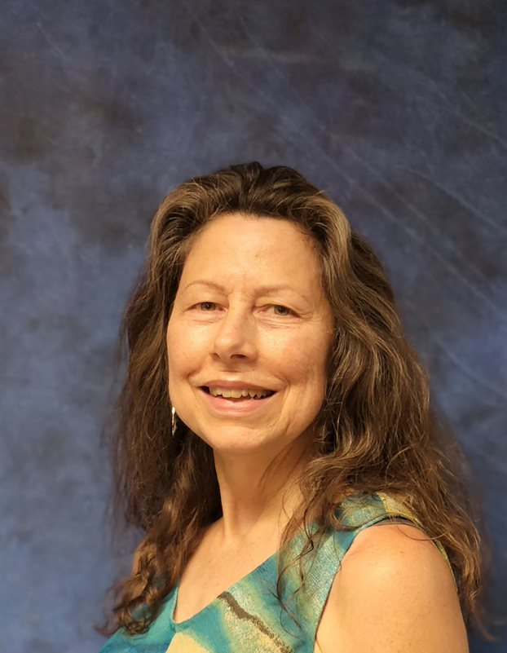
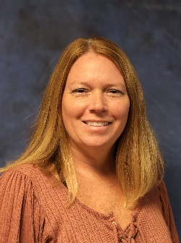
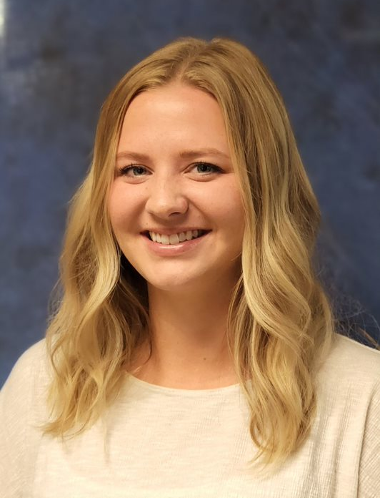
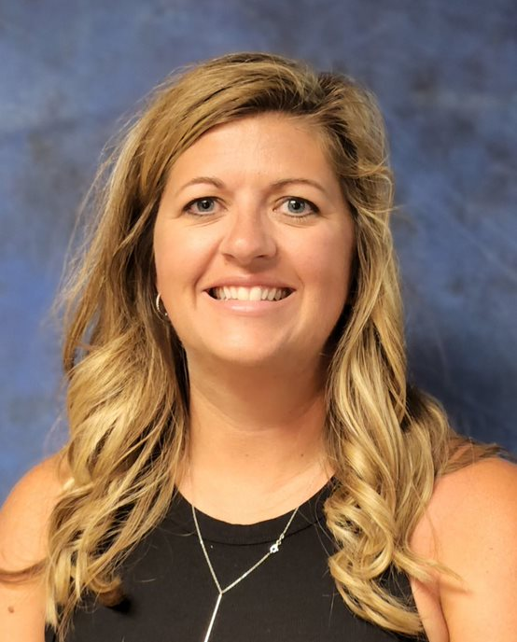
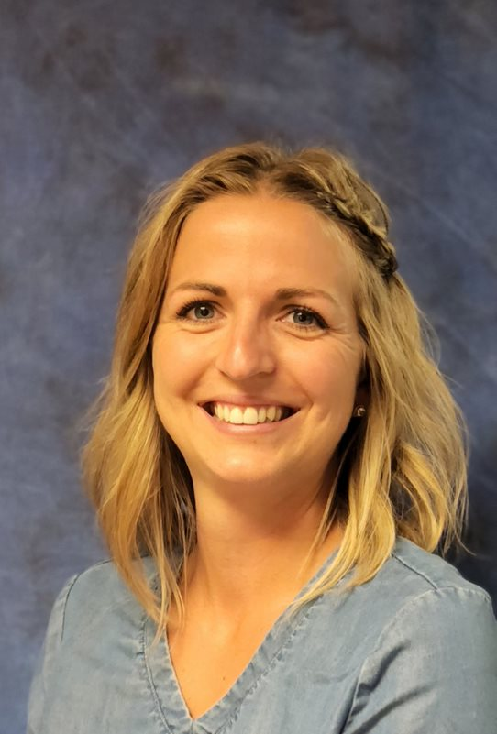
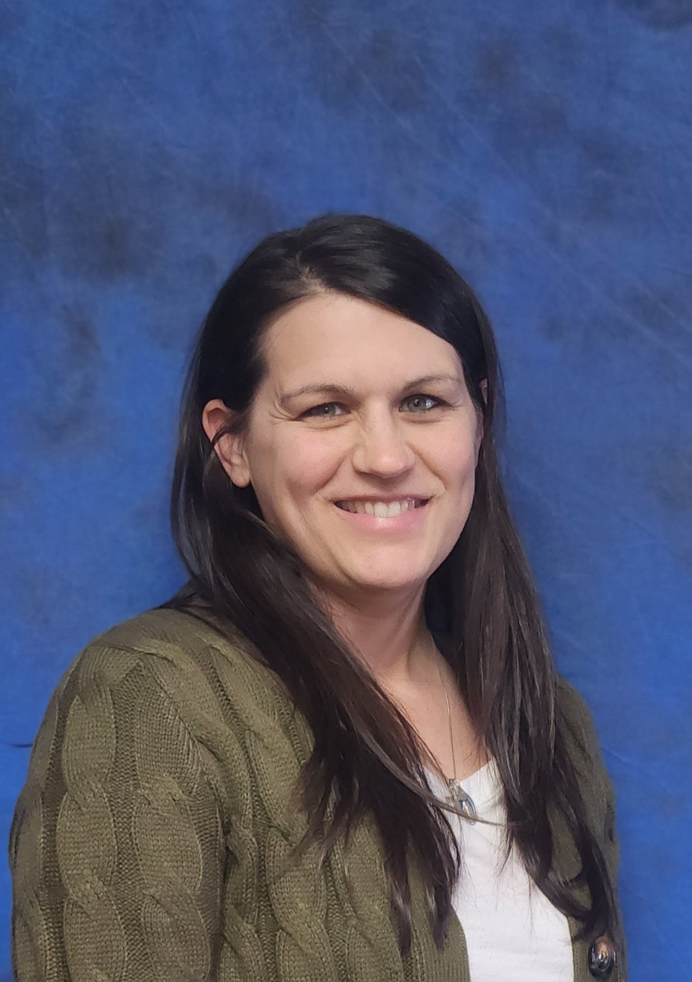
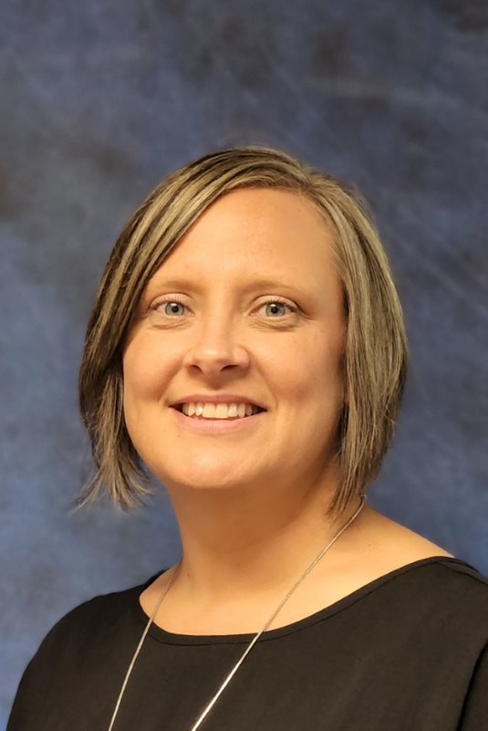

Early Intervention (Birth to age 3)
Zach Selnes, Program Director
Courtney Fricke, Coordinator Early Childhood Special Education
Tracy Agrimson, Teacher
Tracy Brunkow, Teacher
Parker Deen, Teacher
Paula Snell, Teacher
Itinerant Staff:
Danielle Petersen, Audiologist
Kristin King-Aasum, ASD Consultant
Sandy Gorham, BVI, O&M
Terri Kersting, BVI
Pandy King-Henke, DHH
Devon Boots, OT
Emily Dohrn, OT
Itinerant Staff:
Leslie Rolph, OT
Paula Snell, PHD, TBI
Danielle Nesvik, PT
Stacie Ruskell, PT
https://helpmegrowmn.org/HMG/index.htm

Slide 10



Early Intervention (Birth to age 3)
Fundamental program offerings:
Coach parents to help their infants and toddlers when there is a disruption to typical development, like walking and talking.
Connect families to resources (community & school)
Provide services at students’ homes and daycares.
This Photo by Unknown Author is licensed under CC BY-NC-ND

Slide 11
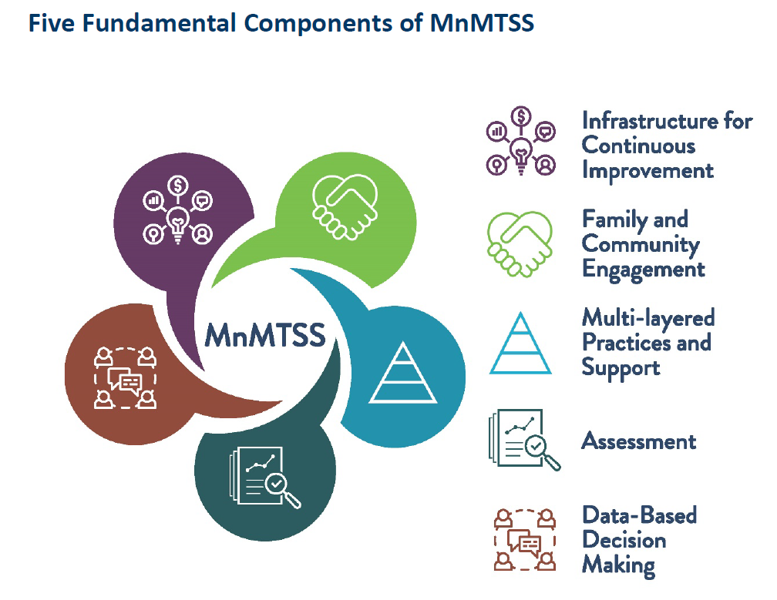
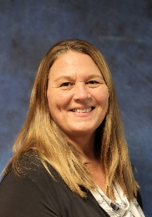
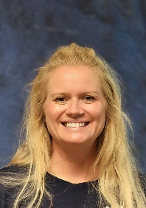
MnMTSS
Minnesota Multi-Tiered System of Supports
Tami Bennett
Data Management School Improvement Coordinator
Ashley Brown
MTSS Behavior Coordinator
Collaborate and coach school leaders and teams
Facilitate professional learning
Build relationships based on trust, reciprocity and integrity
Learn more at:
https://education.mn.gov/mde/dse/mtss/

Slide 12
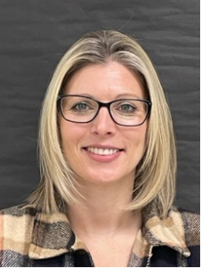
Autism Spectrum Disorder (ASD)
Fundamental Services Provided:
Provide consultation and supports to school districts and programs within HVED.
Collaborate with other staff on initial and re-evaluations (testing and observations)
Support Individual Education Plans and Positive Behavior Support Plans for students with Autism
Support transition to and from home districts and Spectrum Autism program
Kristin King-Aasum
ASD Consultant
Heather Rask
ASD Paraprofessional

Slide 13
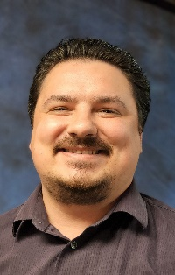
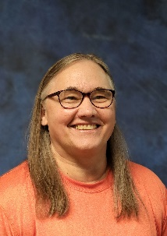
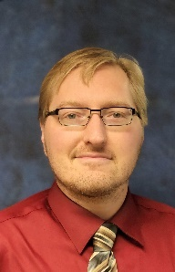
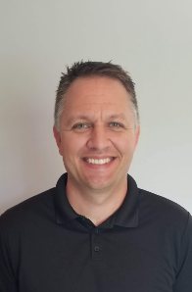

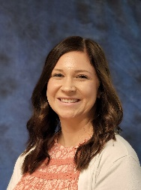
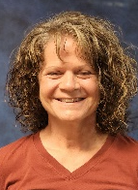
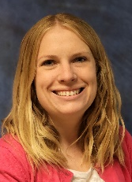
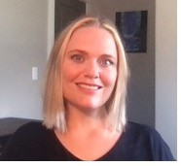
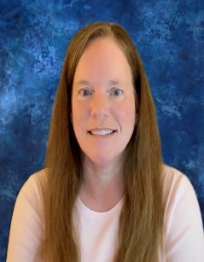
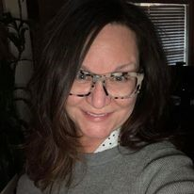
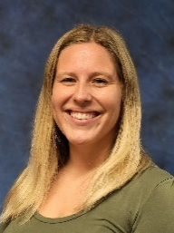
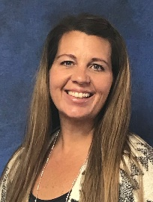
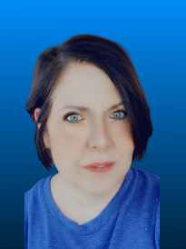
School Psychologists, with support from Academic Testers and Admin Asst
Ryan Berres, La Crescent-Hokah
Rachel Brown, Rushford-Peterson
Gail Evenson, Lewiston-Altura
Alex Kasper, St. Charles
Wes Larson, MNVA
Sadie Linnihan-Vogen, Dover-Eyota
Melissa Papenfuss, Chatfield
Sarah Payne, La Crescent-Hokah
Rhean Perkins, Wabasha-Kellogg
Nancy Smith, Caledonia
Dawn Soriano, Mabel-Canton and Spring Grove
Dorothy Gibson, PEM (not pictured)
Gregg Hilde, PEM (not pictured)
Tarah Sandven, Administrative Assistant
Chrissy Andring, Academic Tester
Theresa Musil-Hull, Academic Tester MNVA

Slide 14

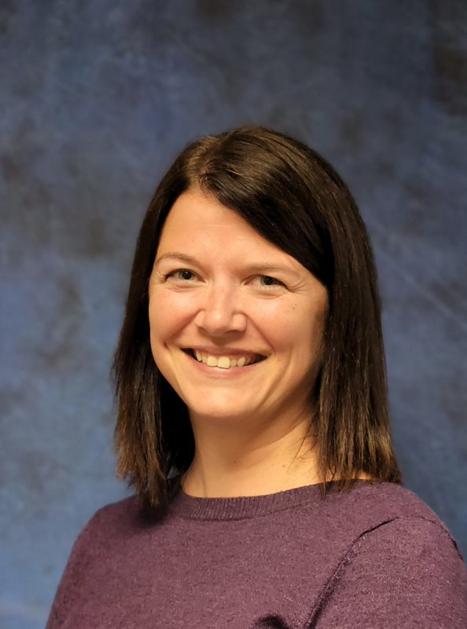
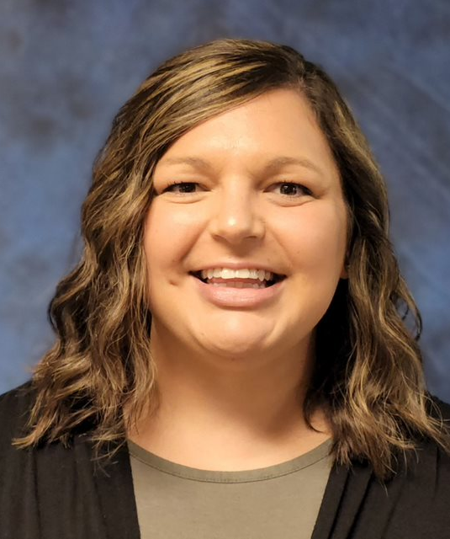
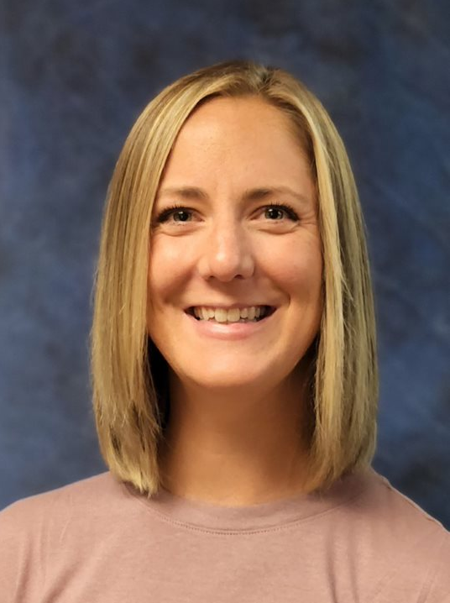
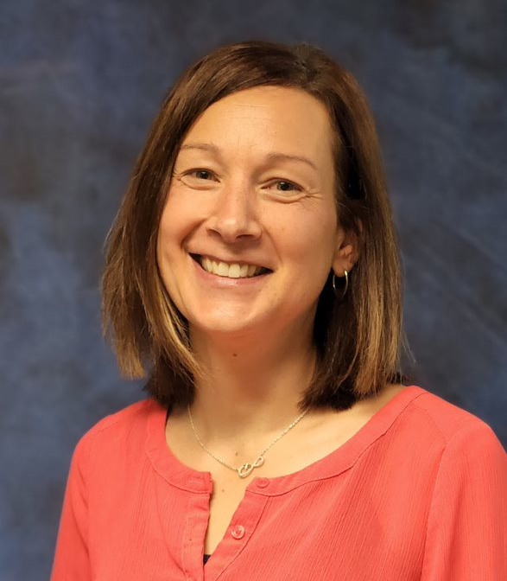
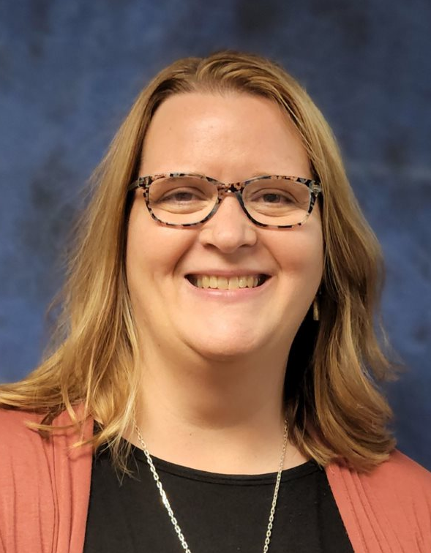
SPECIAL EDUCATION COORDINATORS
L to R: Courtney Fricke; Amber Anderson; Angie Augedahl; Sam Clark; Dawn Kullot; Karen Polyard
Fundamental services provided:
Due Process Support
Problem solve and collaborate with district special education teams
Provide individual support for special education staff
Facilitate various trainings for teams and districts
Train school personnel to manage challenging student behavior using Crisis Prevention Institute (CPI) techniques.

Slide 15
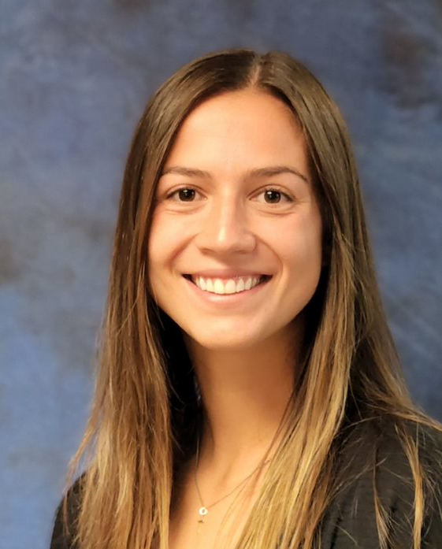
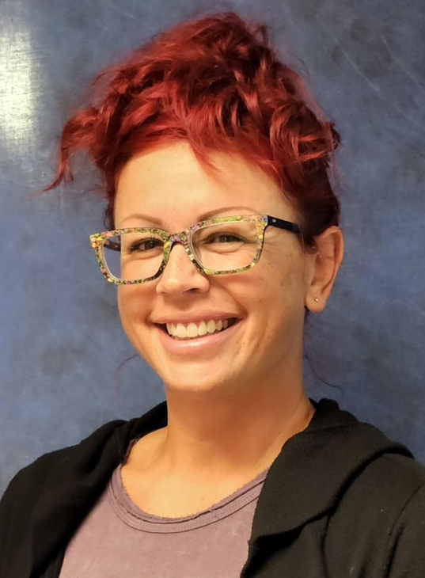
Occupational Therapists (OT)and Certified Occupational Therapy Assistants (COTA)
Sara
Walch
L to R: Devon Boots, OT; Emily Dohrn, OT; Makenna Gabel, COTA; Leslie Rolph, OT, Connie Sweiter, COTA, Sara Walch, virtual OT
Fundamental services provided by the OT and/or COTA:
Evaluate/consult and provide intervention to students from birth to age 21
Provide service with fine motor/visual motor or other physical motor needs
Provide intervention and consultation regarding sensory processing/self-regulation needs
Provide adaptive equipment recommendations and feeding interventions

Slide 16

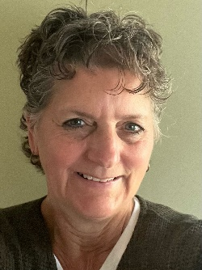
Audiologist/Deaf and Hard of Hearing (DHH)
Fundamental services provided:
Assess hearing ability and determine intervention
Increase access to language development
Advocate students’ needs in the classroom/home
L: Danielle Petersen, Audiologist C: Pandy King-Henke, DHH Teacher R: Janeen Kleffman, DHH Virtual Teacher

Slide 17

Blind Visually Impaired (BVI) and Orientation and Mobility (O & M)
Sandy Gorham, Teacher for the Blind/Visually Impaired (BVI) and Certified Orientation and Mobility Specialist (COMS)
Terri Kersting, Teacher for the Blind/Visually Impaired (BVI)
Fundamental services provided:
Assess B-21 students with qualifying visual impairments to determine accommodations to best access curriculum.
Travels to districts/homes to meet individual student’s needs, to inform teams about the student’s needs, and attend medical eye appointments with parents’ permission.
Attend Region, MDVI, and State meetings along with webinars to network and increase skill set.

Slide 18
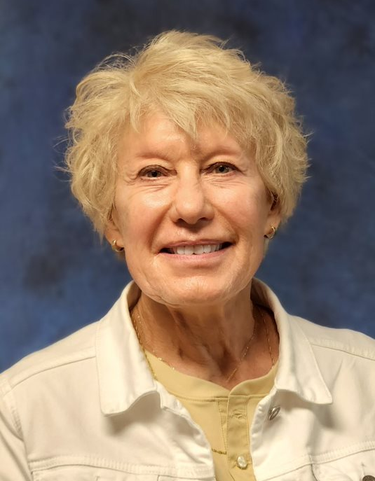

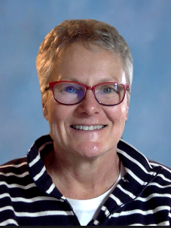
Physical Health Disabilities (PHD) and Traumatic Brain Injury (TBI) & Assistive Technology (AT)
Fundamental services provided:
Serve as the MN licensed person for students identified as Physically Impaired, as well as specific students identified under the Other Health Disabilities, and Traumatic Brain Injury categories, by providing support to teams for evaluation, IEP development, and program options.
Increase awareness of student abilities and limitations by providing information and training on student-specific medical diagnoses and educational implications.
Conduct classroom observations to monitor student progress and provide school staff with recommendations for educational modifications, special and/or related services.
L to R:
Nancy Engrav, PHD, TBI Paula Snell, PHD, TBI Julie Cunningham-Henise, virtual PHD, TBI, AT

Slide 19
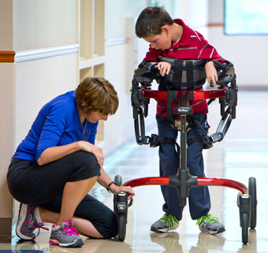
Physical Therapy (PT)
L: Danielle Nesvik, PT
R: Stacie Ruskell, PT
Fundamental services provided:
Designs, teaches, and monitors interventions, adaptations, and modifications for students (B-21), focusing on functional mobility and safe, efficient access and participation in educational activities and routines and in natural learning environments in collaboration with parents, caregivers, educational staff, and students (B-21).
Selects, administers, and interprets screening tools and standardized measurement tools for evaluating of students (B-21) physical abilities.
Selects, modifies, or customizes adaptive equipment and assistive technology in our field of expertise, as well as serving as a liaison among school, medical personnel, and medical equipment vendors.

Slide 20
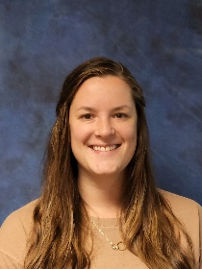
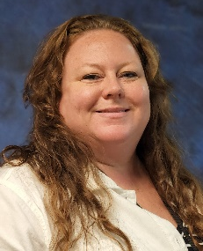
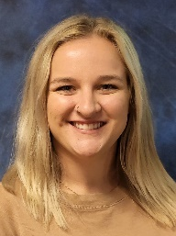
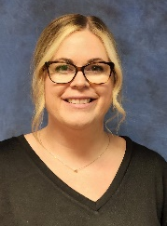
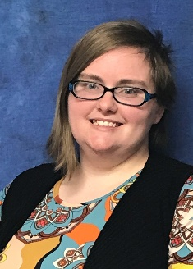
Behavior Specialists
L to R:
Danni Bruns, SAIL
Charlene Hipkins, Houston, Lanesboro, Lewiston-Altura, Bluffview, Ridgeway, Rollingstone, Wabasha-Kellogg
Kiley Meyer, SPECTRUM
Danielle Walther, Caledonia, La Crescent-Hokah, Mabel-Canton, Spring Grove, Rushford-Peterson
Nikki Vanderhoof, Chatfield, Dover-Eyota, Plainview-Elgin-Millville, St. Charles
Fundamental Work:
Coach and support teachers with evidence-based practices related to social, emotional, and behavior needs.
Assist schools in selecting methods to assess Social Emotional Learning (SEL) outcomes.
Use data from SEL measures to enhance social-emotional and behavioral programming.
Train member district and charter school personnel in techniques to manage challenging behavior using Crisis Prevention Institute (CPI) and Safety Care for HVED Programs.

Slide 21




PAES Labs in Caledonia and Kellogg
(Practical Assessment Exploration System)
The PAES Lab is a simulated work environment where individuals will learn:
Work-related problem-solving skills
Proper work behavior by developing soft skills
Insight into job skills and real work settings
Understanding of their learning and training styles for future employment
L to R:
Tammy Heaney, Paraprofessional, Caledonia
Bridget Skelton, Paraprofessional, Kellogg
Crystal Schroeder, Work-based Learning Coordinator

Slide 22





Chatfield Public Schools
https://www.hved6013.org/page/2775
Exceptional Teams Empowering Exceptional Students
Zach Selnes
Director of Special Education
Dawn Kullot
Special Education Coordinator
Melissa Papenfuss
School Psychologist
Terri Kersting
BVI Teacher
Paula Snell
PHD Consultant
Stacie Ruskell
Physical Therapist
Danielle Peterson
Audiologist
Leslie Rolph Occupational Therapist
Julie Cunningham-Henise
Assistive Technology
EI Teacher
Tami Bennett
Data Management-School Improvement Coordinator
Kristin King-Aasum
ASD Consultant
Shay Mahoney
Work-based Learning Coordinator
Ashley Brown
MTSS Behavior Coordinator
Courtney Fricke
ECSE Coordinator
Pandy King-Henke
DHH Teacher
Sandy Gorham
O& M Consultant
Nikki Vanderhoof
Behavior Specialist

Slide 23
SAIL (Students Achieve Independent Learning) Setting IV Behavior Program, Kellogg, MN
Fundamental program offerings:
SAIL exists to provide whole-person learning in a safe environment to support students in reaching their full potential to become contributing citizens in an evolving world.
SAIL provides Level IV special education services for students from our member districts whose needs cannot be met in their home district.
Our vision is: SAIL, the beacon of light for developing safe, civil, and productive citizens.

Slide 24




















SAIL STAFF - Federal Setting IV Behavior
Amy York, Ph.D Program Director
Karen Polyard, SpEd Coordinator
Breyan Richardson, Administrative Assistant
Danni Bruns, Behavior Specialist
Wendy Haake, Teacher, Grades10-12
Amanda Krage, Teacher, Grade 9
Michelle Houston, Teacher, Grades 7-8
Geo Neal, Teacher, Grades 5-6
Karissa Qualey, Teacher, Grades K-4
Brittany Stein, Paraprofessional
Cindy Schmidt, Paraprofessional
Rayne Carrels, Paraprofessional
Angi Siegele, Paraprofessional
Sam Jewson, Paraprofessional
Leta Neal. Paraprofessional
Raini Staudacher, Paraprofessional
Not Pictured:
Sueli Hogan, Substitute Teacher
ITINERANT STAFF:
Emily Dohrn, Occupational Therapist
Gail Evenson, School Psychologist
Jay Koverman, Custodian
Crystal Schroeder, Work-based Learning Coordinator
Kris Lynch, CTSS Mental Health Professional
Gary Gile, Maintenance
Megan Laskaskie, CTSS Mental Health Practitioner

Slide 25
SPECTRUM, Hokah, MN (Specialized Programming, Education, Comprehensive Therapy, and other Resources for their Unique Minds)
Fundamental program offerings:
Individualization in a smaller learning Environment/setting
Collaboration and consultation with service providers at spectrum and member districts
Focus on core areas of Autism

Slide 26




















SPECTRUM STAFF - Federal Setting IV Autism
Clover Schmitt, Ph.D Program Director
Eric Martinez, Program Coordinator
Angie Augedahl, SpEd Coordinator
Tarah Sandven, Administrative Assistant
Autumn Beach, Program Assistant
Kiley Meyer, Behavior Specialist
Corey Connor, Registered Behavior Tech
Heather Rask, Registered Behavior Tech.
Karissa Martin, Teacher
Jesi Melde, Teacher
Andrea Murphy, Teacher
Maia Oudenhoven, Teacher
Luke Vancleave, Paraprofessional
Jadi Heaney, Paraprofessional
Ron Heins, Paraprofessional/Driver
Danielle Holloman, Paraprofessional
Sarah Verweibe, Paraprofessional
Val Howe, Paraprofessional/Driver
Austin Heaney, Paraprofessional
Kathryn Schleich, Paraprofessional
ITINERANT STAFF:
Megan Laskaskie, MTSS Mental Health Practitioner
Heather Twite, SLPA
Kristin King-Aasum, ASD Coordinator

Slide 27





River Valley Academy ALC STAFF
The fundamental purpose of the ALC is to provide individualized post high school pathways, credit recovery, skills training.
Three sites:
Minnesota State College SE – Winona. Staff pictured below.
Caledonia MS/HS – Caledonia, ALC Satellite Site
Spring Grove Schools – Spring Grove, ALC Satellite Site
Clover Schmitt, Ph.D. Program Director
Amber Anderson, SpEd Coordinator
Mary Kaser, Paraprofessional
Patrick Marcotte, Teacher
Chris Nelson, Counselor & SpEd Teacher
Shiyalyn Thicke, Paraprofessional
ITINERANT STAFF
Tara Sandven, Administrative Assistant
Chrissy Andring, Academic Tester
Megan Laskaskie, CTSS Mental Health Practitioner
Kris Lynch, CTSS Mental Health Professional
Crystal Schroeder, Work-based Learning Coordinator

Slide 28

Directors of Special Education
Clover Schmitt, Ph.D.
Districts
Caledonia
La Crescent-Hokah
HVED Programs
River Valley Academy-ALC
and
SPECTRUM
Zach Selnes, Ed.S.
Districts
Chatfield
Dover-Eyota
Plainview-Elgin-Millville
St. Charles
HVED Programs
Early Childhood Special Education
and
Early Intervention (B-3)
Tracy Tweeten-Lind, Ed.S.
Districts
Houston
Lanesboro
Lewiston-Altura
Mabel-Canton
Rushford-Peterson
Spring Grove
Charter Schools
Bluffview Montessori
Ridgeway Community
Rollingstone Community
Amy York, Ph.D.
Districts
Minnesota Virtual Academy
Wabasha-Kellogg
Falcon View Connections Academy
HVED Program
SAIL

Slide 29
Directors of Special Education:
Provide guidance in meeting IDEA
Assist with meeting legal requirements for compliance such as:
manifestation determinations
conciliation meetings
work with coordinators on issues with staff compliance
Work with administration teams regarding all aspects of special education
Provide guidance in program development
Assist with the completion of state reporting requirements
Assist District Admin teams with the supervision of Special Education Teachers
Administer the HVED program responsibilities of
Early Intervention (Birth to 3)
ALC – River Valley Academy in Winona, Caledonia, Spring Grove
SPECTRUM – Autism in Hokah
SAIL – Behavior in Kellogg

Slide 30






District Office, 1410 Bundy Blvd., Winona
Camie Black
Benefits and Payroll Coordinator
Bradley Carlton
Business Manager
Cheri Duffenbach
Human Resources
Manager
Deb Marcotte
Executive Director
Jeff Oian
IT Manager
Melissa Rose
HR Administrative Assistant
Exceptional Teams Empowering Exceptional Students
Mission Statement
In partnership with member districts, will be a progressive educational agency that embraces modern technology and data driven, research-based methodologies and resources to provide a high-quality education to all students so that they may reach their full potential.

Slide 31




HVED SEAC
Special Education Advisory Council
Members: Parents of special needs children, Teachers, Administrators, Board Members
Purpose:
Increase parent’s awareness of district policy related to special education
Collaborate with district decisions related to special education
Recommend priorities for long-term plans
Encourage parent-involvement opportunities
Build collaboration within special education teams
Introduce parents to special education

Slide 32
HIAWATHA VALLEY EDUCATION DISTRICT (HVED)
Strengths
Challenges
Staff
Expertise
Flexibility
Resources
Teamwork
2. Effective and Efficient Operations
Staff Scarcity
2. Facilities
Exceptional Teams Empowering Exceptional Students
www.hved6013.org

Slide 33
Thank you!

