Slide 1
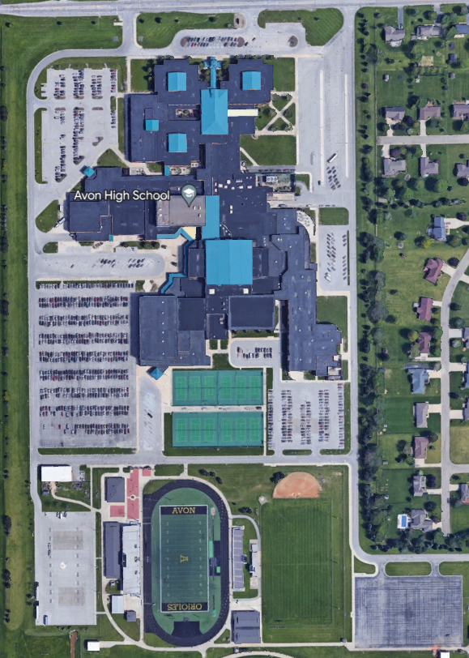
Construction Updates
1
37
33
31
28
19
Avon High SCHOOL

Slide 2
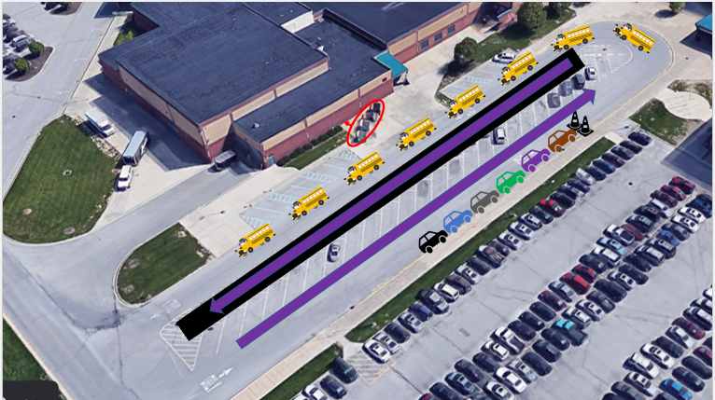
Specialized Transportation
8 Specialized Buses will drop-off and pick-up students at Door 37 beginning on March 13th. This will continue for the foreseeable future.
Students with specialized transportation will be released from class no later than 3PM to load the bus to leave campus.
Morning Arrival
Parents/Guardians may drop-off their student at the barricade and then drive the new traffic path to leave the campus. The barricades will be moved when the buses exit the area.
Afternoon Dismissal
Parents/Guardians will need to remain behind the barricade for the loading of their student(s) until the buses leave campus.
Students are PROHIBITED from exiting through Door 37 at dismissal.
33
31
37

Slide 3
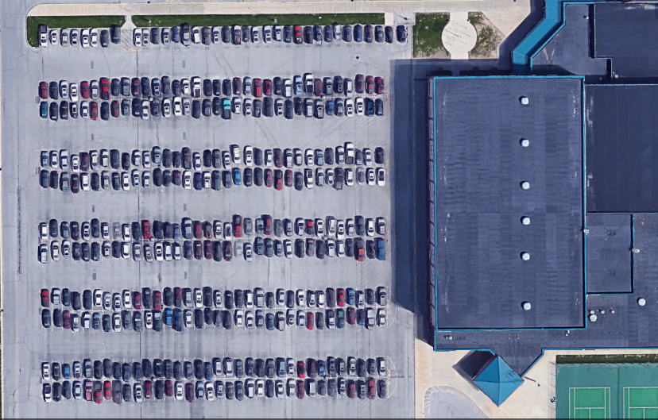
Student Lot
31/33
Beginning April 3rd, the first, second, and third row in the Student Lot will be designated for staff members.
Students will be able to park in the remaining rows of the Student Lot or the overflow parking designated locations in the Band and Baseball/Softball Lot.
28

Slide 4
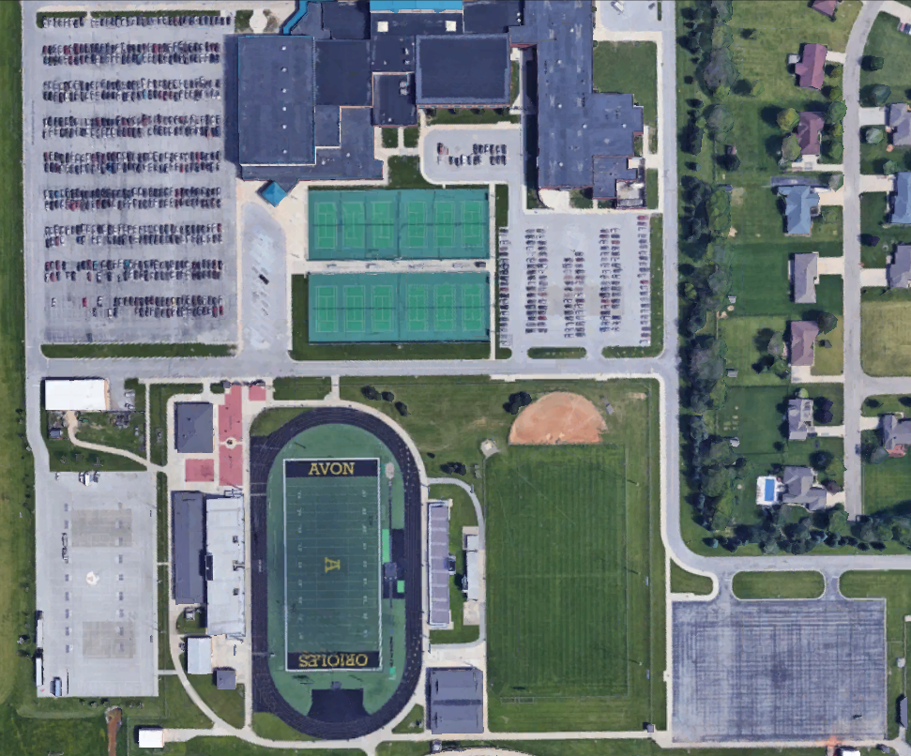
Student Parking
31/33
28
19
Juniors will now be permitted to park in the ALC Parking Lot.
Parking will be first come, first serve in all student designated parking areas (green).
Students are PROHIBITED from parking in a staff/visitor parking spot (yellow) during the school hours of 7:45AM-3:30PM.
Additionally, Door 1 and 33 are strictly for staff/visitor parking.
Student drivers may enter the school at Door 19, 28, and 33 during arrival and exit the school during dismissal at Door 19, 28, 31, and 33.

Slide 5
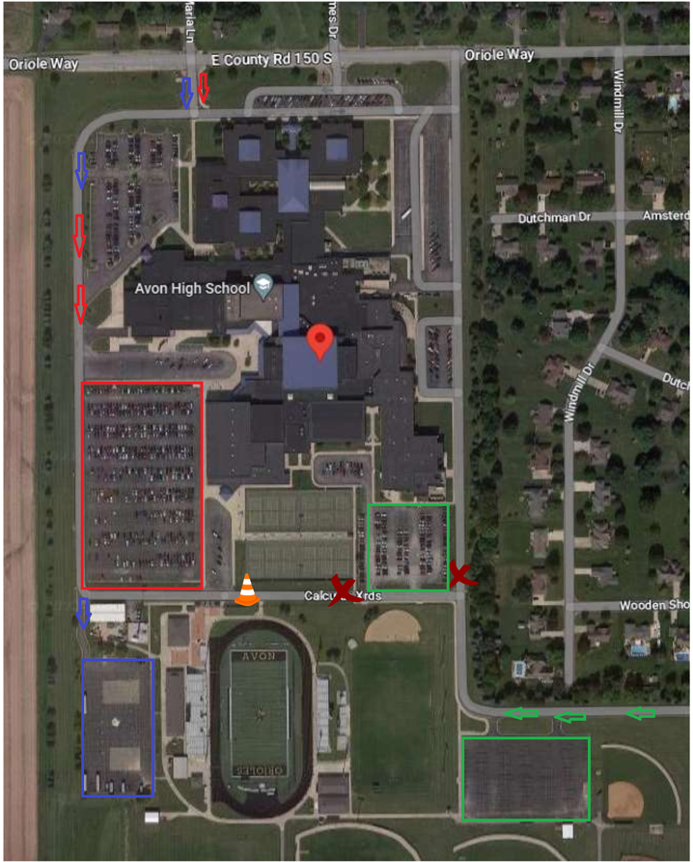
Parking Flow
1
Beginning April 3rd, the parking flow for entering and leaving campus will be different.
The east and south campus gates will be locked during arrival and dismissal time.
Dan Jones Entrance
Drivers will only be able to park in the ALC Parking Lot or Baseball/Softball Lot.
Must exit campus on Dan Jones and will only be able to turn right.
County Road 150 S (Door 1):
Parents/Guardians may still drop-off/pick-up at Door 1, but they must turn right exiting onto CR 150 S.
County Road 150 S (Stoplight):
Student drivers will park in the Student or Band Lot.
Parents/Guardians may still drop-off/pick-up at Door 28 and 33.
Must exit campus at the stoplight.
37
33
31
28
19

