Slide 1
Vision of Self

Slide 2
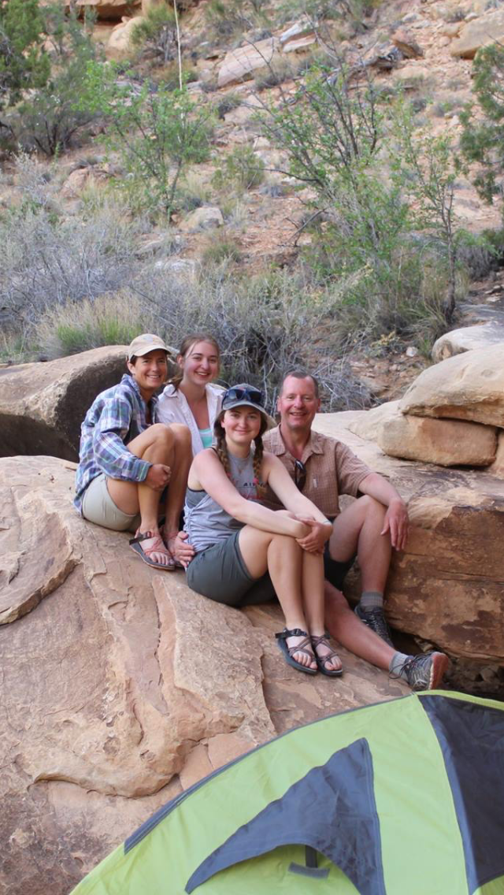
My Journey – My Why
Kathy Hakes-Fastner
Exceptional Services Consultant
kathy@base.education

Slide 3
The Power of BASE
Understanding yourSELf
Understand what Vision of Self is
How have personal stories - impacted your child
Help your child create a more positive vision of self
Students carry so much more than a backpack.

Slide 4
Vision of Self

Slide 5
What are three words you would use to describe yourself

Slide 6
What are three words your teen would use to describe themselves?
Notes:
Vision of Self is all about your view of yourself as a whole-the inside, the outside, who you are as a person, and where you are headed. Sometimes we are able to see our strengths clearly and have a clear view of where we want to move forward. Other times, we can give ourselves messages that are not so positive and those messages can get in the way of moving forward, creating our dreams or just trying something new.

Slide 7
Think – Pair – Share
Your thoughts stopped you from doing something

Slide 8
Shape through Personal Stories
How does your child see themselves
Do you think your child would like to change how they see themselves? Do you think they need to?
How can you continue to help your child/ren develop a healthy vision of self?

Slide 9
Your BASE Task:
Vision of Self (MS/HS)
work thru slide 55
Who am I? (Ele)
Watch Video

Slide 10
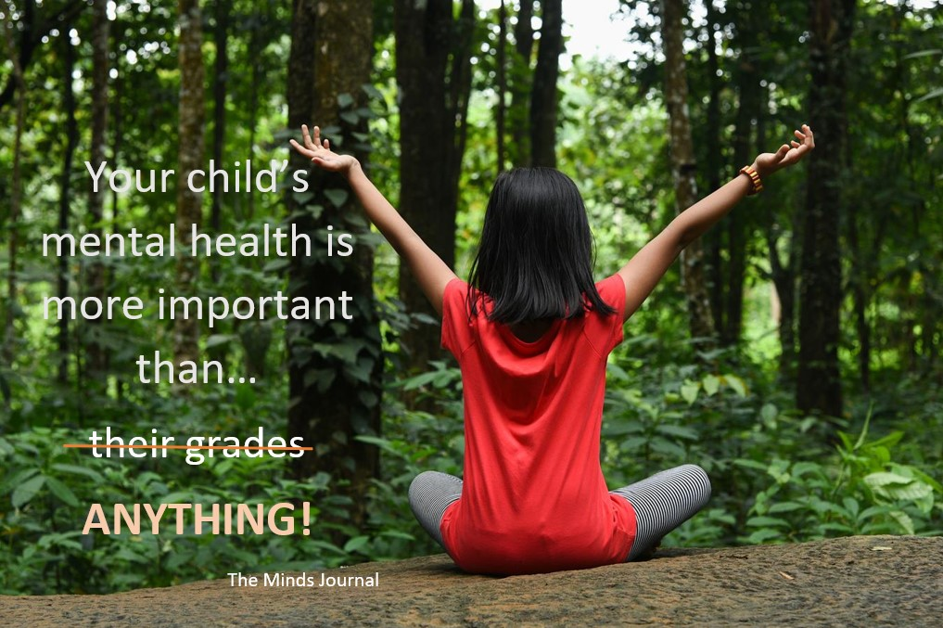
How can you continue to help your child/ren develop a healthy vision of self?

Slide 11
login.base.education
Username & Password charlescounty-base

Slide 12
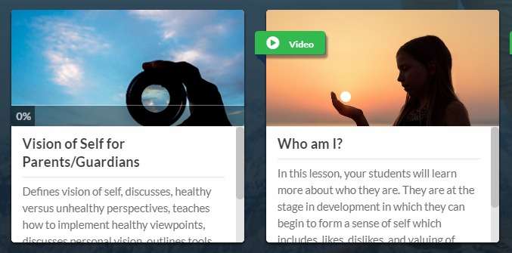

Slide 13
Questions to engage:
What about yourself are you most proud of?
What are things you would like to change?
How would you describe yourself?
In the future, what is important to you?

Slide 14
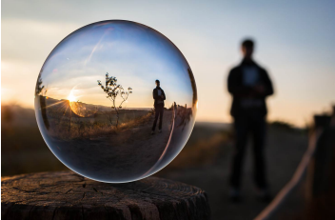
A Personal Vision…
Includes important pieces of their life
Is who they want to be
What they want to do
How they feel
Motivates you
Shapes who you are
& who you become

Slide 15
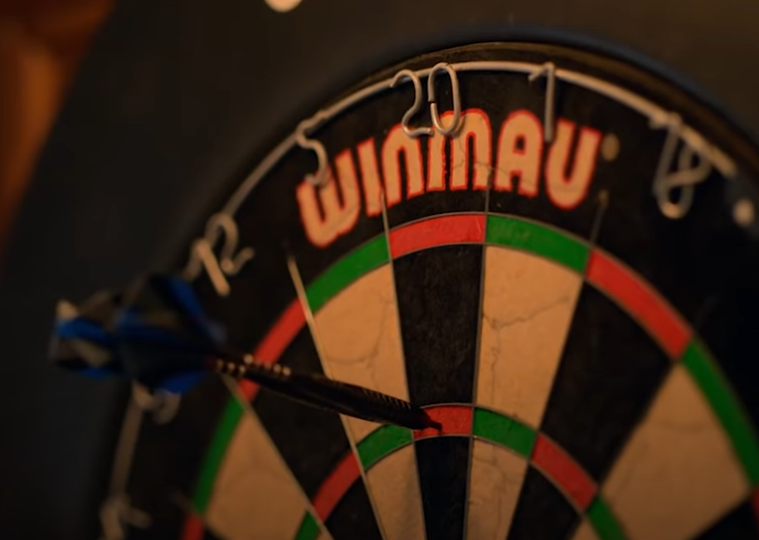
Ted Lasso…
“Be Curious – Not Judgmental”

Slide 16
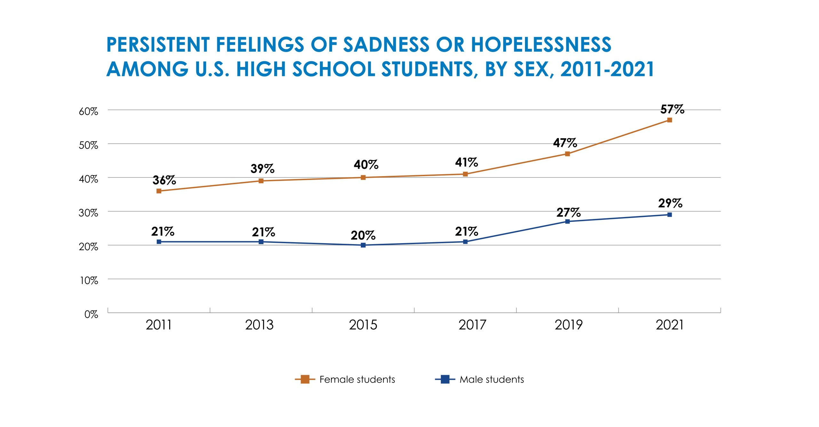
Why does this matter?

Slide 18
Next Steps…. Shaping your Child’s Personal Story
Do you know what your child is thinking?
Stress
Perspective
Family/Friends

Slide 19
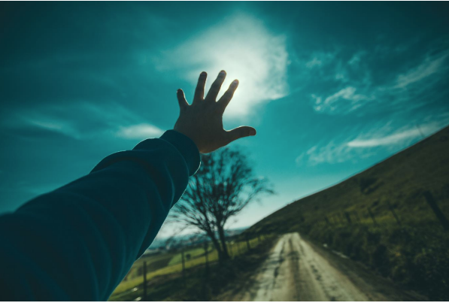
Next Steps…. Create a Healthy Vision of Self
Appreciate how far they’ve come and value all the challenging experiences they’ve endured

Slide 20
THANK You!
You Can Do This..

