Slide 1
Senior Exit Project
Resume & Letter of Application Tips
Larry A. Ryle High School

Slide 2
Senior Exit Resume sections
Name and Contact Info
Objective
Education
Complete address, phone, email
Next year I plan to …
Skills/Honors/Activities
Experience
Paid, Non-paid, Classroom

Slide 3
Limit to ONE page
Use easy to read fonts
Apply Reverse Chronological Order
Proofread: Use spelling/grammar check
No less than 10 points
Start with the most recent event first for every section.
Use spacing to fill up the page.
Have someone else proofread too

Slide 4
Use fonts effectively

Slide 5
Objective statement Examples
Next year I plan to
attend the University of Kentucky and major in business
be in the Marines
work full-time as a welder

Slide 6
education
High School Info
Name, city, state
GPA
Only list if over 3.0
Expected graduation
Courses
List Honors, AP, Dual Credit, and others if they are relevant to your objective
Dates attended
Reverse Chronological Order
List most recent high school first. Work your way back in time.

Slide 7
education Example
Larry A. Ryle High School Union, KY
2019-Present
Expected Graduation: May 2023
GPA: 3.85
Coursework:
Dual Credit – English, Financial Literacy
AP/Honors – European History, US Government, Microsoft Office Specialist

Slide 8
Skills Honors Activities
Can be separated into three headings
Do not type a heading if you do not have anything to list under it
List the dates achieved if applicable
Apply Reverse Chronological Order

Slide 9
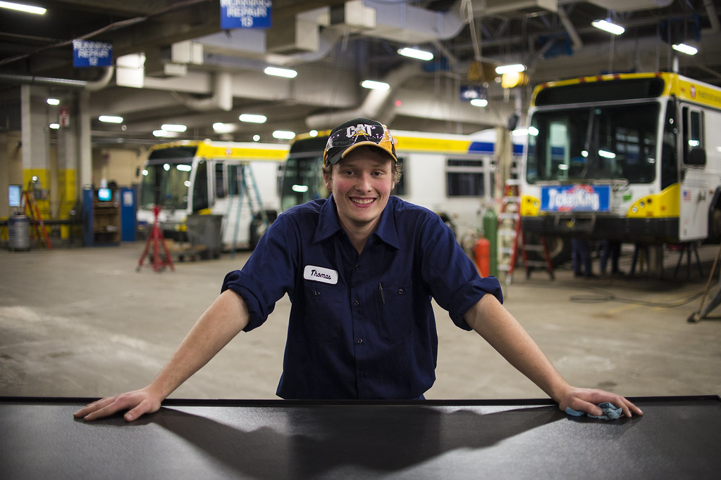
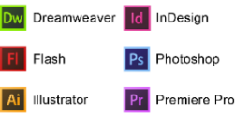
Technical
Non-Technical
Skills
Transferable
This Photo by Unknown Author is licensed under CC BY-NC-ND

Slide 10
Honors
Academic
Sports
General
Clubs
This Photo by Unknown Author is licensed under CC BY-NC-ND

Slide 11
Activities
Sports
Non-Sports
Clubs
General
This Photo by Unknown Author is licensed under CC BY-NC-ND

Slide 12
experience
Paid
Unpaid
Volunteer
Classroom

Slide 13
experience Example
McDonalds Union, KY
2021-Present
Crewmember
Provide excellent customer service
Efficiently take and deliver orders
Responsibly handle money
Resolve customer complaints

Slide 14
BUT I’VE NEVER HAD A JOB!
Student Projects
Leadership & Collaboration
Time Management
Organizational Skills
Communication Skills
Presentations
Yes, You have!
You’ve been a student for 13+ years!
Think about projects/assignments you have done in the classroom that have transferable skills.

Slide 15
experience Example
Ryle High School Union, KY
2022-Present
Office Aid
Support Assistant Principal
Maintain confidential information
Provide filing and phone answering assistance

Slide 16
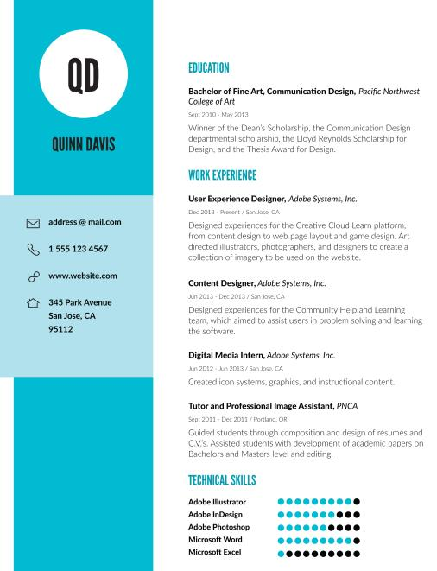
Follow the order of the Senior Exit Guidelines for your Headings even if a template does not.

Slide 17
Letter of Application
Not only tells of your accomplishments,
but it also reveals how effectively
you can communicate.

Slide 18
Evidence of Growth
Person Who Made an Impact During Your Time at Ryle
Reflect on Personal Interests or Experiences
Community Service Experience
What do I write about?

Slide 19
Limit to 1 page
Use a business letter format
Signed in blue or black ink only
Correct spelling, grammar and punctuation
Addressed to Graduation Committee
Include an Enclosure notation for the resume

Slide 20
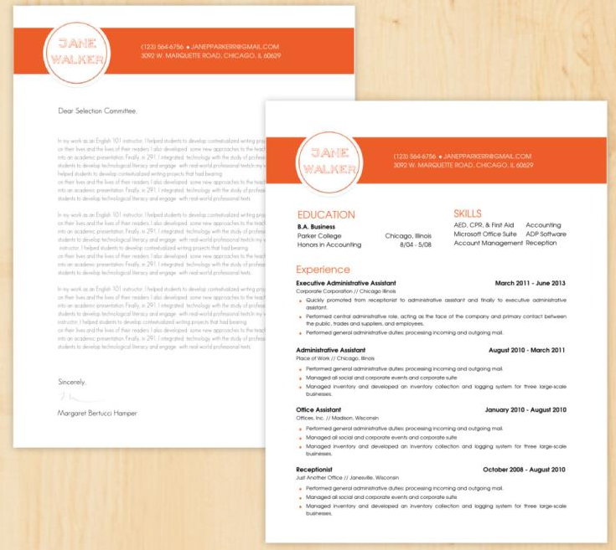

Slide 21
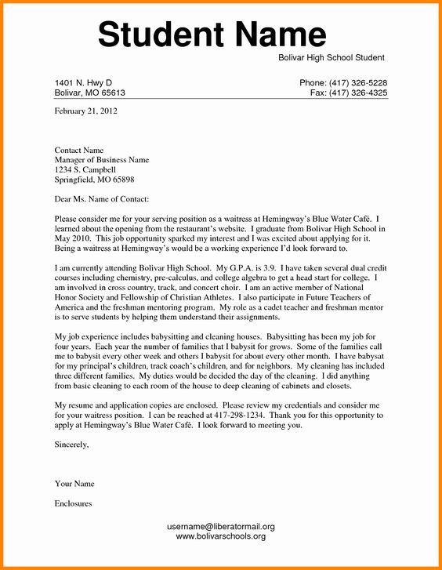
Parts of a Business Letter

Slide 22
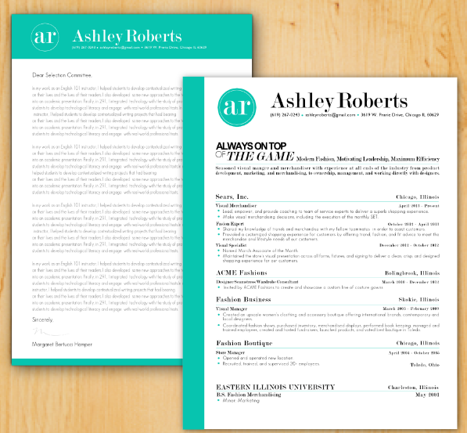
The Formatting Must Match

Slide 23
Look for Templates Word Google Docs Online
Edit the Template to Match Senior Exit Requirements

Slide 24
Use Ryle’s Resources

Slide 25
Check for RAP Workshops!
Larry A. Ryle High School

