Slide 1


Slide 2


Slide 3
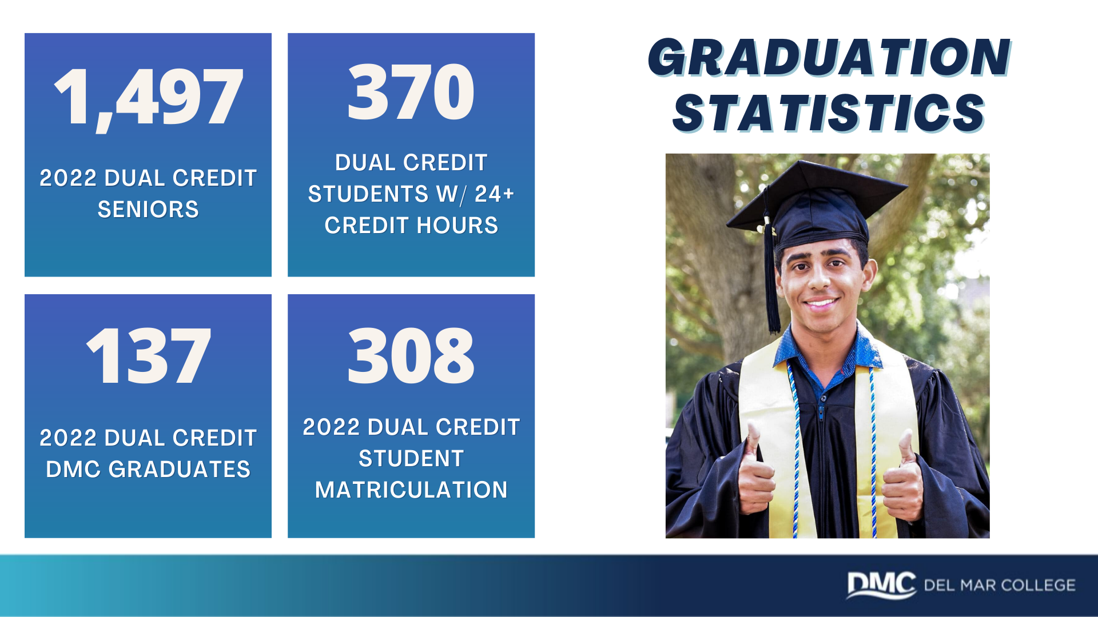

Slide 4
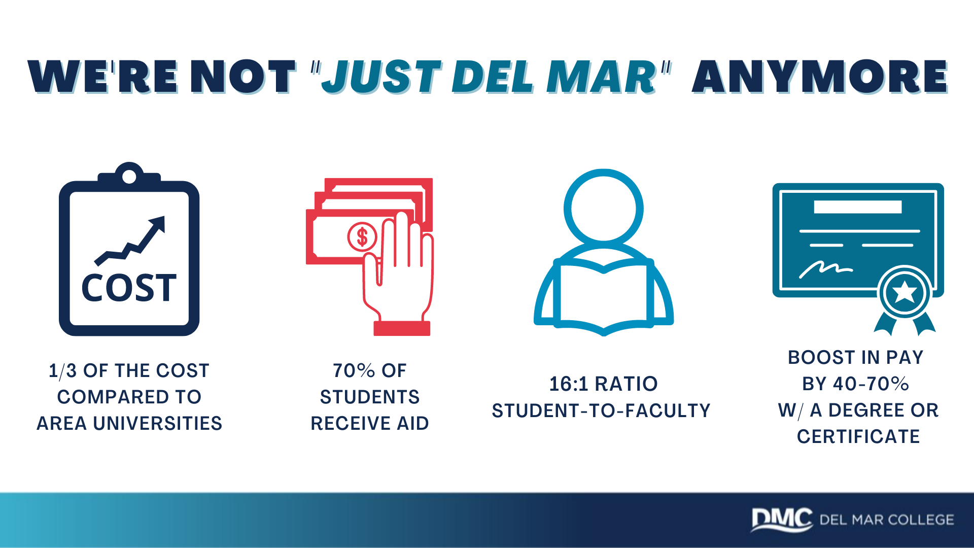

Slide 5


Slide 6


Slide 7
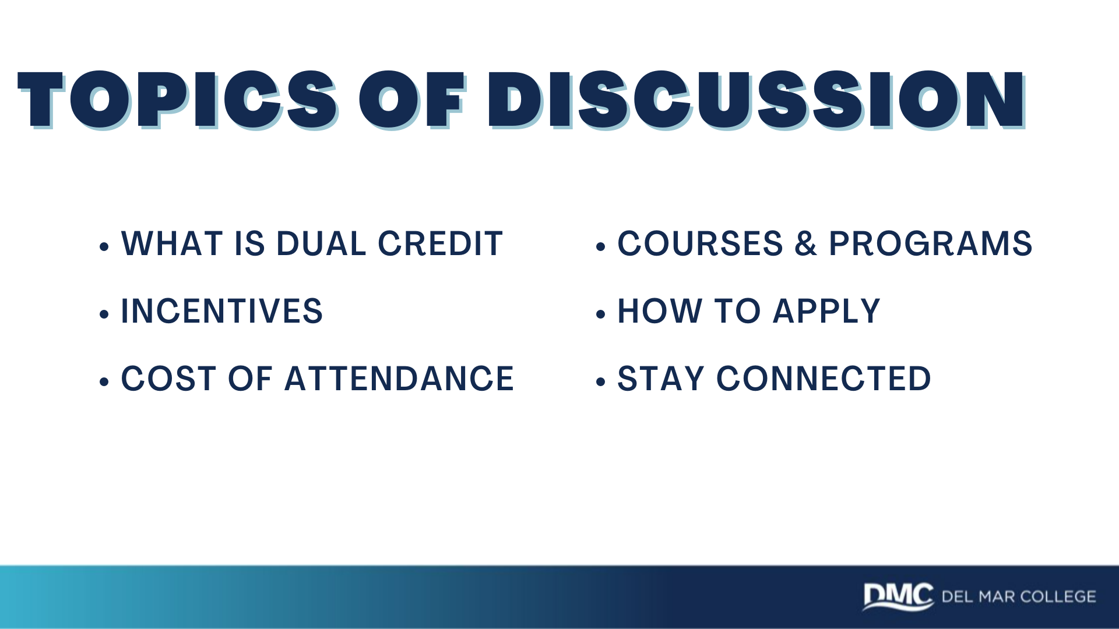

Slide 8
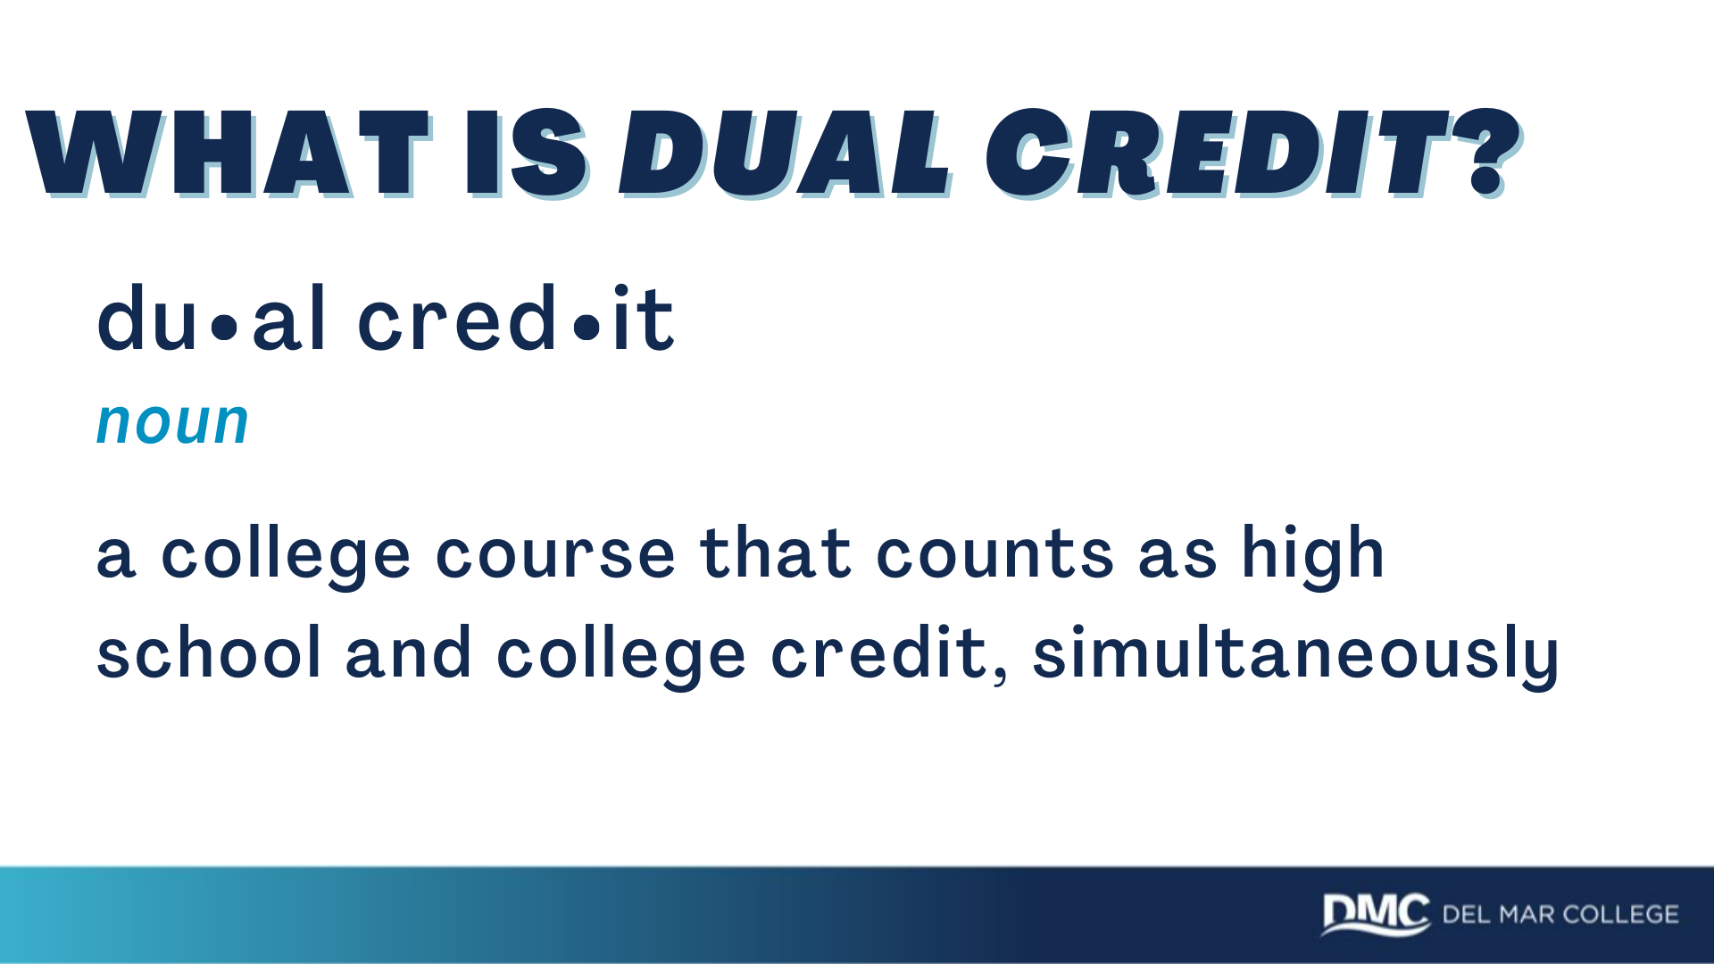

Slide 9
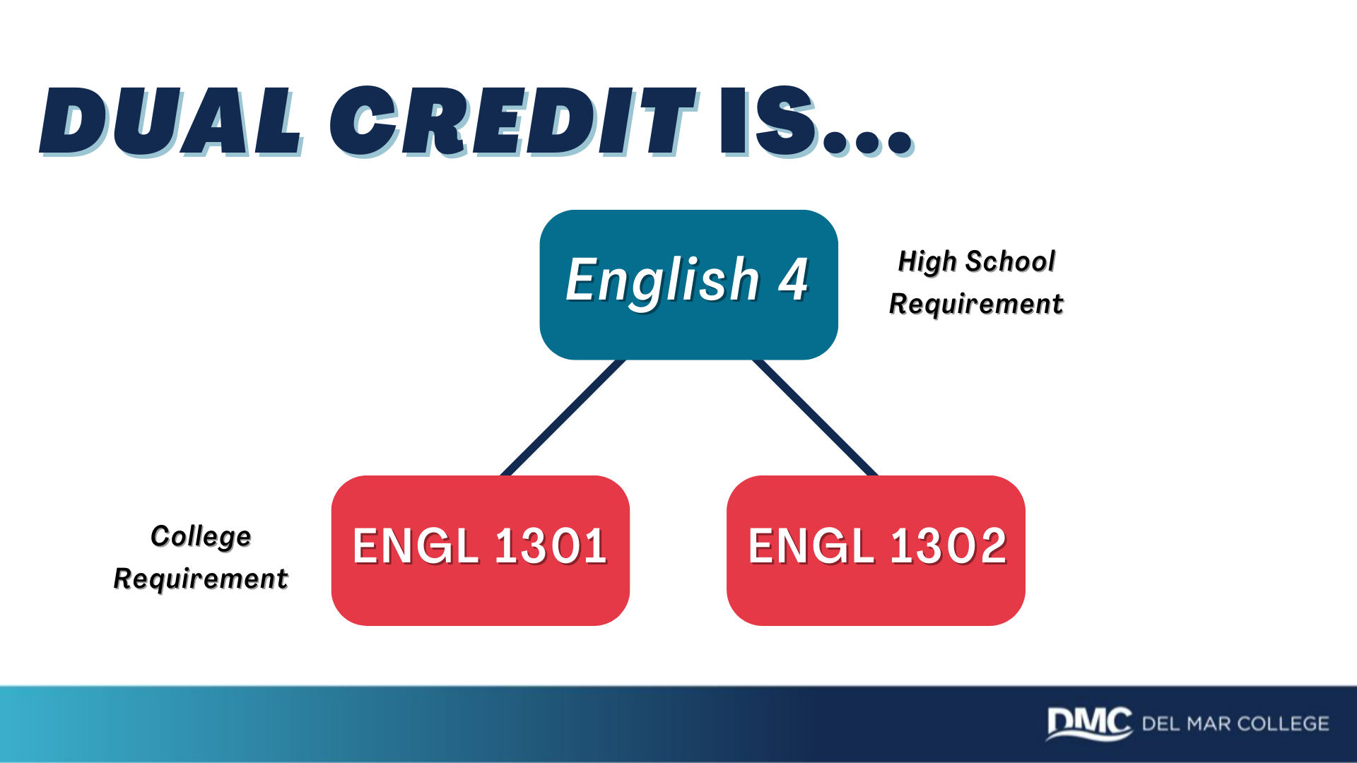

Slide 10
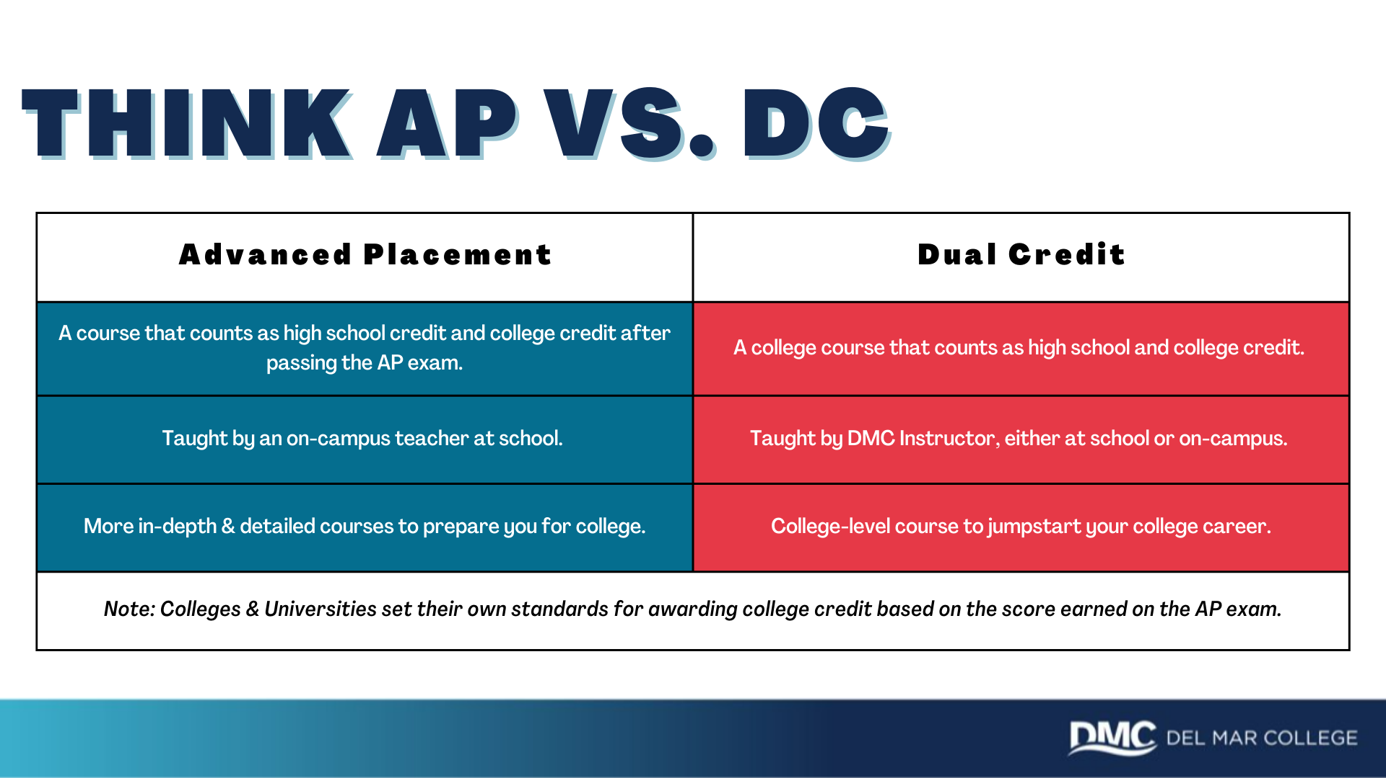

Slide 11
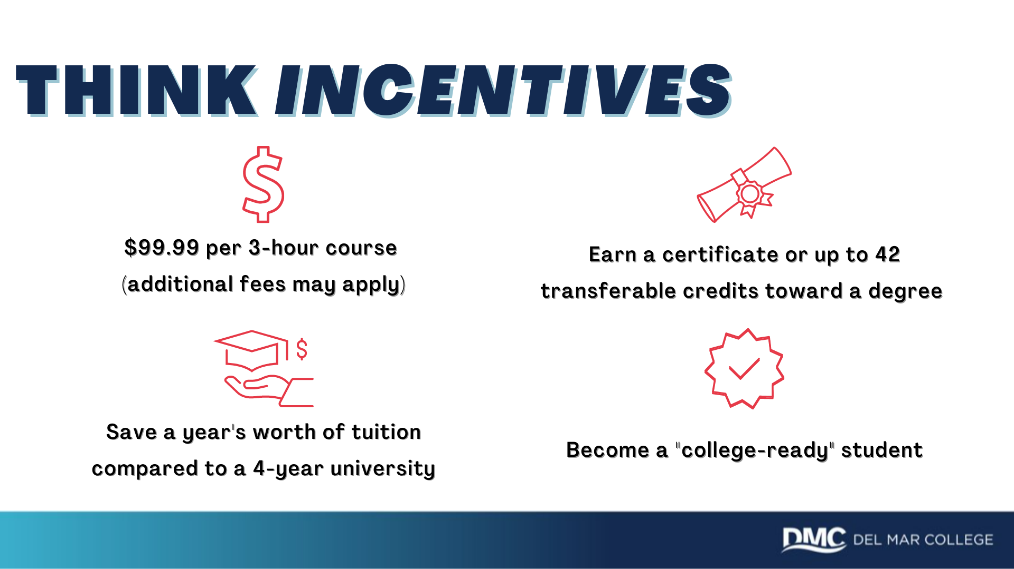
Notes:
- Colege Ready: Coordinator will explain not only the academic side of college readiness, but maturity and how student will be prepared when transiting to a first year in college student after HS. For example how to meet with advisor, communicate with professor, adhere to deadlines etc.

Slide 12
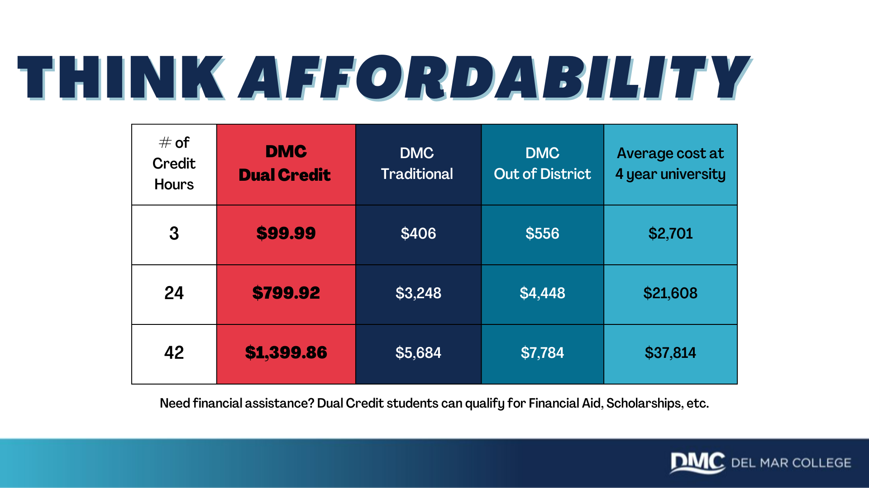

Slide 13

Notes:
Talking Points
•Provides a head start on postsecondary core requirements
•Allows an easier transition to college
•Serves as a “controlled” introduction to college life
•Save Money on College Tuition
Success stories

Slide 14
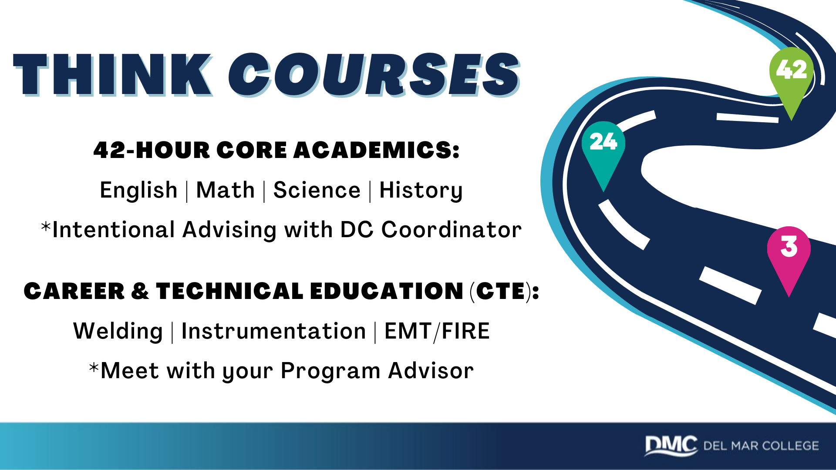

Slide 15
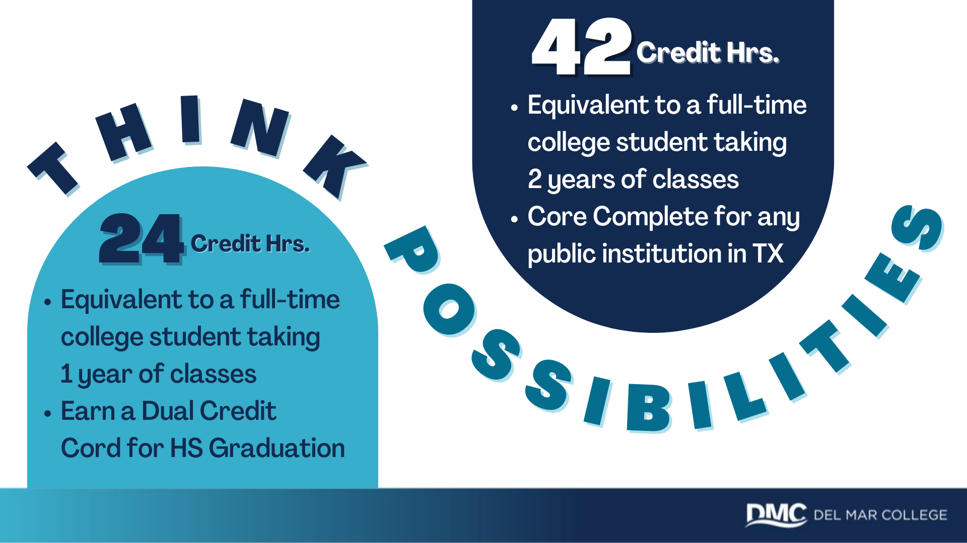
Notes:
Complete Application - www.applytexas.org
Take TSI test - Before registering for the TSI, student must complete the pre assessment activity. Contact the DMC testing center.
Proof of Meningitis - submit vaccination record (good for 5yrs); submit exemption form if family choose not to vaccinate
HS Transcript - request a HS transcript from HS registrar / College Transcript
DC Registration Form - meet with your HS counselor | *DC Reg. Form is ALL that is needed for CURRENT DC Students
*Submitting Incomplete Packets is Discouraged

Slide 16
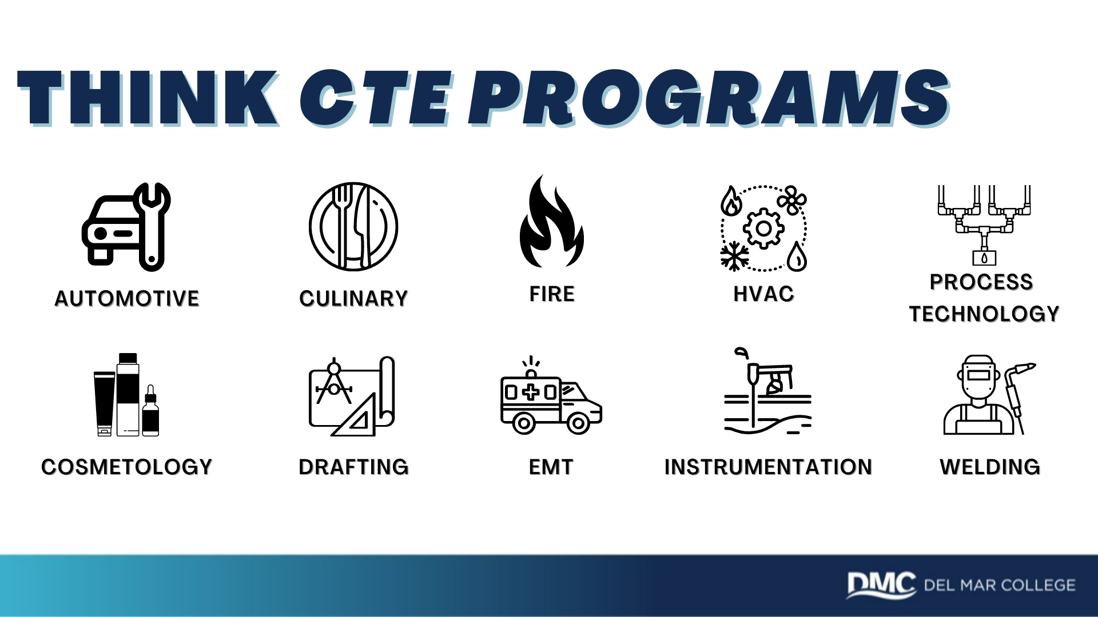
Notes:
8-weeks courses are available for DC students

Slide 17

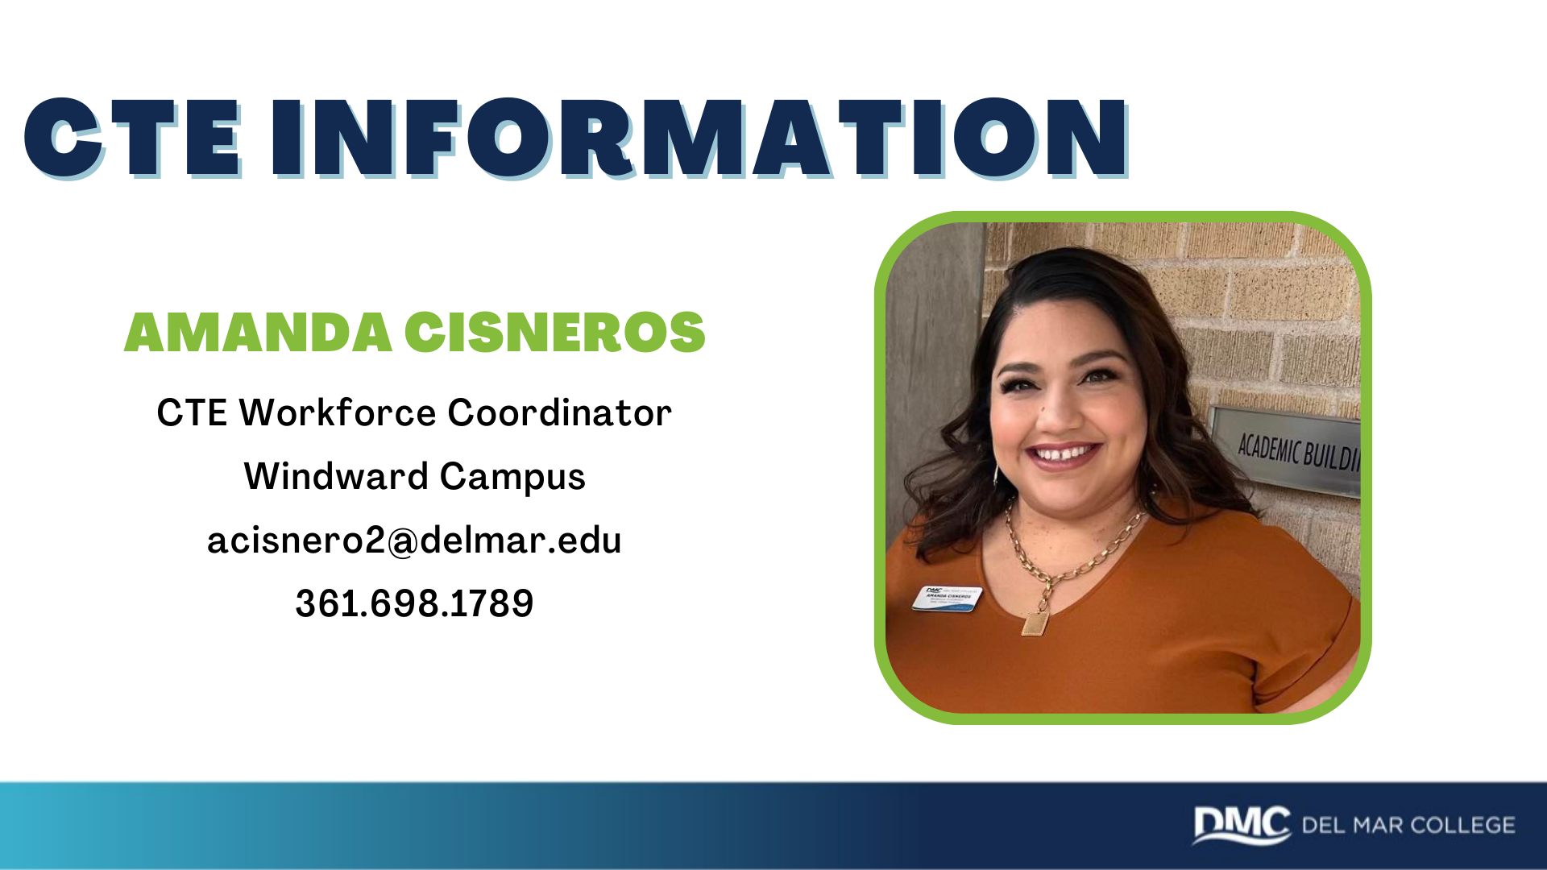

Slide 18

Notes:
Talk about the advising guides and encourage students to start the conversation with their counselors.
Students are to enroll in college course(s) that are paired to a high school course required for graduation and where the student will receive credit for the course on both the college and the high school transcripts per Texas Education Code (TEC) §28.009.

Slide 19
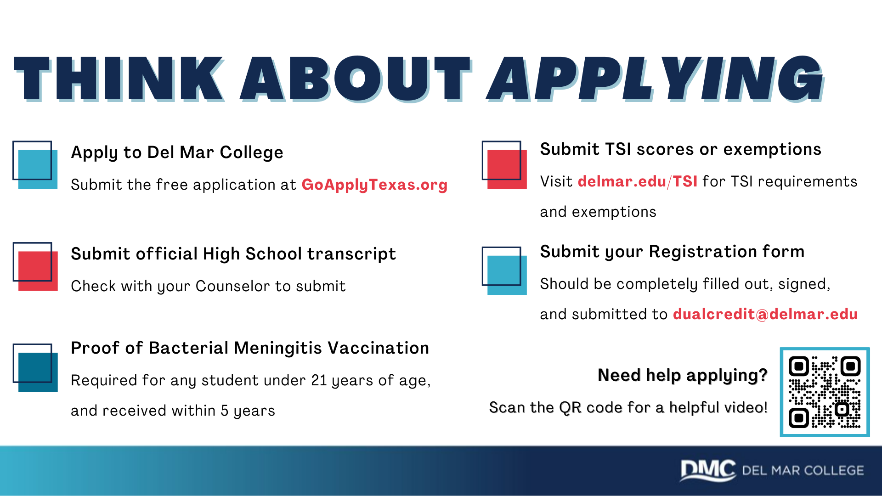
Notes:
42 HOUR CORE
We encourage students to be intentional in dual credit course selection, aligning HS endorsement with their college pathway.
http://www.delmar.edu/Transfer_Guides.aspx

Slide 20
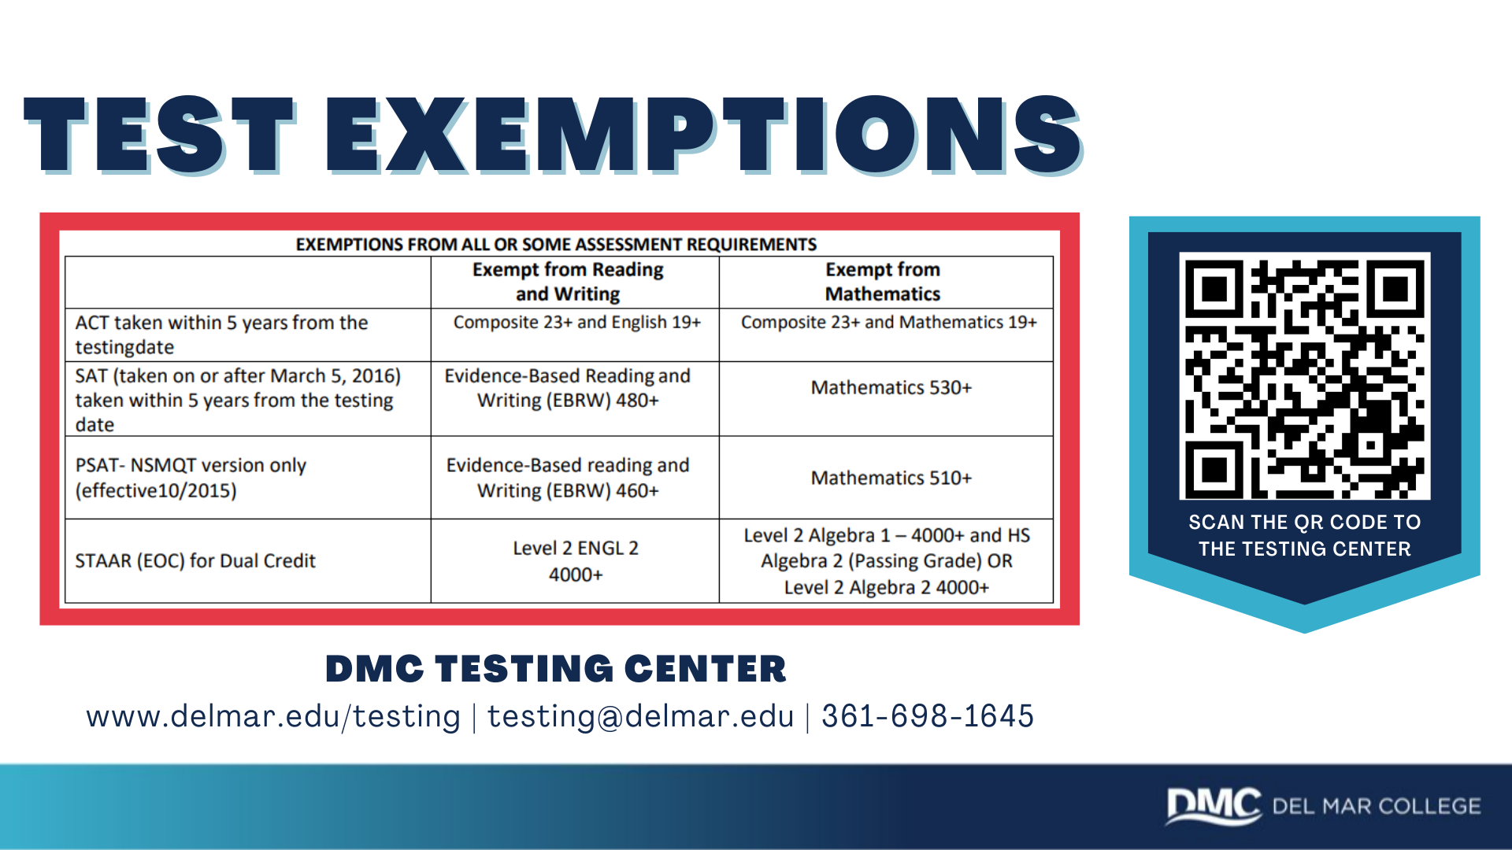
Notes:
Automotive | Waived | Start at 10th grade |30 Credit Hrs. = Level 1 Cert.
Cosmetology | Waived | Start at 10th grade |40 Credit Hrs. = Level 1 Cert.
Culinary *Yr. 4 Require 6hr. Labs | R2 E2 M1 |Start at 10th grade | 32 Credit Hrs. = Level 1 Cert.
EMT*Only Summer & Spring; Only Juniors & Seniors | R3 E3 M2 | Jr. and Sr. Students ONLY | 6 Credit Hrs. = EMT Cert.
Fire *Only Juniors & Seniors | R3 E2 M1 | Start at 11th grade | 29 Credit Hrs. = FIRE Cert.
Instrumentation | Waived | Start at 10th grade | 31 Credit Hrs. = Level 1 Cert.
Process Tech. | Waived | Start at 11th grade | Earn up to 13 Credit Hrs.
Welding | Waived | Start at 10th grade | 27 Credit Hrs. = Level 1 Cert

Slide 21
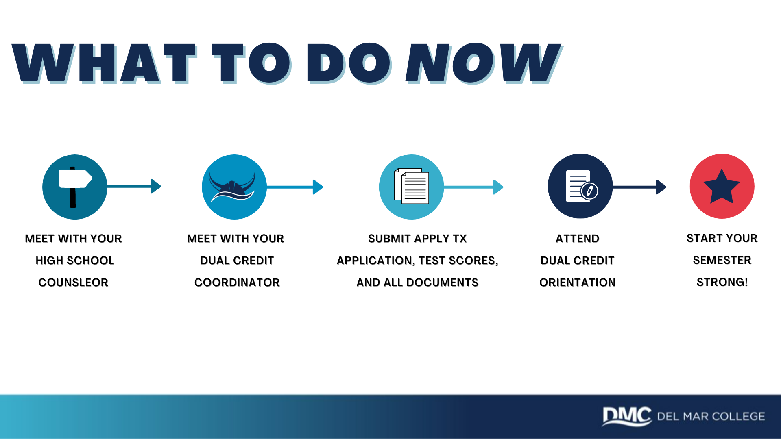

Slide 22


Slide 23
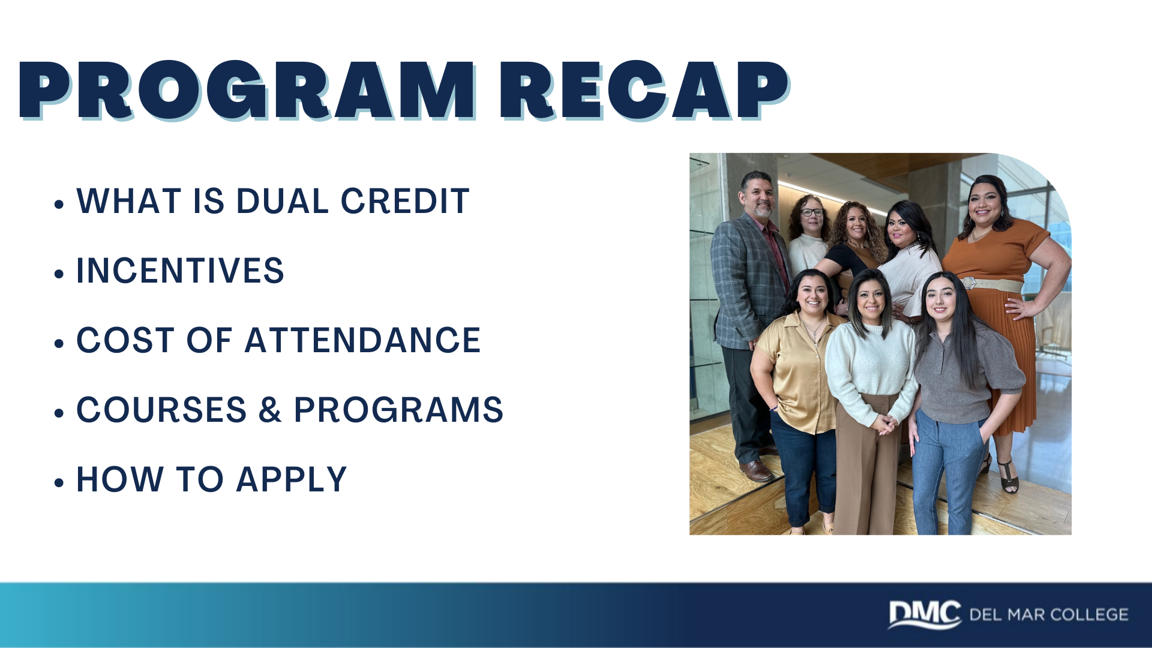

Slide 24
