Slide 1
How to Teach English Language Learners
Tips and Strategies
Christin Smith
ESOL Teacher

Slide 2
First Things First
Make them feel safe and secure
  Give a warm welcome each day
  Assign a buddy
Simplify your language without sacrificing content
Notes:
Introductory notes.

Slide 3

10 Ways to Improve Instruction for ELLs
1. Speak slowly and clearly
  Do not raise your voice
  Use gestures, real objects or visuals
2. Repeat and check for understanding
  Break information into “chunks”
  Explain key terms in simpler language
  Avoid using slang, idioms, abbreviations
  Wait time
Notes:
Beginning course details and/or books/materials needed for a class/project.

Slide 4
10 Ways to Improve Instruction for ELLs
3. Write legibly
4. Clearly explain rules and procedures
  Use proximity and movement to connect to your students
5. Help students understand classroom routines
6. Tell students each lesson’s objectives and activities
  Keep instructions simple and logical
  Write on the board or draw a diagram if needed
7. Connect new information to students’ prior knowledge or experiences

Slide 5

10 Ways to Improve Instruction for ELLs
8. Present information in a variety of ways
  Also use different grouping options
9. Don’t try to correct all errors that they make while writing and speaking
10. Prepare definitions in simplified language
Notes:
A schedule design for optional periods of time/objectives.

Slide 6
Strategies for Teaching ELL Students
Differentiated Instruction
Scaffolding
Graphic Organizers
Interactive Strategies
Vocabulary Learning Strategies
Critical Thinking Skills and Strategies
Notes:
Objectives for instruction and expected results and/or skills developed from learning.

Slide 7

Testing English Language Learners
Multiple-choice items:
  Read the question
  Cover up the answer choices
  Think of the correct answer
  Uncover and read the answer choices
  Find the one that best matches the answer they thought of
Notes:
Relative vocabulary list.

Slide 8
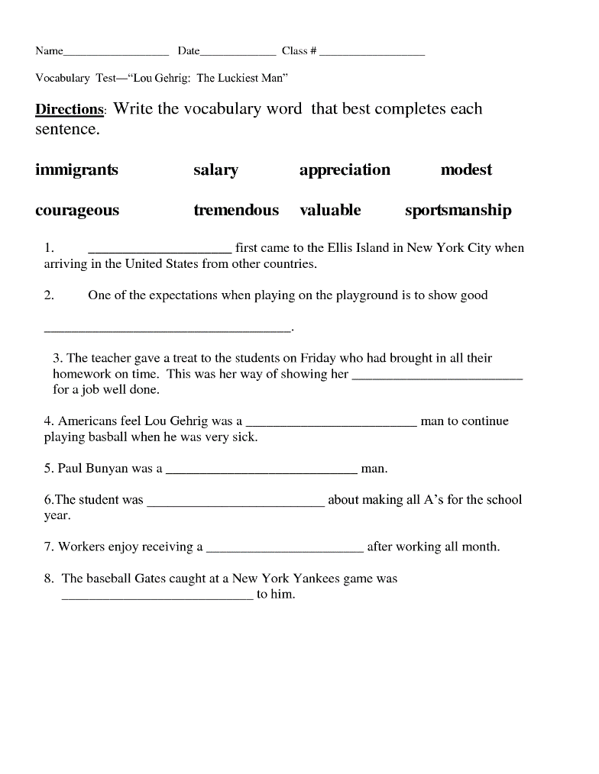
Testing English Language Learners
Vocabulary matching items:
  Read the passage
  Use context clues in the passage to help with meaning of the target item
  Identify the matching synonym (or antonym)
  Mentally replace the target item in its sentence with the synonym (or antonym) to check for sense

Slide 9
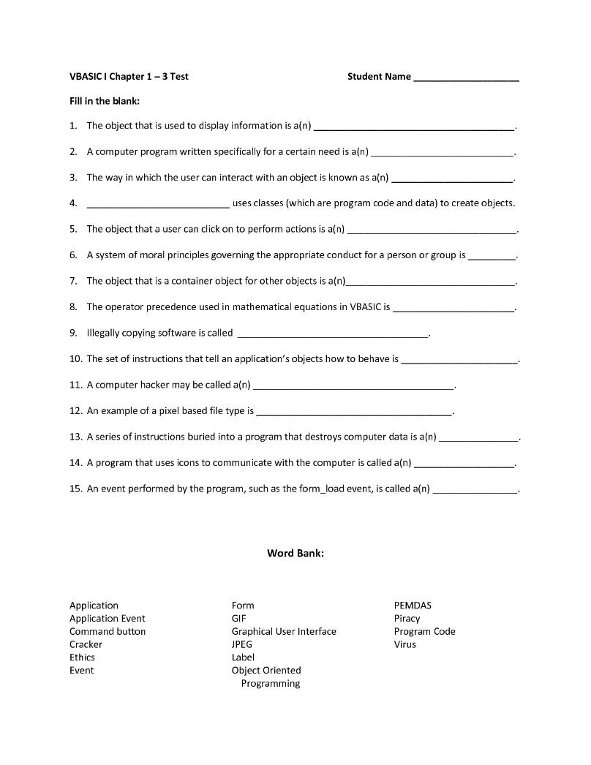
Testing English Language Learners
Fill-in-the blank items:
  Read the item or sentence with the missing word
  When answer choices are provided, look at each answer choice, mentally fill in the blank with each choice, and choose the one that makes the most sense
  When answer choices are not provided, brainstorm two or more possibilities, mentally fill in the blank with each choice, and choose the one that makes the most sense.

Slide 10
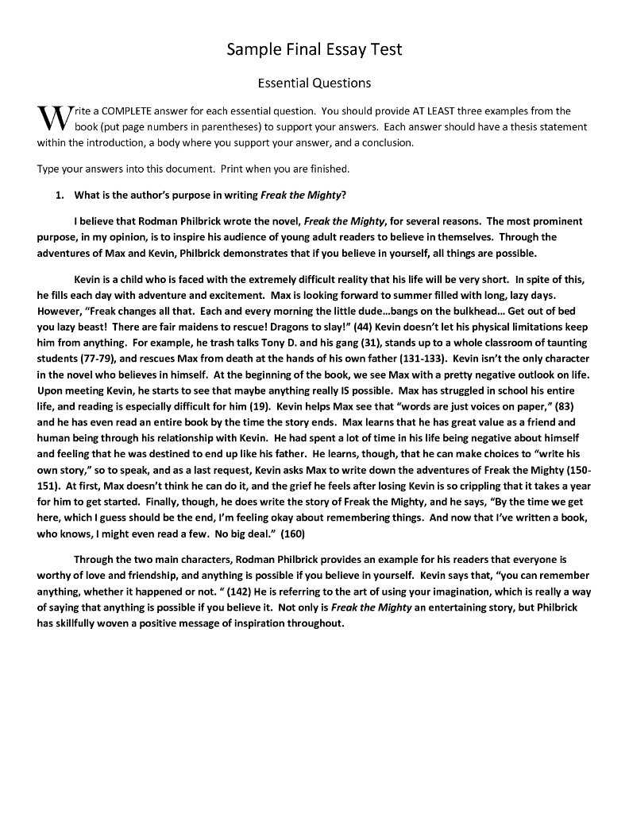
Testing English Language Learners
For essay items:
  Read the instructions in the writing prompt carefully
  Think about the topic before writing
  Organize ideas using notes, outlines, or graphic organizers
  Write about the topic, making sure to have clear main ideas and appropriate supporting details
  Check for clarity of ideas and organization
  Check for grammar, spelling, and punctuation

Slide 11
Test Modifications for ELLs
Read the test aloud
Shorten the test
Extend the time they have to complete the test
Provide pictures to illustrate meaning
Allow the use of a bilingual dictionary
Allow students to respond orally, draw pictures, or diagrams
Use additional forms of assessment such as portfolios, projects, presentations, and performance assessments
Notes:
Example graph/chart.

Slide 12
Teaching Techniques
Walk, Pair, Share
Repetition
Rehearsal
5-2-1
Partner talk
Sentence frames
Hands up, Pair up
Inside, Outside circle
Notes:
An opportunity for questions and discussions.

Slide 13

Who Is Practicing Academic Language???
In most classrooms, it is the teacher, it should be the students!
  Students need to use the language ~20 times in order to learn the material.
  It increases student engagement
Notes:
Example graph/chart.

Slide 14
Student Engagement
When students are practicing academic language
Typical Classroom
This graphic shows the difference in student engagement when the teacher is using the academic language and when the student is using the academic language.

Slide 15
Where Should I Start?!?!
Start every lesson with a context embedded experience
  Picture
  Diagram
  Short video clip (30 seconds)
  Anchor chart with visuals
  Multisensory experience
  Simulation
  Role play
  Graphic organizer
Make sure there is academic language practice within the classroom
  Think-Pair-Share before writing
Notes:
Conclusion to course, lecture, et al.

