Slide 1


WELCOME PARENTS!!!

Slide 2

Kindergarten Roundup
AGENDA FOR TONIGHT ~
Power Point 6:30 P.M.
Q&A 7:00 P.M.

Slide 3
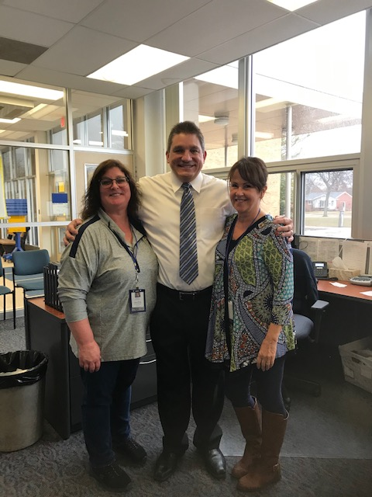
New People in Your Child’s Life will Include:
Brenda Westrate, Health Paraprofessional
Vince Porreca, Principal
Debbie Merta, Administrative Assistant

Slide 4
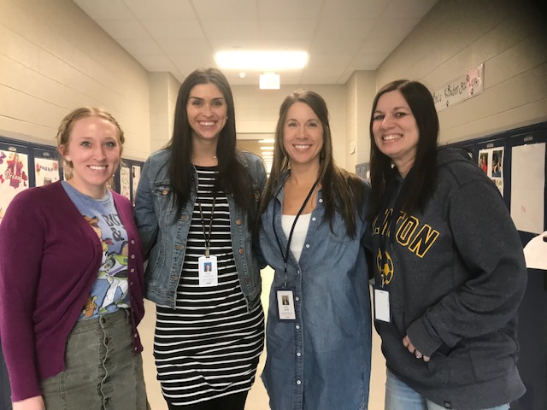
KindergartenTeachers
Mrs. Justina Davidson
Ms. Aly Masciovecchio
Mrs. Dana Pilgrim
Mrs. Nikki Morse

Slide 5
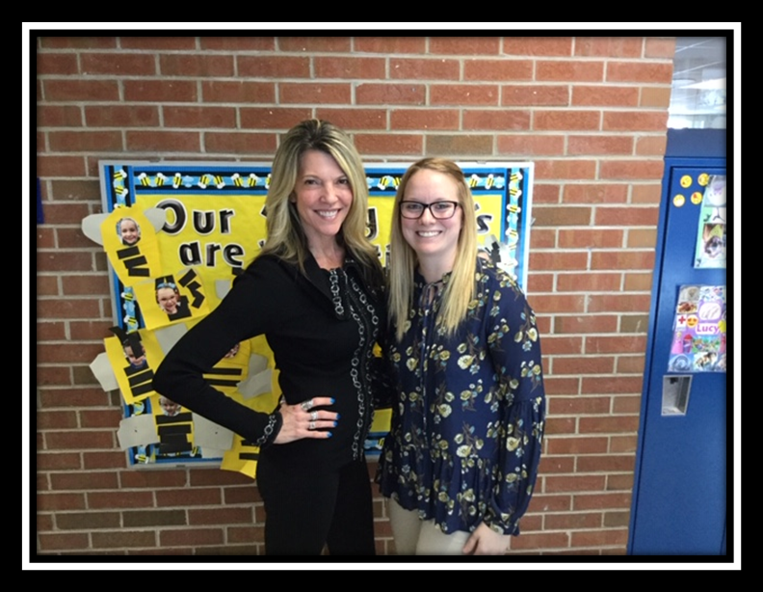
Kindergarten Teachers
@ Anderson for Young 5’s
Mrs. Jennifer Richards – Y5’s
Mrs. Chelsea Jackson – Y5’s

Slide 6
Eligible For Kindergarten?
2021-22: Michigan law states:
a child must be five years old on or before September 1 to enroll in kindergarten.
In Michigan, children are required to begin school by age 6.
Kindergarten, which requires children to be age 5 by Sept. 1 to attend, is not compulsory.

Slide 7
Kindergarten Waiver Option
If a child is not eligible for enrollment per the guidelines specified in the previous slide, the child’s parent or legal guardian can apply for a waiver to enroll their student in school.
This information will be distributed by request.

Slide 8
NEW for Kindergarten 2021-22
Kindergarten Readiness Assessment (KRA) – Fall 2021
State mandated & results shared with parents
These scores will be used to develop instructional groupings, lessons etc.

Slide 9
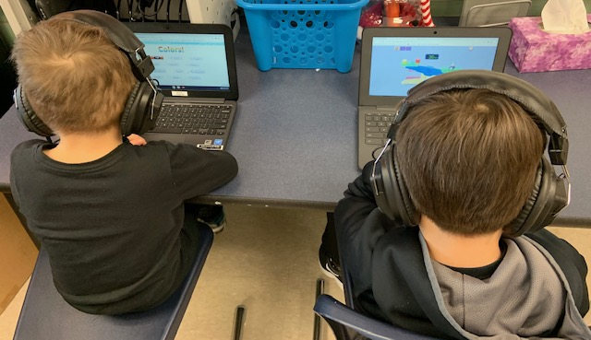
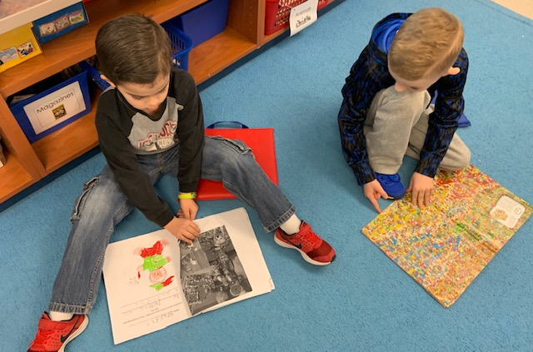
Kindergarten is a time for children to expand their…
Love of learning
General knowledge
Ability to get along with others
Interest in exploring the world

Slide 10
Program Options
Full-Day Kindergarten (unlimited enrollment ~25/class)
Our program is designed to provide a solid foundation for success in school. The full-day allows time to provide rich experiences in:
The BIG 3
  Language Arts (reading and writing)
  Math
  Social development
Important but less time
  Science
  Social Studies
Special topics (1-2 hours / week)
Art, Computers, Music, Physical Education

Slide 11
Program Options
Full Day – Young Fives (1-2 classes 15-18/class)
The Young Fives program is a tuition-free, state-funded program. Students will attend school full day - five days a week.
It is housed at Anderson Elementary School.
Many children may not have the social, emotional or developmental maturity to succeed in a formal full-day Kindergarten program.
The goal of the Y5’s program is to provide exceptional educational opportunities for five-year-old children who are not quite ready to attend a formal full-day Kindergarten, but have different interests and abilities than preschoolers or have aged out of pre-school programs.
.

Slide 12
Program Options
Full Day– Young Fives
Eligibility for Young Fives is determined by birthdate—child must turn five before September 1, 2021. Children who will turn five between September 2 and December 1, 2021, are eligible to attend, if a completed Kindergarten Waiver Form is submitted with your registration.
Students who participate in the Young Fives program in 2021-2022 will attend their home elementary school for Kindergarten the following year, 2022-2023.
Parents may request Young 5’s, but there is no guarantee of placement. (Remember the Screeners/surveys!)

Slide 13
Examples of Kindergarten Schoolwide #’s @one Trenton school in the past 9 years.
  61 = 2011
  77 = 2012
  100 = 2013
  75 = 2014
  81 = 2015
  67 = 2016
  69 = 2017
  75 = 2018
  98 = 2019
  75 = 2020
Due to fluctuations in numbers, parents will NOT be notified of their child’s classroom teacher until late August 2021.
You WILL receive a letter from your child’s teacher 1-2 weeks before school resumes in the fall.

Slide 14
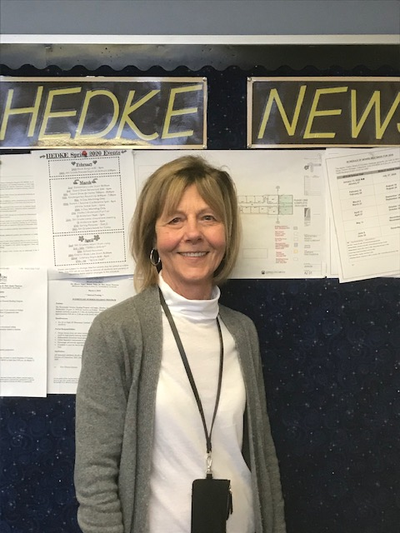
Program Options
Before and After Care – CARE CLUB
The tuition-based program offers childcare before (6:45 – 8:25) and after (3:30 – 6:00) the school day.

Slide 15
Is my child ready to start school?
Good health
and physical
well-being
Language
skills
Social and
emotional
development
Cognitive
and general
knowledge
Motor
development
It is a “whole child” question.

Slide 16
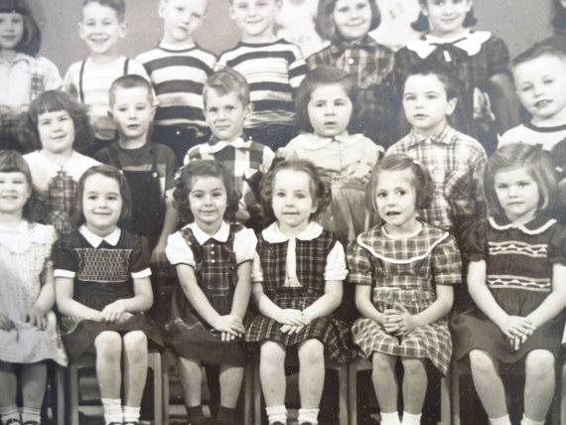
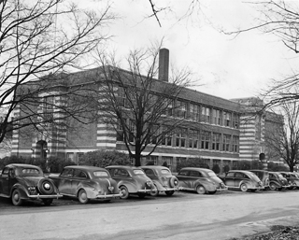

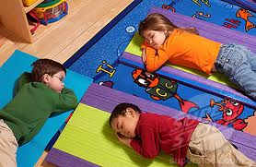
Kindergarten yesterday – ½ day of school

Slide 17
Kindergarten today daily start
8:15-25 Line up outside of Kindergarten doors
8:25 Students enter into classrooms
8:30 Tardy – students have responsibility put items into their locker for the day and turn folder into teacher
Many Kindergarten students ride the bus and enjoy the experience. For many, it’s their first opportunity to be independent of their parents.

Slide 18

Kindergarten today daily start
Each school day starts with our school pledge and the pledge of allegiance….kindergarten students get their turn to lead starting in May.

Slide 19
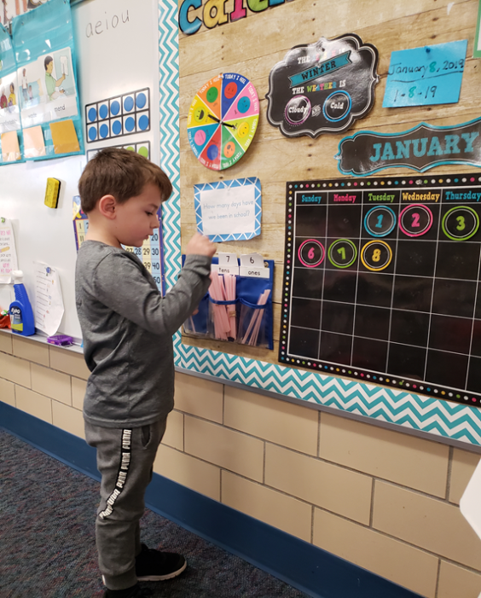
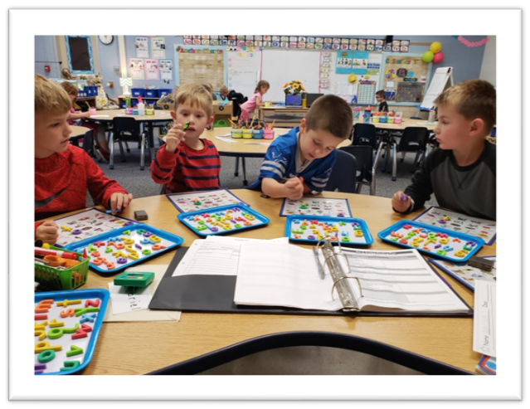
Kindergarten today
Calendar
Daily Message
Learning Centers: Daily 5, Guided Reading, Shared / Reading and Writing, Listen to reading, Read to self/other

Slide 20
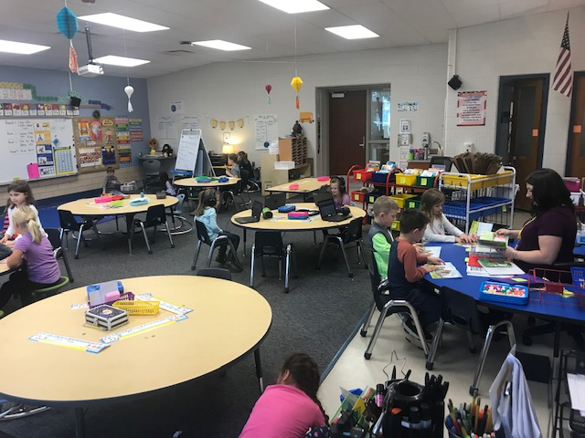
Literacy Development
Modeled Reading and Writing (read-a-loud)
Shared / Guided / Independent Reading and Writing
Small Group and Whole Group Instruction
Vocabulary

Slide 21
READING IS ESSENTIAL
It is important to remember that reading is a process. The course of this process is as individual as each child. It isn’t as important where your child is in the process as it is where they are heading. You are the key, the single most important part of your child’s reading journey.
Read with and to your child each day

Slide 22
Please keep in mind…
There is normal variation in the rate and nature of
individual development and learning within an age
group.
Most children are stronger in some areas than in others.

Slide 23
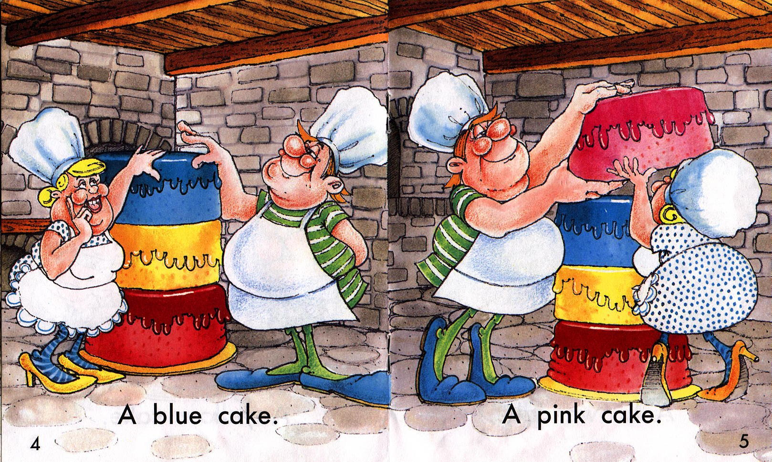
Predictable
Patterned
Picture Support

Slide 24
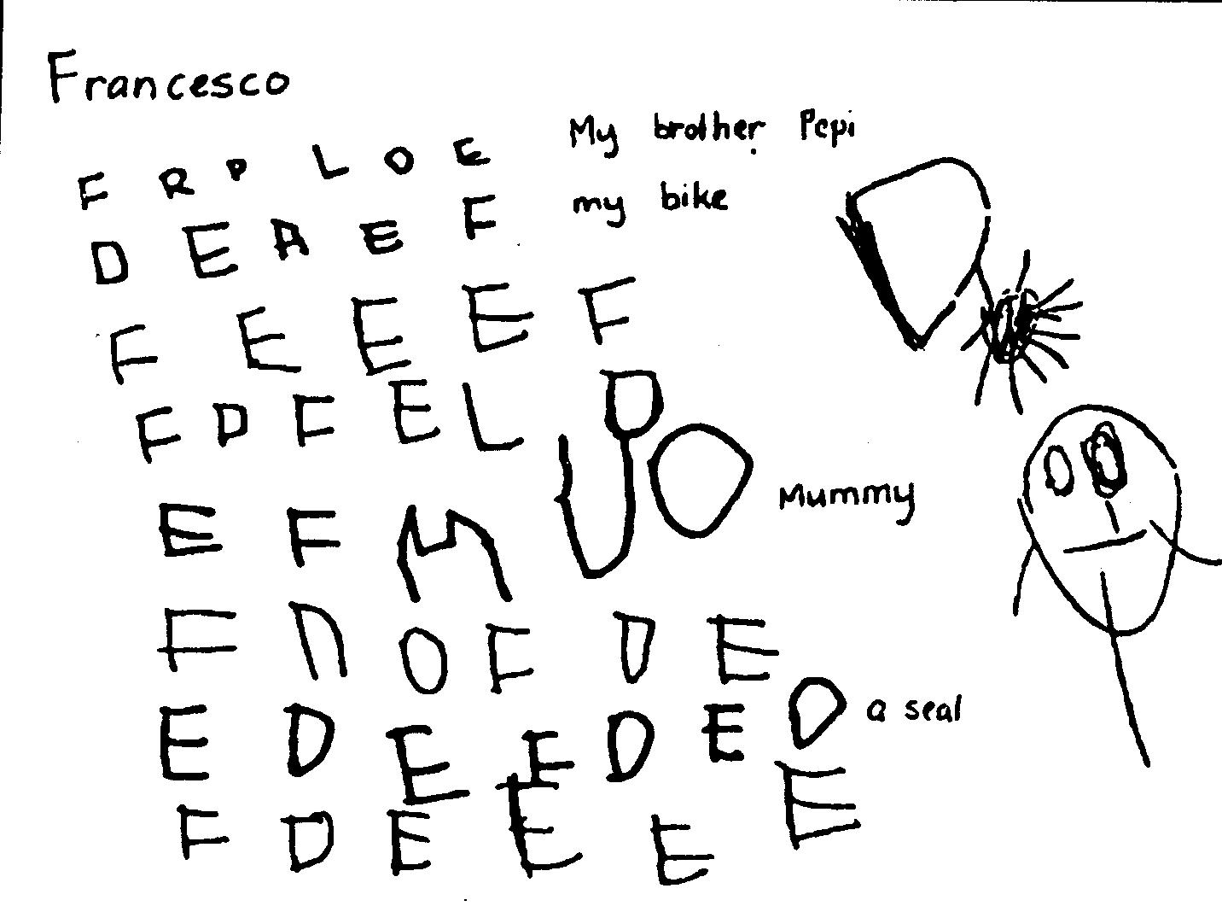
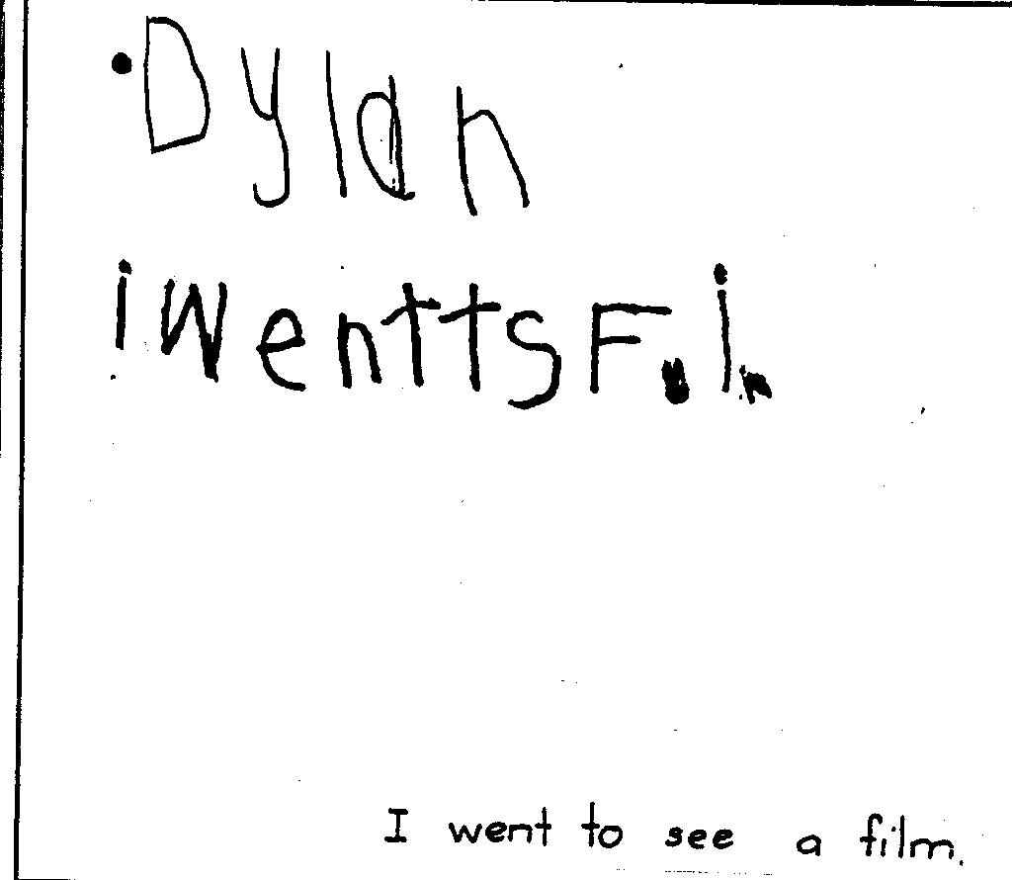
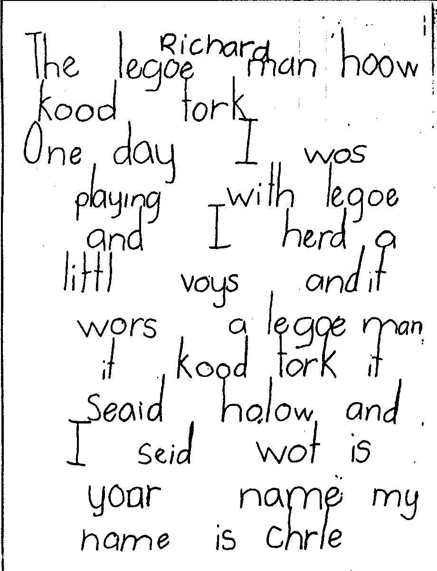
Writing Development
Emergent
Pre-Emergent
Developing
1st Grade

Slide 25
snack time
Students are given snack time on a daily basis. Snacks are peanut and tree nut free.
We request that you do your best to provide healthy snacks such as vegetables, fruit, whole grain crackers, etc. This same principle applies to birthday treats.
Food allergies pose significant health issues and we take steps to make sure our rooms are healthy for all involved.

Slide 26
Lunch time
Students can get a hot lunch and/or bring a lunch.
If you decide to use Chartwells, you may add money to your child’s account. It is deducted each time that your child buys.
All families may apply for free or reduced lunch when registering your child for school.

Slide 27
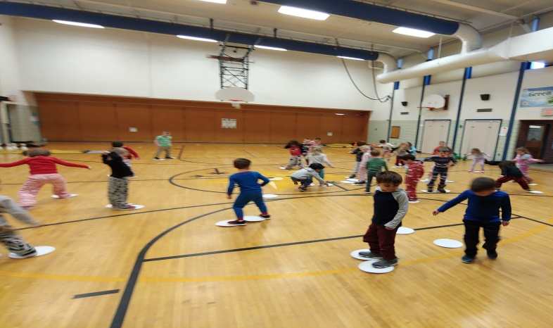
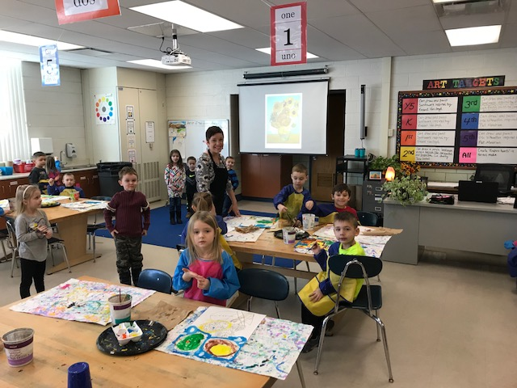
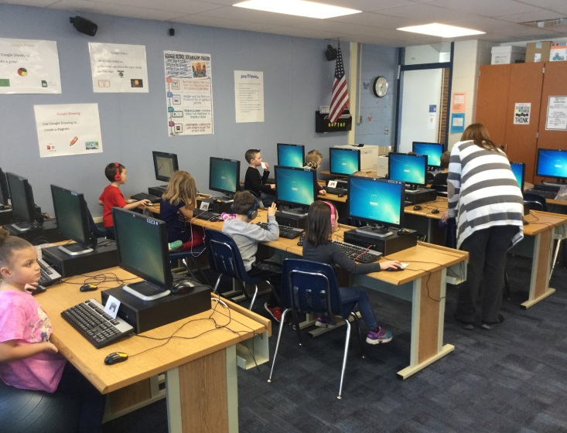
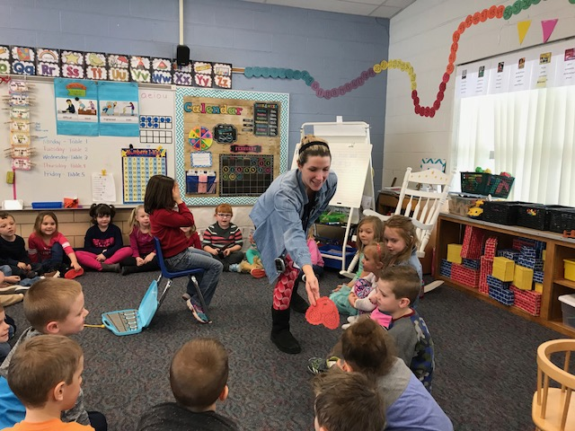
Encore Classes
Physical Education
Art
Computers
Music

Slide 28
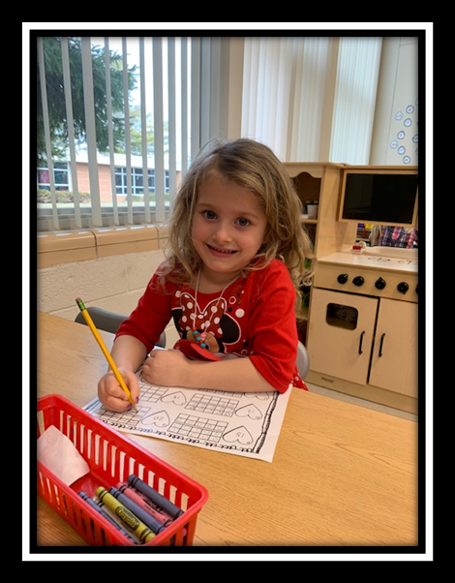
mathematics
Small / Large Group Instruction
Math Games
Partner Work
Hands-On Center Activities
Number Concepts
Graphing
Patterning
Measurement
Geometry
Addition / Subtraction
C = Concrete
P = Pictorial
A = Abstract

Slide 29
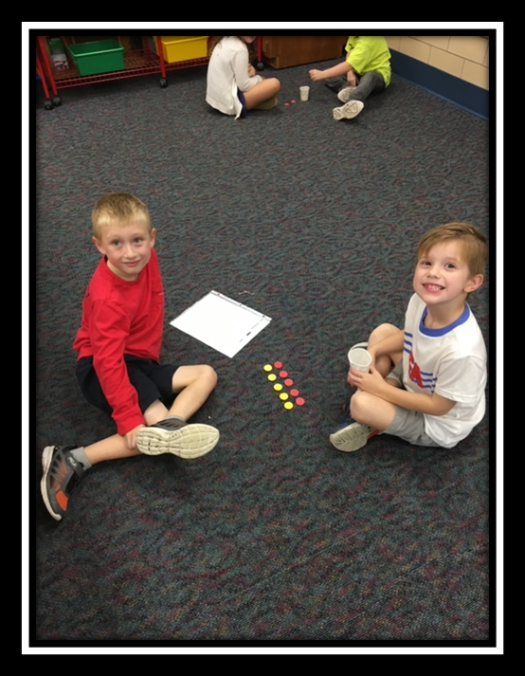
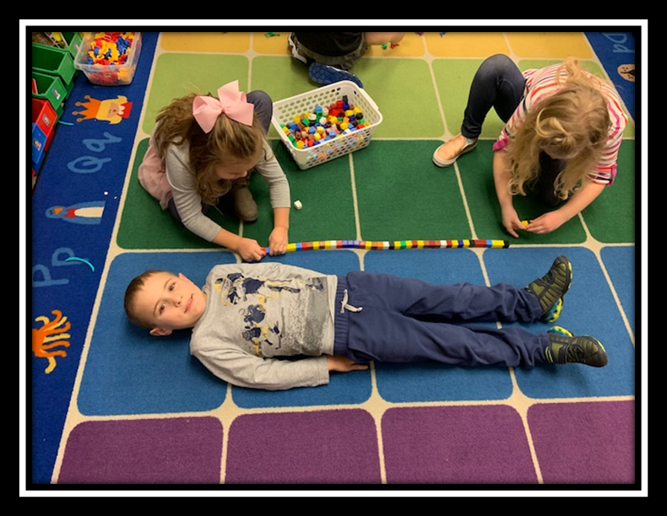
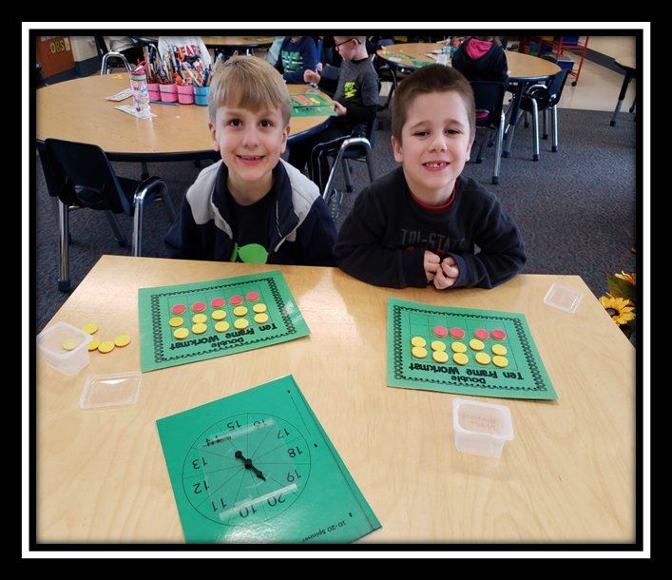
mathematics

Slide 30
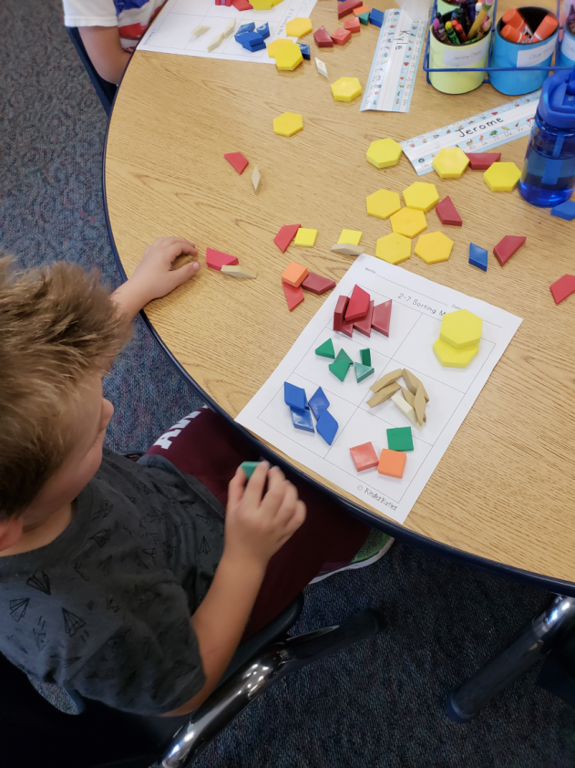
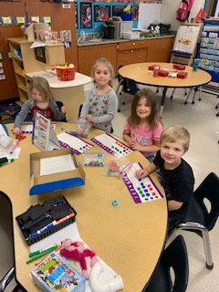
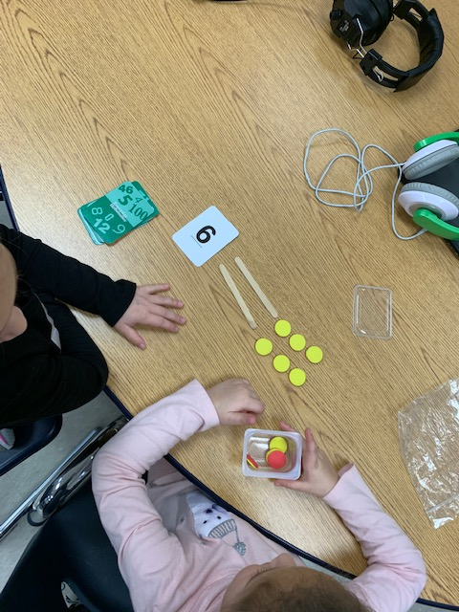
mathematics

Slide 31
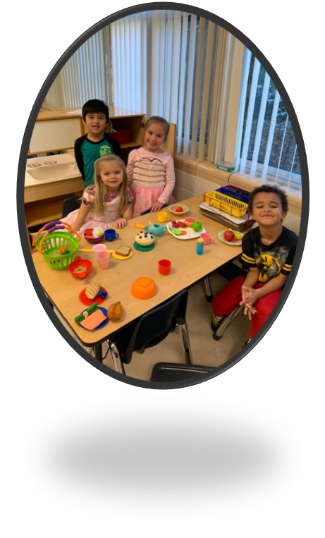
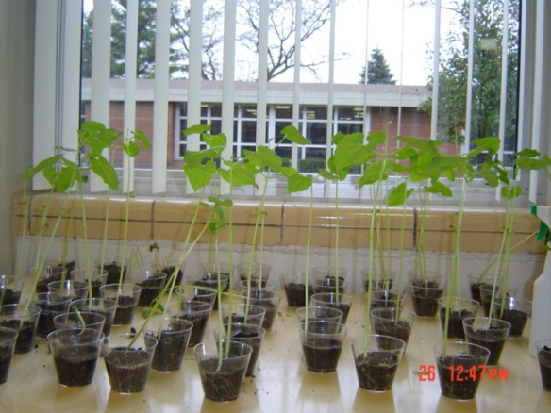
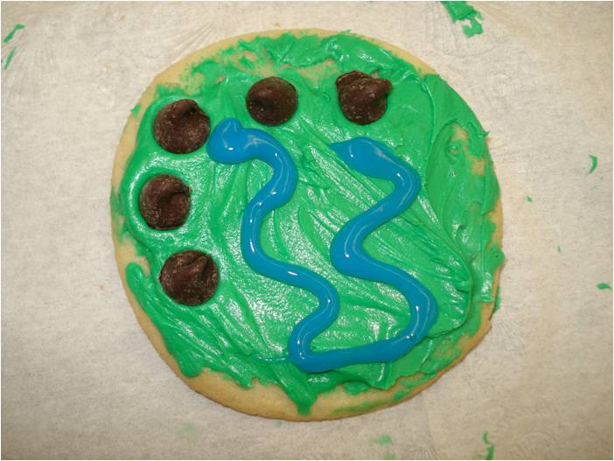
Science & Social Studies
STEMscopes - Inquiry-based approach exploring:
Humans and the needs of organisms
Dealing with weather
Living things and their habitats
Using forces to change motion (pushes/pulls and speed/direction)
Kindergartners begin to learn about
Social Studies disciplines (history,
geography, government,
and economics through the lens of
“Myself and Others”.
Lessons include:
    Who am I?
    Where am I?
    How do I get what I want and need?
    How do I get along with others?

Slide 32
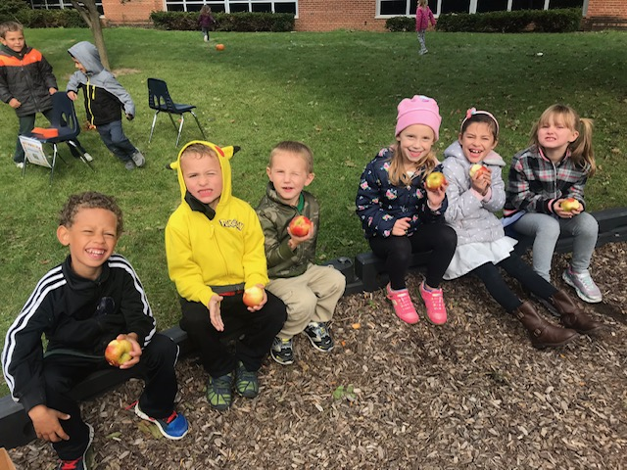
Social/Emotional/Physical
Recess
Play
Caring and Sharing
Cooperating
Making Friends
Interacting
Following Routines & Rules
Trying New Things
Respecting Differences
Self Regulation

Slide 33
~Special Days ~
Walk-A-Thon
Fire Prevention Week
Halloween Parade
Constitution Day
Winter Music Program
Valentine’s Day
Fun Run
BOB Week
Field Day

Slide 34
PBIS ~ 3 Rules
❶ Be Respectful
❷ Be Responsible
❸ Be Safe
Unofficial rule – use your best effort!

Slide 35
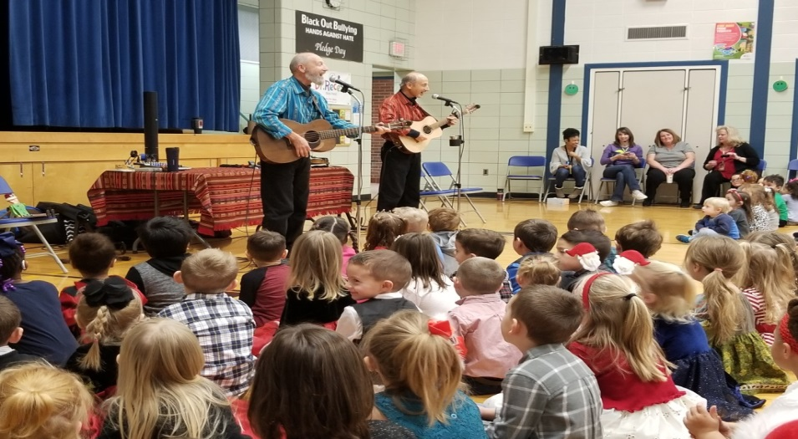
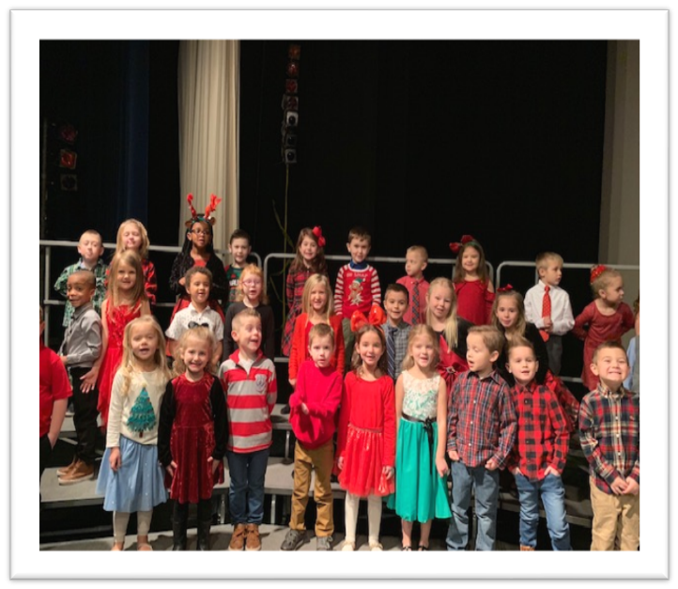
Field trips & Special Events

Slide 36
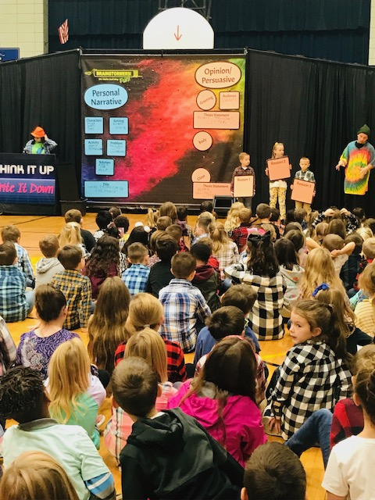
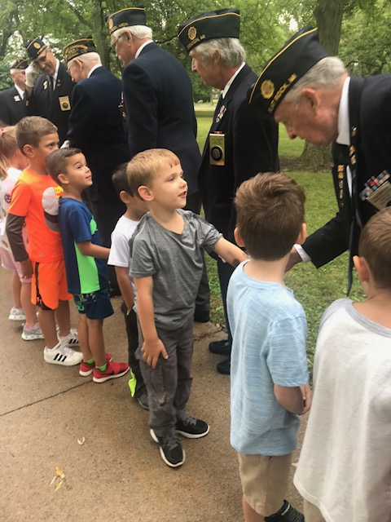
Field trips & Special Events

Slide 37
How Can I Help my child be successful?
ENJOY THE EARLY YEARS!
Realize entering school will have an impact on your “normal” life
Schedule vacations during school holidays
Schedule appointments after school
Get your child to school on time every day
Be involved in your child’s education
You are still an important teacher in your child’s education
Read aloud to your child every day
Get and stay connected!
Sign up for school messages (teacher remind/see saw etc.)
Keep your contact information current
Join the PTO
Volunteer at the school or from home
Participate in the “life of the school” (ex. Dress up days, field day, field trips)

Slide 38
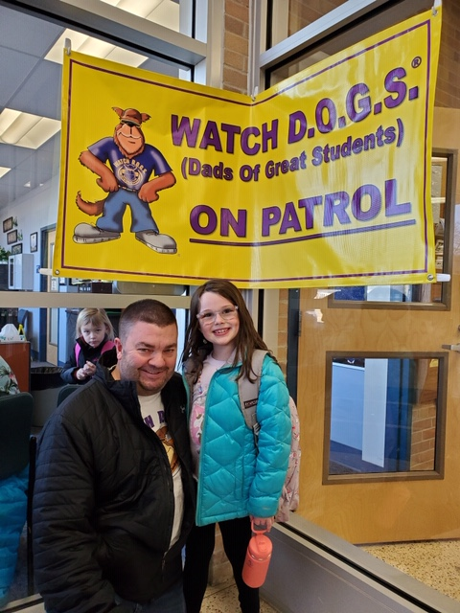
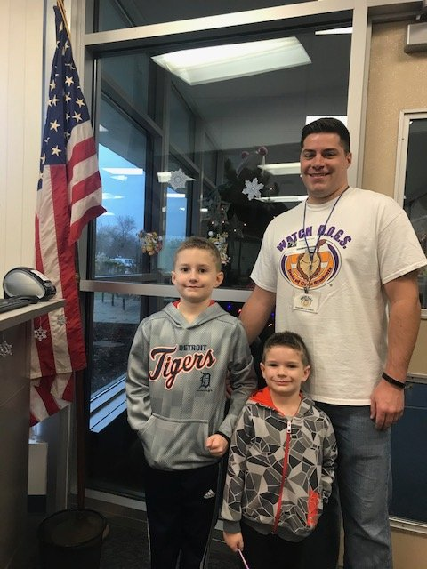
~Watch Dogs~

Slide 39
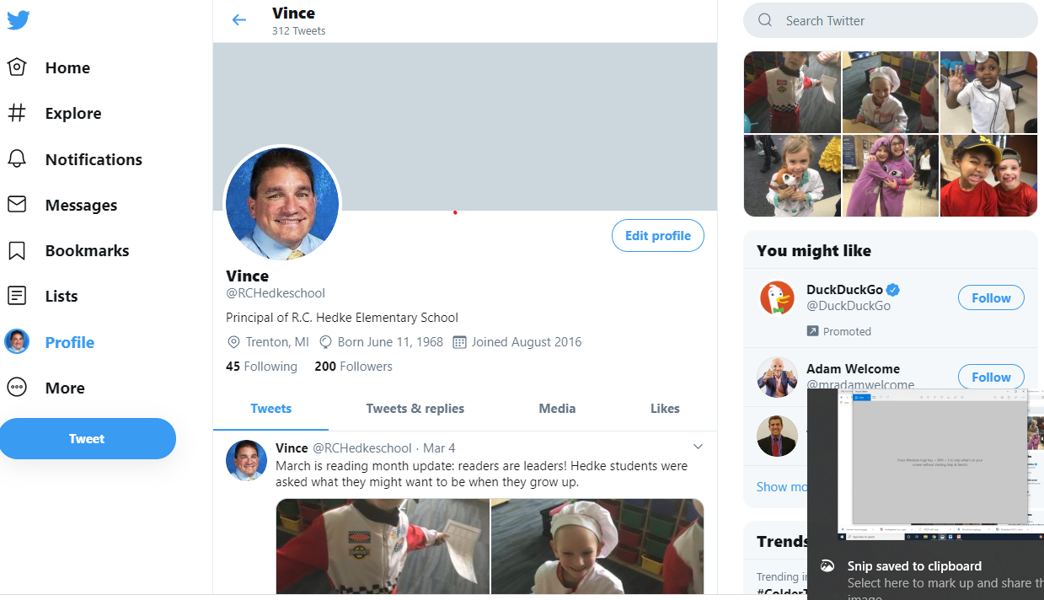
Follow our school on Twitter: https://twitter.com/RCHedkeschool

Slide 40

Follow your school district on your phone:
Download the
Trenton Public Schools App
from the App store

Slide 41


Follow your school at: www.trentonpublicschools.com
https://hedkeschool.weebly.com/

Slide 42
Thank you!
We look forward to seeing
you on Tuesday, September 7, 2021!

Slide 43
ORDERLY DISMISSAL ☺
Parent Homework:
Complete a brief online survey:
Parent Kindergarten Survey
Go to the Trenton Web Site and complete the Pre-Registration forms online
Registration forms
Go to the Trenton Board of Education Office (on Charlton in front of THS) and turn in your completed Pre-Registration Forms and pick up our gift to your child – their own “Future Graduate” shirt!
Review and work on the items on the Readiness Checklist

Slide 44
Final Registration
DEAR PARENTS,
After you complete the pre-registration forms on the previous page and submit them, the receptionist at the Trenton Board of Education office will contact you to make an appointment for final registration.
Thank you for your commitment and support!
“We’re from Trenton! Who could be prouder?”

