Slide 1
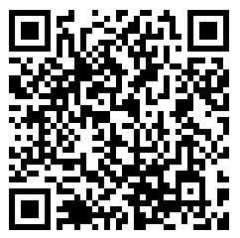
WELCOME TO
JEFFERSON MIDDLE SCHOOL
If interested, you may scan the QR code to follow along with this presentation.

Slide 2
JEFFERSON MIDDLE SCHOOL
Incoming Sixth Grade Orientation
January 24, 2023

Slide 3
JEFFERSON SCHOOL SONG
Now when the Jefferson Huskies fall in line
We know our team will win another time
And for the dear old school we love so well
And for the red and white we’ll yell and yell
And then we’ll fight, fight, fight, for Jefferson
And when it’s over that’s a job well done
We’ll back our team of Huskies every time
To help them win, win, win, FIGHT!

Slide 4
CONTACT INFORMATION
Ms. Shannon Blasy Principal blasysm@midlandps.org
Ms. Lindsay Timmerman Counseling timmermanl@midlandps.org
Ms. Lynsey Johnson Special Education Supervisor johnsonla@midlandps.org
Dr. Steve Poole
Assistant Principal
pooles@midlandps.org
Ms. Lisa Rabie
Administrative Assistant
rabielf@midlandps.org

Slide 5
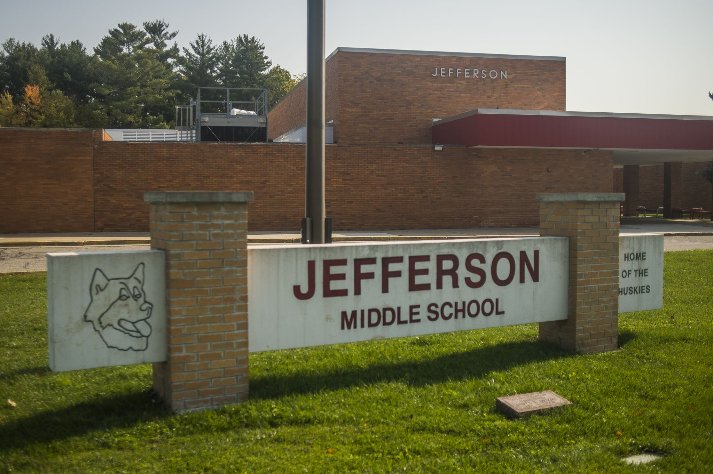
CURRENT ENROLLMENT
905 students
Grades 6-8
jms.midlandps.org

Slide 6
TIPS FOR SUCCESS IN MIDDLE SCHOOL
Check ParentVue in Synergy regularly. Here you can view attendance and grades.
Monitor your child’s attendance, no more than 5 absences allowed per semester.
Make sure your child goes to bed and gets enough sleep, school starts earlier
Have a routine for homework, help them create good time management skills
Encourage your child to get involved with extracurricular activities

Slide 7
PARENT INVOLVEMENT
JPAC – Jefferson Parent Advisory Committee – Contact President, Keyona Bradford, at JPACmidland@gmail.com for more information
Sponsor a club
Coach a team or assist a coach
Volunteer at the school

Slide 8
EXTRA CURRICULAR ACTIVITIES
Sports
Athletic Director: Carlos McGee
All information will be on the JMS website under the sports tab
All athletes must have a physical on file prior to participation
Fall: Football, Pom, Cheer, Cross Country, Volleyball
Winter I: Boys Swimming, Girls Basketball, and Wrestling
Winter II: Girls Swimming, and Boys Basketball
Spring: Track & Field
Clubs
Listed on the JMS website
Start your own
Keep an eye out in the fall for an introductory night

Slide 9
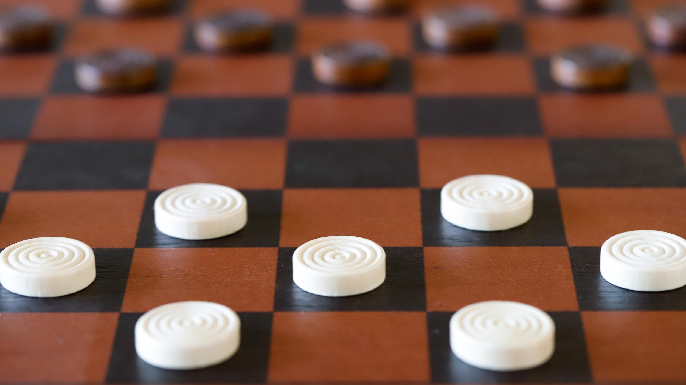
AFTER SCHOOL PROGRAMMING
The ROCK at JMS or the Community Center
Contact 989-835-2542 for more information, ask for Jill
Open until 6:00 PM

Slide 10
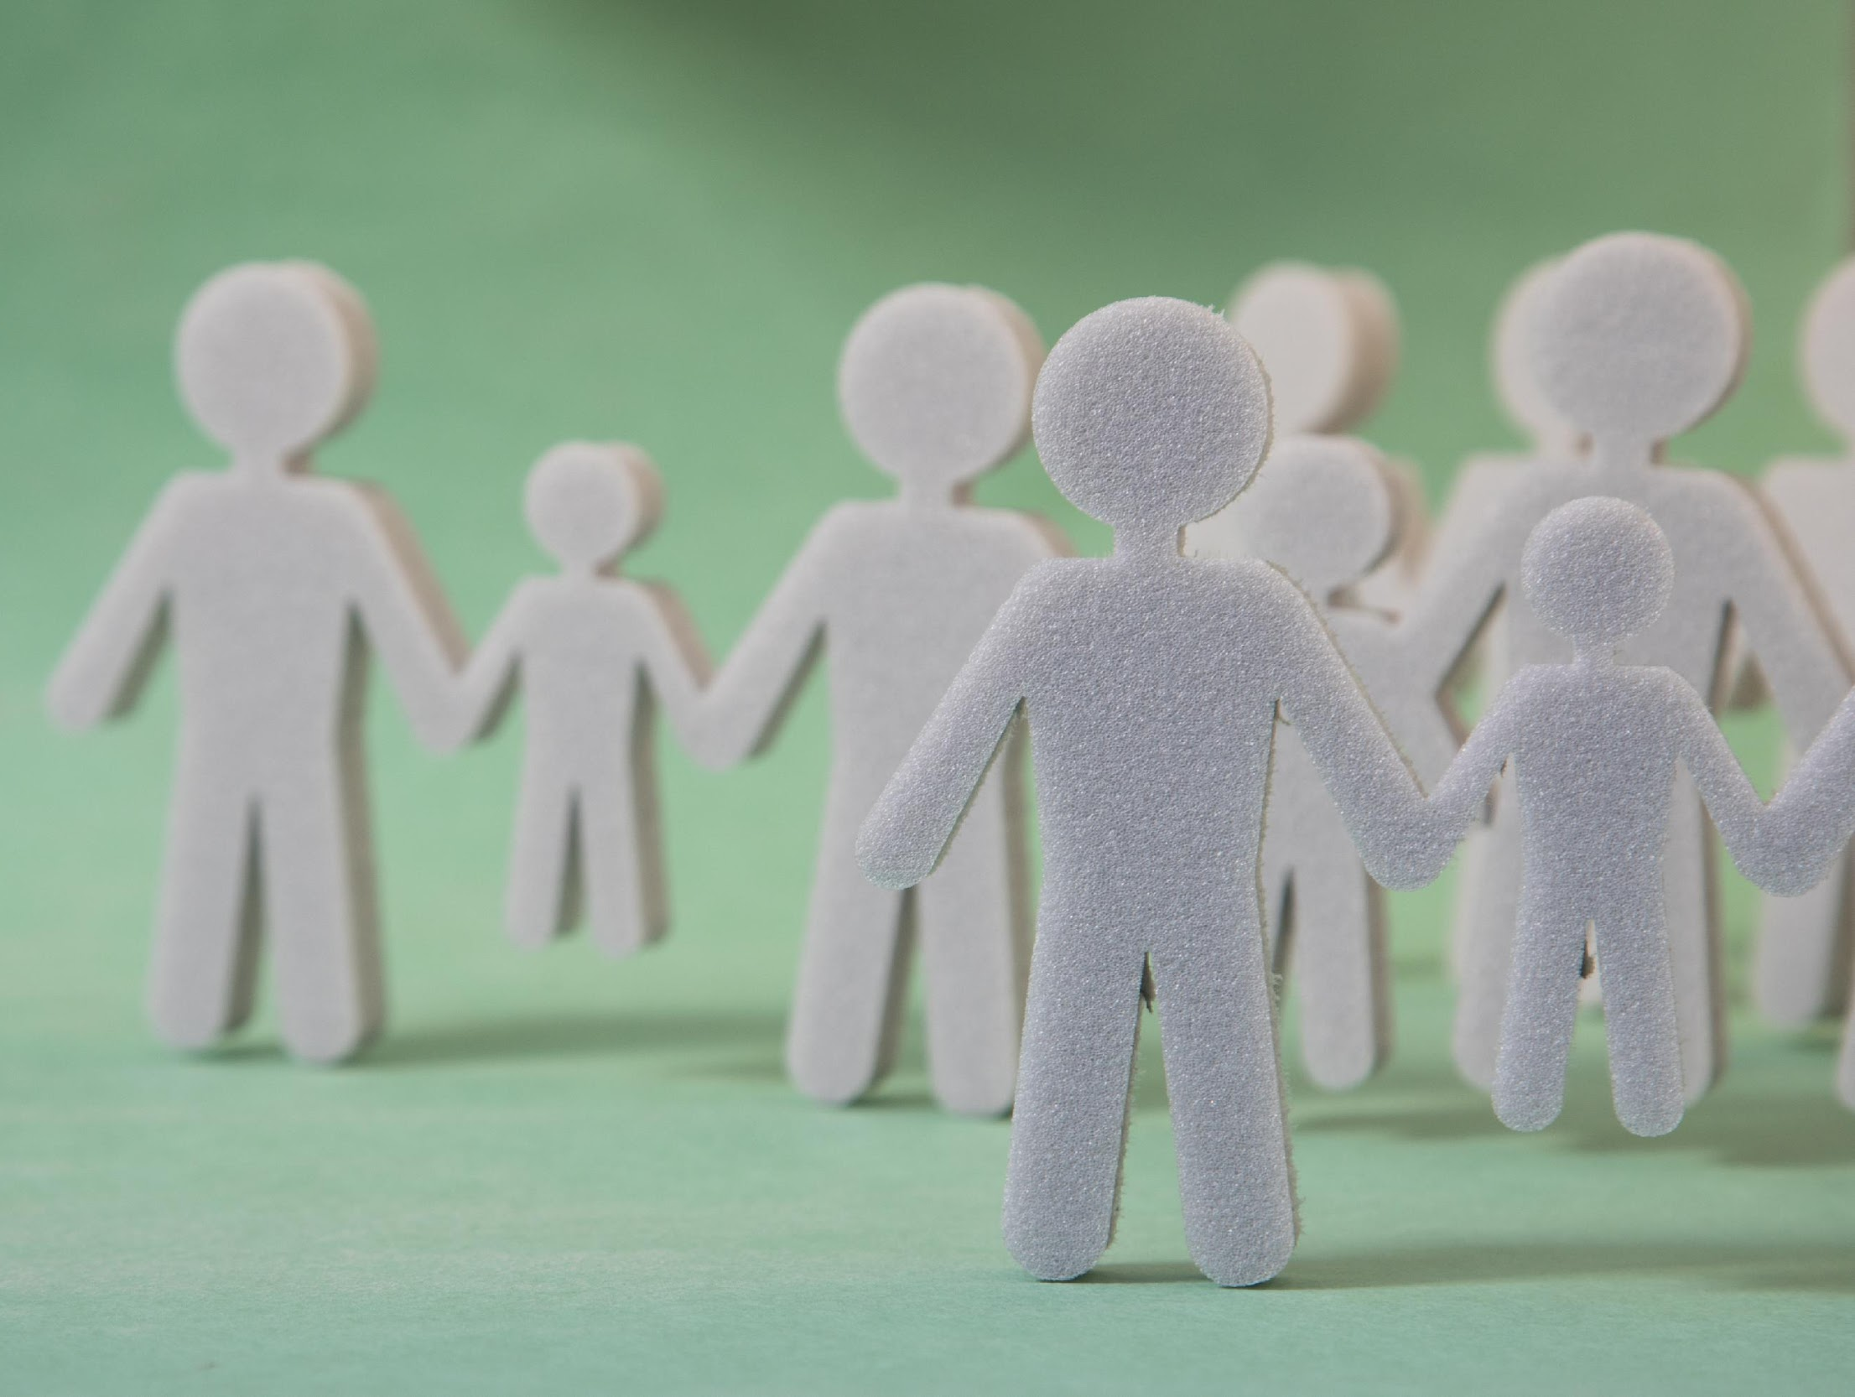
SIXTH GRADE TEAMS
Three Teams, consisting of 3-4 teachers
Allstars, Pathfinders, Trailblazers
Your child’s reading and writing teacher serves as a homeroom teacher
Less travel, less contact with seventh and eighth grade
Transition from elementary to middle school

Slide 11
DAILY SCHEDULE
Tentatively doors open at 7:40 AM
*Breakfast will be served in the cafeteria at 7:25 AM
1st Period 7:55 – 8:50
2nd Period 8:55 – 9:55
3rd Period 10:00 – 10:55
4th Period 11:00 – 11:30
LUNCH 11:35 – 12:05
4th Period 12:10 – 12:40
5th Period 12:45 – 1:40
6th Period 1:45 – 2:40

Slide 12
SIXTH GRADE CORE SUBJECTS
Reading
Writing
Math
Science
World Geography & Global Issues

Slide 13
SIXTH GRADE ENCORE
ART - up to 3 days
PE - up to 3 days
Spanish - 2 days
Orchestra - 2 days
Band - 2 days
Choir - 1 day
Math Lab - 2 days
CSI - 2 days

Slide 14
ATTENDANCE
In middle school, attendance is taken every period.
A student is counted tardy to class if they arrive late. If they arrive more than 10 minutes late it is marked as an absence.
There is 5 minutes of passing time between each class.
First two-weeks – monitor attendance

Slide 15
ATTENDANCE CONTINUED
If your child is going to be absent, please call the office at 989-923-5873. All you need to say is “This is John Doe, Father of Jane Doe, she is sick today May 5, 2023, and will not be in school.”
If we do not receive a call from you, two things will happen:
You will get an automated call from our attendance system stating your child has an unexcused absence on the evening of May 5 (or said date). Please call us the next day to excuse the absence.
If we don’t hear from you, we will contact you to make sure you know that your child is absent.

Slide 16
LOCKERS
Students have their own lockers
Do not share locker combinations with anyone
Do not leave your locker “spun”
Always shut your locker and spin the combination so it will not open

Slide 17
MY SCHOOL COUNSELOR CAN HELP ME WITH…..
All things social, emotional, and academic.
Planning for the future (HS, college, career)
Making hard choices
Developing healthy habits
Adjusting to change at home (moving, divorce, new sibling, etc.)
Improving organization and study skills
Making friends
Getting into my locker
Apologizing, taking ownership, and fixing my mistakes
Working through my feelings
Addressing anxiety, depression, and other mental health concerns
Connecting with school and community resources
Resolving conflict
Grieving a loss
Solving a personal hygiene problem (deodorant, pads/tampons, etc.)
Meeting a basic need (food, clothes, etc.)
Building self-esteem, self-worth, and self-confidence
Navigating an unsafe or uncomfortable situation
If I am not the best person to help, I will connect you with someone who can.

Slide 18
APPROPRIATE TECHNOLOGY USE
Students are responsible for their chargers as well as their Chromebooks.
Students should NEVER share their passwords with other students.
Phones should remain in the lockers during instructional time turned off. If phones are visible during class time, the phone will be confiscated and either returned to the student by the end of the day or a parent will be contacted to pick up the device.
GoGuardian - teacher and parent use
Handbook: Violation of Acceptable Use Policy A student shall not violate or attempt to violate School District policies, administrative regulations, and directives concerning School District or personal computers, networks, and telephone systems. Violation of any of the rules and responsibilities may result in a loss of access privileges/technology privileges/computer usage and may result in other disciplinary or legal actions including restitution.

Slide 19
CANVAS
Teacher/Student Use
All teachers use Canvas for their classes
Assignments
created/graded in Canvas; synced with Synergy at midnight
posted in Canvas; grades entered in Synergy at a later date
Students should check Canvas daily, especially when absent
Become an Observer (click below)
Create a pairing code
Register and use pairing code

Slide 20
PARENT DROP OFF
How do I get to school?
Bus, walk, bike, drop-off (For information on bus pick-up and drop-off times, please contact transportation.)
Where do I go?
Please enter the drop-off parking lot from Chapel Ln. It is a one-way parking lot. Please pull all the way up and come to a complete stop to drop-off your child.
What time is breakfast?
7:25 AM
Free and reduced lunch
Please make sure to apply as soon as possible. The form is located on the JMS website.
Parents can enter the building through the office only.

Slide 21
FYI
Supply lists will be handed out
Lunch
- Students can pack a lunch
- Students can buy a lunch; you can put money on their account linked on the JMS website
- There are a lot of choices in middle school -- discuss healthy eating habits at home
Read the Friday Newsletters -- they contain relevant information each week
Here is the link to the school handbook:
https://docs.google.com/document/d/1-RJ7J3sdwGW6FAYrwC-tcW5pmtgc-OeNWDv8lO7gPos/copy
When do I get my Chromebook?
Chromebooks will be distributed at the beginning of the year upon receipt of user agreements and permission slips.
Should I get the insurance?
Yes, students need to get their Chromebooks repaired because accidents happen and it will alleviate the stress of having to replace the device

Slide 22
HOMEWORK
Homework will depend on the teacher and subject area.
Please help your child plan a time to complete it.

Slide 23
MEDIA CENTER
Students can check-out books before school, between classes, and during lunch.
If books are not returned there will be a fine causing grades to be blocked on Synergy/ParentVUE/StudentVUE, and other items will be held.

Slide 24
GRADES
In fifth grade students did not receive letter grades.
This year they will receive grades and will get a report card every 9 weeks.
We recommend to a set day and time each week to check your child’s grade in Synergy (StudentVUE or ParentVUE) and take the time to discuss your child’s grades.
This is a good time to encourage your child to contact their teachers about questions they may have in order to work on their self-advocacy skills.

Slide 25
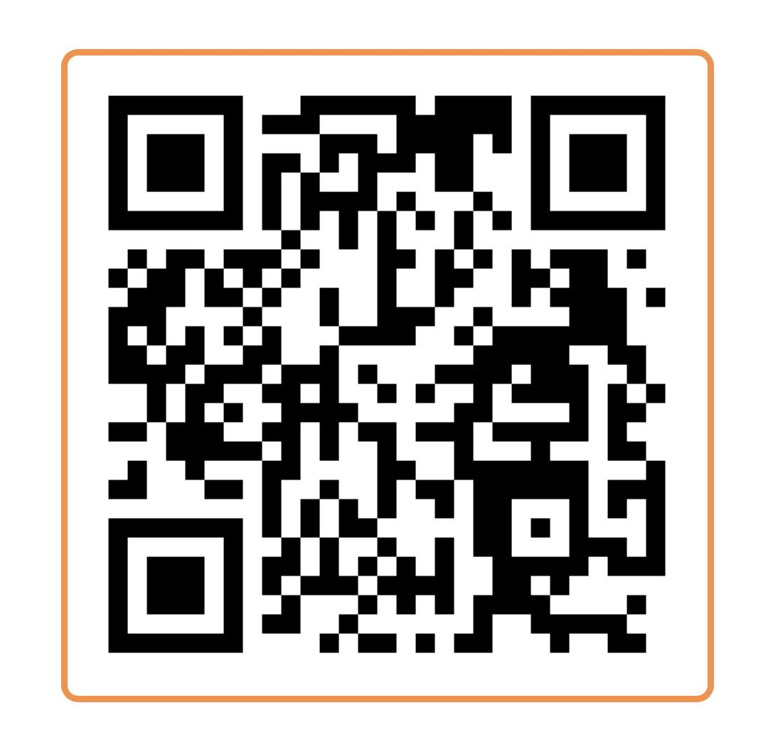
JPAC
Jefferson Parent Advisory Committee- Many hands make for light work! We have tasks that are big and small.
We are a group of parents that get together once a month to work together on finding ways to support staff and students throughout the school year.
We work on providing school assemblies,fundraising, field trips, restaurant and family nights, ski day, and SO much more.
We have implemented a new communication tool for the school. Please join using the QR code here to stay up to date on everything Jefferson related.

Slide 26
QUESTIONS
Schedules will be handed out in August and a walk through of the building to try their lockers and find their classes will be available then.
This presentation and all handouts will be emailed to parents and will be located on the JMS website.

