Slide 1
Robert’s Rules
Refresher for
NYSTC Policy Boards
Credit: The information in this presentation is predominantly based on the work of Jay Worona, New York State School Boards Association, shared with permission from him. NYSTC are grateful for his generosity.

Slide 2
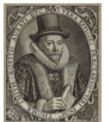
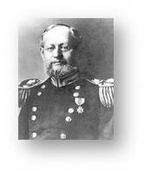
ORIGIN OF PARLIAMENTARY PROCEDURE
Parliamentary procedure started in 1562 in England with Sir Thomas Smyth writing down the procedures for carrying on the business of the Parliament.
The Official Rule Book is Robert’s Rules of Order written by U.S. Army General and engineer Henry Martyn Robert. It was first published in 1876 and is still the most popular authority.

Slide 3
GOALS OF PARLIAMENTARY PROCEDURE
Make meetings run smoothly in sync with time constraints under which Boards operate
Assure all members get to voice their opinion
Maintain order
Parliamentary Procedures should be used to provide decorum to meetings, not for purposes of obstructing democracy.
All members get the chance to voice their opinion and vote
Must take yes and no votes - anyone who doesn’t vote is abstaining
Example “10 in favor, 4 opposed, and 2 abstaining”
Note: member names must be listed for all but unanimous votes on minutes.

Slide 4
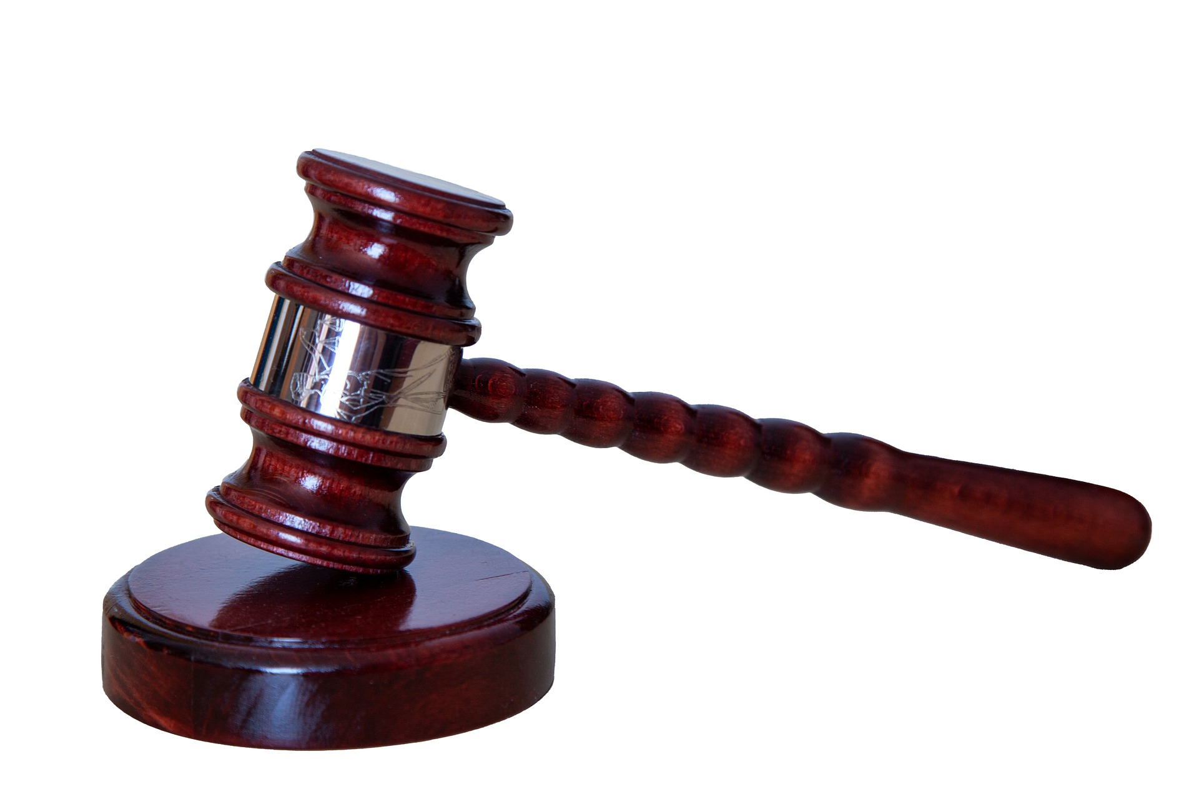
BASIC PARLIAMENTARY PROCEDURE FOR POLICY BOARDS
A motion starts a discussion between members
Only one topic at a time can be discussed by members
The member who makes a motion has the right to discuss it first
The Chairperson Shall Ensure:
Each board member has a chance to speak on each issue being considered. It is the Chairperson’s responsibility to manage time.
Before a member is allowed to speak to an issue for a second time, each member who has not spoken is provided an opportunity.
Discussion pertains to the current agenda item being addressed and halt discussion that does not apply to the business at hand. The Chairperson may ask the membership if the issue should be placed on a future agenda for discussion and, if so, make a note to do so.

Slide 5
DOCUMENTING MINUTES
✔ Name of Teacher Center
✔ Name of meeting
✔ Date, time and place of meeting
✔ Members present
✔ Others present
✔Affirmation that a quorum is present
✔ Clearly state motion, who made it and second
✔ Results of motion - Add numbers, also add names if not unanimous
✔Motion to adjourn meeting -who, made and specific time
✔Minutes submitted by with name and title
Issued by the SED Teacher Center Program Office October 2021
Notes:
Director: Review a copy of your center’s minutes and make recommendations for changes to the Board based on SED TCPO Guidance

Slide 6
MAJORITY RULES REVIEW
Definition of Majority under Roberts Rules of Order: 1/2 of members present at any meeting plus 1 is the minimum number of members required to vote for a motion to pass
SPECIAL NEW YORK STATE RULES:
New York State Law sets forth a majority of the entire body,
not simply those present is required for the body to take official action.
Notes:
References:
https://www.nysenate.gov/legislation/laws/GCN/41
https://docsopengovernment.dos.ny.gov/coog/otext/o3103.htm
Example: 11 Members - Who are members? Only members listed in your Continuation Application-Not the director. Director is a guest of the policy board. Policy Board chair is in charge of the meeting. If membership changes during the year, you need to notify the NYSED program office to ensure your FS-10As etc will be accepted.
Simple Majority? 6: ½ of 11 is 5.5, the first whole person more than this is 6.
⅔ majority is also sometimes required, such as for bylaws changes: 11 x .66 = 7.26 so you need 8 people to change bylaws

Slide 7
Guidance on Policy Board Quorum
“All policy board meetings pertaining to teacher center business for the 2020-21 program year onward will need to include at least a majority of total board membership, even if current by-laws indicate fewer than ‘a majority’ is needed for a quorum. This includes the policy board meeting minutes approving the 2020-21 Continuation Application and FS-10 due to the Program Office by June 5th.
All by-laws submitted with the 2020-21 Continuation Application shall include a definition of quorum in compliance with ‘a majority of the policy board membership’.” Dawn Graham, NYSED Teacher Center Program Office 2/2020
Notes:
Director: Review your bylaws in advance and make recommendations to the Board based on SED TCPO guidance.

Slide 8
CALCULATING MAJORITY FOR YOUR POLICY BOARD
Who are members? Only members officially listed in your Continuation Application - Not the director, invited guests or members of the public.
Most business requires a simple majority: Example: For 11 members, 6 is the majority
Bylaw revisions require a ⅔ majority. Example: For 11 members, 8 is the ⅔ majority.
Notes:
Why is this important? Representatives of the Public Body are those entrusted with the business at hand. If your membership changes, it needs to be reported to the program office because your board roster needs to match.

Slide 9
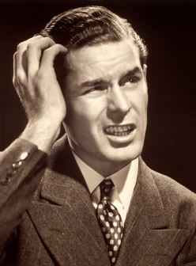
Examples of Majority Requirements in Practice
If 5 out of 11 Policy Board members attend a meeting, how many members’ yes votes are required to pass standard business agenda items?
If 8 out of 11 Policy Board members attend a meeting, how many members’ yes votes are required to pass bylaws changes?
Notes:
There is no meeting without at least 6 out of 11 members present to bring the meeting to order. No business can be conducted. This is why it is critical all policy board members attend as much as possible and it is recommended they alert the director and/or policy board chair if they cannot attend. This way, any issues can be addressed in advance.
8 - or 100% of those in attendance.

Slide 10
PUBLIC PARTICIPATION - Open Meetings Law
Teacher Centers are public bodies and should follow Committee on Open Government Guidance - https://opengovernment.ny.gov/
The public has the right to attend meetings of public bodies, listen to debate and watch the decision-making process.
Rules for maintenance of order on school property apply to attendance at meetings
Meeting rooms must be of adequate size to accommodate members of public who wish to observe
Public has right to record meetings for broadcast by audio or video means
For public comment periods when permitted by the public body:
The board can set time limits, limit subjects, determine place on agenda for comment
Notes:
Open Meetings Law requires only guests have the ability to view and listen to meetings-not participate. Public bodies, including teacher centers, may provide some mechanism by which members of the public can address the board that does not take up significant time set aside for the work of the center or provide some individuals with more access and influence than others which can undermine trust in the public body. School boards are a good example for this, with individuals given a predetermined amount of time to speak at the meeting. - A full NYSTC presentation is available on OML - Note: As of June 2022 fully remote meetings are no longer permissible

