Slide 2
Ways to Save
Use ER wisely
$45.3
million dollars
Use the ER wisely Visit the emergency room for life-threatening emergencies only
Choose a Primary Care Physician Get your free preventive care exams
Go to the right place for care Use urgent care or walk-in clinics for non-life-threatening emergencies
Informed Health Line Call the 24-Hour Nurse Line at 1-800-556-1555 to get guidance from a trained nurse if you are not sure where to go for care
Teladoc Take advantage of the most convenient and
least costly way to get help quick, 24/7 at
1-855-835-2362
43% of all emergency room visits in the last plan year were for non-urgent care, for things like sore throat or sinus infection.
This cost the TRS fund over $45 million dollars. It cost the participant an average of $909 out of pocket too.
Notes:
Your TRS-ActiveCare plan comes with several ways to save money on your out-of-pocket costs.

Slide 3
Ways to Save
Use 90-day supply
$10.7
million dollars
Participants could have saved the plan $10.7 million dollars in the last plan year if they had purchased medications in 90-day supplies.
This cost the participants $6.7 million dollars in additional out-of-pocket costs.
Take advantage of the preventive care benefits. 82.4% of adult participants DID NOT get their annual wellness exam last year.
Preventive wellness care in the network is covered at 100%.
Dollars spent on preventive care are the most important dollars spent by the plan. This is an opportunity for the participant to stay informed about their health.
38% of eligible women DID NOT take advantage of their annual mammogram last year.
82.4%
of
TRS-ActiveCare participants DID NOT get their annual wellness exams
Notes:
Your TRS-ActiveCare plan comes with several ways to save money on your out-of-pocket costs.

Slide 4
Ways to Save
Teladoc
$9
million dollars
The plan saved $9 million dollars in the last plan year because care was redirected from the ER or an Urgent Care to Teladoc.
Teladoc is an under utilized opportunity. There were only 62,358 consults in the last plan year.
Take advantage of this convenient and low cost option.
USIN is a company that works with participants to redirect them from a hospital setting to an imaging facility when they need an MRI or a CAT scan. USIN saved the plan $702,274 so far this year.
Certain types of care, like advanced imaging services or lab services, can cost much less if the participant uses an independent radiology facility or a laboratory like Quest. Call customer service for help in finding the best location for care.
Go to the right place for care
$702,274
Notes:
Your TRS-ActiveCare plan comes with several ways to save money on your out-of-pocket costs.

Slide 5
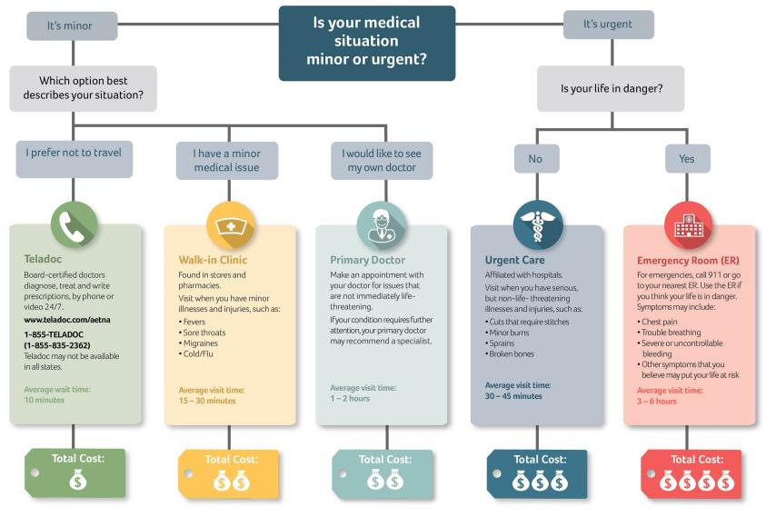
Go to the Right Place for Care
Notes:
Know where to go for care
Use the emergency room (ER) for life-threatening emergencies only – Life-threatening emergencies warrant a trip to the closest ER. For non-emergency care, there are other options.
Use an urgent care center or walk-in clinic for non-life-threatening emergencies – If it is not a true emergency but you need help in a hurry, please consider visiting an urgent care center or walk-in clinic. You can find them by using the DocFind online provider directory. (Note to presenter: Kelsey Select participants will not have coverage for walk-in clinics)
Go to www.trsactivecareaetna.com and click “Find a Doctor or Facility” on the home page. Not sure where to go?
Call the 24-Hour Nurse Information Line at 1-800-556-1555 to get guidance from a trained nurse.
About freestanding emergency rooms: Freestanding emergency rooms (ERs) are owned by independent groups or individuals and provide many of the same services as hospital-based ERs. Unfortunately, they also bill like regular ERs. This means your non-emergency visit can cost a great deal more than an urgent care center for the same services. Remember new this plan year, you will pay a $500 copay per visit plus 20% after your deductible has been met.

Slide 6
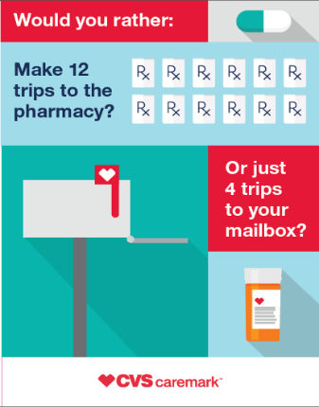
Fill 90-Day Supplies of Maintenance Medications to Save Money
You may be paying higher out-of-pocket costs for maintenance medications
When it comes to medications that are taken regularly, there are two easy ways to save time and money:
Retail-Plus pharmacies that fill 90-day supplies of maintenance drugs.
Use the Retail-Plus pharmacy locator online at http://info.caremark.com/trsactivecare.
90-day refills by Caremark’s mail-order services.
There’s no cost for shipping and Caremark will deliver anywhere you like.
Caremark will contact the doctor for a new prescription and handle all the details.
You can set up mail order by visiting Caremark.com/mailservice.
You can fill a 90-day supply through mail order, and break up your coinsurance or copay into three monthly payments. For example, you can pay $15 per month to satisfy your $45 copay for a 90-day supply of a maintenance medication when using the mail-order service.
Notes:
Save time and money with a 90-day supply – When it comes to medications that are taken regularly, there are two easy ways to save time and money:
Retail- Plus pharmacies that sell 60- to 90-day supplies of maintenance drugs.
90-day refills by Caremark’s mail-order services.
There’s no cost for shipping and Caremark will deliver anywhere you like.
Caremark will contact the doctor for a new prescription and handle all the details.
You can set up mail order by visiting Caremark.com/mailservice.

Slide 7
More Ways to Save
Use generic drugs when available.
They are the most affordable drugs and offer you the lowest copay. Use mail order or Retail-Plus to save the most money.
Use in-network freestanding medical service facilities for labs and imaging. Hospital-based labs and facilities can cost more.
Don’t confuse this with freestanding emergency rooms.
Adopt healthy habits
Do your best to eat right, exercise and get regular health screenings.
Join a Live Healthy America wellness program that is available with your TRS-ActiveCare plan.
www.trsactivecarelivehealthychallenge.com
Notes:
Use generic drugs – They are the most affordable drugs and offer you the lowest copay. Generic drugs are pharmaceutically and therapeutically equivalent to brand-name drugs.
Use freestanding medical service facilities – You can generally lower medical expenses by scheduling laboratory work, imaging and other outpatient services at freestanding medical service facilities instead of at full-service hospitals. (except in the case of freestanding emergency rooms, see below).
Adopt healthy habits – Do your best to eat right, exercise and get regular health screenings. Sign up for member newsletters or read online articles or health and fitness tips. Encourage all family members to live a healthy lifestyle, too. Check on the wellness programs that are available with your ActiveCare plan.
Join the Live Healthy Challenge! As a TRS-ActiveCare plan participant, you have the opportunity to join in and make a positive choice to live a happier and healthier life! You will be able to form a team of 2-10 people or participate as a team of 1, and you can win a prize!
Remember, you get additional savings when you use a Quest Diagnostics lab. To find them, use DocFind. Go to www.trsactivecareaetna.com and click “Find a Doctor or Facility” on the home page.
(Note to presenter: Kelsey Select participants will not use Quest for lab services. They must use Kelsey lab services. They can visit kelsey-seybold.com/trs to find providers.)

Slide 8
Know you are making the right choice
Let’s go to the TRS website, www.trs.texas.gov

