Slide 1
AHS Freshmen Presentation: Graduation Requirements & Academic Planning

Slide 3
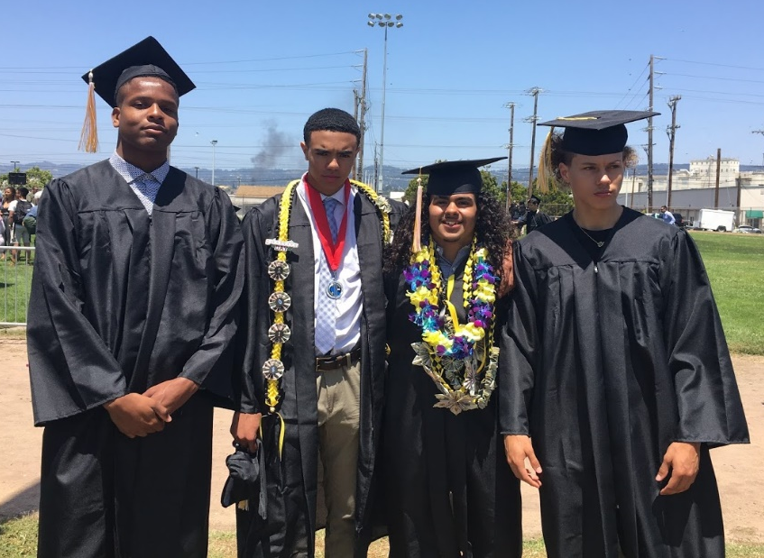
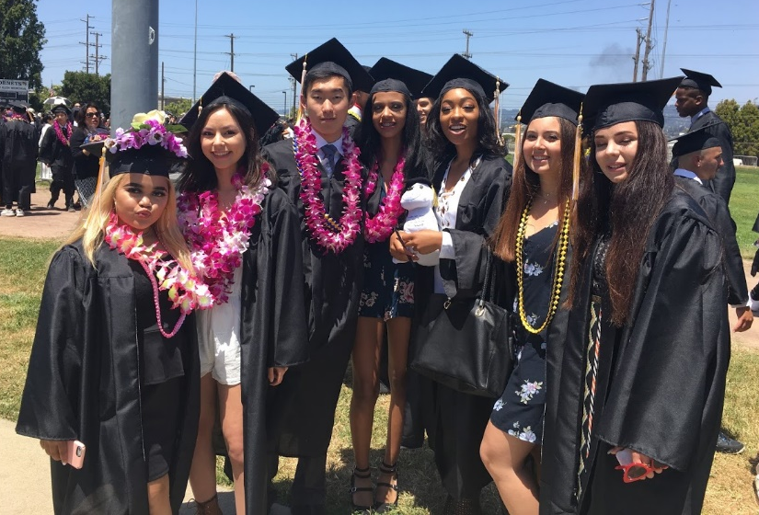
Objective
To let 9thgraders know about graduation requirements, post-secondary options and introduce 4-year Academic Plans.

Slide 4
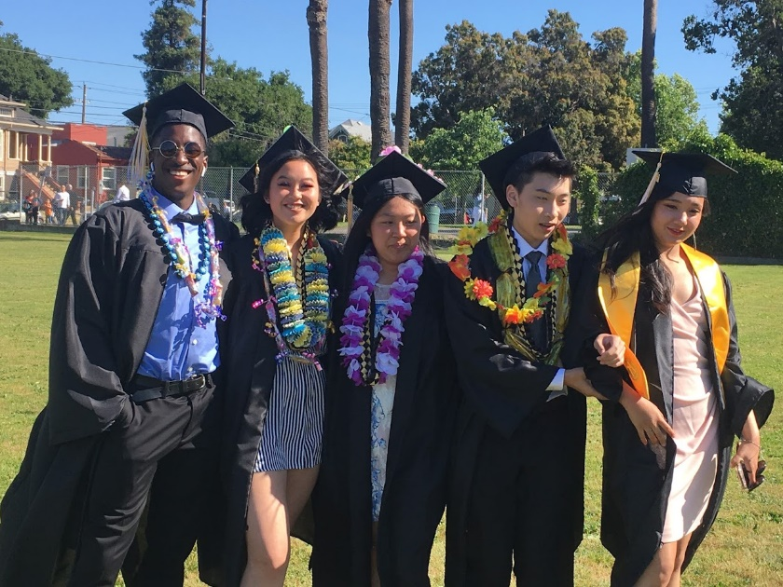
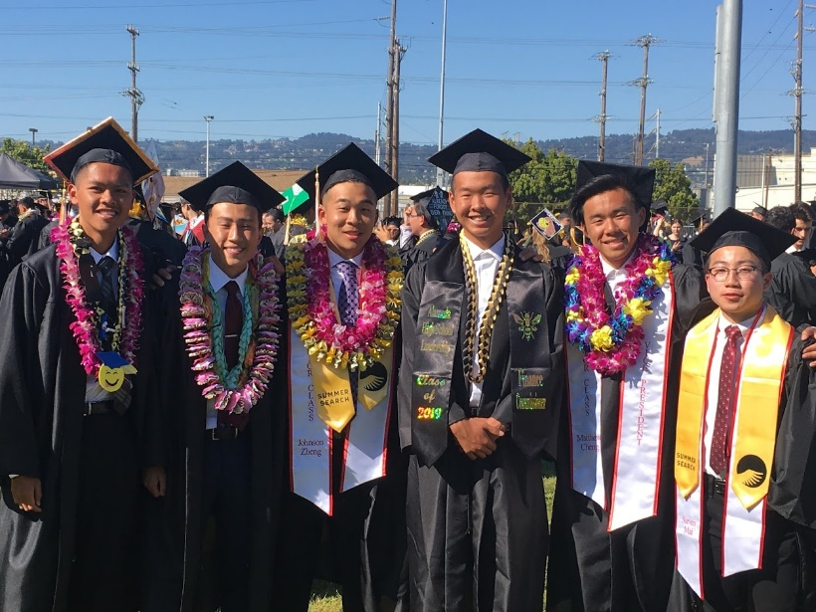
Rationale
To ensure that all freshmen understand the graduation requirements and how to prepare for four years of high school.

Slide 5
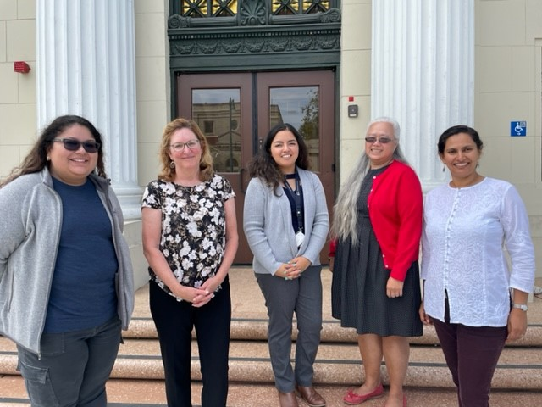
AHS School Counselors
9th Grade: Ms. Perez in Rm C125
10th – 12th Grades: Ms. D’Ambrosio, Ms. Albor, Ms. Loy, Ms. Patil in Rm C132

Slide 6
Graduation Requirements for the Class of 2026
Credit
Requirements
220
Meet
Subject
Requirements
Minimum
GPA of 1.75
20 Hours of
Community
Service

Slide 7
Credit Requirements for Graduation
English | 40 Credits |  | Navigating Life | 5 Credits
Social Studies | 30 Credits |  | Ethnic Studies | 5 Credits
Math | 20 Credits |  | Visual Perf. Art / CTE | 10 Credits
Science (Lab) 1yr Bio. Life 1 yr. Physical | 20 Credits |  | World Language / CTE | 10 Credits
Physical Education | 20 Credits |  | Electives | 60 Credits
 |  |  | Total Credits Needed | 220

Slide 8
How Are Credits Earned?
5 credits per class each semester only if you earn a passing grade of a D or higher! Credit is NOT
earned if you receive a F.
Semester 1 Semester 2
(August – December ) ( January – June )
English 5 English 5
Spanish 5 Spanish 5
Biology 5 Biology 5
Math 5 Math 5
PE 5 PE 5
Ethnic Studies 5 Navigating Life 5
________________________________________________
1st Semester = 30 2nd Semester = 30
= 60 Credits Per School Year!

Slide 9
Mock 9th Grade Transcript
 | Crs-ID | Course Title | Mark | Att/Comp
 | Grade 9 | 1st Semester
 | Alameda | High School
p | EECD | English 1P | F | 5.00 0.00
p | FSCD | Spanish 1P | B | 5.00 5.00
p | SJCI | IntroEthStud P | A | 5.00 5.00
p | MDCD | Algebra 1P | D | 5.00 5.00
* | PZGD | Phys Ed 9 | F | 5.00 0.00
p | QBCI | Biology P | D | 5.00 5.00
 | Credit Att: | 30.0 Cmp: 20.0 | TGPA: | 1.5
 | Grade 9 | 2nd Semester
 | Alameda | High School
p | EECD | English 1P | B | 5.00 5.00
p | FSCD | Spanish 1P | A | 5.00 5.00
p | DDGD | Navigating Life | A | 5.00 5.00
p | MDCD | Algebra 1P | C | 5.00 5.00
* | PZGD | Phys Ed 9 | D | 5.00 5.00
p | QBCI | Biology P | F | 5.00 0.00
 | Credit Att: | 30.0 Cmp: 25.0 | TGPA: | 2.33
 | CREDIT SUMMARY
Subject Area | Credit required | Comp | Needed
Navigating Life | 5.00 | 5.00 | 0.00
English | 40.00 | 5.00 | 35.00
Visual/PerfArt/CTE | 10.00 | 0.00 | 10.00
World Lang/CTE | 10.00 | 10.00 | 0.00
HS Algebra | 10.00 | 10.00 | 0.00
Mathematics | 10.00 | 0.00 | 10.00
Life Science | 10.00 | 5.00 | 5.00
Physical Science | 10.00 | 0.00 | 0.00
World History | 10.00 | 0.00 | 0.00
US History | 10.00 | 0.00 | 0.00
Government | 5.00 | 0.00 | 0.00
Economics | 5.00 | 0.00 | 0.00
Physical Education | 20.00 | 5.00 | 15.00
Ethnic Studies | 5.00 | 5.00 | 0.00
Electives | 60.00 | 0.00 | 60.00
*TOTALS* | 220.00 | 45.00 | 175.00
 | Weighted | Non-Wgtd
Acad GPA (9-12) | 2.20 | 2.20
Acad GPA (10-12) | 0.00 | 0.00
Total GPA (9-12) | 1.91 | 1.91

Slide 10
Post Secondary Plans
4-year college
Community college options:
- Transfer to a 4-year college
- Complete an Associates degree in a Vocational program to prepare for the world of work.
Military
Apprenticeship programs
Employment

Slide 11
History
2 years
B) English
4 Years
G) College Prep Elective
1 Year
F) Visual/ Performing Art
1 Year
UC/CSU
A-G
Minimum Course Requirements
Grades of C or better required.
C) Math
3 Years
(Alg.1, Geom., Alg. 2)
4 Recommended
E) Foreign Language
2 Years
3 Recommended
D) Science
2 Years Lab Science
3 Recommended

Slide 13
Academic 4-year Planning

Slide 14
Planning
It is important to be Prepared.
All students will create an Academic Plan in Aeries to help them map out their High School journey and prepare for their post-secondary goals.
Once created, students will have the opportunity to update their plan each year during Course Selection.

Slide 15
Developing your 4-year Plan
Students need to make sure that they take the classes required for graduation.
Students need to make sure they are meeting all the requirements necessary for their post-high school goals (e.g. meeting the A-G requirements for college admissions).
AP/honors classes are advanced classes. Before signing up for an advanced class, make sure you understand the rigor and commitment you are making by choosing it. Students can take a maximum of 4 AP/honors classes each year.
Students are allowed to take only 1 math class and 1 science class each year.

Slide 16
Math Sequence
Students must select the correct math course in sequence
Class Completed Enroll in: Next Class
Algebra 1 (passed with a grade of C or higher)
Geometry (required for 4-year college admissions)
Algebra 2 or Advanced Algebra 2 (fast paced class recommended for strong math students who received B’s or higher in both Algebra 1 and Geometry)
(Either class required for 4-year college admission)
Geometry (passed with a grade of C or higher)
Precalculus or Honors Precalculus (rec. for students who received a C or higher in Advanced Algebra 2)
or
Statistics (11th-12th grade only)
Algebra 2 or Adv. Algebra 2 (passed with a grade of C or higher)
Precalculus or PreCalculus HP or Statistics (passed with a grade of C or higher)
Calculus, AP Calculus AB, AP Statistics (11th-12th grade only) or AP Calculus BC upon completion of AP Calculus AB. See Course Catalog for prerequisite details

Slide 17
PE Requirement
Two years of PE are required for graduation.
Options for the 2nd year of PE: PE, Dance, Jujitsu
Students are encouraged to take their 2nd year of PE as sophomores
A student may qualify for a PE Exemption for the 2nd year of PE based on successful participation on school sports teams.
Completion of two seasons on a school athletic team will exemption one year of PE. One season will exempt one semester of PE.
.

Slide 18
Course Catalog
Refer to the AHS Course Catalog for details and questions about classes.
The Catalog is available on the website under “Students”.
.

Slide 19
Sophomore Course Requirements
Sophomores are required to take 6 classes.
English 2
World History– Choose between MW History P or AP World History
Math
PE or Elective
Science or Elective
Foreign Language or Elective

Slide 20
Junior Course Requirements
Juniors are required to take 6 classes.
English 3 – Choose between English 3 P and AP English 3
US History– Choose between US History P or AP US History
Math or Elective
Science or Elective
Elective
Elective

Slide 21
Senior Course Requirements
Seniors are required to take a minimum of 5 classes. Students may only have a free period if they will have a minimum of 180 by the end of your junior year.
English: Choose between English 4 P & AP English 4
Government (semester) + Economics (semester) or AP Government (year) + Economics (semester) * note if you choose AP Government, the semester of Economics may be 0 period.
Elective
Elective
Elective
Elective or free period

Slide 22
Reminders
Hornet Pride!
Create your Academic Plan with care. Make sure you have chosen classes that will meet your requirements for graduation and your post-secondary plans.
Aim for a balanced 4-year plan where you meet all requirements plus have time to enjoy your non-academic related interests.
Make sure you have met all prerequisites as listed in the Catalog.
Make sure you understand what category each of your classes is counting for towards graduation purposes as listed in the Catalog.
The Plan you are creating is a plan. Adding a class to your Plan does not guarantee that you will get into that class in the future.

Slide 23
Creating your own 4-year Plan
Step 1.
Complete your 4-year plan worksheet

Slide 25
Creating your own 4-year Plan
Step 2.
In Aeries, go to Classes and select Academic Plan
Your 9th grade classes are already entered so you just need to plan for 10-12th grades.

Slide 26
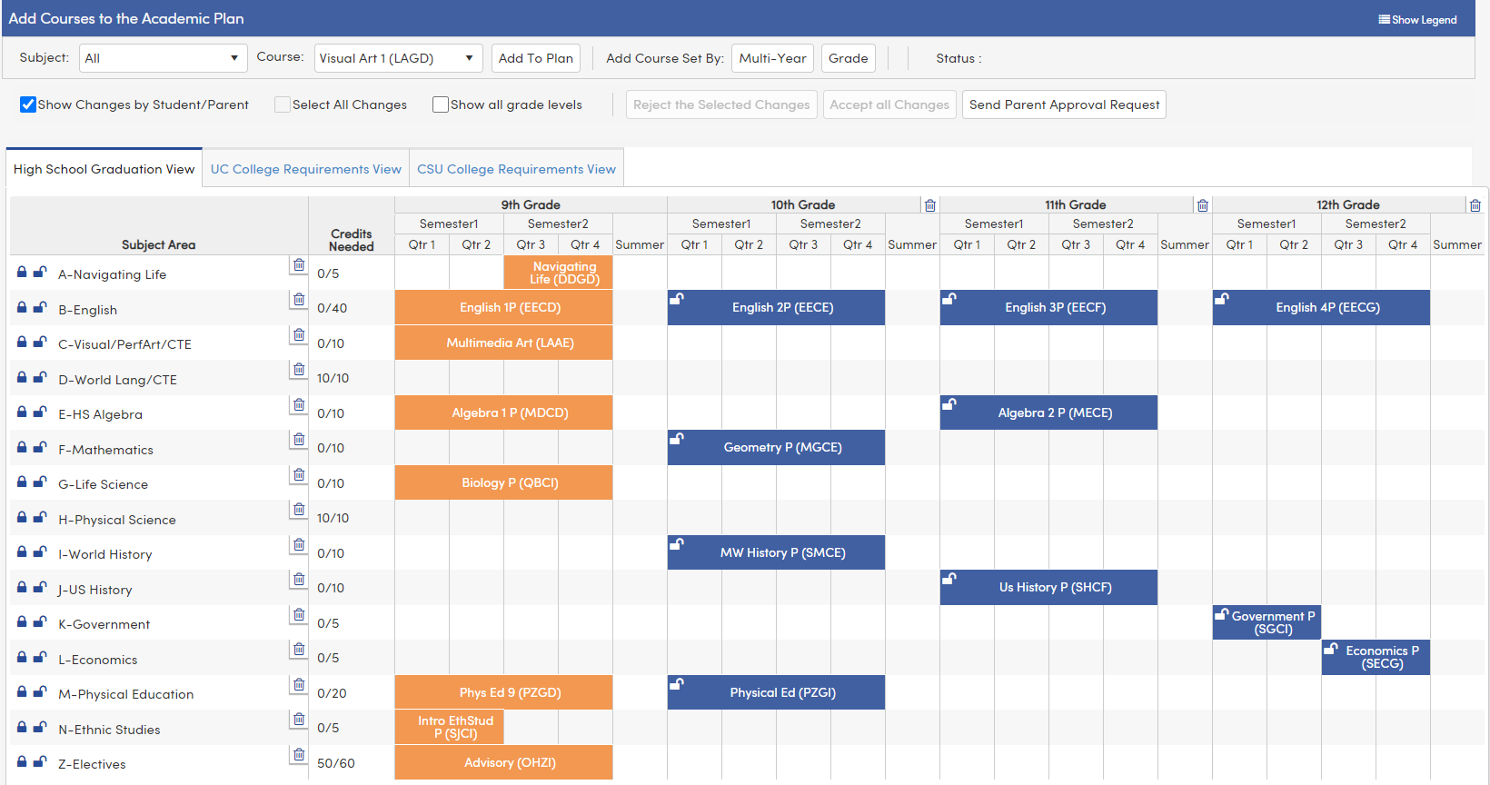
Academic Plan in Aeries
Notes:
Green= classes completed
Orange = classes currently enrolled
Blue = planned classes
Some classes needed for graduation have been prepopulated. Students can change those.
Point out the graduation requirement tracker

Slide 27
How to Add a Class
1. Type in the code for the class you would like to add.
Select the class.
Click on the “Add to Plan” button
1.
3.
2.

Slide 28
1. After you choose “add” you get this screen
2. Choose what grade level you want to take the class.
3. Choose “Year Long” for the term
Do NOT Choose Summer for the Term!

Slide 29
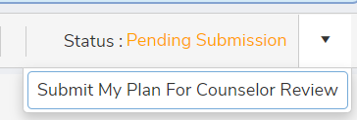
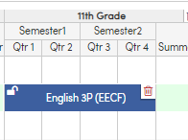
4. Select “Place the Course.
5. Continue adding classes until you have entered all of your selections for each grade level.
6. When you are done, Submit your Plan.
7. If you make a mistake or want to change a class that has been pre-populated, use the trashcan to delete the class.

Slide 30
Reminder: Do NOT choose SUMMER for the term!
Summer Term

Slide 31
Creating your own 4-year Plan
Follow the printed instructions if you need more detailed support.
Your 4-year plan must be in entered in Aeries by January 23.
You will have the opportunity to update your 4-year plan again during Course Selection.

Slide 32
Grade Level Requirements
 | 9th | 10th | 11th | 12th
English | English 1 | English 2 | English 3 | English 4
Math | X | X
Science | Biology
Social Studies |  | World History | US History | Government & Economics
PE | X
Navigating Life | X
Ethnic Studies | X
VPA/CTE
WL/CTE
Electives

Slide 33
Math Sequence
Students must select the correct math course in sequence
9th Grade Class Completed Enroll in: 10th Grade Class
Algebra 1 (passed with a grade of C or higher)
Geometry (required for 4-year college admissions)
Algebra 2
or
Advanced Algebra 2 (fast paced class recommended for strong math students who received B’s or higher in both Algebra 1 and Geometry)
(Either class required for 4-year college admission)
Geometry (passed with a grade of C or higher)
Algebra 2 or Adv. Algebra 2 (passed with a grade of C or higher)
Precalculus or Honors Precalculus (rec. for students who received a C or higher in Advanced Algebra 2)
or
Statistics

