Slide 1
Academic Plans
How to Enter Selections into Aeries

Slide 2
Planning
It is important to be Prepared.
All AHS students will create an Academic Plan in Aeries to help them map out their High School journey and prepare for their post-secondary goals.
Once created, students will have the opportunity to update their plan each year during Course Selection.

Slide 3
Creating your Aeries Academic Plan
Step 1.
Review the appropriate grade level presentations to ensure you are familiar with requirements.
Complete your 4-year plan worksheet to help focus your course decision making.
Review the AHS Catalog for course information.

Slide 4
Creating your Aeries Academic Plan
Step 2.
In Aeries, go to Classes and select Academic Plan
The next slide shows what you will see. Classes you have already completed are in green. Classes you are currently taking are orange. Some classes like English and social studies are pre-populated in blue. Your selections will be teal.
You will need to add in class selections for all future grade levels.

Slide 5
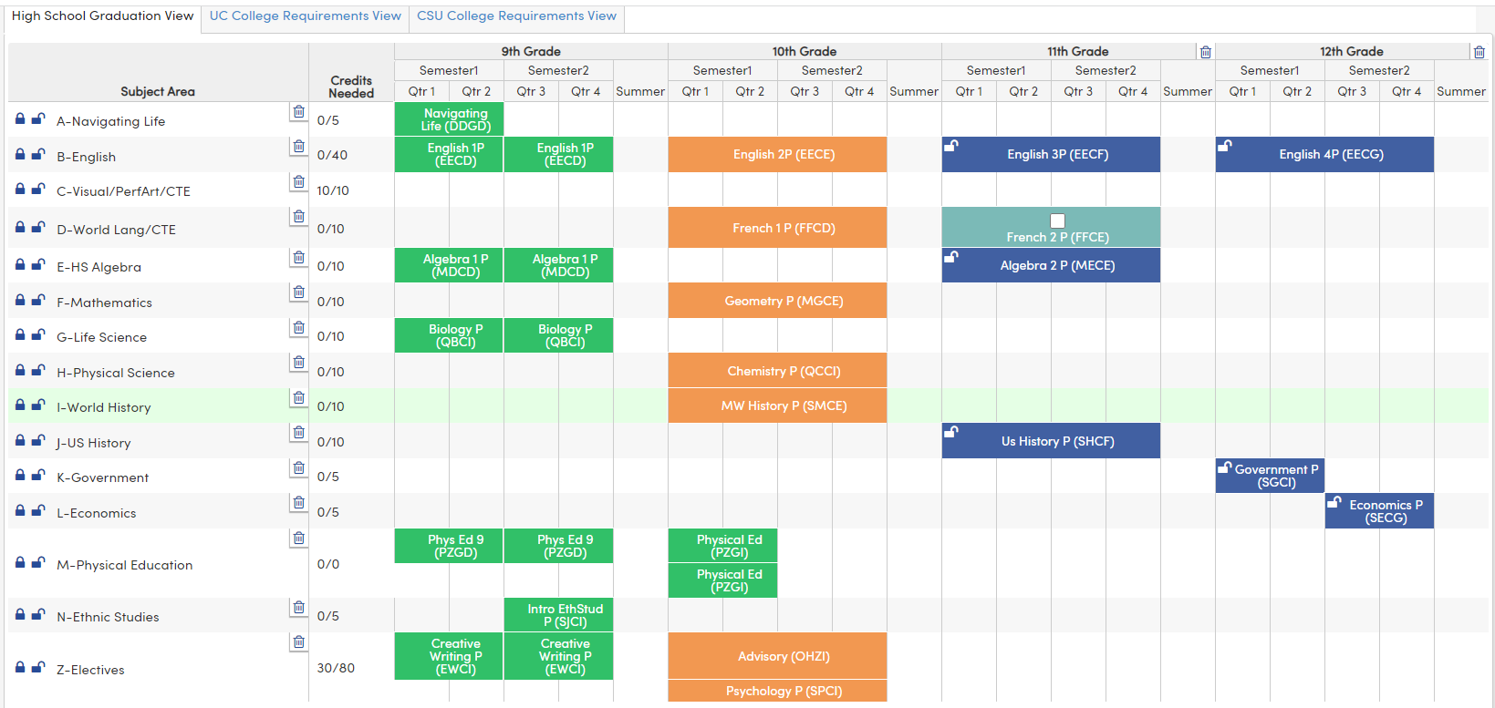
Academic Plan in Aeries
Notes:
Green= classes completed
Orange = classes currently enrolled
Blue = planned classes
Some classes needed for graduation have been prepopulated. Students can change those.
Point out the graduation requirement tracker

Slide 6
How to Add a Class
1.
3.
1. Type in the code or name for the class you would like to add.
Select the class.
Click on the “Add to Plan” button
2.

Slide 7
4. After you choose “add” you get this screen
5. Choose which grade level you want to take the class.
6. Choose “Year Long” for the term
Do NOT Choose Summer for the Term!

Slide 8
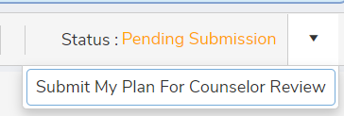
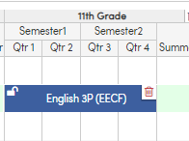
7. Select “Place the Course.
8. Continue adding classes until you have entered all of your selections for each grade level.
9. When you are done, Submit your Plan.
10. If you make a mistake or want to change a class that has been pre-populated, use the trashcan to delete the class.

Slide 9
Reminder: Do NOT choose SUMMER for the term!
Summer Term

Slide 10
Creating your Aeries Academic Plan
Follow the printed instructions if you need more detailed help. Available on the website.
Academic Plan can only be created from Student Aeries Accounts.
Students will only be able to make changes to their Academic plans during open Academic Plan windows.

