Slide 1
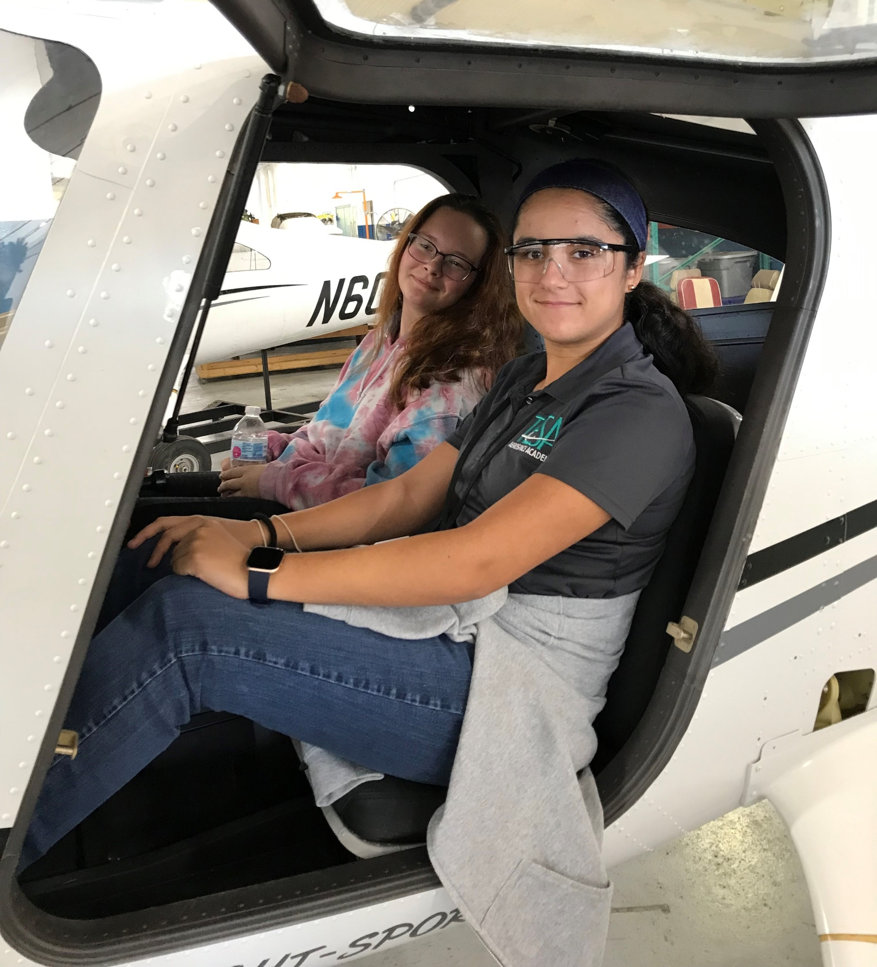
EST. 2015
Technology, Engineering, Science & Aeronautics
For More information,
Please:

Slide 2
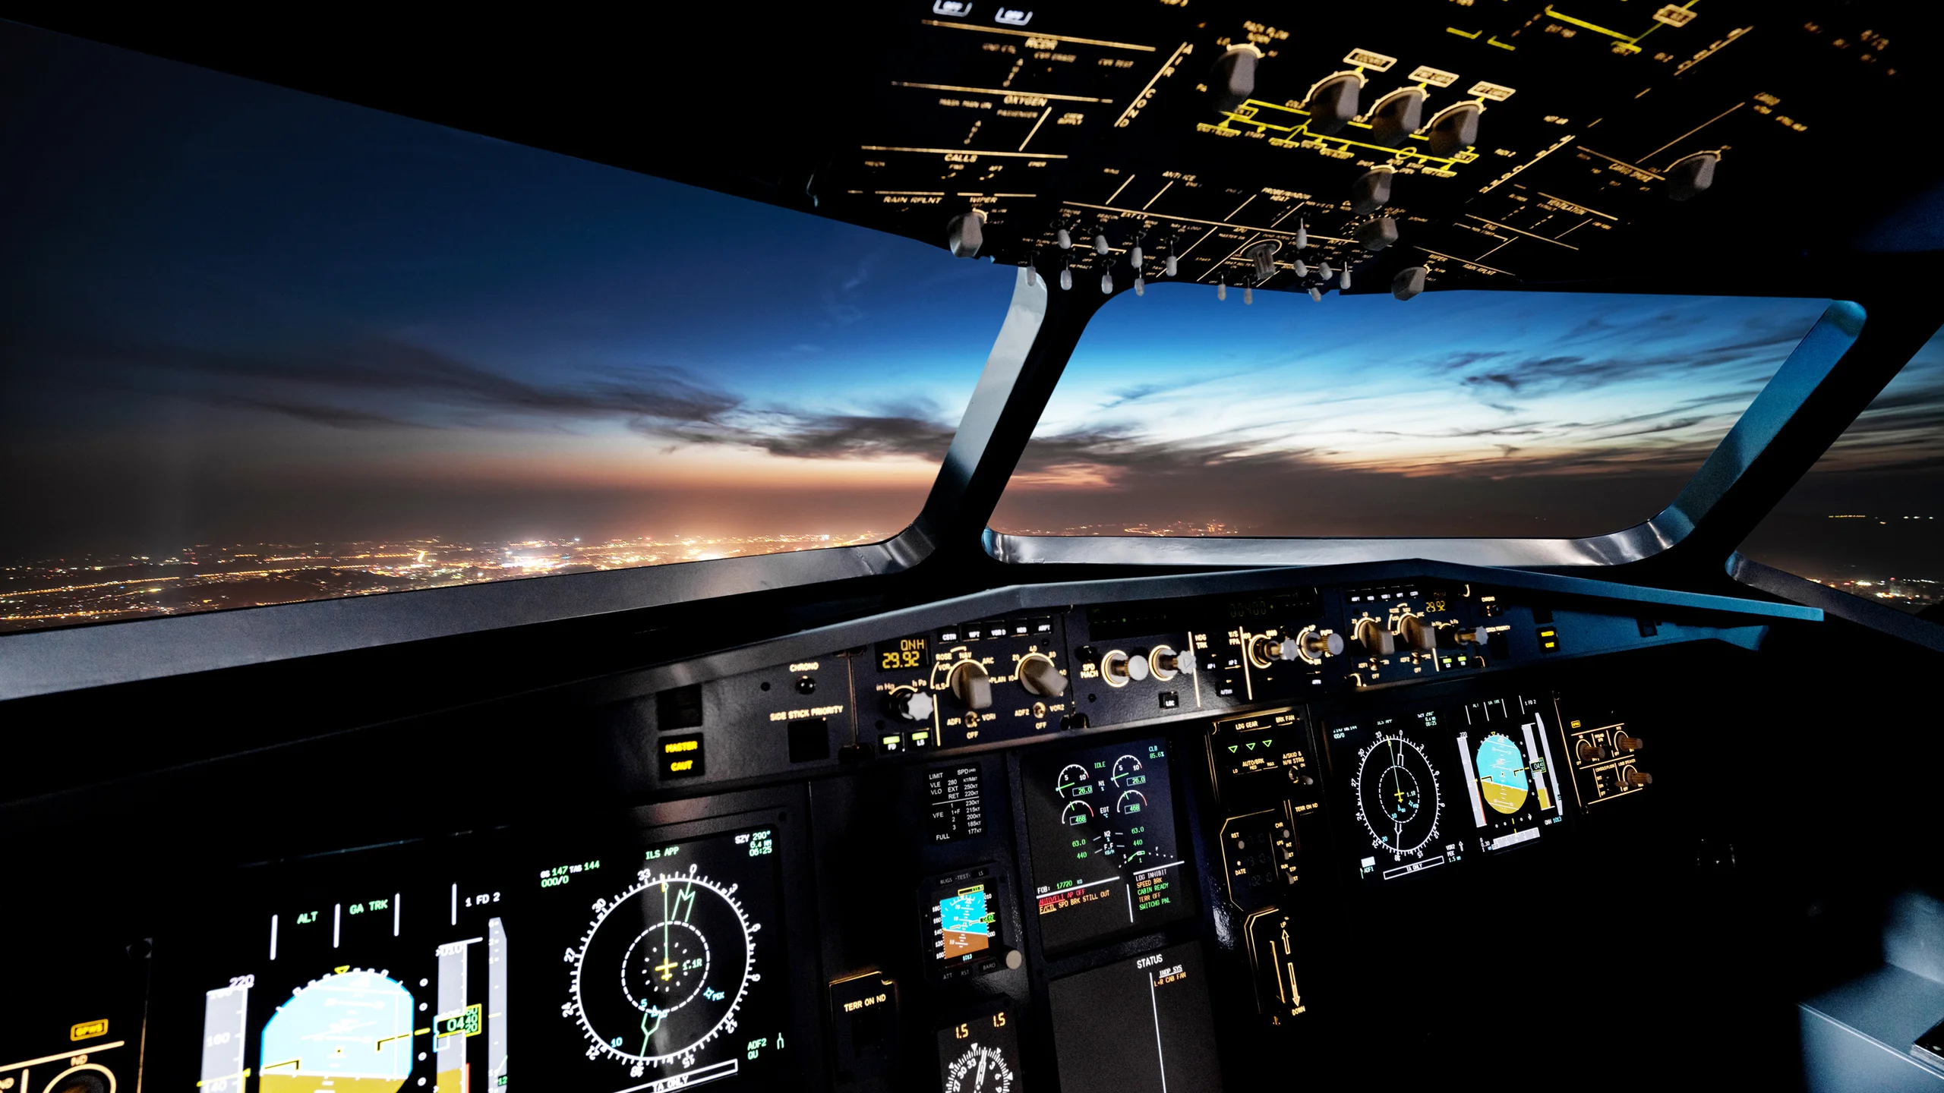
Instructors
Amanda Silva – High School Science Instructor, Navy Veteran
Aerospace Technologies 1 & 2
Charles Ellis – ERAU Adjunct Professor, Pilot/Flight Instructor, Navy Veteran
Private Pilot Ground Operations
5 credits with ERAU
Charles Smith – ERAU Adjunct Professor
Unmanned Aircraft Systems, UAS Operations
3 credits each semester with ERAU

Slide 3
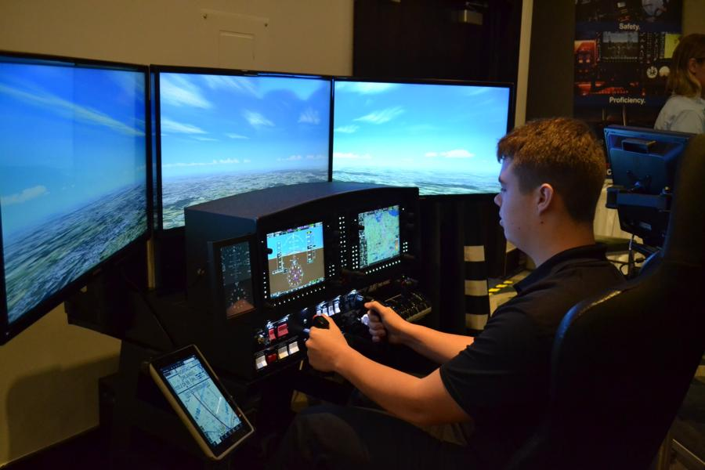
Course Sequence
9th Grade – Aerospace Technology 1
10th Grade – Aerospace Technology 2
11th Grade – Private Pilot Operations
12th Grade – Unmanned Aircraft Systems; Unmanned Operations
*course sequence is always subject to change

Slide 4
Academy Highlights
Only Aeronautics-based academy in Volusia
Certified Gold Level Career Academy
Embry-Riddle Dual Enrollment Courses (Total of 11 credits)
Flight Simulators
Field Studies: EPIC Flight Academy, Fun & Sun Air Show, Daytona International Airport, NASA Kennedy Space Center etc.
Industry Certifications:
FAA Private Pilot, USI Safety Certification, UAS Remote Pilot
Yearly participation in NASA Astronaut Challenge, Drone Competition, Sun N Fun Air Show, etc…

Slide 5
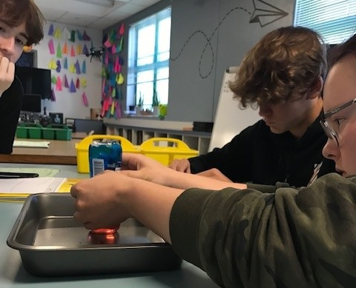
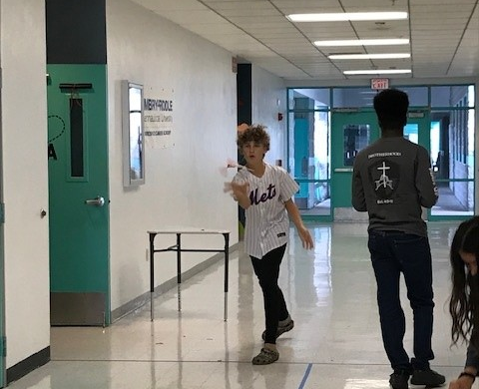
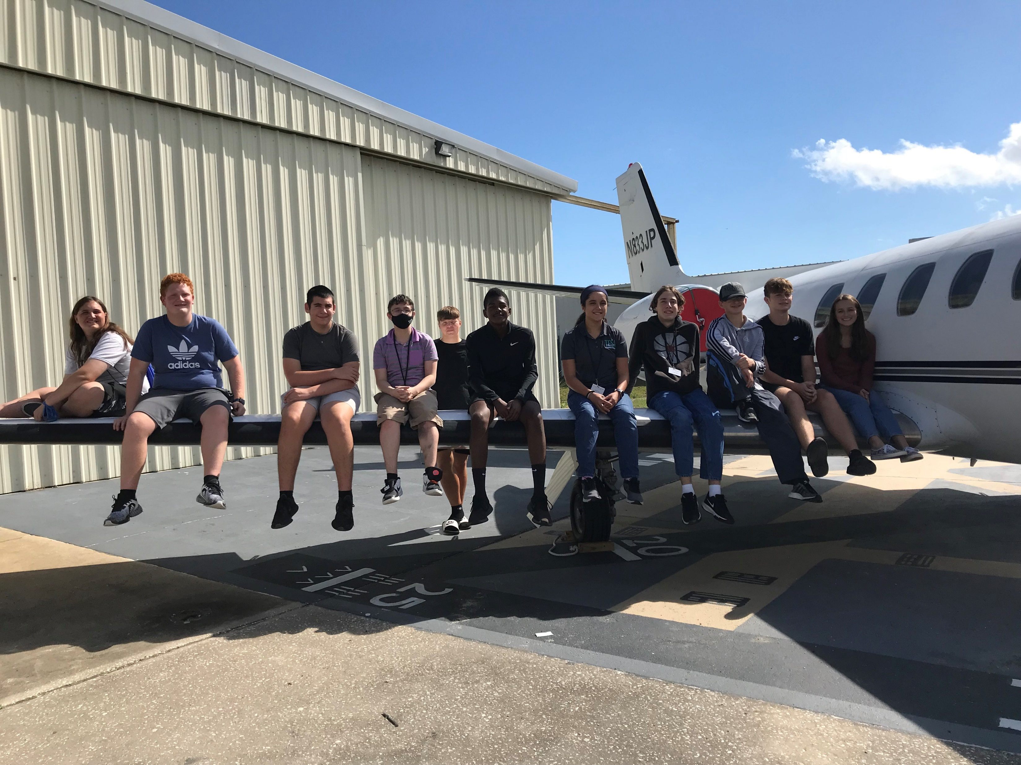
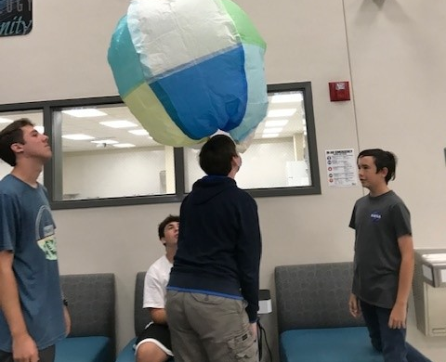
TESA Academy
“Until you spread your wings, you have no idea how far you’ll fly.”

