Slide 1
Dual Credit
Joliet Township High School:
2023 – 2024 School year

Slide 2
Welcome to Dual Credit
As a Dual Credit student, you will have the opportunity to experience life as a college student while still in high school. However, this also means you now have the responsibilities that are part of college life.
This presentation is designed to help familiarize you with the Dual Credit program at JTHS, your responsibilities as a student, and the resources available to help ensure your academic success.

Slide 3
What is Dual Credit?
The Dual Credit program is a partnership between JTHS and JJC, USF, and other programs. Juniors and senior high school students earn both high school and college credit upon successful completion of Dual Credit courses.
Note: Sophomores are now able to earn dual credit in Honors Pre-Calculus/Math 142
if all prerequisites and requirements are met. See JTHS Dual Credit Website for more
information.
Notes:
JTHS is proud to partner with JJC, USF and other community partners to bring these offerings to our studnets and families.
Dual credit programs target juniors and seniors with early college credit opportunities.
After successful completion of these classes, students will earn graduation credit towards their high school transcript
& credit at their university, college, or trade school.

Slide 4
Benefits of Dual credit
Earn College Credit Prior to High School Graduation
Reduces overall college costs
Students are considered JJC students and therefore granted access to JJC resources and activities on campus.
Students can take dual credit courses as part of the regular school day.
Dual credit courses help prepare students for the transition to college by engaging them in college-level work.
Note: There is a $50 cost for each Non-CTE dual credit course at JJC which may be paid online through JJC’s Dual Credit website.

Slide 5
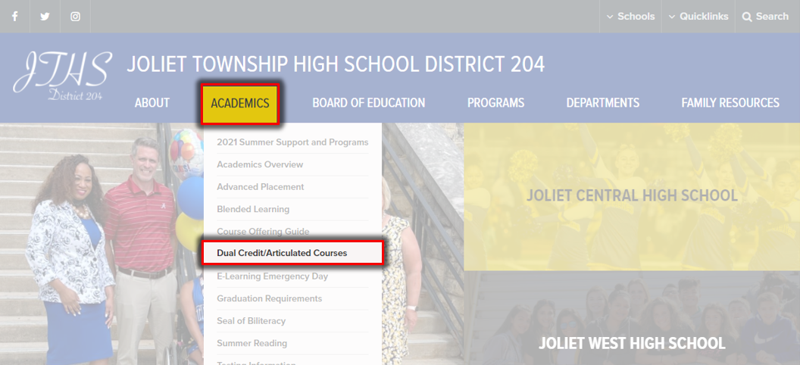
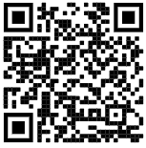
Website: jths.org/academics/dual-credtiarticulated-courses
Scan Me

Slide 6
English & MAth: Dual Credit Registration
Students registering for Dual Credit must register at JJC before they are enrolled in the course at JTHS. Their JJC ID number must be included on JTHS forms.
Students do not need to have a qualifying score (SAT, ACT, ALEKS, Accuplacer) before enrolling in Dual Credit; however, placement scores must be met prior to the end of the current school year.

Slide 7
Senior Year English: Dual Credit English 101
ACCUPLACER | ACCUPLACER
READING | 246-300
WRITING | 5-8
ACT
English | 19 or higher
PSAT10/SAT
Evidence-Based Reading and Writing | 480 or higher

Slide 8
Math Dual Enrollment Opportunities 2023-2024 School Year
AP Statistics/Math 128
Honors Pre-Calculus/Math 142
AP Calculus/Math 170
Registration Steps:
1. Complete JTHS Dual Credit Approval Form by April 15th.
2. Complete JJC Dual Credit Online Application; you will need your Social Security number as a part of the application.
3. 24-48 hours after completing JJC Dual Credit Online Application, retrieve your JJC ID# and JJC email address: LINK
4. Sign up to take the ALEKS Math test and remediate as needed to earn a qualifying score: LINK
Note: There is a $50 cost for each Non-CTE dual credit course at JJC which may be paid online
Through JJC's Dual Credit website.

Slide 9
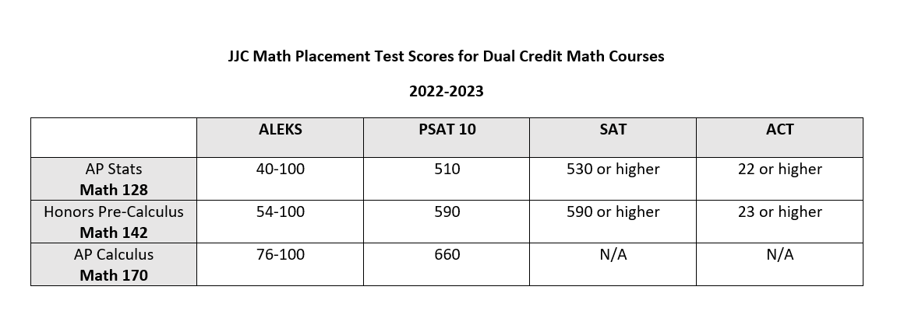
Math: Dual-Credit
Note:
All students enrolled in dual credit math courses are required to take the ALEKS placement test. Students will have multiple opportunities to improve their ALEKS score. (A qualifying score must be submitted to counselor prior to the end of the current school year for enrollment in the course the following school year )
Must have successful completion of Geometry ("C" or better) for both semesters.
For more information on JJC Placement Testing or to sign up to take the ALEKS Math test, Click Here

Slide 10
Career and Technical Education Dual Credit Opportunities
Consumer Economics JJC FIN 100 One Semester Class, Also Counts for Consumer Ed Graduation requirement
Culinary Arts 1 JJC CA106 Must earn “Managers Certification” & “Allergen Certification” during class.
Early Childhood Education JJC CDEV 137
Exploring the Teaching Profession USF EDUC 107
Engineering & Architecture 1, 2, 3 JJC CADD 101
Vocational Auto Mechanics 1 JJC AS 106
CTE Teachers will enroll students once class begins
No Cost to Students
Notes:
JTHS Robust career and technical programs offer a variety of dual credits
Student merely need to enroll in the program. Their teacher will walk them through the college/university enrollment process during class for their dual credit institution.
Uppon successful completion studnets will get that graduation credit on their transcript as well as credit at their college or university
An important note is no tuition cost, these programs are free.

Slide 11
Career and Technical Education Dual Enrollment Programs
Seniors ONLY
Senior Year & 16 Years of Age
Off-site class/training
Reliable Transportation required NOT provided by JTHS
Applications required Exception: Cosmetology
Multiple Classes or Parts
Full Year program Exception: NA101 is 1 Semester
College Expectations
No tuition cost for students Exception: Cosmetology
Additional expectations vary per program
Including but not limited to; uniforms, background check, Saturday trainings, blended/remote class, clinical experience, COVID-19 Vaccination

Slide 12
Career and Technical Education Dual Enrollment Programs
Advanced Integrated Maintenance (AIM)
Industrial Controls I - Analog 4 Credits
Industrial Maintenance Fundamentals 3 Credits
​Basic Wiring and Circuit Design 4 Credits
Industrial Fluid Power 3 Credits
NA 101 Certified Nurse Assistant
6 Credits
Night or Weekend course
Includes a work based clinical Experience
Fire Science and Emergency Services
Introduction to Public Safety Careers 3 Credits
Principles of Emergency Services 3 Credits
First Responder 4 Credits
Architecture, Construction Management, Engineering (ACE)
Intro to Architecture Profession 2 Credits
Blueprint Reading 3 Credits
​Intro to Construction Management 2 Credits
Intro to Sustainability 2 Credits
Intro to Engineering 2 Credits
Law Enforcement
Introduction to Public Safety Careers 3 Credits
Intro to Law Enforcement 3 Credits
First Responder 4 Credits
Cosmetology
Professional’s Choice Hair Design Academy
Taught on JJC’s Campus

Slide 13
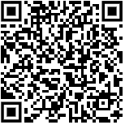
Career and Technical Education Dual Enrollment Programs
Seniors ONLY
Certified Nursing Assistant One Semester Class with Clinical Experience
Fire Science & Emergency Medical Services
Law Enforcement
Advanced Integrated Maintenance (AIM)
Architecture, Construction Management, Engineering (ACE)
Student & Parent meeting prior to class beginning to communicate details
Apply Here
Due Feb 1

Slide 14
Career and Technical Education Dual Enrollment Programs
Seniors ONLY
Cosmetology Program
Professional’s Choice Hair Design Academy
Tuition covered by student/families
Talk to your counselor for additional details

Slide 15
Science Dual Enrollment Opportunities 2023-2024 School Year
Biology 151/152
HS chemistry
Placement into English 101
PSAT 10 ERW score of 480
Placement into Math 098
PSAT 10 Math 460
Chemistry 101/102
C or better in Geometry
HS chemistry
Placement into English 101
PSAT 10 ERW score of 480
Placement into Math 140
PSAT 10 Math score 590
Registration Steps:
Complete Approval Form located on JTHS website.
Apply to JJC online.
Class registration form will be provided as long as student meets requirements of course.
* Cost of tuition and textbooks, as well as transportation, is the responsibility of the student and family. Approximate cost for BIO 151/152 and CHEM 101/102 is $850 per semester.

Slide 16
Dual Credit Options for 2023-2024
Applied Life
KIN 207 First Aid
KIN 200 Personal Trainer
Mathematics
AP Statistics
Pre-Calculus and Trigonometry Honors
AP Calculus AB
Science
Biology 151/152
Chemistry 101/102
English
Rhetoric 101/102
Taught on JJC’s Campus

