Slide 1
Bookworms Reading Program
Written/researched by Dr. Michael McKenna and Sharon Walpole from 2011 through 2017
Based on use of complete books instead of excerpts; paced to match State Standards; free lesson plans & manuals
Features evidence-based routines to build Foundational Skills, Fluency, Comprehension, Knowledge.
Consists of three segments: Shared Reading, English Language Arts (Interactive Reading), Differentiated Instruction
Three 45 minute segments complete Bookworms Reading Block

Slide 2
Shared Reading – 45 minutes
Students Share Written Responses from Previous Day
Teacher leads Word Studies daily
Students given Purposes for Reading set by Teacher daily
Choral or Echo Reading with Whole group/Partners daily
Comprehension Discussion-Whole Group daily
Update Anchor Chart(s) daily
Written Response to Earlier Reading by Students daily-Individual Work

Slide 3
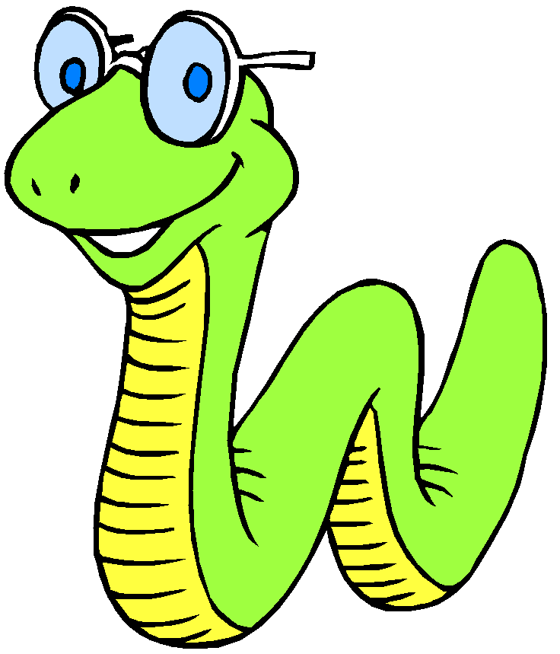
English Language Arts Instruction - 45 minutes
Read Aloud by Teacher of Above Grade Level Book with Oral Comprehension Questions for Students
Summary of Daily Reading
Student Sentence Composing
Written Responses
Teacher-Directed Sentence Writing
Teacher Directed Writing Instruction (Opinion, Narrative, Informational)
Sharing of Student Writing
Grammar Studies

Slide 4
Differentiated Instruction – 45 Minutes
Students work in small groups with teacher
Small Groups rotate through 3 Stations to complete following Work:
1st Group Work – Works with Teacher on Phonics & Reading Skills
2nd Group Work – Students complete Word Study work & Written Responses
3rd Group Work - Self-Selected Reading/Additional Writing Activities/Grammar Skills Work

Slide 5
Bookworms Videos
To better understand how this program is taught in classrooms, click the links below to watch videos of real classes and teachers using the components of the Bookworms Program.
Small Group Vocabulary & Comprehension: https://www.youtube.com/watch?v=B-bpLp7ybrE
Consonant-Vowel-e: https://www.youtube.com/watch?v=wyXqUOmq3XU
Fluency and Comprehension: https://www.youtube.com/watch?v=PcS2fFNDJsk
Blends & Digraphs: https://www.youtube.com/watch?v=SxeZlSHlXcg
Using Letter Sounds: https://www.youtube.com/watch?v=oreavHs5nDM
r-Controlled Vowels: https://www.youtube.com/watch?v=v54_4Lhp6TA
Dictated Sentences: https://www.youtube.com/watch?v=dGMx1yT1XX8
Using Letter Sound 2: https://www.youtube.com/watch?v=GFBnHsXJYv8

Slide 6
For questions or more information on our Bookworms Instructional Resource, please contact:
Teressa Kimbrell,
FDES Parent Engagement Coordinator, at
Teressa.Kimbrell@appling.k12.ga.us
or
FDES: 912-367-3250

