Slide 1
Advanced Placement at LWHS
Potential Courses Offered at LWHS
2023/2024

Slide 2
I. College freshman level course:
Advanced Placement (AP) Overview
What is AP?
Curriculum defined by CollegeBoard
Often a faster pace
Quality of work expected
II. Set national curriculum
Not an honors course—this is college-level work
$99, $145 for Research & Seminar
What to expect?
Greater workload:
Homework | Average of one hour a night
Higher levels of thinking; strong reading comprehension
Mastery of material | Long term retention with little review
Independent learning
Time management challenges:
More time out of class needed to achieve
Maintain great attendance

Slide 3
College Admissions:
Why Take AP: The 3 C’s
Opportunity to stand out in the college admissions process
Opportunity to gain college-level skills
Opportunity to gain self confidence that will better ensure college success
College Prep For All Subjects:
More rigorous course work | Prepared for what college will be like
Develop the study habits, persistence, and resilience needed for tackling rigorous coursework
Larger sense of accomplishment | Confidence comes from meeting challenges
College Credit:
May be possible to earn college credit (save $$$) or advanced standing by scoring well on the AP Exam

Slide 4
Considerations
Don’t take AP courses simply because they look good on a transcript: Students must be committed to the depth of learning for the entire year
If students drop an AP course after the drop period either semester, a “W” will be placed on their high school transcript
For second semester drops, counselors are required to notify colleges (for seniors)
As in life, each student needs to seek his/her own balance
It is critical to evaluate time commitments and priorities
Some students may experience elevated stress/anxiety due to increased depth, rigor, and pace of the work
Students should be prepared for a possible grade dip

Slide 5
Questions?
Supporting last names:
A- Coo Lenore Gallucci lgallucci@lwsd.org
Cop- Faq– Phil Magnenat pmagnenat@lwsd.org
Far-Hak Margaret Campbell mcampbell@lwsd.org
Hal-Ld – Cameron McGinnis cmcginnis@lwsd.org
Le-Ok – Kaitlyn Bradley
kbradley@lwsd.org
Ol-Si - Wendi Thomas wthomas@lwsd.org
Sj-Z - Perry Sampley psampley@lwsd.org
Students should:
Read the course catalog
Speak to current teachers of the AP courses they are interested in taking
Check out AP policies on several college websites
Evaluate outside of school commitments
Complete the 4-year planner

Slide 6
Potential AP Offerings at LWHS *Actual offering is based on the number of registered students, availability and interest of instructor, and logistical ability to schedule the course for the upcoming year.

Slide 7
AP – Fine Arts

Slide 8
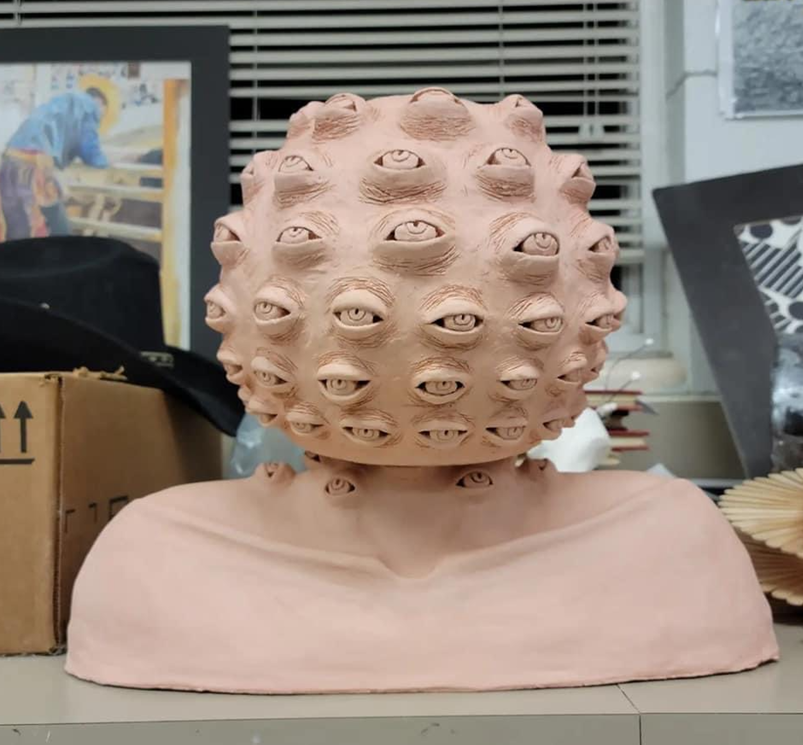
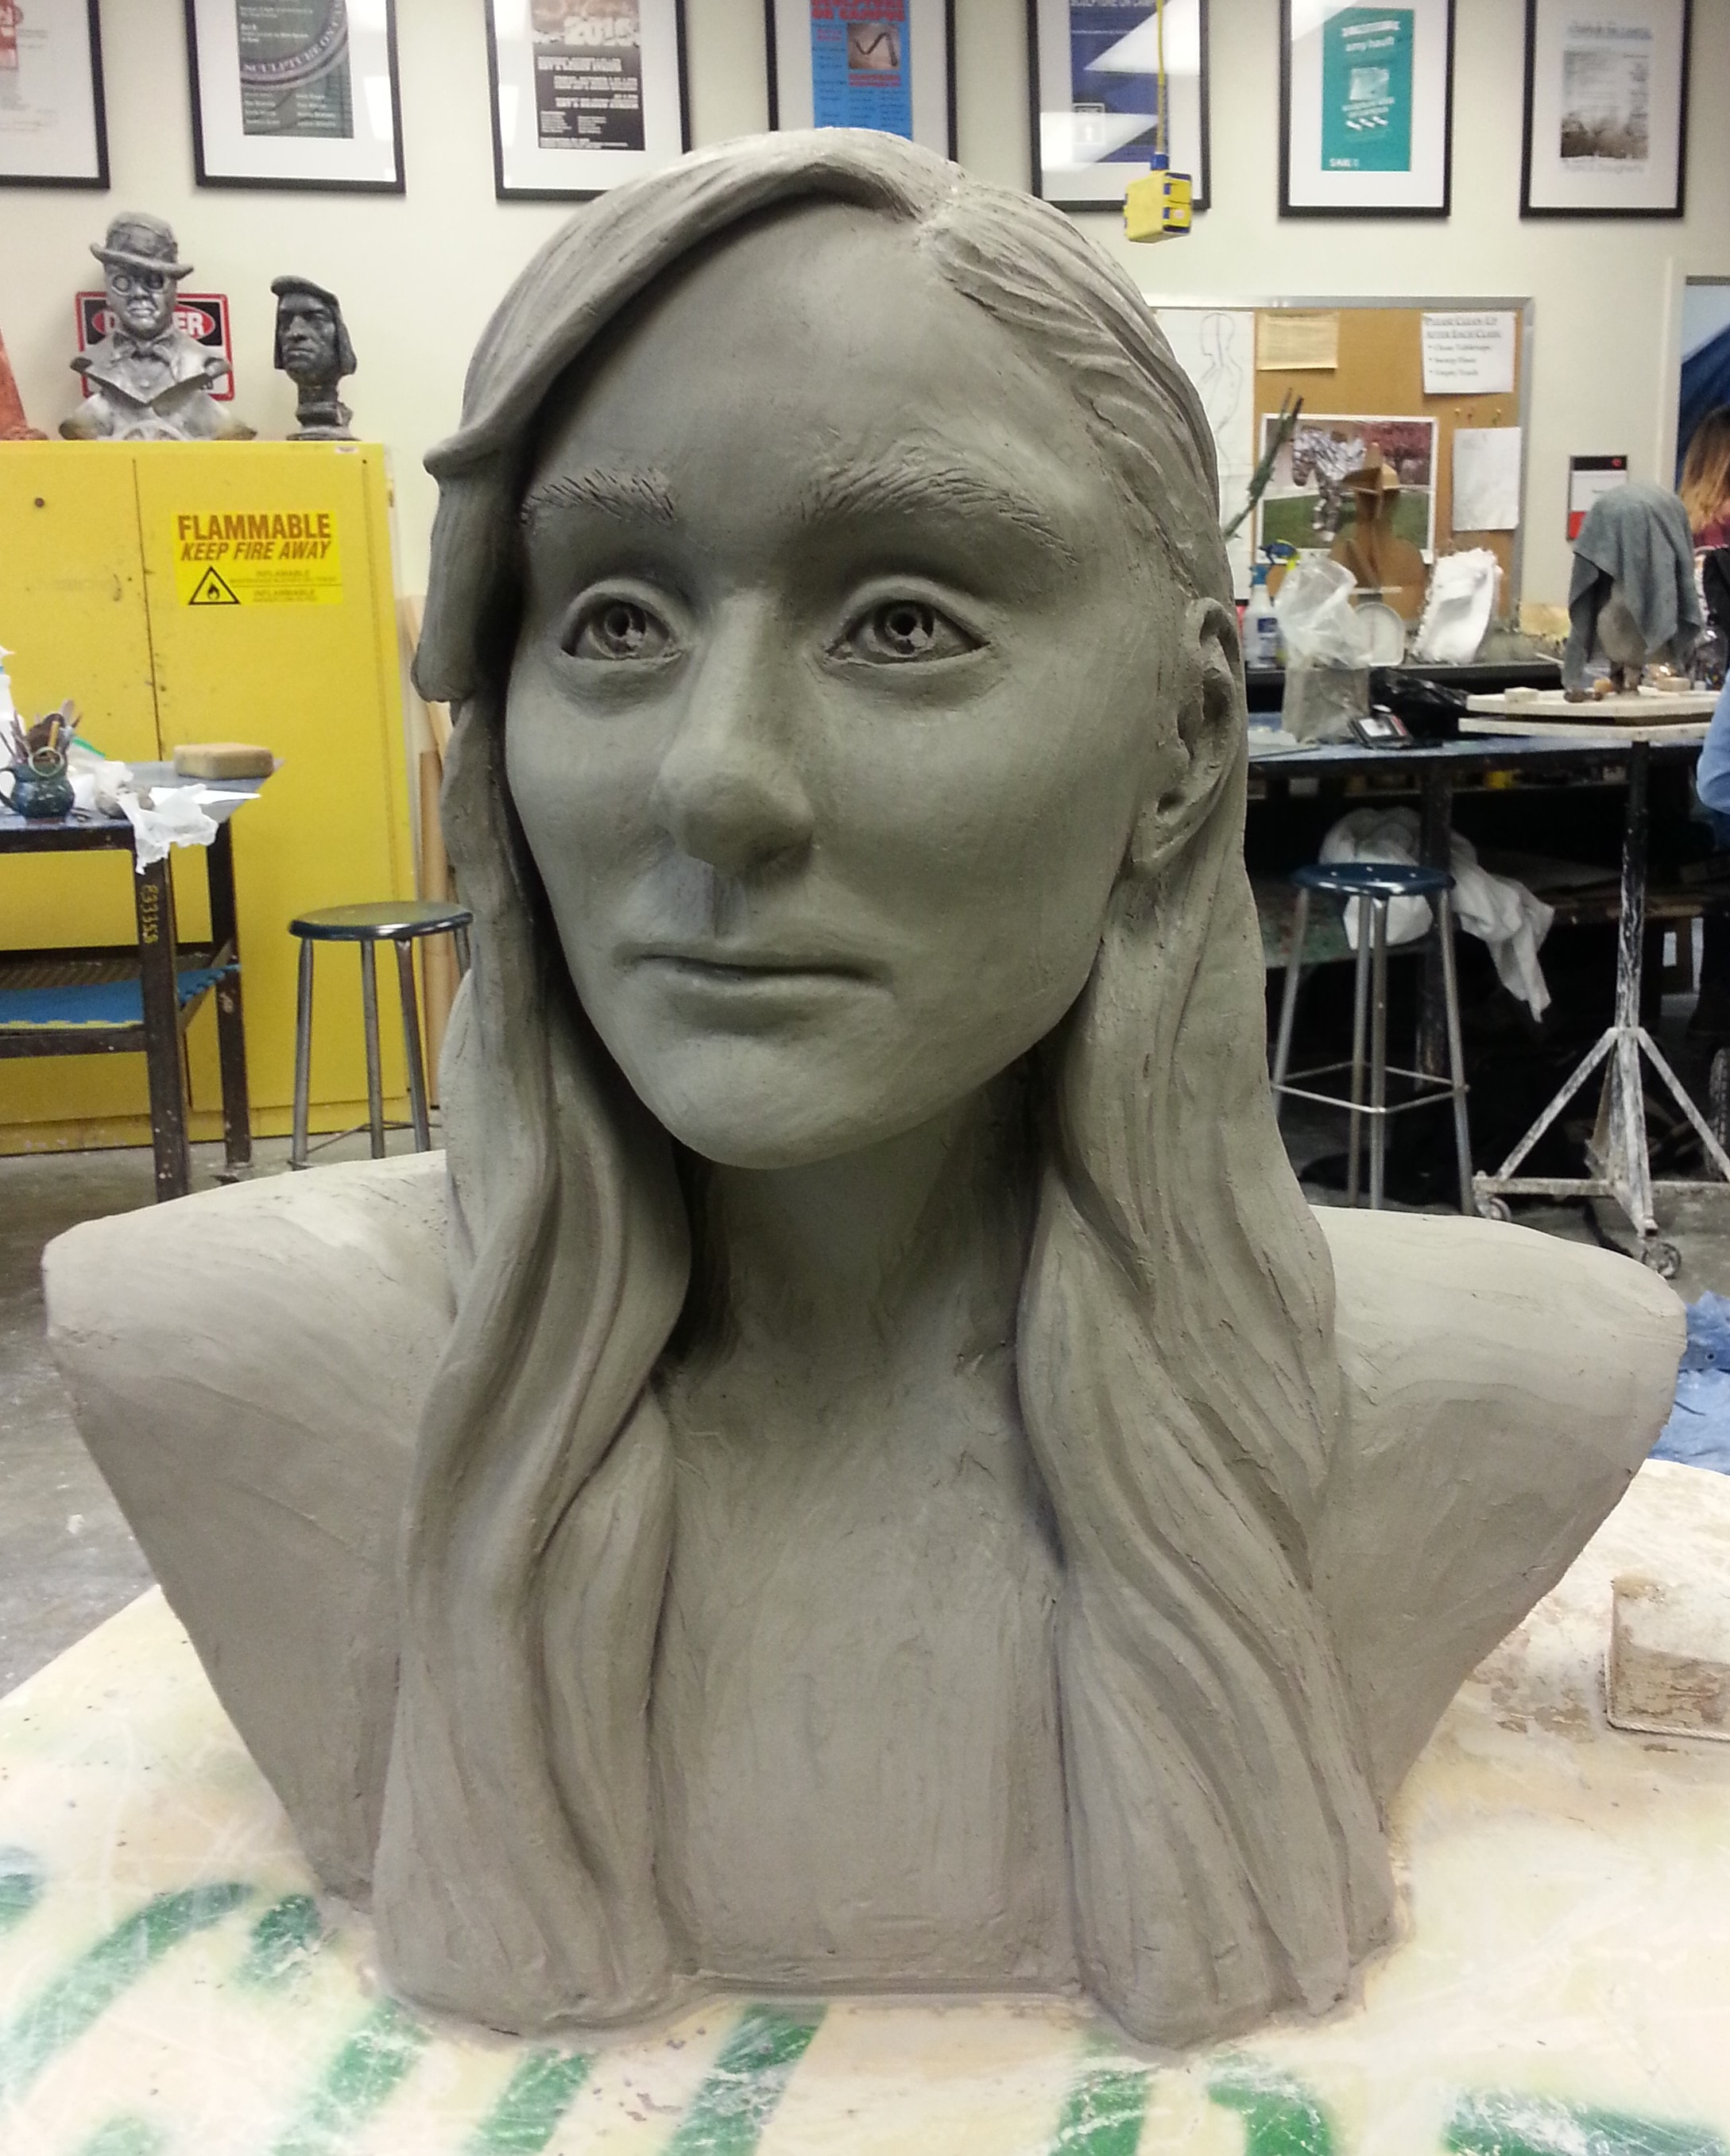
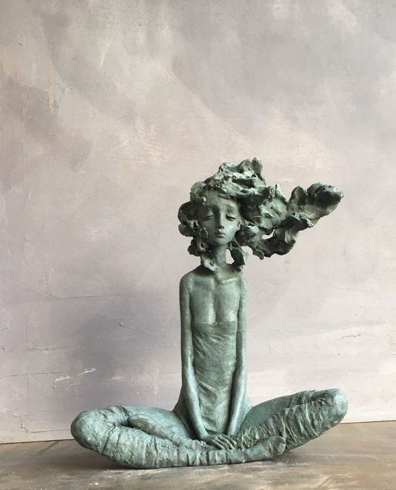
AP 3D Art + Design
ART187/ART188
1 credit – 1 year course
Pre-req – Ceramics I + II
- Build a Body of Work
- Develop a Portfolio for Submission
- Intensive, Independent Studio Practice
-Hand Building and/or Wheel Throwing

Slide 9
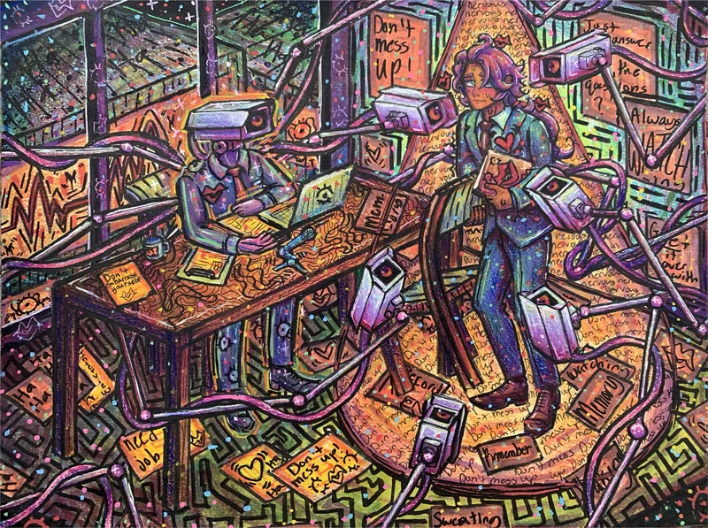
AP 2D Art + Design
1 credit – 1 year course
Pre-req – Art I + II
- Build a Body of Work
- Develop a Portfolio for Submission
- Intensive, Independent Studio Practice
- Any 2D Media

Slide 10
AP – - Social Studies

Slide 11
Open to sophomores (10th grade)
Will practice the AP skills necessary for future classes
Will write a lot of timed essays
Will read a lot of primary source material
Homework (2-3 hours per week)
Weekly chapter reading
Ongoing project research
80% of grade based on tests/projects
Emphasis on big-picture history
Class incorporates use of simulations and interactive activities
AP World History
Jill Berge (jberge@lwsd.org) Michael Dawson (mdawson@lwsd.org) Maik Hollinger (mhollinger@lwsd.org) Amy Sullivan (asullivan@lwsd.org)

Slide 12
AP Human Geography
AP Human Geography is an introductory college-level human geography course. Students cultivate their understanding of human geography through data and geographic analyses as they explore topics like patterns and spatial organization, human impacts and interactions with their environment, and spatial processes and societal changes.
Course is designed for 9th graders as an introduction to AP Classes. This course can be taken instead of 9th grade Ancient Civilizations.
Units Unit 1: Thinking Geographically Unit 2: Population and Migration Patterns and Processes Unit 3: Cultural Patterns and Processes Unit 4: Political Patterns and Processes Unit 5: Agriculture and Rural Land-Use Patterns and Processes Unit 6: Cities and Urban Land-Use Patterns and Processes Unit 7: Industrial and Economic Development Patterns and Processes

Slide 13
AP United States History
Contact: Beau Hansen bhansen@lwsd.org
Junior Year (11th grade) History Class
Expect an average of 1 hr. of homework per night – mostly textbook reading and answering questions modeled after the types of questions for the AP Exam.
Students will learn historical reasoning and analysis from Making America and other provided texts and primary sources.
Students will have a variety of learning experiences including:
Lectures on pivotal topics and historical events
Primary Source Documents
Simulations, projects, mock trials, and discussions.
Expect fun projects, immersive and engaging group work, and rigorous historical research!
This class is about forming a narrative about United States history as opposed to memorizing dates. This class will help students make sophisticated connections across time periods and locations.

Slide 14
AP United States Government & Politics
contact: Michael Dawson (mdawson@lwsd.org) or Bethany Shoda (bshoda@lwsd.org)
This course focuses on the American Political System; how it works, who is involved, and your role in it. There are 5 Units:
Foundations of American Democracy
Political Ideologies and Beliefs
Political Participation
Interactions Among the Branches of Government
Civil Rights/Civil Liberties
------> 2-3 hours of homework a week
Mostly reading the textbook and/or required texts such as The Constitution, The Declaration of Independence, a few Federalist Essays, etc.
There are a few projects throughout the year as well that will require some work at home to be done.

Slide 15
AP Economics
AP Microeconomics/ Macroeconomics is a yearlong introductory college-level economics course
No prerequisites. If you’ve taken Economics before, join us again! If you’re thinking of studying business, marketing, or finance in college, get a head start!
This course will cover the basics of economics, including the fundamentals, how markets work, and the role of government in the economy through games, simulations, and projects. Let’s have some fun!
CTE and Social Studies elective credit available
Open to 10th-12th grade
For Econ Class!

Slide 17
AP – English

Slide 18
AP Literature and Composition
Contact: Tena Lasik tlasik@lwsd.org or Terry Terich (tterich@lwsd.org)
Seniors Only
30 min – 1 hour homework/night
Focus for the year Literature for the year
Close passage analysis strategies
Allusions
Literary Movements
Critical Approaches to literature
Essentials of poetry and fiction
Style and Cohesion in writing
Discussion techniques and strategies
Presentation Skills
AP Exam Prep
The Book Thief – Markus Zusak
Cyrano de Bergerac – Edmond Rostand
The Great Gatsby – F. Scott Fitzgerald
Frankenstein – Mary Shelley
The Catcher in the Rye – JD Salinger
Great Expectations – Charles Dickens
2 Choice Novels from AP suggested list
Various Poetry
5 Steps to a 5 (McGraw Hill prep workbook)

Slide 19
Junior Year (11th grade) English Class
Expect an average of 1 hr. of homework per night – mostly reading, writing, and annotating.
Students will learn rhetorical strategies from Patterns for College Writing as well as The Language of Composition.
Separate book studies will be done quarterly on:
Tim O’Brien’s The Things They Carried
Bryan Stevenson's Just Mercy
William Shakespeare’s Hamlet
AP English Language &
Composition
contact: Sarah Fradkin (sfradkin@lwsd.org)
Amy Sullivan (asullivan@lwsd.org)
Expect fun projects, immersive and engaging group work, and rigorous analysis!

Slide 20
AP – World Languages

Slide 21
How much homework is there? Roughly 2 hours per week
What do we do in the class? Read, write, speak, and listen about topics ranging from Bolivian beauty pageants to Guatemalan education to Latin dance!
What textbook do we use? Temas (no class fee)
Contact Kristen Tylee, ktylee@lwsd.org

Slide 22
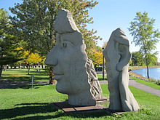
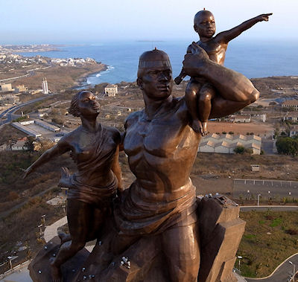
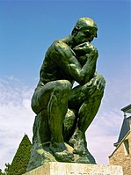
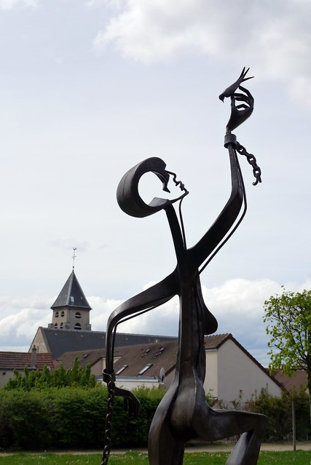
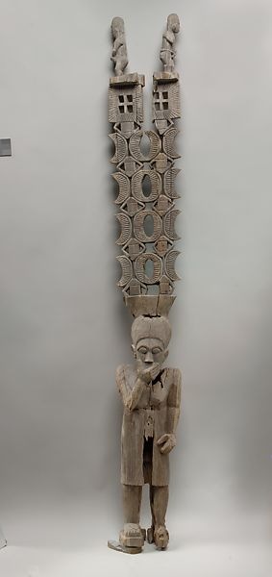
AP French
Language and Culture
Contact: Emily Wilcox, ewilcox@lwsd.org
How much homework is there?
Roughly 2 hours per week
What do we do in the class?
We have candid conversations in French about what is in the headlines.
We read and hear stories related to current and historical events in the Francophone world.
We dive into the arts and look at its lasting impact on society.
Une sculpture québécoise
Une sculpture sénégalaise
Une sculpture française
What textbook do we use?
APprenons and Allons au de-là
Deux sculptures haïtiennes
Une sculpture malgache
Are there class fees?
Just the AP Test itself

Slide 23
AP – Science

Slide 24
AP Chemistry
Topics include: bonding, kinetics, equilibrium, redox, acid/base and thermochemistry
This is a lab-based science with potential to earn college credit
The AP Exam is the primary focus of the course
Challenging course
Weekly homework (2-3 hours)

Slide 25
AP Environmental Science (APES)
Take part in a hands-on class and learn about relevant issues in our world.
Apply everything you’ve learned in your high school career!
Biology Required, Chemistry taken concurrently or prior. Counts toward Science OR CTE!!
Learn about…
Population growth
Feeding the world
Climate change’s impact on the globe
Taking care of animals
Growing plants

Slide 26
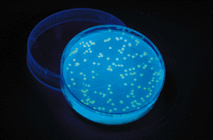
AP BIOLOGY
In-depth learning of how living things work
All the intricacies of what makes us tick!
Many different kinds of lab experiences
Biotechnology, experimental design, data analysis
Potential to earn college credit
AP Exam
opportunities to work through material with peers
debate biological ethics
Challenging and rewarding!
Students leave feeling ACCOMPLISHED
Helps prepare students for college science courses

Slide 27
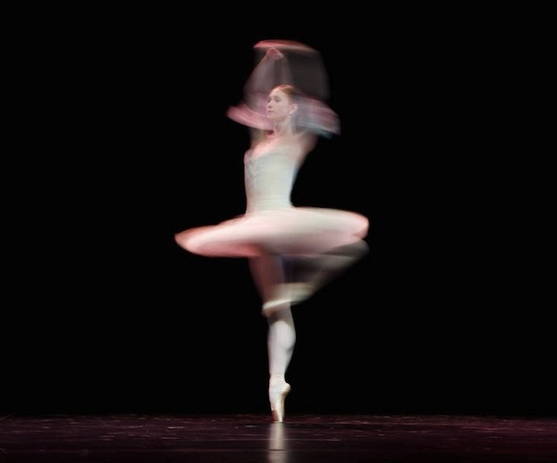
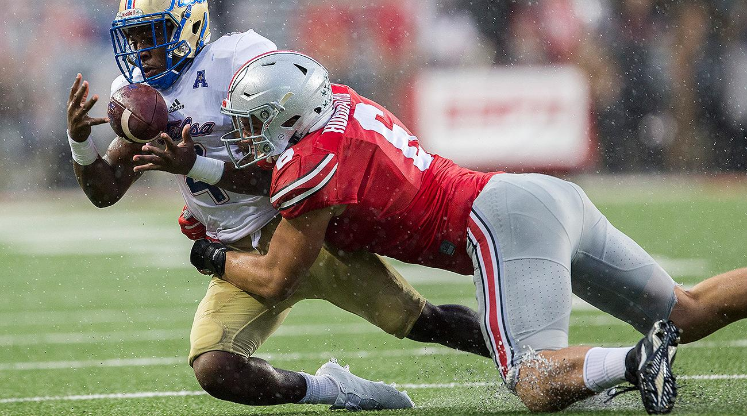
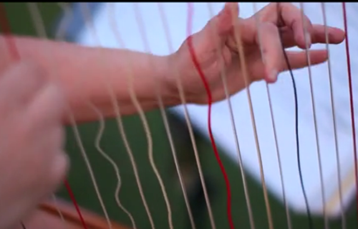
AP Physics 1
No prior physics required!
Topics include kinematics, forces, uniform circular motion, work, energy and power, impulse and momentum, rotational kinematics and dynamics, simple harmonic motion.
Class work emphasizes deep understanding of concepts through conversations and demonstrations relating mathematical equations to the ideas of real-life experiences.
Math is the language of physics. Successful completion of Algebra 2 is strongly recommended.
Homework is critical to success and averages 45 minutes after every day of class.
Lab work is emphasized for hands-on
understanding of concepts. At least 25% of
class time is inquiry-based laboratory
experiences.
Astronomy 2 concurrent enrollment is
expected to meet new state standards.

Slide 28
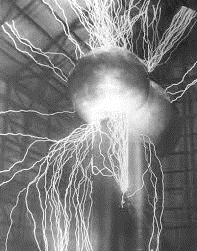
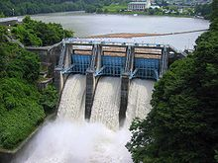
AP Physics 2
After PITU OR AP Physics 1
Topics include fluid mechanics, thermodynamics, electricity and magnetism, light waves and optics, atomic and nuclear physics
Class work emphasizes deep understanding of concepts through conversations and demonstrations relating mathematical equations to the ideas of real-life experiences.
Math is the language of physics. Successful completion of Algebra 2 is strongly recommended.
Homework is critical to success and averages 2 hours a week
Lab work is emphasized for hands-on understanding of concepts. This includes simulations and hands-on labs.
AP Physics 1 recommended, but not required
(see Ms Petersen for more info)

Slide 29
AP Computer Science A (The Programming AP Class)
Credits:
Occupational Ed OR Science
Overview
Prerequisites: Algebra 2, 10th Grade
Curriculum:
Curriculum: University of Washington / Microsoft Teals
UW similar classes: CSE 142 - Computer Programming I
Language: Java (Beginning - Intermediate Level)
Homework: 30-45 minutes/night
Outcomes:
97% of LW students pass AP the test (4.5 average score)
You will know how to program in Java at a college level.
Bottom Line:
No prior programming experience needed! (But it is helpful)
Lab based course.
If you can only take one-year computer science class at LW, you are a strong student, and you are interested in STEM fields, then this is the course for you.

Slide 30
AP Computer Science Principles (The Computer Concepts AP Class)
Outcomes:
Credits:
Occupational Ed OR Science
Overview
Prerequisites: Geometry, 9th Grade
Curriculum:
Code.org / Microsoft Teals
UW similar classes: CSE 120 - Computer Science Principles
Language: Javascript (Beginning Level)
Homework: 15-20 minutes/night
You will be able to think critically about a variety of topics in computer science like the internet, big data, encryption, hacking and innovations.
You will be able to program in Javascript at a starting level and submit an App using Applab as a final project
Bottom Line:
No prior programming experience needed.
This AP class was designed to be equivalent to computer science for non-majors at the university level. It is engaging for students of all levels / backgrounds.
– Less homework than a typical AP class because it is lab and portfolio based.

Slide 31
AP – Math

Slide 32
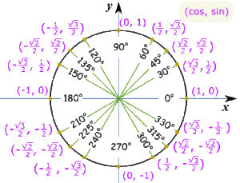
AP Pre-Calculus
Contact: Morgan Douglas mordouglas@lwsd.org
Covers college level Pre-Calculus
Pre-requisites
Algebra 2 or Algebra 2 Honors
A love/passion for math
Resources
AP Pre-Calculus Book
AP Central Website
Homework
College Credit through the AP Calculus Exam:
Currently Unknown but estimated to be 2-3 hours
Earning a score of 3, 4, or 5 on the AP Pre-Calculus Exam in May
Amount of college credit depends on their score and the university they plan to attend
College Credit through Bellevue College :
We will be applying for Bellevue College Credit for this course, but it has not yet been confirmed

Slide 33
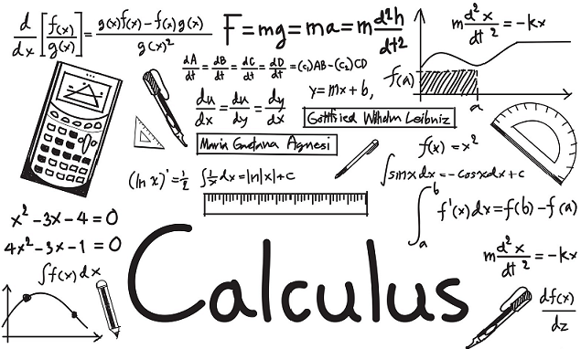
AP Calculus AB
Contact: Fei Lu, flu@lwsd.org Nadia Marcus, nmarcus@lwsd.org
Covers 1 semester of college level calculus (Calculus I)
Pre-requisites
Pre-Calculus
Calculus Foundations
A love/passion for math
Resources
AP Calculus Book
Baron’s AP Calculus Test Prep Book
AP Central Website
Homework
Approx. 3 hours per week
College Credit through the AP Calculus Exam:
Earning a score of 3, 4, or 5 on the AP Calculus Exam in May
Amount of college credit depends on their score and the university they plan to attend
College Credit through Bellevue College :
Registering for College in the High School credit through Bellevue College
Grade in AP Calculus AB class becomes grade for Bellevue College Math151 class. Stays on college transcript.
A letter is sent home in December explaining the procedure to register in January.

Slide 34
AP Calculus BC
Contact: Lisa Martinez lmartinez@lwsd.org
Math Concepts:
Course Details
2nd year course for students who have already completed AP Calculus AB
Advanced Integration
Planar Analysis in Polar,
Textbook – AP Edition Calculus 11e, R. Larson & B. Edwards
45-60 minutes of homework/night
Parametric, and Vector forms
Infinite Series Convergence
Taylor Series approximations
College Credit
Recommendations:
AP Calculus BC Exam in May OR
Two quarters of College in the High School credit through Bellevue College - Math 152 Calculus II & Math 153 Calculus III
AP Calculus AB
Ability to reason abstractly
Strong algebraic and trigonometric
skills

Slide 35
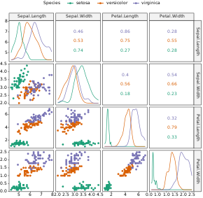
AP Statistics
Contact: Morgan Douglas mordouglas@lwsd.org
Covers of college level Statistics- 1 Semester
Exploring Data
Sampling Data
Anticipating Patterns
Statistical Inference
Resources
AP Statistics Book- Practice of Statistics
AP Central Website
College Credit through the AP Calculus Exam:
Earning a score of 3, 4, or 5 on the AP Calculus Exam in May
Amount of college credit depends on their score and the university they plan to attend
Pre-requisites
At least Algebra 2*
* Recommend you have also taken Pre-Calculus
A love/passion for math
College Credit through Bellevue College :
Registering for College in the High School credit through Bellevue College
Grade in AP Statistics class becomes grade for Bellevue College. Stays on college transcript.
Homework
Approx. 2-3 hours per week

Slide 36
AP – Capstone

Slide 37
AP Seminar Contact Jill Berge (jberge@lwsd.org) or Terry Terich (tterich@lwsd.org)
Students learn how to navigate the world of scholarly research
Students learn how to “do college”
Skills-based class where students will:
Research and analyze current issues
Determine and assess credibility of sources
Work individually and collaboratively to propose solutions
Homework: about 2 hours a week

Slide 38
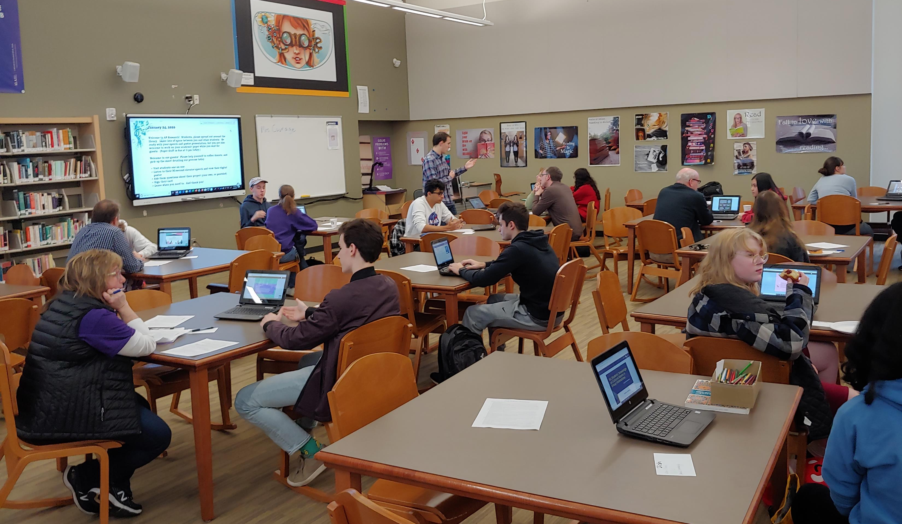
AP Research
Students complete their own college-level research study
Homework: about 2 hours a week
Students who complete Seminar and Research (+ 4 AP classes) earn the Capstone Diploma
Questions? Contact Jill Berge (jberge@lwsd.org) or Matt Macomber (mmacomber@lwsd.org)

