Slide 1
Mercer Island School District
Highlights from the Healthy Youth Survey
(March 1, 2015)

Slide 2
Student Participation
Blank Space
308 (85%) of Grade 6 students
311 (83%) of Grade 8 students
262 (78%) of Grade 10 students
216 (63%) of Grade 12 students
Blank Line
Blank Line
Blank Line

Slide 3
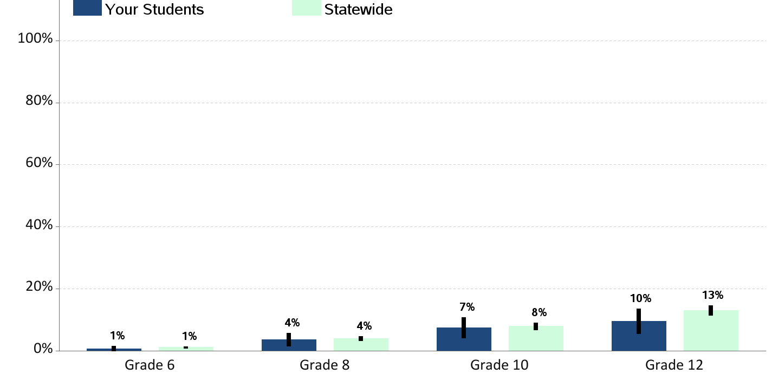
Current Cigarette Smoking Percent of students who report smoking cigarettes in the past 30 days

Slide 4
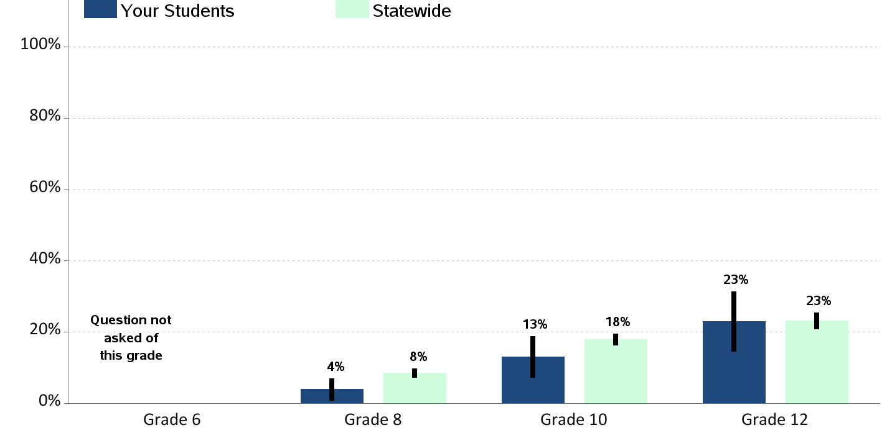
E-Cigarette Smoking or Vaping Percent of students who report using an electronic cigarette, e-cig or vape pen in the past 30 days

Slide 5
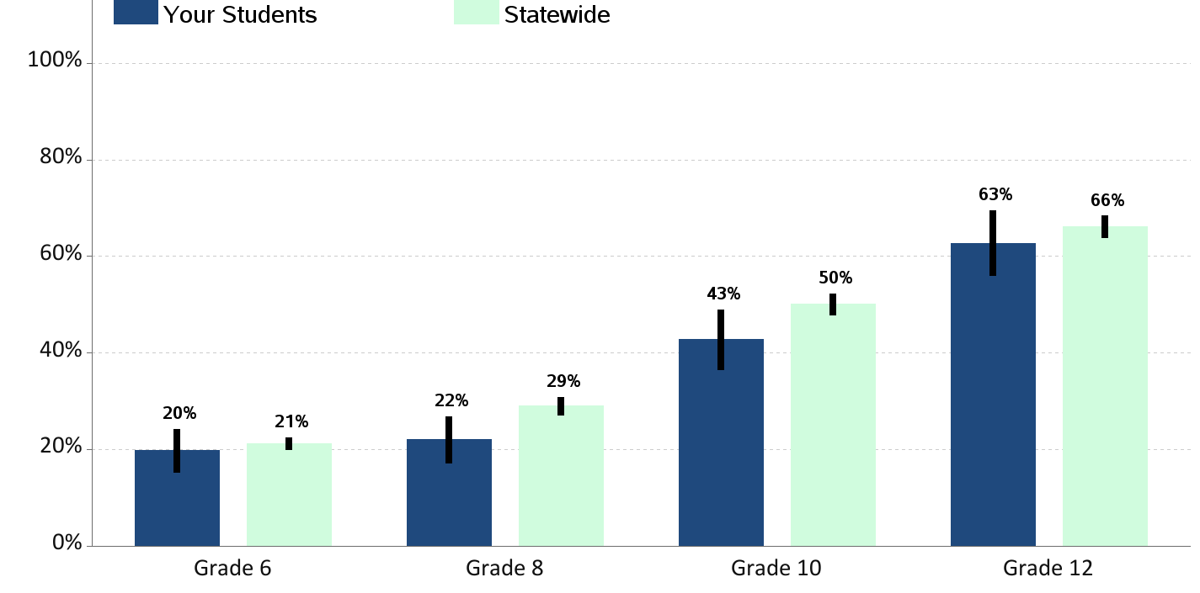
Lifetime Alcohol Use Percent of students who report having ever drunk more than a sip of alcohol

Slide 6
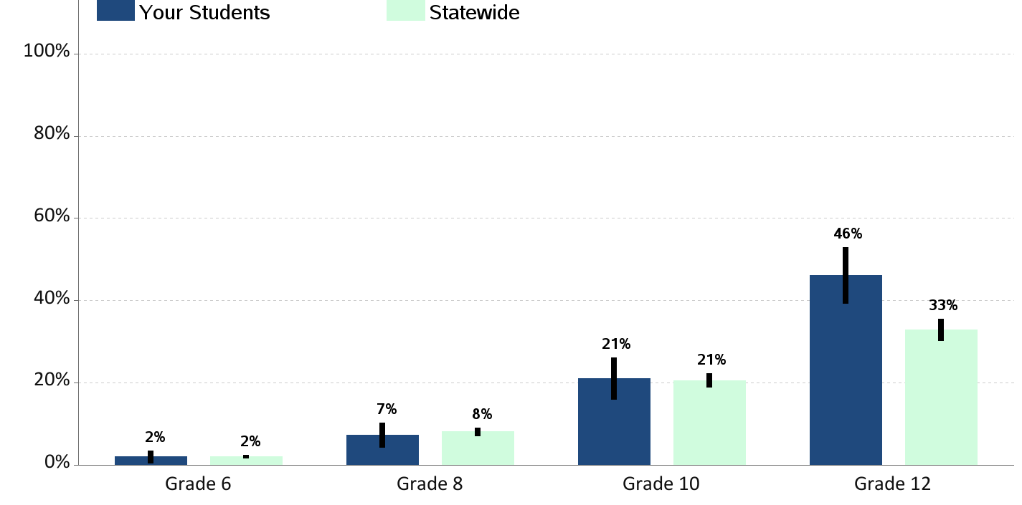
Current Alcohol Use Percent of students who report having drunk a glass, can or bottle of alcohol in the past 30 days

Slide 7
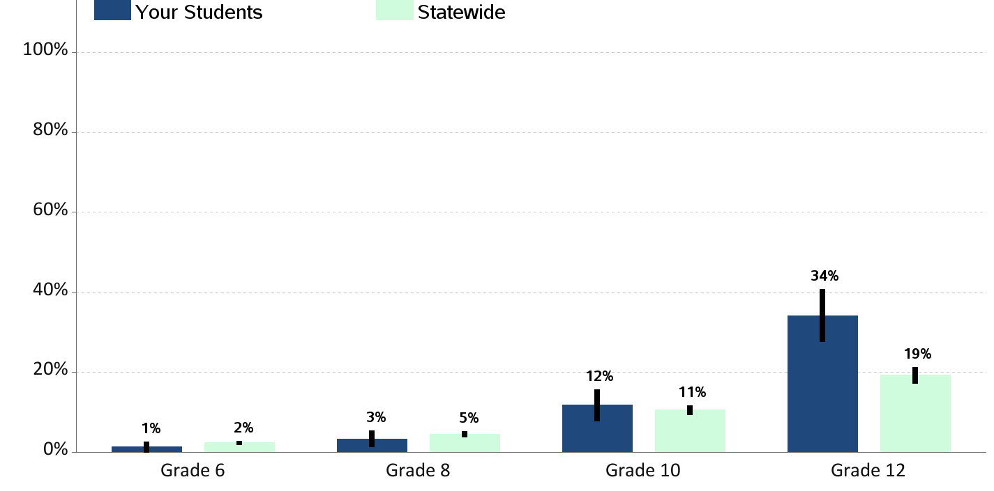
Current Binge Drinking Percent of students who report having drunk 5 or more drinks in a row in the past 2 weeks

Slide 8
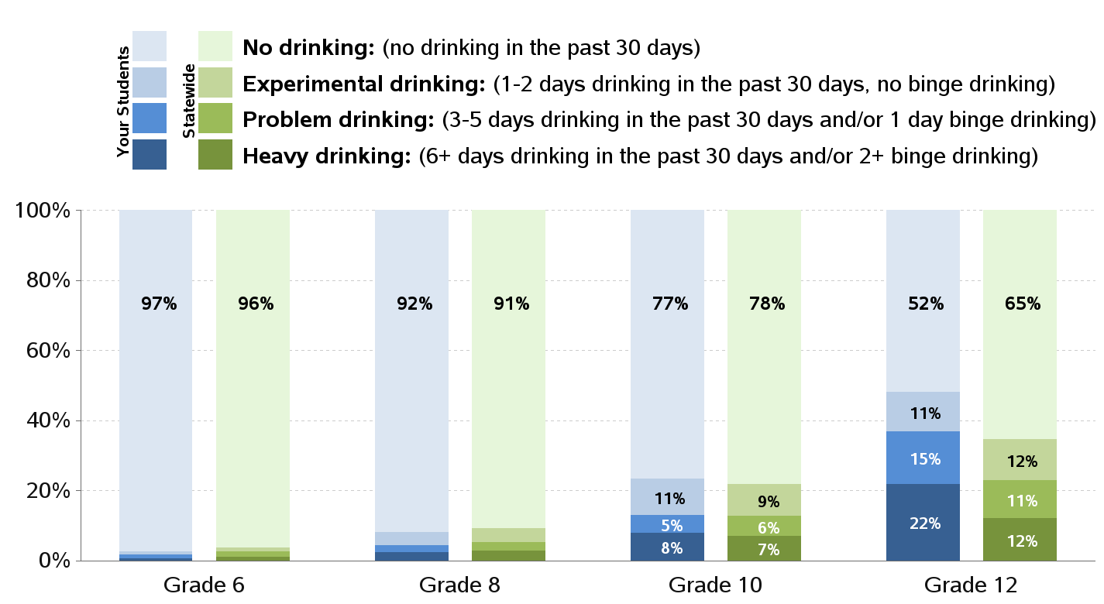
Levels of Alcohol Use

Slide 9
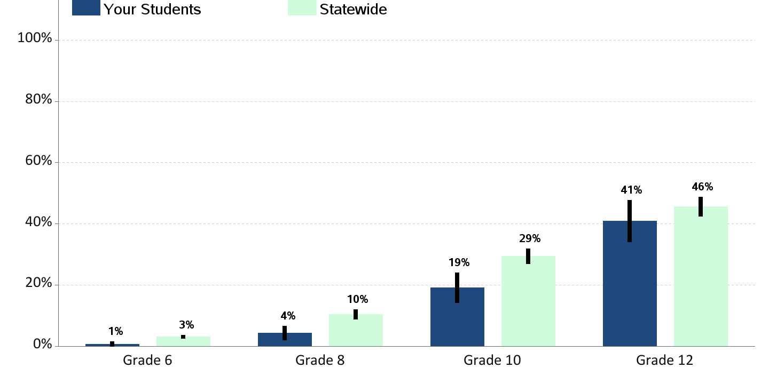
Lifetime Marijuana Use Percent of students who report having ever used marijuana |

Slide 10
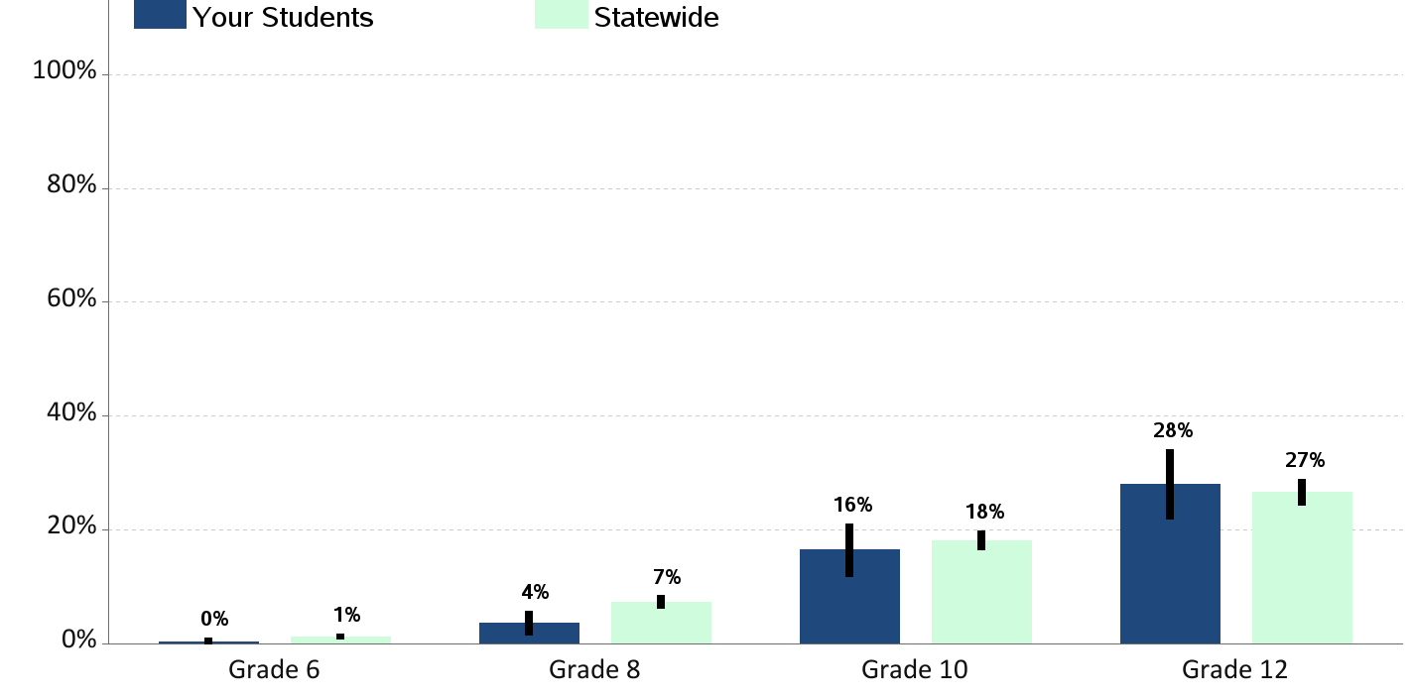
Current Marijuana Use Percent of students who report using marijuana in the past 30 days

Slide 11
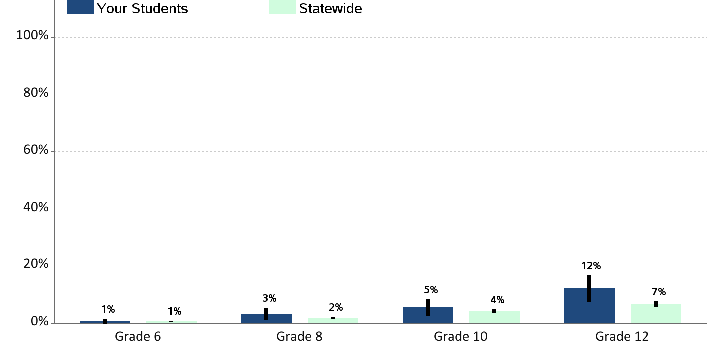
Current Illegal Drug Use Percent of students who report using illegal drugs in the past 30 days (not including alcohol, tobacco or marijuana)

Slide 12
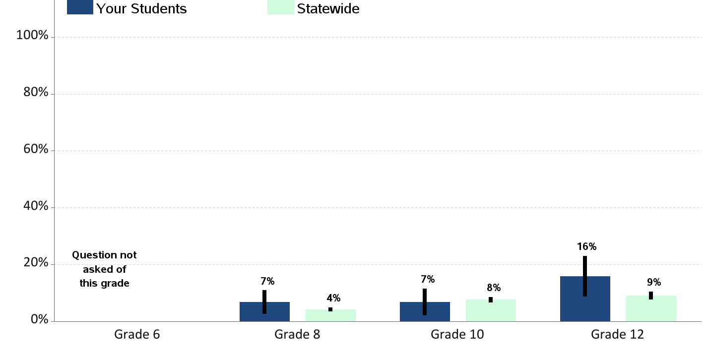
Current Prescription Drug Use Percent of students who report using prescription drugs not prescribed to them in the past 30 days

Slide 13
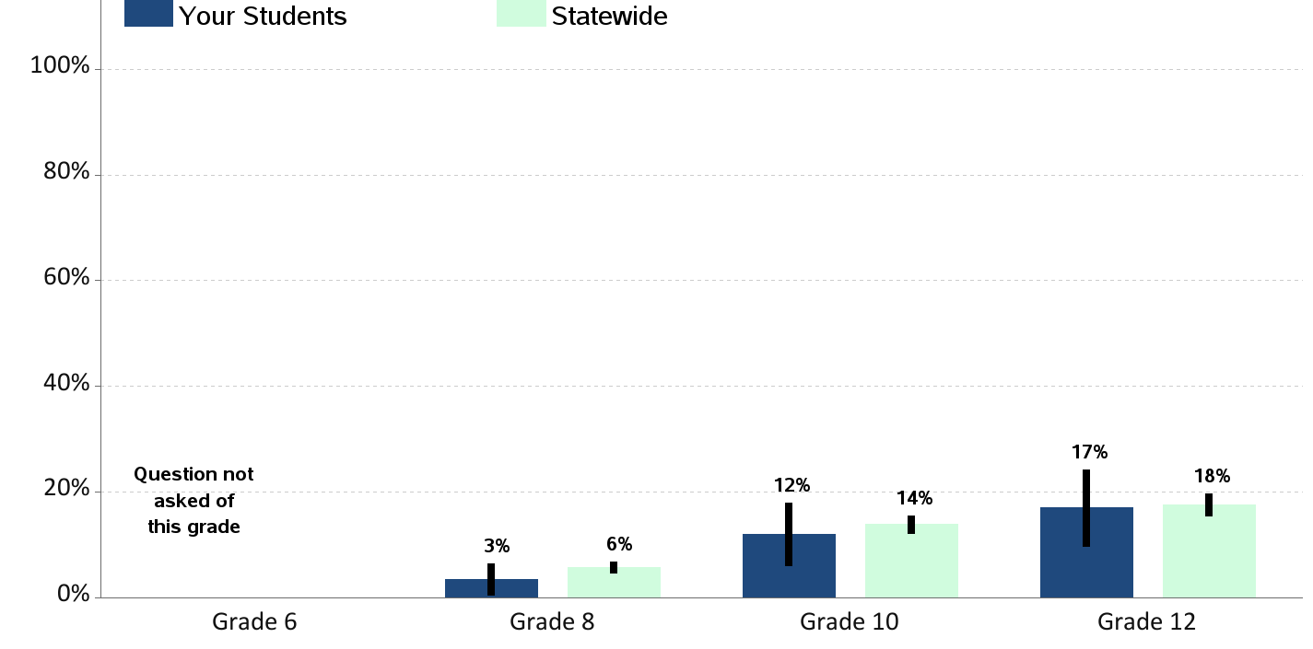
Substance Use at School Percent of students who report being drunk or high at school in the past year

Slide 14
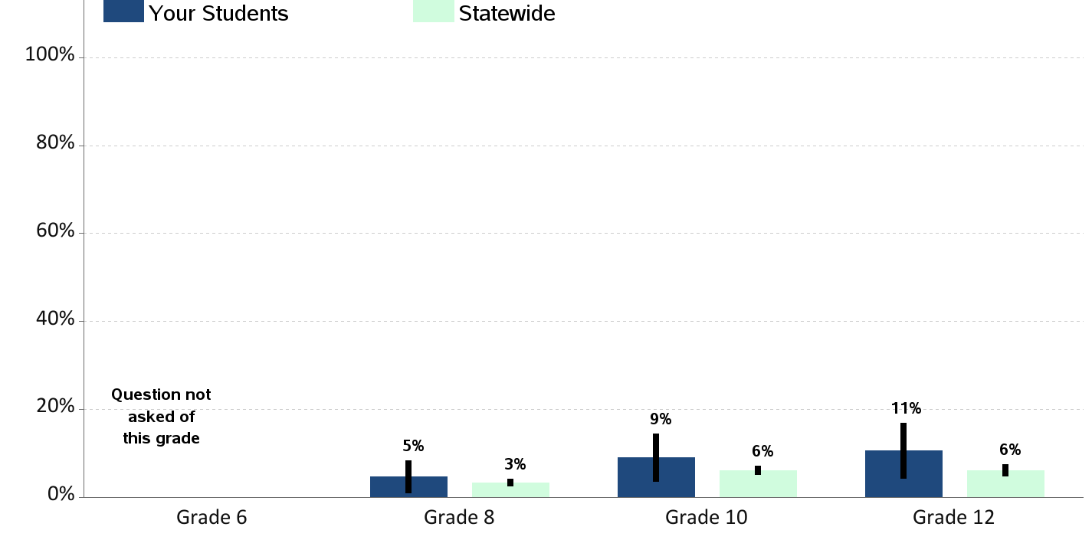
Alcohol Use on School Property Percent of students who report having at least one drink of alcohol on school property in the past 30 days

Slide 15
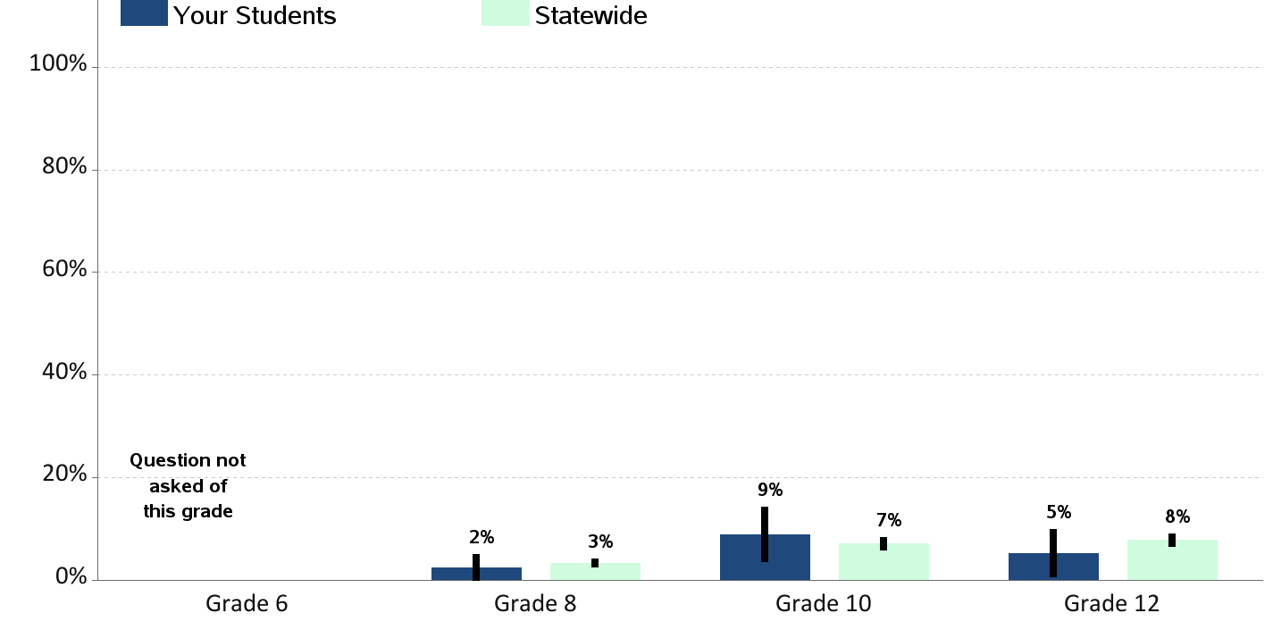
Marijuana Use on School Property Percent of students who report using marijuana on school property in the past 30 days

Slide 16
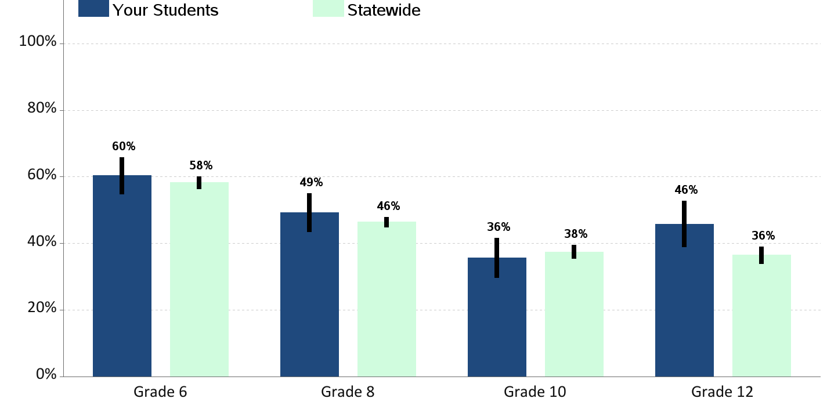
Enjoyment of School Percent of students who report "often" or "almost always" enjoying being at school in the past year

Slide 17
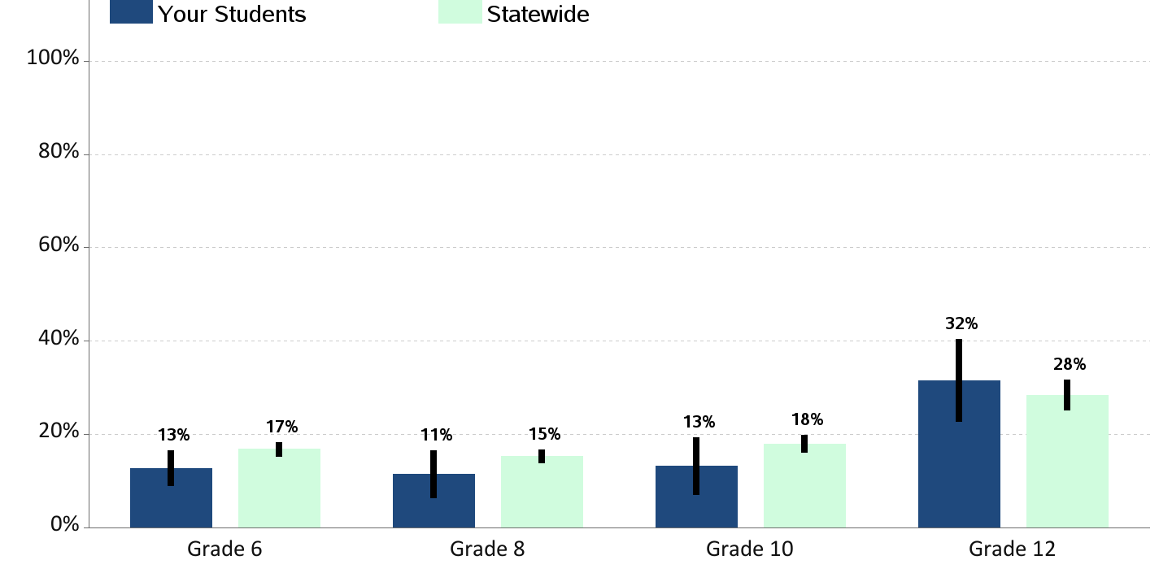
Skipping School Percent of students who report skipping 1 or more whole days of school in the past 4 weeks

Slide 18
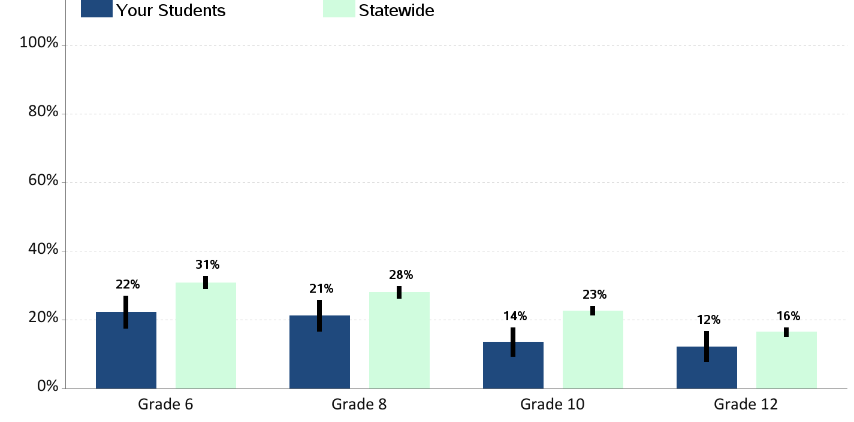
Bullying Percent of students who report being bullied in the past 30 days

Slide 19
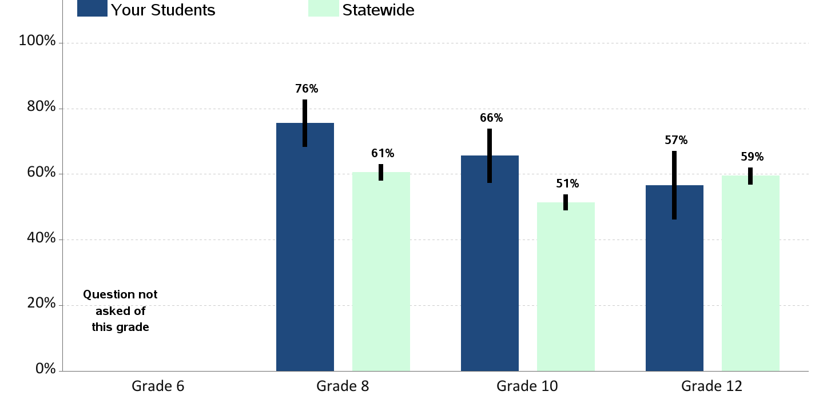
School Tries to Stop Bullying Percent of students who report teachers or other adults at school “almost always” or “often” try to stop bullying

Slide 20
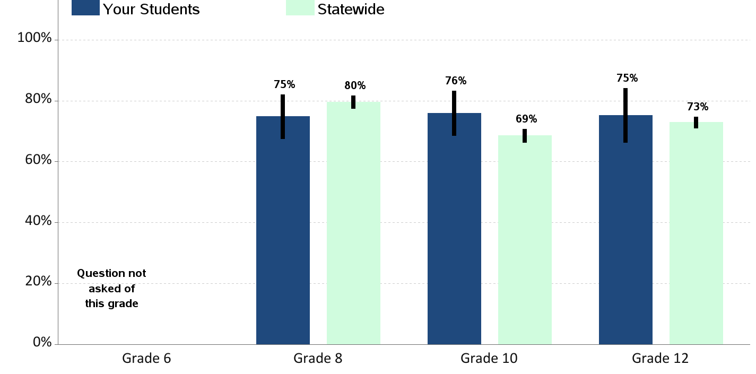
Students Know How to Report Bullying Percent of students who report they know how to report bullying at school |

Slide 21
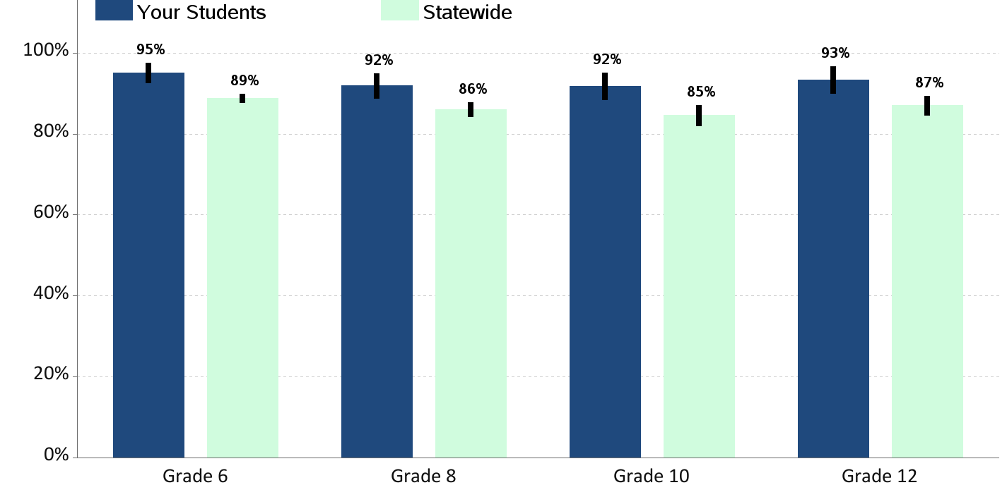
Feeling Safe at School Percent of students who report that they feel safe at school |

Slide 22
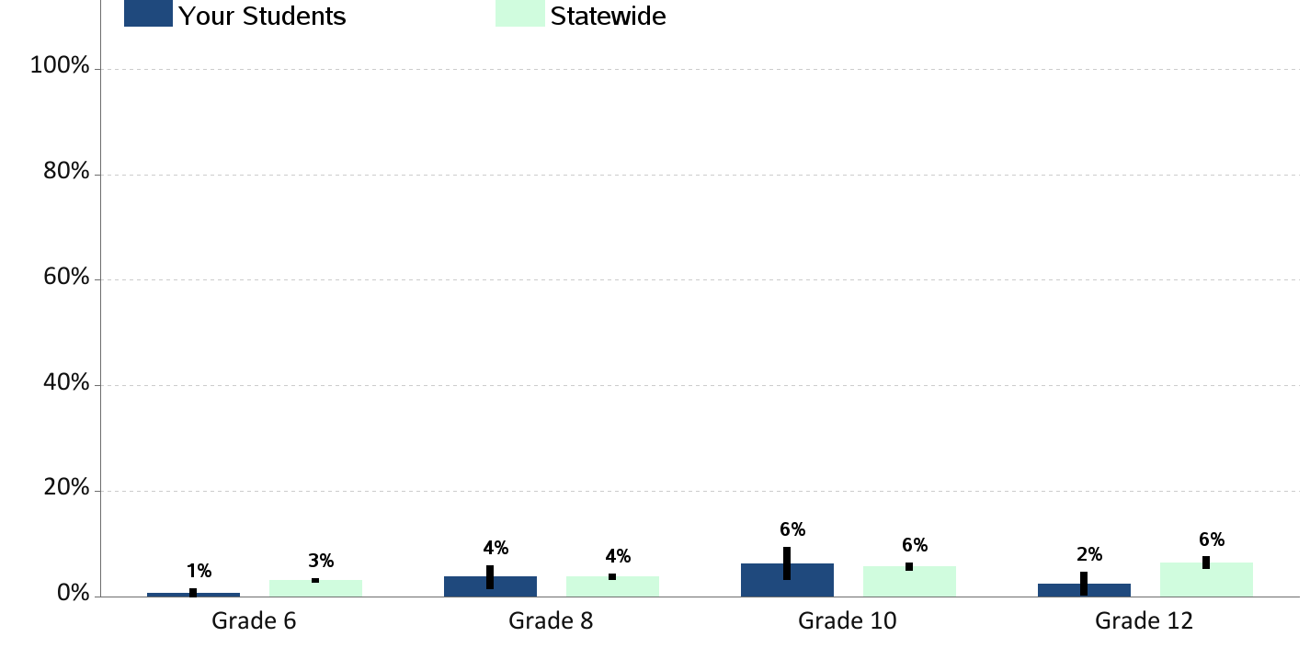
Weapon Carrying at School Percent of students who report carrying a weapon on school property in the past 30 days

Slide 23
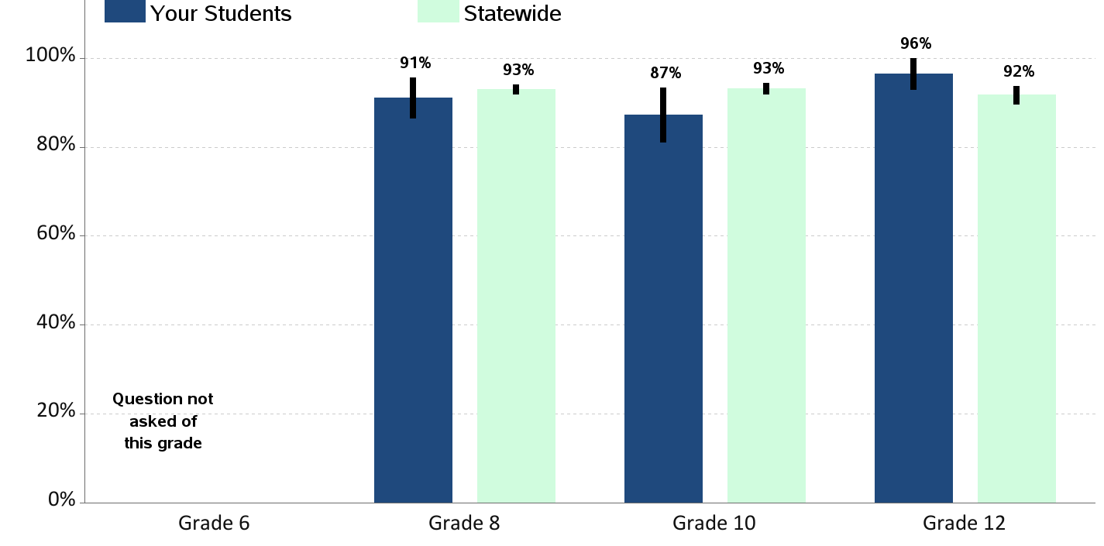
Opportunities for School Involvement Percent of students who report that they have lots of chances for involvement in school activities

Slide 24
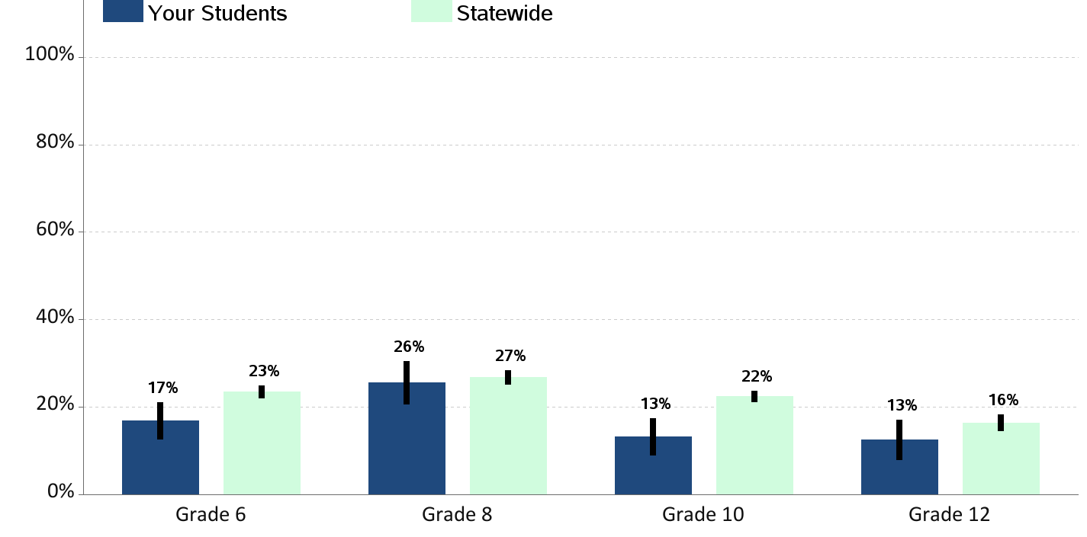
Physical Fighting Percent of students who report being in a physical fight in the past year

Slide 25
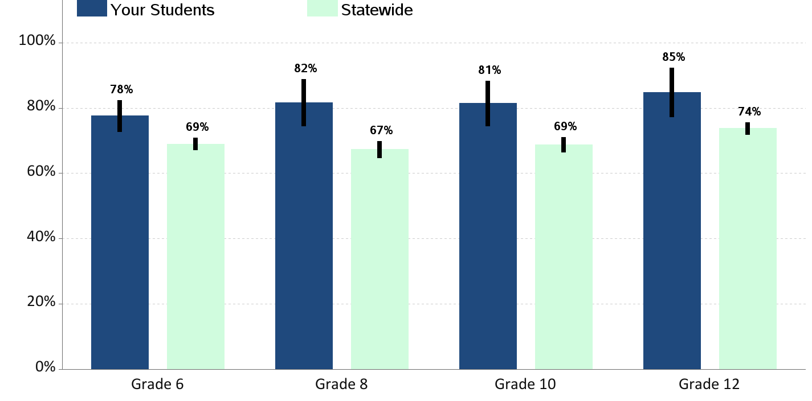
Students Can Problem Solve Percent of students who report they possess problem solving skills |

Slide 26
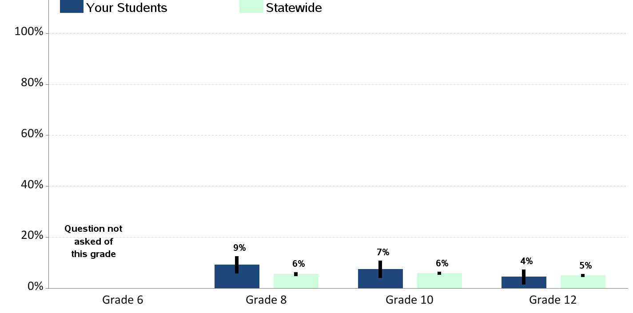
Gang Membership Percent of students who report being members of a gang in the past year

Slide 27
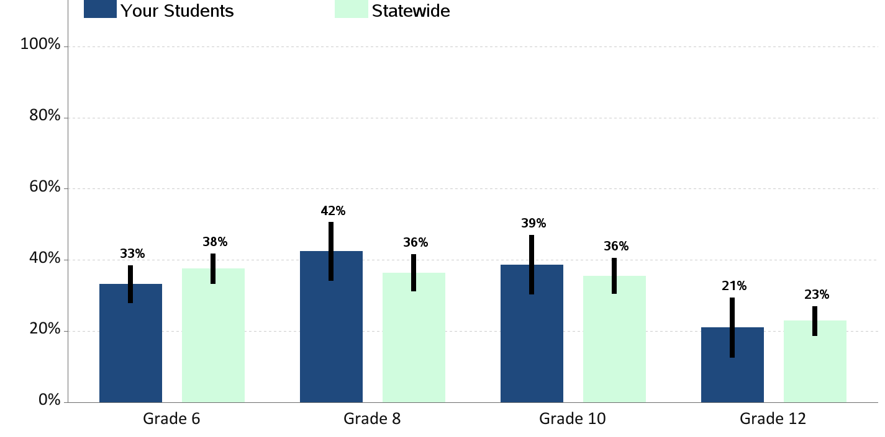
Walking/Biking To or From School Percent of students who report walking or riding a bicycle to or from school during an average week

Slide 28
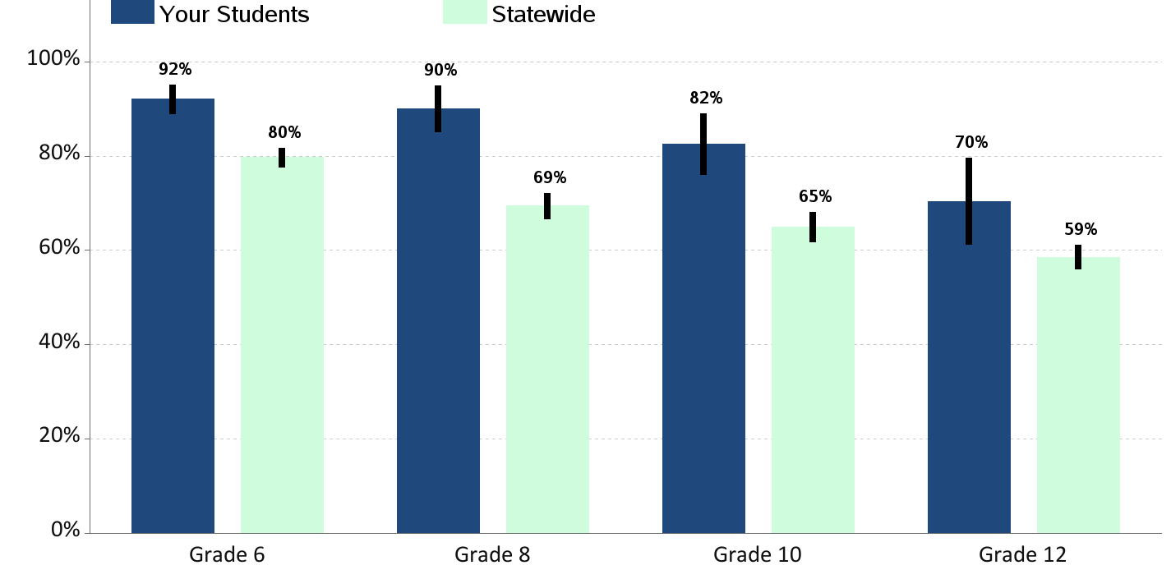
Eating Breakfast Percent of students who report eating breakfast today |

Slide 29
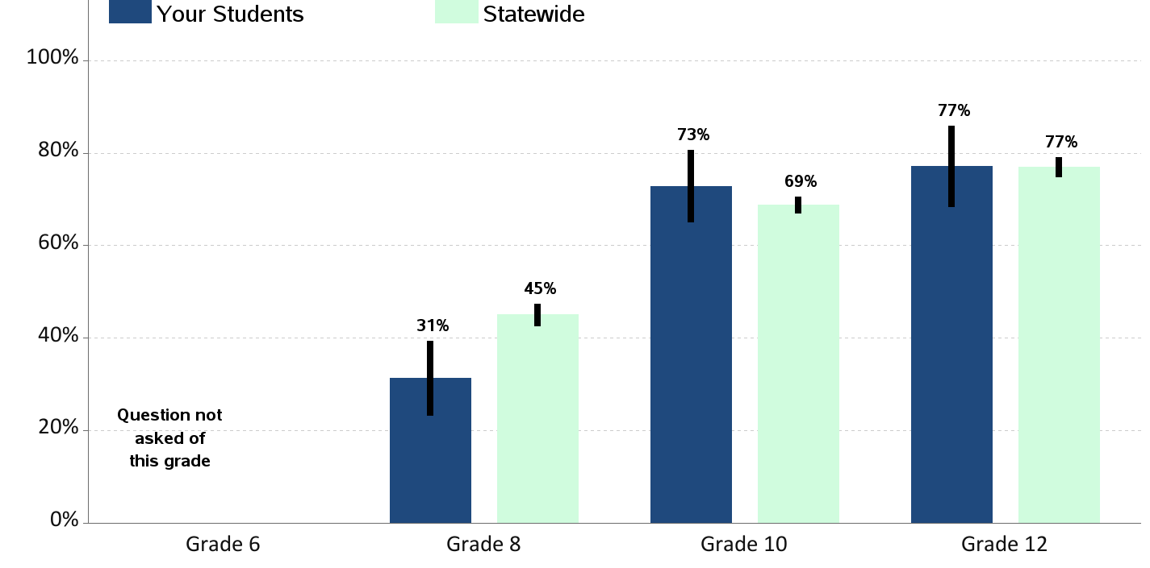
Sleep on a School Night Percent of students who report sleeping less than 8 hours on an average school night

Slide 30
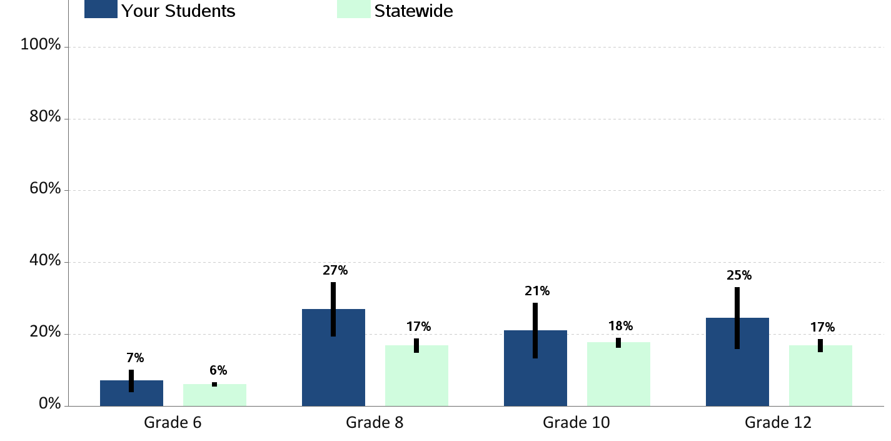
Riding with a Drinking Driver Percent of students who report having ridden in the past 30 days with a driver who had been drinking alcohol

Slide 31
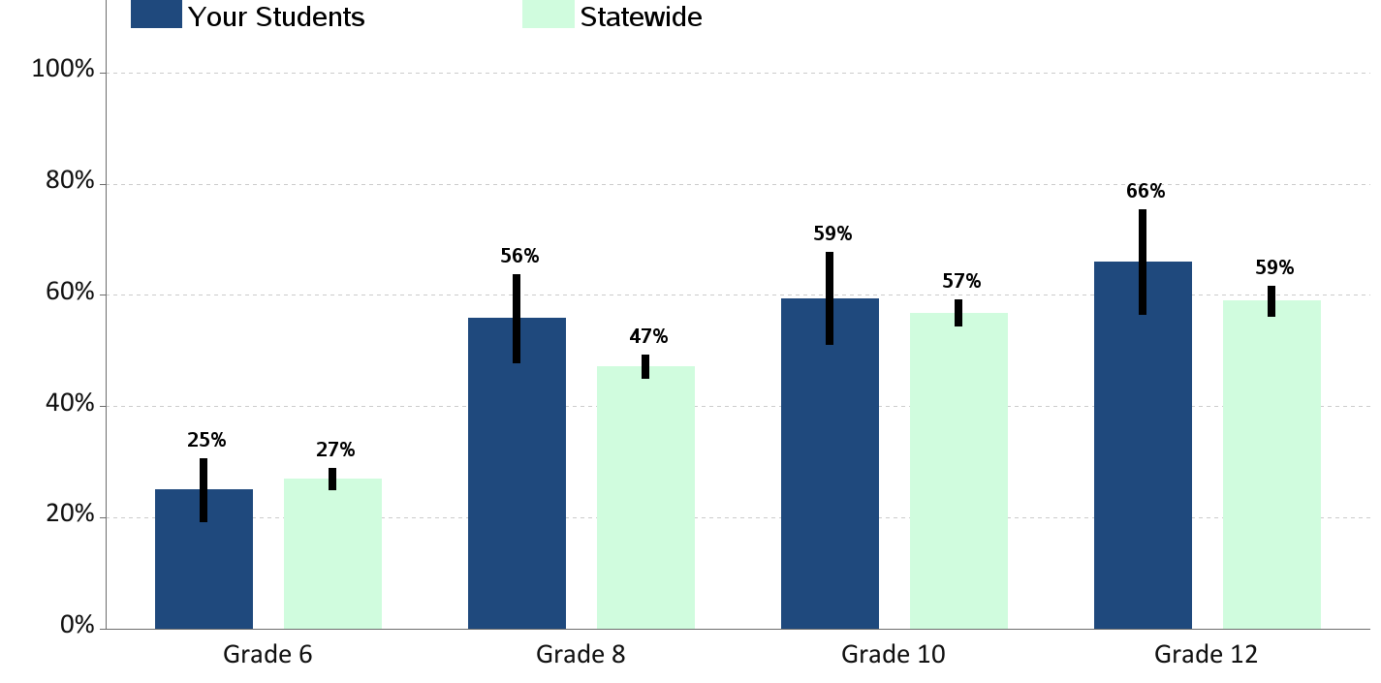
Riding With a Texting Driver Percent of students who report having ridden in the past 30 days with a driver who was texting or emailing

Slide 32
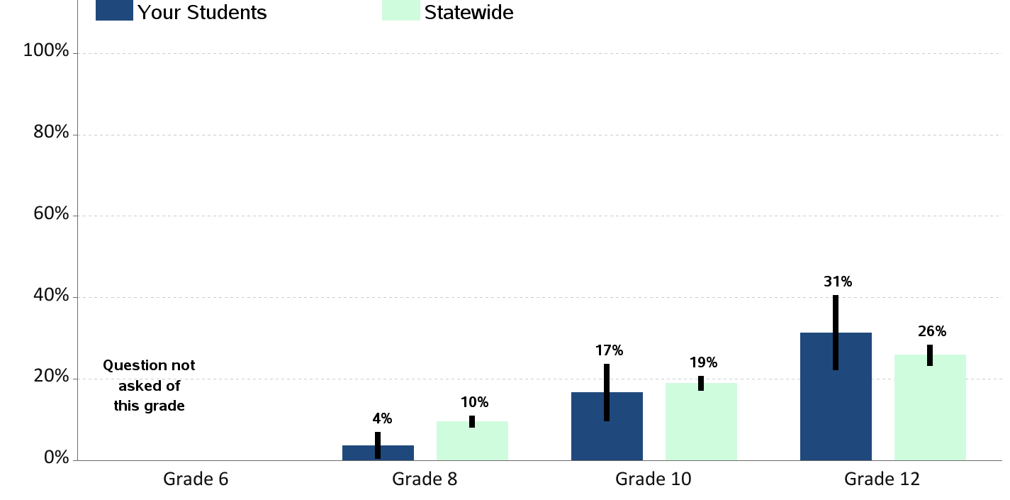
Riding With a Recent Marijuana User Percent of students who report having ridden in the past 30 days with a driver who had been using marijuana

Slide 33
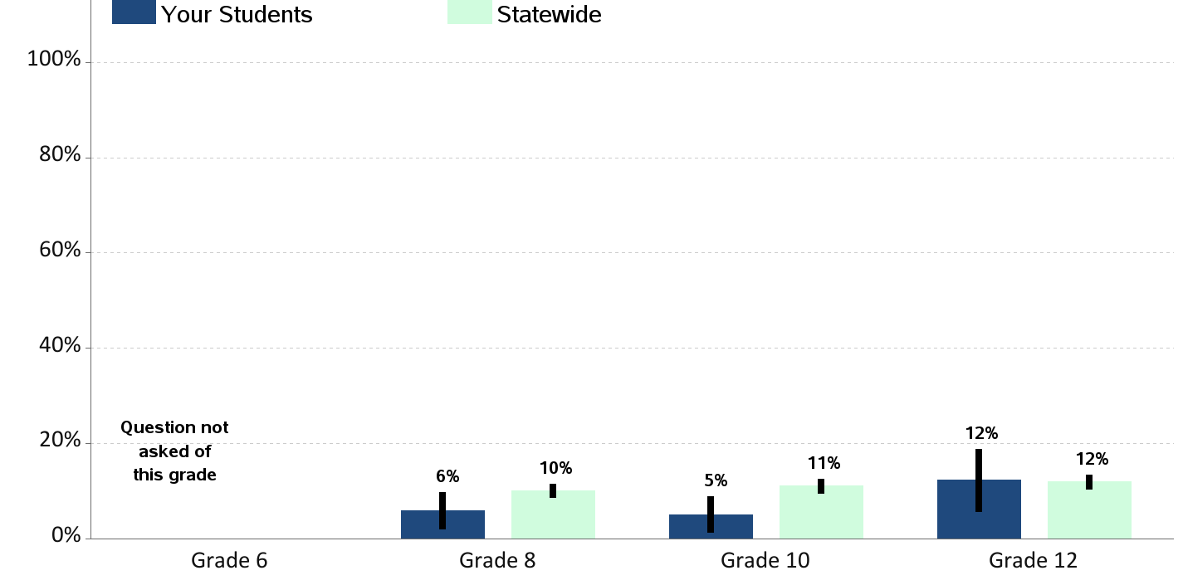
Excessive Sugar Sweetened Beverages Consumption Percent of students who report drinking sugar sweetened beverages 2 or more times a day |

Slide 34
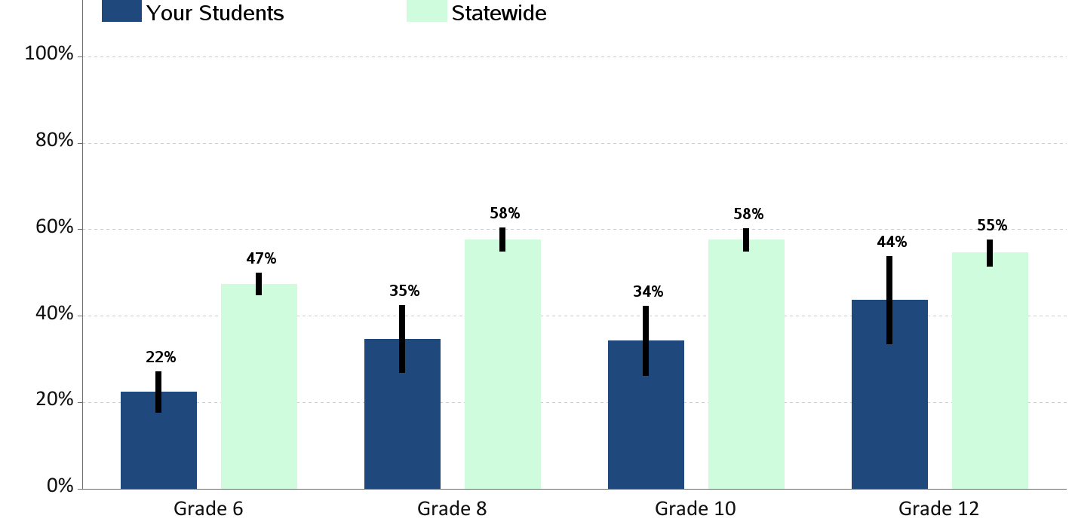
Excessive Television/Video Game Use Percent of students who report 3 or more hours watching television, playing video games or using the computer for fun on an average school day

Slide 35
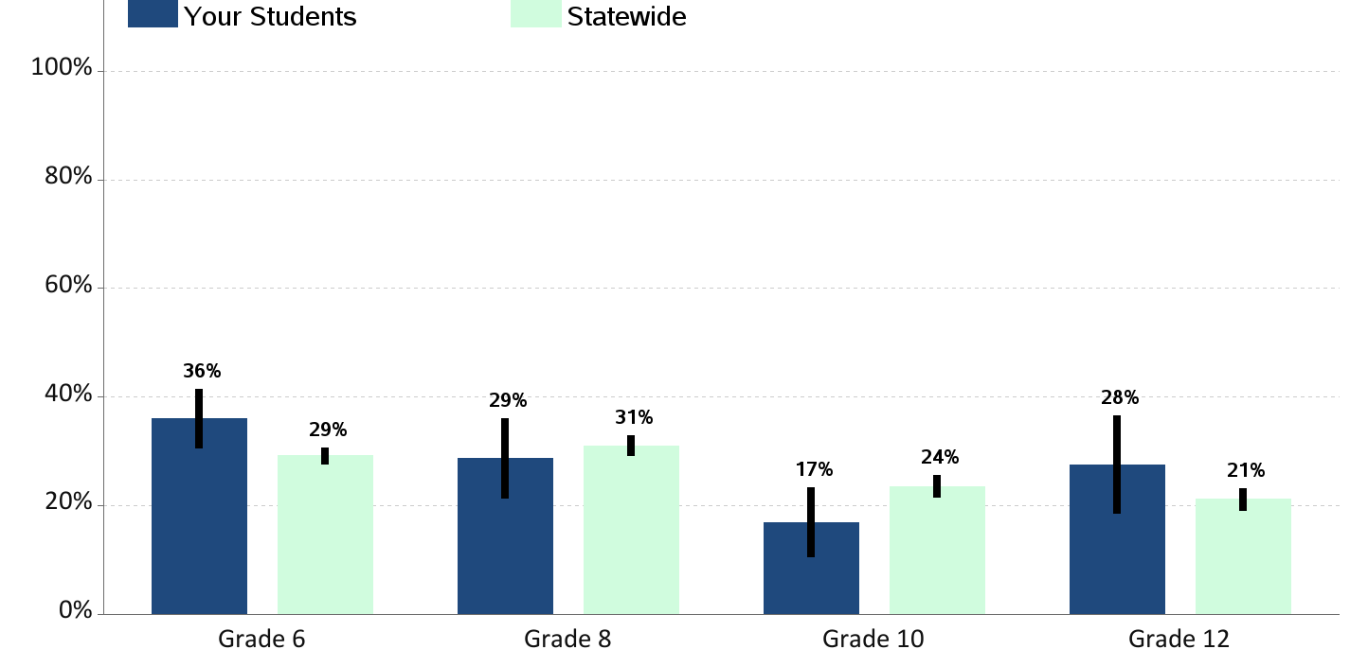
60 Minutes of Physical Activity per Day Percent of students who report being physically active 60 minutes per day, 7 days a week

Slide 36
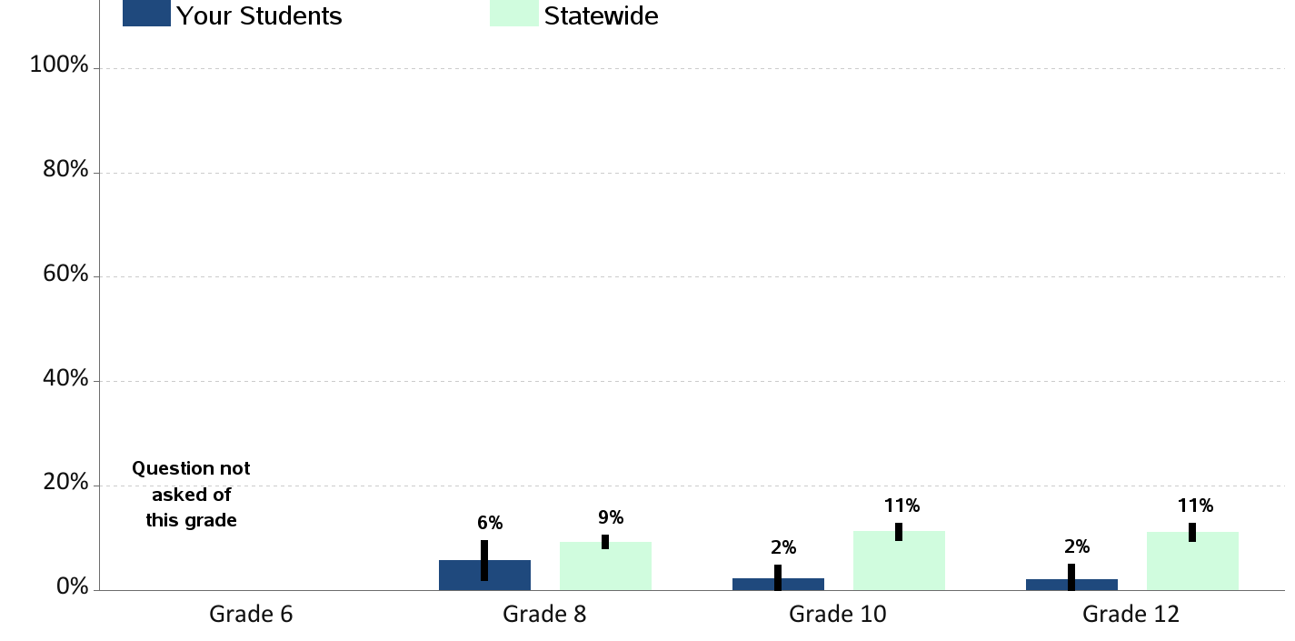
Obesity Percent of students who are obese (according to reported height and weight)

Slide 37
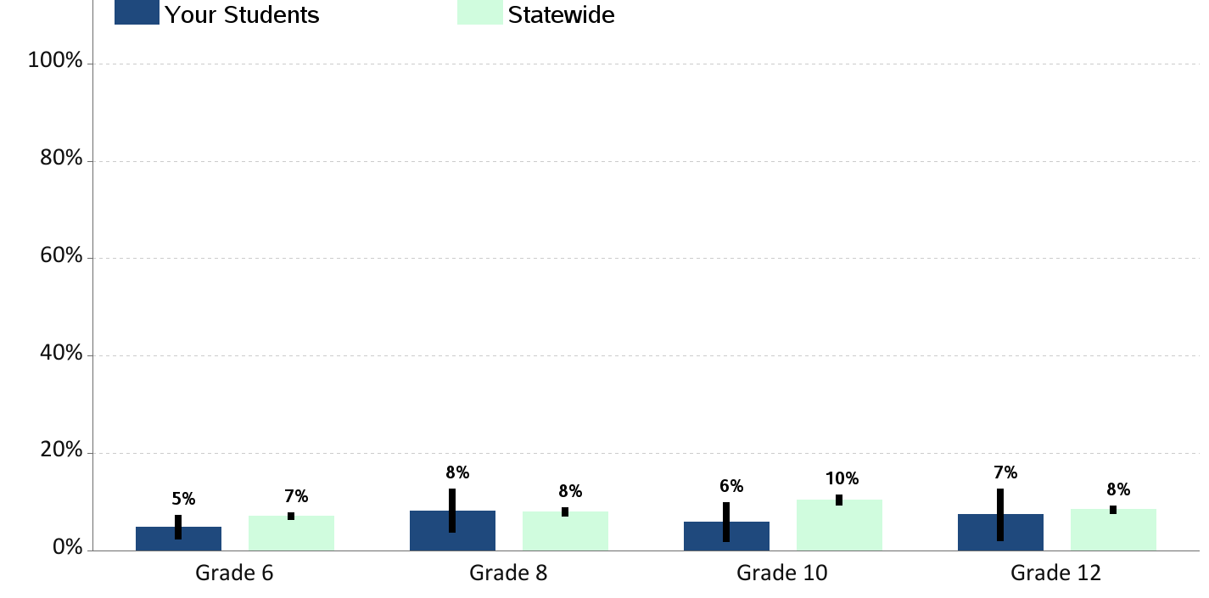
Current Asthma Percent of students who currently have asthma |

Slide 38
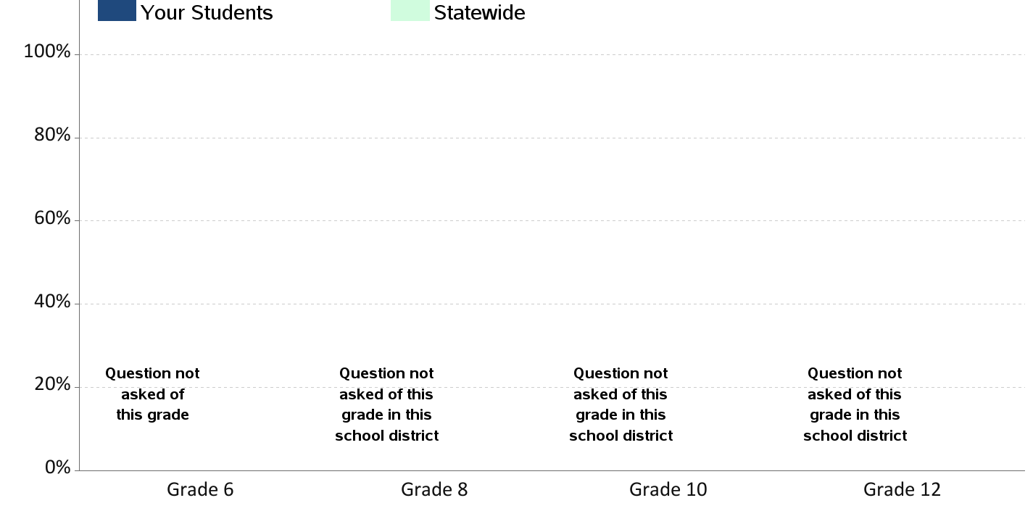
Lifetime Sexual Activity Percent of students who report ever having sexual intercourse in their lifetime

Slide 39
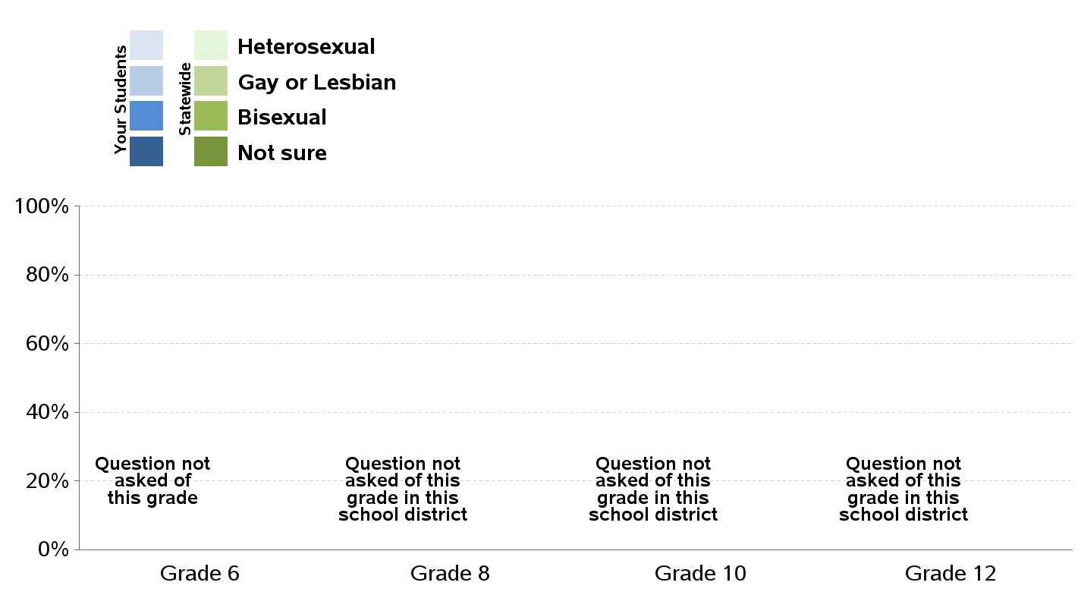
Sexual Orientation

Slide 40
Lifetime Sexual Abuse Percent of students who report having ever been in a in a situation where someone made them engage in kissing, sexual touch or sexual intercourse when they did not want to

Slide 41
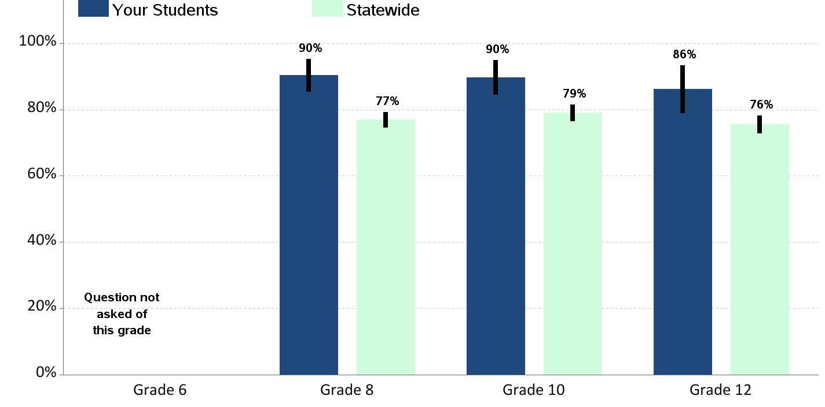
Access to Dental Care Percent of students who report visiting a dentist for a routine checkup in the past year

Slide 42
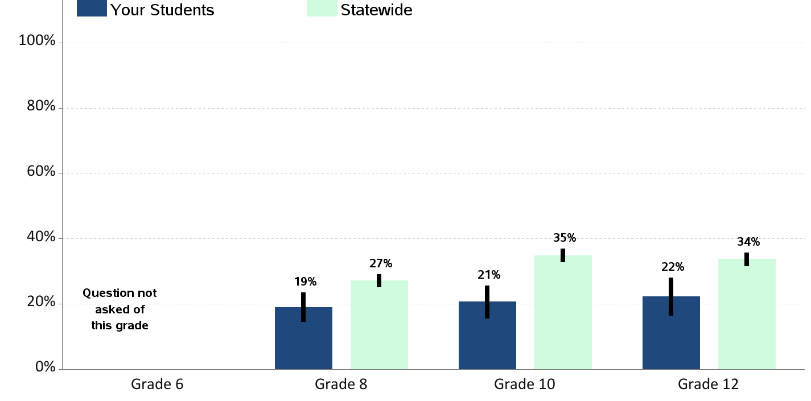
Depression Percent of students who report experiencing depressive feelings in the past year

Slide 43
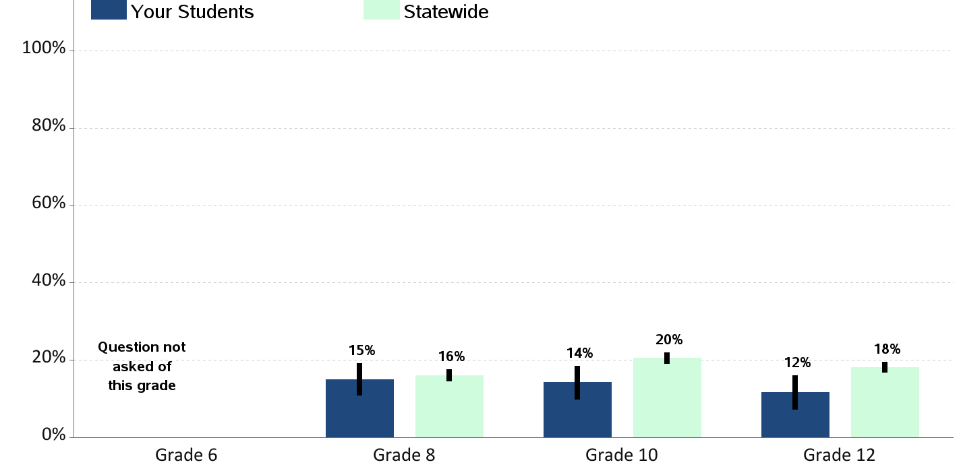
Contemplation of Suicide Percent of students who report having seriously considered suicide in the past year

Slide 44
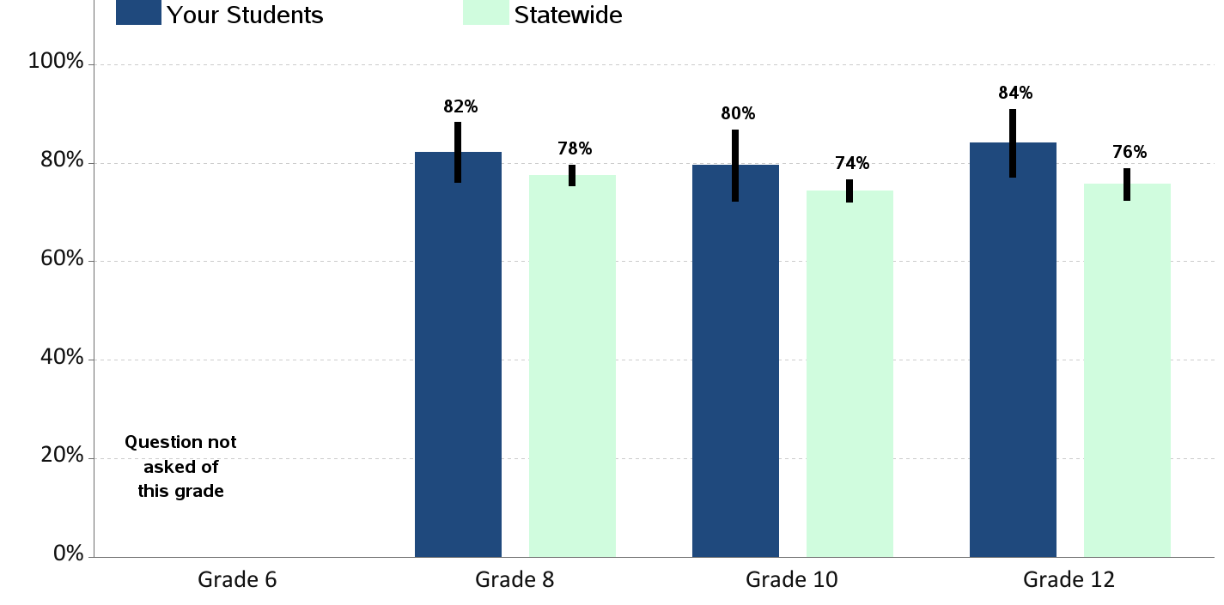
Someone in Community to Talk To Percent of students who report having an adult in their neighborhood or community they can talk to about something important

Slide 45
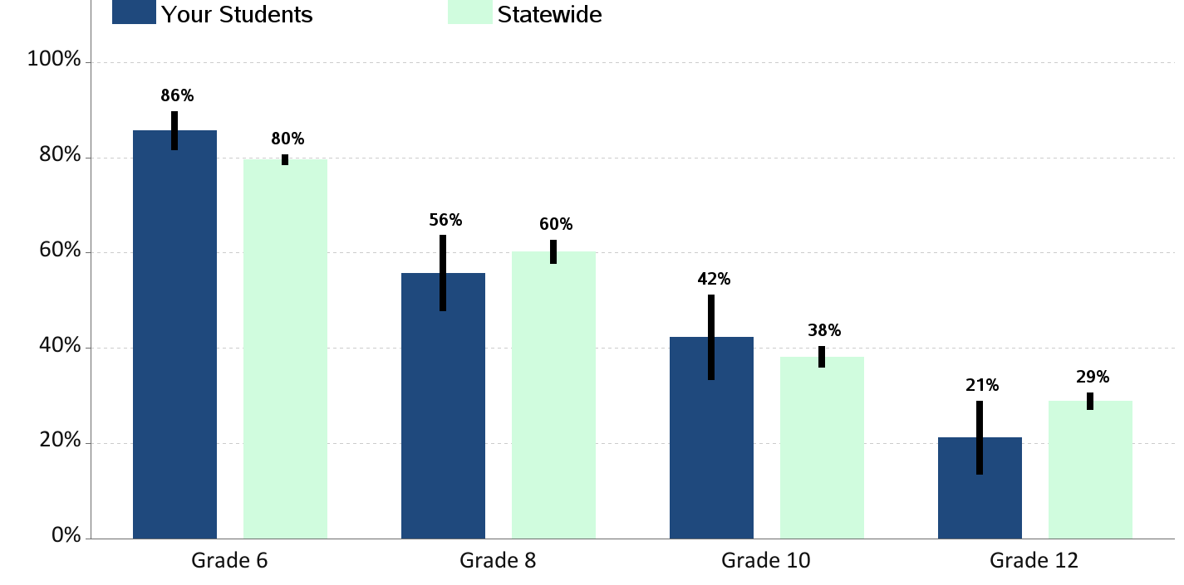
Perception of Neighborhood Norms - Alcohol Percent of students who report that adults in their neighborhood think youth drinking is "very wrong"

Slide 46
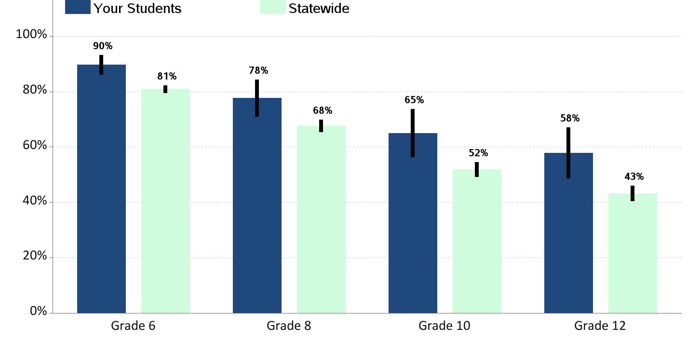
Perception of Neighborhood Norms - Smoking Percent of students who report that adults in their neighborhood think youth smoking is "very wrong"

Slide 47
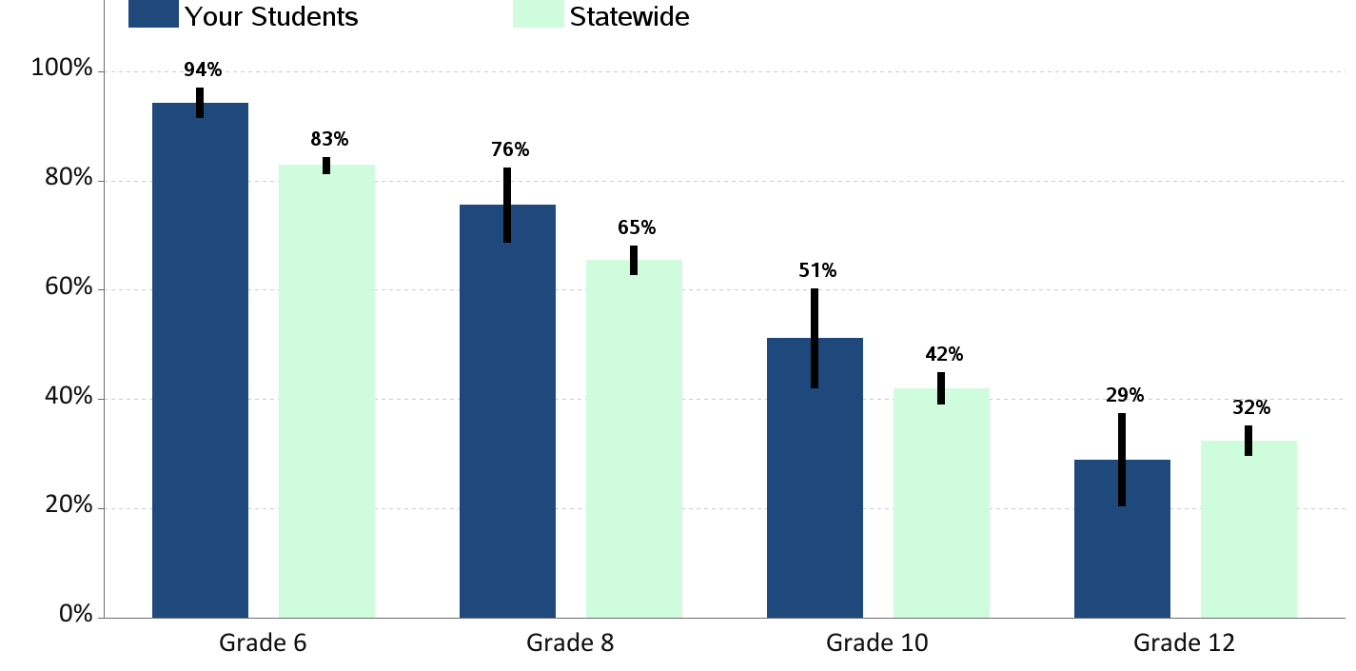
Perception of Neighborhood Norms - Marijuana Percent of students who report that adults in their neighborhood think youth marijuana use is "very wrong"

Slide 48
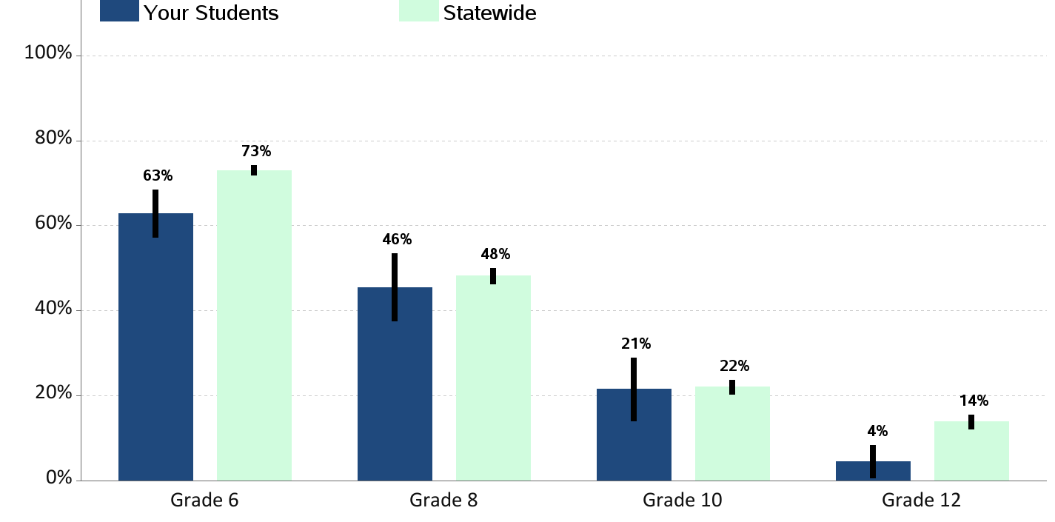
Perceived Availability of Alcohol Percent of students who report alcohol would be "very hard" to get

Slide 49
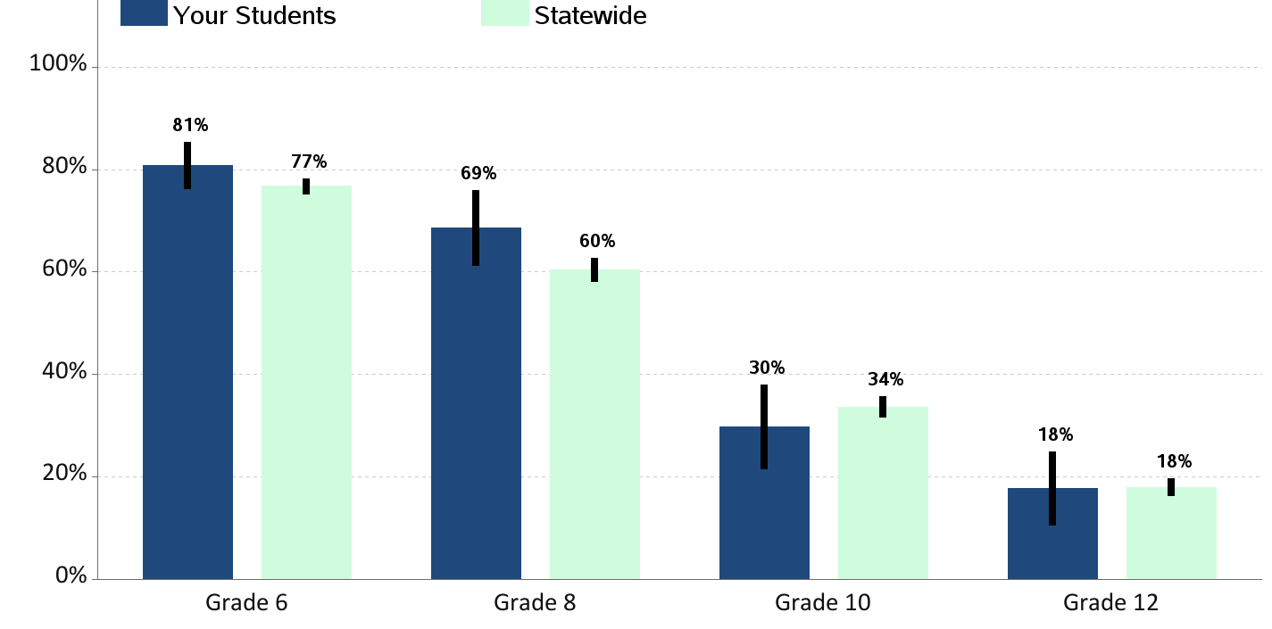
Perceived Availability of Cigarettes Percent of students who report cigarettes would be "very hard" to get

Slide 50
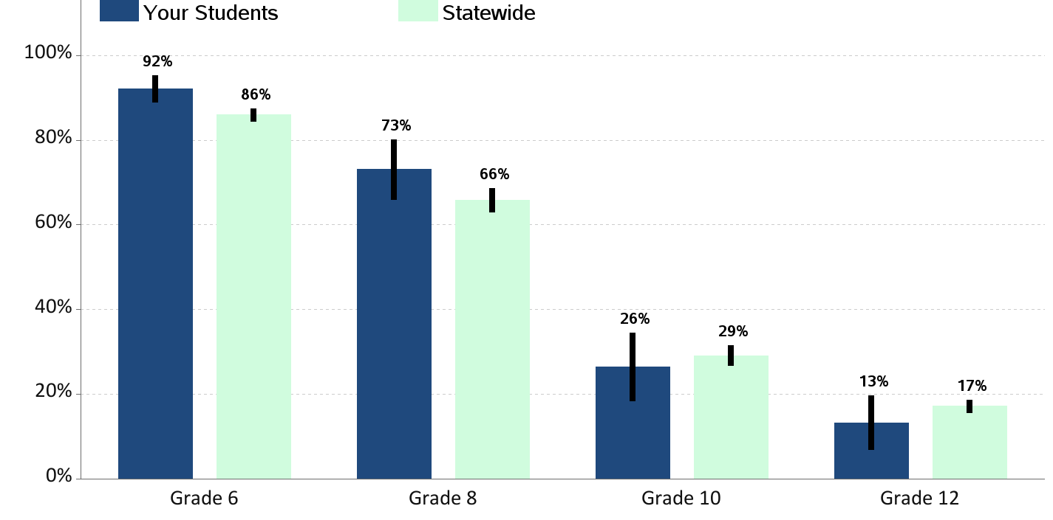
Perceived Availability of Marijuana Percent of students who report marijuana would be "very hard" to get

Slide 51
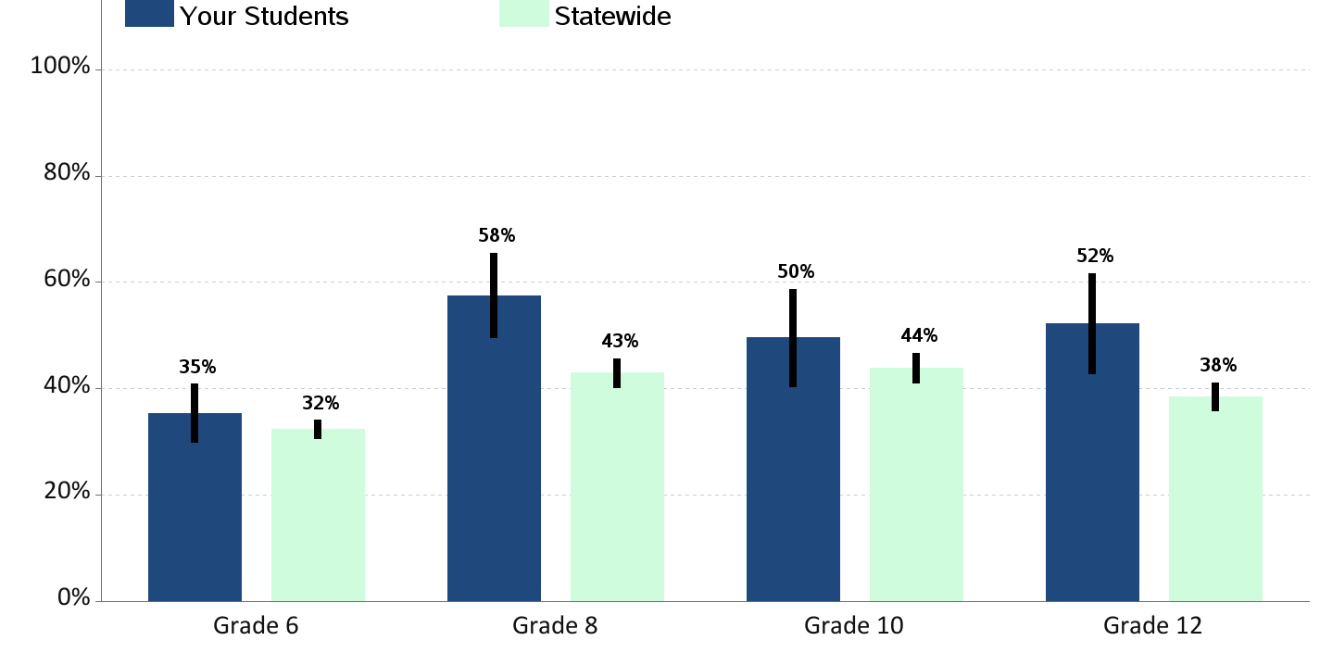
Perceived Risk of Regular Alcohol Use Percent of students who report "great risk" of harm from drinking alcohol daily

Slide 52
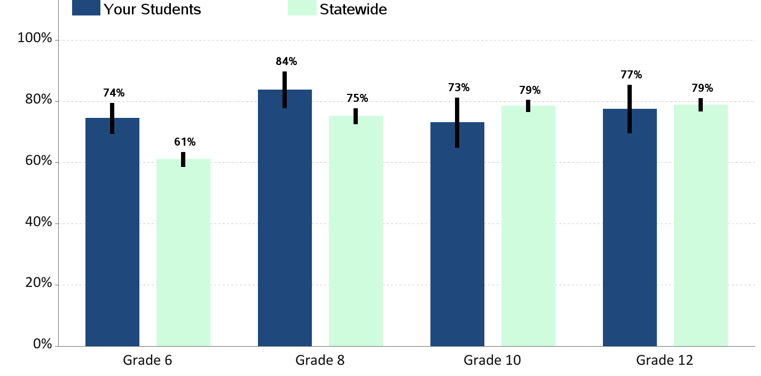
Perceived Risk of Regular Cigarette Smoking Percent of students who report "great risk" of harm from smoking a pack or more a day

Slide 53
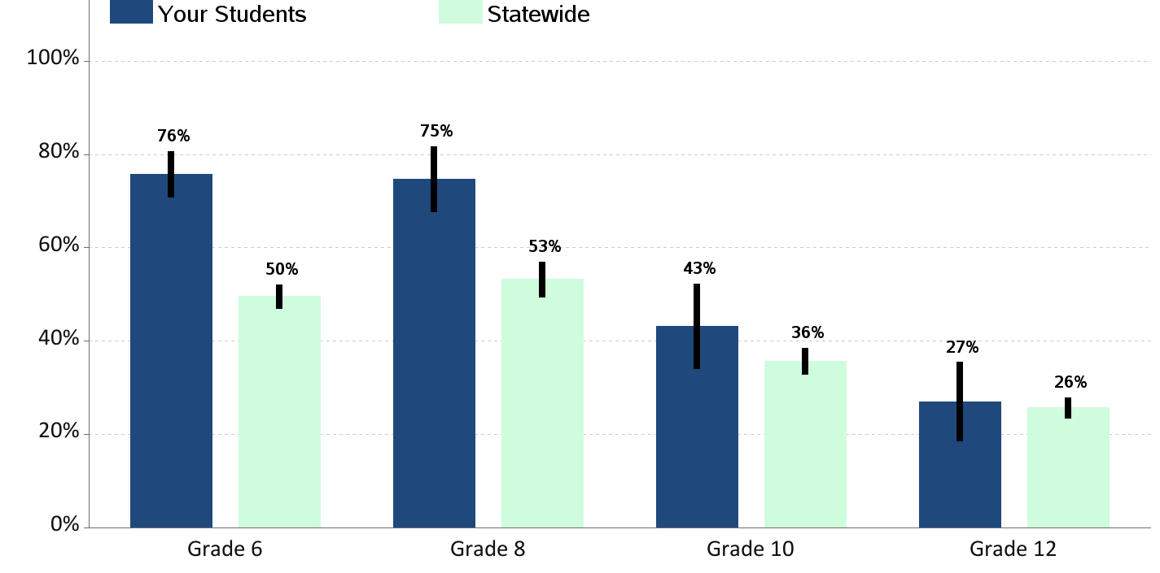
Perceived Risk of Regular Marijuana Use Percent of students who report "great risk" of harm from using marijuana at least once or twice a week

