Slide 1
Improving reading comprehension using evidence-based practices
Tiffany P. Hogan, PhD, CCC-SLP
MGH Institute of Health Professions, Boston, MA, USA
Harvard University
thogan@mghihp.edu @tiffanyphogan
@seehearspeakpodcast
@sailliteracylab

Slide 2
ACKNOWLEDGEMENTS
National Institute of Health, National Institute on Deafness and Other Communication Disorders
Co-Principal Investigator, National Institutes of Health R01 (R01 DC018823): Translating research into school-based practice via small-group, language-focused comprehension intervention, Co-PI Shayne Piasta, Co-Is: Mindy Bridges & Kandace Fleming.
Co-Principal Investigator, National Institutes of Health R01 (R01 DC016895): Orthography and phonology in word learning as a predictor of dyslexia in children with language impairment, 2018-2023. Co-PI Julie Wolter, Co-Is: Jessie Ricketts & Yaacov Petscher.
Co-Investigator, National Institutes of Health R01 (R01 DC010784): Working memory and word learning in children with typical development and language impairment, 2011-2016, PI: Shelley Gray; Co-Is: Mary Alt, Nelson Cowan, & Sam Green
Graduate Student, National Institutes of Health P50 (P50 DC2746): Collaboration on specific language impairment, 2001-2004, PI: J. Bruce Tomblin
Institute of Education Sciences, Reading for Understanding Initiative
Co-Investigator, Institute of Education Sciences Reading for Understanding Research Initiative (R305F100002): The Language Bases of Reading Comprehension, 2010-2016, PI: Laura Justice; Co-Is: Shelley Gray, Hugh Catts, & Kate Cain

Slide 3
Disclosures: Tiffany Hogan
MGH Institute of Health Professions, Salary
National Institutes of Health, Grant support
American Institute for Research - Tools Chart, Paid Consultant
Arizona State University, Grant Consultant
(unpaid) Scientific Studies of Reading, Elected Board Member
(unpaid) Co-founder of DLDandme.org
(unpaid) Host, SeeHearSpeak Podcast
Lexia Learning, Paid Consultant
DESE: MA, VA, RI, CO, NY Paid Consultant

Slide 4
#Goals for this talk
Overview work on language comprehension, focus on poor reader subgroups
Review an evidence-based, systematic Tier 1 (classroom) FREE curricula
Provide resources
Discussion

Slide 5
The Simple View of Reading (Catts, Hogan, & Fey, 2003; Catts, Hogan, & Adlof, 2005; Hoover & Gough, 1990)
Reading

Slide 6
The Simple View of Reading
Reading
Word Recognition

Slide 7
The Simple View of Reading
Reading
Word Recognition
Listening Comprehension

Slide 8
The Simple View of Reading
Reading
Word Recognition
Listening Comprehension

Slide 9
The Simple View of Reading
Reading
Listening Comprehension
Word Recognition

Slide 10
The Simple View of Reading
Reading
Listening Comprehension
Word Recognition

Slide 11
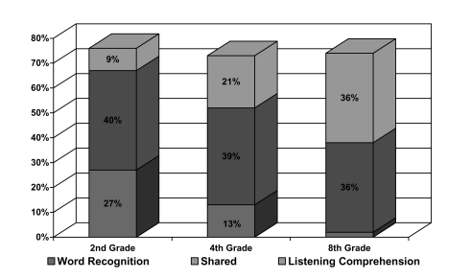
Catts, Hogan, & Adlof, 2005

Slide 12
Word Reading VS Listening comprehension

Slide 13
Word reading is the ability to accurately translate printed letter patterns into spoken words

Slide 14
Laip
Adjex
Yeng
Zirdn’t
gaked
WMRT-R Word Attack Subtest

Slide 15
Listening Comprehension IS the ability to understand spoken language

Slide 16
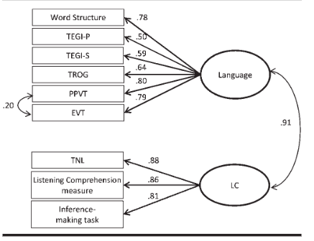
Listening or Language Comprehension?
Used interchangeably because they are the same on construct (LARRC, 2017)
But measured differently

Slide 17
An Example

Slide 18
Sally first let loose a team of gophers. The plan backfired when a dog chased them away. She then threw a party but the guests failed to bring their motorcycles. Furthermore, her stereo system was not loud enough. Obscene phone calls gave her some hope until the number was changed. It was the installation of the blinking neon lights across the street that finally did the trick. Sally framed the ad from the classified section and now has it hanging on her wall.

Slide 19
Where did Sally put the gophers?
Why did Sally want the guests to bring their motorcycles?
What did the ad say?

Slide 20
Simple View conclusions
Both components need to be considered when thinking of “reading”
(Hogan et al., 2014)

Slide 21
What’s language got to do with it?

Slide 22
Language
Form = sounds
LANGUAGE
Phonology
Grammar & Semantics
Pragmatics
Word Reading
Listening Comprehension
Content = vocabulary
& grammar
Use = social
Hogan, The Reading League Journal, 2022

Slide 23
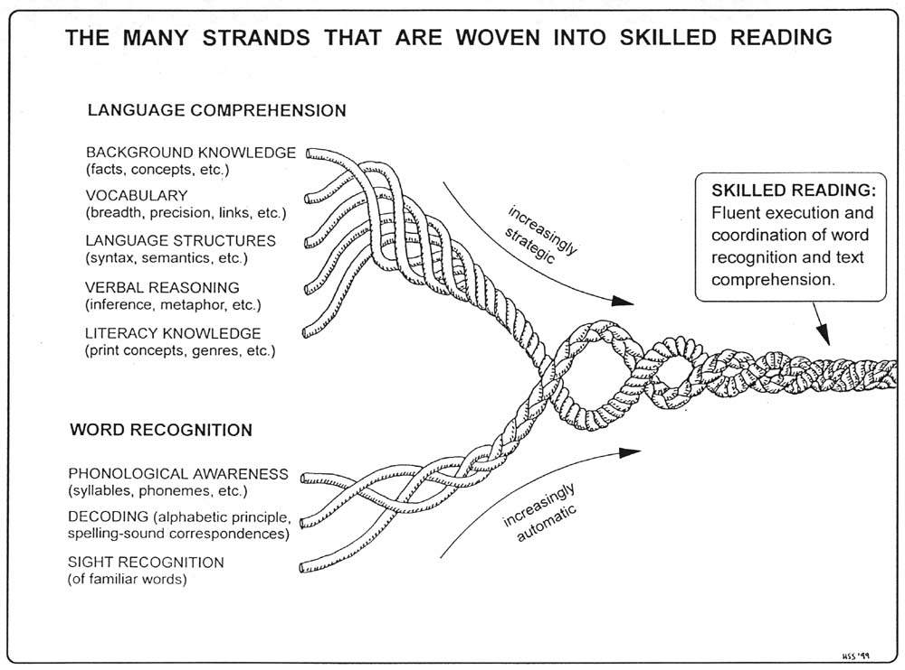
See Scarborough, H. S. in Neuman, S.B. & Dickinson, D. K. (2001). Handbook of Early Literacy Research. New York: Guilford Press.
Chat with Dr. Scarborough: https://www.youtube.com/watch?v=83tfzOFpBak&feature=youtu.be

Slide 24
Subgrouping poor readers
Poor readers are not all the same…
Simple view can be used to subgroup poor readers based on individual differences

Slide 25
Poor Reader Subgroups

Slide 26
Poor Reader Subgroups (Catts, Hogan, & Adlof, 2005; Catts, Hogan, & Fey, 2003)
Good
Poor
Word Recognition
Poor
Good
Listening Comprehension

Slide 27
Good
Poor
Word Recognition
Poor
Dyslexia
Good
Listening Comprehension

Slide 28
Dyslexia is a word-reading deficit

Slide 29
Facts about Dyslexia
A person is born with dyslexia, persists across the lifetime
Brain difference
~1 in 10 children
Cuts across SES and other disorders
Key deficits in phonological (sound) and orthographic (letter) processing
Many laws require early screening
(Snowling, 2019)

Slide 30
Word Recognition
Good
Poor
Developmental Language Disorder (DLD)
Poor
Dyslexia
Good
Listening Comprehension

Slide 31
Developmental Language Disorder
Developmental Language Disorder is when a child or adult has difficulties talking and/or understanding language

Slide 32
The Facts about DLD
A person is born with DLD, persists across the lifetime
Brain difference
~1 in 10 children
Cuts across SES and other disorders
Hallmarks are difficulty learning new words and remembering them (vocabulary) and grammar learning & use
(McGregor, 2020)

Slide 33
www.dldandme.org

Slide 34
DLD facts
https://radld.org/wp-content/uploads/2019/04/DLD-Fact-Sheet-English.pdf
Translated in 20 languages!!!
https://radld.org/about/dld/dld-fact-sheet/

Slide 35
Myths about DLD (https://dldandme.org/myths-about-dld/)

Slide 36
Myths about DLD (https://dldandme.org/myths-about-dld/)

Slide 37
How does Language development progress in children with DLD?
https://cldp.ku.edu/sites/cldp.ku.edu/files/docs/OpenAccessE-BookOctober2018.pdf
Mabel Rice: A train leaving the station late…the trajectory and sequence is very similar, but there are persistent delays

Slide 38
WHY? DLD IS DEVELOPMENTAL
Late Talker
Immature Grammar
Difficulty connecting sentences together to tell cohesive story
Elementary
Pre-K/K
Toddlers

Slide 39
Growing with DLD
https://www.youtube.com/watch?v=ooORu9vVBpE

Slide 40
Reading
DLD
Dyslexia
Word Recognition
Listening Comprehension

Slide 41
Poor
Dyslexia
Dyslexia +DLD
Word Recognition
Good
Poor
Good
Developmental Language Disorder (DLD)
Listening Comprehension

Slide 42
Catts, Hogan, & Adlof, 2005

Slide 43
Question
?
Is dyslexia a language disorder?

Slide 44
Language
LANGUAGE
Phonology
Grammar & Semantics
Pragmatics
Dyslexia
Developmental Language Disorder

Slide 45
https://www.ncbi.nlm.nih.gov/pubmed/30458538

Slide 46
Dyslexia versus developmental language disorder
Take home messages
Children with dyslexia have a deficit in word reading, ranging from mild to severe
Children with DLD have a deficit in language, ranging from mild to severe
50% of children with DLD have dyslexia
Both children with dyslexia and DLD have language deficits, but their language deficits are different.
Almost all poor readers have some early speech and language delays.
(Adlof & Hogan, 2018)

Slide 47
Simple view across development

Slide 48
Language and Reading Research Consortium (LARRC) and Chiu, Y. D. (2018). The Simple
View of Reading across development: the prediction of grade 3 reading comprehension by
prekindergarten skills. Remedial and Special Education, 39(5), 289-303.

Slide 49
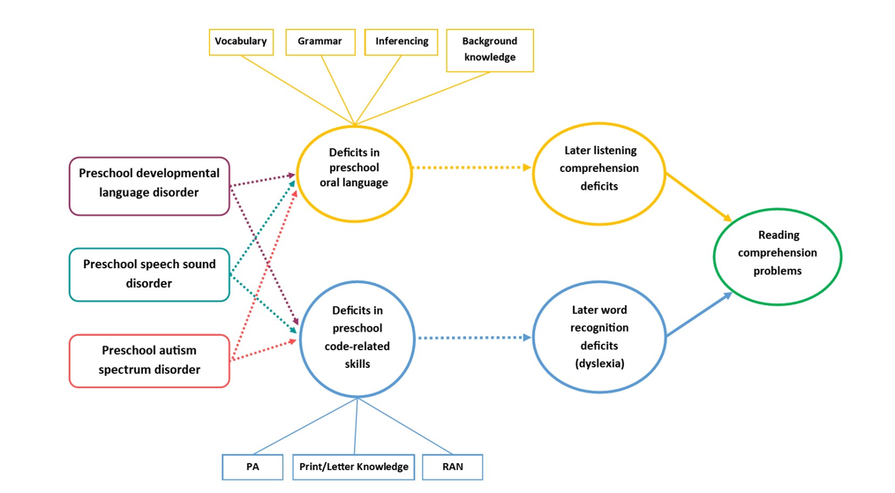
Komesidou & Hogan, 2020, IDA perspectives

Slide 50
Implications of Longitudinal data on simple view
Separate skills
Need to stimulate both
Early identification of both word reading and listening comprehension

Slide 51
school-age children with speech and language impairments OFTEN are struggling readers. (Stoeckel et al., 2013)

Slide 52
A STory
Labels used to qualify for services
DD
SLD
SLI
Where does DLD fit?
Developmental Delay
Speech & Language Impairment
Specific Learning Disability
Diagnosis
Dyslexia and/or Developmental Language Disorder

Slide 53
Why isn’t DLD better known?
It affects approximately 1 in 10 children! (Tomblin et al., 1997)
Maybe because…
Language is hard to explain
Language difficulties are easier to conceal, and misunderstood
Language development is not well understood
Kids don’t ‘catch up’ by waiting another year, instead Mathew effect kicks in
Late talkers confuse matters (~25% go on to have DLD)
Language has been the domain of SLPs.
It has been called by many names: https://dldandme.org/terminology/

Slide 55
DLD advocacy
Karla McGregor et al, 2020: https://pubs.asha.org/doi/full/10.1044/2019_PERSP-19-00083
Karla McGregor 2020: https://pubs.asha.org/doi/full/10.1044/2020_LSHSS-20-00003

Slide 56
Dldandme.org

Slide 58
Developmental Language Disorder (DLD) Awareness Day Oct 18, 2019
radld.org
2020: Oct 16
2021: Oct 15
2022: Oct 14

Slide 59
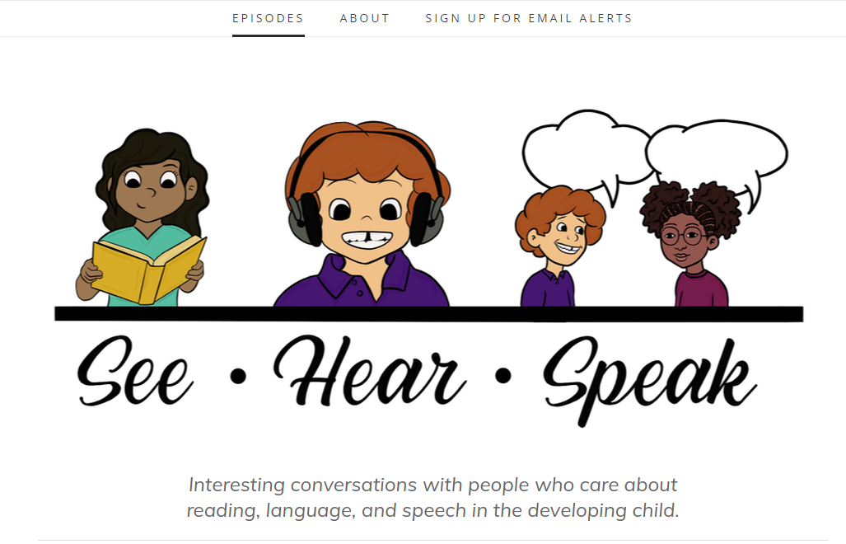
seehearspeakpodcast.com
History of DLD
Awareness campaigns for DLD
DLD & Working Memory
DLD & ADHD
A parent’s perspective on DLD

Slide 60
When Is DLD Identified?
What percentage of children with DLD are identified as having language difficulties in Kindergarten?
90%
75%
50%
20%

Slide 61
dld: Common, but Hidden, Disorder
Only ~20% of children with DLD are identified in early childhood / early elementary school (see Adlof & Hogan, 2019 for review)
Who is identified? (Wittke, Spaulding, & Schechtman, 2013)
Those with executive functioning deficits
Those who have mothers with high SES
Long term impact of having DLD (with lack of validation…and education)
Low self esteem
Shame
Unable to negotiate with language
Reading deficits…which lead to knowledge deficits
Juvenile delinquency
Higher rate of sexual assault
Lieser AM, Van der Voort D, Spaulding TJ. You have the right to remain silent: The ability of adolescents with
developmental language disorder to understand their legal rights. Journal of Communication Disorders.
http://pamelasnow.blogspot.com/2018/06/behaviour-as-form-of-communication.html
https://www.gse.harvard.edu/news/19/12/harvard-edcast-bringing-hidden-language-disorder-light

Slide 62
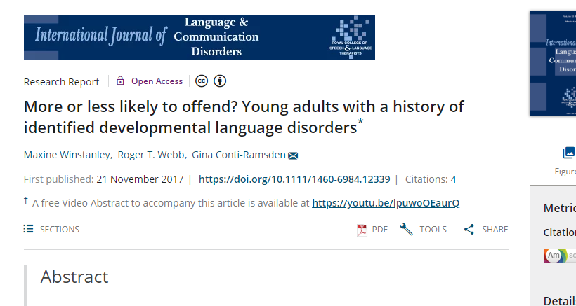
“Adults with a history of DLD who received targeted intervention during their school years reported less contact with their local police service compared with AMPs at age 24.”
“There is a need for early identification of children with DLD. Early intervention aimed at ameliorating such difficulties could possibly have distal outcomes in relation to offending.”

Slide 63
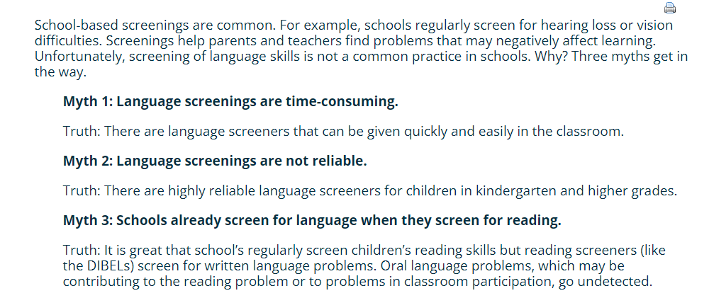
Why isn’t DLD caught earlier in Schools?
https://dldandme.org/school-language-screening/

Slide 64
‘Reading’ Changes Over Time
The Simple View is not so simple….

Slide 65
‘Reading’ changes over time (Catts, Hogan, & Adlof, 2005)
Reading Comprehension
Listening Comprehension
Word Recognition

Slide 66
‘Reading’ changes over time (Catts, Hogan, & Adlof, 2005)
Reading Comprehension
Word Recognition
Listening Comprehension

Slide 67
RESULTS: CHANGE OVER TIME
Word Recognition
G1 G2 G3
.81 (.48) .48
Reading Comprehension
Listening Comprehension
.22 (.57) .60
LARRC. (2015). Learning to read: Should we keep things simple? Reading Research Quarterly, 50, 151-169.

Slide 68
WRMT-R – Passage Comprehension
Grade 1 and below:
The boy has a cap on his _______
(with a picture of a boy walking with a cap on his head)

Slide 69
WRMT- R – Passage Comprehension
Grade 4 starting point:
The can of paint is nearly full. Susan will use it to _______ the walls (paint and cover are correct)
As soon as Tony tried to say anything, he would feel the other children looking at him. His face would get red, and the _____ wouldn’t come out. (words, truth, sentence, question, answer are correct)

Slide 70
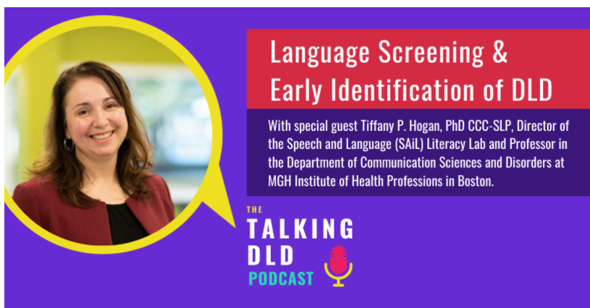
Shout OUT!
https://thedldproject.com/language-screening-and-early-identification-of-dld/

Slide 71
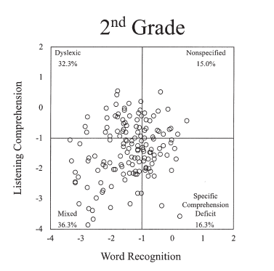
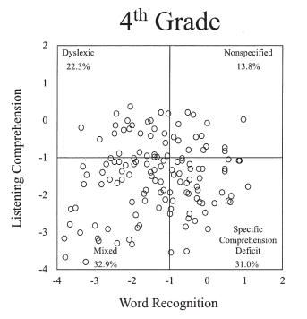
Catts, Hogan, & Adlof, 2005

Slide 72
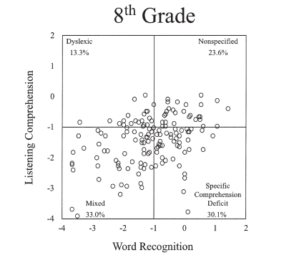
Catts, Hogan, & Adlof, 2005

Slide 73
Good
DLD
Word Recognition
Good
Poor
Poor
Dyslexia
Dyslexia + DLD
Listening Comprehension

Slide 74
Good
DLD
Word Recognition
Good
Poor
Poor
Dyslexia
Dyslexia + DLD
Listening Comprehension

Slide 75
Most Late Emerging Poor Readers are actually Late Identified
Catts et al., 2012; Petscher et al, 2017

Slide 76
Komesidou & Hogan, 2020, IDA perspectives

Slide 77
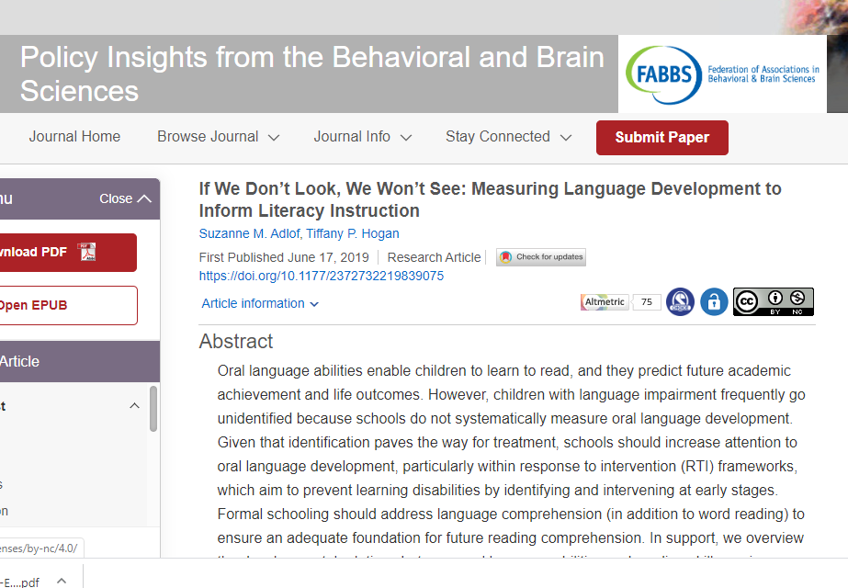
https://journals.sagepub.com/doi/full/10.1177/2372732219839075

Slide 78
Early screening for DLD
https://tinyurl.com/screen4DLD
https://charts.intensiveintervention.org/chart/academic-screening

Slide 79
Open source google doc

Slide 80
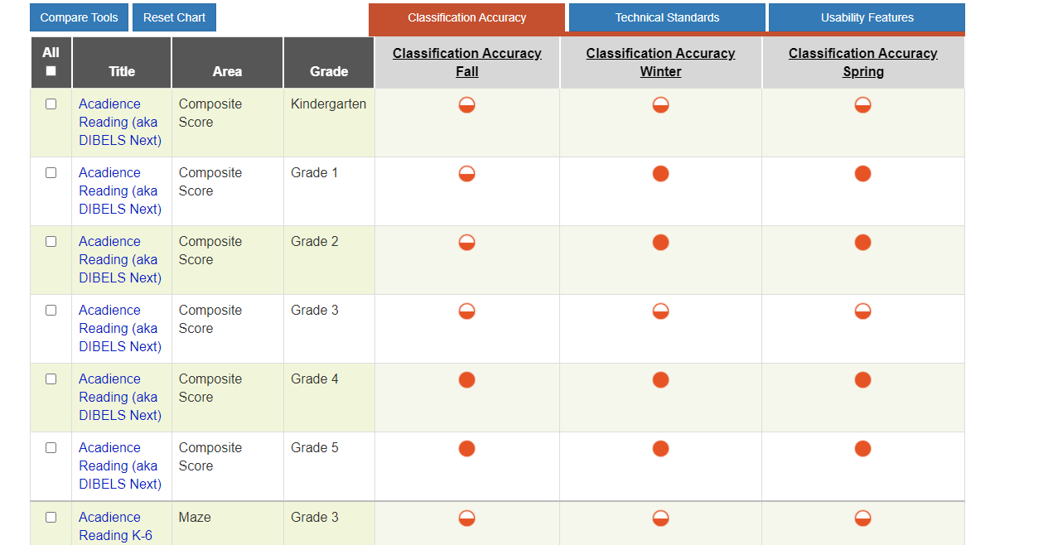
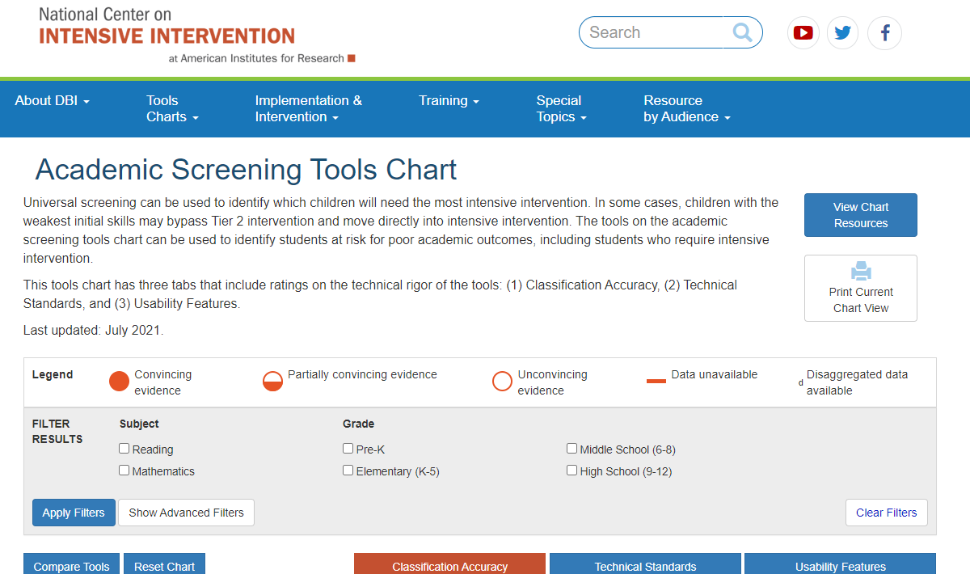
Tools Charts:
Screening
Progress Monitoring
Also..intervention
https://charts.intensiveintervention.org/ascreening

Slide 82
Dyslexia: An ounce of prevention is worth a pound of diagnosis https://psyarxiv.com/nvgje

Slide 83
School-based Process to Identify Those Who Need Support
Quality Small group support
(Tier 2)
IEP (Tier 3)
Evidence-Based Classroom Reading Instruction (Tier 1)
Progress Monitoring
(Tier 2)
Testing
(Tier 3)
Screening of all (Tier 1)

Slide 84
Komesidou & Hogan, 2020, IDA perspectives

Slide 85
ATTEND TO BOTH WORD READING & LANGUAGE Comprehension
Quality Small group support
(Tier 2)
IEP (Tier 3)
Evidence-Based Classroom Reading Instruction (Tier 1)
Progress Monitoring
(Tier 2)
Testing
(Tier 3)
Screening of all (Tier 1)

Slide 86
#GOALS – MUCH more WORK to be DONE
1. routine screening (and testing) for word reading difficulties (dyslexia) and language comprehension difficulties (DLD) in early grades,
2. evidence-based instruction in both word reading and language comprehension for all children,
3. developmentally appropriate instruction across the grades,
4. Build an understanding of neurodiversity

Slide 87
FACTS about Language comp
Language is important for both word reading and language comprehension – the foundations of reading comprehension (LARRC, 2015)
Language is a skill in and of itself, worthy of stimulation, not only in service of reading comprehension (Hogan et al., 2014)
Children do not need to be able to read books to benefit from book-based language stimulation (LARRC, Jiang, & Logan, 2019)
Implementing language curricula complements structured literacy to teach word reading

Slide 88
Books
Two sets of books
Decodables
Language rich books that showcase our language goals

Slide 89
How to SUpport Children with DLD in IN the SChools (Curran & Hogan, 2021)
Look for DLD (screening & follow-up testing)
Need for Implementation Science
Label to qualify for services vs DLD diagnosis
Talk about DLD
Advocacy
Focus on acceptance of individual differences
Provide high quality evidence based tiered language comprehension instruction

Slide 90
Access to lessons
Pre-K to Grade 3
https://larrc.ehe.osu.edu/
-click read ‘curriculum download’ button on upper right side

Slide 91
Access to lessons
Pre-K to Grade 3
https://larrc.ehe.osu.edu/
-click read ‘curriculum download’ button on upper right side
Middle & High School
https://www.meadowscenter.org/library/resource/pact-plus-sample-lessons
Middle & High School
http://stari.serpmedia.org/index.html

Slide 92
ATTEND TO BOTH WORD READING & LANGUAGE Comprehension
Quality Small group support
(Tier 2)
IEP (Tier 3)
Evidence-Based Classroom Reading Instruction (Tier 1)
Progress Monitoring
(Tier 2)
Testing
(Tier 3)
Screening of all (Tier 1)

Slide 93
Let’s KNow
3 years to define and develop…
language-based comprehension intervention
grades PreK to Grade 3 & ELL PreK
systematic and iterative developmental process
2-year randomized control trial

Slide 94
Almost 700 Free 30 min Lessons!
https://larrc.ehe.osu.edu/curriculum/downloads/

Slide 95
5 key malleable factors

Slide 96
Unifying Principles
Language-based
Text-based
Concept-based
Adaptable
Motivating
Systematically organized
Notes:
These are our Unifying Principles of Instruction that will govern a set of Practices across grades PreK-3.
Text-based
We want to connect children to a variety of text structures and provide word-reading and text-integration practice.
Our lessons will include expository and narrative texts representing a variety of text structures, and students will be provided extensive opportunities to analyze these texts.
Adaptable
Something we learned from our school teams is that being able to adapt the lesson content for learners of all different levels is incredibly important. Therefore, we want to provide options for differentiating instruction.
Concept-based
Research has shown us that children’s knowledge of scientific content can be improved simultaneously to their listening and reading comprehension.
We want to focus on developing children’s background knowledge by exploring scientific content and have organized instruction around multi-lesson content units, (e.g., The Human Body) as a content area domain that spirals across three levels of instruction.
Motivating: we have looked at the empirically validated ways to increase motivation during instruction and shaped our lessons to include:
high-interest texts (including texts that help students make connections between school and life)
opportunities for students to make choices (including choices about tasks and texts and the opportunity to discuss choices)
peer-peer collaboration (including engagement in hands-on learning activities)
meaningful instructional goals (including allowing students to track their progress towards mastery goals)
Systematically organized-
Organize instruction and student practice to over time.
We interleave practice opportunities that are aligned to instructional objectives (e.g., grammar, word knowledge, text structure, integration) within and across lessons and content units.
Language Focused
This is the center of our diagram because we emphasize reading comprehension as largely and foremost a language-based developmental process.
All of our lessons have an explicit focus on developing children’s language skills.
We have also aligned our objectives with the Common Core State Standards for English Language Arts and address a fourfold scope of language-focused objectives that transcend four domains: (a) grammar, (b) word knowledge, (c) text structure, and (d) integration

Slide 97
Year 1: Advisory Panel Conclusions
Include both informational and narrative texts
Texts should be the backbone of intervention
Strategic selection of words
Vocabulary tied to texts
Align with Common Core and State Standards

Slide 98
Year 1: Advisory Panel Conclusions
Lesson format
Include a range of lesson types
Scripted lessons with examples
30 minutes maximum
Content-based, language-based curricular supplement to current ELA

Slide 99
Let’s Know!
Four units
2 expository texts (animals and earth materials)
2 fiction (fiction and folktales)
Each unit had 3 fiction or expository texts to accompany the lessons

Slide 100
Lesson Structure
Goal – teacher introduces the purpose of lesson
I do – teacher models the skill targeted
We do – children and teacher practice the skill together
You do – children practice skill independently
Close - teacher summarizes and reviews what they learned

Slide 101
Let’s Know! (LARRC) FINDINGS
Field studies showed that teachers implementing Let’s Know! language curriculum used significantly more language-facilitating strategies than teachers implementing business-as-usual conditions (LARRC, Pratt, & Logan, 2014)
Also used more language-facilitating strategies when implementing Let’s Know! as compared to when implementing typical ELA lessons

Slide 102
RCT: Impacts of Let’s Know! on listening and reading comprehension (LARRC, Jiang, & Logan, 2019; LARRC, 2022)
Students in Grades PreK-3 (n= 1695 across 304 classrooms) across 4 states) who received Let’s Know! showed significant gains in key areas of language
Vocabulary
Comprehension monitoring
G1-G3 Indirect effect on standardized reading comprehension through vocabulary
Notes:
Our final study involved looking at the Impacts of LK on our distal measures, which included standardized measures of language comprehension and reading comprehension. Based on our initial analyses with both cohorts, there were not significant effects on LC or RC. We are currently exploring moderation with respect to child factors. I am particularly interested in the effects of this instruction on students who started the year with low language skills. I am also interested in examining factors related to the implementation of the curriculum.
Multilevel model
Imputation

Slide 103
Let’s review a lesson

Slide 104
5 key malleable factors
Hogan et al., 2011

Slide 105
Basic Language Skills
1. Vocabulary 2. Grammar

Slide 106
Vocabulary
Number of words
Depth of word knowledge
Connections
Use basic definitions, teach concepts
Link new words to known words
Teach subtle differences in a category
Flowers: rose, tulip, daisy
Multi-sensory exposure

Slide 107
Vocabulary Instruction
Orthography
Phonology
Semantics
“point of contact” learning is helpful to learning a new word
A word should be taught in conjunction with other like
words

Slide 108
Beeman, et al (1994)
Foot
Cry
Glass
Cut

Slide 109
Grammar
Teach in context
Use variety of texts
‘Mentor’ text

Slide 110
https://www.theinformedslp.com/how-to/grammar-chart

Slide 111
Effect of Teacher language
Preschool and kindergarten teachers’ complexity of sentences linked to children’s grammar and vocabulary learning
“Together, the results imply that complex syntax is an important source of linguistic information for word learners, and that teachers’ syntax may be another, often overlooked but potentially malleable dimension of classroom quality.”
(Farrow, Wasik, & Hindman, 2020)

Slide 112
Higher-level Language Skills
3. Inferencing
4. Comprehension Monitoring
5. Text Structure Knowledge

Slide 113
Inferencing
More than just vocabulary and grammar
Use background knowledge to ‘fill in the gaps’

Slide 114
Inferencing
Filling in the gaps in text
Much of what we take from a story is not explicitly stated
Building background knowledge
Activate “schema” before reading story
Inferential questioning
Example: “Why is Bobby so angry?”
Story shows Bobby making a sand castle. Next, Bobby is red-faced and his castle is flattened, presumably by a wave.
Follow with, “What knocked his castle over?”
When correct response given, “How did you know that?”

Slide 115
Comprehension Monitoring
Strategies to check that one is understanding text
Periodic summaries
Main points
Can monitor breakdowns
Think-alouds
Teacher models comprehension monitoring
Question whether the story
is making sense

Slide 116
Wait a minute - how is comprehension monitoring different than strategies?
Teaching comprehension monitoring within a larger set of skills, as an integrated whole…
…different from teaching only (or mainly) strategies

Slide 117
Text Structure Knowledge
Characteristics of written material
Key elements in narrative – story grammar
Setting
Main character
His/her problem
His/her attempts to solve problem
Resolution or ending
Point out each component
Visuals
Story rainbow – each element represented by color
Story keychain – each element represented by key
(mindwingconcepts.com)

Slide 119
Expository Text Structure
Problem – Solution
Description
Compare – Contrast
Cause – Effect
Chronological/Sequence

Slide 120
How to Help Children with DLD in IN the SChools (Curran & Hogan, 2021)
Look for DLD (screening & follow-up testing)
Need for Implementation Science
Label to qualify for services vs DLD diagnosis
Talk about DLD
Advocacy
Focus on acceptance of individual differences
Provide high quality evidence based tiered language comprehension instruction
Create DLD friendly classroom environment

Slide 122
In the classroom
Face the child
Make clear, explicit statements
Repeat and rephrase key instructions
Use multimodal supports
Allow extra time to process language
Ask child to repeat instructions

Slide 123
In the classroom
Breakdown larger information into chunks
Use visually distinct sections
Use graphics and icons
Provide key definitions
Have questions and text on same page

Slide 124
Supporting Child with DLD outside of school
Tell parents about DLD
Encourage discussion of DLD with all around child
Include child
Stimulate language through daily routines
Allow extra time for homework

Slide 125
Practice to Research to Practice Gap:
It takes approximately 17 years for only 14% of efficacy research to make it into practice. (Morris et al., 2011)

Slide 126
Partnership with Worcester Public Schools
Promote early identification of students at risk of language and reading difficulties, including dyslexia
Understand the language and reading development of students with and without language difficulties, from kindergarten to second grade (Hogan & Wolter, Ricketts, & Petscher)
Determine the effectiveness of small-group interventions for students with language difficulties (Hogan & Piasta, Bridges, & Fleming)
Support regular and special education

Slide 127
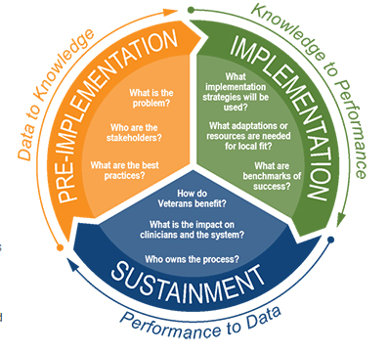
Implementation Science
QUERI Implementation Road
map (va.gov)
The QUERI Implementation Roadmap is a comprehensive, practical guide for health care practitioners and researchers to plan and deploy methods to support uptake of effective practices in routine care settings.
School-based IS framework (Komesidou & Hogan, 2021)

Slide 129
What we learned screening for DLD (Komesidou Et Al., 2022)
Barriers
Lack of awareness of what DLD is & importance for early ID
Lack of systems in place for collaboration between Gen Ed and SLP
Lack of efficient DLD screeners
Lack of sensitive early ID of DLD in ELL populations
Lack of structure for further assessment and support
Facilitators
Supportive school leaders
Interest by teachers beyond word reading
School-based data manager
Screening for dyslexia
Learning communities and commitment to professional development
New laws focused on dyslexia screening

Slide 130
CSD Implementation science
Facebook group
Imp-Sci is for all: A CSD Research-Practice Exchange
Sign up for email about future offerings
https://info.mghihp.edu/isforall

Slide 131
Take home messages

Slide 132
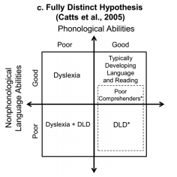
ATTEND TO BOTH WORD READING & LANGUAGE Comprehension
Quality Small group support
(Tier 2)
IEP (Tier 3)
Evidence-Based Classroom Reading Instruction (Tier 1)
Progress Monitoring
(Tier 2)
Testing
(Tier 3)
Screening of all (Tier 1)

Slide 133
REsources

Slide 134
https://nces.ed.gov/pubsearch/pubsinfo.asp?pubid=WWCPGLit21

Slide 135
https://ccsso.org/sites/default/files/2018-06/RfU Initiative Brief Policy Report.pdf

Slide 137
https://www.thereadingleague.org/what-is-the-science-of-reading/

Slide 138
Access to lessons
Pre-K to Grade 3
https://larrc.ehe.osu.edu/
-click read ‘curriculum download’ button on upper right side
Middle & High School
https://www.meadowscenter.org/library/resource/pact-plus-sample-lessons
Middle & High School
http://stari.serpmedia.org/index.html

Slide 139
https://knowledgematterscampaign.org/

Slide 140
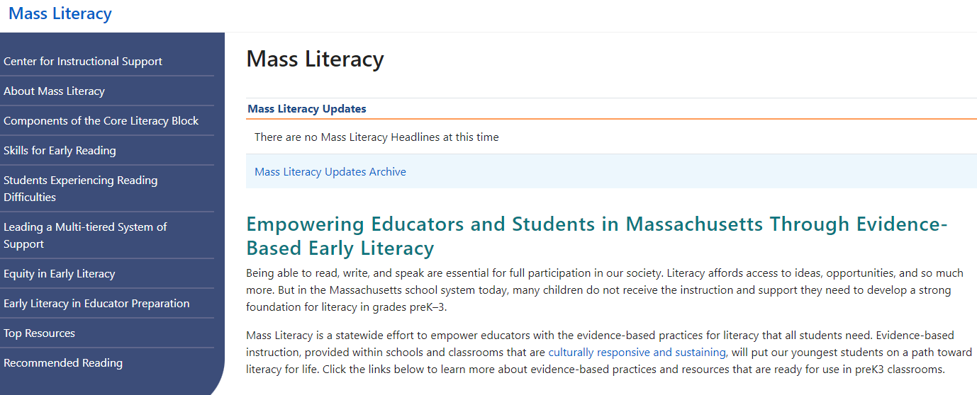
MASs Literacy
https://www.doe.mass.edu/massliteracy/

Slide 141
THANK YOU & Good luck! CHANGE THE world one child at a time…
Email: thogan@mghihp.edu
Twitter: @tiffanyphogan
Web: http://www.mghihp.edu/sail-lab/
Facebook: sailliteracylab
Instagram: @seehearspeakpodcast
Podcast: seehearspeakpodcast.com
DLD information: dldandme.org

