Slide 1
Glendale Students of The Month
2022-2023

Slide 2
September Theme: Respectful & Responsible

Slide 3
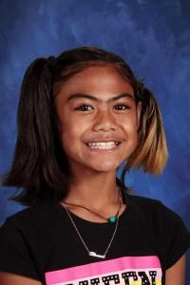
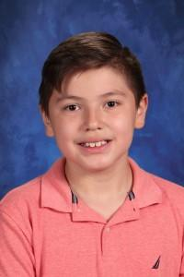
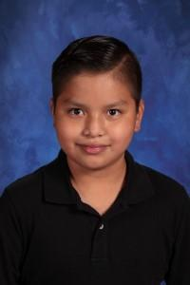
6th Grade
Anaseini Kuma Angel Olvera Guarneros III Emilio Silverio Cruz

Slide 4
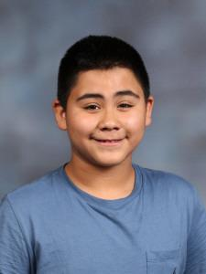
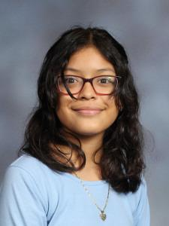
6th Grade & 7th Grade
Arlette Flores-Zetino Ruben Avila-Hernandez Sofia Valenzuela Gonzalez

Slide 5
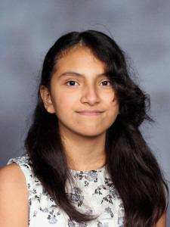
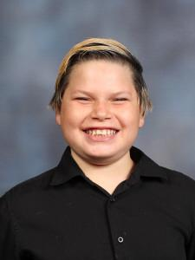
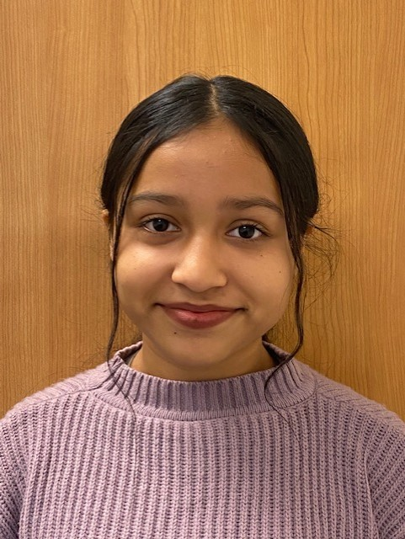
7th Grade
Paola Rodriguez Bahena Alex Izenberg Rubi Almazan Barrera

Slide 6
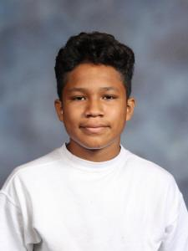
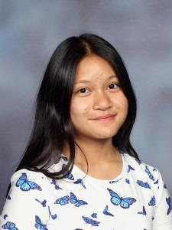
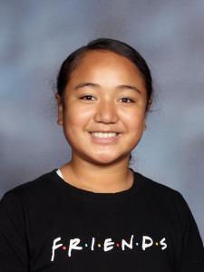
8th Grade
Jose Suriano Romulo Mya Snow Paw Lahviere Bernard

Slide 7
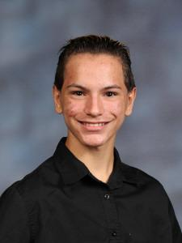
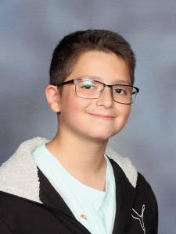
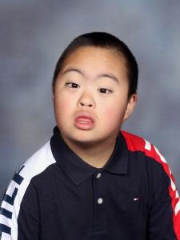
8th Grade
Daniel Izenberg Miguel Santana Madrigal Hector Jimenez

Slide 8
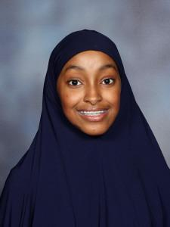
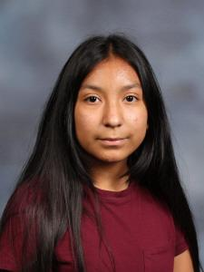
8th Grade
Hamdi Noor Lesly Resendiz

Slide 9
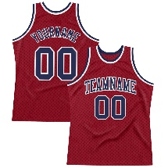
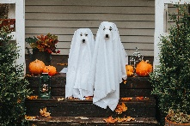
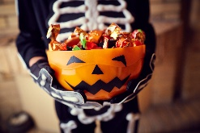
ANTIBULLYING SPIRIT WEEK 2022
WEDNESDAY 10/26: Team up against bullying
Wear your favorite sports team jersey or gear
FRIDAY 10/28: Glendale Middle chooses to be bully-free!
Wear your favorite Glendale gear or Glendale colors
MONDAY 10/24:
Roll out Antibullying Spirit Week
TUESDAY 10/25: You are NOT alone…
TWIN DAY!!!
Dress alike with a friend or group of friends.
THURSDAY 10/27: Put bulling to rest on Pajama Day!
Wear your favorite/coziest PJ’s to school.
MONDAY 10/31: HALLOWEEN
Come to school in your Halloween best (and we’ll put the hate to rest!)

Slide 10
ANTIBULLYING WEEK – Advisory Activities
MONDAY 10/24:
Ms. Gino presents Antibullying Week &
HIB 101 [kahoot]
(via Advisory streaming)
FRIDAY 10/28: Human arrow with students rocking Glendale gear!
Everyone sign the Pounce Pledge Paw during Advisory
WEDNESDAY 10/26: Skits brought to you by the Theater 1 students via GlendaleBuzz
(via Advisory streaming)
TUESDAY 10/25: Who will you stand up for? Arrow activity
THURSDAY 10/27: Antibullying vocabulary word-search activity
MONDAY 10/31: HALLOWEEN
Bury the bad [words]
Halloween dance 1:30-2:30pm

Slide 11
Counselor’s Corner
Suicide Prevention Lessons this week;
In November, we will be focusing on College & Career Readiness. (Our family night is Thurs, Nov 10th from 5:30-7:30 PM and our school-wide student conference is on Friday, Nov 11th from 8-10 AM).
We are still looking for presenters who’d be willing to share their college/career experience with our students!

Slide 12
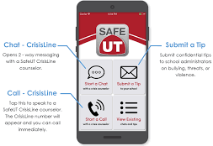
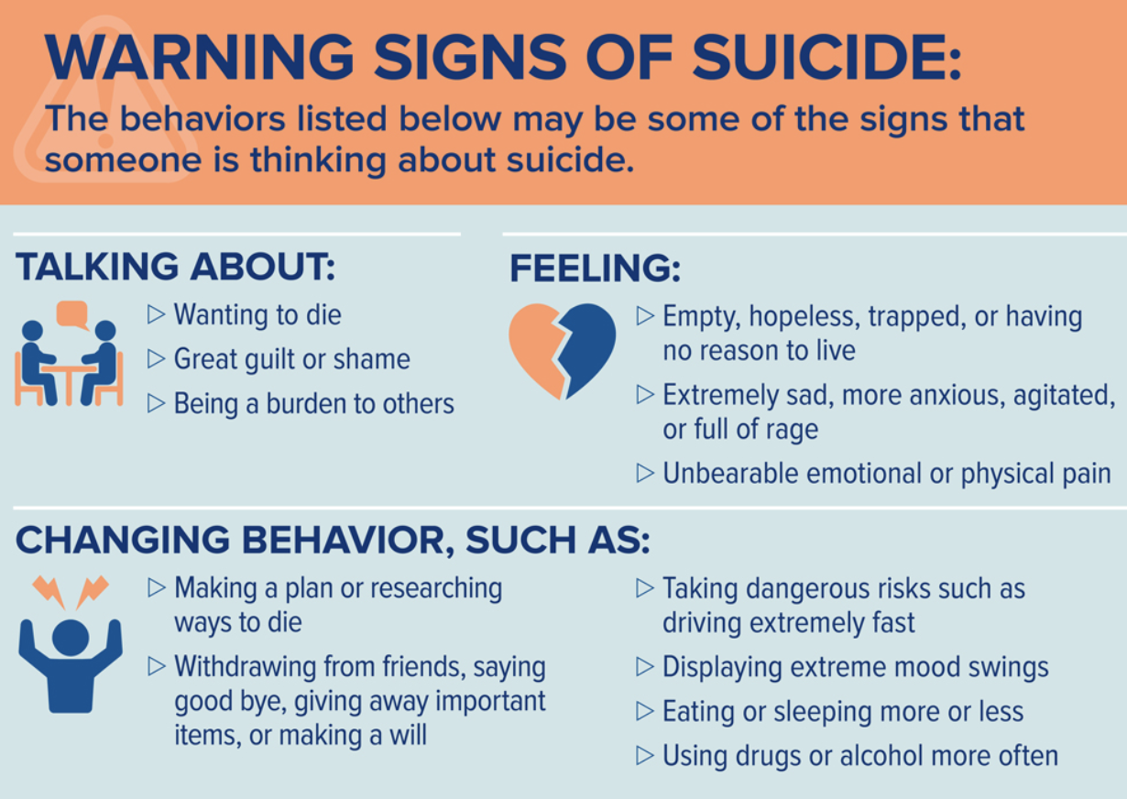
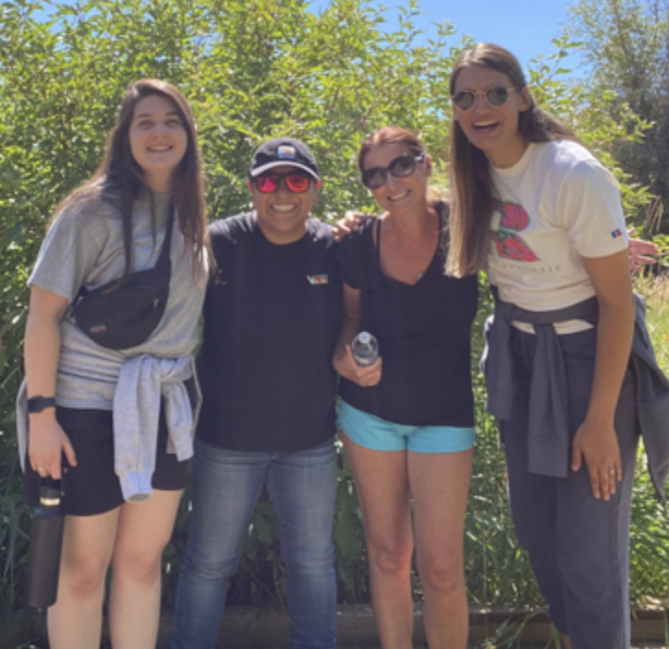
Suicide Prevention
We used Lifelines Training Videos for Students which went through the warning signs.
Coming Soon: QPR Suicide Prevention for Families Trainings

