Slide 1
Financial Aid 101
Presented by:
Katie Sprunger
Edgewood College

Slide 2

Financing A College Education
A successful experience requires a collaborative effort by:
  Student
  Parent
  Institution
  Government

Slide 3


Slide 4
What is the EFC?
Federal Methodology:
A formula created by Congress to determine your Expected Family Contribution(EFC)
  The same formula applies to all applicants.
  Measures your ability, not willingness to pay.
  EFC components:
    Parent Income and Assets
    Student Income and Assets
Things not considered: value of primary residence, consumer debt, or retirement accounts.

Slide 5

What is Financial Need?
Cost of Attendance (COA) = A
Tuition, Fees, Room, Board, Transportation, and Misc.
Expected Family Contribution(EFC)from FAFSA = B
Income, Assets, Number in Family, Number in College
A – B = (C) Your Financial Need

Slide 6
Your need depends on the cost!
 | UW System | Voc Tech | Private
COA | $38,000 | $28,000 | $48,000
EFC | $5,000 | $5,000 | $5,000
NEED | $33,000 | $23,000 | $43,000

Slide 7

Scholarships
Academic
Creative Talent
Athletic Talent
Ethnicity/Religion

Slide 8

Need-Based Grants
Federal Government
    Pell
    SEOG
    TEACH Grant
State Government
    Wisconsin Grant
Institutional
    Varies by institution

Slide 9

Loans
Federal Direct Loan (22-23 UG rates)
  Subsidized and Unsubsidized 4.99%
  $3,500 Subsidized
  $2,000 Unsubsidized
PLUS: Parent Loan for Undergraduate Students
  7.54 %
Alternative Loans (vary)
Institutional (vary)

Slide 10
Financial Aid Limitations
Federal Pell Grant
  6 years at full time status
Wisconsin Grant
  10 semesters
**Usage is cumulative throughout college career.**
**Other programs may also have additional limitations – check with the aid office for further details.**

Slide 11


Student Employment
Part-time employment
  On campus
  Designated off-campus locations
Questions to ask
  When are jobs available?
  How does a student secure a job?
  Does the student get paid directly or is it applied to their account?
Be prepared to complete new hire paperwork
  I9, WT4, W4
  Bring 2 original forms of identification

Slide 12


Eligibility for Financial Aid
Don’t eliminate yourself! Remember it’s
There is no income cutoff for financial aid.
Complete admission process.
Contact the Aid Office if financial circumstances change.

Slide 13
Before FAFSA filing….
FSA ID tips
FSA ID = electronic signature for student and parent
  Separate email and mobile phone required
Create at least 3 days prior to FAFSA filing.
Write down usernames, passwords, security question answers.
Will need access to email and/or mobile phone during this process.

Slide 14
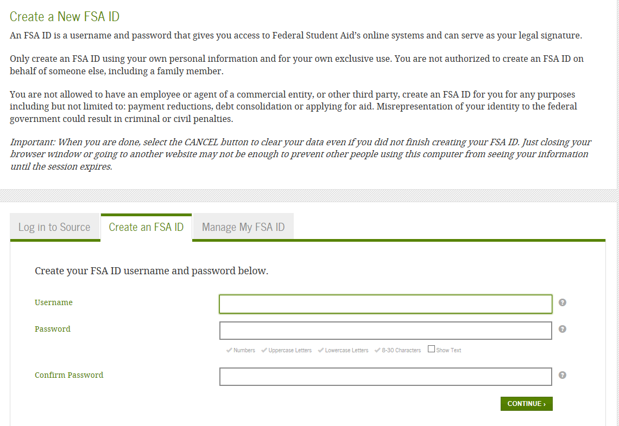
Create Your FSA ID www.studentaid.gov
Email:
Each FSA ID must have a unique email address (you and your parent cannot use the same email address).
You must have access to this email account.
Username:
Don’t include personal info such as date of birth or name.
If you see a message “Username taken, create a different username,” then someone has already used that username.

Slide 15
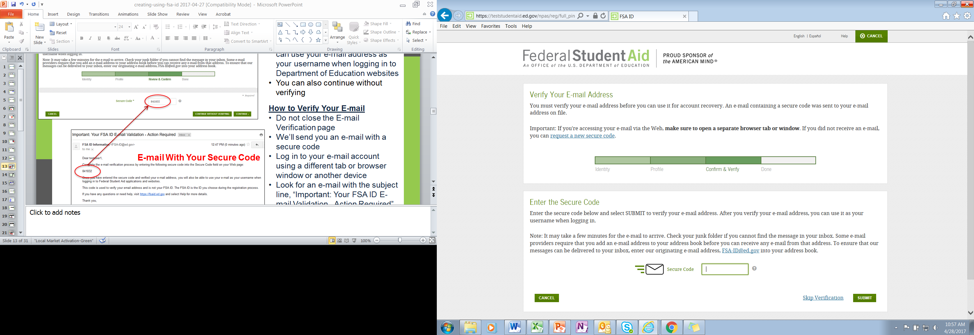
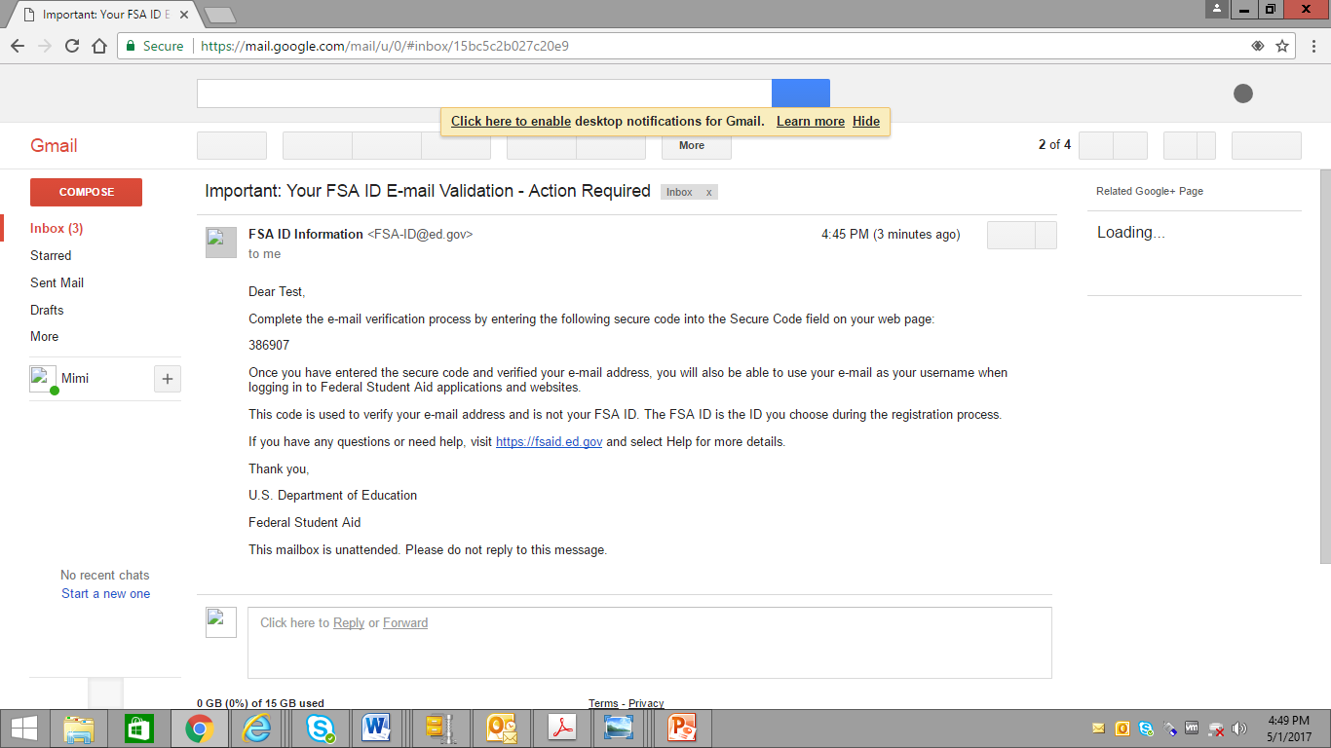
Verify Your Email/Mobile Phone
Email Verification Page
Email With Your Secure Code

Slide 16
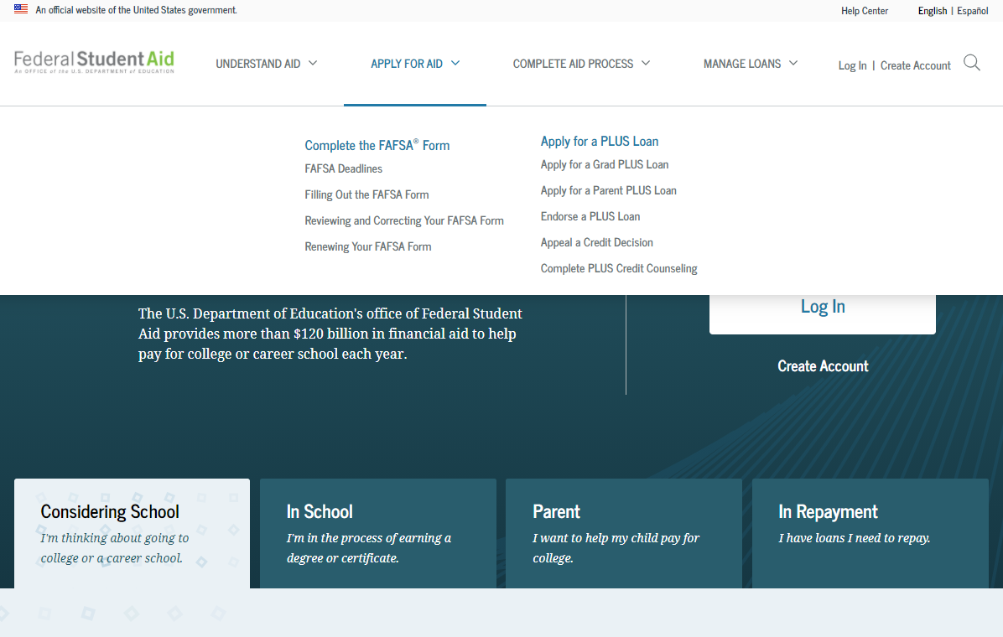
FAFSA opens October 1 www.studentaid.gov

Slide 17
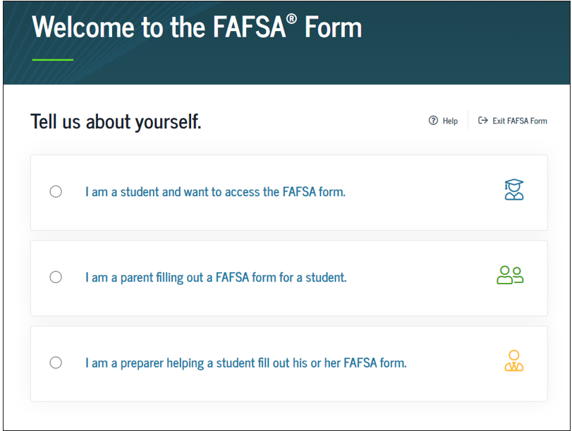
Who is completing the FAFSA?

Slide 18
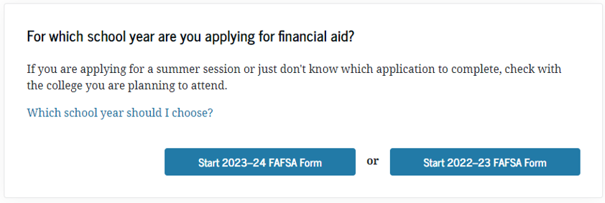
Fall 2023 applicants choose
2023-2024

Slide 19
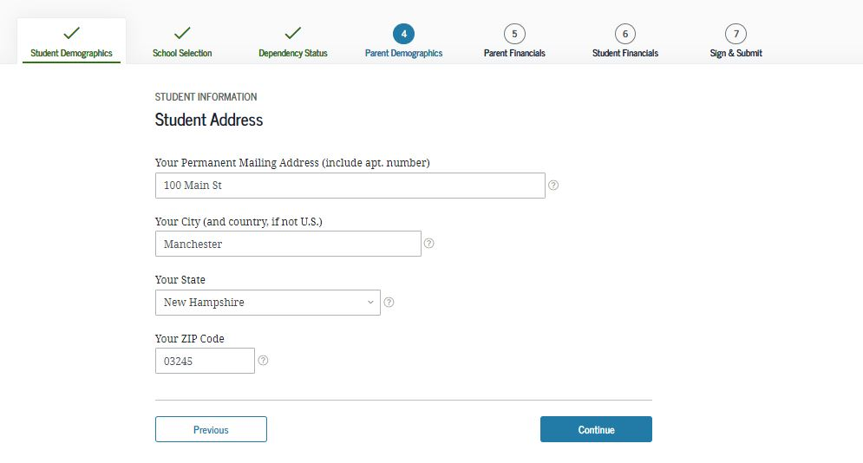
Step One: Student Information
Student’s Name
Date of Birth
Citizenship Status
Marital Status
Email Address

Slide 20
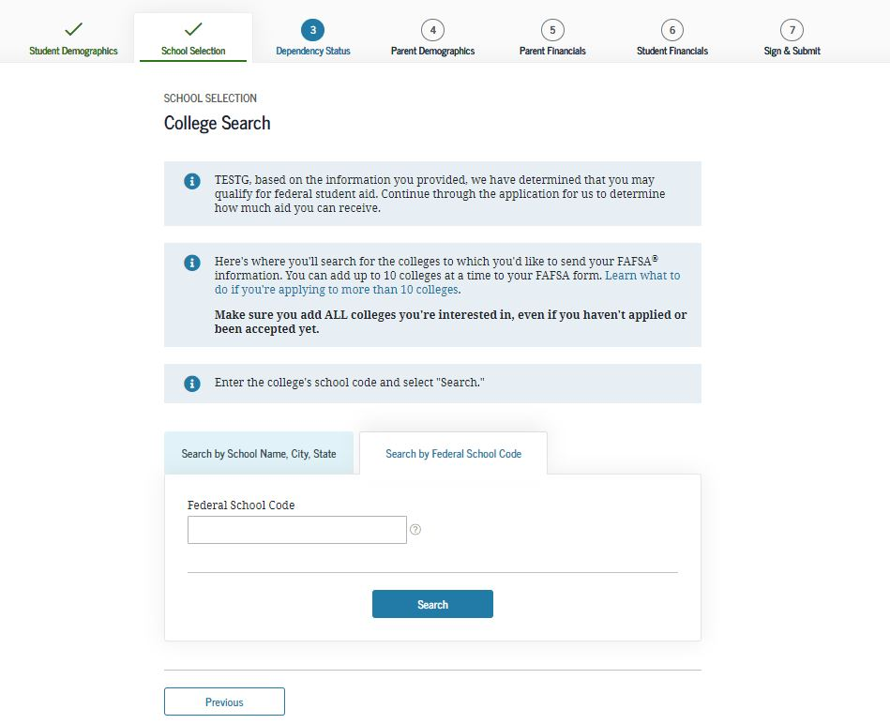
Step Two: Schools
Enter up to 10 potential colleges
  School Code
  Housing Plans

Slide 21
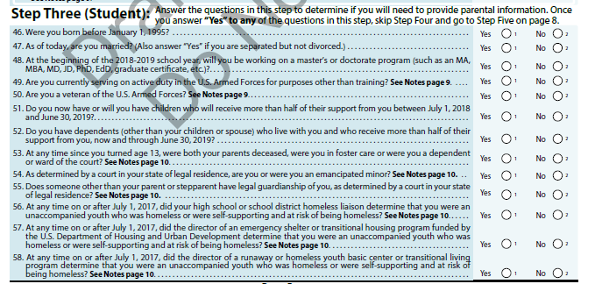
Step Three: Student Status
If student answers “NO” to all questions, then at least one parent’s information and signature is required.
If student answers “Yes” to any question, then student is Independent only their income and assets will be considered.

Slide 22
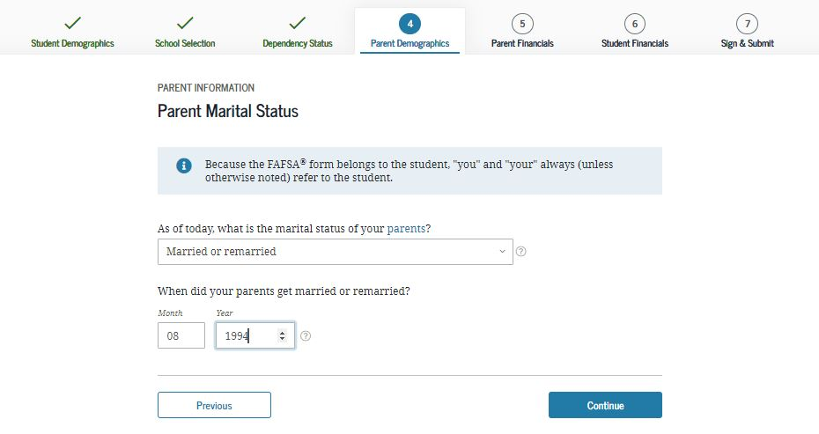
Step Four: Parent Info
Which parent’s information must be included on the FAFSA?
Parents are married – Both parents
Parents are divorced (not remarried) - Only parent with whom student lives with most
Parents are divorced (remarried) - Parent and step parent with whom student lives with most
Parents were never married (don’t live together) – Only parent with whom student lives with the most
Parents are not married (DO live together) – Both parents

Slide 23

IRS Data Retrieval Tool
While completing FAFSA, applicant may submit real-time request to IRS for tax data
IRS will authenticate taxpayer’s identity and send real-time results to applicant in new window
Address entered must match the address on the tax return EXACTLY
Applicant chooses whether or not to transfer data to FAFSA
Participation is voluntary
Could reduce documents requested by financial aid office

Slide 24
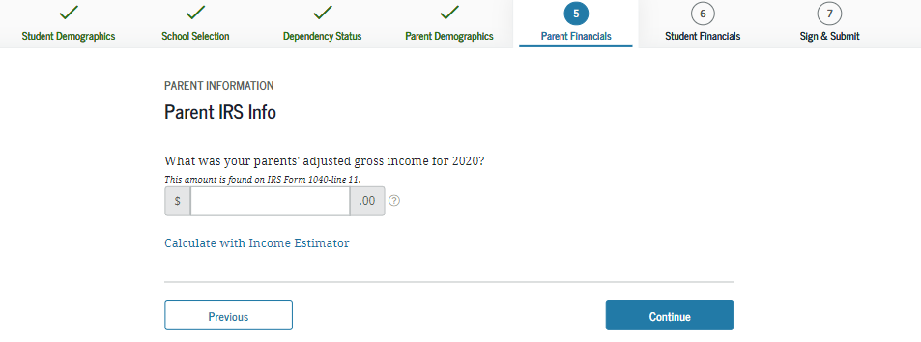
Step Four: Parent Info Continued
Parent Finances
2021 AGI (line references from Federal Taxes or W2 forms)
2021 Federal taxes paid
Current cash/checking/savings
Current investments
  Do not include value of:
    Primary residence
    Retirement accounts
    Family controlled business with less than 100 employees
Current household members and Number of College Students

Slide 25
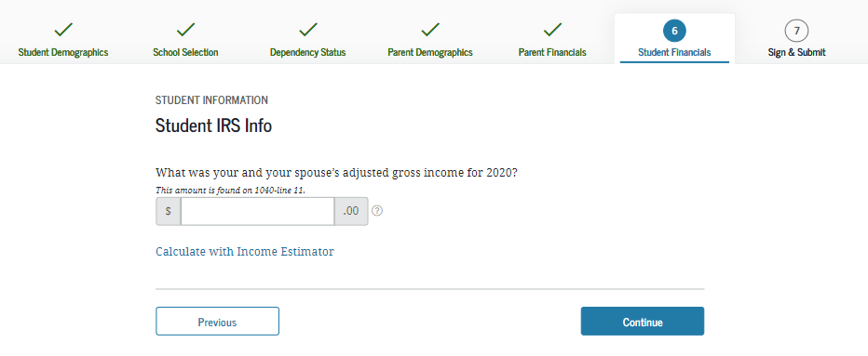
Step Five: Student Information
Questions include:
2021 AGI (line references from Federal Taxes or W2 forms)
2021 Federal taxes paid
Current cash/checking/saving
Current investments

Slide 26
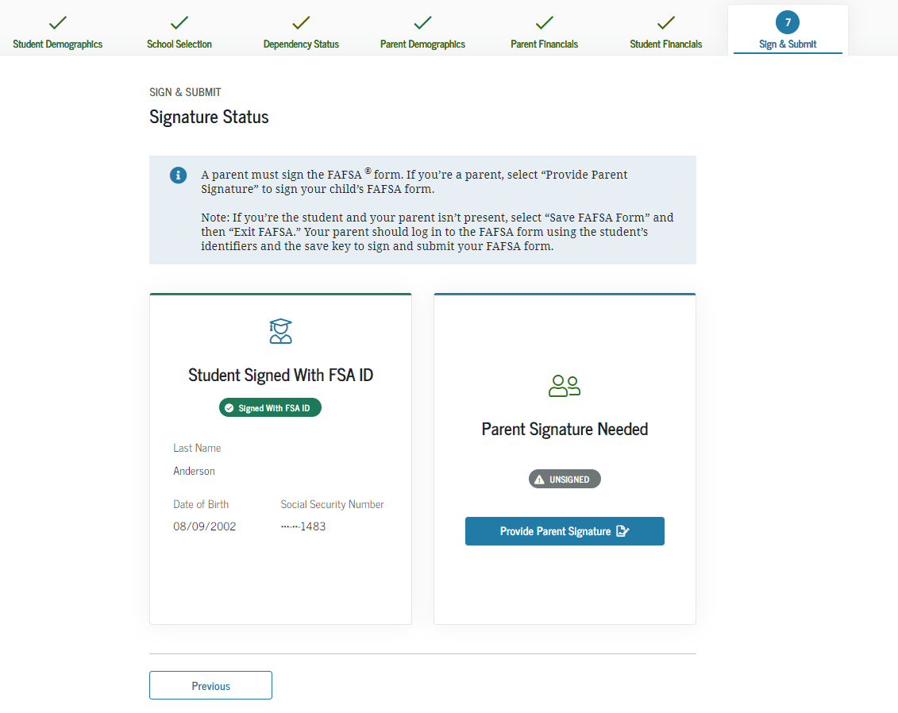
Step Six: Signatures

Slide 27
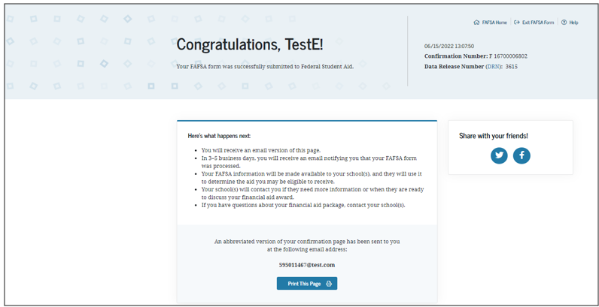
Confirmation Page

Slide 28

Frequent FAFSA Errors
Failing to file the FAFSA annually
Filing the wrong year’s FAFSA
Missing financial aid deadlines
Using the wrong Social Security Number (SSN) or date of birth
Errors in student or parent marital status
Incorrect data related to divorced parents
Reporting wrong tax filing status (e.g., head of household)
Reporting retirement plans and the net worth of the family home as investments

Slide 29
Special Circumstances?
Contact the Financial Aid Office
Divorce/Separation
Loss of income or benefits
One-time income
Death or Disability of student or parent
Substantial medical/dental expenses not covered by insurance
Elementary or secondary school tuition
Dependency override
(Note: Professional Judgment is at the sole discretion of each institution.)

Slide 30



The Application Process
Student submits FAFSA
ED calculates EFC and returns results to student
ED sends copy of result to state & schools of choice
School follows up with student

Slide 31

Verification
The Department of Education picks about 30% of students randomly for verification.
Provide documentation to school
  Verification Worksheet
  Consent to IRS data retrieval or submit a tax return transcript
  Asset Statements
  Child Support Paid Documentation
  Others items as determined by the school

Slide 32

Response from Schools
The Financial Aid Office issues a:
FINANCIAL AID PACKAGE
*Processing times vary*
*Delivery methods vary*
Consisting Of:
  The Cost of Attendance
  Your Financial Aid Eligibility
  A description of each program
  What to do next
If you feel you have special circumstances, let the aid office know!

Slide 33
Questions to consider
  Are the scholarships renewable?
    Requirements?
      GPA, participation, major, max number of terms
  Grant/Loan combination
  Will the student graduate in 4 or 5 years? What is the additional cost?
  Are there additional fees for specific majors?
  How is student employment handled?
  Actual cost minus aid – not just the most aid

Slide 34
How are we going to pay?
Direct Costs (tuition, room & board, fees, books)
- Financial aid
= Remaining balance due
Am I billed for the year or by the term?
What are my payment options?
When are payments due?
Do I need an additional loan? If yes, ensure that loans are finalized 1 month prior to the start of the term.

Slide 35
Net Price Calculator (NPC)
Aid estimate prior to actual financial aid package
  Located on individual college’s website (all schools are required to have this)
  Families provide basic financial information
    Parent and student income and assets
Changes in actual aid packages may result if information used on the NPC is significantly different than that on the FAFSA

Slide 36

Other Resources
Parent or Student Employer Scholarships
Corporation for National and Community Service
Veterans/ROTC Benefits
Bureau of Indian Affairs (BIA) Grants
Division of Vocational Rehabilitation (DVR)
Higher Educational Aids Board (HEAB)

Slide 37






Scholarship Searches
www.fastweb.com
www.collegeexpress.com
  www.finaid.org
www.salliemae.com/college-planning/tools/scholarship-search/
bigfuture.collegeboard.org
www.cappex.com

Slide 38

Avoid Being Scammed
APPLYING FOR AID IS A FREE PROCESS!
Department of Education Office
studentaid.gov/resources/scams
Better Business Bureau
www.bbb.org
Financial aid scam notices
Tips to avoid scams
Check legitimacy of scholarship agencies

Slide 39

College Goal Wisconsin
Free FAFSA filing assistance from aid experts
95.7 percent of the families felt it was worth participating
College Goal Wisconsin events will take place virtually and in person during October and November.
  Go to www.collegegoalwi.org for dates and details.

Slide 40

Final
Apply early – watch deadlines
Schools may have additional aid forms
Each school evaluates the student differently
Read ALL materials issued by the school
Inform your school of any “special circumstances”
Always keep copies

Slide 41

Questions?

