Slide 1
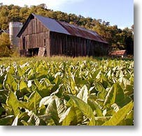
Clinton Co. Migrant Education Program
We offer many educational & health services!
Do You Qualify for Our Program?
.Have you or your family moved from one town or school district to another within three years?
.Did you move here to do agricultural type work or seeking agricultural work?
.Are you doing or seeking any of the following types of work:
Working on a farm
Working in tobacco
Working in tobacco greenhouse
Milking cows
Feeding cattle
Working in plant nursery/greenhouse
Working on a poultry farm
Tree growing or harvesting
Working at Tyson Chicken Processing Plant
If you answered “yes” to any of these questions, please get in touch with us! We would love to help your family?
Do You Need Help?
EVERYTHING IS FREE !!!
Clinton Co. Migrant Education Program
1273 Ky Hwy 90 West
Albany, KY 42602
Albany, KY 42602
Phone: 606-688-0146
Danielle Hicks
Cindy Choate
Sandra Guffey
Wayne Hughes

