Slide 1
Board of Education
Budget Work Session FY2023
Ms. Tammy McCourt, Assistant Superintendent
February 2, 2022

Slide 2
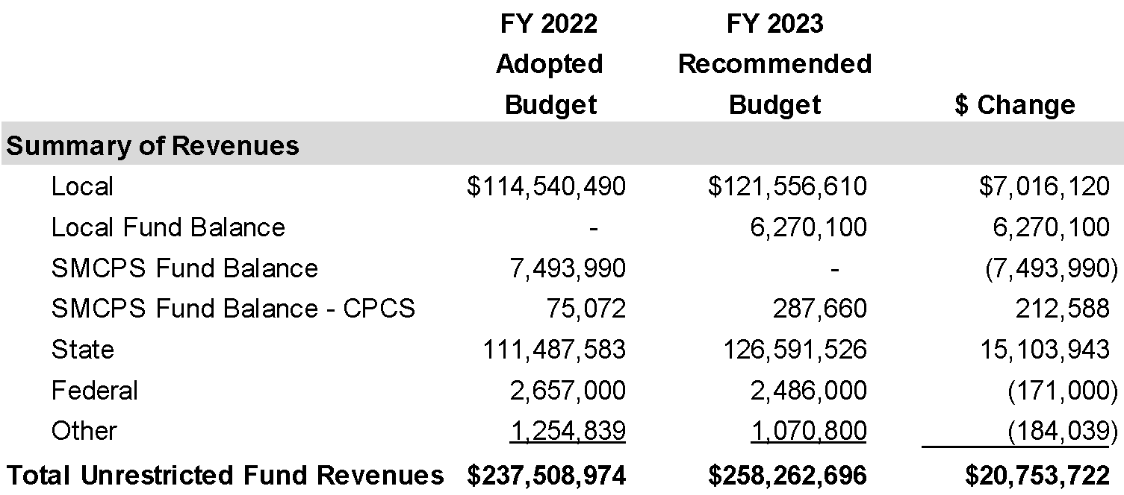
Unrestricted Fund Revenue Budget
As originally presented….
State Revenues reflect a shift in Blueprint funding from Restricted Funds:
Special Education
Prekindergarten
Transitional Supplemental Instruction
Teacher Salary Incentive
Mental Health Coordinator
FY2021 = $3,855,566

Slide 3
Unrestricted Fund Revenue Budget
Updated State Aid amounts provided on 1/21/22….
State Revenues reflect a shift in Blueprint funding from Restricted Funds:
Special Education
Prekindergarten
Transitional Supplemental Instruction
Teacher Salary Incentive
Mental Health Coordinator
FY2021 = $3,855,566

Slide 4
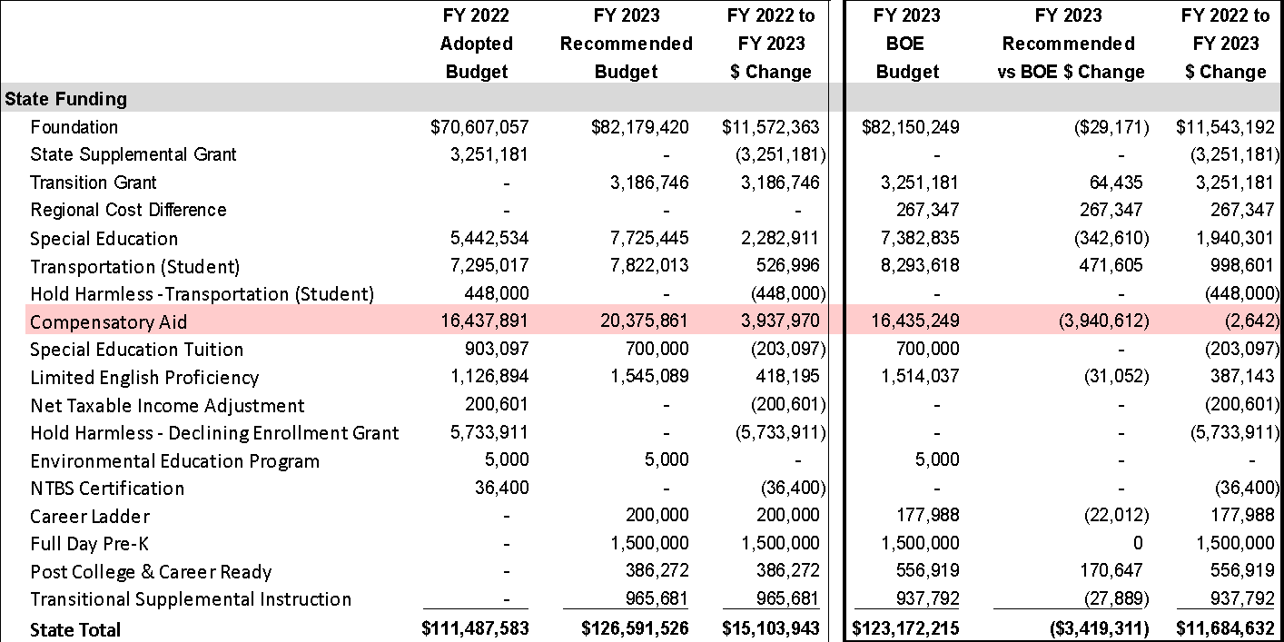
Unrestricted Fund Revenue Budget
Updated State Aid amounts provided on 1/21/22….
State Revenues reflect a shift in Blueprint funding from Restricted Funds:
Special Education
Prekindergarten
Transitional Supplemental Instruction
Teacher Salary Incentive
Mental Health Coordinator
FY2021 = $3,855,566

Slide 5
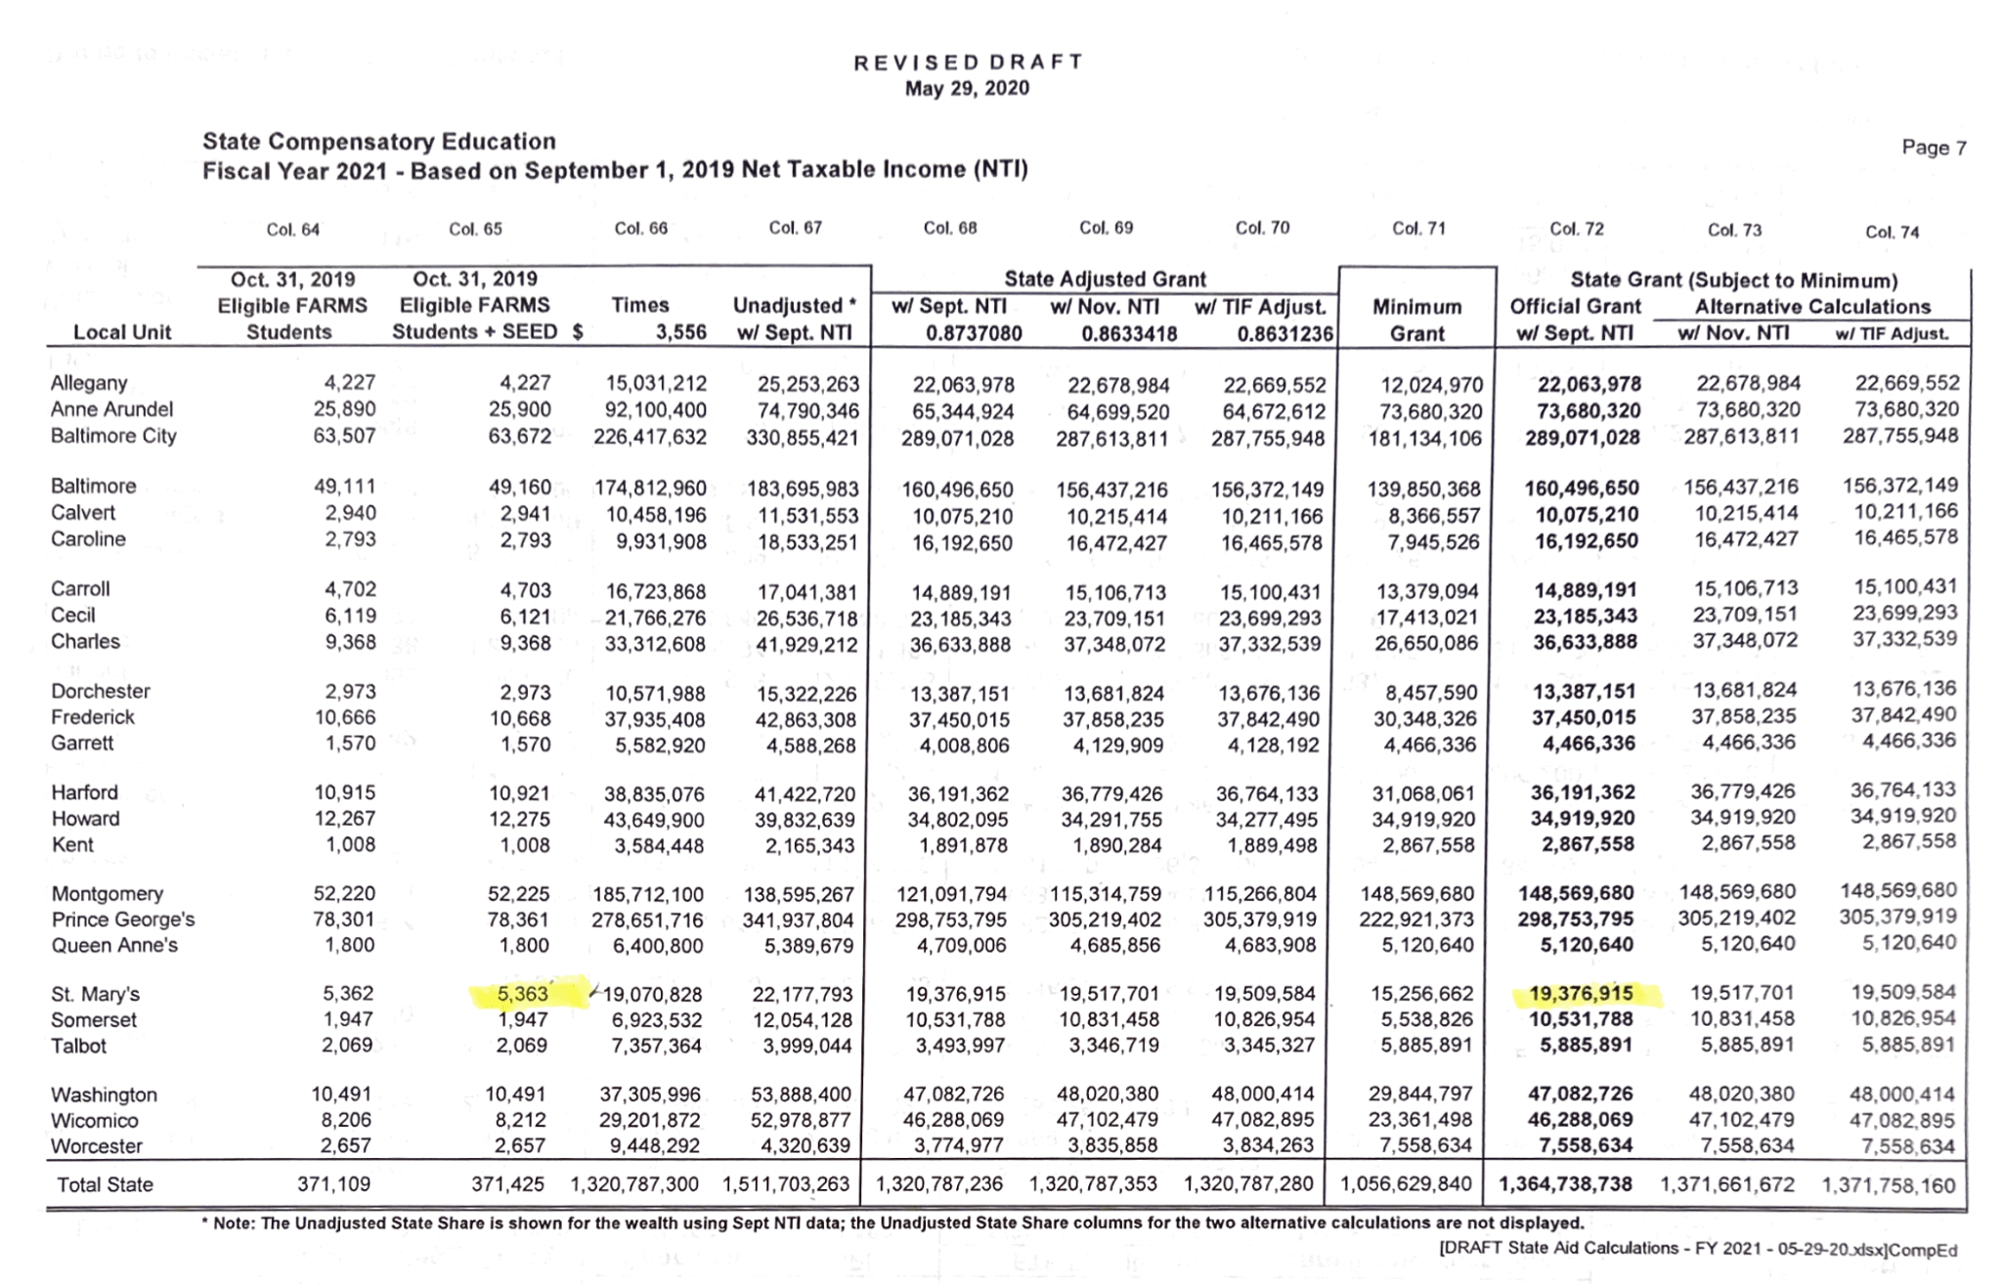
MSDE Compensatory Education 2021

Slide 6
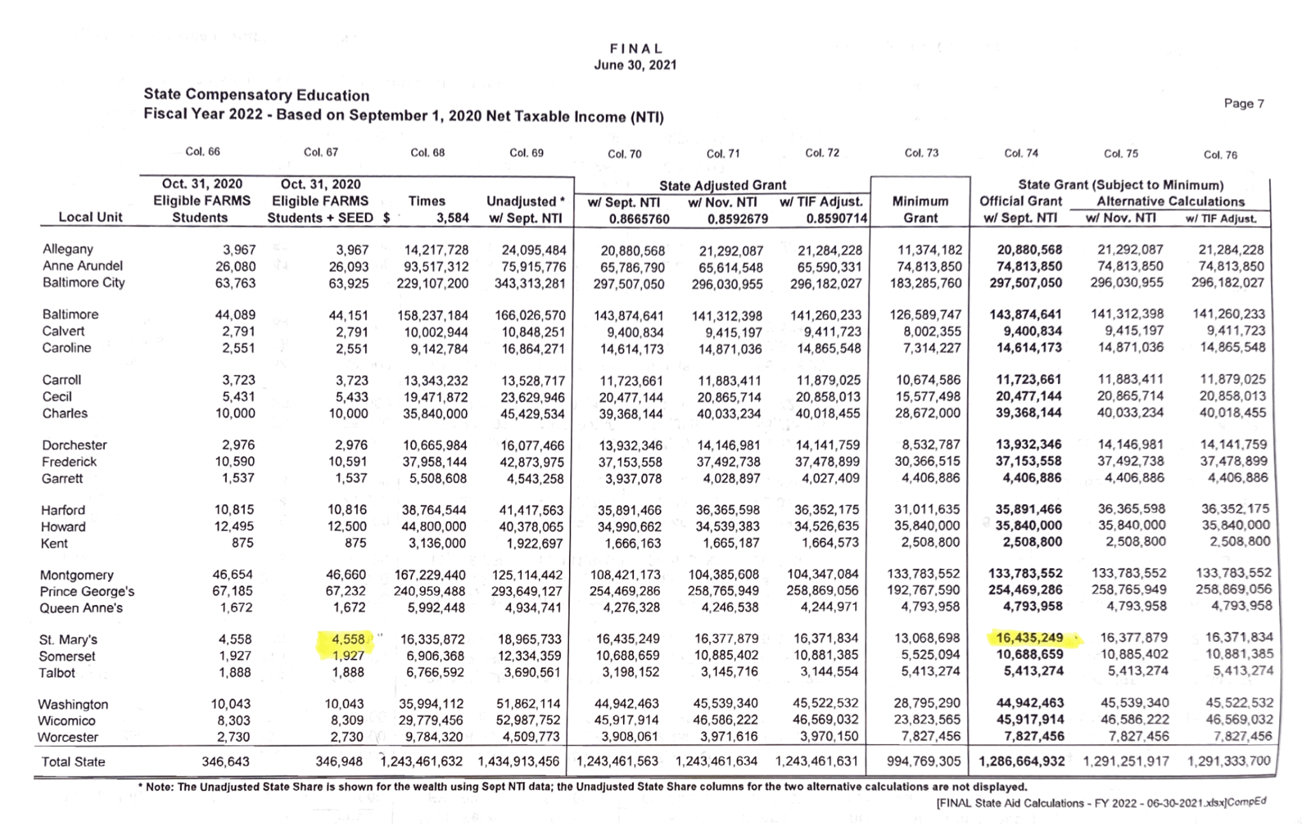
MSDE Compensatory Education 2022

Slide 7
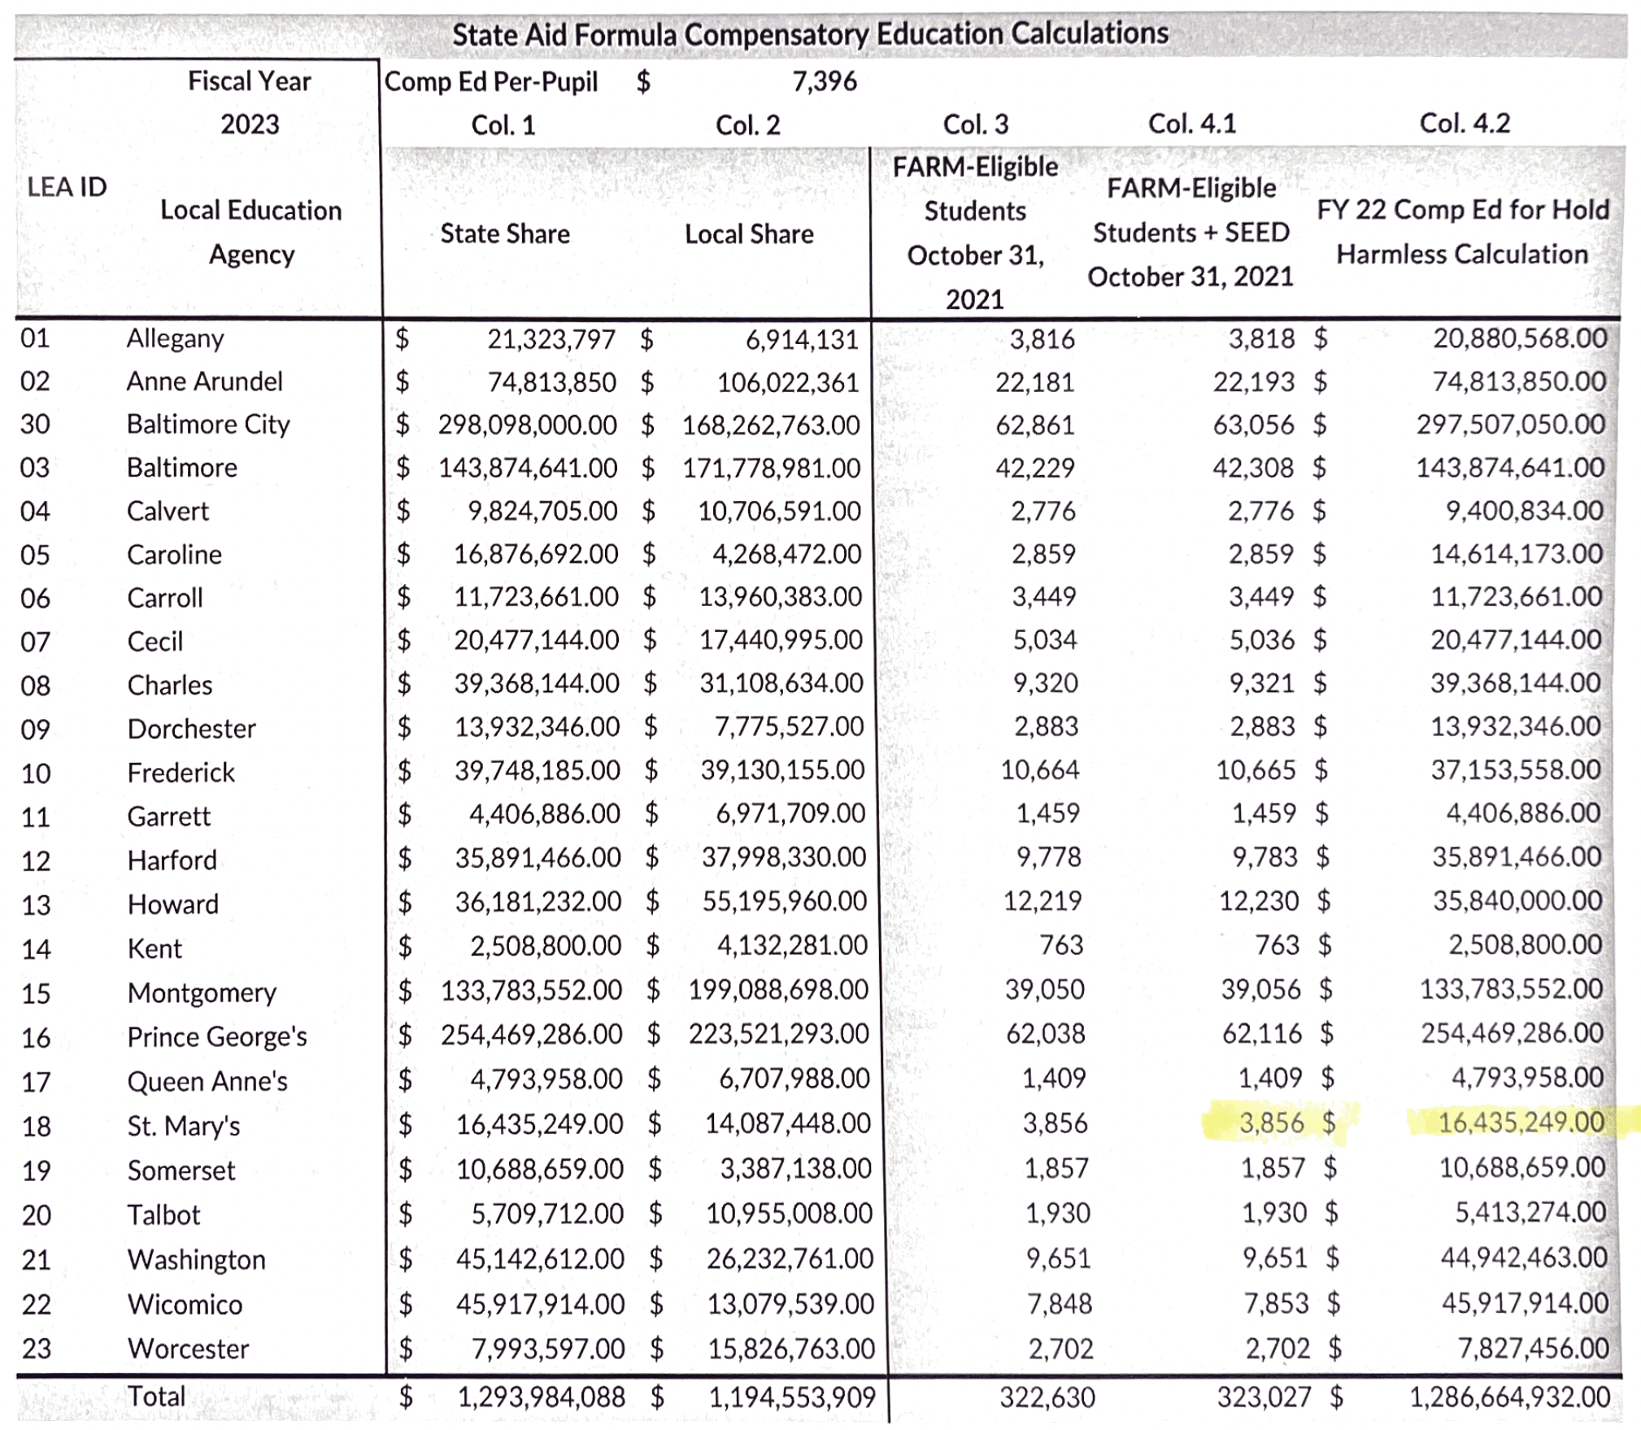
MSDE Compensatory Education 2023

Slide 8
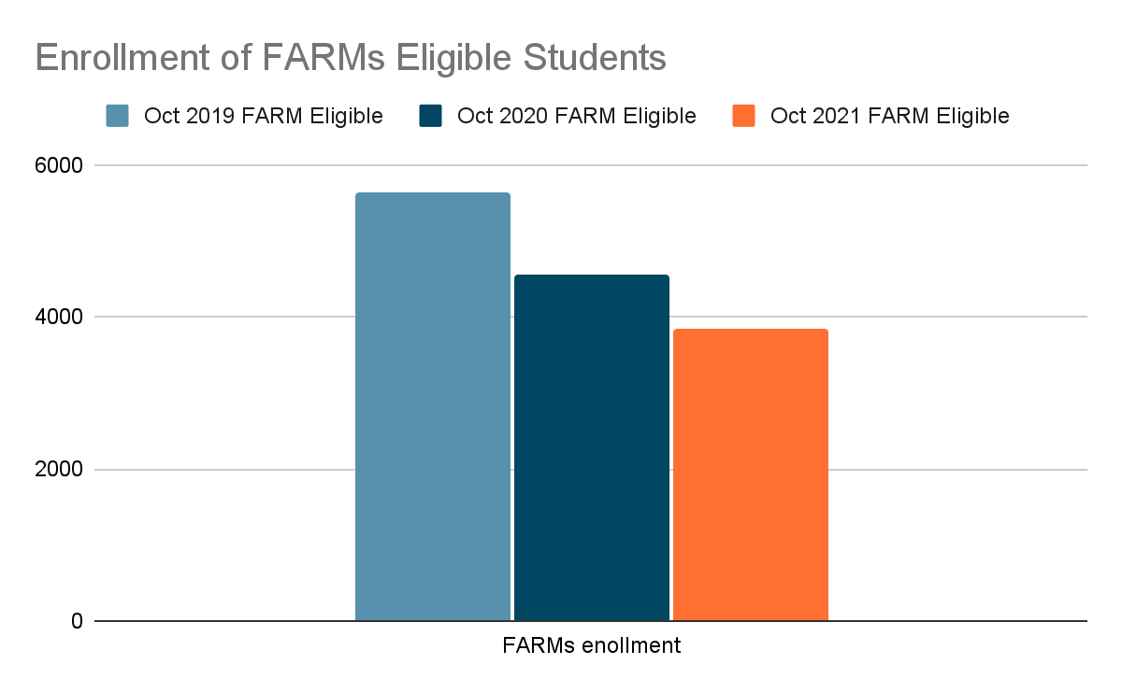
SMCPS FARM Eligible Student Counts
 | FARM Eligible Oct 2019 | FARM Eligible Oct 2020 | FARM Eligible Oct 2021
Total for SMCPS | 5363 | 4558 | 3856
In SMCPS, we have had a total of 1,507 fewer students identified as FARMs eligible in October of 2021 than in October of 2019. This is a reduction of almost one third of the total economically disadvantaged students attending St. Mary’s County Public Schools.
This is the opposite of what we are actually seeing in our communities - we have many more students in distress due to the economic strain two years of a pandemic have had on our families.
Decrease of 805
Total decrease 1,507

Slide 9
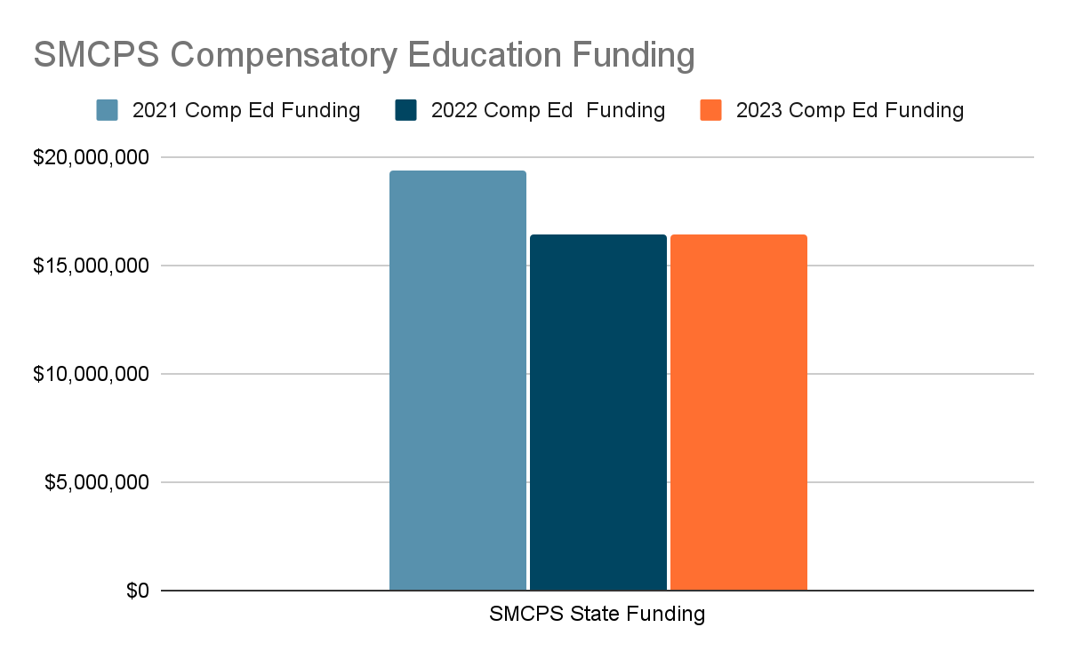
SMCPS Total
Compensatory Educ.
 | 2021 Comp Educ Funding | 2022 Comp Educ Funding | 2023 Comp Educ Funding
State Funding SMCPS | $19,376,915 | $16,435,249 | $16,435,249
Decrease of $2,941,666
Hold Harmless

Slide 10
Hold Harmless
 | FARM Eligible Oct 2019 | FARM Eligible Oct 2020 | FARM Eligible Oct 2021
Total for SMCPS | 5363 | 4558 | 3856
 | 2021 Comp Educ Funding | 2022 Comp Educ Funding | 2023 Comp Educ Funding
State Funding SMCPS | $19,376,915 | $16,435,249 | $16,435,249
For 2023, Compensatory Education Funding was “held harmless” and maintained at the previous year’s funding, even though our FARMs numbers decreased by an additional 702 students… for a total two year reduction of 1,507 students - or a decline of 28% in identified eligible students.

Slide 11
Unrestricted Fund Revenue Budget
Updated State Aid amounts provided on 1/21/22….
State Revenues reflect a shift in Blueprint funding from Restricted Funds:
Special Education
Prekindergarten
Transitional Supplemental Instruction
Teacher Salary Incentive
Mental Health Coordinator
FY2021 = $3,855,566
As a result of the funding for Compensatory Education being held at the 2022 rate and not the pre-pandemic amount of 2021, we will have to reduce our budget request by $3.4 million. This reduction must be made in recurring expenses, so we will be removing the request for all new positions from the unrestricted fund.

Slide 12
Budget Highlights
Step & COLA increase per current 4 year agreement (year 3)
Contracted bus PVA increase, hourly driver/attendant rate increase, fuel cost increase
Substitute rate increase
New positions

Slide 13
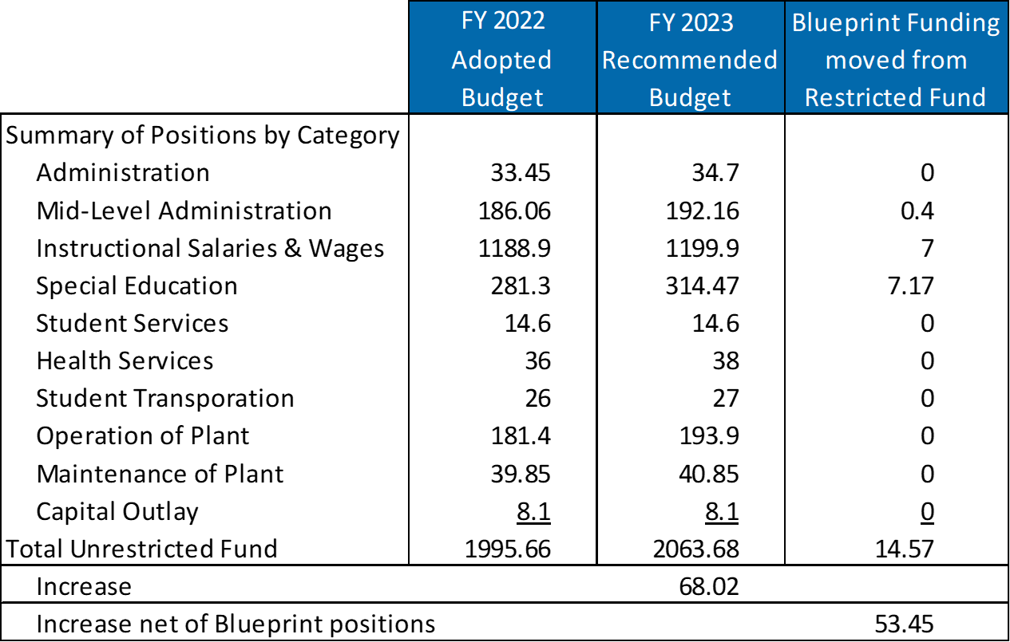
Budget Highlights
As originally presented….
New positions requested
Existing positions for SY2022 – moving from restricted fund to unrestricted.

Slide 14
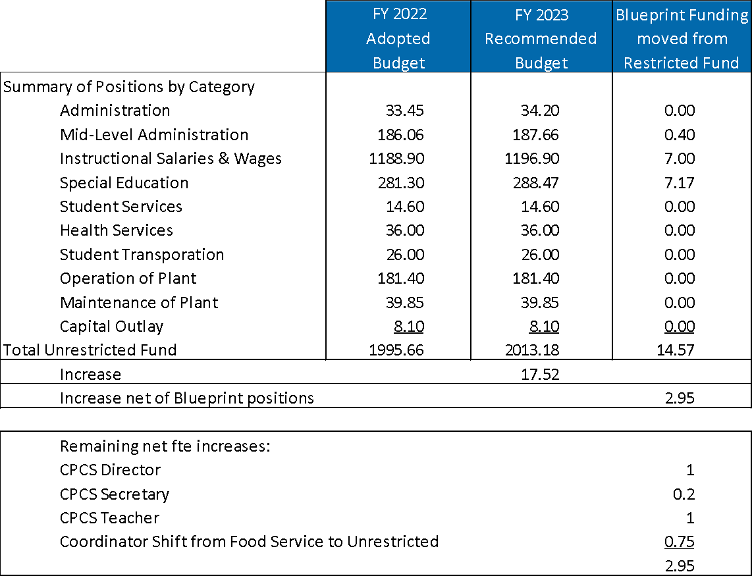
Budget Highlights
Updated following the release of State Aid amounts ….
New positions removed
Existing positions for SY2022 – moving from restricted fund to unrestricted.

Slide 15
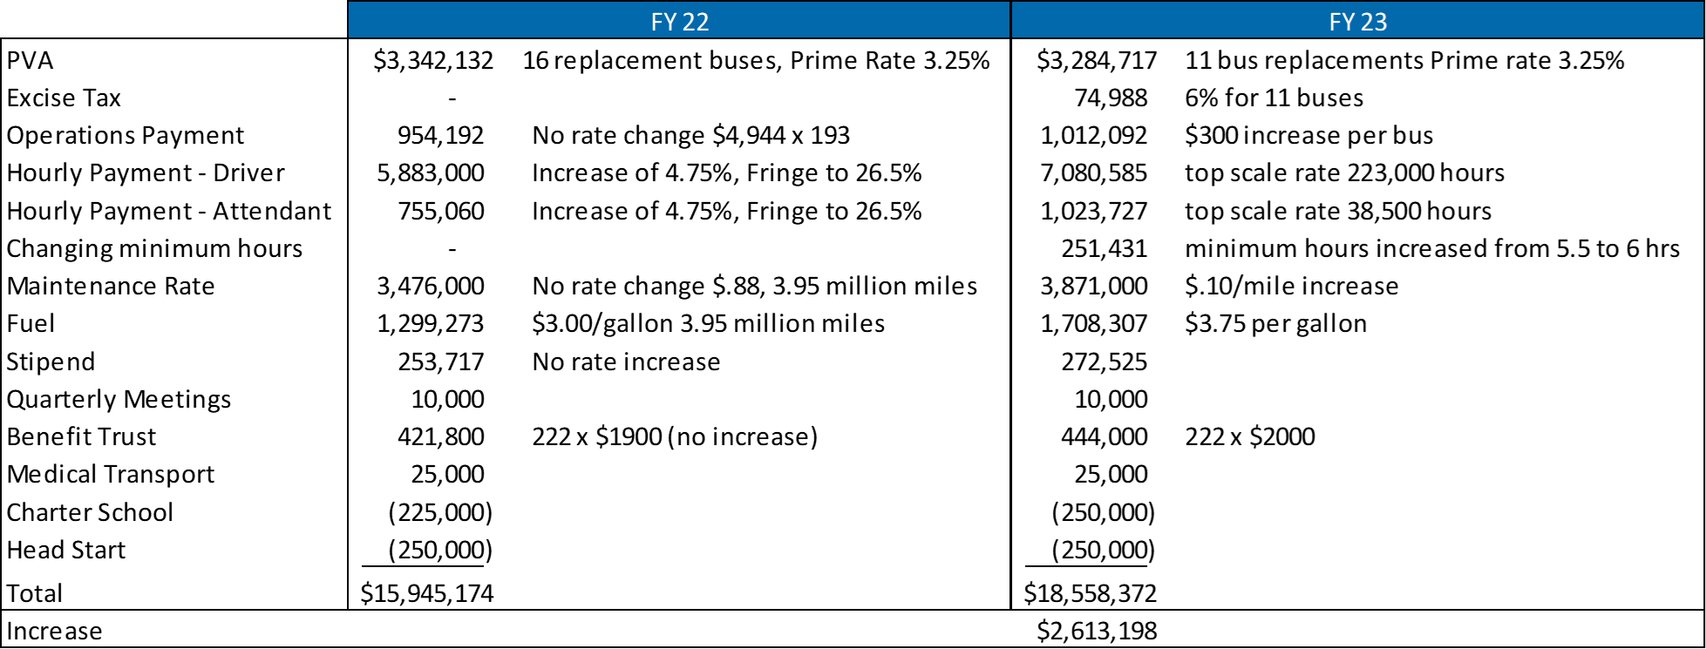
Budget Highlights
Contracted bus increase

Slide 16
School Bus Contractor - Public Comment
Reduce MPG used in calculations from 7.25 MPG to 6.5 MPG. Increase = $197,113
Data does not support 6.5 MPG.
Increase amount for paid spare buses from $3,000 to $3,500.
30 paid spare buses, cost to increase = $15,000

Slide 17
Budget Highlights
Substitute rate increase

Slide 18
Budget Highlights: Use of Fund Balance
Elementary ELA Textbook Adoption, $2,000,000
Continuation of school-based technology refresh, $2,270,100
Network switches
Network Host storage expansion
Interactive SMART TV’s for classrooms
Teacher and student laptop refresh
Other Post Employment Benefits (OPEB), $2,000,000

Slide 19
Blueprint Funding
Projections by the Department of Legislative Services
Based on pre-pandemic enrollment and FARMS
Local and State Foundation and Concentration of Effort
FY2023 | DLS Projection | MSDE Budget | Delta
Foundation | $144.75 | $140.90 | -$3.85
Concentration of Poverty | 40.50 | 30.50 | -10.00
(in millions) | $185.25 | $171.40 | -$13.85

Slide 20
Important Dates
February 9 – Board of Education budget approval

