Slide 1
Budget Work Session
Operating Budget
FY2023
Dr. J. Scott Smith, Superintendent
Ms. Tammy McCourt, Assistant Superintendent
January 5, 2022

Slide 2
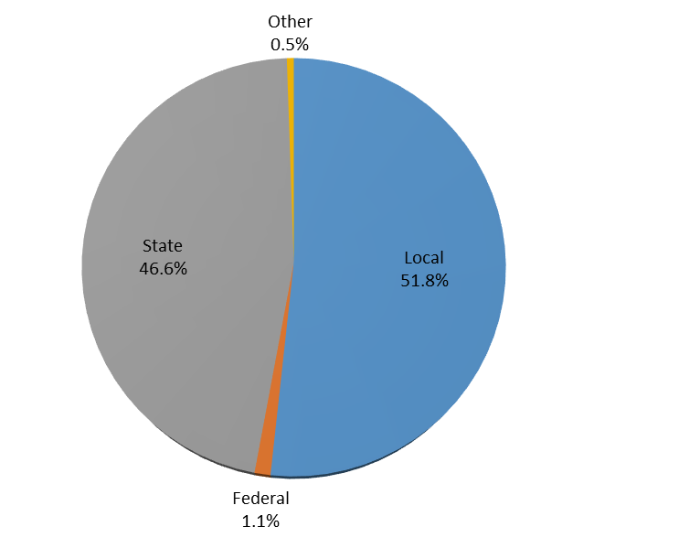
Proposed FY2023 Revenue Budget

Slide 3
Unrestricted Fund Revenue Budget
State Revenues reflect a shift in Blueprint funding from Restricted Funds:
Special Education
Prekindergarten
Transitional Supplemental Instruction
Teacher Salary Incentive
Mental Health Coordinator
FY2021 = $3,855,566

Slide 4
Blueprint Accountability – Local Funding
Local Funding increase of $7,016,120 or 6%

Slide 5
Blueprint Accountability – State Funding
State Funding, net of $3,855,566 shift from Restricted Fund, increase of
$11,248,377 or 9.8%

Slide 6
Proposed FY2023 Expenditure Budget
Utilities
Transportation
Textbooks
Professional development
Materials
Technology
Supplies
Maintenance
Program operations
Equipment

Slide 7
Total Operating Budget

Slide 8
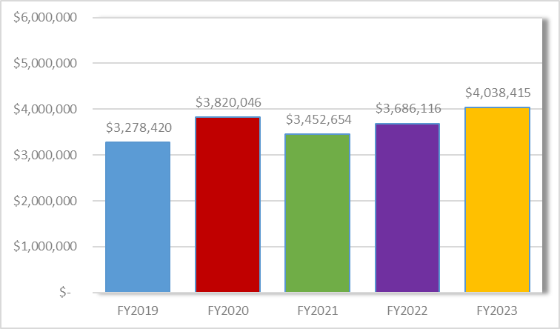
Administration
Requested Increase:
$352,299 (9.6% increase)
Highlights:
Funding for negotiations
Bi-annual GASB 34 report
Network switches
Virtual recruitment
New Coordinating Supervisor of Internal Investigations (.5)
Reclassification of Administrative Assistant
Reclassification of Coordinator of Information Technology

Slide 9
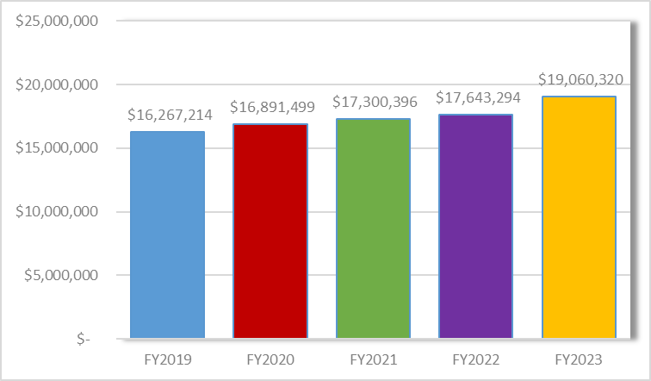
Mid-Level Administration
Requested Increase:
$1,417,026 (8% increase)
Highlights:
Funding for negotiations
Technology enhancements, to include disaster recovery software, cloud phone upgrade, storage area network
Equity, engagement and early access training
New Early Childhood Education Fiscal Secretary
New Supervisor of AAO
New School Secretary (2.5)
New Charter School Director
Reclassification of AAO Officer
Reclassification of Charter School Deans

Slide 10
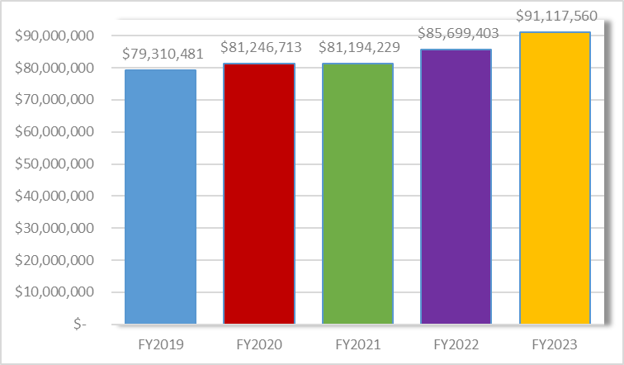
Instructional Salaries and Wages
Requested Increase:
$5,418,157 (6.3% increase)
Highlights:
Funding for negotiations
Reallocation of Blueprint positions from Restricted (7)
Blueprint National Board Certification
New IRT – Teachers Academy (11 month)
New Early Childhood Education IRT (11 m)
New Health & PE IRT/Teacher (1o month)
New Charter School Teacher
Reclassification IRT AAO (2 -to 11 month)
Increase in substitute rate of pay
Reclassification Judy Center Specialist (grant funded – Community Services category)

Slide 11
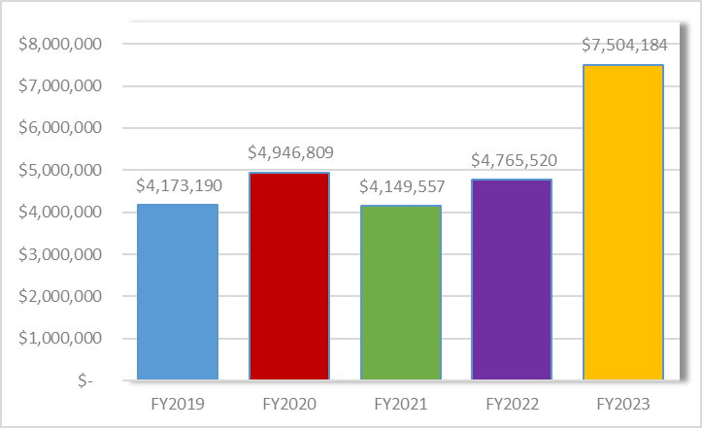
Textbooks and Instructional Supplies
Requested Increase:
$2,738,664 (57.5% increase)
Highlights:
AP American Government textbooks
College Board assessment testing
Instructional software for students: DESMOS, Edgenuity (CTE), SmartMusic, Quaver, Primary Learning
Use of Fund Balance: $4,270,100
Elementary ELA Textbook Adoption $2m
    Continuation of school-based technology refresh $2,270,100
          Network switches
  Network Host storage expansion
Interactive SMART TV’s for classrooms
Teacher and student laptop refresh

Slide 12
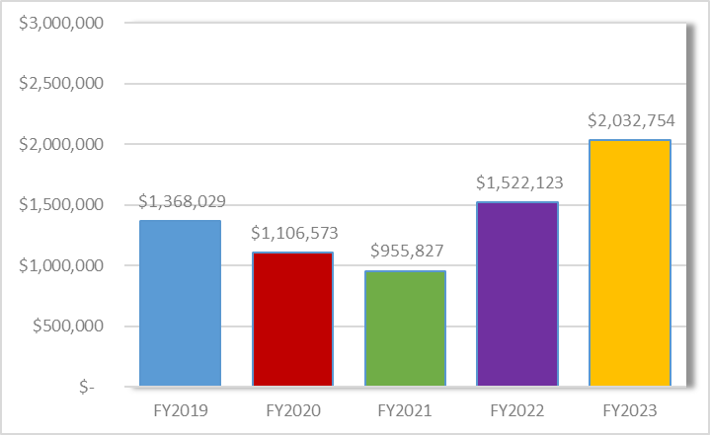
Other Instructional Costs
Requested Increase:
$510,631 (33.5% increase)
Highlights:
Migration to new website to ensure accessibility compliance
Contracted temporary services
High Roads contract increase and reallocation from Blueprint Restricted (IAEC)

Slide 13
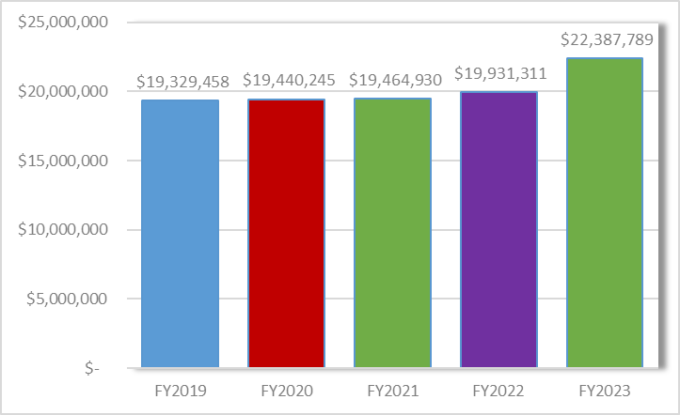
Special Education
Requested Increase:
$2,456,478 (12.3% increase)
Highlights:
Funding for negotiations
High Roads contract increase and reallocation from Blueprint Restricted
Non-public placements
Contracted therapists rate increase
Reclassification of Speech Language Pathologist (to 11 month)
New IEP Facilitators (13; 10 month)
New Paraeducators (10)
New Secretary
New Behavior Specialists (2)
Reallocation of Blueprint positions from Restricted (7.17)

Slide 14
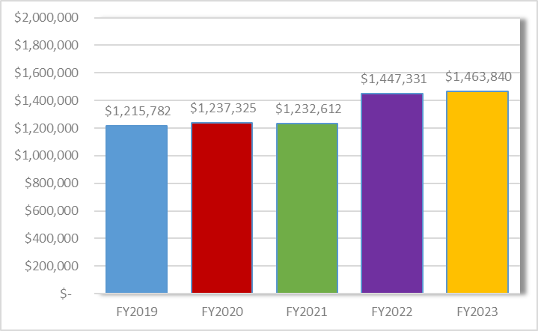
Student Personnel Services
Requested Increase:
$16,509 (1.1% increase)
Highlights:
Funding for negotiations

Slide 15
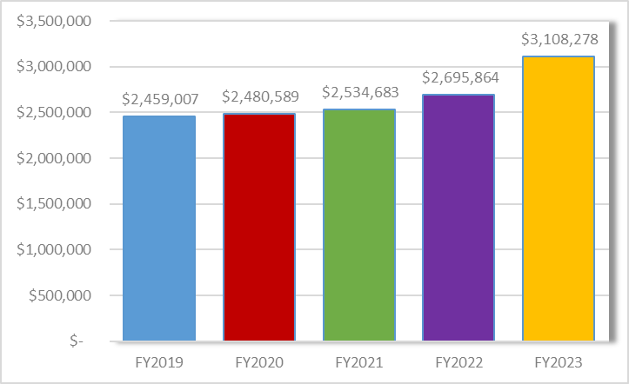
Student Health Services
Requested Increase:
$412,414 (15.3% increase)
Highlights:
Funding for negotiations
Increase in substitute nurse rate of pay
Nurse, shift from Restricted Funds (11 month)
New Floating Nurse (10 month)

Slide 16
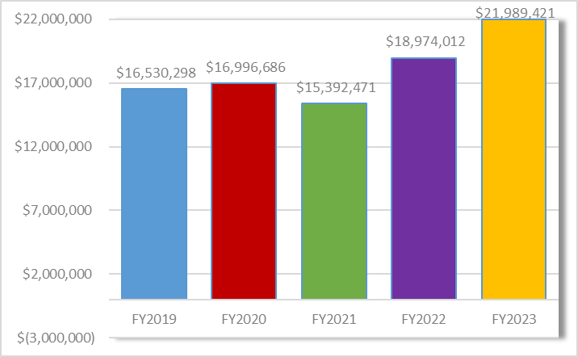
Student Transportation
Requested Increase:
$3,015,409 (15.9% increase)
Highlights:
Funding for negotiations
Contracted bus PVA increase
Hourly contracted driver/attendant rate and minimum hours increase
Fuel rate of $3.75/gallon
Maintenance and operations fee increase
Healthcare Trust contribution increase
VersaTrans annual hosting software
Two replacement buses
New Transportation Specialist
Notes:
ESSER funds for the second year of the incentive, hourly driver/attendant rate the top of the established SMCPS payscale with the amount paid by the contractor at a contractor determined rate plus the 26.5% admin rate.

Slide 17
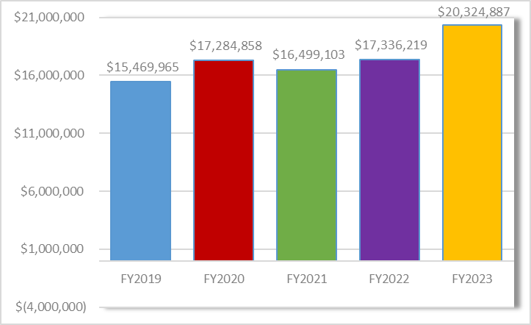
Operation of Plant
Requested Increase:
$2,988,668 (17.2% increase)
Highlights:
Funding for negotiations
Utilities
Replacement vehicles
Emergency Quick Reference Guide
AHERA 3 year inspections
Blind/Curtain replacements/repairs
Sprinkler repairs/annual inspection contract increase
Facilities Management Systems software
Property Insurance increase
Upkeep of grounds (turf fields)

Slide 18
Operation of Plant - continued
Requested Increase:
$2,998,668 (17.2% increase)
Highlights:
Reclassification of IT Project Coordinator (3)
Reclassification of Programmer/Database Administrator (2)
Reclassification of Information Technology Assistant
Reclassification of Fiscal Secretary
Reclassification of Administrative Assistant
Reclassification of Logistics Support Manager
New Coordinating Supervisor of Internal Investigations (.5)
New Safety & Security Assistants (10)
New Safety & Security Team Leads (2)

Slide 19
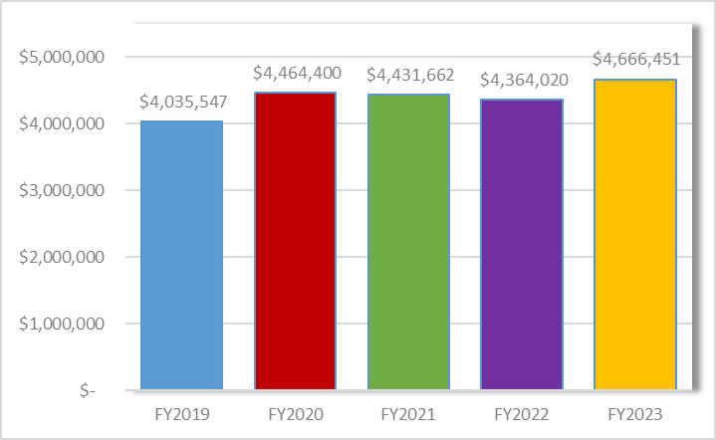
Maintenance of Plant
Requested Increase:
$302,431 (6.9% increase)
Highlights:
Funding for negotiations
Replacement iPads
Building repairs & painting
LHS electrical to scoreboard
BBES, ECC, LHS line striping
New Maintenance Trades I

Slide 20
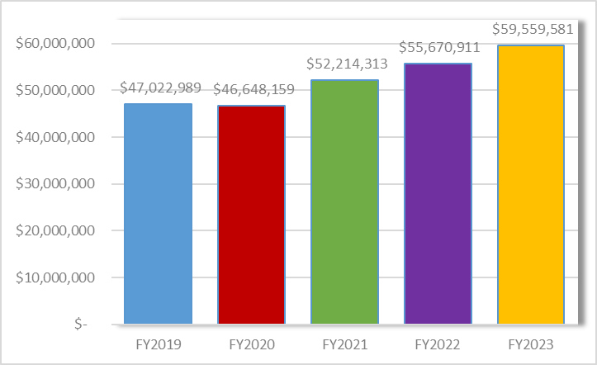
Fixed Charges
Requested Increase:
$3,888,670 (7.0% increase)
Highlights:
Social Security associated with negotiations and reallocated Blueprint funded positions
Pension increase
Health Insurance estimate to be received Feb/Mar, 5% estimated increase
General liability/workers compensation insurance
Use of Fund Balance: $2,000,000
Other Post Employment Benefits (OPEB)

Slide 21
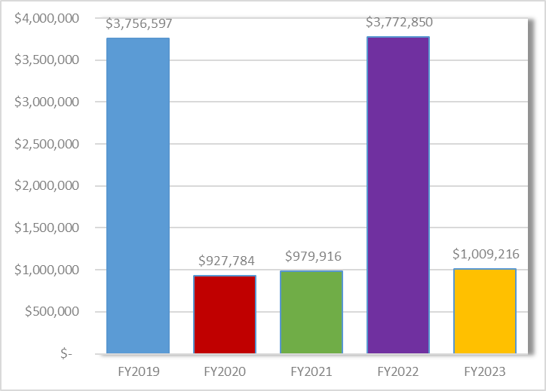
Capital Outlay
Requested:
-$2,763,634 (73.3% decrease)
Highlights:
Funding for negotiations
Building modifications
Reclassification of Project Management Coordinator I

Slide 22
Important Dates
January 13 – Board of Education budget public hearing
January 19– Board of Education budget work session
January 26 – Board of Education budget approval

