Slide 1

School Health Advisory Council
2021-2022 School Year
Annual Progress Report
To the Board of Trustees
May 2022
Notes:
1

Slide 2
School Health Advisory Council
Every independent school district is required by law to have a school health advisory council (SHAC) of which the majority of members must be parents who are not employed by the school district. The SHAC is annually appointed by the local education agency Board of Trustees.
Texas Education Code
Title 2, Chapter 28, Section 28.004
Notes:
2

Slide 3

State Legislated SHAC Requirements
Committee-related
The following are requirements of
local SHACs per legislation
Texas Education Code, Chapter 28, Section 28.004:
A parent must serve as a co-chair
A minimum of five members must be appointed to serve on the SHAC by Board of Trustees
Majority of members must be parents who are not employees of the district
SHAC must meet at least 4 times a year
SHAC must deliver an annual report to the Board of Trustees
SHAC is required to submit recommendations regarding the districts’ health and human sexuality education curriculum

Slide 4
State Legislated Requirements
District/Campus-Related
SHACs can provide oversight for the following activities
required of local campus/districts per legislation
Texas Education Code, Chapter 28, Section 28.004:
Provide written notice, course content and parents’ rights regarding sexuality education if taught
Ensure that full-day pre-k students participate in 30 minutes of daily vigorous activity
Include goals and objectives for CSH in HS and MS Campus Improvement Plans
Administer FitnessGram® to all students in grades 3-12
Choose an evidenced based alcohol awareness instructional program
Use the PAPA program in HS or MS health classes

Slide 5

Lackland ISD SHAC Members
2021-2022
LaTanya Sheehan, Parent, Co-Chair Tonya Hyde, Asst. Supt. Co-Chair
Victoria Smith, Parent Emmanuel Guerrier, Parent
Andrea Martini, Parent Angela Kinney, Parent
April Leiva-DeHoyos, Parent Margaret Bartlow, Student
Robert Walker, Parent Marquise Mahaffey, Parent
Alfredo Concha, Operations Marcelle Conte, Nurse
Claudia Castillo, SES Coordinator Daniel Rigney, Coach
Michelle Tarvin, Admin. Terence Cunningham, Student
Crystal Gajokowski, Parent Lusa Meza, Parent
Notes:
5
This slide is a typical representation of members. Adjust to match your district composition. Remember that the law now states that a parent must be the chairperson or at least co-chair of the SHAC and that the majority of members must be parents.

Slide 6
2021-2022 SHAC
Meeting Dates
General Council Meetings
October 6, 2021
December 1, 2021
February 9, 2022
March 9, 2022 *
April 13, 2022*
Physical Fitness Sub-Committee Meetings
Worked together to complete wellness evaluation components. No formal meeting was scheduled.
Five Scheduled Required Meetings with public meetings for Health and Human Sexuality Materials Review
https://www.lacklandisd.net/community/school-health-advisory-council
Notes:
6

Slide 7
Review of SHAC Activity & Accomplishments
  Recruited new members
  Performed evaluation of local wellness policy – FFA (Local) – posted on District webpage
  Updated the LISD Bloodborne Pathogen Guidelines
  Reviewed and approved Safeschools training for bloodborne pathogens, child abuse and maltreatment, bullying and harassment, substance abuse, mental health promotion, and suicide prevention.
  Provided feedback and communications to the community about COVID-19 safety.
  Supported the review of health and human sexuality curriculum
  Facilitated public hearing and recommendations for the adoption of health and human sexuality curriculum
Notes:
7

Slide 8
SHAC Recommendation
Continue monthly Let’s Talk opportunities to discuss health and wellness activities
Focus on identified areas for growth from the 2021-2022 wellness plan evaluation.
Continue to support student social-emotional needs throughout the COVID-19 pandemic. (Yearly calendar of guidance lessons for both campuses)

Slide 9
FitnessGram

Slide 10
FitnessGram

Slide 11
District -Wide Accomplishments
  Completed the 2021-2022 TEA School Health Survey
  Year long Wellness Wednesdays Newsletters (Staff)
  Participation in TRS and Edwards Risk Management Spring and Fall Fitness Challenges (Staff)
  Participated in National School Lunch Week and School Breakfast Week
  Continue Let’s Talk – Parent Engagement
  District-wide support for nutrition, counseling, and mental health
  Facilitated public hearings and recommendations related to the adoption of Health and Human Sexuality Curriculum and the Coordinated Health School Program
Notes:
11

Slide 12


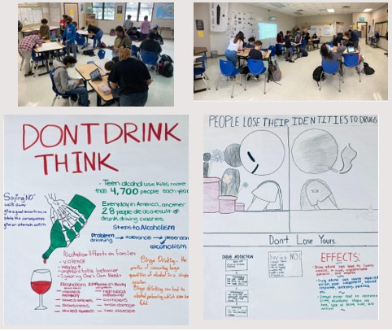

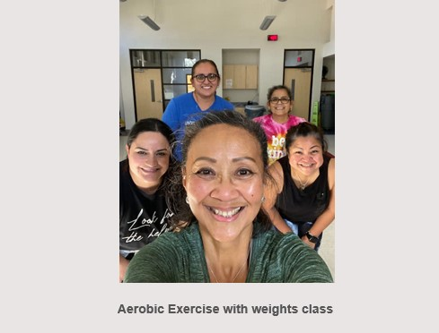
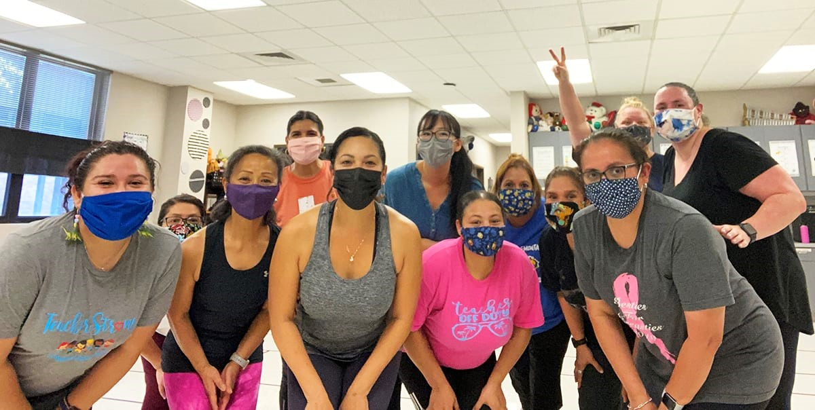

Slide 13
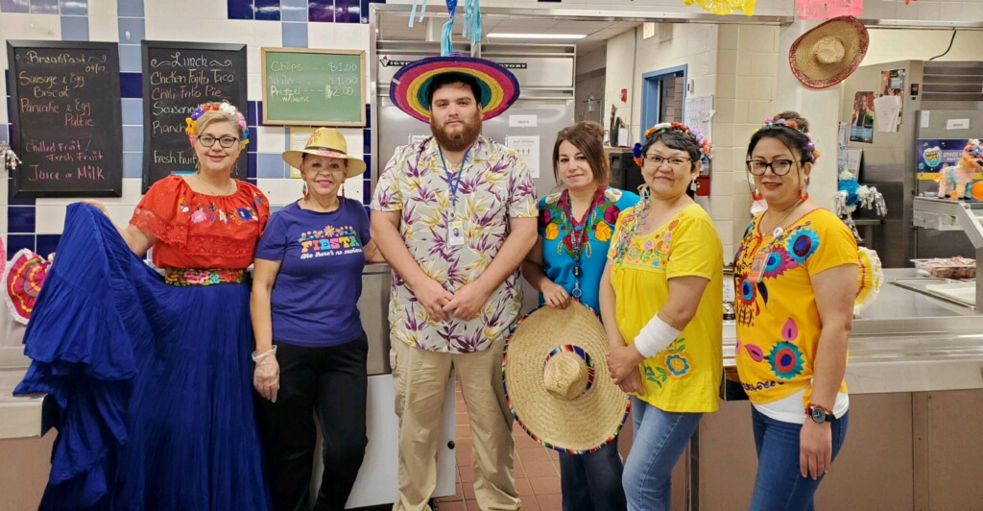
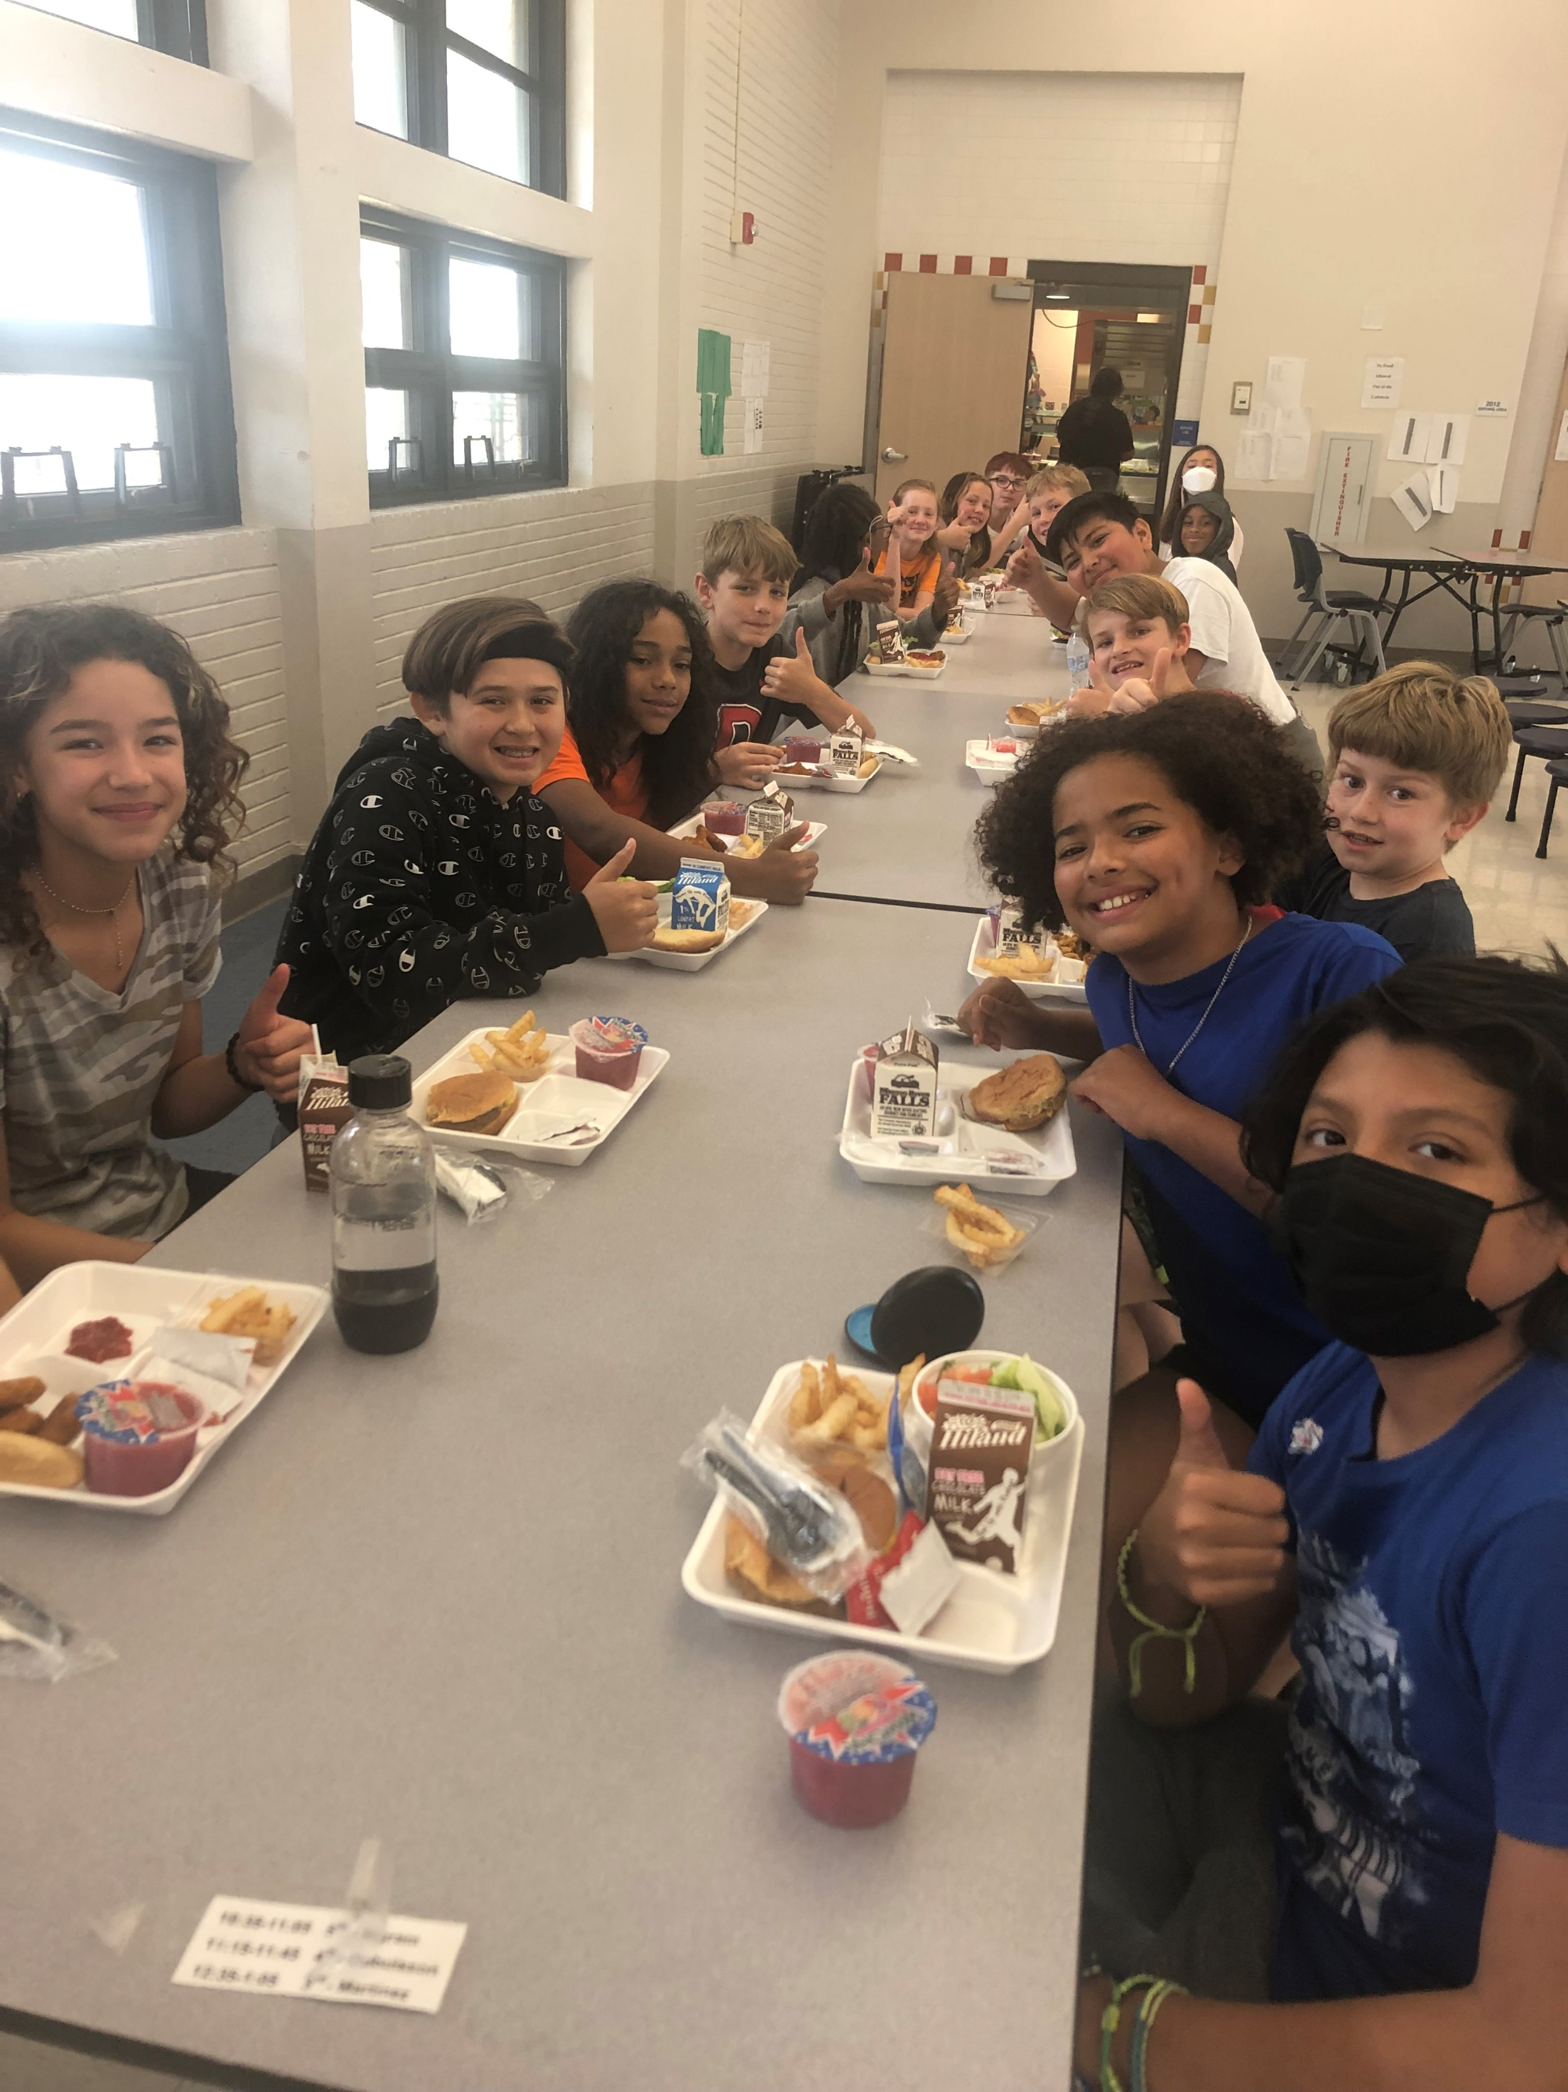


Slide 14

Useful Web Sites
Texas School Health Advisory Committee:
  www.dshs.state.tx.us/schoolhealth/shadvise.shtm
TXPTA Healthy Lifestyle web page:
www.txpta.org/programs/healthy-lifestyles
TEA Fitness Data: www.tea.state.tx.us./index4.aspx?id=397
Youth Risk Behavior Surveillance (YRBS) Survey: www.dshs.state.tx.us/chs/yrbs/query/yrbss_form.shtm
Weight of the Nation: http://theweightofthenation.hbo.com/films
CDC Coordinated School Health: www.cdc.gov/HealthyYouth/CSHP
Texas Department of Agriculture Square Meals: www.squaremeals.org/fn/home/page/0,1248,2348_2349_0_0,00.html
Regional Education Service Centers: http://ritter.tea.state.tx.us/ESC
Texas online help for childhood obesity: www.reshapingtexas.org
Texas Legislature Online: www.capitol.state.tx.us

