Slide 1
(ROX) Ruling our experiences
@Ruling our experiences
@BeingAGIRLROX

Slide 2
Mission:
to create generations of confident girls who control their own relationships, Experiences, decisions and futures.
Ruling our experiences (ROX) © 2020

Slide 3
What does rox do?
Ruling our experiences (ROX) © 2020

Slide 4
What is rox?
Ruling our experiences (ROX) © 2020

Slide 5
Messages Girls receive
Self-concept & decision-making
Relationships
academics
careers
leadership
Ruling our experiences (ROX) © 2020

Slide 6
Why girls
Girls experience unique challenges
The experiences of today’s girls are different from previous generations
Girls are at higher risk for negative outcomes
Depression/anxiety
Sexual harassment/sexual violence
Girls are disproportionately represented in leadership roles
Why it’s important we invest in girls in our community
Ruling our experiences (ROX) © 2020

Slide 7
Girls' Index
Ruling our experiences (ROX) © 2020

Slide 8
How rox programming works
ROX trains …
Facilitators lead …
Girls learn how to …
Communicate Effectively
Develop Healthy Relationships
Stand Up for Themselves
Form a healthy body image
Navigate social media & cyberspace
Stay safe and defend themselves
Manage stress & pressure
Plan for college & their career
Become leaders
licensed school counselors, social workers and educators to become program facilitators.
small groups of girls through the 20-week evidence-based curriculum.
Ruling our experiences (ROX) © 2020

Slide 9
Social & emotional Learning needs
Academic Barriers
Non-academic Barriers
Students experiences, at school and at home, impact their interactions with others and ultimately how they are able to perform in the classroom
When the social and emotional needs of students are attended to in schools:
Learning is more personalized
Connections between students and their learning environments are strengthened
Students develop a sense of belonging, build strong relationships, and feel a connection to school
Ruling our experiences (ROX) © 2020

Slide 10
Safe & healthy students
Effective ROX Programs Align with:
School Climate Initiatives
Student Support & Academic Enrichment Grants
Social & Emotional Learning Initiatives (SEL)
Healthy Relationships & Dating Violence Mandates
Whole Child Initiatives
Response To Intervention (RTI: Tier 1)
Ruling our experiences (ROX) © 2020

Slide 11
How rox is implemented
95% of ROX programs are school-based & co-curricular;
Advisory
Health
Study Hall
Lunch/Recess
ROX programs work best when they are part of the school/district comprehensive school counseling program
Curriculum is aligned with the ASCA Mindsets & Behaviors
Ruling our experiences (ROX) © 2020

Slide 12
ROX outcomes
CONTINUALLY INFORMED BY DATA & OUTCOMES
ROX continually studies and researches the impact of their programming through pre, post, and longitudinal data collection. Their findings inform their curricular revisions and program offerings.
Ruling our experiences (ROX) © 2020

Slide 13
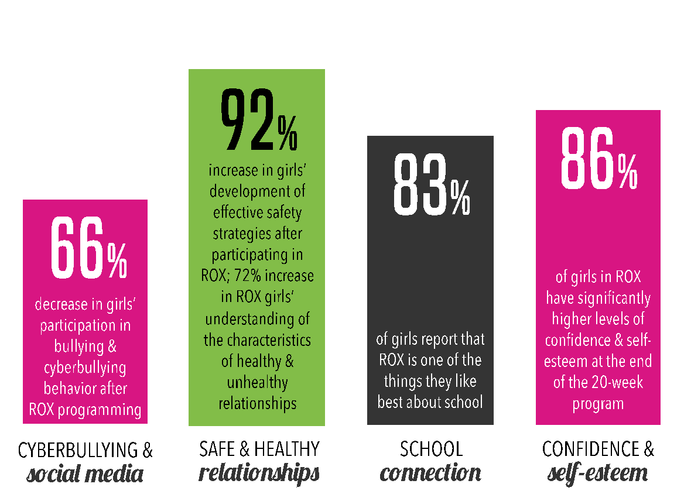
Using data to measure impact
Ruling our experiences (ROX) © 2020

Slide 14
Why rox?
Ruling our experiences (ROX) © 2020

