Slide 1
St. Mary’s County Public Schools
July 2022

Slide 2
New for this year
Davis Vision Providers are in-network as of July 1, 2022.
Blue Rewards will be offered again this year. Make sure you earn your $100 reward.

Slide 5
BlueChoice HMO Open Access – Plan 1
 | In-network
Annual medical deductible (individual/family) | $100 Ind/$200 Family
Annual medical out-of-pocket maximum (individual/family) | $800/$1,600
Preventive care | No charge
Primary care provider (PCP) office visit | $15 copay
Specialist office visit | $15 copay
Labs | No charge (LabCorp)
X-ray & Specialty imaging | No charge
OutPt. Physical, Speech, Occupational Therapy (50 visits/condition/year) | $15 copay
Convenience care (retail health clinic) | $15 copay
Urgent care | $35 copay
Emergency room | $75 copay (waived if admitted)
Inpatient hospital services—facility | Deductible, then no charge

Slide 6
BlueChoice HMO Open Access – Plan 2
 | In-network
Annual medical deductible (individual/family) | No Deductible
Annual medical out-of-pocket maximum (individual/family) | $2,000/$6,000
Preventive care | No charge
Primary care provider (PCP) office visit | $5 copay
Specialist office visit | $10 copay
Labs | No charge (LabCorp)
X-ray & Specialty imaging | No charge
OutPt. Physical, Speech, Occupational Therapy (30 visits/condition/year/combined) | $10 copay
Convenience care (retail health clinic) | $5 PCP/$10 Specialist copay
Urgent care | $10 copay
Emergency room | $75 copay (waived if admitted)
Inpatient hospital services—facility | No charge

Slide 7
 | HMO Plan 1 | HMO Plan 2
Annual medical deductible (individual/family) | $100/$200 | None
Annual medical out-of-pocket maximum (individual/family) | $800/$1,600 | $2,000/$6,000
Preventive care | No charge | No charge
Primary care provider (PCP) office visit | $15 copay | $5 copay
Specialist office visit | $15 copay | $10 copay
Labs (LabCorp) | No charge | No charge
X-ray | No charge | No charge
OutPt Physical, Speech, Occupational Therapy | $15 copay | $10 copay
Convenience care (retail health clinic) | $15 copay | $5/$10 copay
Urgent care | $35 copay | $10 copay
Emergency room (copay waived if admitted) | $75 copay | $75 copay
Inpatient hospital services—facility | Deductible, then no charge | No charge

Slide 8
Away from Home Care
Members who live in another part of the country for at least 90 consecutive days may be eligible for “Away From Home Care”
Contact Member Services to enroll and ask for the Away From Home Care Coordinator.
Once enrolled, you have access to routine and urgent care through an affiliated BCBS HMO.
Great program for out-of-state college students. Not all states participate, so check first.
Must enroll on an annual basis.

Slide 9
Away from Home Care
The following states do not participate in Away From Home Care:
Alabama | Nebraska | Tennessee
Alaska | North Carolina | Utah
Idaho | North Dakota | Vermont
Iowa | Oregon | Washington
Kansas | Rhode Island | West Virginia
Mississippi | South Carolina | Wyoming
Montana | South Dakota | Puerto Rico

Slide 10
BlueChoice Triple Option Open Access – Plan 1
Plan Highlights
 | Level 1 | Level 2 | Level 3
Selection of PCP | Required for Level 1 | Recommended | Recommended
Referrals | Not required; however, must stay in the BlueChoice Network | Not required | Not required
Labs | Use of LabCorp required | Any PPO Lab | All Other Labs
Networks | BlueChoice Regional Network (no balance billing) | BlueCard PPO Network (no balance billing) | Par/Non-Par (may balance billed)
Coinsurance | 95% | 85% | 70%

Slide 11
BlueChoice Triple Option Open Access – Plan 1
 | Level 1 | Level 2 | Level 3
Annual medical deductible (Ind/Family) | $125/$250 | $250/$500 | $500/$1,000
Annual medical out-of-pocket maximum (Ind/Family) | $500/$1,000 | $1,000/$2,000 | $1,500/$3,000
Preventive care | No charge | No charge | Ded, then 30% AB
Primary care provider (PCP) office visit | $15 copay | $25 copay | Ded, then 30% AB
Specialist office visit | $35 copay | $50 copay | Ded, then 30% AB
Labs | No copay (LabCorp) | 100% AB | 100% AB
X-ray and Specialty Imaging | No copay | 100% AB | 100% AB
OutPt. Physical, Speech Occupational Therapy (100 days combined per condition per year) | $35 copay | $50 copay | Ded, then 30% AB
Convenience care (retail health clinic) | $15 PCP/$35 Spec | $25 PCP/$50 Spec | Ded, then 30% AB
Urgent care | $35 copay | $35 copay | $35 copay
Emergency room (copay waived if admitted) | $75 copay | $75 copay | $75 copay
Inpatient hospital services—facility | Ded, then 5% AB | Ded, then 15% AB | Ded, then 30% AB

Slide 12
BlueChoice Triple Option Open Access – Plan 2
Plan Highlights
 | Level 1 | Level 2 | Level 3
Selection of PCP | Required for Level 1 | Recommended | Recommended
Referrals | Not required; however must stay in the BlueChoice Network | Not required | Not required
Labs | Use of LabCorp required | Any PPO Lab | All Other Labs
Networks | BlueChoice Regional Network (no balance billing) | BlueCard PPO Network (no balance billing) | Par/Non-Par (may balance billed)
Coinsurance | 100% | 90% | 80%

Slide 13
BlueChoice Triple Option Open Access – Plan 2
 | Level 1 | Level 2 | Level 3
Annual medical deductible (Ind/Family) | None | $200/$400 | $300/$600
Annual medical out-of-pocket maximum (Ind/Family) | $2,000/$6,000 | $500/$1,000 | $1,000/$2,000
Preventive care | No charge | No charge | Ded, then 20% AB
Primary care provider (PCP) office visit | $10 copay | $15 copay | Ded, then 20% AB
Specialist office visit | $10 copay | $15 copay | Ded, then 20% AB
Labs | No copay (LabCorp) | $15 copay | Ded, then 20% AB
X-ray and Specialty Imaging | No copay | $15 copay | Ded, then 20% AB
OutPt. Physical, Speech Occupational Therapy | $10 copay (30 visits /condition/year) | $15 copay (100 visits/condition/yr) | Ded, then 20% AB (100/condition/yr)
Convenience care (retail health clinic) | $10 copay | $15 copay | Ded, then 20% AB
Urgent care | $10 copay | $15 copay | Ded, then 20% AB
Emergency room (copay waived if admitted) | $75 copay | $75 copay | $75 copay
Inpatient hospital services—facility | 100% AB | Ded, then 10% AB | Ded, then 20% AB

Slide 16
CVS/Caremark/Mail Order
 | One-month medication supply | Maintenance medications (3-month supply)
Tier 0: Preventive drugs | $0 copay | $0 copay
Tier 1: Generic drugs | $10 | $10 ($20 at all other pharmacies)
Tier 2: Preferred brand drugs | $15 | $15 ($30 at all other pharmacies)
Tier 3: Non-preferred brand drugs | $15 | $15 ($30 at all other pharmacies)
Notes:
Maintenance Medications are taken regularly for ongoing conditions such as diabetes, high blood pressure and asthma.

Slide 21
 | In-network | Out-of-network
Deductible | $50 Individual / $150 Family
Annual maximum | $1,200 Per Person
Preventive and diagnostic | 20% AB after deductible | 20% AB after deductible
Basic services | 20% AB after deductible | 20% AB after deductible
Major services—surgical | 20% AB after deductible | 20% AB after deductible
Major services—restorative | 20% AB after deductible | 20% AB after deductible
Orthodontic services | 50% AB, no deductible | 50% AB, no deductible
Lifetime maximum on orthodontic services | $2,000 per child under age 19

Slide 23
Select Vision/BlueVision Plus Davis Vision Providers are In-Network
Eye Exams
Once every 12 months
100% AB
Frames & Lenses
Once every 12 months
Frames Reimbursement: $50.00
Lenses Reimbursement
Single = $52.00
Bifocal = $82.00
Trifocal = $101.00
Contact Lenses Reimbursement
$97.00
$352.00, medically necessary

Slide 24
Select Vision/BlueVision Plus Davis Vision Providers are In-Network
Retail Providers Include:
Target
Walmart
Sam’s Club
JC Penney
Visionworks
Pearle Vision
My Eye Dr
America’s Best
E-commerce Options
Warby Parker
1-800-contacts
Glasses.com
Befitting.com
Lasik discounts through Qualsight

Slide 26
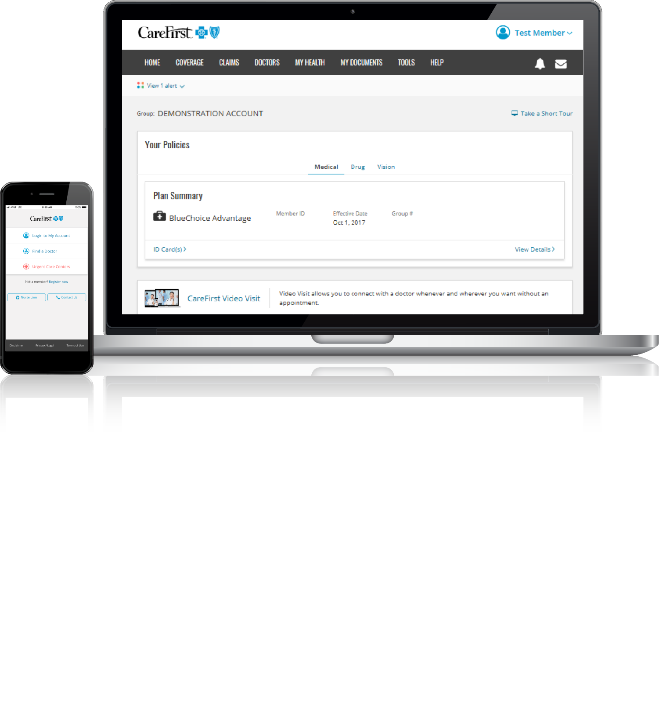
My Account: wherever you are
View claims and Explanation of Benefits (EOBs)
Find a doctor, facility or pharmacy
Check your benefits
View, order and print ID cards
Estimate medical expenses
carefirst.com/myaccount
Notes:
As a CareFirst member, you have access to a secure website with tools and information personalized just for you.
My Account is our online Member portal that is available online and on your mobile device.
This is where you can view claims, find doctors, check benefits, view, order and print ID cards, and estimate expenses.
Many things that you would normally call us for and wait on hold for can be done on My Account.

Slide 27
KNOW BEFORE YOU GO
MAKE THE MOST OF YOUR PLAN
Your first place to call*:
Not sure where to go?
Other treatment options:
Primary care provider (PCP)
24-hour Nurse Advice Line
800-535-9700
CareFirst Video Visit
Convenience care centers (retail health clinics)
Urgent care centers
Emergency room (ER)
*In the case of a life-threatening emergency, you should always call 911 or your local emergency services.
Notes:
Understanding your options when you need medical care is key to getting the best treatment with the lowest out-of-pocket costs. Except for emergencies, your first call should be to your primary care provider. As a CareFirst member, you have many resources available.
It is important to maintain a relationship with your PCP and use them for all preventive care. However, we understand they may not be available 24/7.
FirstHelp is our 24-hour nurse line where you can speak to a nurse and receive advice and determine whether you should wait for your PCP or seek urgent care.
CareFirst Video Visit allows you see a doctor using your computer, smart phone, or tablet to treat things like ear infections, sinus infections and regular colds.
Convenience care consists of places like CVS Minute Clinic (including in select Target stores) and Walgreen’s Healthcare Clinics. They assist with minor concerns like colds and ear infections.
Urgent Care Centers consists of places like ExpressCare and Patient First and help with more severe illnesses or injuries when you need care on weekends or after hours. They can treat things like broken bones, allergic reactions, asthma symptoms, and even animal bites.
The emergency room is appropriate for acute illnesses and trauma. Call 911 for life-threatening injuries or illnesses.

Slide 28
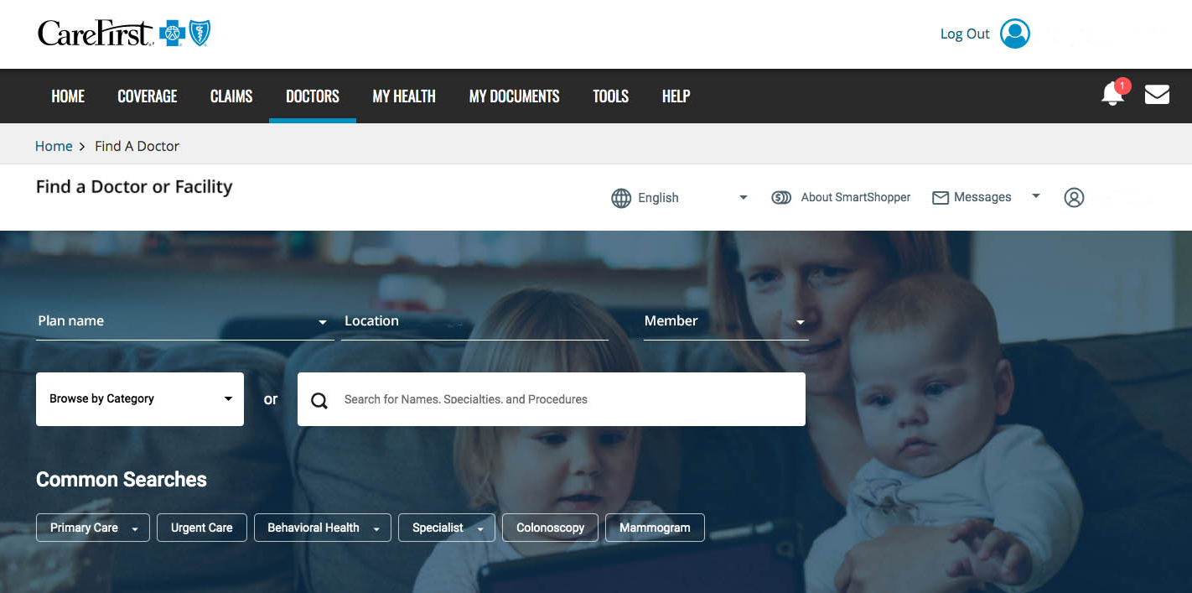
FIND A DOCTOR
MAKE THE MOST OF YOUR PLAN
carefirst.com/doctor

Slide 29
CAREFIRST VIDEO VISIT
MAKE THE MOST OF YOUR PLAN
Convenient care when you need it from your smartphone, tablet or computer.
Urgent care services—access board-certified doctors 24/7/365, no appointment needed
Behavioral health, diet/nutrition and breast-feeding support—schedule a visit and meet with a licensed professional
Register at carefirstvideovisit.com to get started
*In the case of a life-threatening emergency, you should always call 911 or your local emergency services. CareFirst Video Visit does not replace these services.

Slide 30
Notes:
Living a healthy life is all about making good choices every day, and CareFirst BlueCross BlueShield can help you do just that.
Blue365 is an exciting program that offers exclusive health and wellness deals that will keep you healthy and happy, every day of the year. Blue365 delivers great discounts from top national and local retailers on fitness gear, gym memberships, family activities, healthy eating options and much more.
Some discount services include Farmin fitness products, healthy eating cookbooks, Reebok, Snap fitness centers, and even medical devises like hearing aids, contacts and life alerts.

Slide 32
CareFirst has partnered with Sharecare, Inc. to bring you a wellness program that puts the power of health directly in your hands.
You can access the program’s personalized tools whenever and wherever you want, either online or through the mobile app.
This wellness program is administered by Sharecare, Inc., an independent company that provides health improvement management services to CareFirst members. Sharecare, Inc. does not provide CareFirst BlueCross BlueShield products or services and is solely responsible for the health improvement management services it provides.
Notes:
Sharecare is a digital health company founded by Jeff Arnold, founder of WebMD and Dr. Oz, leading cardiac surgeon and creator of the Dr. Oz show.

Slide 33
Wellness resources
Access motivating digital resources anytime, anywhere:
RealAge®: Learn the physical age of your body, compared to your calendar age with the online health assessment
A personalized health timeline: Receive recommendations, content and programs
Trackers: Connect your wearable devices or enter your own data to monitor sleep, steps, nutrition and more
Challenges: Provide extra motivation for achieving your health goals
A health profile: Access your important health data all in one place
Inspirations and Relax 360°: Break free from stress, unwind at the end of the day or ease into a restful night of sleep with meditation, streaming music and videos

Slide 35
Getting started
Visit carefirst.com/sharecare
You’ll need to:
Enter your CareFirst My Account username and password, and
Complete the one-time registration with Sharecare.
Notes:
Completing this one-time registration links your CareFirst information and helps personalize your experience.

Slide 36
Blue Rewards Incentive program
With Blue Rewards, you can earn rewards for taking steps to get and stay healthy! You will earn a $100 incentive card for completing the following steps before March 1, 2023:
Select a primary care provider (PCP)
Consent to receive wellness emails
Complete a health screening
Take the RealAge® test

Slide 37
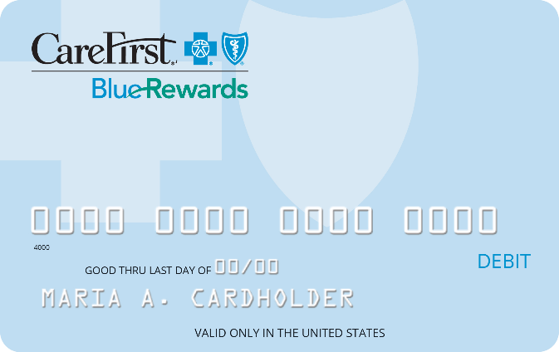
Blue Rewards incentive type
You’ll receive the CareFirst Blue Rewards Visa® Incentive Card in the mail once you complete all of the required steps. The incentive card can be used to pay for your annual deductible or other out-of-pocket expenses like copays or coinsurance related to your CareFirst health plan.
You must use the funds before the end of the benefit period, as the balance does not carry over.
The CareFirst Blue Rewards Visa Incentive Card is issued by The Bancorp Bank, Member FDIC, pursuant to a license from Visa U.S.A. Inc. Cards may be used only at merchants in the U.S. and District of Columbia wherever Visa debit cards are accepted for eligible expenses. See Cardholder Agreement for details.

Slide 38
Blue Rewards incentive card guidelines
Question | Answer
Who can use the card? | The card can be used by the policyholder and covered members (including children).
How many cards will be issued? | There will be one card per family, issued to the policyholder.
When can the reward funds be used? | The reward funds can be used for expenses incurred within the benefit period in which the incentive was earned.
What happens if I forget my card when I make a purchase? | Members can reimburse themselves (with a receipt) for any eligible expense that was incurred during the benefit period. Members will have a 90 day grace period from the end of the benefit period to submit expenses.
Do the funds rollover? | No – the funds are “use it or lose it” during the benefit period.

Slide 39
Blue Rewards incentive card guidelines
Question | Answer
How can the card be used? | To pay copays, coinsurance or deductible expenses for CareFirst covered medical, prescription drug, dental or vision services. The Blue Rewards card can only be used at approved locations like doctors’ offices, pharmacies, vision centers, etc.
How long is the incentive card effective? | The incentive funds can only be used for the benefit period in which the incentive was earned however the card is good for four years. Members should hold onto the card and newly earned incentives will be loaded to the existing card.
Do receipts for card purchases need to be retained? | Yes, please keep all your receipts.
Where can card balances and reimbursements be accessed? | Log in to your Sharecare account at carefirst.com/sharecare and select Achieve. Next, click Rewards then Blue Rewards Incentive Program. Under the Rewards tab, select Manage Your Blue Rewards, which connects you to the incentive card administrator’s website.

