Slide 2
AND THE WINNERS ARE…

Slide 3
SOPHOMORE
STILL LIFE

Slide 4
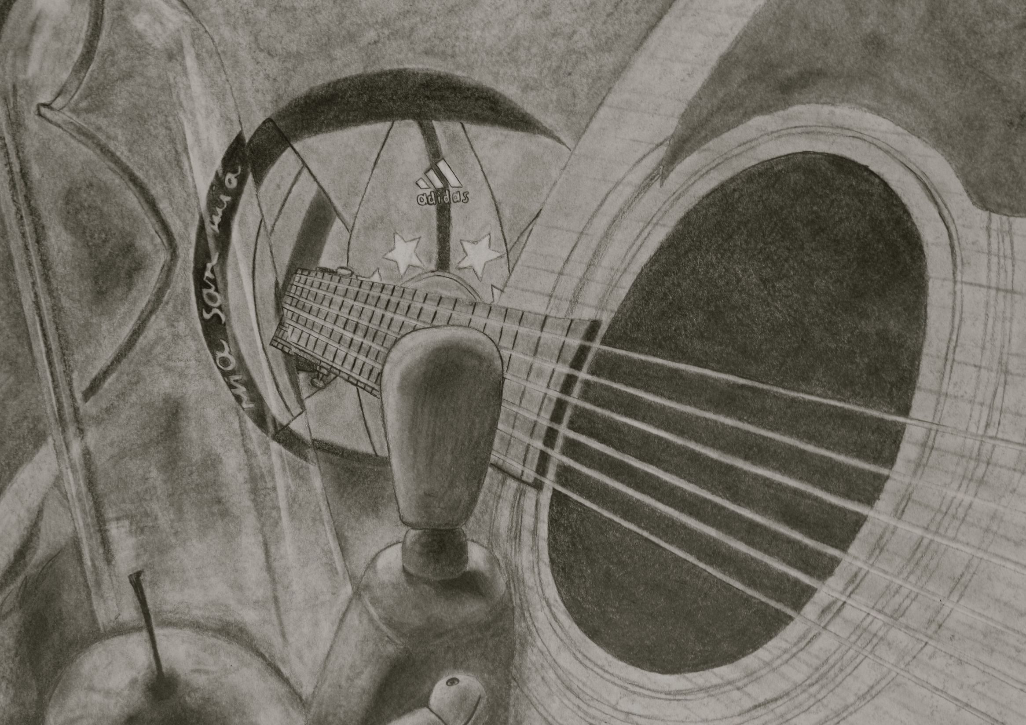
THIRD PLACE
TREVOR PEREZ

Slide 5
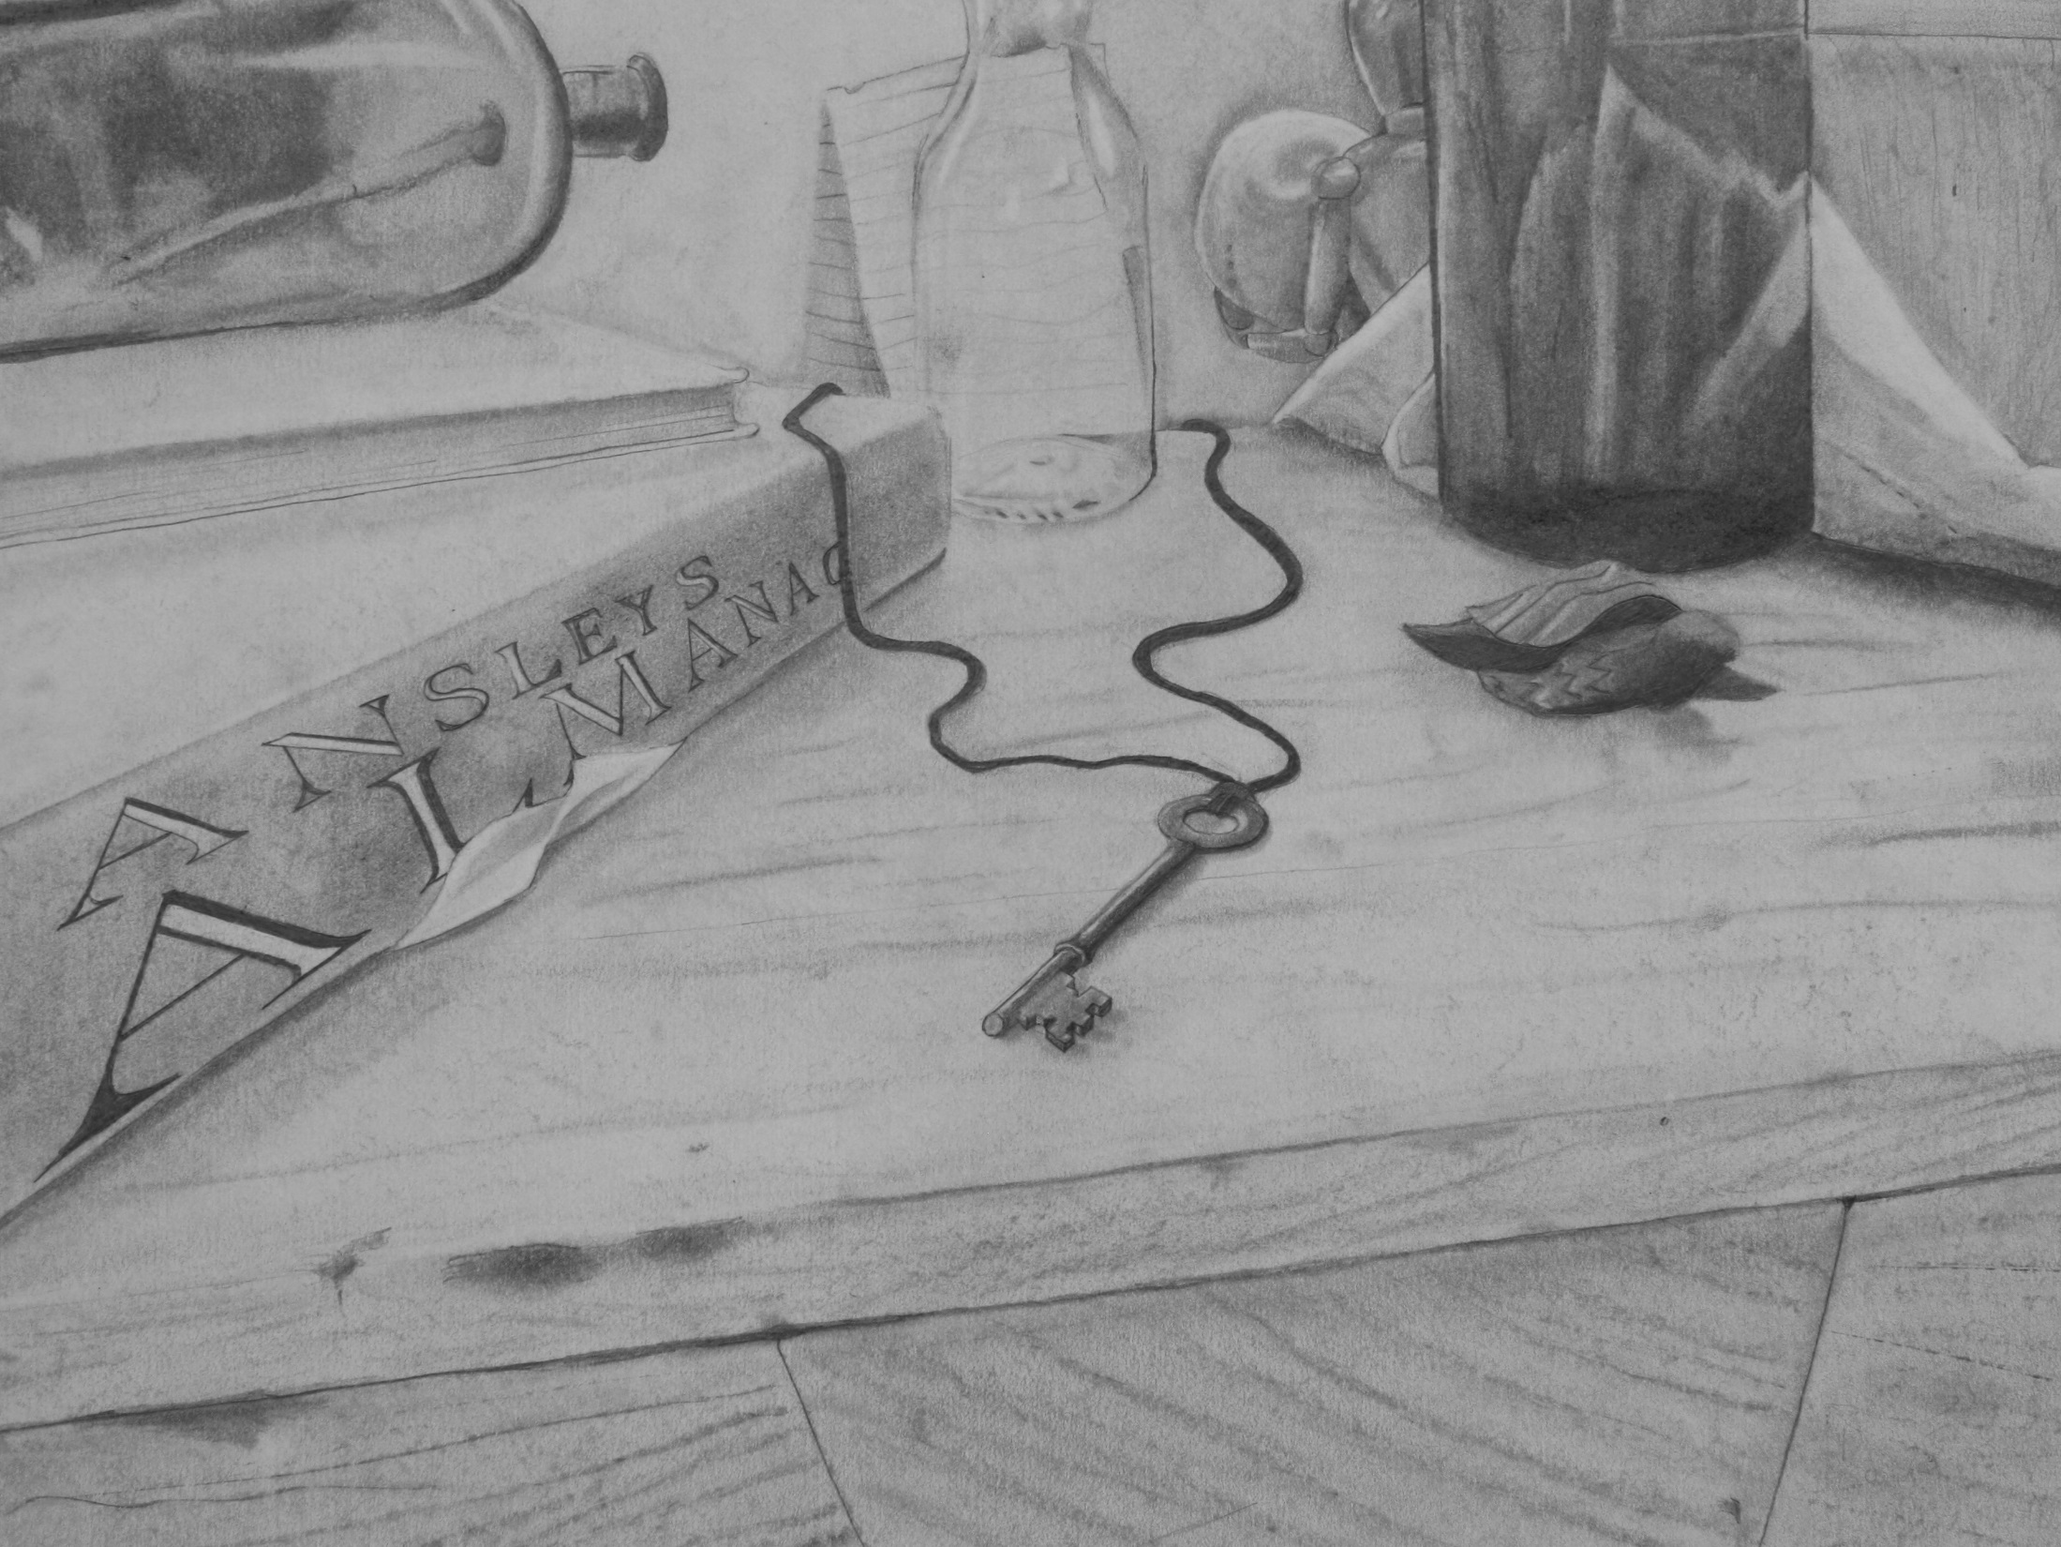
SECOND PLACE
DIEGO PEREZ-ARACENA

Slide 6
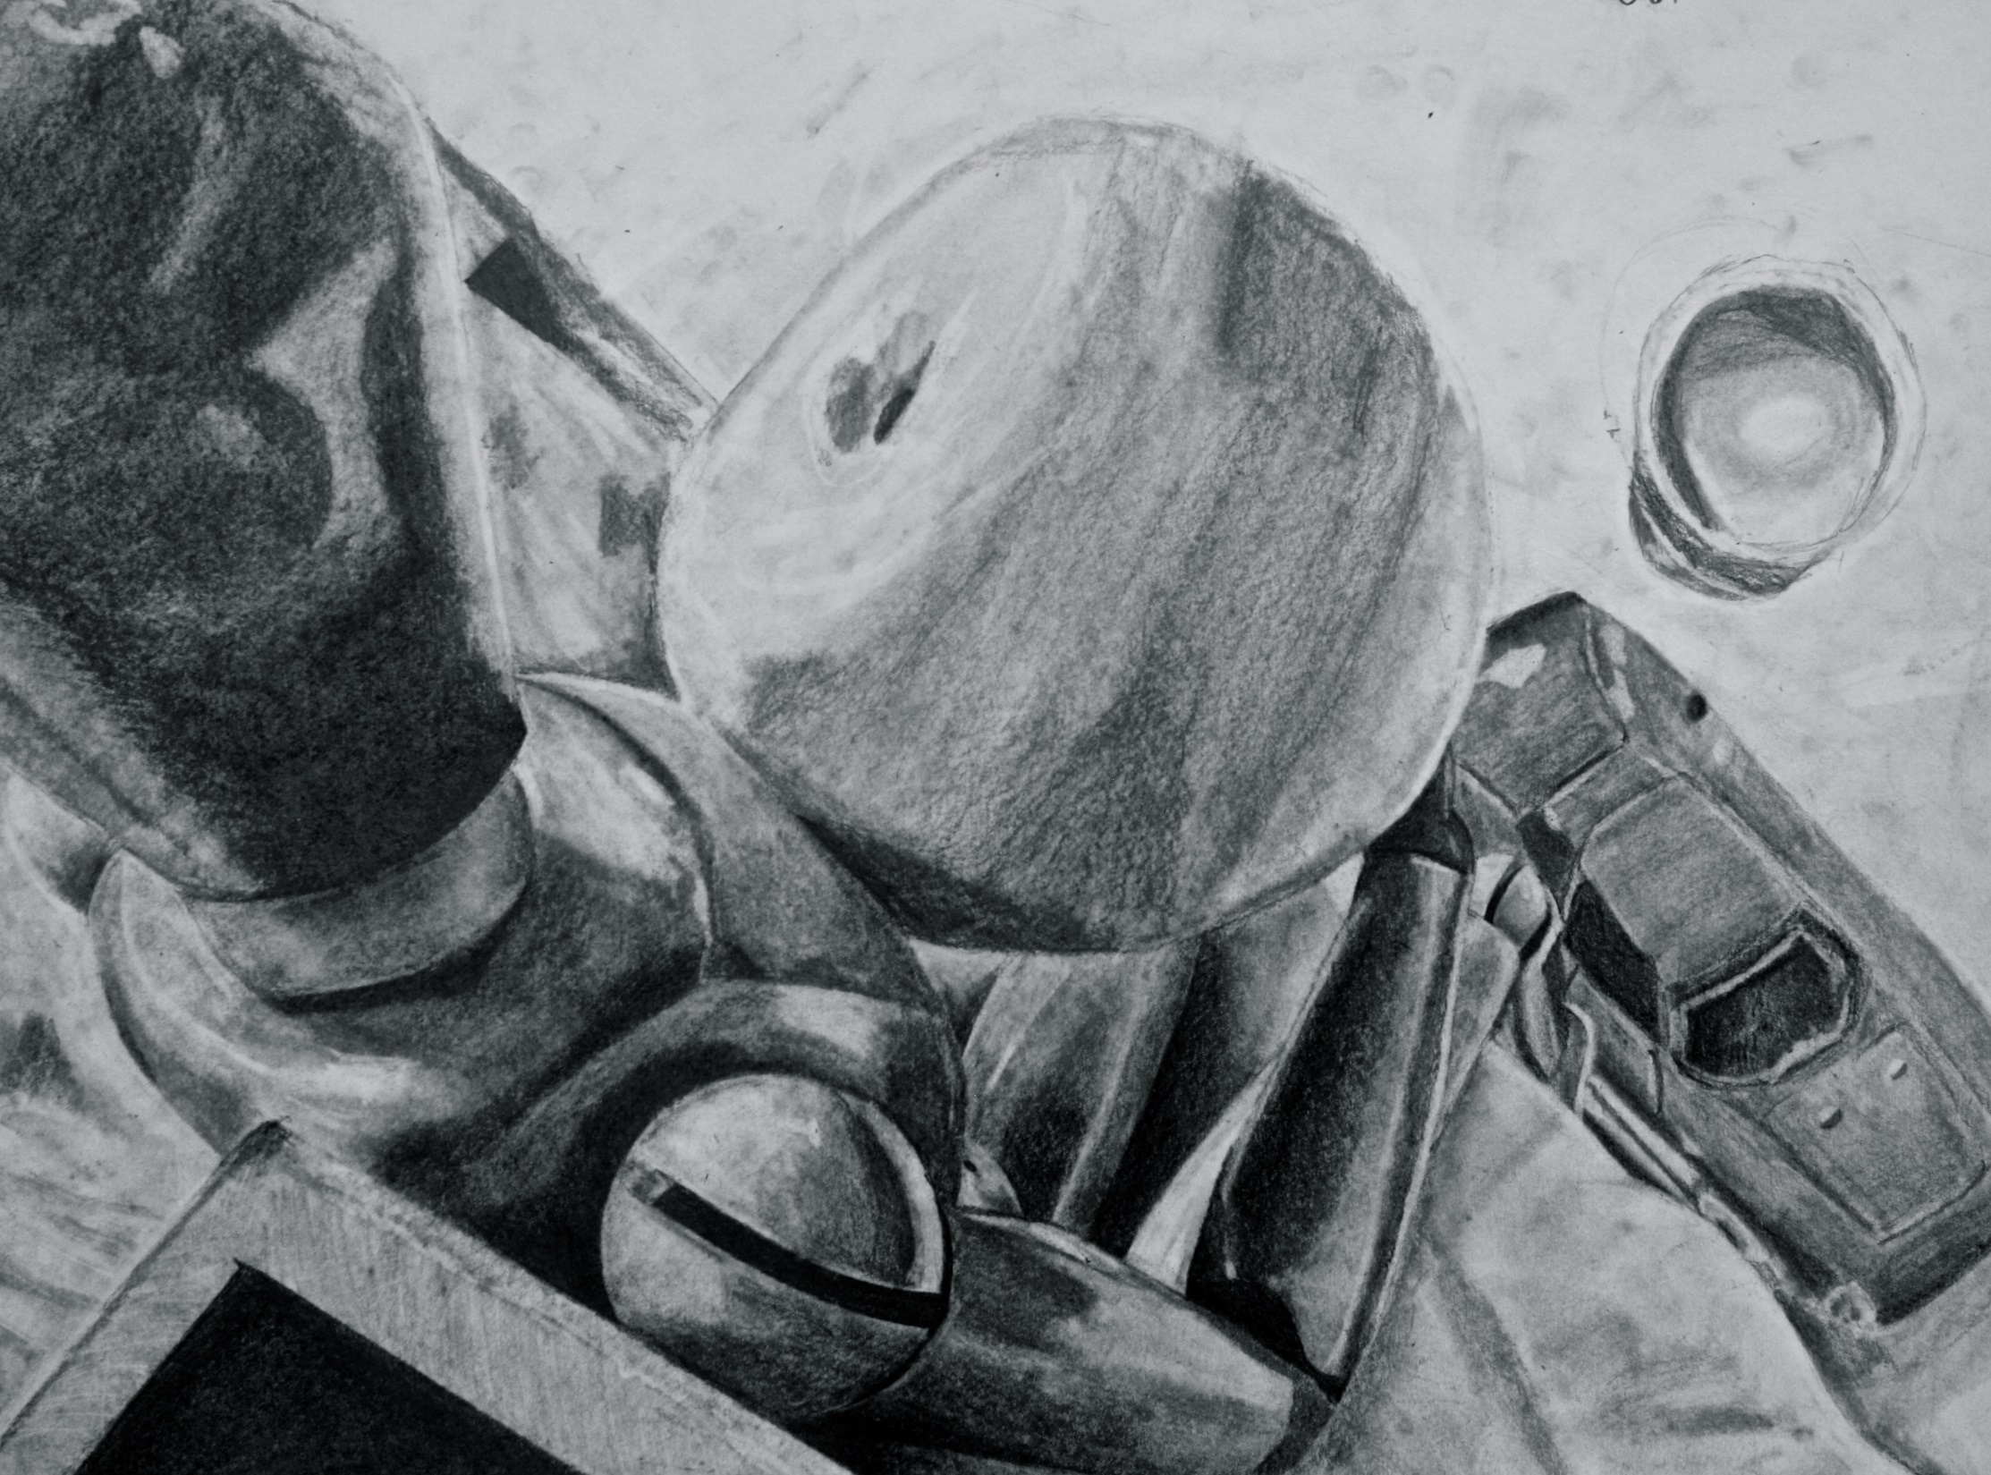
FIRST PLACE
QUINTIN HOGGARD

Slide 7
SOPHOMORE
SURREALISM

Slide 8
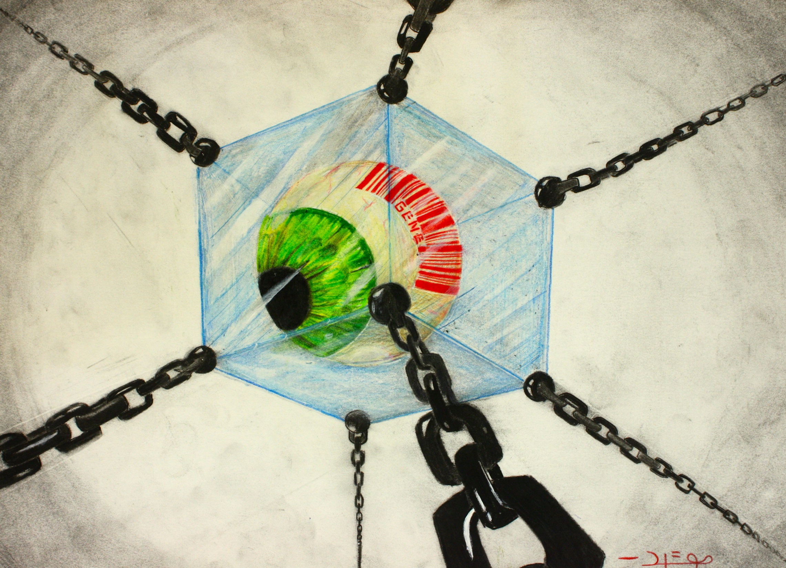
THIRD PLACE
DIEGO PEREZ - ARACENA

Slide 9
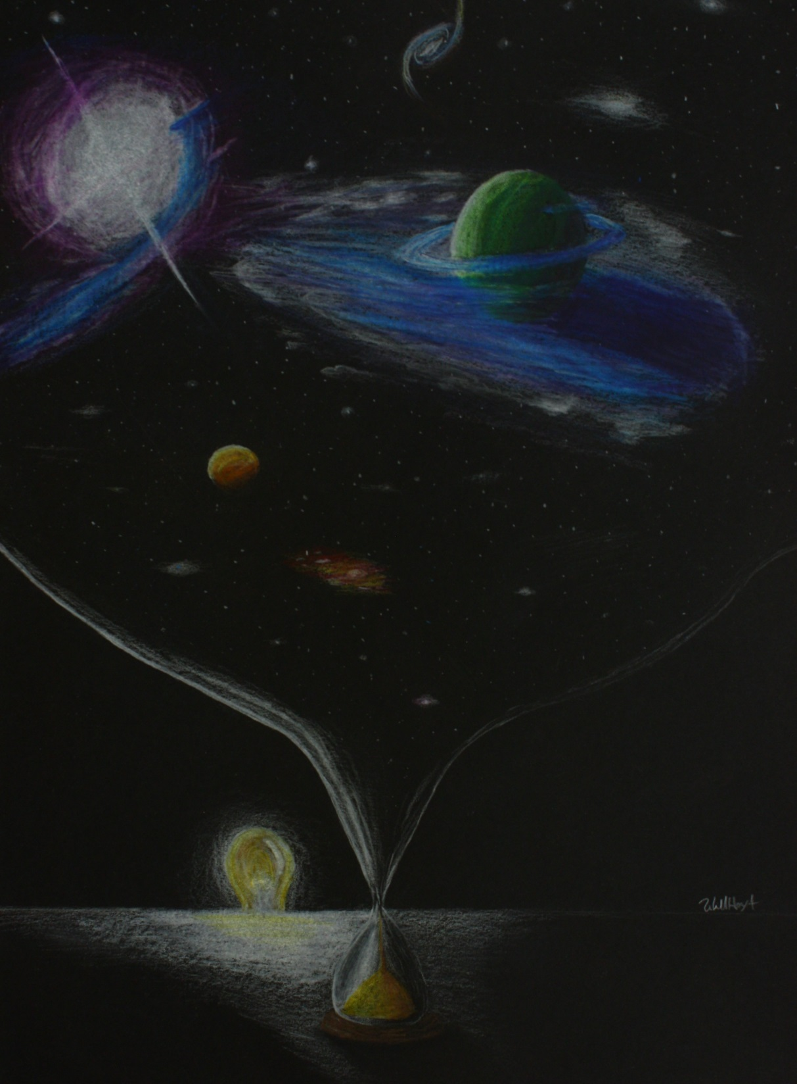
SECOND PLACE
WILL HOYT

Slide 10
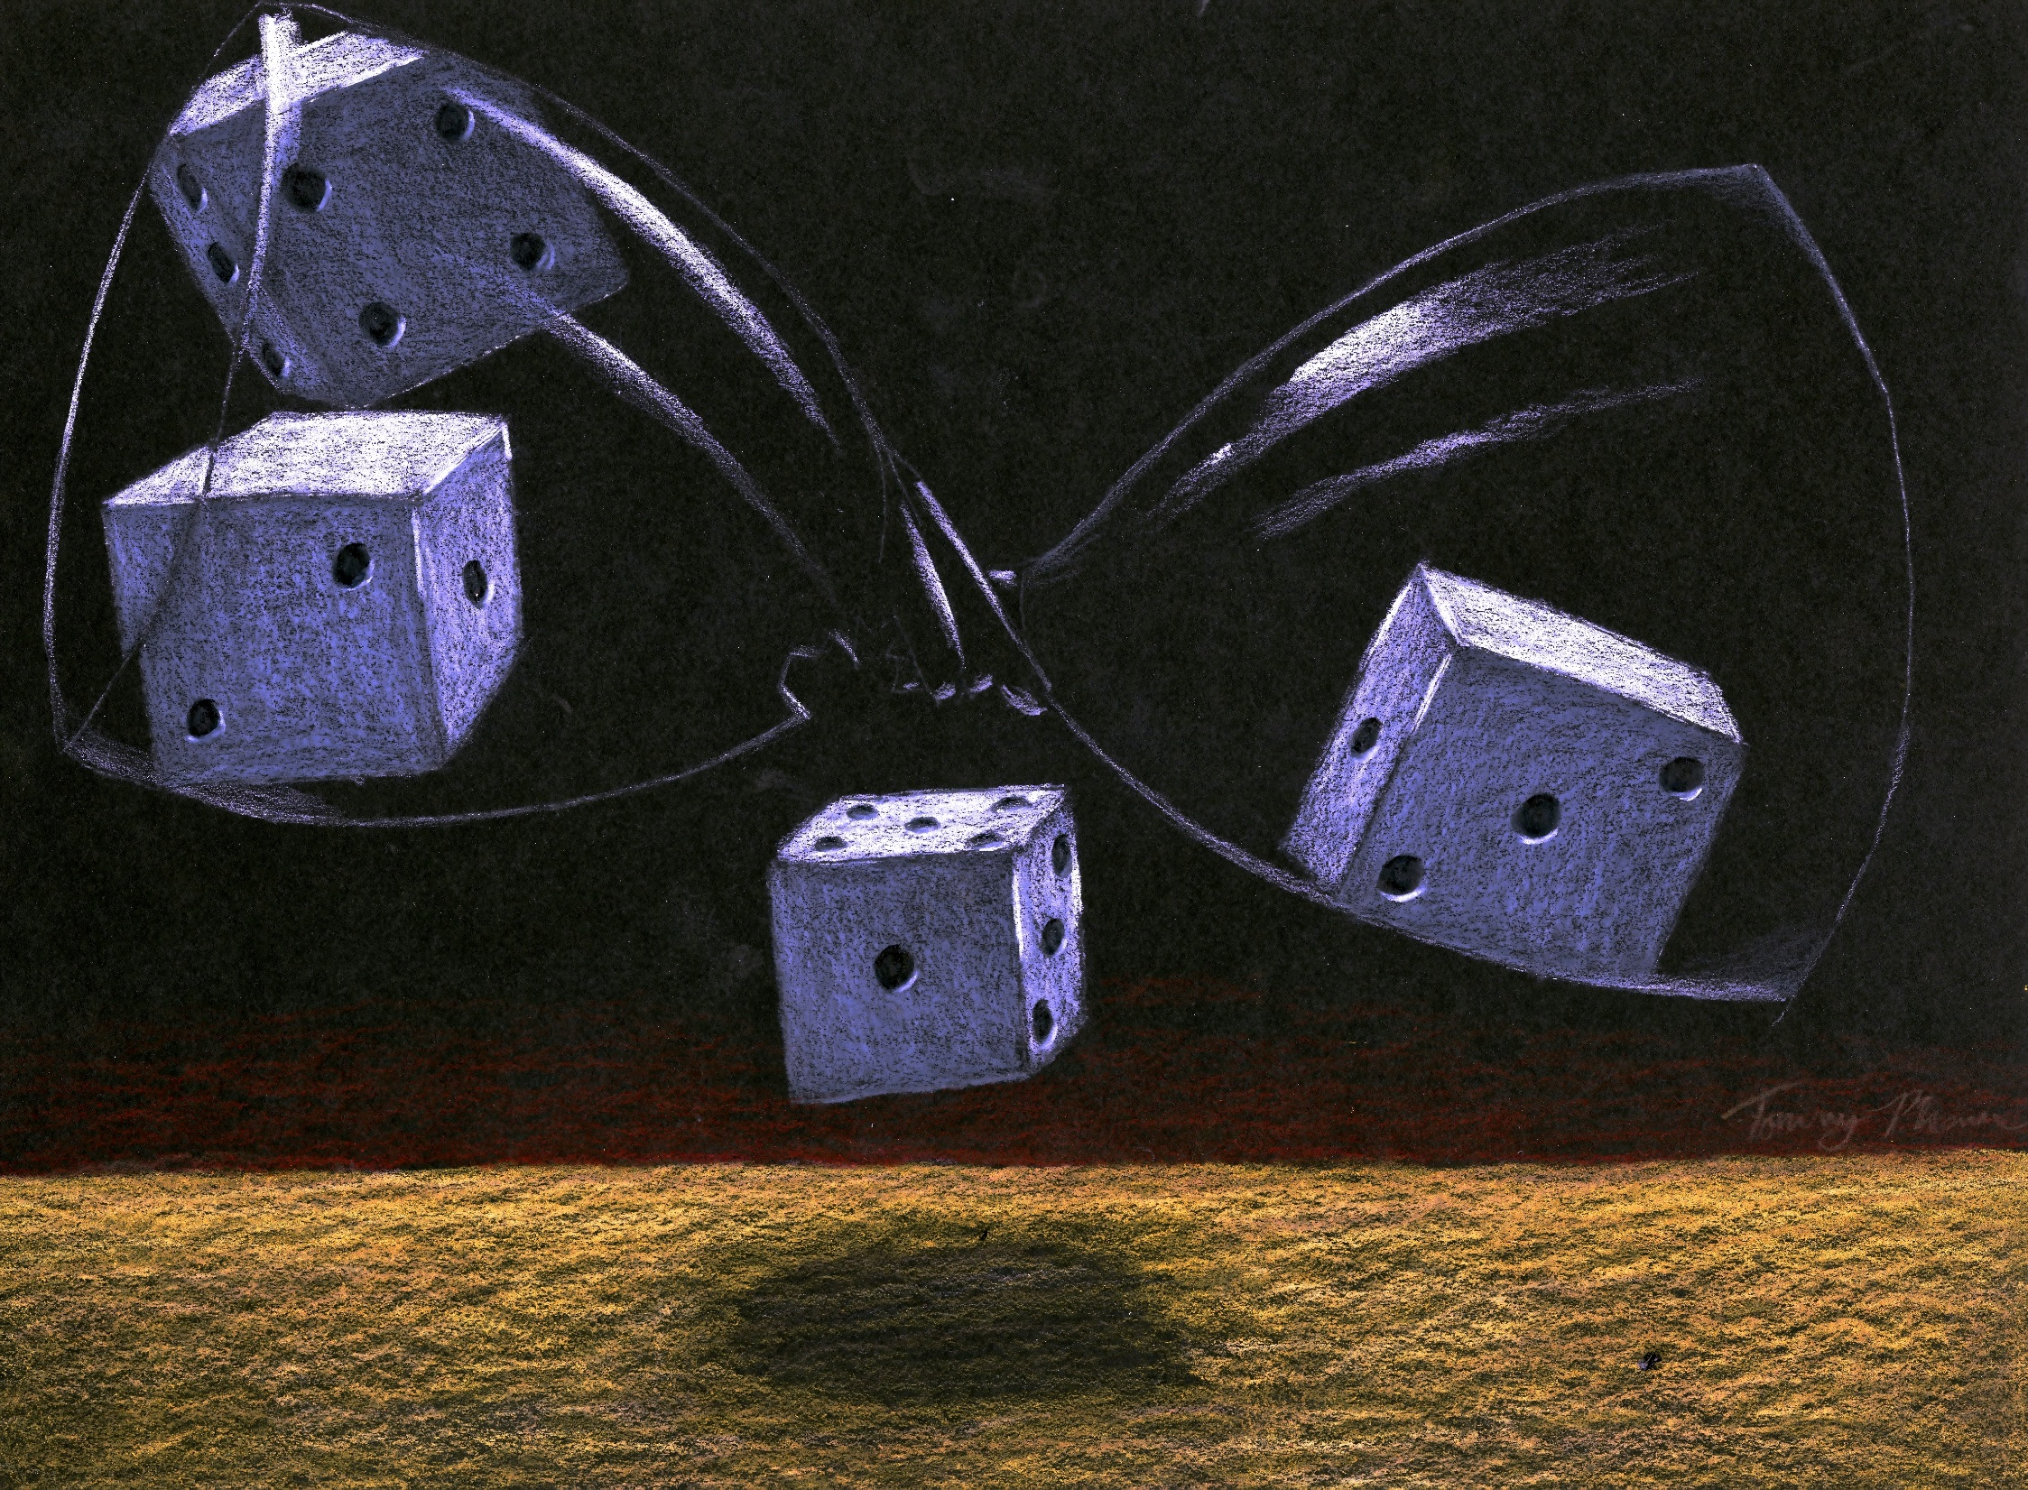
FIRST PLACE
TOMMY PHAM

Slide 11
JUNIOR HONORS
CHARCOAL PORTFOLIO

Slide 12
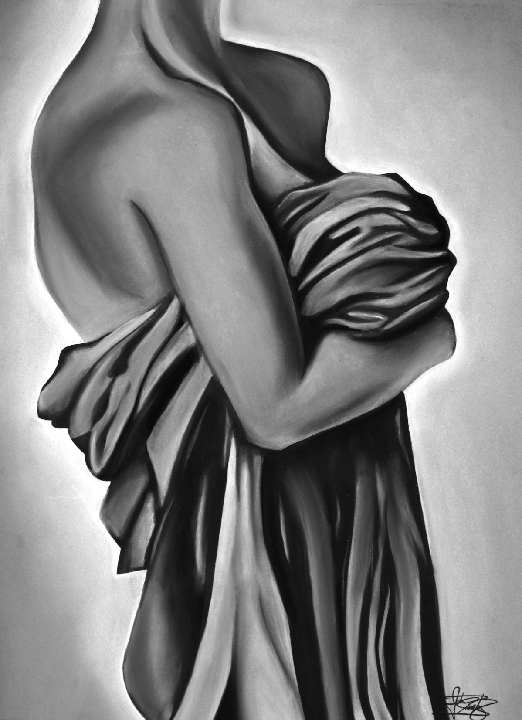
THIRD PLACE
JUSTIN SANCHEZ

Slide 13
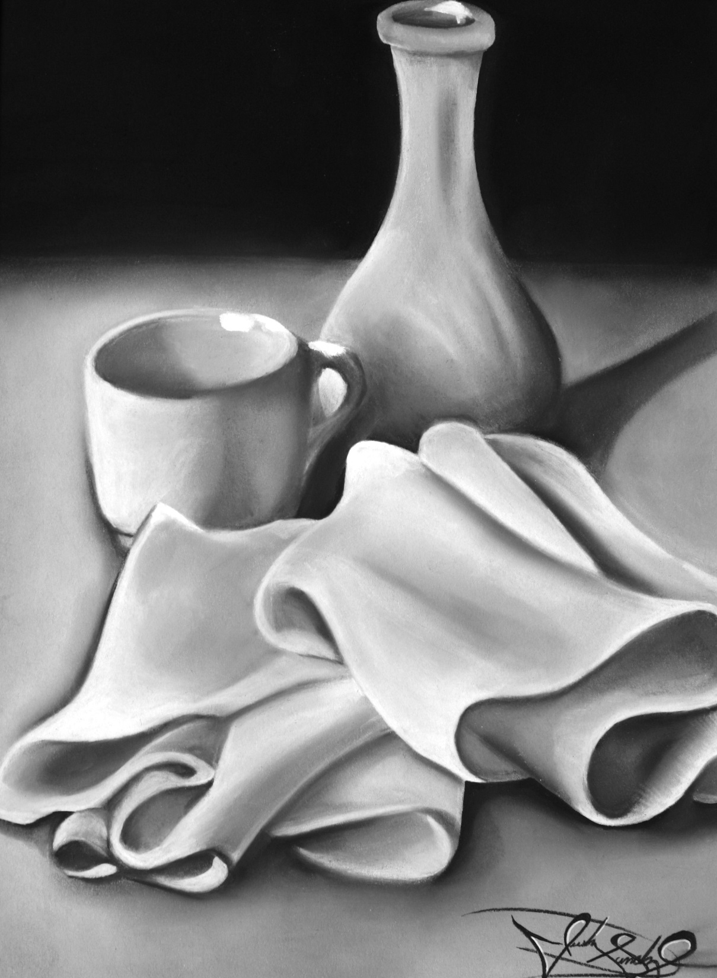
SECOND PLACE
JUSTIN SANCHEZ

Slide 14
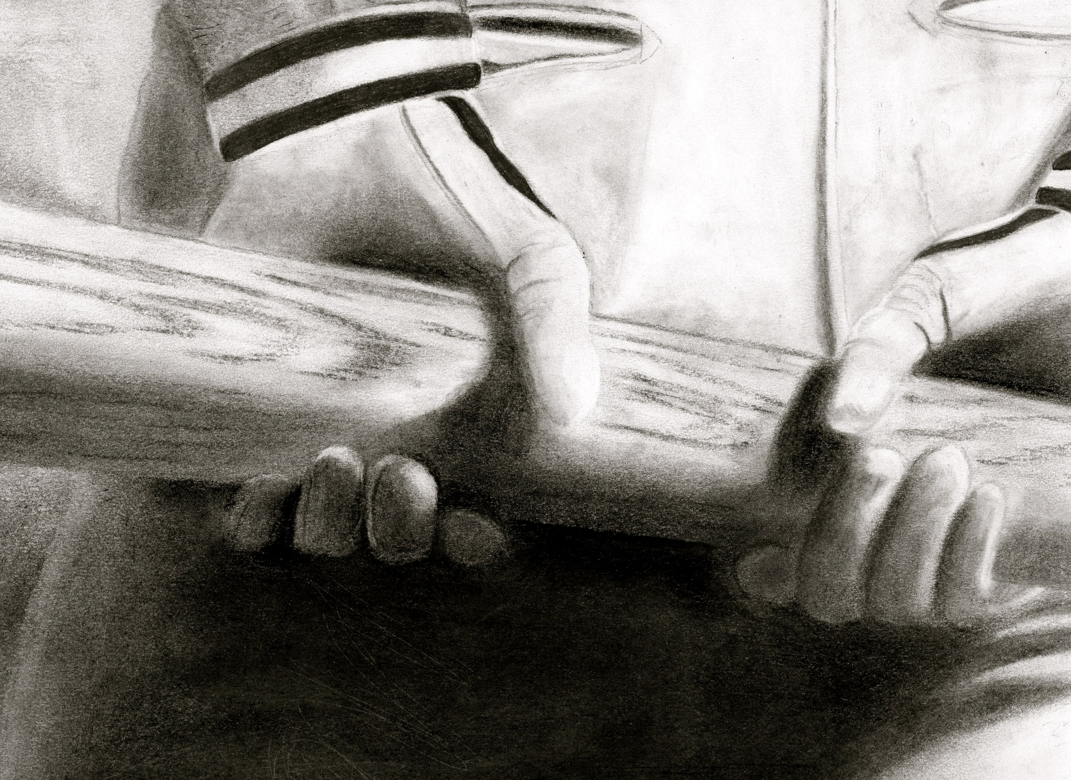
FIRST PLACE
LUCAS ORTIZ

Slide 15
JUNIOR HONORS
POINTILISM (DOTS)

Slide 16
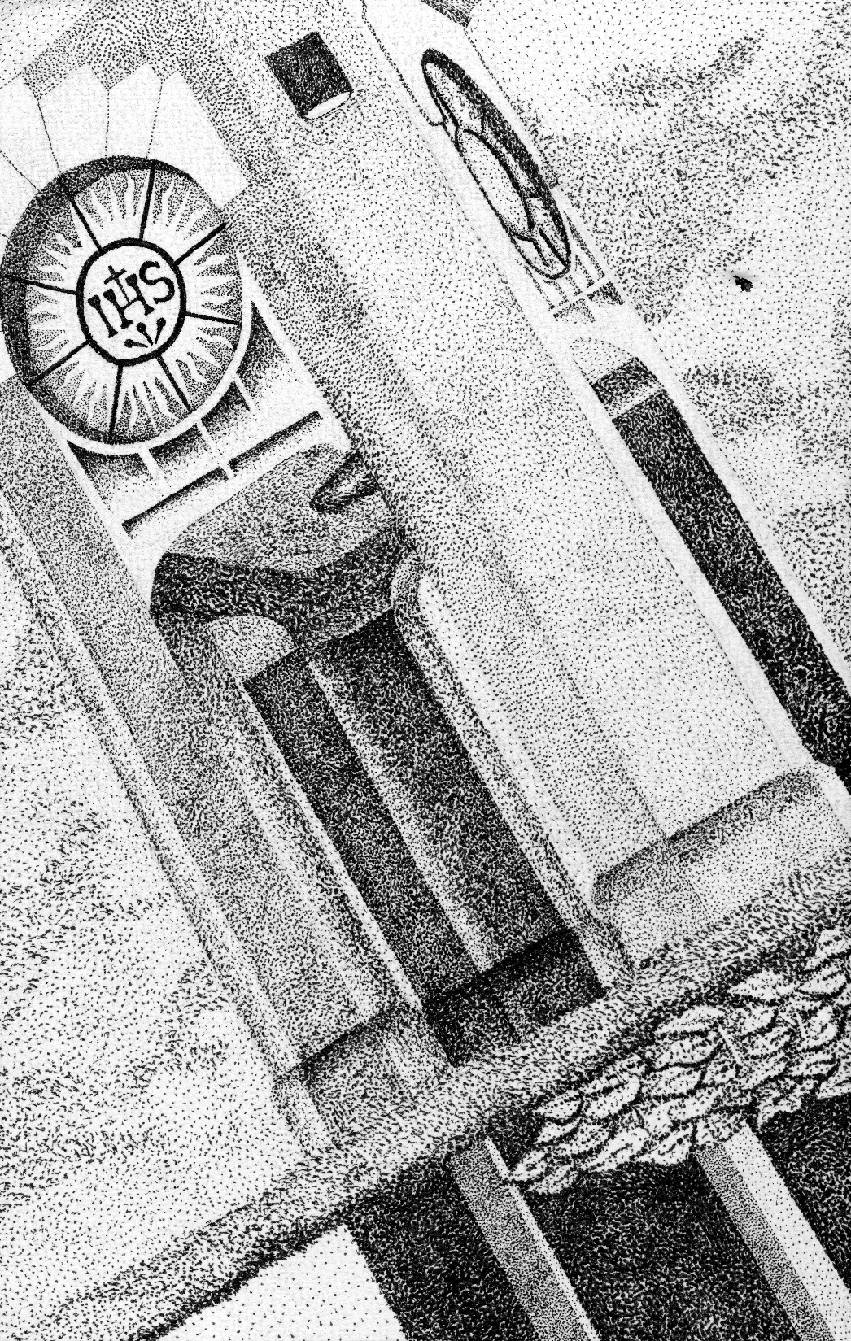
THIRD PLACE
NATHAN WEGNER

Slide 17
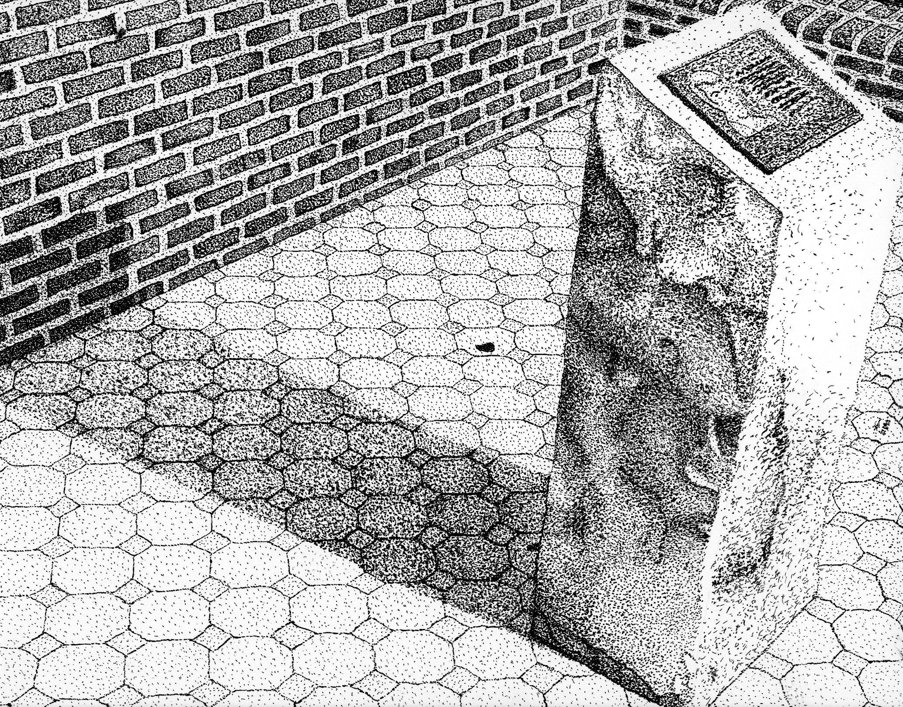
SECOND PLACE
TYSON DUNN

Slide 18
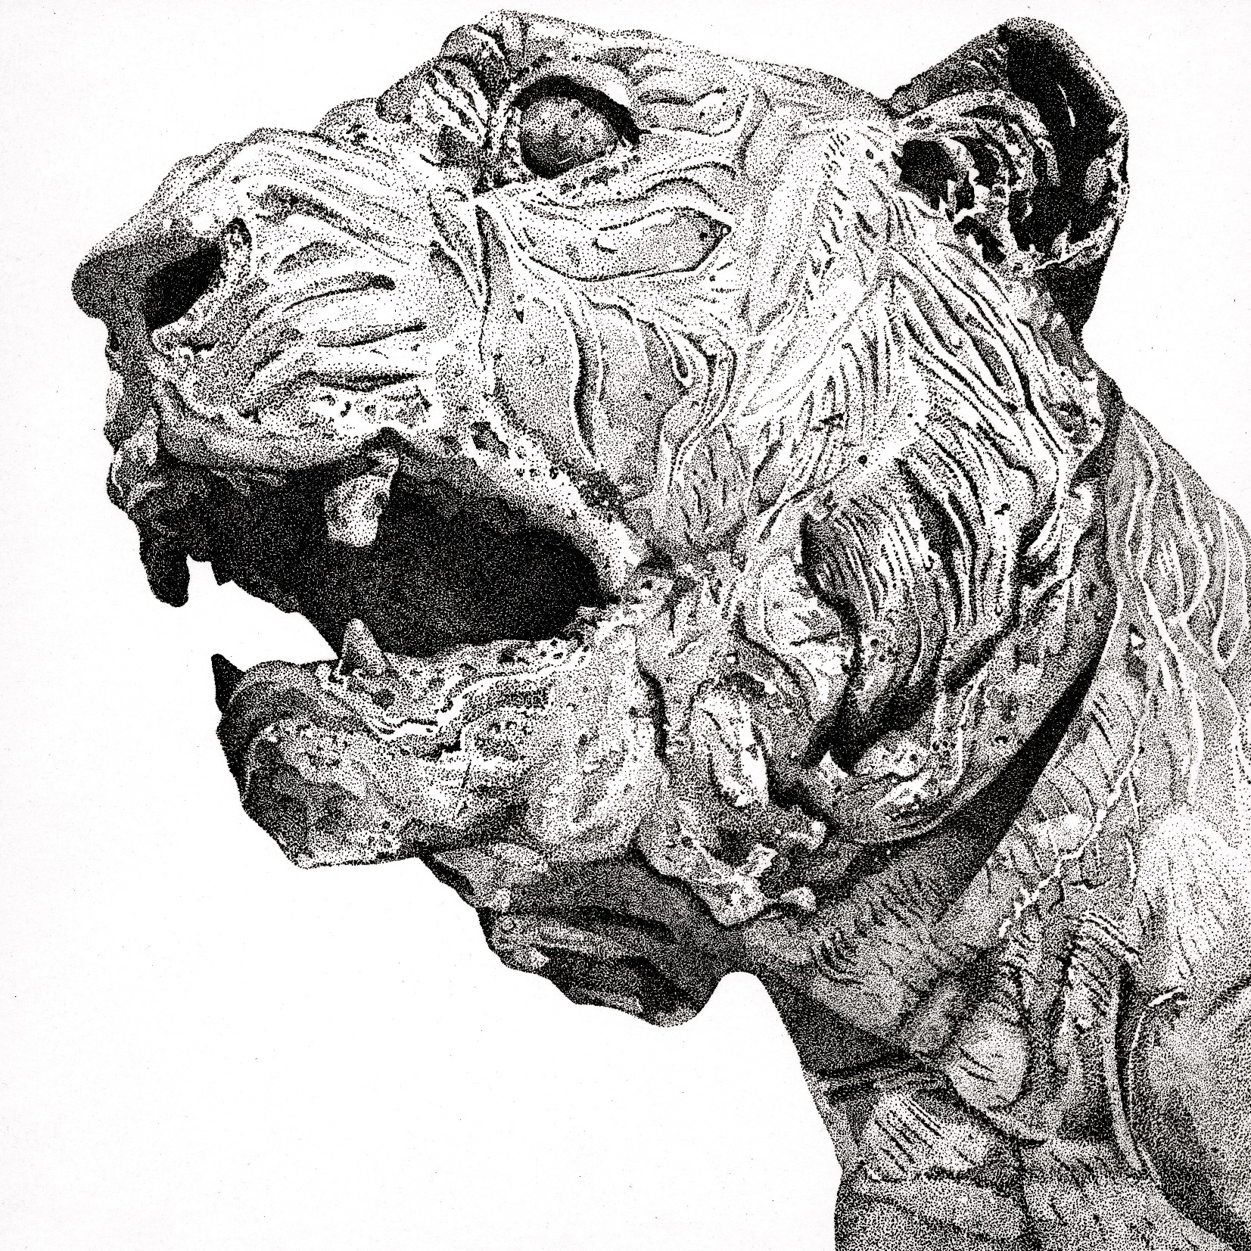
FIRST PLACE
JUSTIN SANCHEZ

Slide 19
JUNIOR HONORS
GOUACHE PAINTING

Slide 20
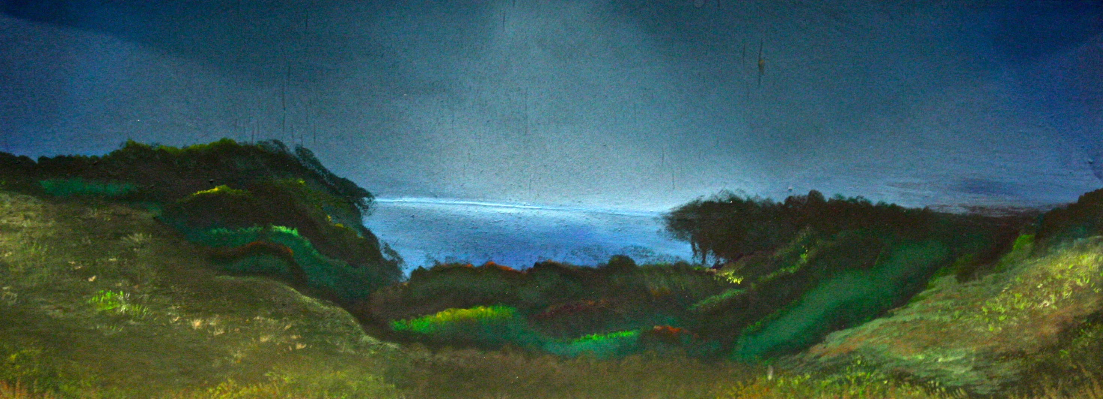
THIRD PLACE
TONY BOGHDADI

Slide 21
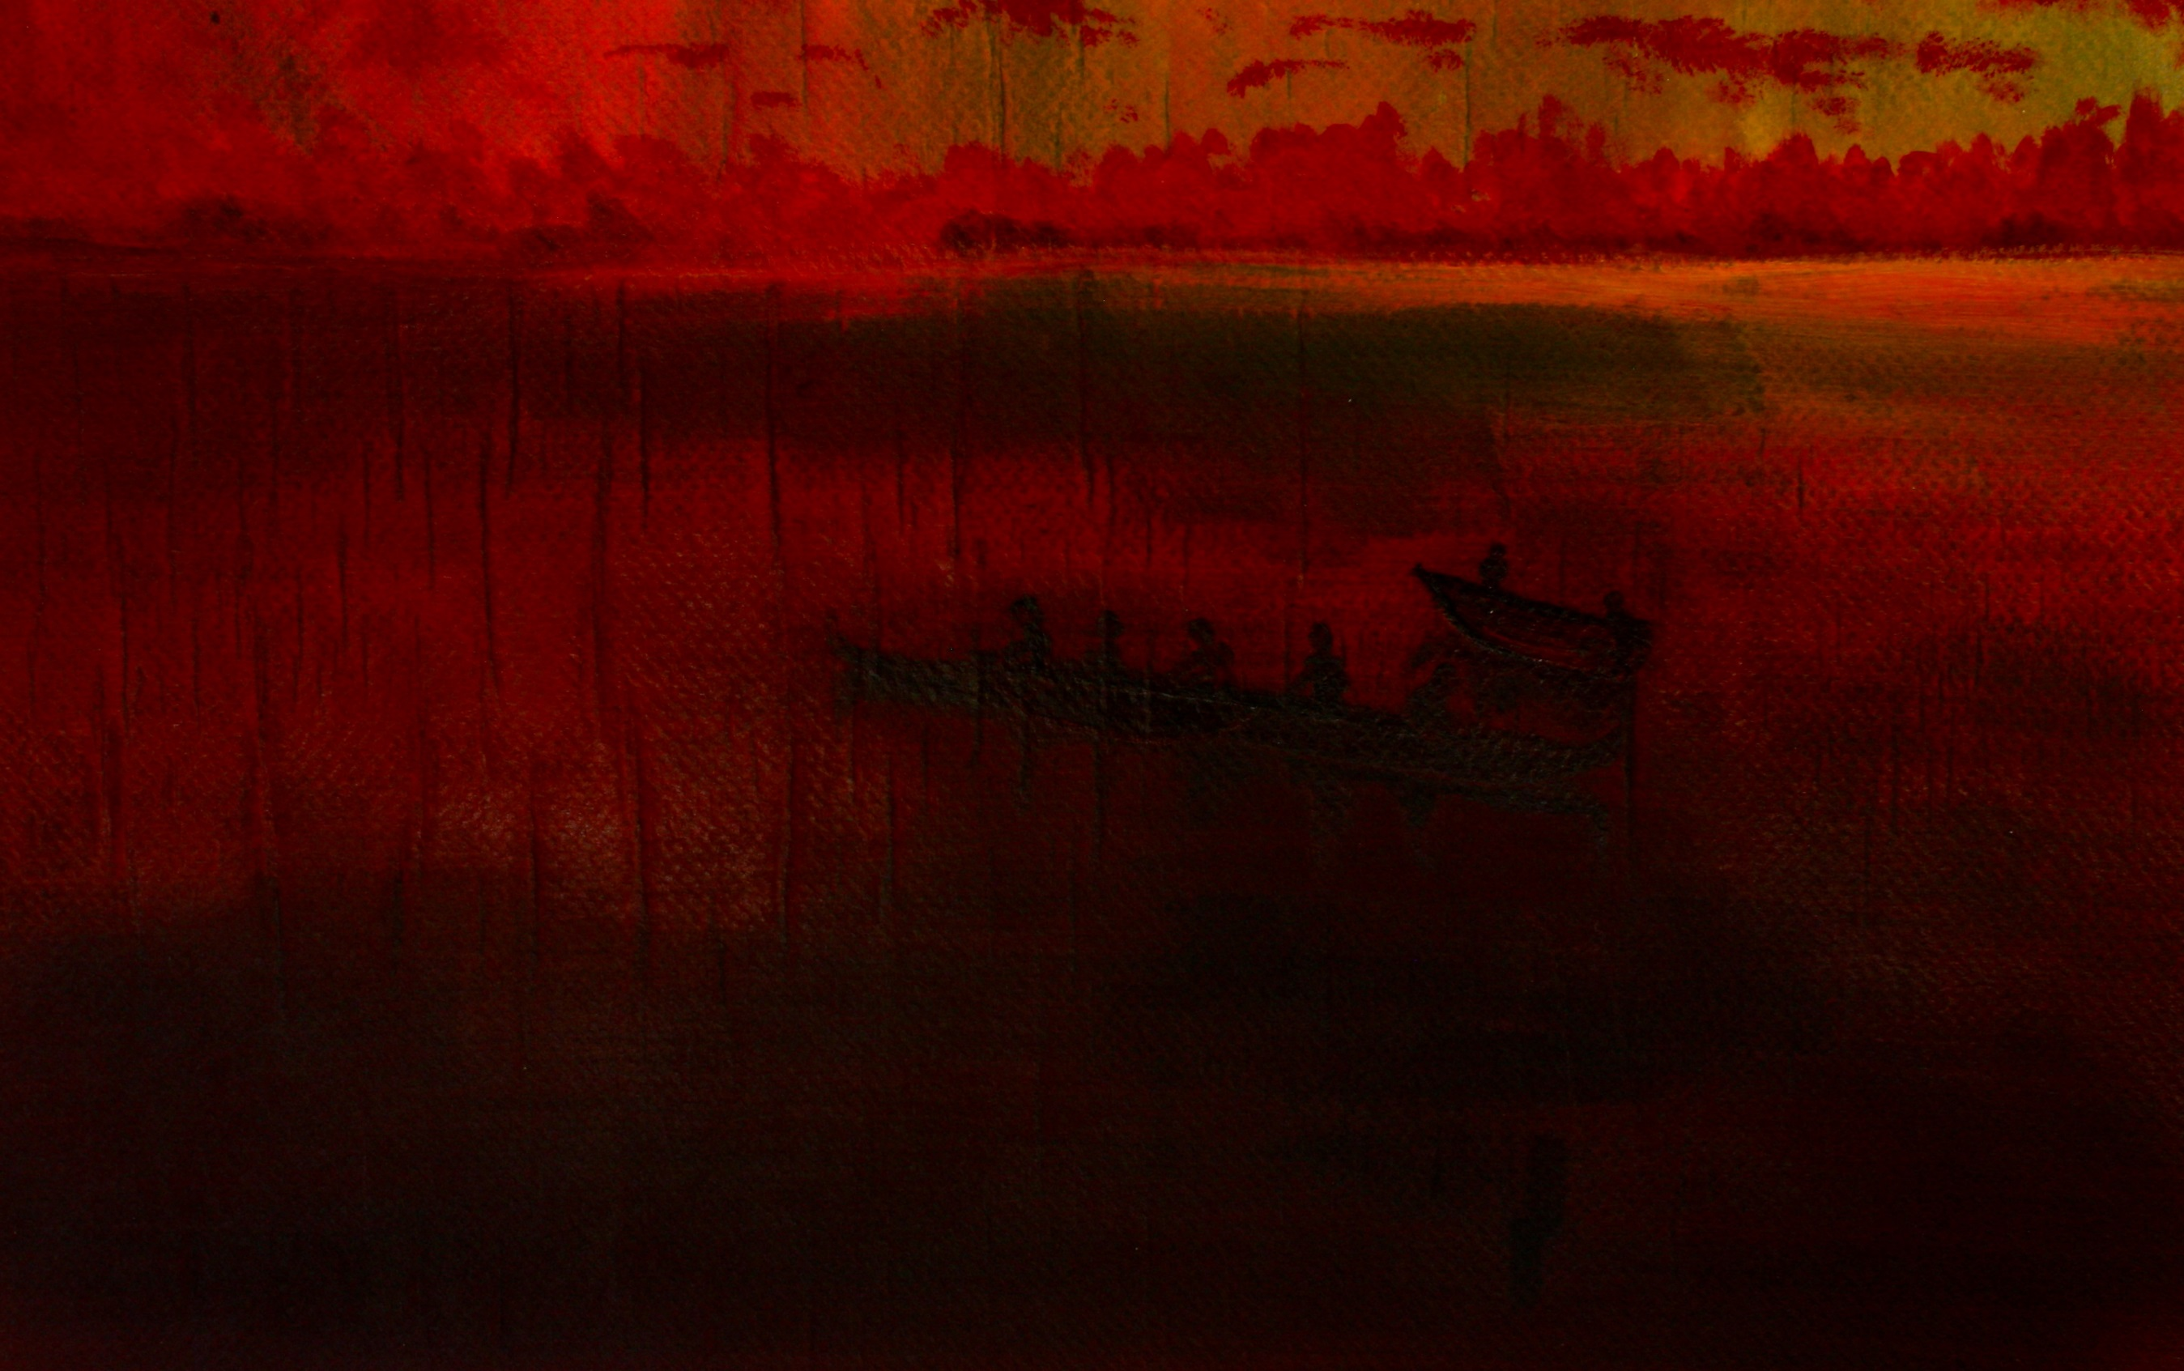
SECOND PLACE
CONOR LOWMAN

Slide 22
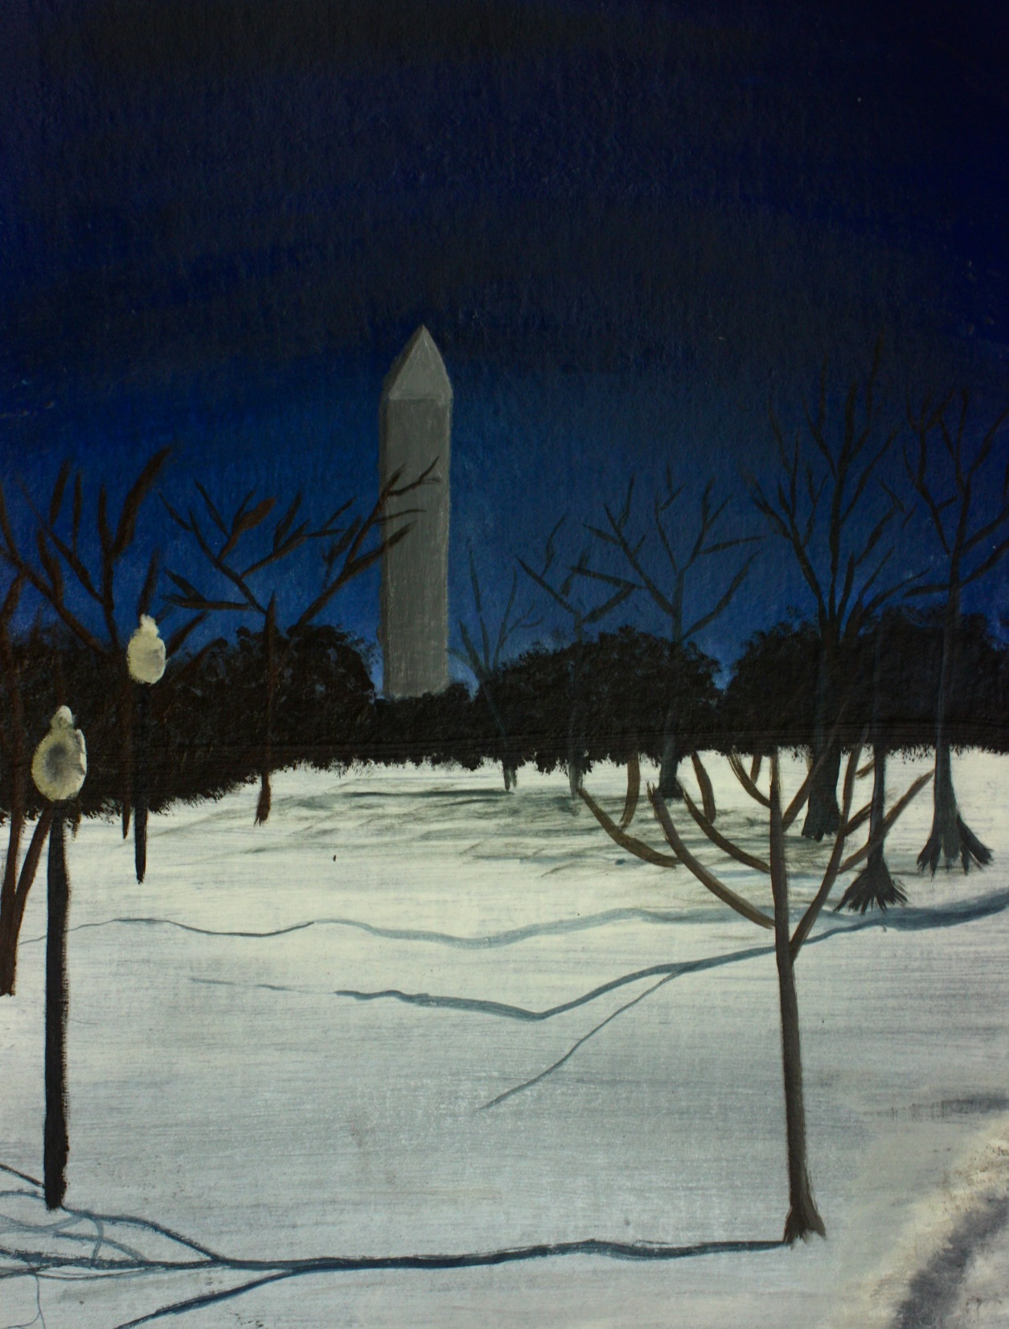
FIRST PLACE
GUILLERMO RODRIGUEZ

Slide 23
JUNIOR HONORS
GOUACHE PORTRAITS

Slide 24
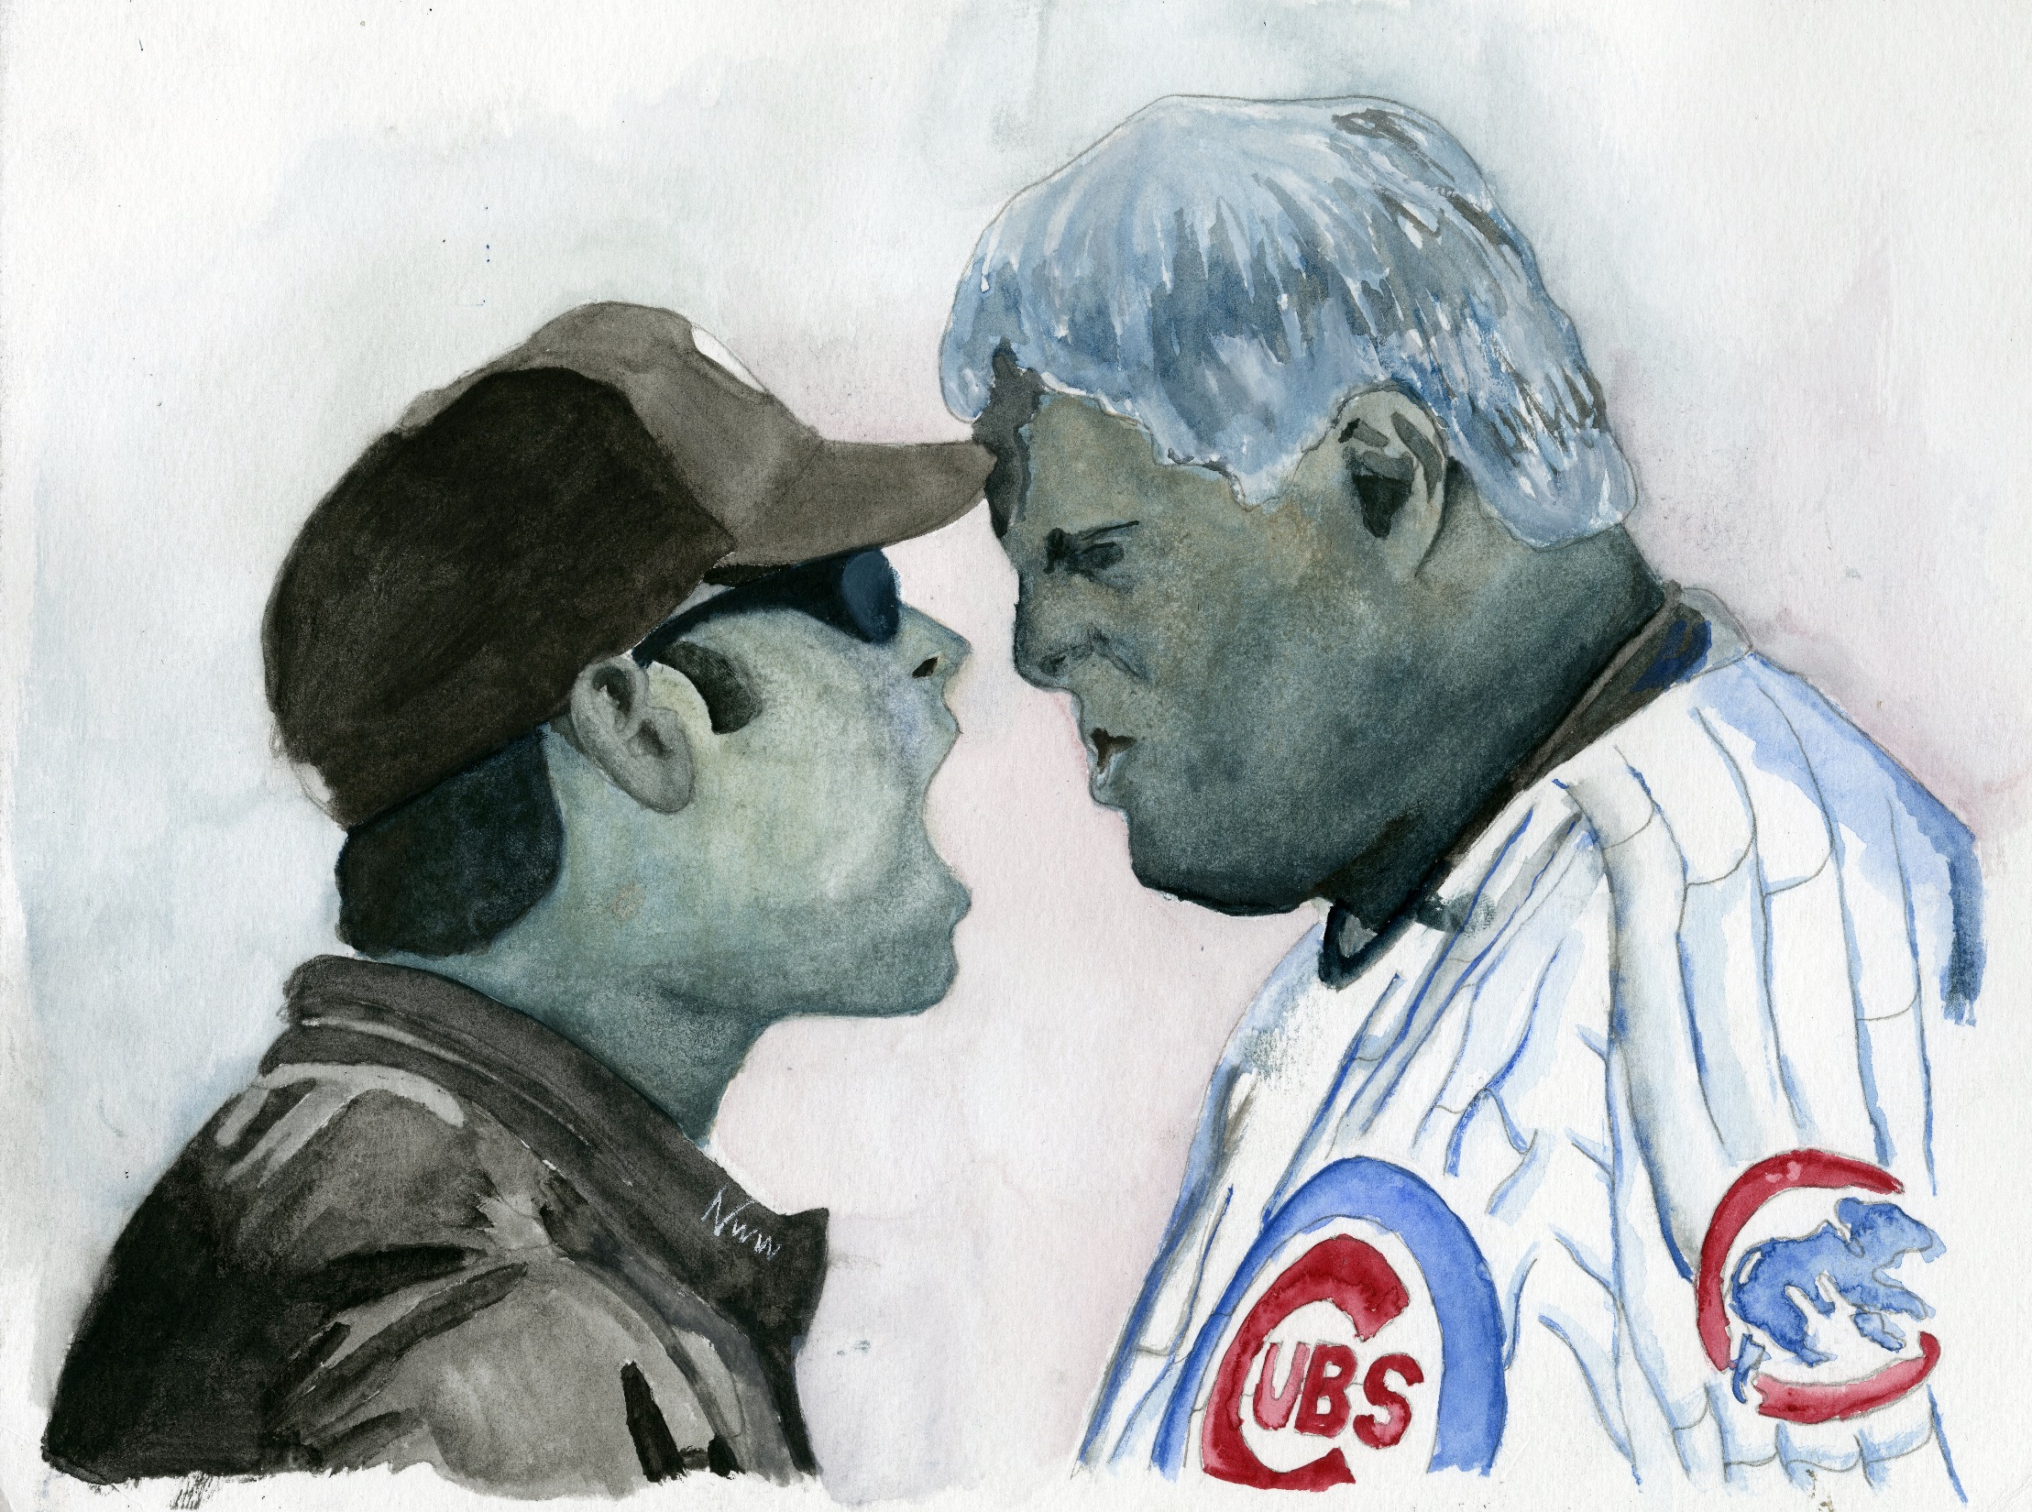
THIRD PLACE
NATHAN WEGNER

Slide 25
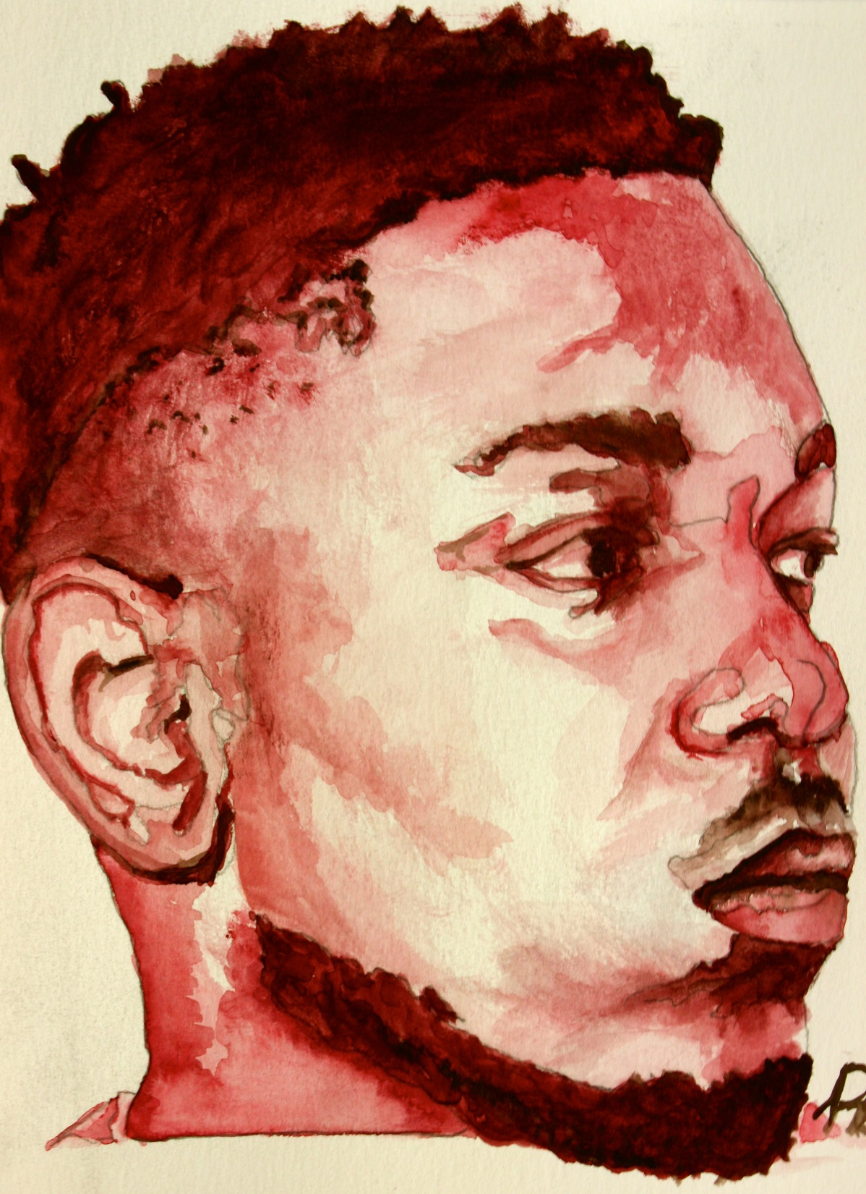
SECOND PLACE
RHETT BROZ

Slide 26
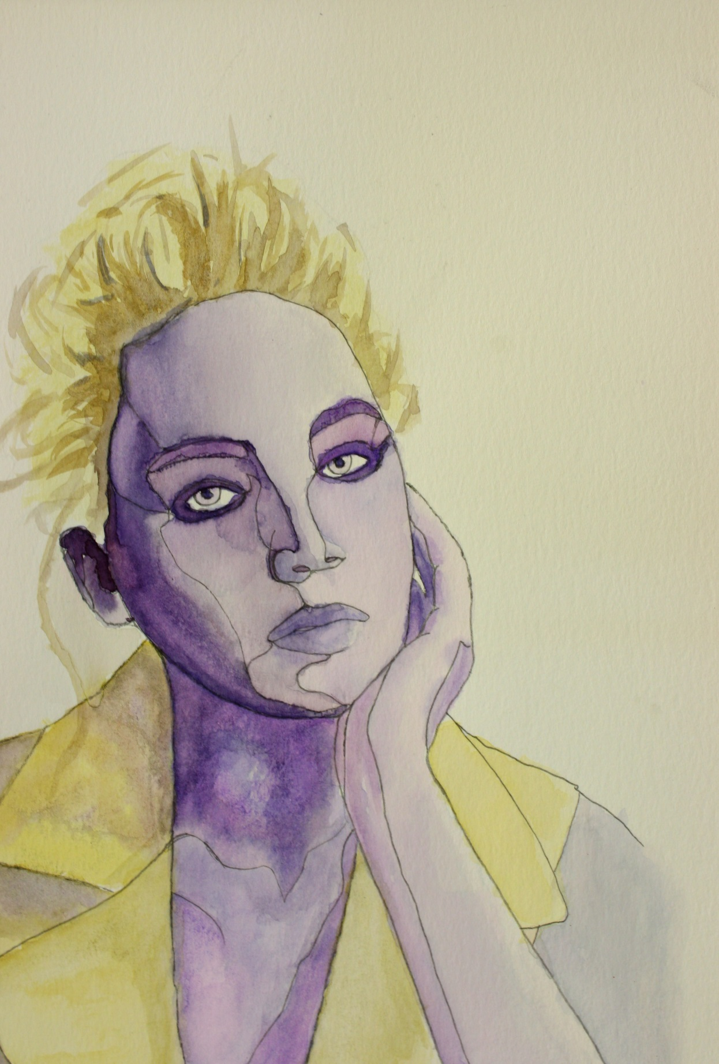
FIRST PLACE
CHRIS BONDOC

Slide 27
JUNIOR HONORS
PEN & INK STUDIES

Slide 28
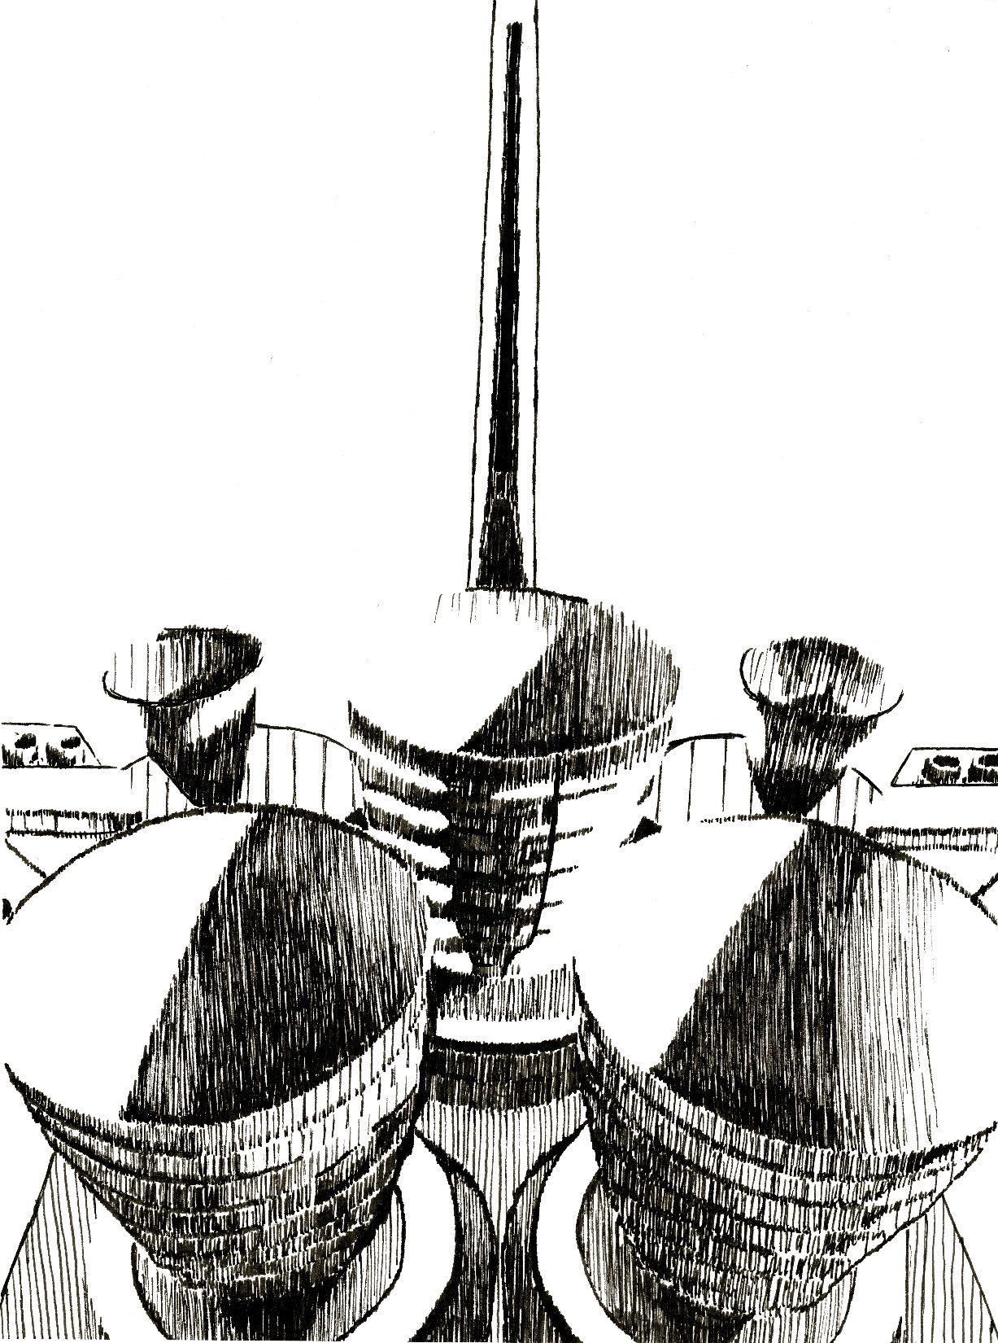
THIRD PLACE
CHRIS BONDOC

Slide 29
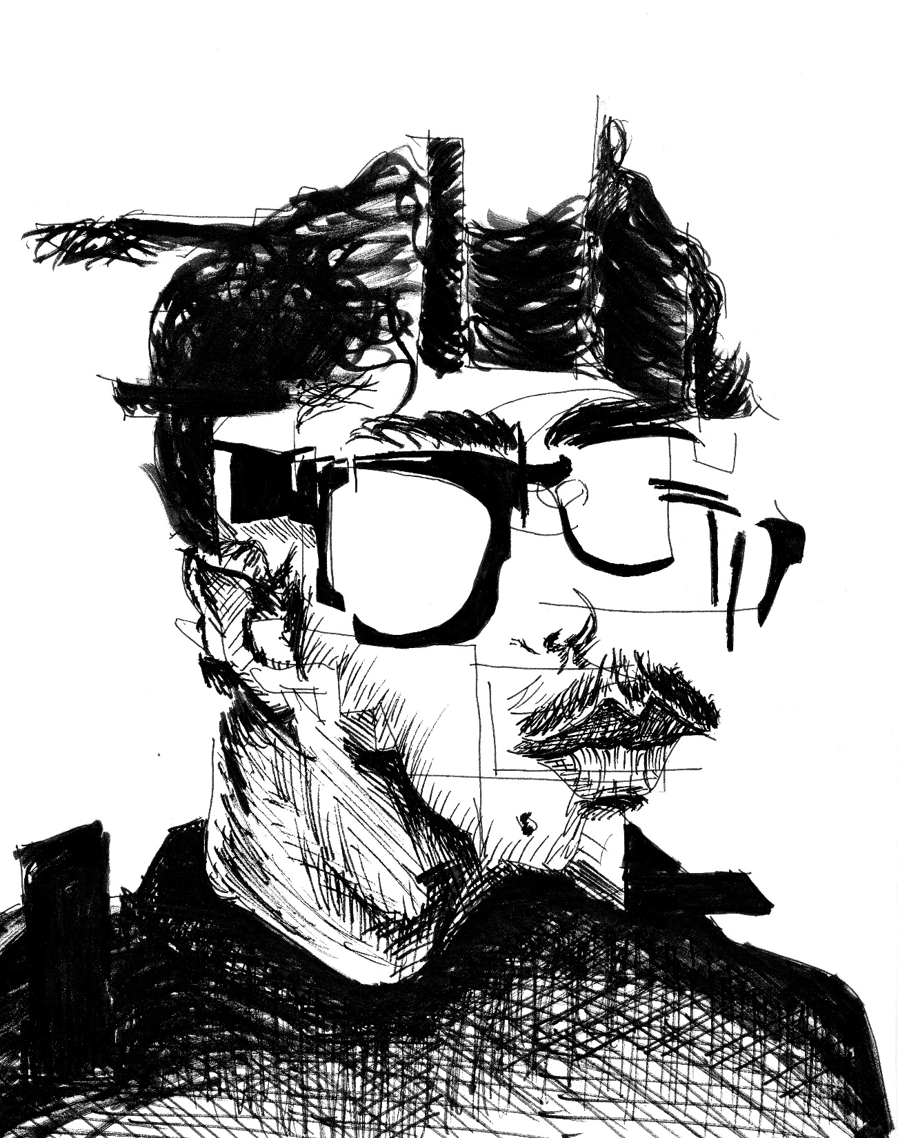
SECOND PLACE
RHETT BROZ

Slide 30
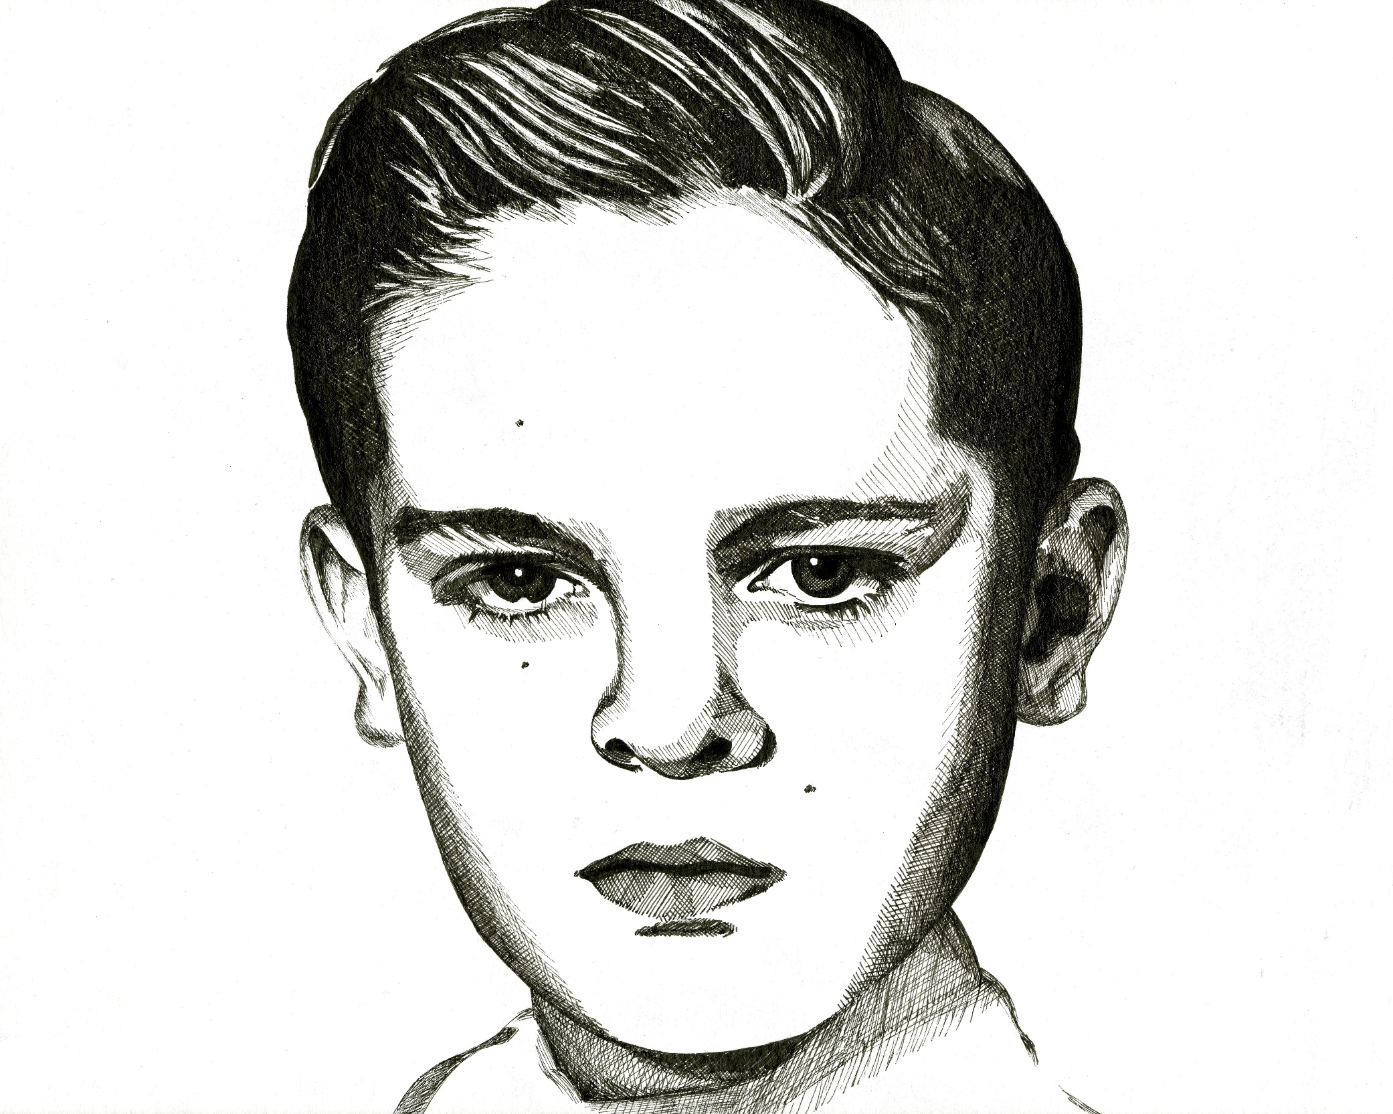
FIRST PLACE
JUSTIN SANCHEZ

Slide 31
JUNIOR HONORS
SCRATCHBOARD

Slide 32
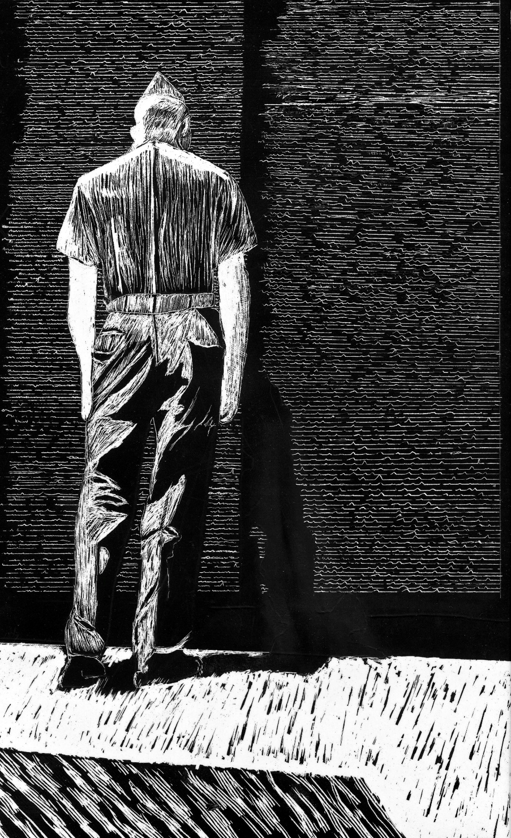
THIRD PLACE
NOAH ARMENIA

Slide 33
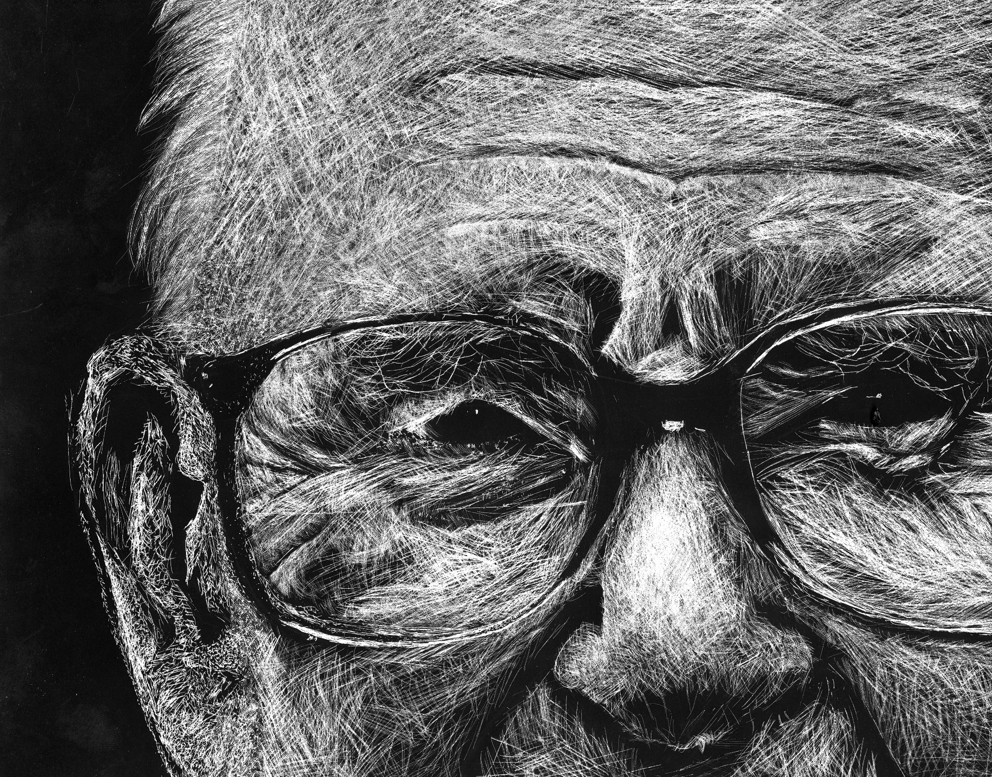
SECOND PLACE
AUSTIN SMITH

Slide 34
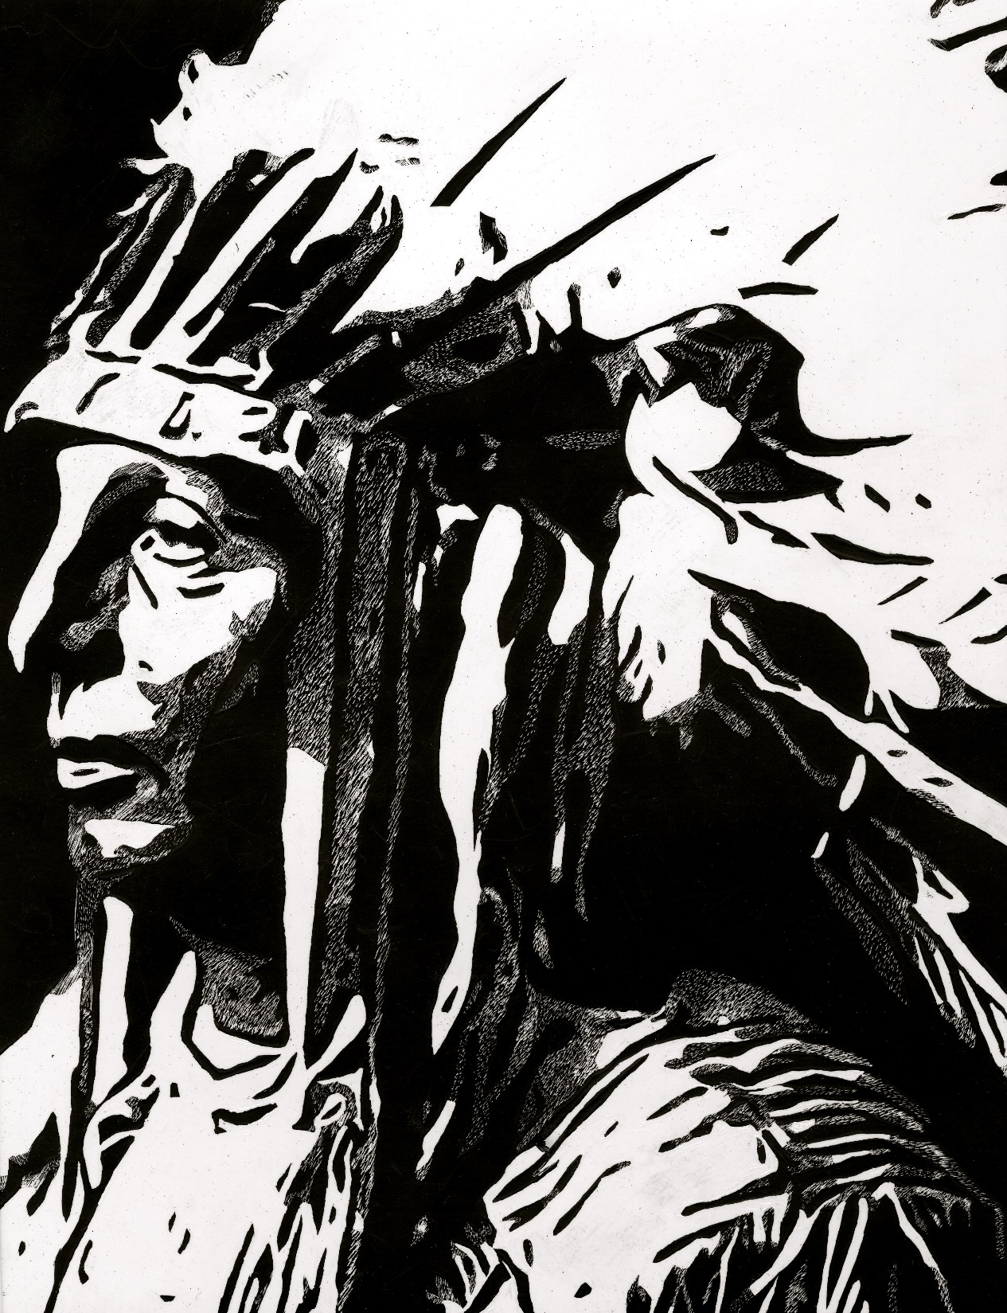
FIRST PLACE
WILL SANDS

Slide 35
JUNIOR HONORS
ACRYLIC PAINTING

Slide 36
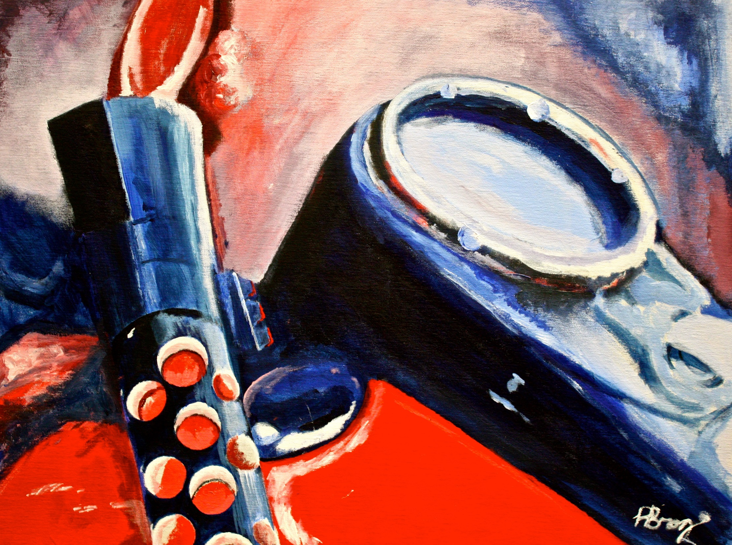
THIRD PLACE
RHETT BROZ

Slide 37
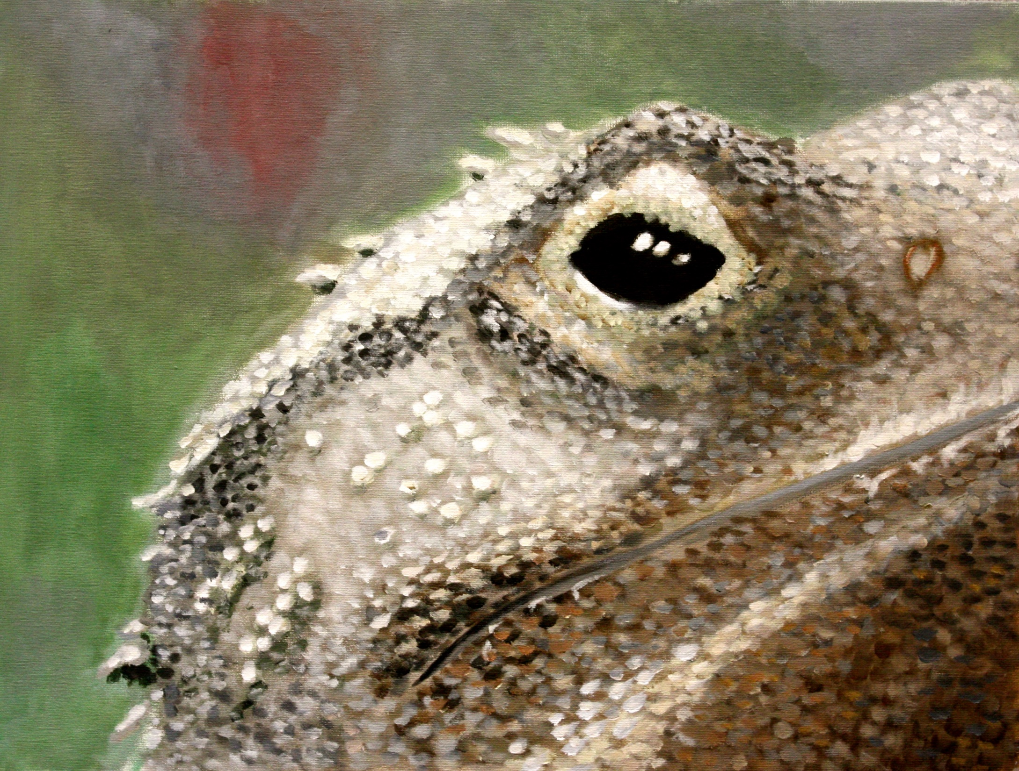
SECOND PLACE
HECTOR RIZO

Slide 38
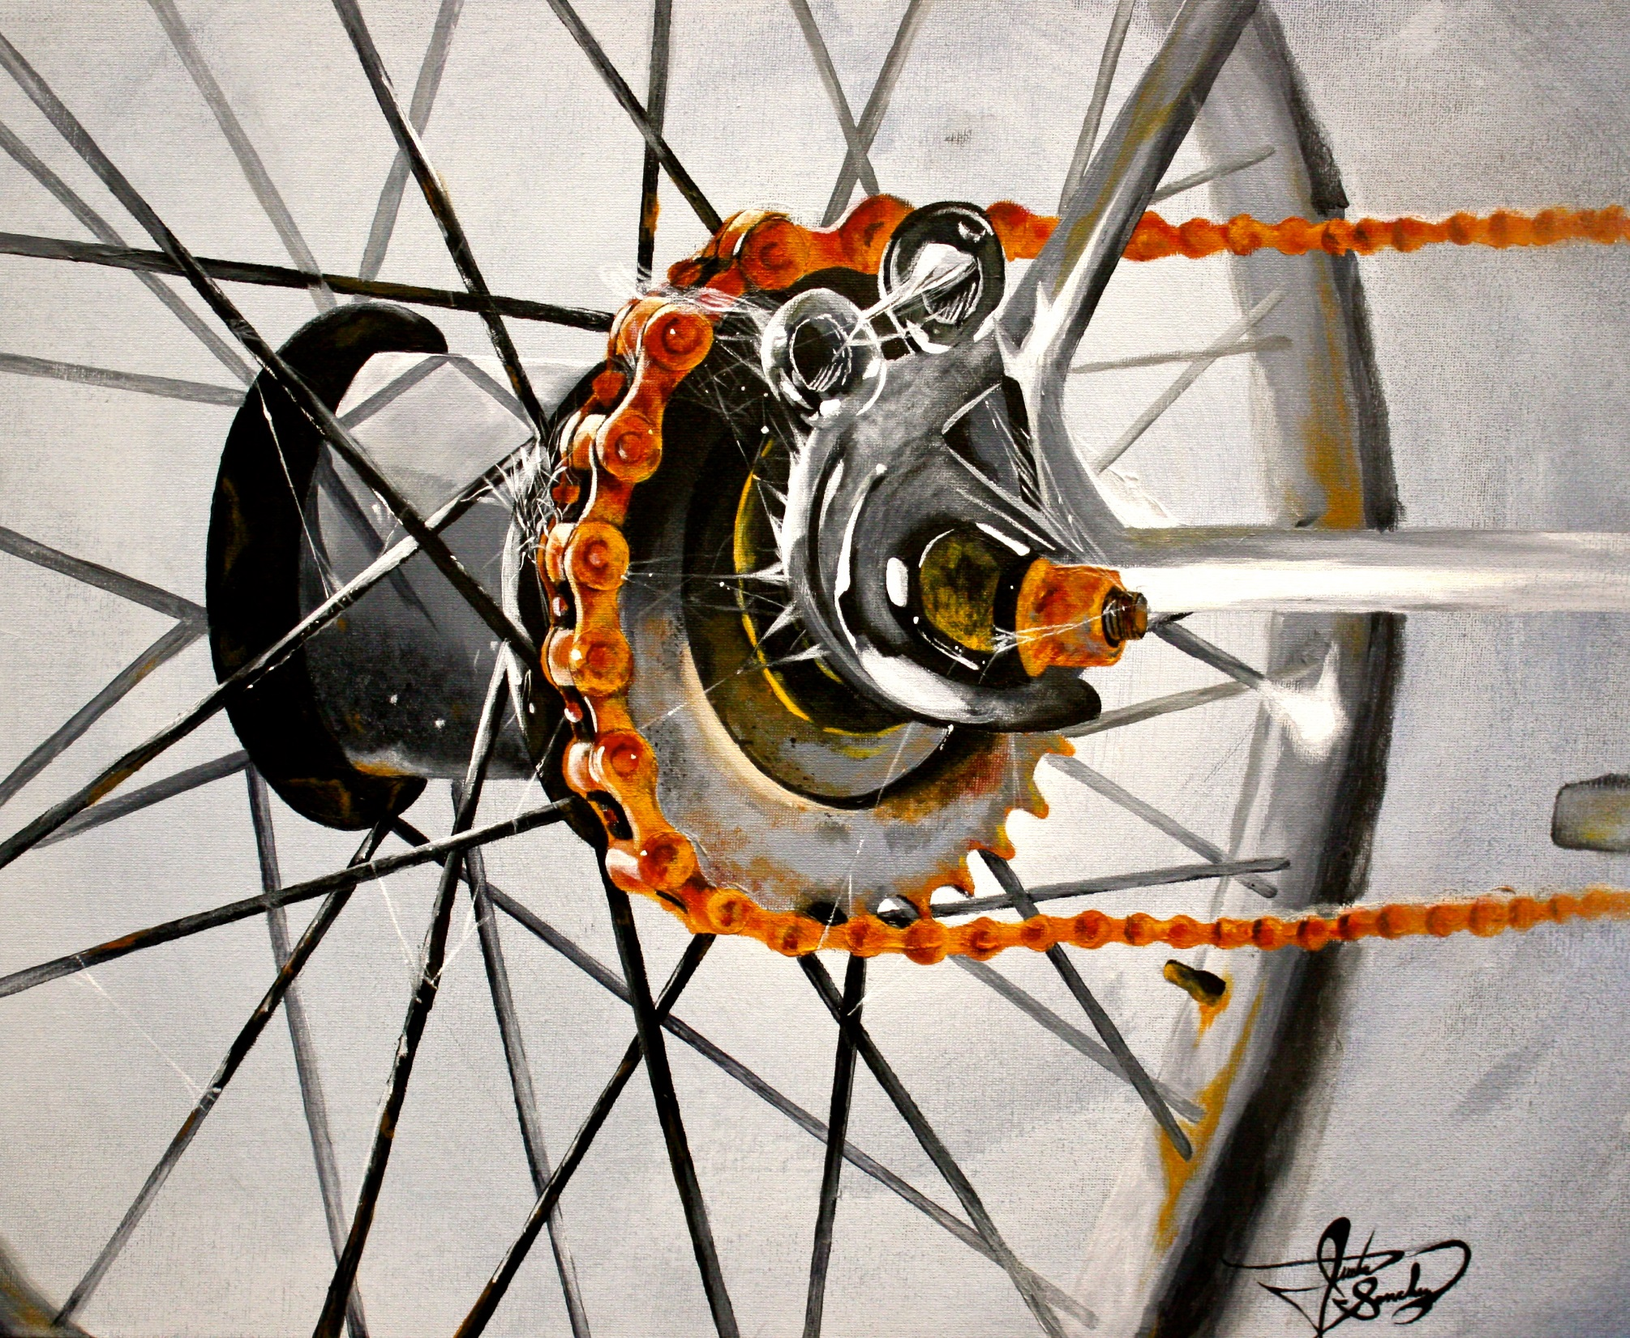
FIRST PLACE
JUSTIN SANCHEZ

Slide 39
AP SENIOR
TEACHER COMMISSION

Slide 40
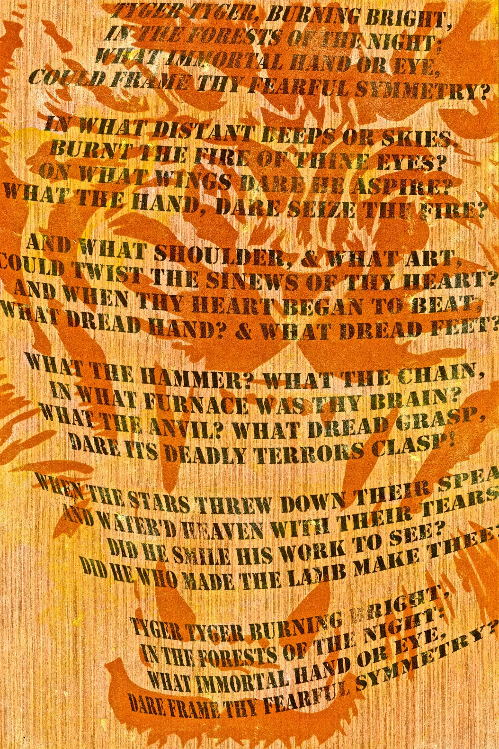
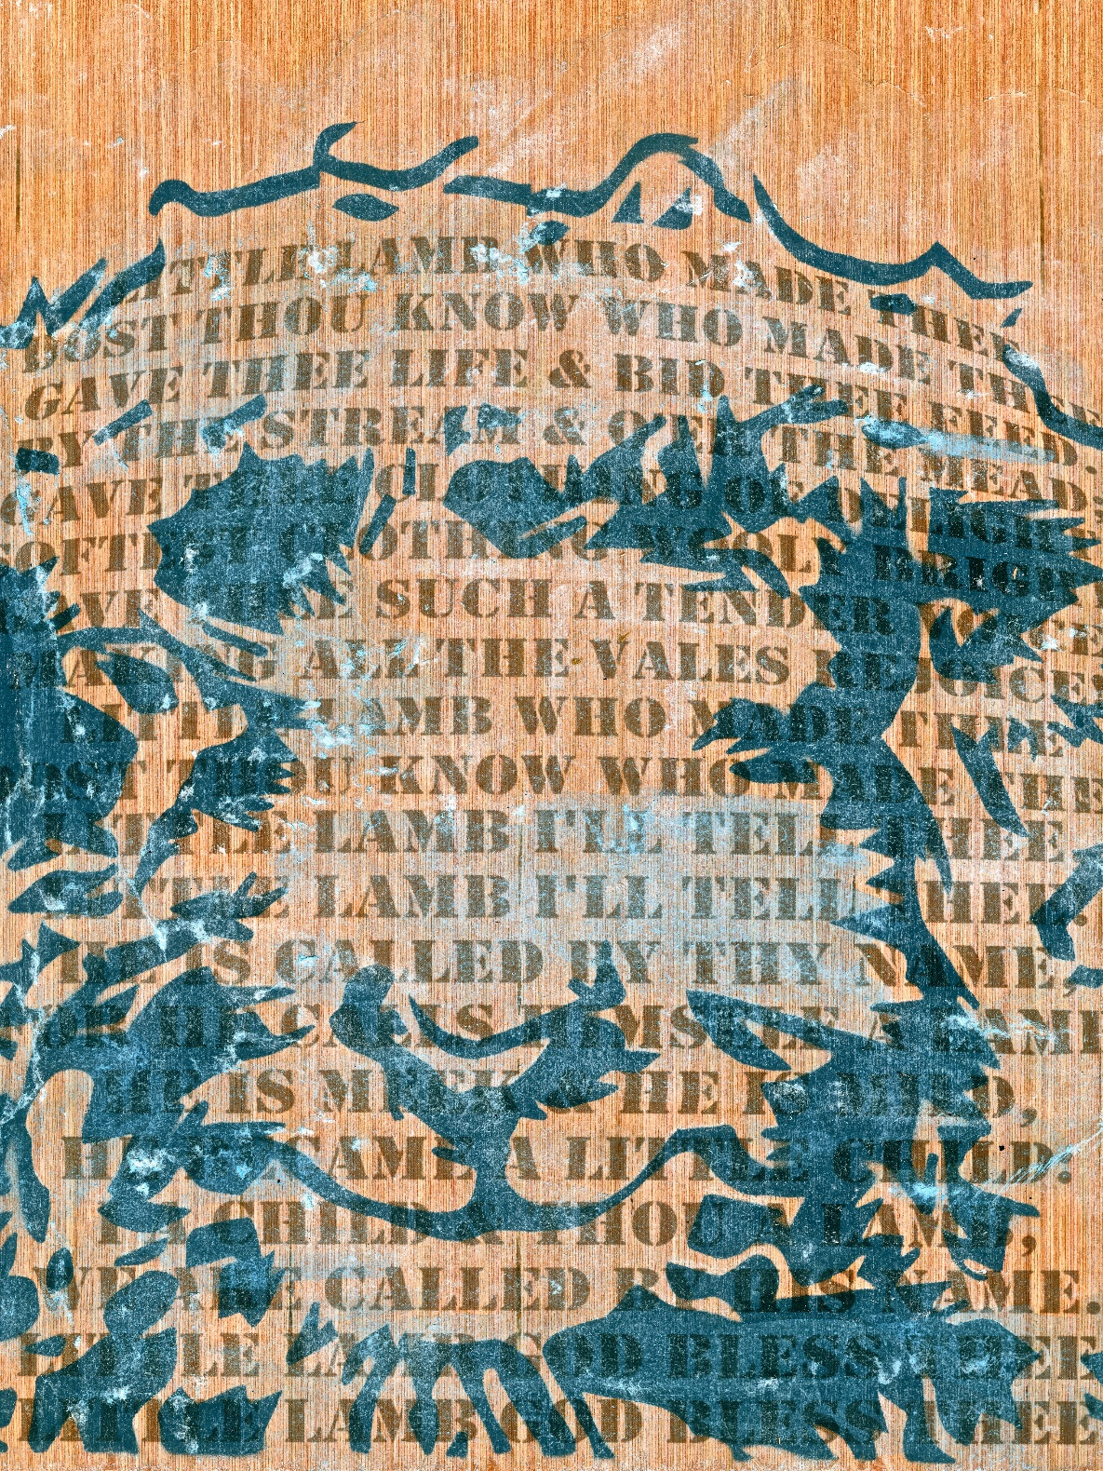
THIRD PLACE
CHARLES BUTLER

Slide 41
SECOND PLACE
CALVIN SCOTT

Slide 42
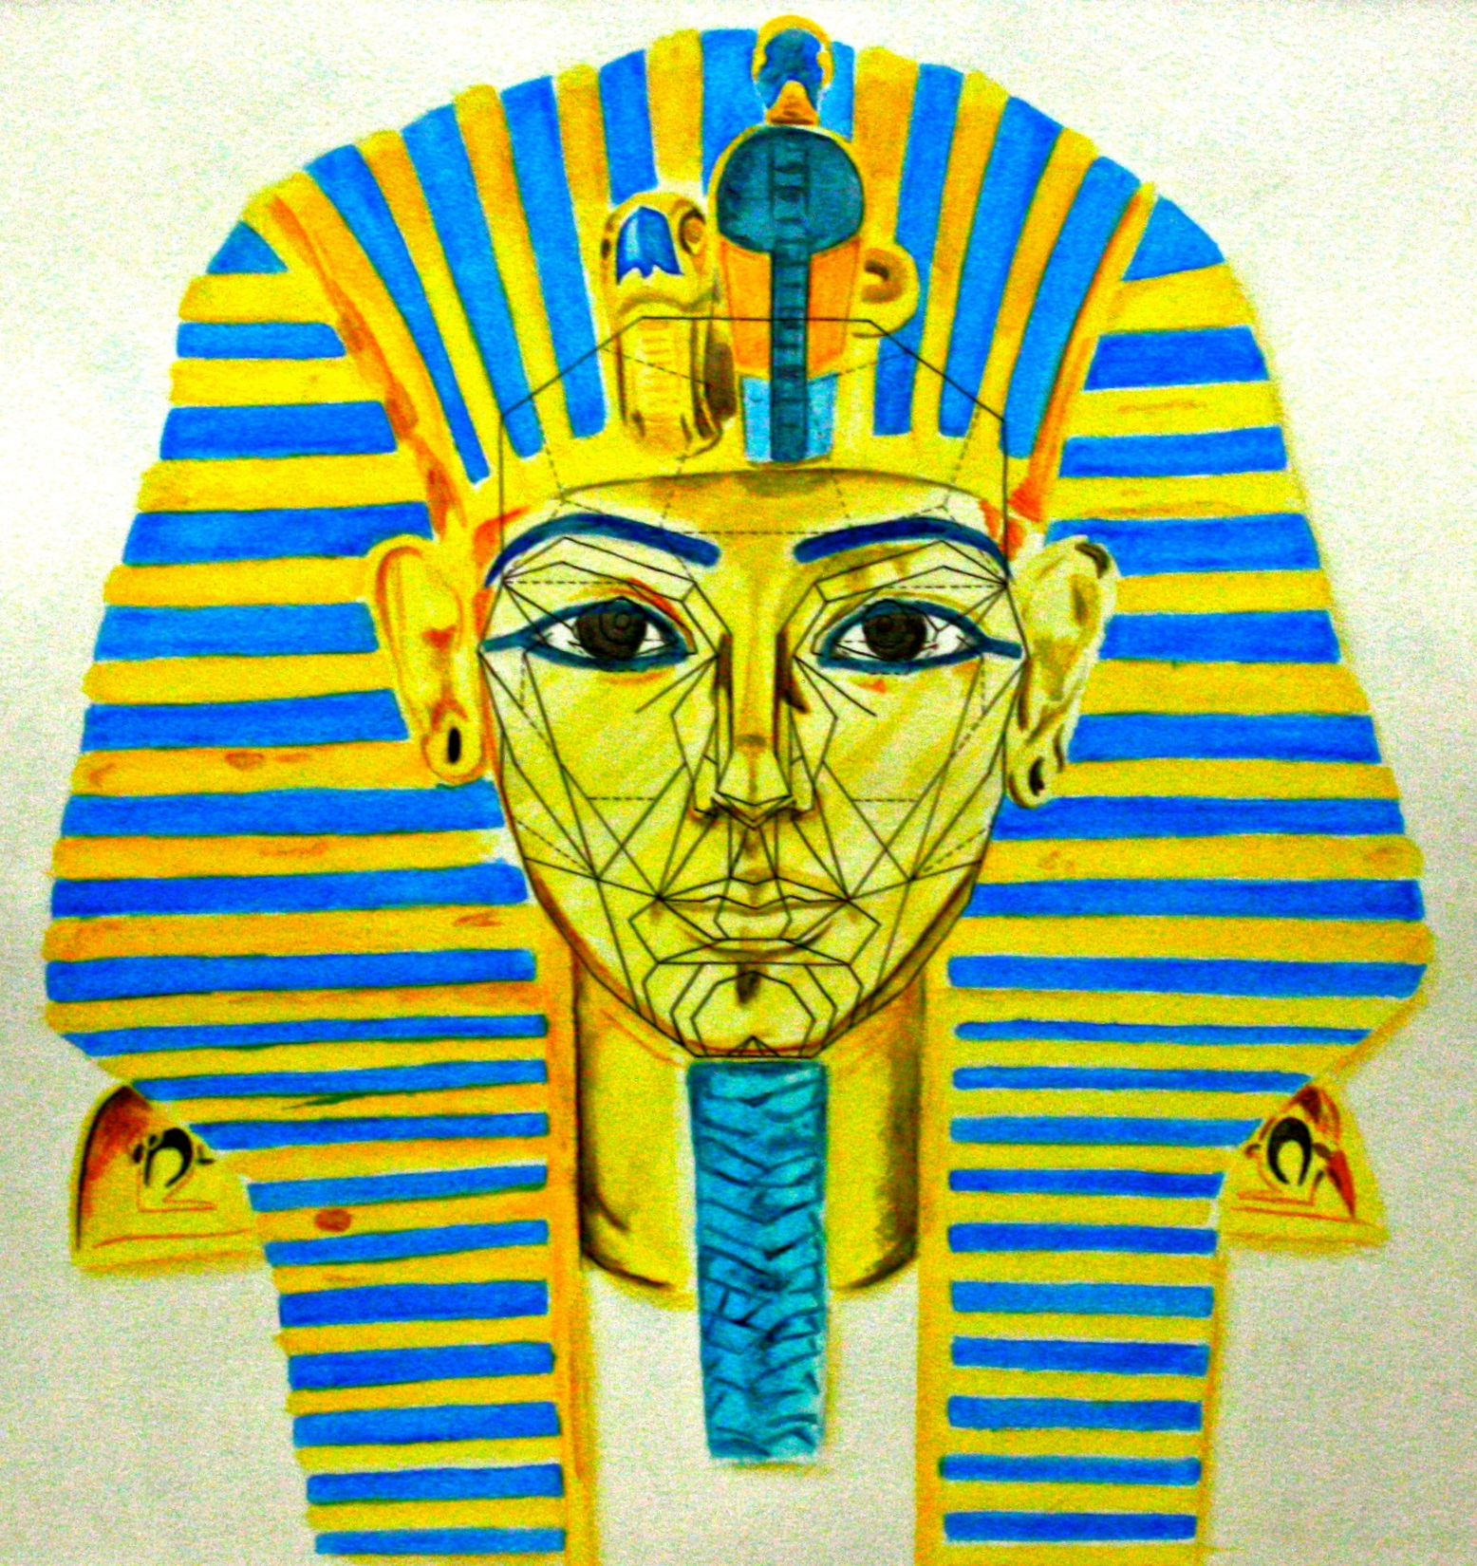
FIRST PLACE
VICTOR BUFANO

Slide 43
SENIOR
AP PORTFOLIO

Slide 44
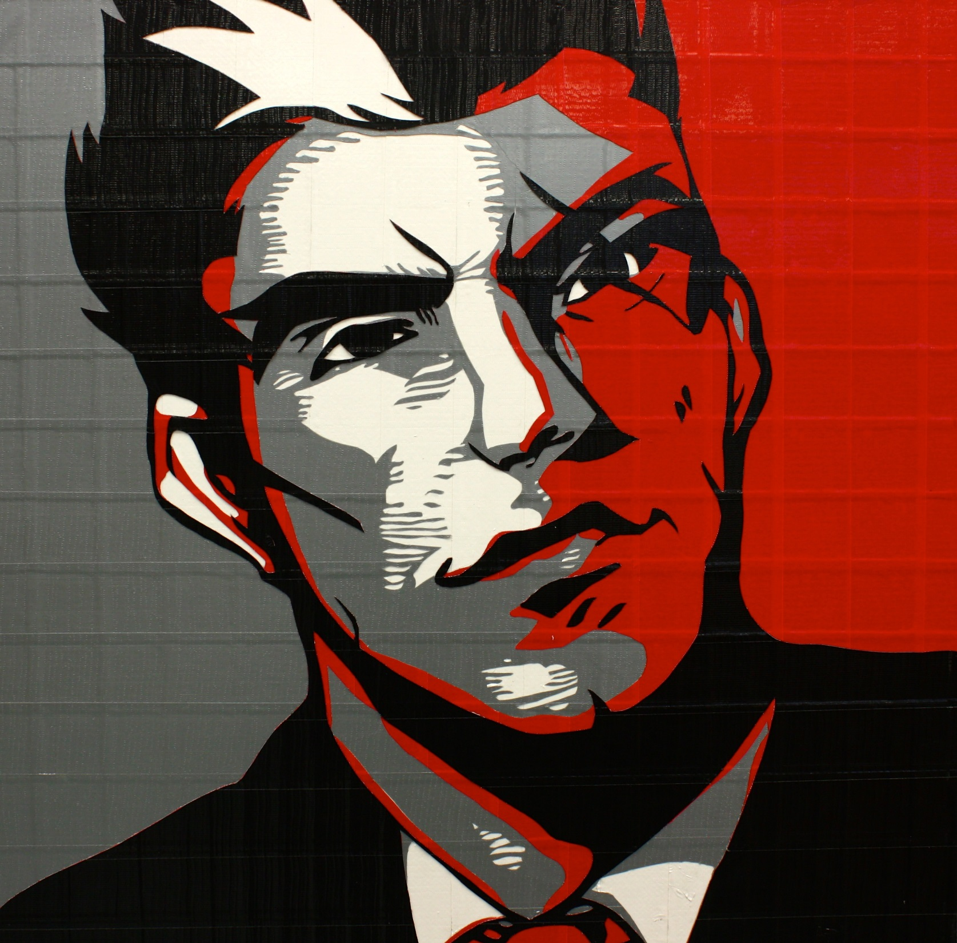
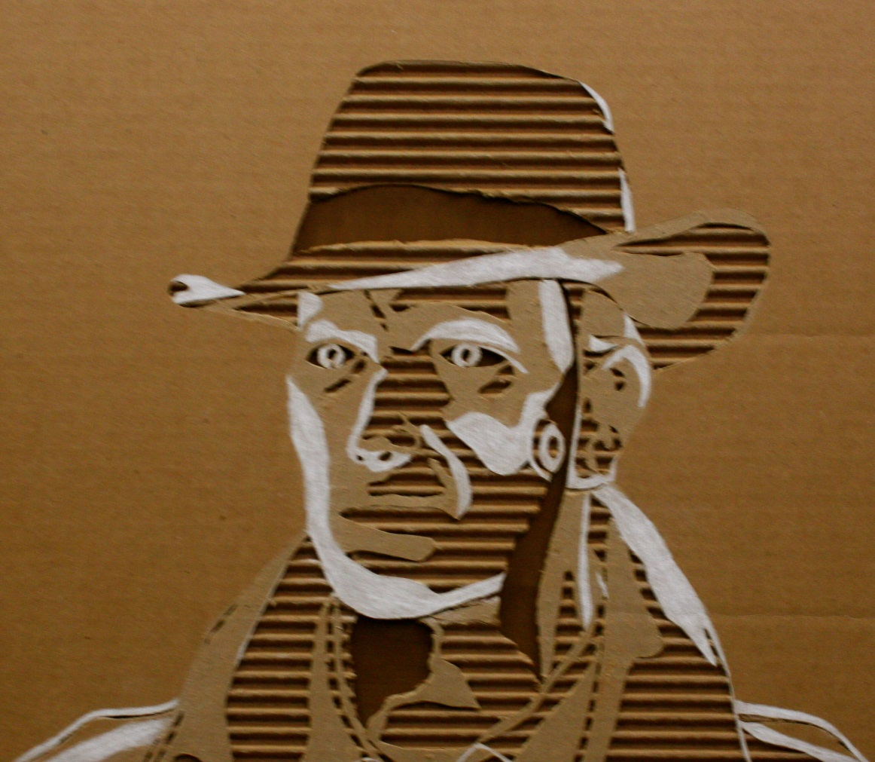
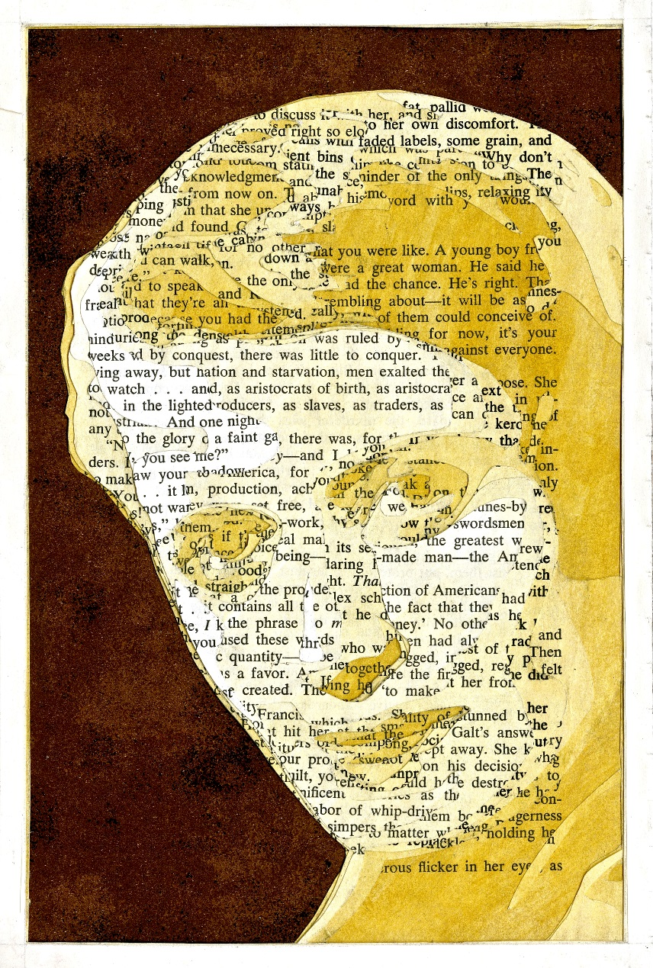
THIRD PLACE
JACOB ZELEN

Slide 45
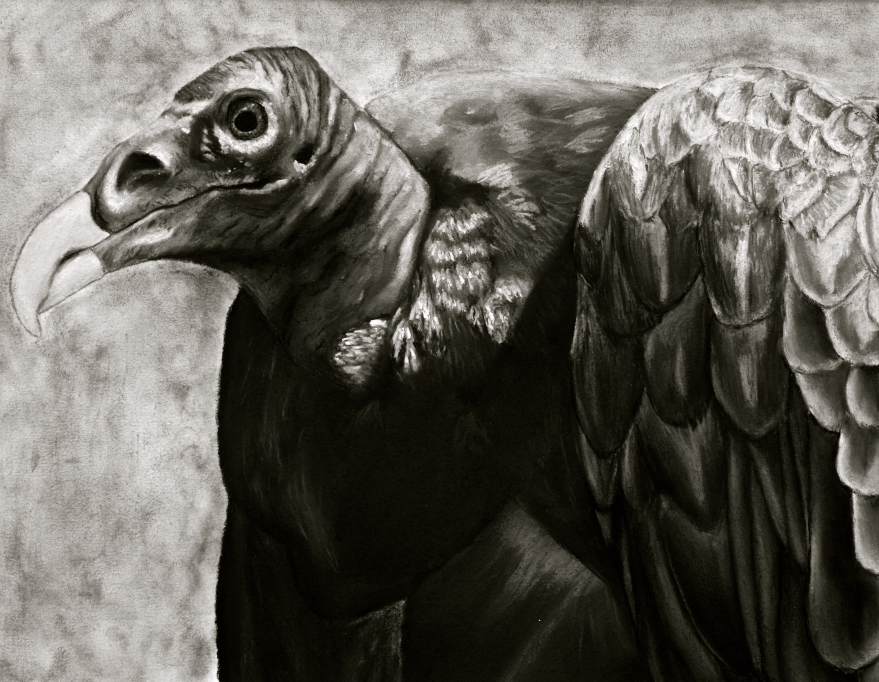
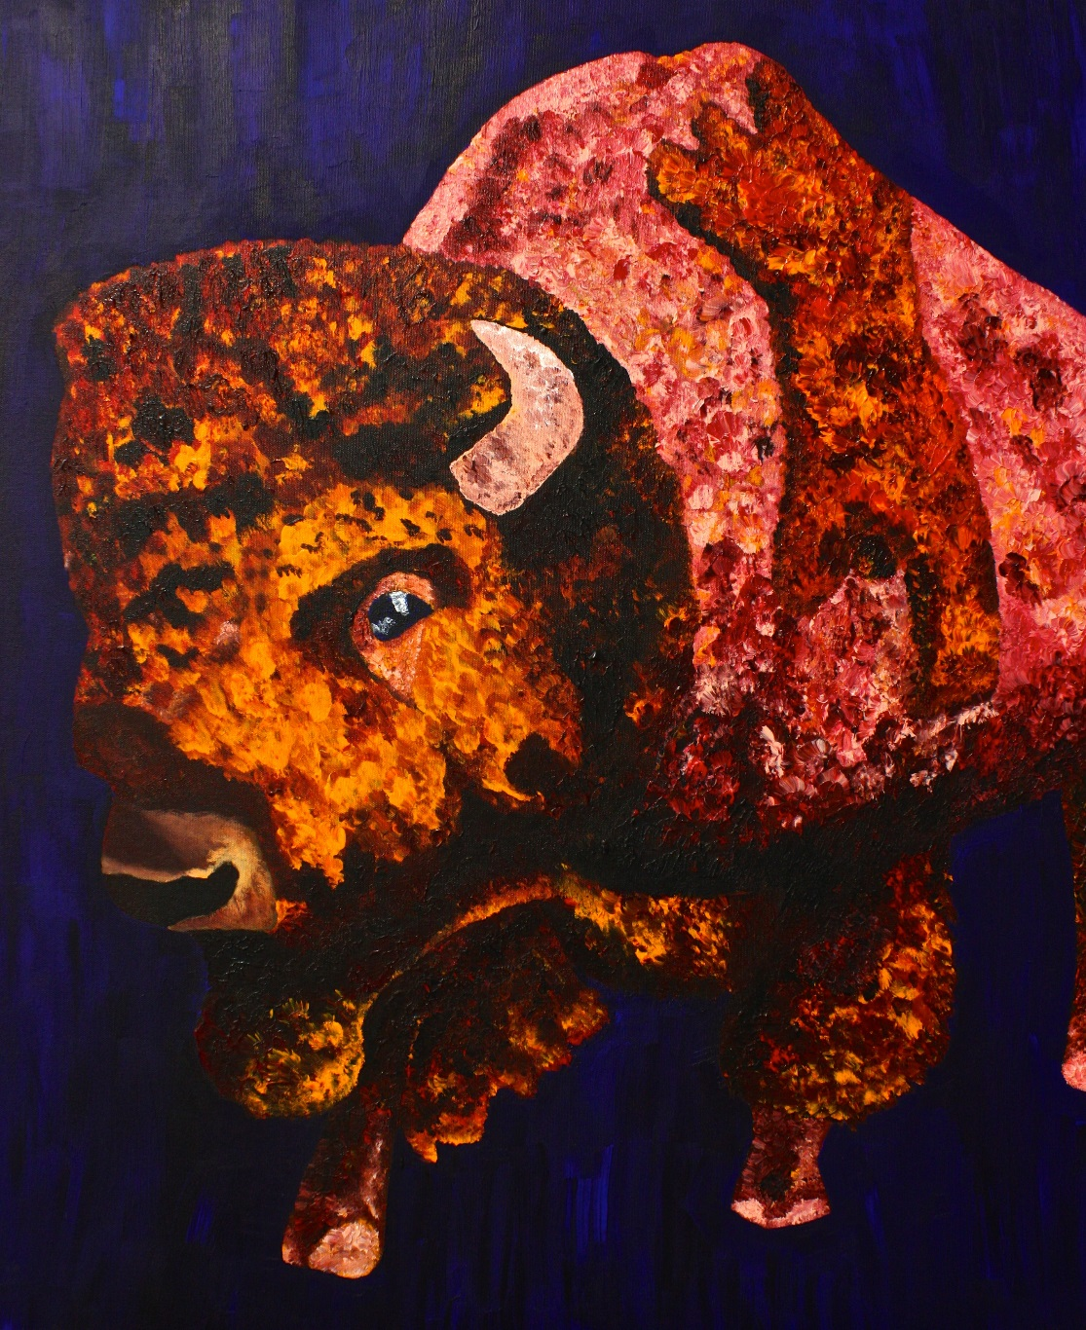
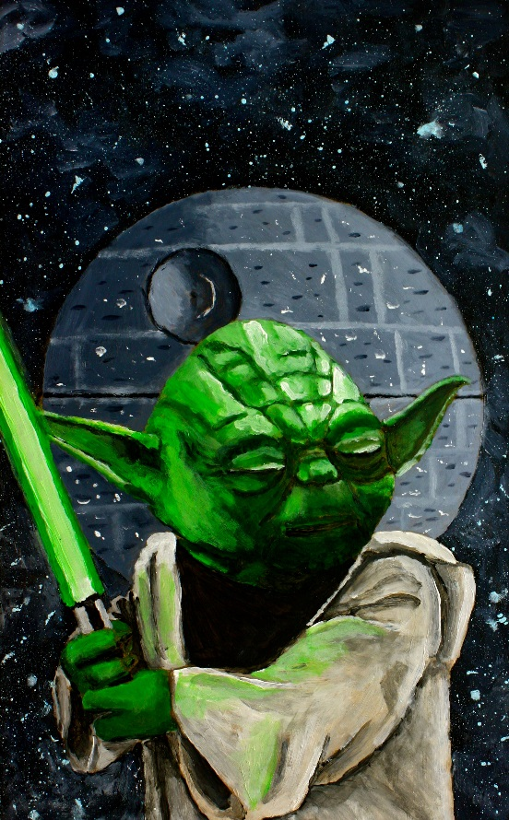
SECOND PLACE
DANNY KERVIN

Slide 46
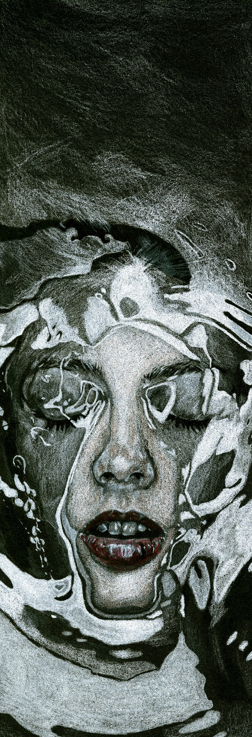
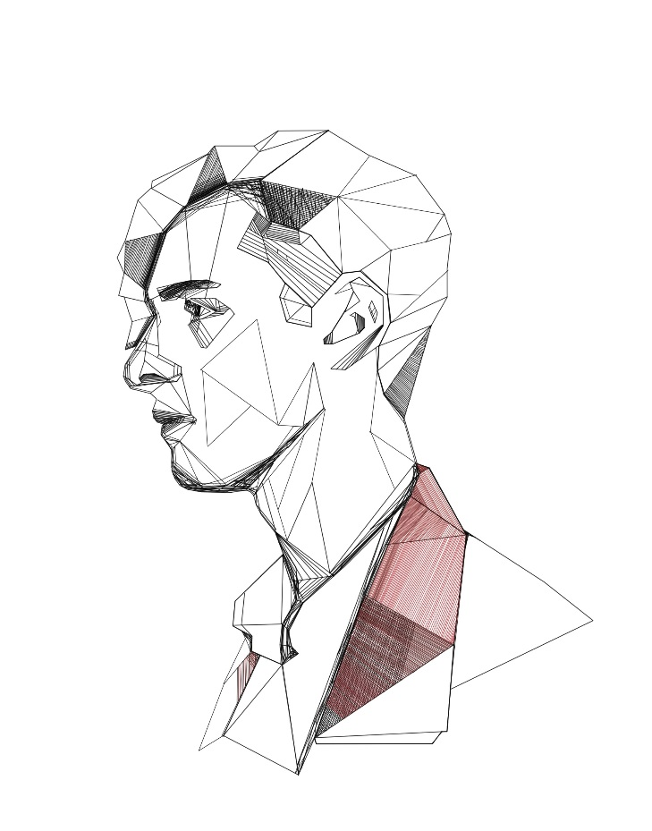
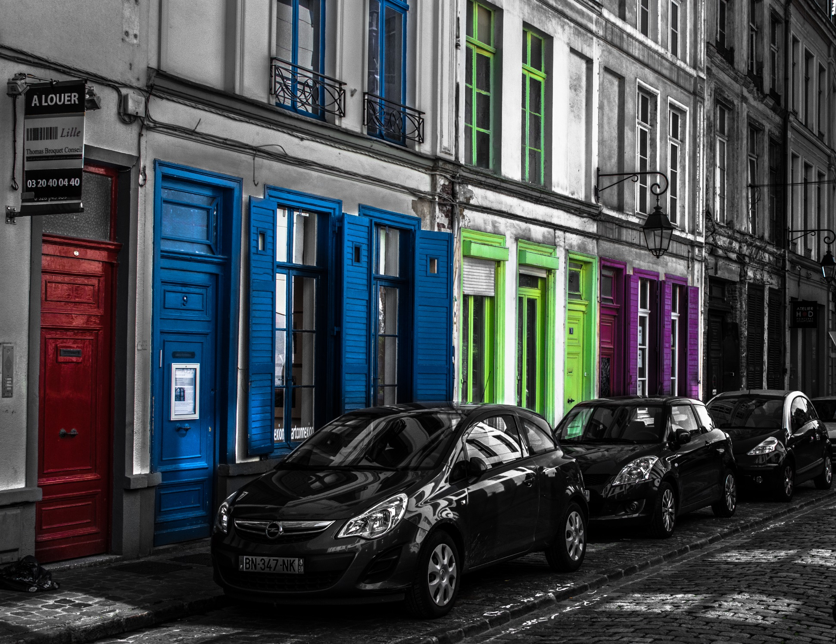
FIRST PLACE
CALVIN SCOTT

Slide 47
BEST IN SHOW

Slide 48
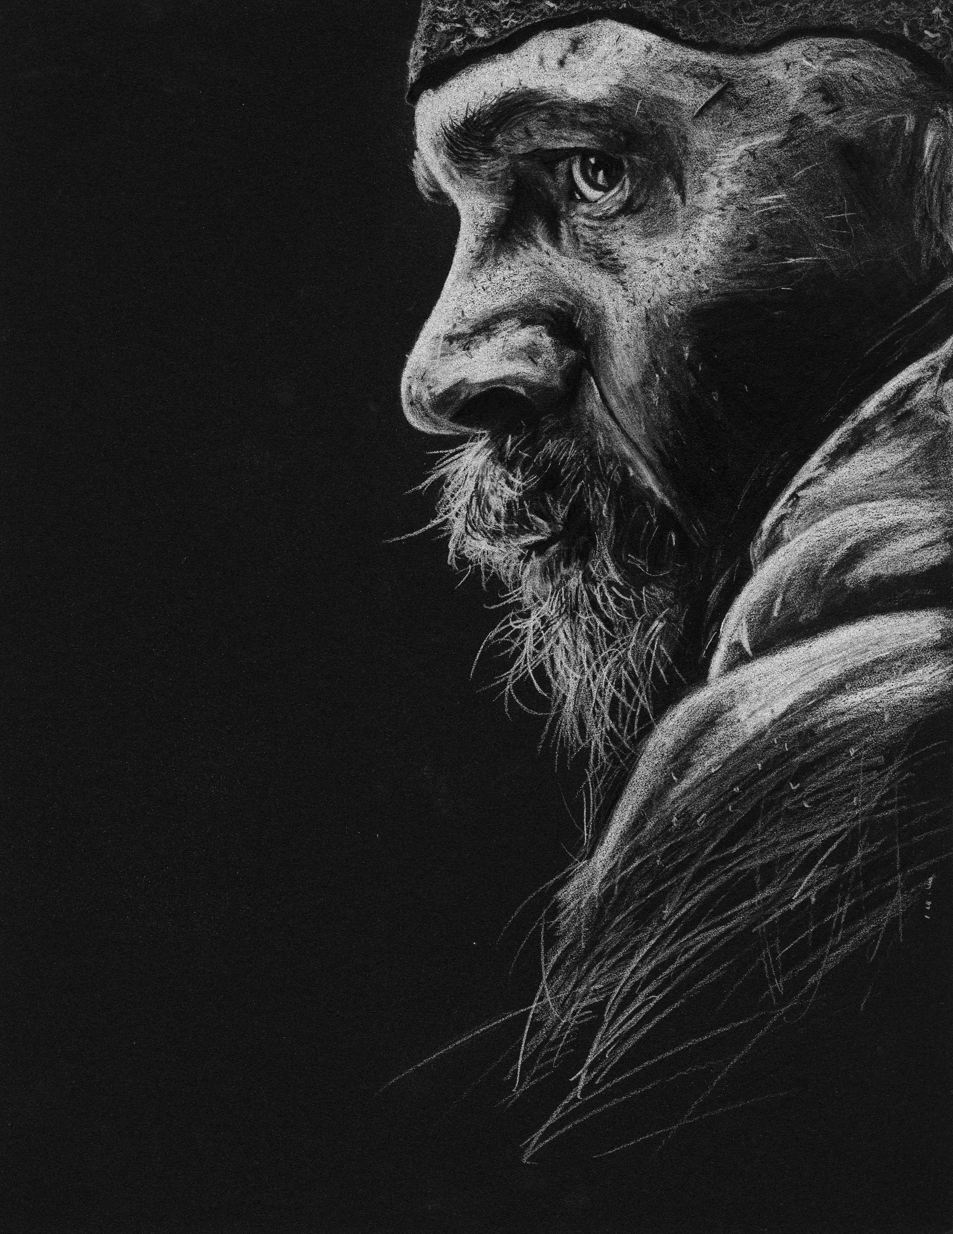
CALVIN SCOTT
COLORED PENCIL ON ILLUSTRATION BOARD

