Slide 1
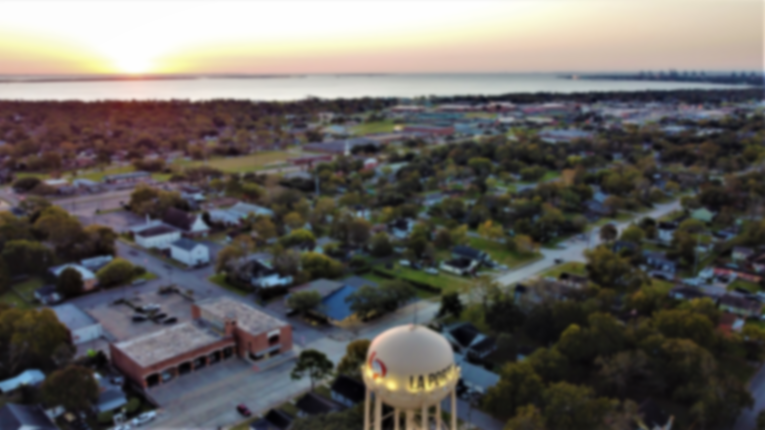
LA PORTE ISD Great Things Happen Here!
Welcome
New Teachers & Staff!
August 2, 2022

Slide 2
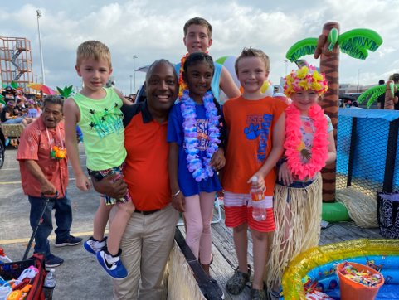
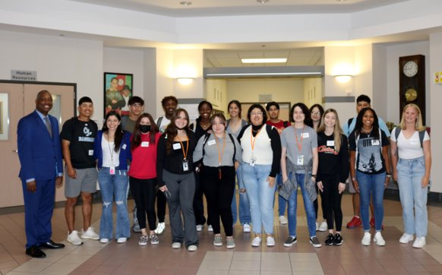
Our Mission
Every student’s success is our number one priority.

Slide 3
We believe...
We believe every child, regardless of race, ethnicity or social class must participate in the democratic privilege of learning in great schools taught by caring rockstar teachers!
Education is the new currency of the 21st century, and there has never been a more critical time in our nation’s history that a quality education did not carry more value than it does today.
The future of our great nation will be preserved by a highly educated citizenry. Educating the public is the job of the public-school system!

Slide 4
LPISD Facts
TEA Accountability B
La Porte ISD founded in 1915
Long standing tradition of academic and extracurricular excellence
1,010 employees 202 vacancies 1,212 total positions plus substitutes and student workers
$145.9M annual operating budget general fund 2022-2023
81% of our general fund budget is dedicated to staffing
$48.9M general fund balance (district savings account)
Board of Trustees approved a 3% raise and a longevity stipend of up to $3,000 for all staff for 2022-2023
Starting teacher salary is $60,000

Slide 5
More LPISD Facts
Estimated 2022-2023 excess revenue, A.K.A. Recapture (goes to the state) $$58,771,928
Largest employer in La Porte, Texas​
Demographics: Hispanic 53%, White 36%, AA 7% Other 4%​
Our students in 2022
6,963 students ​
1068 Associate Degrees earned through San Jacinto College since 2017
104 AP Scholars from 2018-2022
National Merit finalist
12 Academic All State athletes
State qualifying girls and boys cross country teams; individual state golf medalist
13 UIL Sweepstakes awards

Slide 6
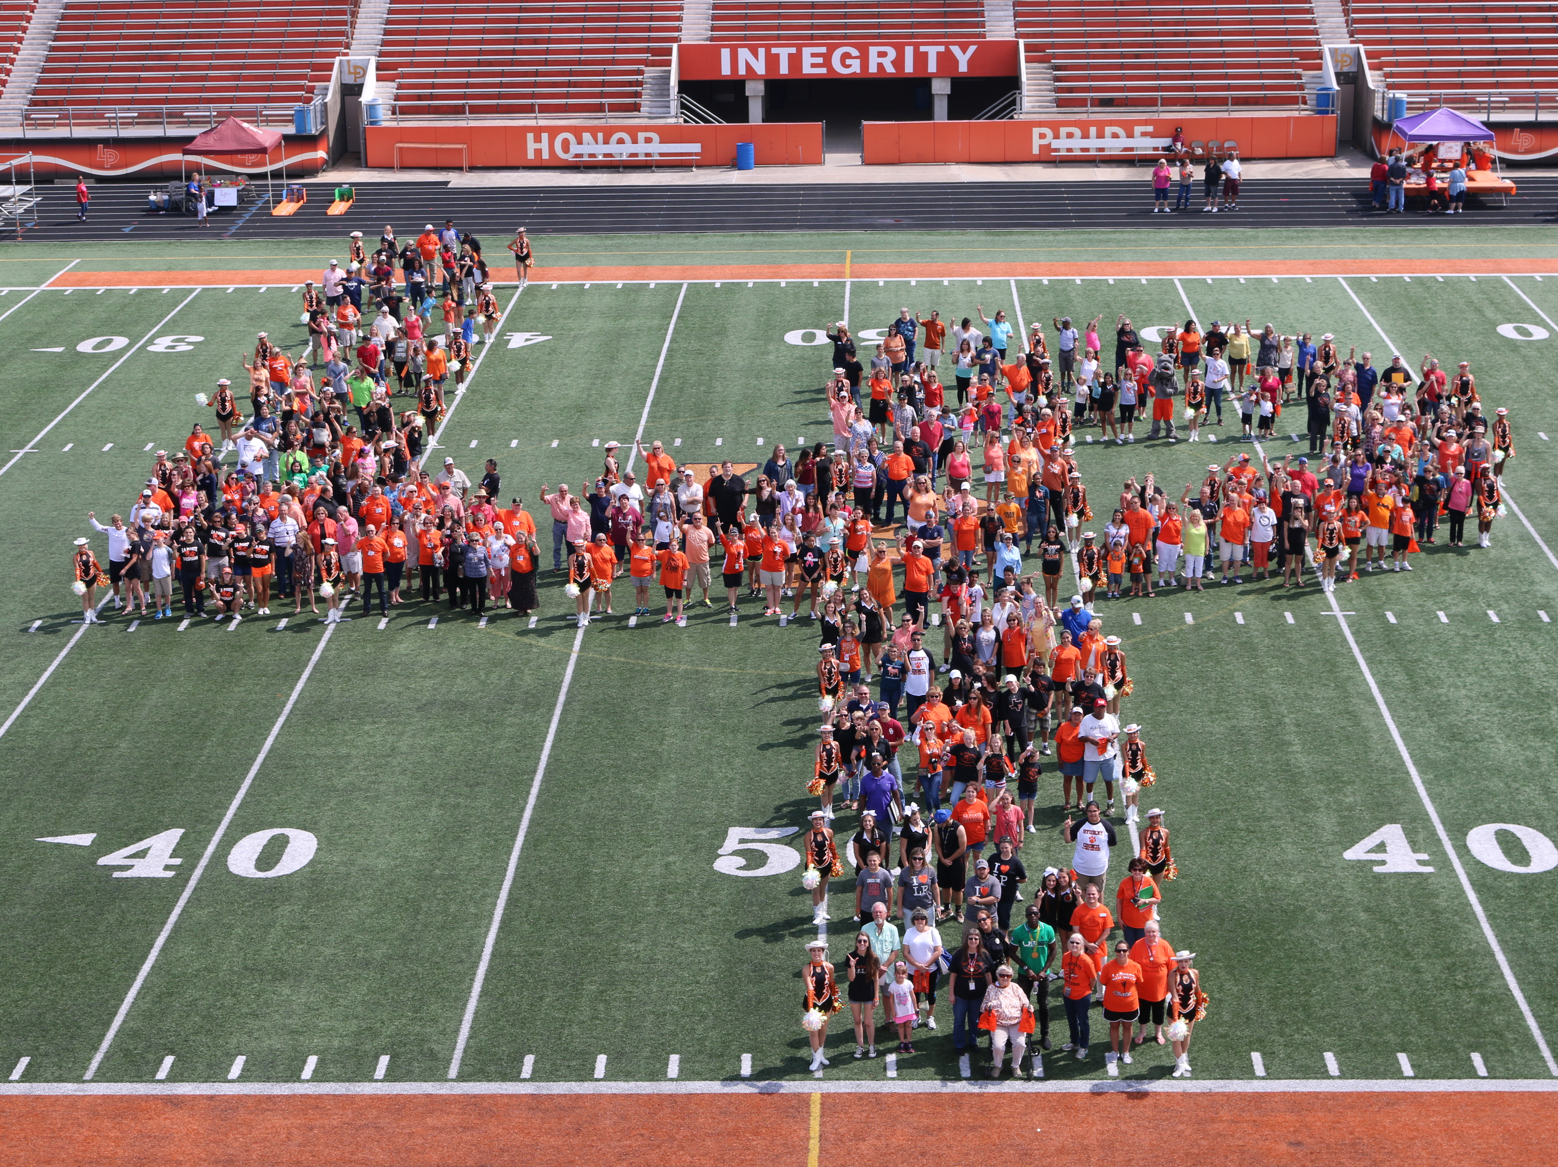
Demographics
White – 36%
African-American – 9%
Hispanic – 52%
Limited English Proficient – 13%
Economically Disadvantaged – 59%*
Special Education – 12%
*Based on applications for free and reduced lunch and state
certification

Slide 7
Big Rocks
"Highly productive districts have a laser focus on positive student outcomes."
District-wide literacy focus
Provide equitable opportunities for student success
Close learning gaps and improve student performance in all areas
Encourage and promote student innovation
Become a TEA "A" Rated District!

Slide 8
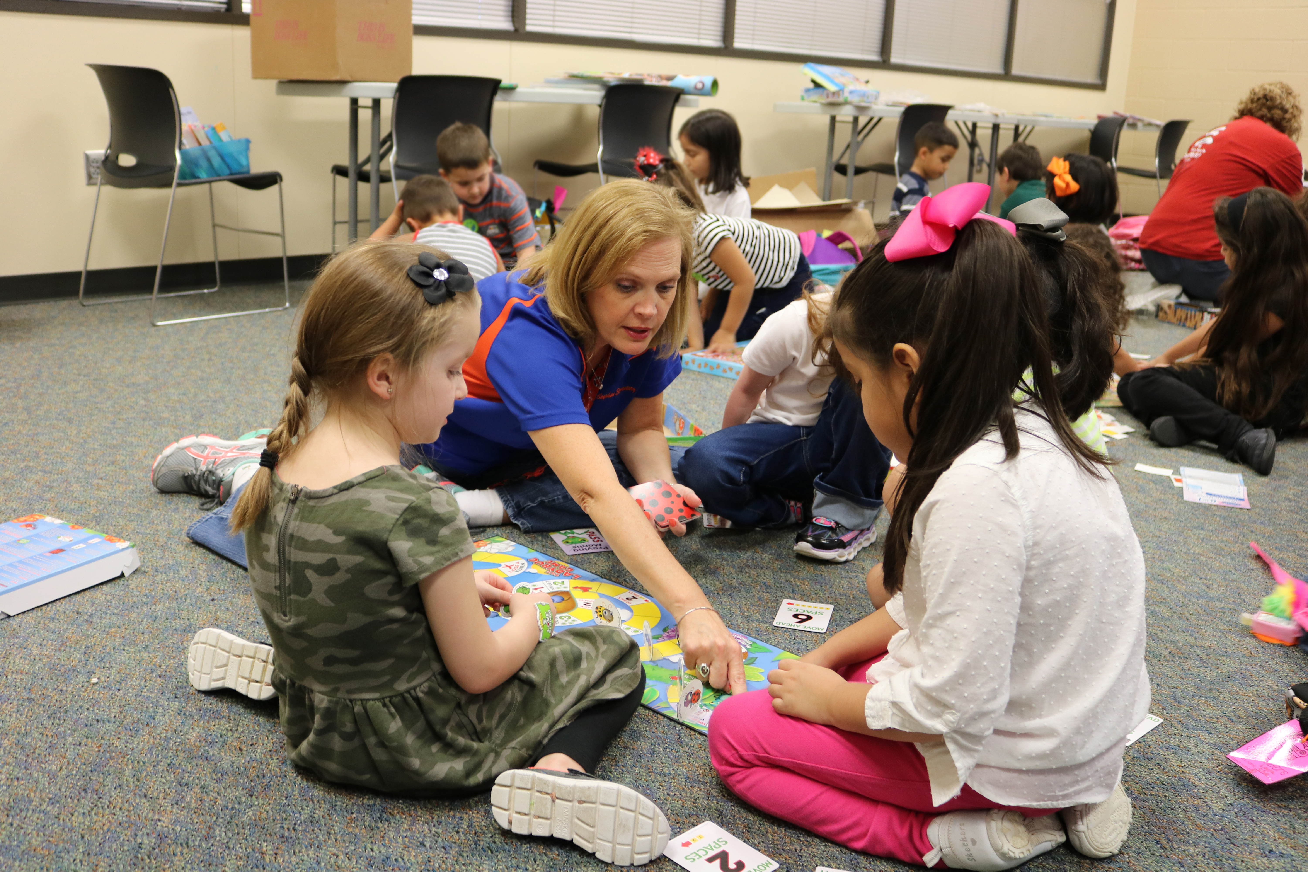
Qualities of an effective teacher
Adaptable
Prepared
Positive
Creative
Strong communicator
Good listener
Focus on collaboration
Have a sense of humor
Respect students
Admit mistakes
Value real-world learning
Life-long learners

Slide 9
Dare to be great!
Work hard and be nice
High expectations for all
Culture of caring, collegiality, collaboration, and communication
Nurture meaningful relationships
Positive district ambassadors
Communicate our vision of greatness to all stakeholders
Encourage parental involvement/engagement
Engage our community

Slide 10
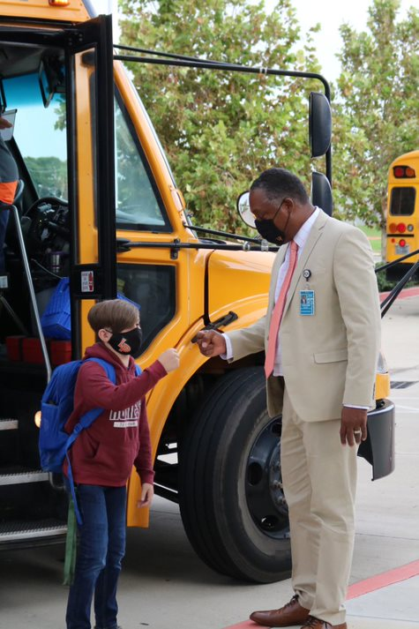
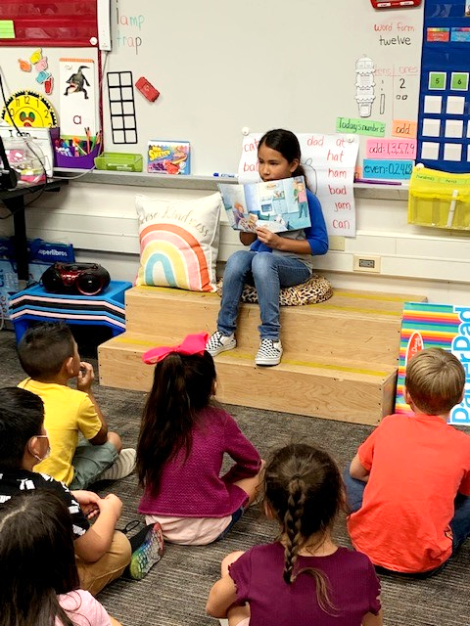
We want to see you win!
Win in the classroom
Win at being a great professional educator
Win at enjoying your students and parents
Win at building relationships
Win at ensuring your students succeed academically
Win at having a successful year in La Porte ISD
Be the teacher you needed as a child
"Legacy is not leaving something for people.
It's leaving something in people."

Slide 11
Remember Your "Why"
You are noble merchants of hope
You are fearless protectors of democracy
You are patriotic nation builders
Your daily interactions will have a positive impact on students’ lives
Your life is meaningful because you are teacher!
You are supercalifragilisticexpialidocious!!!

