Slide 1
Engaging and Supporting the Whole Child at RCCSD: A Data and Learning Session
Office of Grants, Community Schools & Diversity, Equity and Inclusion

Slide 2
Academic Reports
Office of Curriculum Update
Middle School Academics and Supports
High School Academics and Supports
Elementary Academics and Supports
Community Schools & Grant Programming
Diversity, Equity & Inclusion
Notes:
This is where you have already been with presentations. You’ve heard about tier 1 curriculum and instruction updates as well as specific interventions and programs being implemented at each building level. Here is the why for that work. As educators, we have to root our decisions in concrete data to determine root cause of needs to be able to develop an appropriate plan for addressing those needs. In this presentation, we will look at some historical data for the RCCSD and explore the need for equitable outcomes for all students as well as ways we can work within the community schools model to ensure that we are supporting the whole student.

Slide 3
Session Objectives
Explore historical data from a diversity lens
Explore current data from a diversity lens
Review the NYS Policy on Diversity, Equity and Inclusion
Understand how diverse populations relate to district accountability (ESSA)
Examine connection between DEI and Community Schools
Identify Next Steps

Slide 4
Strong DEI (Diversity, Equity and Inclusion) policies, in partnership with parents and families, empower students from all backgrounds to visualize successful futures for themselves and provide them with a sense of belonging and self worth.
Strong DEI (Diversity, Equity and Inclusion) policies, in partnership with parents and families, empower students from all backgrounds to visualize successful futures for themselves and provide them with a sense of belonging and
self worth.
NYS Board of Regents Policy Statement, May 2021
Notes:
If we have partnered with parents and done exactly this, haven’t we succeeded?
Belonging = inclusion
This means academic growth and success for all learners, social-emotional success for all learners
This means support, engagement and feelings of efficacy for all staff

Slide 5
“In order to see where we are going, we not only must remember where we have been, but we must understand where we have been.” — Ella Baker
Notes:
Before we can have a solid plan for the future of RCCSD, we need to explore where we have been. This will allow us to have a clear, less biased vision for how we best move forward.

Slide 6
Long Term Data Analysis
1996-2022 Review of State Report Cards
Consider and Compare Constant Items in Reporting
Identify Trends and Areas for Deeper Analysis
Purpose: To Understand- Not a Weapon to Defend but a Tool to Guide
Notes:
To understand where we have been, I conducted a historical data analysis reviewing state report cars from 1996-2021. The items being reported on are those data points that were most consistently included through each of these years. Annually, more data points are added, but these are the points that have been available consistently since 1996, allowing us to make the most apples to apples comparison across the years to be able to identify trends and areas needing deeper root cause analysis. The purpose of data analysis is never to use data as a weapon but instead use data as a tool to help us develop a deeper understanding of what is really happening.

Slide 7
Data Protocol
Predict: What will a historical data analysis show about this district?
Observe: What do we observe in the historical data?
Infer: What can we infer about the data based on what we have seen? Are we serving the diverse needs of our students?
So What Now?: Agreements for collectively moving instruction and achievement
Notes:
Do the PREDICT before moving to the next slide.

Slide 8
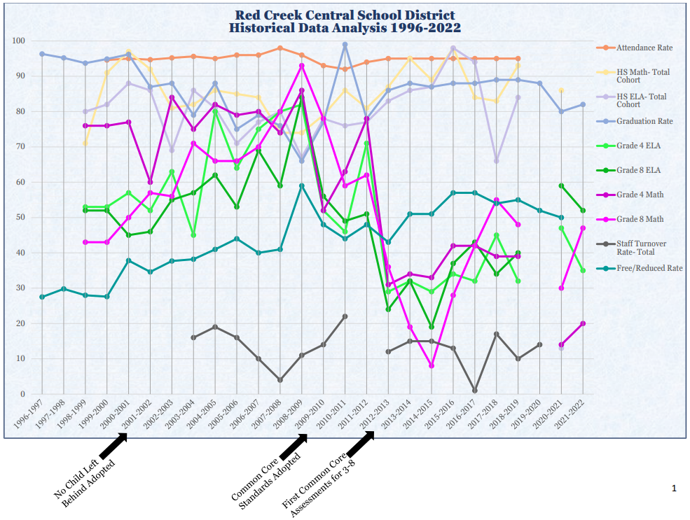
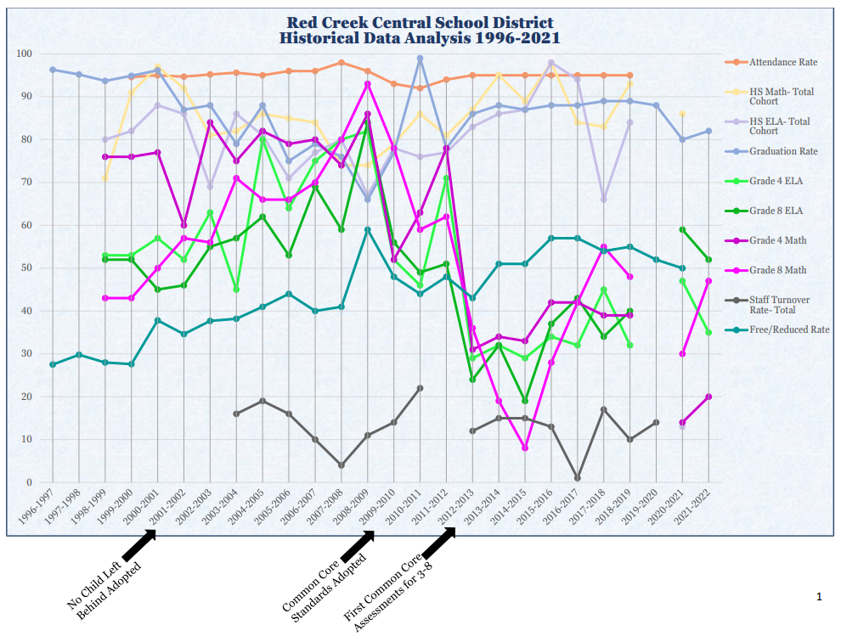
Notes:
Walk group through what each of these points are.
2001-2002 Adoption of NCLB
2009-2010 Adoption of Common Core Learning Standards
2012-2013 First Administration of Common Core Assessments for 3-8

Slide 9
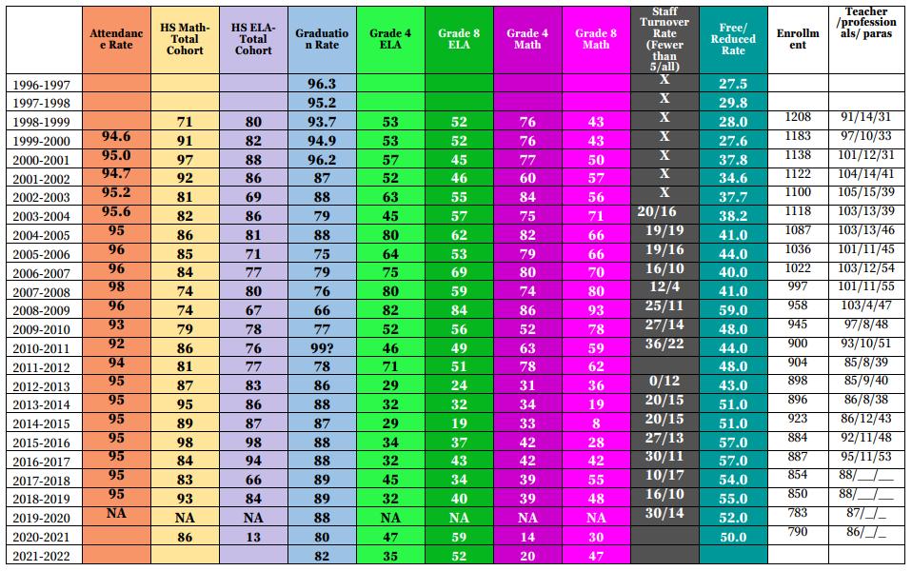
Notes:
Highlight/explain trend lines:
4th grade math trending down
8th grade math trending down (less steep than 4th grade)
HS Math Total Cohort Trending Up- indicating either fabulously effective interventions or fewer students taking upper level math courses
FRPL: steady trend up

Slide 10
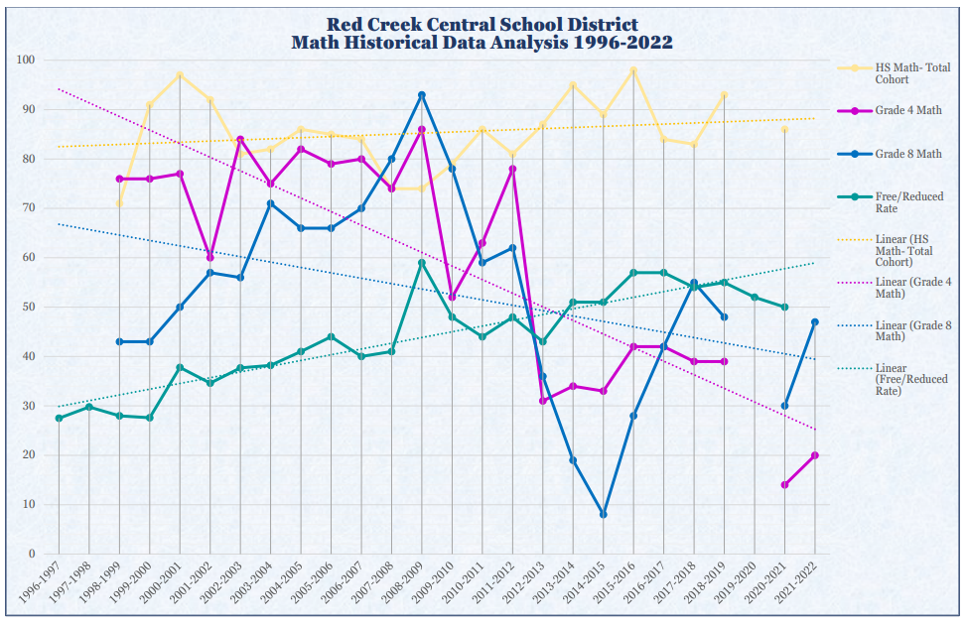
Notes:
Highlight/explain trend lines:
4th grade math trending down
8th grade math trending down (less steep than 4th grade)
HS Math Total Cohort Trending Up- indicating either fabulously effective interventions or fewer students taking upper level math courses
FRPL: steady trend up

Slide 11
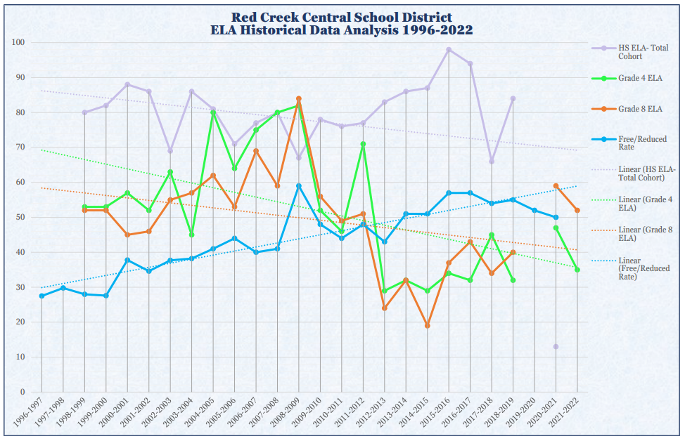
Notes:
Highlight/explain trend lines:
4th grade ELA trending down
8th grade ELA trending down (less steep than 4th grade)
HS Total Cohort: trending down
FRPL: steady trend up
*What is the community impact of steadily decreasing ELA performance? Does that indicate a comparable decline in literacy rates throughout this community?

Slide 12
Subgroup Performance: Graduation Rate Class of 2022
Notes:
Highlight discrepancies between subgroup
Allude to ESSA- more description will be coming later about how districts will be held accountable for each of these groups

Slide 13
First Impressions of Data
Notes:
What do you notice? (concrete observations- no assumptions)
What do you wonder?
Are all of our students being served equitably?

Slide 14
NYS Board of Regents’ Call to Action
Governance
Teaching
& Learning
Workforce
Development
Diverse Schools & Learning Opportunities
Family & Community Engagement
Student Supports, Discipline, Wellness
Utilize engagement practices that are built on mutual trust, confidence, and respect
Address the need for inclusive and culturally responsive teaching and learning, including opportunities for civic engagement
Ensure that opportunities, coursework, activities, programs, etc. are accessible to all students
Focus on the well-being of the whole child to enhance all students’ self-identity, self-confidence, and self-esteem
Establish a DEI Committee that is representative of all stakeholders
Recruit and retain a diverse workforce in all areas and at all levels to prepare students to engage in a global society
Notes:
This is NOT CRT
Those inequitable outcomes are what the US DOE noticed as their call to action to adopt the Every Student Succeeds Act (ESSA)
NYS has an ESSA plan that contains a commitment to equitable outcomes for diverse student populations
The NYS DEI Call to Action focuses in on 6 areas – explain each briefly

Slide 15
Community Schools and DEI Priorities
Governance
Teaching
& Learning
Workforce
Development
Diverse Schools & Learning Opportunities
Family & Community Engagement
Student Supports, Discipline, Wellness
In alignment with the district’s Strategic Plan:
Establish a DEI Committee/ Community Schools and 21st CCLC Advisory Board
Establish goals and work plan of committee
Track and analyze data to measure effectiveness of work plan
Continued review of academic and social-emotional growth and outcome data
Aligned systems for tiered supports across the district
Ensure opportunities for civic engagement
Ensure opportunities for parents to engage and participate in their children’s education
Survey parent needs for supporting children and education
Collaborate with local teacher prep programs to increase diversity of district workforce
Ensure that students have access to career development learning opportunities
Ensure that opportunities, coursework, activities, programs, etc. are accessible to all students
Ensure balance of opportunities for enrichment and intervention
Focus on the well-being of the whole child to enhance all students’ self-identity, self-confidence, and self-esteem
Align systems for support and monitor impact
Notes:
This is NOT CRT
Under each of these six areas and in alignment with the district’s strategic plan, the Director of Grants/Coordinator of DEI will be prioritizing these items

Slide 16
DEI and ESSA
Overview of ESSA
The Every Student Succeeds Act (ESSA) provides external measures (outcomes) on how well our internal actions are helping our students succeed
Effective January 2018
NYS plan is built upon the No Child Left Behind accountability system but moves beyond just looking at student test scores as accountability measures
This includes reporting for additional subgroups and monitoring to ensure equitable outcomes

Slide 17
Previous System
Current System
Notes:
Cross walk of NCLB accountability vs. ESSA accountability systems

Slide 18
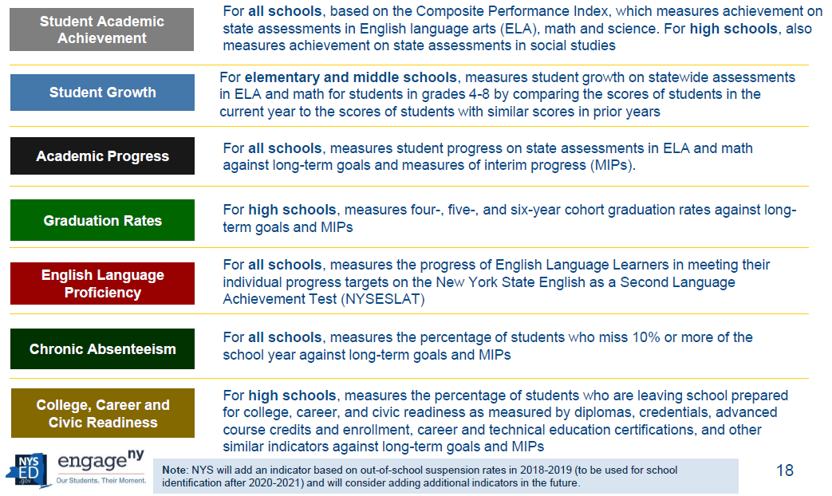
The Metrics Have Changed
Notes:
We are no longer measured just on test scores, but each of these items
And, we will be measured for all of these items across all subgroups

Slide 19
College, Career, & Civic Readiness
Determined based on a weighted score for graduation diploma type
2.0 Weight:
Regents with Advanced Designation
Regents with CTE Endorsement
Regents with Seal of Biliteracy
Regents with Concurrent Enrollment or AP Courses
1.5 Weight:
Regents Diploma with CDOS Endorsement
Skills and Achievement Credential with a Score of 3 on the NYSAA
1.0 Weight:
Regents or Local Diploma Only
Skills and Achievement Credential with a score of 2 on the NYSAA
0.5 Weight:
High School Equivalency Diploma (formerly GED)
CDOS Credential
0 Weight:
No Diploma or High School Equivalency
Notes:
One new measure is CCCR
Our district in the 2018-2019 school year received the lowest score (1-4) for this accountability measure- across all sub groups
Good news-consist outcome, Bad news- our students aren’t completing CCCR opportunities (hence a large focus on improving this in our strategic plan)

Slide 20
Key Changes Impacting RCCSD
Measures of Interim Progress (MIP’s) are set by NYS as growth goals for each subgroup
Prior Subgroups: Race, English Language Learners (ELL), Students with Disabilities (SWD) and Economic Status
Added Subgroups: Military, Homeless, Foster
Subgroups are calculated based on 30 students. Under ESSA, NYSED will combine multiple years of data to reach that count of 30.
Algorithms for determining Targeted Support and Improvement Schools (TSI) and Comprehensive Support and Improvement Schools (CSI)
Graduation Rate: NYS Goal is 95%, NYS expects that if other accountability measures are improving, graduation rate will likely improve
Chronic Absenteeism will be looked at for two groups (grades 1-8 and grades 9-12)
Notes:
How does ESSA impact RCCSD? Here are the biggest items in the changes that could impact the accountability status of the RCCSD.
While this was adopted in 2018, there has been a two year pause during COVID to identifying new schools/districts.
While RCCSD is currently in “Good Standing” our students with disabilities populations both in the elementary and high school buildings would only need one additional indicator to score at a level 1 to have that building designated as a Targeted Support and Improvement School
This places increased pressure on the need for a multipronged approach to improving academics

Slide 21
Tackling Needs and Meeting ESSA Goals: A Three-Pronged Approach
Proactive:
Proactive:
Reactive:
DEI, Community Schools Programming and Initiatives
Improved Tier 2/ Tier 3 Academic and Behavioral Supports and Systems
Tier 1 Curriculum
& Instructional Improvement
Building Principals and Director of Curriculum as Primary Instructional Leaders
Building Principals, Director of Grants/DEI, 21st Century Team, DEI and Community Schools Advisory Board
Building Principals, Administrative Intern, Director of Grants/DEI, Intervention Teams
Notes:
Every leader must be an integral part of this process
Leadership team needs to be aligned and cohesive to have a consistent set of expectations for improvement
Can’t be a here is where my job ends and yours begins but a “how can we do this together” approach

Slide 22
Tier 1 Curriculum & Instructional Improvement
Coordinated Approach by Building Principals and Director of Curriculum
Program Review: To assess current state of curriculum and instruction in ELA and math
Establishing non-negotiable expectations for use of instructional time at each building
Conduct Instructional Rounds/Learning Walks to monitor fidelity of implementation and provide instructional feedback to teachers
Use Instructional Coaches (through WFL BOCES) to provide targeted support for teachers
Notes:
So, what is next?
Principals and Director of Curriculum TOGETHER
Aligned understanding, unified front, consistent, collaborative follow through

Slide 23
DEI & Community Schools Programming
Coordinated Approach by Building Principals, Director of Grants/Coordinator of DEI, 21st CCLC Team and DEI/Community Schools Advisory Board
Personalize supports and programs to each building level (including both intervention and enrichment opportunities)
Establish Advisory Board of diverse stakeholder groups (as previously detailed)
Streamline continuum of community resources
Conduct community/parent needs assessment
Ensure balance of enrichment and intervention opportunities for all students
Implement Adult Education opportunities in collaboration with the RCCC
Increase community partnerships and collaboration to support the whole child

Slide 24
Improved Tier 2/Tier 3 Supports (MTSS)
Coordinated Approach by Building Principals, Administrative Intern, Director of Grants/Coordinator of DEI, and Intervention Teams
Conduct Resource Mapping to identify available interventions and supports for tier 2 (small group) and tier 3 (intensive, individual supports) for BOTH social-emotional-behavioral needs as well as academic needs
Ensure all interventions are research-based and highly-effective
Establish a consistent, sustainable system for identifying student needs, allocating intervention supports and progress monitoring effectiveness of tiered supports (not a one size fits all approach)
Ensure that all students receiving an intervention have a measurable SMART goal associated with their specific need and intervention
Monitor fidelity of implementation of systems and interventions
Notes:
Providing appropriate interventions (both academically and behaviorally/socially/emotionally) will take all hands on deck- especially when we look at the disproportionate current outcomes for students across the district
We need to shift as an admin team to be academically focused and data-driven by using our admin time to constantly reflect to data and the direct impact of our work on student outcomes

Slide 25
Next Steps with Data
Data deep dives with math and ELA content and teachers (October Conference Day)
Cohort data analysis tracking vertical progress and cohort growth (Next Admin Team Meeting)
Share cohort data and subgroup performance data with staff and BOE (October)
Establish BOE subgroup performance goals and commitment to supporting and engaging diverse learners (October)
"Develop a system for looking at and using data, such as grade-level trends and cohort data"- Strategic Plan, P. 13​
"Implement data analysis protocols to adjust curriculum, lesson plans, and classroom instruction"- Strategic Plan, P. 16​
"Analyze data to identify subgroups needing additional supports and enrichment"- Strategic Plan, P. 16​
"Create and/or review BOE Policy focused on procedures and processes on DEI, Strategic Plan, P. 4​
Notes:
Again, my role is focusing on tier 2- equity across subgroups. Does it appear all students are getting what they need at personalized levels.

Slide 26
Questions?

