Slide 1
The Big Red C is here:

Slide 2
My Management Philosophy
“I believe all students can learn with the proper support and guidance.
My management style is transformational.
I engage the team so we can learn from each other and collaborate on the best outcome for the district.”

Slide 5
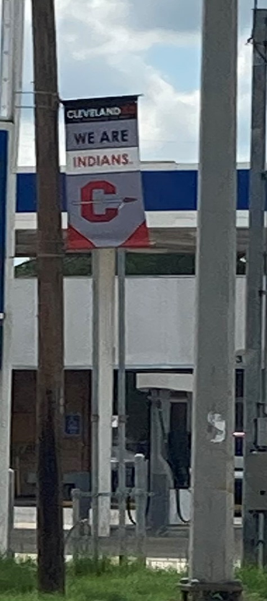
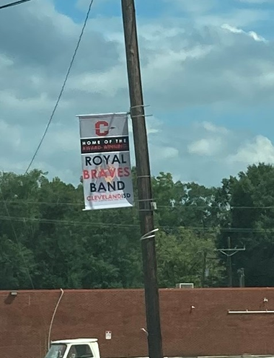
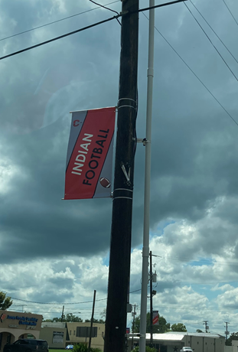
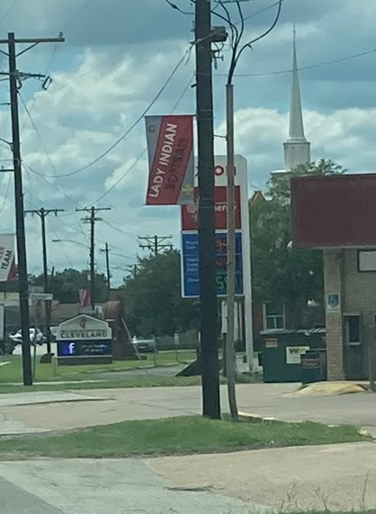
Hometown Banners

Slide 6
CTE Programs
30 Different programs of students in 13 career clusters:
Agriculture, Food and National Resources
Architecture and Construction
Arts, A/V Technology and Communications
Business, Marketing and Finance
Education and Training
Health Science
Hospitality and Tourism
Human Services
Information Technology
Law and Public Service
Manufacturing
STEM
Transportation, Distribution and Logistics

Slide 7
AMAZING AWARD WINNING TEAMS!!
CULINARY ARTS
SkillsUSA Competition
GOLD
Prepared Speech
Quiz Bowl and Entrepreneurship
Commercial Making
Silver
Quiz Bowl
Bronze
Restaurant Service
Entrepreneurship
WELDING TEAM
15 students earned certifications and scholarships.
1 student certified in all events, earning 52,000.00 in scholarships.
1 student earned $9,000.00 in scholarships and 2 certifications.
1 student earned 2 certifications and $21,000.00 in scholarships.
ROYAL BRAVES BAND
60 years of straight #1’s at Marching Contest.
#1 at Concert & Sight-Reading Contest
Sweepstakes

Slide 8
Air Force JROTC!
Distinguished Unit with Merit Awards
Distinguished Unit Awards
Silver Star for Excellence in Community Service
Leadership Academic Bowl National Finalist
CHEER TEAM!
2020-21
Chevy Spotlight Award
UIL State Spirit Coed
2021-2022
CAN Lone Star Classic Regionals
Top Team Chant & Cheer
2022-23
Top Team Most Spirited Program at UCA Cheer Camp
Top Team Cheer at UCA Cheer Camp – Varsity
Cosmetology
SkillsUSA Competition
3D Freehand Nail Art
State Champs
Silver Awards
Hair
Color
Fantasy Updo’s
Show/Cutting

Slide 9
CHS Seniors:
CHS Class of 2022
323 Junior Colleges
230 4-year Universities
24 Trade Schools
9 Military Enlistments
100 Workforce
CHS Scholarship amount $1,559,827.00
Local Scholarship $95,420.00
Technical/Trade Scholarship $164,500.00
4 years Institutional Scholarship $555,195.00
Military Scholarship $744,712.00

Slide 10
Enrollment: Past & Current
MAY 2022 11,243 students
lost -1,300 students to the charter school.
SEPT. 2022 11,447 students
We gained 1,500 students over summer

Slide 11
Enrollment Projections
2023-24 13,000 Total Students
2024-25 14,000 Total Students
2030-31 23,000 Total Students

Slide 12
Campus Capacity
Current Max Capacity
North Elementary Campuses
Cleveland Middle School
Cleveland 9th Center
Cleveland High School
South Elementary Campuses
Santa Fe Middle School
3060
3400
1700
1800
1008
1200
2307
3400
2340
3400
880
1600
Total
11,295
14,800

Slide 13
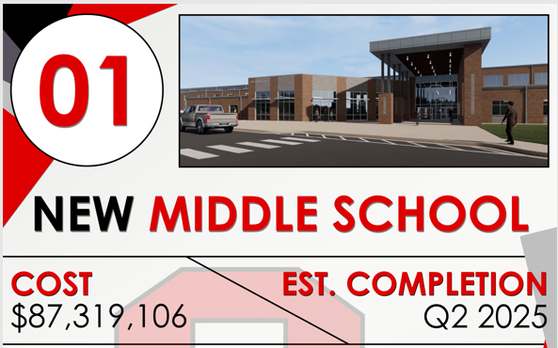
Community Approved Projects

Slide 14
Community Approved Projects

Slide 15
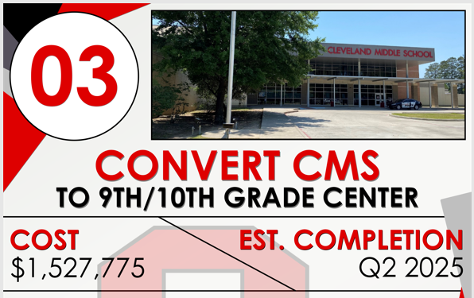
Community Approved Projects

Slide 16
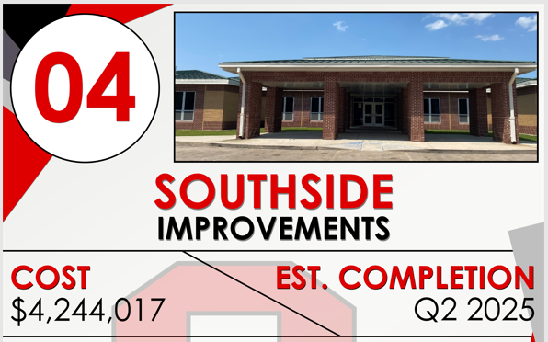
Community Approved Projects

Slide 17
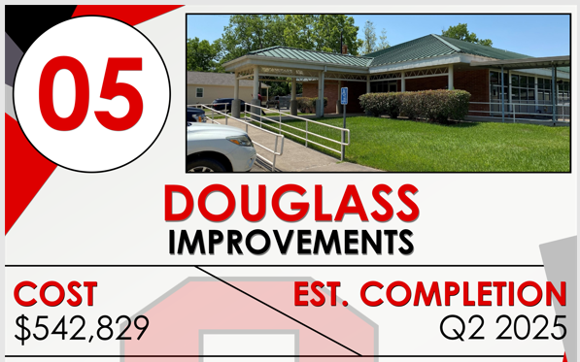
Community Approved Projects

Slide 18
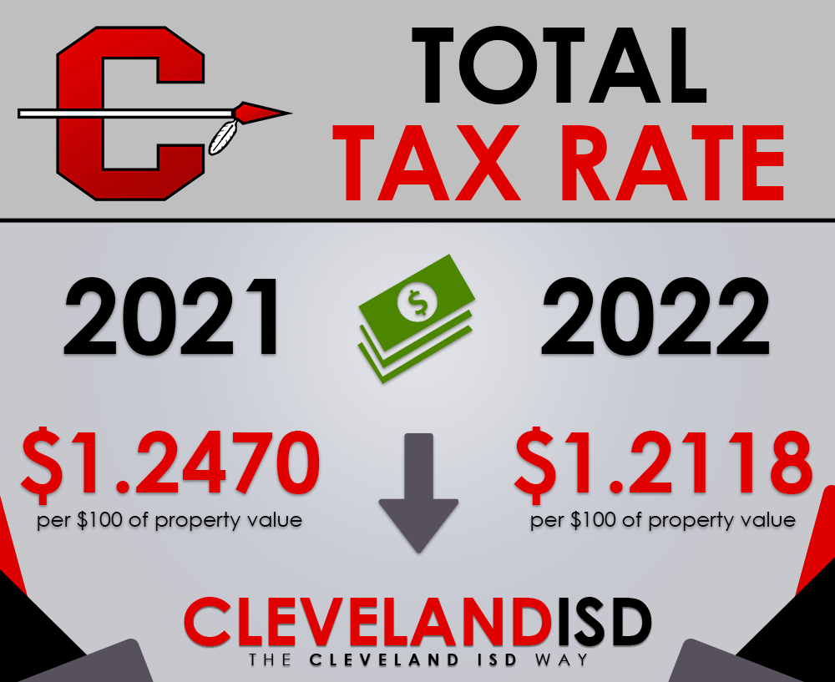
District Total Tax Rate

Slide 19
Voting Dates
Last Day to Register to Vote: October 11th
Early Voting Begins: October 24th
Last Day of Early Voting: November 4th
Election Day: November 8th

Slide 20
Cleveland ISD
Bond Referendum Information
November 2022
Stephen McCanless, Superintendent
Office 281-592-8717
smccanless@clevelandisd.org

