Slide 1
Bloodborne, airborne and droplet pathogens
Scarborough Fire Department
Annual Training 2022
Notes:
This is our annual Bloodborne training for 2022

Slide 2
What’s this all about?!
  OSHA 1910.1030- any employee that may come in to contact with Blood or Blood products must attend yearly training.
  Additional education is required each time there is a change in procedure
  Training is site specific

Slide 3
What is Occupational Exposure
  OSHA Defines Occupational Exposure as a reasonably anticipated skin, eye, mucus membrane or parenteral contact with blood or other potentially infectious material that may result from the performance of an employees duty
  Not the same as an EXPOSURE Incident, an Exposure incident is a specific incident in which someone has been exposed

Slide 4
Exposure Control Plan
Updated yearly by the Designated Infection Control Officer.
Annual training must cover the updates
Located on SFD Training Website, Google Operations Page, Captain’s Office, Deputy's Office, Administrative Office and in Human Resources at Town Hall.
The plan covers Universal Precautions, Engineering controls, work restriction and post exposure follow up.

Slide 5
Disease Process
Causes of Disease
  Microorganisms that are carried in human blood or body fluids
    Normal Flora- assist the body as a natural defense to maintain health by preventing harmful bacteria from growing
    Bacteria- Need certain conditions to grow but can survive out side the human body
    Virus- A packet of genetic material that is surrounded by protein covering, unable to grow or reproduce out side a living host.
    Prion - A disease-causing agent that is not bacterial, fungal, or viral and contains no genetic material.
Notes:
Normal Flora is damaged by the use of antibacterial soaps, lotions, sprays. Alcohol based cleaners are OK and do not damage.
Bacteria in certain conditions can remain viable out side the body and cause infection.
Virus- Does not survive out side the human body,

Slide 6
Disease Process
Type of Disease
  Infectious- Illness resulting for Bacteria, virus, fungi, prion or parasite.
  Communicable- A disease that is readily spread from one person to another under certain conditions.
  Vector - An organism, such as an insect or animal that transmits disease-carrying germs.
Notes:
Infectious only means caused by a pathogen
A disease may be infectious but not communicable, we are focus on communicable diseases.

Slide 7

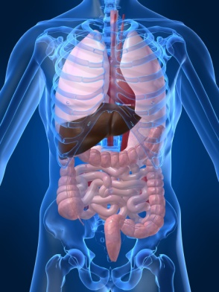


NORMAL FLORA
Microorganisms (usually bacteria) are found on healthy human body surfaces
Each body site has its own normal flora

Slide 8
Disease Process
Risk of transmission
  Primary – comes from blood, vaginal secretions and semen only a risk in sexual contact.
  Secondary- Fluid from joints, around the heart, abdomen, spinal fluid and other body fluids that contain VISIBLE blood.
  Not a risk for transmission, Urine, Fecal matter, Vomit, tears, Unless they contain VISIBLE blood.

Slide 9
Disease Process
How is disease spread? (Disease Vector)
  Direct Contact- Direct contact of infected blood with blood form another person
    Example- You apply pressure to a person who has a laceration to an artery in their leg. During the transfer of the patient to the backboard you cut your forearm and the patients blood get on your arm.
  Indirect Contact- Spread from a person to an object and than to another person
    Example- You are working a MVC, when moving the patient you get cut by glass that has the patients blood all over it.
    Example 2- A person has Norovirus and drinks from a glass. Then you drink from the same glass and contract the virus.

Slide 10
Assessing the risk of exposure
Four factors to consider
  Organism
    Each organism has a specific mode of entry
  Dose of the Organism
    Number or organism present in exposure, Each disease has a number requirement, If there is no Disease present, infection cannot occur. For Viruses, this is known as Viral Load.
  Host resistance to Organism
    The healthier you are, less chance for infection
  Strength of the Organism *
      (Virulence) Strength outside vs. inside the body. HIV and TB do not survive in air and light
Notes:
* Hepatitis has been found in 1 study, a dialysis facility, to survive on stainless steal for 7 days. They have not been able to reproduce this in other studies

Slide 11
Assessing the risk of exposure
Bodies Natural Defenses
  Skin- First line of Defense
  Conjunctiva- Protects the eyes by the motion of the eyelids and tears.
  Lungs- Cilia, mucous membranes, cough mechanism
  GI Tract- Acid of gastric juices and bile secretions
  Immune System- resistance for infection
Factors that compromise resistance
  Smoking, Age, Drug use, Trauma, Malnutrition, chronic diseases.
Notes:
This is why it is important to try and stay as healthy as possible.

Slide 12
Exposure Incidents
Contact with skin: wash exposed areas with antimicrobial soap and running water
Contact with eyes or mucous membranes: flush affected area with running water for at least 15 minutes
Contact with clothing: remove contaminated clothing, wash underlying skin with antimicrobial soap and running water. Be careful not to spread the contamination. (Note, it is best to initially wash with cold water until visible contamination has been removed). This keeps the pores in the skin closed.

Slide 13
Exposure Incidents
Contact the Designated Infection Control Officer at 730-4297, Someone is on call 24/7
The DICO will make exposure determination
If deemed an exposure, source testing will be requested.
  If source is negative, no further testing or evaluation is needed
  If Source is positive, follow up testing of the employee will take place if vaccination history is not on file or insufficient.
  Any information obtained in regards to the Source Disease status must be kept confidential, failure to do so may result in civil liability
  Follow up will be confidential and results will not be known by the Department.

Slide 14
Bloodborne, airborne and droplet diseases

Slide 15
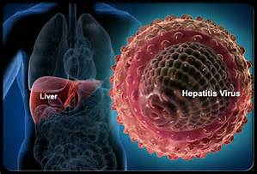
Hepatitis B (HBV)
Transmitted by blood to blood contact, sexual contact and indirect contact.
2006 CDC reported that HBV in public safety lower than general public
Signs and symptoms will begin like a flu like illness and may progress to jaundice, fatigue, abdominal pain, dark urine, whitish stool and smokers often lose interest in smoking
6.0-30.0% risk of infection if from Source positive needle stick and not vaccinated
  50-60% of people do not know they are infected with the disease

Slide 16
Hepatitis B (HBV)
This disease can be prevented
  Two vaccines available, Recombivax and Engerix.
  Low risk of side effects. May include low grade fever, soreness at injection site
  Has been used since 1982
  Offered to each employee at no cost
  Vaccine only good for HBV and will not protect against other types of Hepatitis.
  Series consists of 3 doses, First shot, 2nd shot 4 weeks later, 3rd shot 6 months after the first.
  Titer within 2 months of last shot, may need to repeat the series if you did not respond to the vaccine.
  If you chose to decline vaccination, Declination form must be signed.

Slide 17
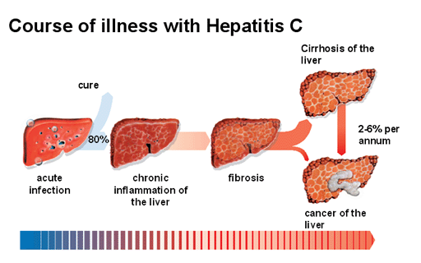
Hepatitis C (HCV)
Transmitted by Blood to Blood Contact, blood transfusions, needle stick injuries, Sexual contact
Tattoos and body piercings are factors that increase the risk 15-30%
Sexual Contact 15-20%
IV Drug users is the highest risk group 42%
Incubation period 6-7 weeks
Signs and symptoms are much like HBV, Flu like illness, loss of appetite, headache and nausea
5 studies show that Fire/EMS personnel are at no Increase risk

Slide 18
Hepatitis C (HCV)
No Vaccine available, post exposure treatment is counseling, post exposure testing HCV-RNA at 2 weeks
Rapid test available to know source status in 23 minutes.
There is effective treatment where 75-95% of people have been cured.
1 Transmission via splash into the eyes and 1 via non intact skin.
Treatment consists of 3 drugs-Interferon, Ribavirin and 1 other. And is covered under workers comp

Slide 19
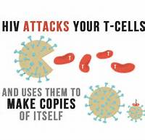
Human Immunodeficiency Virus (HIV)
Virus which attacks the bodies immune system and its ability to fight infection
Virus progress to AIDS
Transmission primarily sexual contact-M/M, M/F, F/M
Second is IV drug users sharing needles and syringes
Third is mother to Infant (1-3%)
Smaller numbers consist of Blood Transfusions and needle stick injuries,
  57 Health care workers have documented and acquired infections, none since 2001.

Slide 20
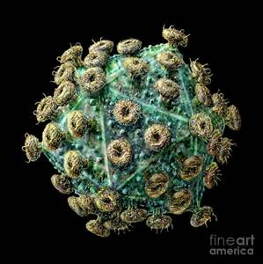
Human Immunodeficiency Virus (HIV)
HIV is not a highly infectious disease
  Does not survive out side the body
  Donated blood screened for p24 (closes the window phase to 1-6 days)
Higher Risk exposures:
  Deep puncture injury
  Visible blood on device
  Device had been in patients vein or artery, not iv tubing
  Patient HIV positive with High Viral Load
  Large gauge (18+) hollow bore needle
HIV CELL

Slide 21
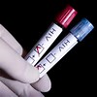
Human Immunodeficiency Virus (HIV)
Post exposure
  Test source patient, if source negative, no further testing of staff needed
  Source positive- Must conduct viral load testing, Viral load above 1500 copies/ml, considered high. 96% Patient receiving antiviral drugs and responding to treatment with low viral load, are unable to transmit the disease
  Rapid testing available, 10-20 minutes to know results.
  Must know source status to indicate Post Exposure Prophylactic treatment (PEP)
    If PEP is indicated, counseling must be conducted on drug interactions, side effects, pregnancy, CBC, LFT etc.
  Risk date:
    Sharps injury 0.3%
    Mucus Membrane 0.09%
    Non Intact skin 1 case in studies (1999)

Slide 22
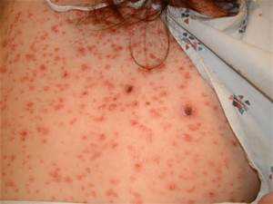
Syphilis
Disease caused by bacteria
Cases in the United States are on the rise, mostly males.
Primarily a sexual transmitted disease, but direct blood to blood contact may pose a transmission risk
High risk groups include IV drug users, prostitutes, HIV positive and HVC positive persons.
Signs and symptoms
  Primary lesion or chancre may appear 3 wks after exposure
  4-6 weeks rash on soles of feet and palms of hands may occur.
  May progress in to latent phase if not treated.
  Treatment consists of Long acting PCN
Syphilis Rash

Slide 23
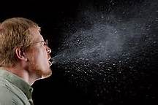
Airborne and Droplet Diseases

Slide 24
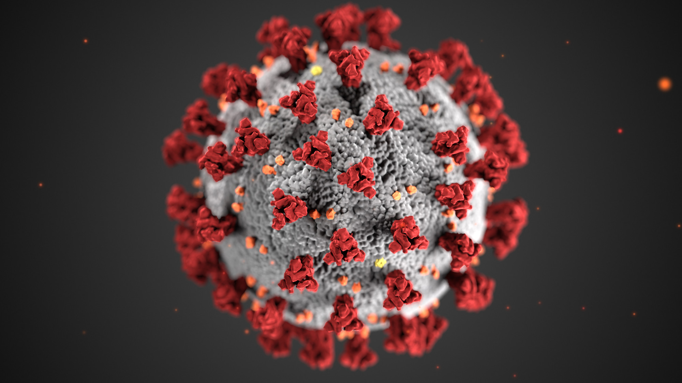
Corona Virus (Covid-19)
COVID-19 is thought to spread mainly through close contact from person to person, including between people who are physically near each other (within about 6 feet).
People who are infected but do not show symptoms can also spread the virus to others.
Respiratory droplets can also land on surfaces and objects. It is possible that a person could get COVID-19 by touching a surface or object that has the virus on it and then touching their own mouth, nose, or eyes.
COVID-19 affects different people in different ways. Infected people have had a wide range of symptoms reported – from mild symptoms to severe illness.

Slide 25
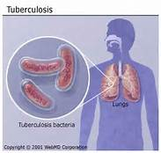
Tuberculosis (TB)
TB Is caused by a bacteria not a virus
Spread by droplet which are expelled by an infected person
TB Is not a highly communicable disease
Risk for exposure is based on time with infected person, if ventilation was present and any prevention measures that were used
  Exposure time is between 2-10 hours in an unventilated confined space.

Slide 26
Tuberculosis (TB)
TB Infection- Positive on test but no Disease, cannot pass on disease. No need for repeat testing or yearly chest x-rays unless you develop symptoms.
TB Disease- Positive test, Positive x-ray, positive lab data. May be able to pass disease on.
If following an exposure you test positive, you may be offered a drug treatment lasting 6-9 months
Symptoms include
  Cough >3 wks Plus two of the following
    Weight loss, night sweats, swollen lymph glands, chest pain, hoarseness.

Slide 27
Tuberculosis (TB)
New complication
  Multi drug Resistant TB (MDR-TB)
    Does not respond to drugs that are currently used
    Mostly seen in Immunocompromised persons/immigrants
    Still many drugs available to treat this
  Extensively Resistant TB (XDR-TB)
    Resistant to 2 most common antibiotics plus two injectable antibiotics
    About 4% of MDR-TB are now XDR-TB
    Still is treatable and not more infectious
    MAINE EMS PROVIDERS ARE CONSIDERED LOW RISK!!
    Therefor EMS does not require annual PPD testing

Slide 28
Seasonal Flu (Influenza)
    Influenza (flu) is a contagious respiratory illness caused by influenza viruses. It can cause mild to severe illness. Serious outcomes of flu infection can result in hospitalization or death. Some people, such as older people, young children, and people with certain health conditions, are at high risk of serious flu complications.
    The typical incubation period for influenza is 1—4 days (average: 2 days). Most healthy adults may be able to infect others beginning 1 day before symptoms develop and up to 5 to 7 days after becoming sick.

Slide 29
Seasonal Flu (Influenza) Continued
    Flu-like symptoms include fever, cough, sore throat, runny or stuffy nose, body aches, headache, chills and fatigue. Some people also may have vomiting and diarrhea. People may be infected with the flu, and have respiratory symptoms without a fever (CDC).
    The flu virus can “live” on some surfaces for up to 24 hours. (Keyboard, Door handles Etc.
    CDC suggests that healthcare professionals receive he flu vaccine annually. (Unless there are medical contra-indications)

Slide 30
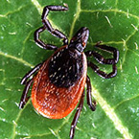
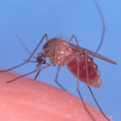
Tick and Mosquito Borne Diseases

Slide 31
Tick Borne Diseases
Anaplasmosis
Babesiosis
Ehrlichiosis
Lyme
Powassan Encephalitis
Rocky Mountain Spotted Fever
Click on the Disease Name for a link to Maine CDC’s Information
Please visit the link below for Tick Borne Disease Prevention
http://www.maine.gov/dhhs/mecdc/infectious-disease/epi/vector-borne/lyme/tick-prevention.shtml

Slide 32
Mosquito-Borne Diseases
Dengue
Chikungunya
Eastern Equine Encephalitis
Malaria
West Nile Virus
Yellow Fever
Zika
Click on the Disease Name for a link to Maine CDC’s Information

Slide 33
Mosquito-Borne Disease Prevention
Wear insect repellent: Yes! It is safe. When used as directed, insect repellent is the BEST way to protect yourself from mosquito bites—even children and pregnant women should protect themselves. Higher percentages of active ingredient provide longer lasting protection.
DEET: Products containing DEET include Cutter, OFF!, Skintastic.
Picaridin (also known as KBR 3023, Bayrepel, and icaridin): Products containing picaridin include Cutter Advanced, Skin So Soft Bug Guard Plus, and Autan outside the United States).
Oil of lemon eucalyptus (OLE) or PMD: Repel contains OLE.
IR3535: Products containing IR3535 include Skin So Soft Bug Guard Plus Expedition and SkinSmart.
Cover up: When weather permits, wear long-sleeved shirts and pants.
Keep mosquitoes outside: Use air conditioning or make sure that you repair and use window/door screens.

Slide 34

Other Diseases

Slide 35
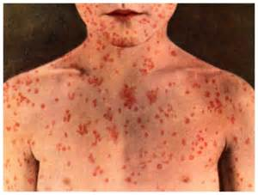
Measles
Transmission
  Airborne disease
  Direct contact with respiratory secretions
  Incubation period 7-18 days
Different Name
  Hard Measles
  Red Measles
  Nine day Measles

Slide 36
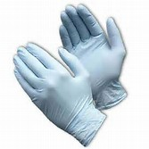
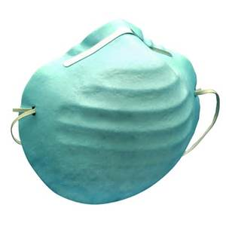
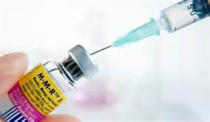
Measles
Symptoms
  Fever
  Rash
  Coryza
  Cough
  Koplik Spots (buccal mucosa)
  Conjunctivitis
Prevention
  Mask the patient
  Use gloves
  Vaccinate

Slide 37
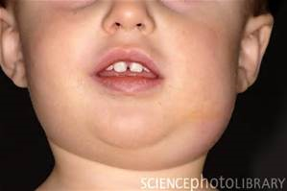
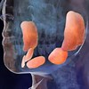
Mumps
Mumps is an inflammation of the salivary glands
Transmission
  Direct contact with respiratory secretions
  Face to face contact
  > 5 minutes in the same room
  If exposed and no immunity- work
  restriction is from day 12- 26 following
  exposure
Signs and symptoms
  Fever
  Swelling of Salivary Glands
  Orchitis an inflammation of testicles (unilateral)

Slide 38

Mumps
Prevention
  Vaccination
  2 doses 1 month apart
  If you cannot show documentation of immunity- Vaccinate, a titer is not required
Vaccine
  Live virus
  Cannot give to pregnant women
  Not effective post exposure.
  If received vaccine prior to 1967, must revaccinate

Slide 39
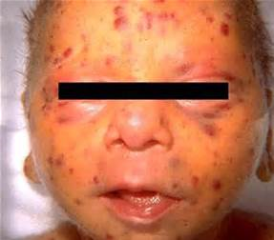
Rubella
Rubella is a virus, also know as German Measles or the 3 day measles
Transmission
    Face to face contact
Signs and symptoms
  Low grade fever
  Rash
  Coryza
  Headach
Prevention
  Vaccinate
  Place surgical mask on the patient
  Place surgical mask on your self if not possible to mask patient
  Incubation period 14-23 days

Slide 40
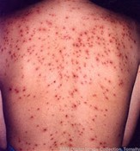
Chickenpox (varicella)
Varicella Zoster is chickenpox and Herpes Zoster is shingles
Transmission
  Face to face contact
  > 5 minutes of contact
  Contact with draining lesions

Slide 41

Chickenpox (varicella)
Signs and Symptoms
  Lesions on covered areas of the body
  Fever
  photosensitivity
Prevention
  Vaccination
  Place a surgical mask on the patient
  Place mask on yourself if not able to place on patient
Vaccine
  Live Virus
  2 doses,1 month apart
Incubation Period 10-21 days following exposure

Slide 42
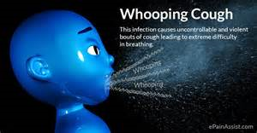
Pertussis (Whooping cough)
  Pertussis is a highly contagious bacterial disease that causes uncontrollable, violent coughing
  Initial symptoms, similar to the common cold, usually develop about a week after exposure to the bacteria.

Slide 43
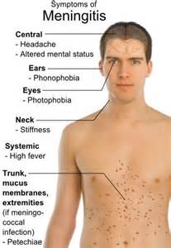
Meningitis
Can be a bacteria or virus
Viral meningitis not an exposure risk, generally resolves with out specific treatment
  90% of cases are viral
Bacterial meningitis is communicable
Bacterial meningitis is serious- can result in
  Brain damage
  Hearing loss
  Limb amputation
  Death
Transmitted by exchanging respiratory and throat secretions (saliva or spit) during close (for example, coughing or kissing)

Slide 44
Meningitis
Exposure
  Unprotected mouth to mouth
  Suction/intubation with no use of PPE
  Prolonged contact >8hr like with air travel
  Incubation Period is 2-10 Days
  Post exposure-Rifampin or Cipro
Prevention
  Mask the patient If unable than mask yourself
  Vaccinate
    Children
    College
    Teens

Slide 45
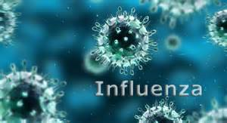
Seasonal Influenza
Transmission
  Droplet produced by coughing, poor hand hygiene
Prevention
  Hand washing
  Cough Etiquette
  Mask the patient
  Seasonal Influenza vaccine
Viral infection that spreads easily form person to person
Three types of seasonal influenza-A, B, C.
Only type A & B are included in vaccine

Slide 46
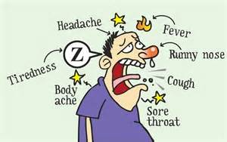
Seasonal influenza
Vaccine
    Many different types available
    Healthcare considered High risk
    CANNOT CAUSE THE FLU
Trivalent
  2 influenza “A” and influenza “B”
Quadrivalent
  2 Influenza “A” and 2 Influenza “B” viruses
Signs and Symptoms
  Fever or chills
  Cough
  Sore throat
  Runny Nose
  Muscle or body aches
  Headaches
  Vomiting, diarrhea

Slide 47
MRSA
Staph is commonly found in the nose and skin in health people.
Staph can lead to serious infections in surgical wounds, bloodstream and pneumonia.
Risk factors
  Severity of illness
  Underlying diseases such as chronic renal failure, insulin dependent DM, peripheral vascular disease, dermatitis and lesions
  Invasive procedures such as dialysis, invasive devices (central lines, ports) urinary catheters
  Repeated contact with healthcare system (hospitalizations, nursing homes)
  Previous Hx of colonization

Slide 48
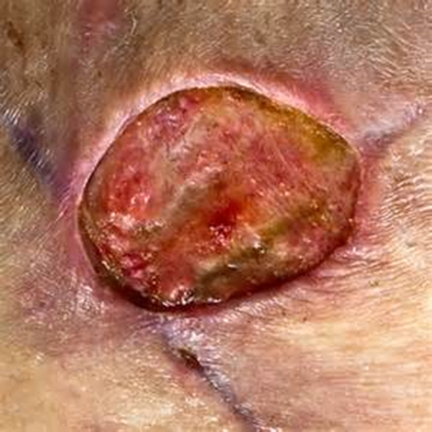
MRSA
Transmission occurs when EMS providers contact sites of infection or common areas such as stethoscopes, door knobs etc. that have contaminated surface.
Hands of personnel are the most common mode of transmission

Slide 49
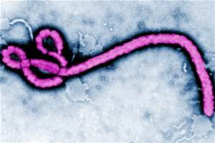
Ebola (Hemorrhagic fever)
The virus spreads by direct contact with body fluids, such as blood, of an infected human or other animals.
The viral load is the highest when a patient has just expired.
Signs and symptoms typically start between two days and three weeks after contracting the virus.
Early Signs and Symptoms include fever, sore throat, muscle pain, and headaches.
Later Signs and Symptoms include vomiting, diarrhea and rash, bleeding internally and externally.
After 21 days, if an exposed person does not develop symptoms, they will not become sick with Ebola.

Slide 50
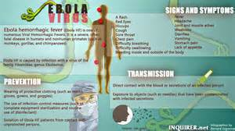
Ebola (Hemorrhagic fever)
No specific approved FDA vaccine for the virus is available, although a number of potential vaccinations are being studied.
People who care for those infected with Ebola should wear protective clothing including masks, gloves, gowns and goggles.
The virus is able to survive on objects for a few hours in a dried state, and can survive for a few days within body fluids

Slide 51
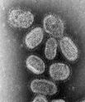







Ebola (Hemorrhagic fever)
How infectious is Ebola Virus?
Influenza
1,000
HIV
100
Ebola
1

Slide 52
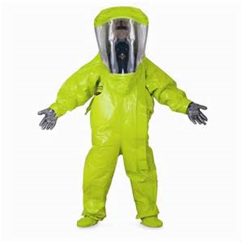
Employee protection
The number ONE concern

Slide 53
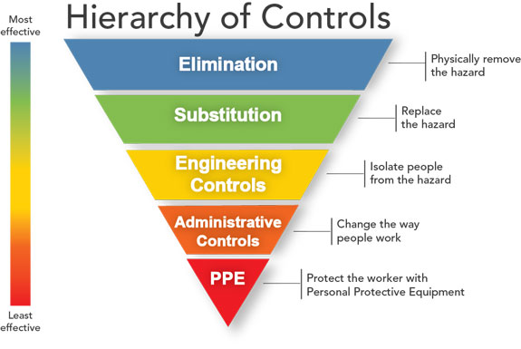
Engineering controls

Slide 54
Engineering controls
Hand washing
  Hand washing is the primary way we can prevent infection and protect our selves
  If a sink isn't available- we have placed waterless cleaners in all fire equipment and on the side door of all the ambulances as well as making waterless solution throughout the stations.
  No artificial finger Nails are allowed (CDC 2002)
Bio Hazard waste system
  Items that are soaked, caked and have the potential to leak are considered Bio Hazard and must be placed in a Red bag. This waste will be disposed of by a biohazard waste company.
  All other waste is considered normal waste and does not need to go into a Red bag

Slide 55
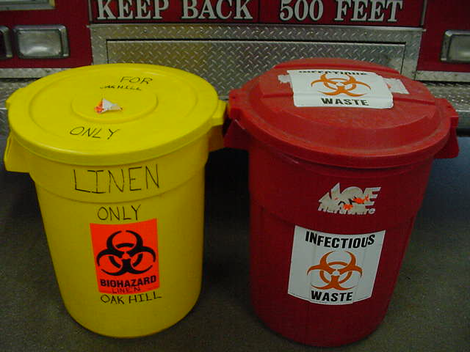
Engineering controls
Bio Hazard waste cont.
  Bio Hazard bins are located at Oakhill and Dunstan. This laundry will be washed in the extractor washer at Dunstan.
  White laundry bins In restrooms at Oakhill for laundry that can be cleaned in Oakhill washer and dryer.
  Once you place something in a red bag, you don’t get it back

Slide 56
Engineering controls
Red bags are for materials soaked in blood or OPIM. These bags will be disposed of by a medical waste company.
Yellow bags are for contaminated equipment that can and will be decontaminated at Dunstan Station. Be sure to label the outside of the bag to assure the equipment is returned to it’s proper location.
  White laundry bins In restrooms at Oakhill for laundry that can be cleaned in Oakhill washer and dryer.

Slide 57
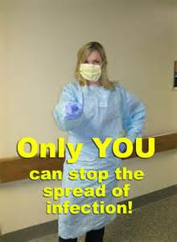
Engineering controls-ppe
Personal Protective Equipment
  Gloves, latex free
  Protective eyewear
  Masks- Surgical not N95
  Gowns
  Respiratory Devices- BVM, pocket masks etc.
PPE should be worn whenever there is the possibility of blood or Other Potential Infectious Materials (OPIM), see the following table

Slide 58
Recommendation of PPE
Unless OPIM are visible in your work field
Task or Activity | Gloves | Gown | Mask | Eyewear
Spurting Blood | Yes | Yes | Yes | Yes
Minimal Bleeding | Yes | No | No | No
Childbirth | Yes | Yes | Yes | Yes
IV Access | Yes | No | No | No
Intubation | Yes | No | Yes | Yes
Waste Clean up | Yes | No | No | No
Vital Signs | No | No | No | No
Cardiac Monitoring | No | No | No | No

Slide 59

Housekeeping
Cleaner (CaviCide) Used for standard decontamination
  USE GLOVES(Hepatoxic)
  Contact time 3-5 minutes
  Ready to use, no mixing
  High Level Disinfectant
    TB
    HIV
    HEP B
    MRSA
    VRE
    Fungi

Slide 60

Housekeeping
Cleaner (10% Bleach) for Enteric Infections (Norovirus and GI Symptoms )
  USE GLOVES
  Will Stain Clothing
  Mixing 10% Bleach to 90% tap water
  Contact time
    C.difficile spores 3 min
    Bacteria 30 sec
    Viruses 1 min
    Norovirus / Rotavirus 10­-20 minutes

Slide 61
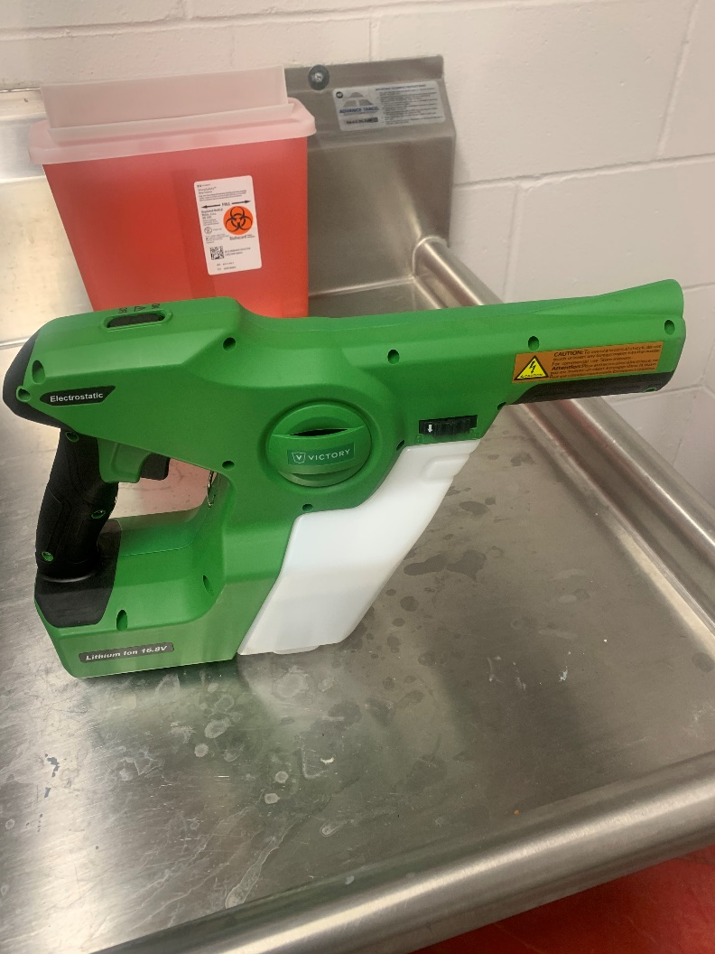
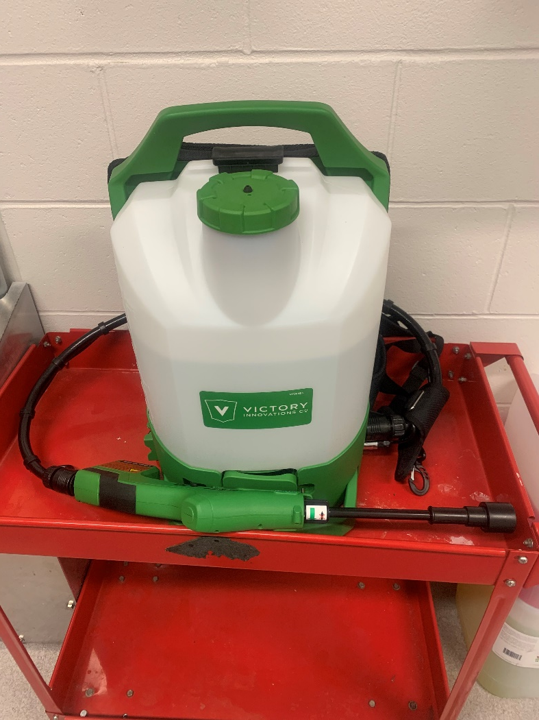
Housekeeping
  Electrostatic Sprayer Technology

Slide 62
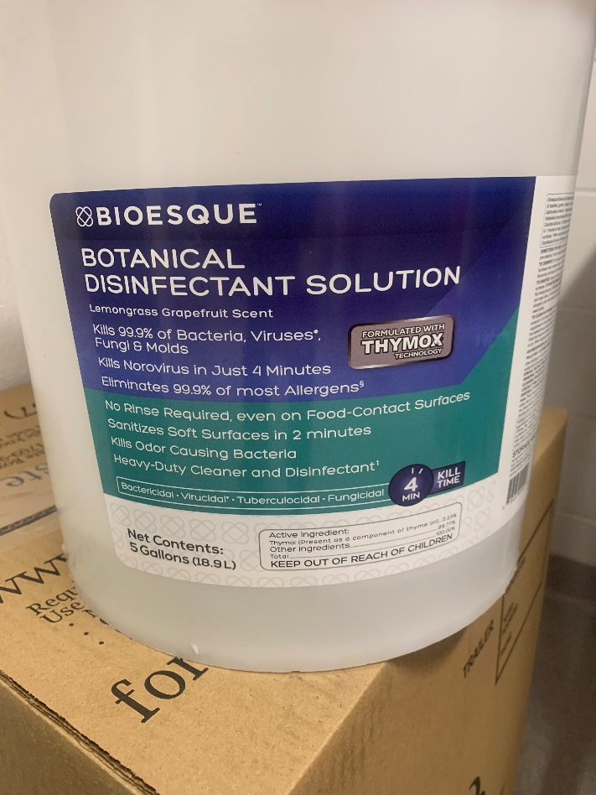
Housekeeping
  Electrostatic Sprayer Technology
  Electrostatic sprayers work by charging liquids (i.e., cleaners, sanitizers, and disinfectants) as they pass through a sprayer nozzle. This generates charged droplets that repel one another and actively seek out environmental surfaces, which they stick to and even wrap around to coat all sides. The result is a uniform coating of sanitizer or disinfectant on sprayed objects, including hard-to-reach areas that manual cleaning can miss. The technology also helps avoid liquid pooling often associated with trigger sprayers.

Slide 63
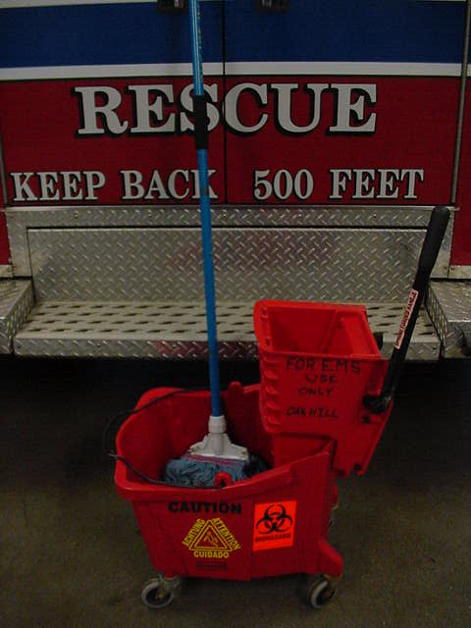
Housekeeping
Do not use the red mop and bucket used for station cleaning
Red buckets and mop handle are for Bio Hazard only

Slide 64
Routine Decontamination
All department Apparatus is decontaminated every Saturday. All surfaces in the stations and apparatus are to be wiped down with approved cleaner and allowed to air dry.
Decontamination also needs to be completed whenever there is a concern and possibility of contamination.

Slide 65
Special Decontamination Orders
Special decontamination orders may be disseminated by the Infection Control Officer or Administrative staff during increased sick rates with similar symptoms amongst employees or epidemic / pandemic events.
Decontamination frequency and disinfect agent will be determined by the Infection Control Officer.

Slide 66
Exercise Equipment and shower areas
Studies have shown an increase in the rates of MRSA infections within Fire Stations
Exercise Equipment must be wiped down with approved cleaner after each use
Showers and sinks must also be cleaned after use
Razors, towels and personal items must not be left in the shower area

Slide 67
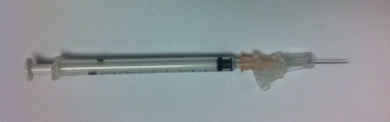
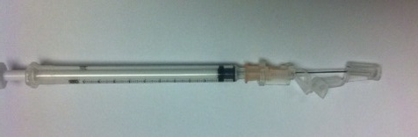
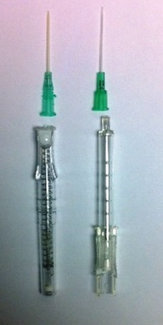
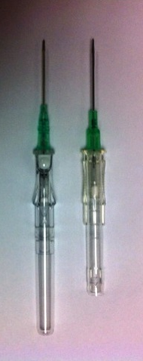
Pre-Engineered sharps
Medications/Injections
IV Needles

Slide 68
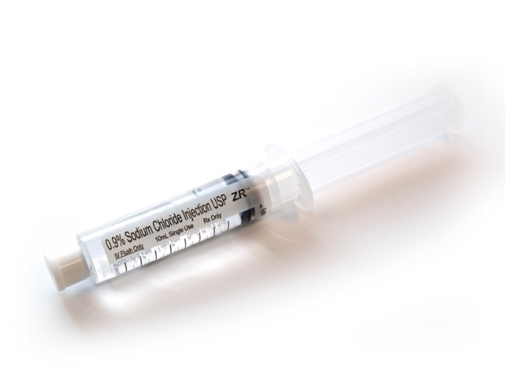
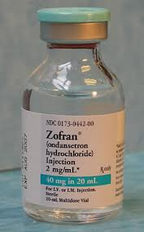
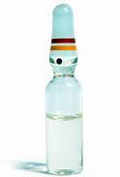
Medication Administration
Prefilled Syringe
Vials
AMPULE

Slide 69
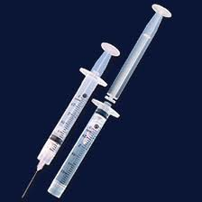
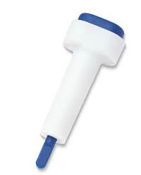
Miscellaneous Sharps
Syringes
Lancets
CAUTION! EMS CALLS FOR HEROIN OVERDOSES OR KNOWN DRUG USERS, MAY HAVE CONTAMINIATED SHARPS LAYING AROUND

Slide 70
Contaminated Uniforms and Turnout gear
Once contaminated you cannot bring these home
Must be washed to the manufactures recommendation and NFPA 1581
Washer and gear drier are available at Dunstan Station
DO NOT use the washing machines at Black Point, Pleasant Hill or Oakhill for contaminated uniforms or equipment.
Do NOT enter living quarters with contaminated uniforms or gear! (Any turnout gear shall not be brought into any stations living areas.)

Slide 71

Vaccination Program

Slide 72
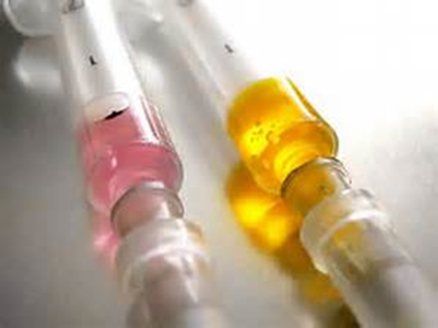
Vaccination
We are classified as Health Care providers and it is recommended you have certain vaccinations
  Varicella (Chicken Pox or documentation of prior infection), MMR, Influenza, TDAP, Hepatitis B.
Vaccination will limit the need for post exposure follow up/ Treatment
Currently exploring the logistic of an “IN House” Program at no cost to the employee.
In the meantime if you need a vaccination please see your PCP or contact Captain Contreras to work on alternative options

Slide 73

Communicable Disease history & immunization record
This will be kept confidential and only be accessed to assist in the evaluation as to which vaccines to offer and post exposure follow up.
Records must turned in at the beginning of employment and updates must be submitted to the Designated Infection Control Officer or the Administrative Assistants.
If you chose not to provide this information, you MUST sign the declination portion of the form
The intent of this program is to ensure you remain healthy and are protected

Slide 74

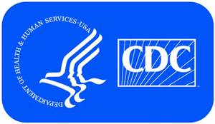
Work restrictions
Center for Disease Control makes recommendation on work restrictions in regards to communicable diseases, they are listed in our Exposure Plan, Appendix M
The Town of Scarborough will follow CDC recommendations
If you are sick do not come to work. If you do, you will be sent home.
If you have a fever of 101 Degrees Fahrenheit do not come to work or you will be sent home.

Slide 75
Conclusion
Rules are in place for your health and safety
Failure to follow these rules is a risk that does not need to be taken
Questions Contact Captain Contreras
Call 207-730-4288
or E-Mail
Ncontreras@scarboroughmaine.org

Slide 76
Contact List
Infection Control Officer’s Primary Contact: 730-4297
Designated Infection Control Officer
Captain Nathaniel Contreras
Alt Phone 730-4288
Email Ncontreras@Scarboroughmaine.org
Program Administrator
Fire Chief Richard Kindelan
Phone 730-4201
Email Rkindelan@Scarboroughmaine.org
Fire Department Physician
Dr. Jeanne Scheddel, Concentra Medical Services
Secondary Designated Infection Control Officer
Lt.Shannon Mazyck
Email smazyck@scarboroughmaine.org
Deputy Chief
Kevin Duross
Phone 730-4202
Email Kdross@Scarboroughmaine.org

