Slide 1
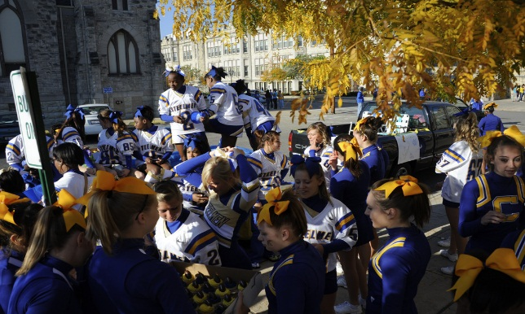
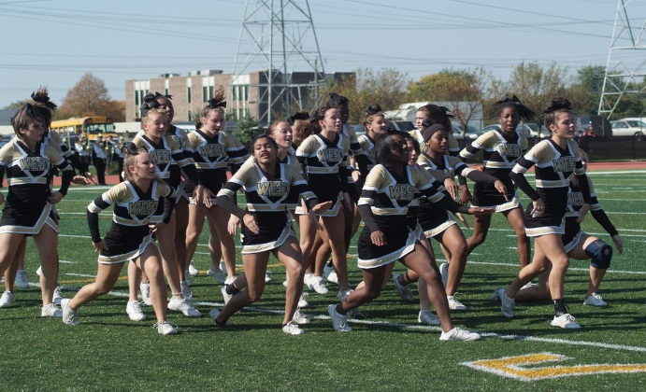
Joliet Township High School

Slide 2
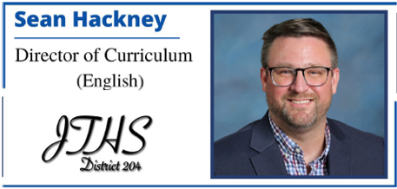
Presenters

Slide 3
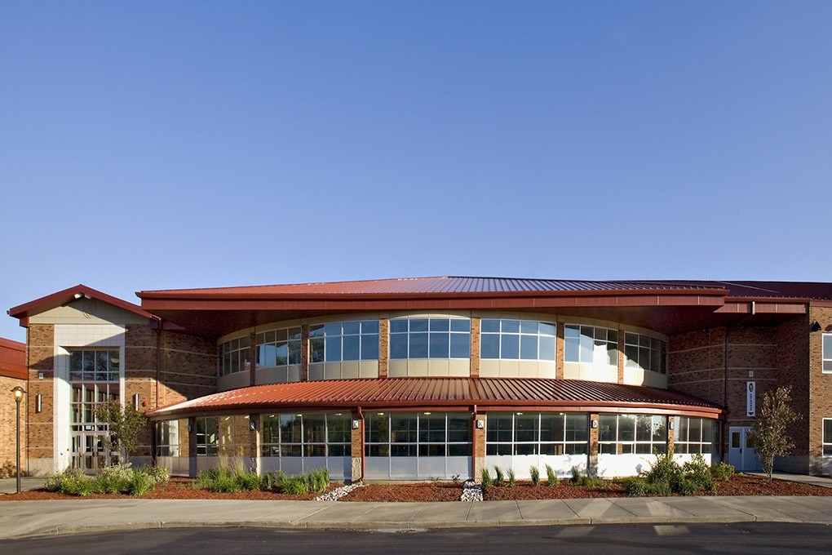
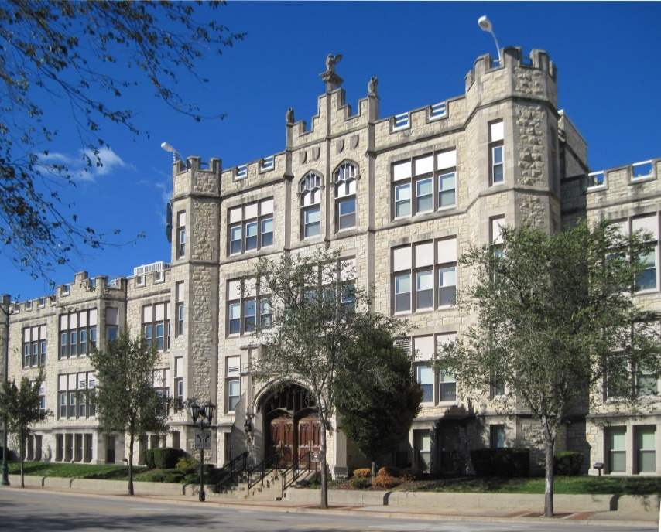
Objectives
Importance/Role of PSAT
Course placement
Honors & AP
Electives
Support

Slide 4
Student Graduation Requirements
Must earn 22 credits to graduate
Must earn 16 credits as follows:
4 years of English
3 years of Mathematics
2.5 years of Social Science
2 years of Science
½ year of Consumer Education
½ year of Health
1 year of Art/CTE/Music/World Language
Must enroll in:
3.5 years of PE or ROTC
Successful completion of all graduation requirements above are necessary prior to receiving a diploma.

Slide 5
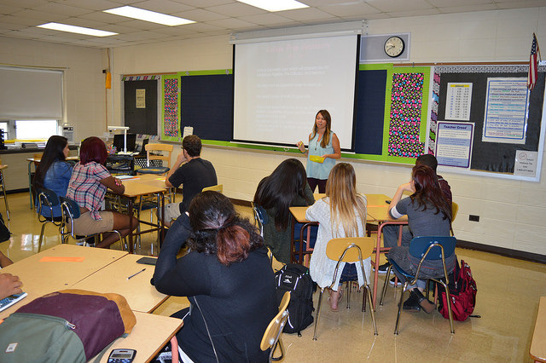
Freshman Academy
7:20 a.m. – 3:15 p.m.
8 periods of 55 minutes each

Slide 6
Freshman Schedule:
Freshman Academics
English | Pre-AP English 1 | Pre-AP Honors English 1
Math | Algebra 1 | Honors Algebra 1
 | Geometry | Honors Geometry
 | Honors Advanced Algebra
Social Studies | Pre-AP World History/Geography | AP Human Geography
Science | Biology | Honors Biology
Applied Life | PE | ROTC
Electives / Support | Art/CTE/Music/World Language | Literacy / Double Block
Lunch / Advisory

Slide 7
Academic Supports
Customized Schedules for:
Students with and Individualized Education Plan (IEP)
Director of Special Services:
Jamila Cage jcage@jths.org
Students who are English Language Leaners (ELL)
ELL Program Director:
Paul Oswald poswald@jths.org
General Education Students:
Advisory Learning Lab
Online Tutoring
Math Interventionist
Writing Lab

Slide 8
Advanced Placement Programs
The program allows students to participate in a college level course and gives them the opportunity to place out of college courses and potentially earn college credit.
AP courses available to qualified incoming 9th grade students:
AP Human Geography
AP Computer Science Principles

Slide 9
Make-up Day for PSAT 8
Central Campus
October 15, 2022 – 7:30 a.m.-noon
Bring #2 pencils and CALCULATOR

Slide 10
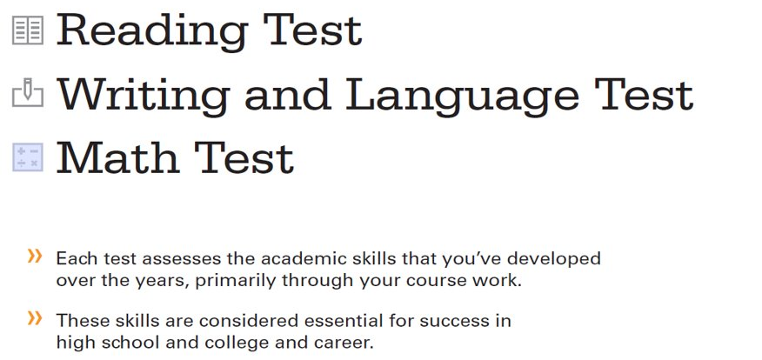
PSAT 8/9 test includes

Slide 11
PSAT 8/9 English Reading & Writing (ERW)
Placement into English, Science, and Social Science courses from:
ERW score.
8th grade teacher recommendation
PSAT 8 ERW Score​ | Course​
720 to 440​ | Pre-AP Honors English 1, Honors Biology,​ AP Human Geography​
430 to 370​ | Pre-AP English 1, Biology, Pre-AP World History/Geography​
360 to 120​ | Pre-AP English 1, Literacy, Biology,​ Pre-AP World History/Geography​

Slide 12
PSAT 8/9 Math
Placement into Math courses from:
PSAT 8 Math Score
8th grade teacher recommendation
Previous coursework when applicable
PSAT 8 Math Score​ | Course​
720 to 460​ | Advanced Algebra Honors, Geometry Honors, Geometry, Algebra 1 Honors
450 to 390​ | Algebra 1
380 to 120​ | Algebra 1 (Double Block)

Slide 13
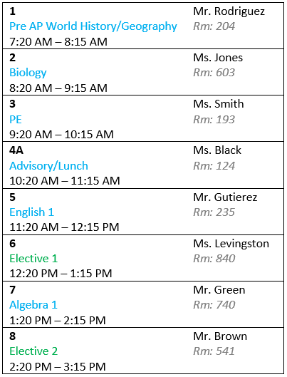
Electives
JTHS Proudly supports students with academic needs
Orientation to Business
Orientation to Human & Public Services
Choir
PLTW Principles of Biomedical Science
JTHS is excited to offer a variety of electives:
Band
Orientation to Technology
Intro to Art
PLTW Introduction to Engineering Design
Health Science
AP Computer Science Principles
Orchestra

Slide 14
Curriculum Preview Night
For incoming 9th Graders
December 7, 2022 @ 6:00pm

Slide 15
Questions?
English | Sean Hackney | shackney@jths.org
Math | Nicole McMorris | nmcmorris@jths.org
Social Studies | Paul Oswald | poswald@jths.org
Science | Diane McDonald | dmcdonald@jths.org
Applied Life Central | Angel Hauert | ahauert@jths.org
Applied Life West | Pat O’Neil | poneil@jths.org
Fine Arts | Bret Marcum | bmarcum@jths.org
CTE | Chris McGuffey | cmcguffey@jths.org
Special Services | Jamila Cage | jcage@jths.org
English Language Learners | Paul Oswald | poswald@jths.org
Strategic Partnerships | Shelley Clark | sclark@jths.org
Notes:
Paul

