Slide 1
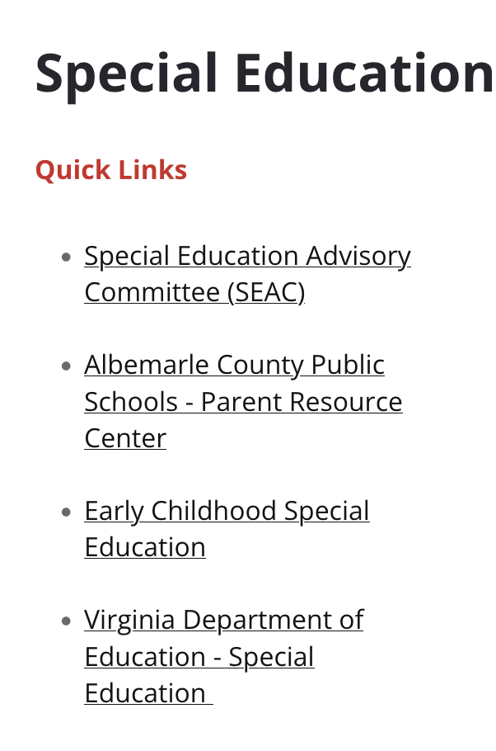
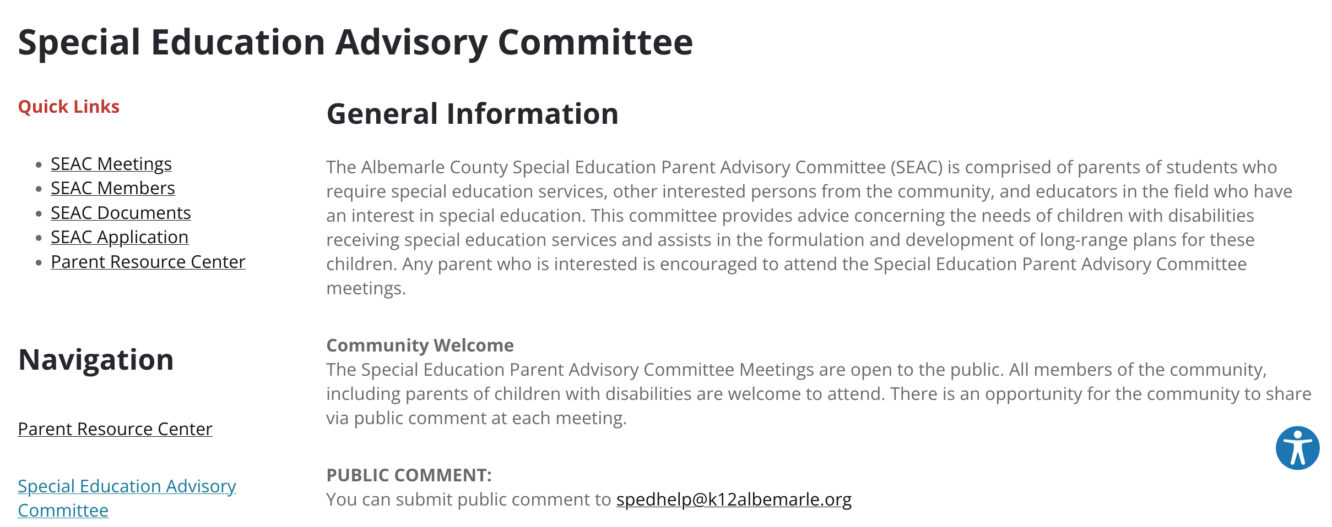
www.k12albemarle.org/our-departments/special-education

Slide 2
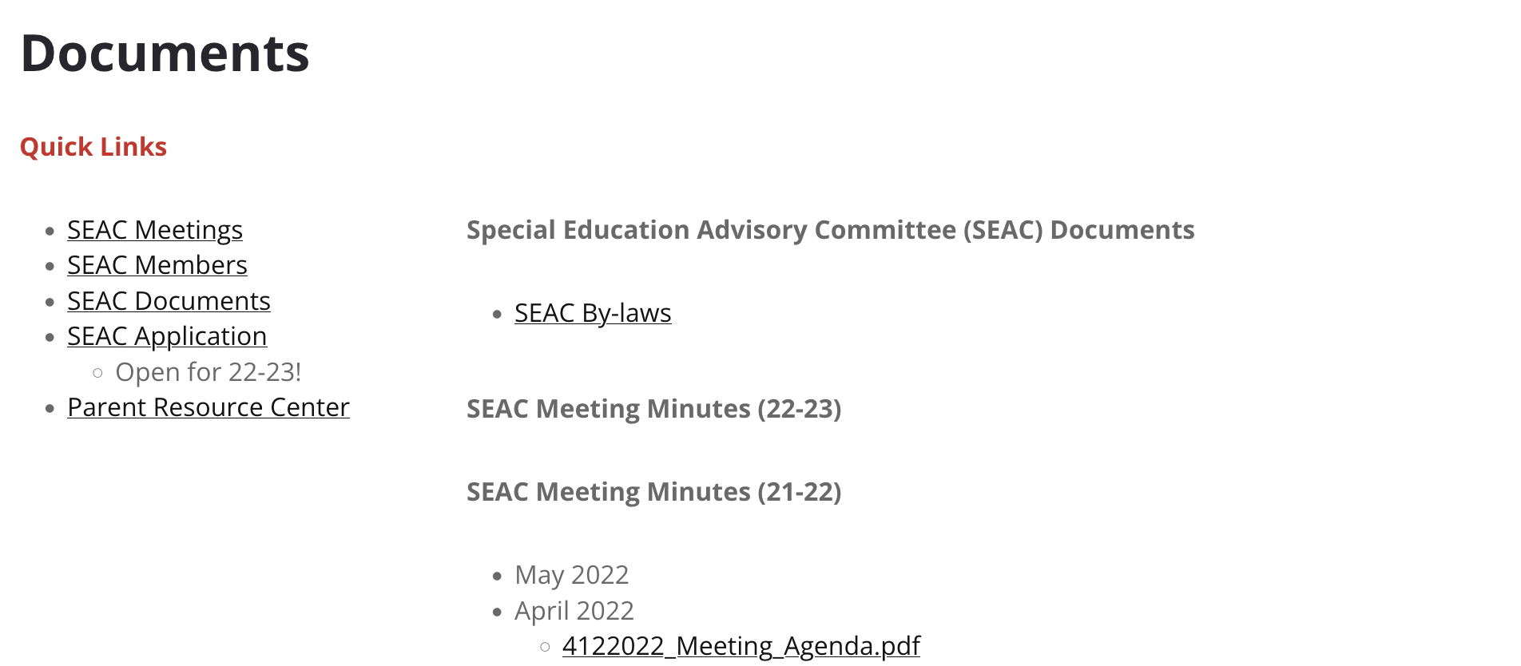
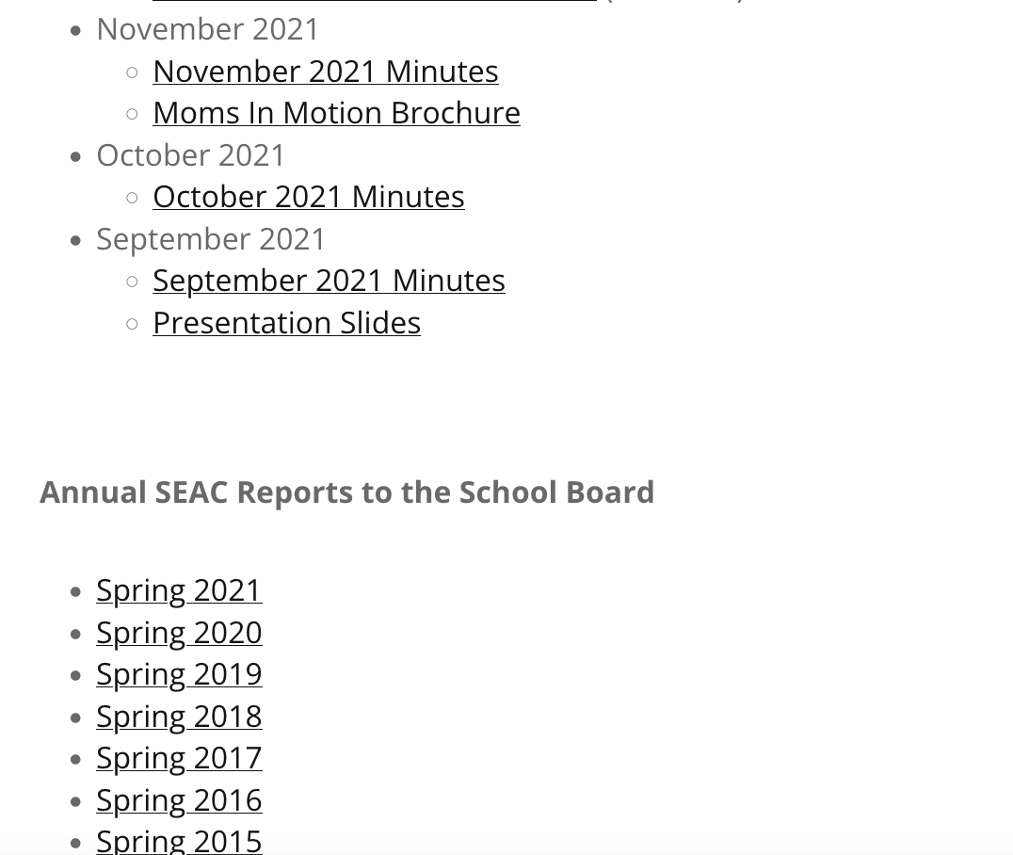

Slide 3
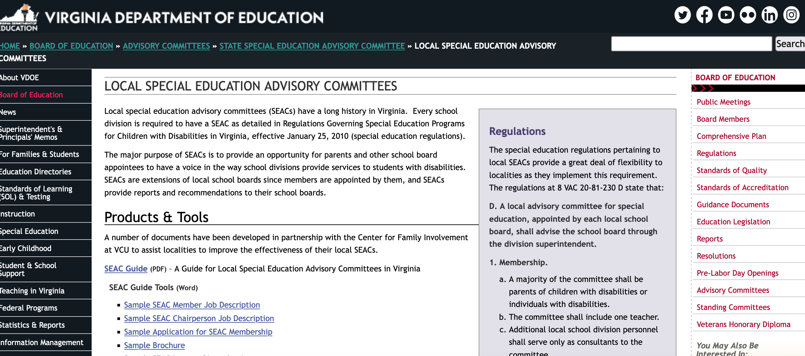
https://doe.virginia.gov/boe/committees_advisory/special_ed/local_sped_advisory_committees/index.shtml

Slide 11
Timeline
Engage with your community and encourage family feedback – beginning now ☺
Annual report – finalized by March? Presented to school board in April?
Review of division annual plan, including budget, month?

Slide 12
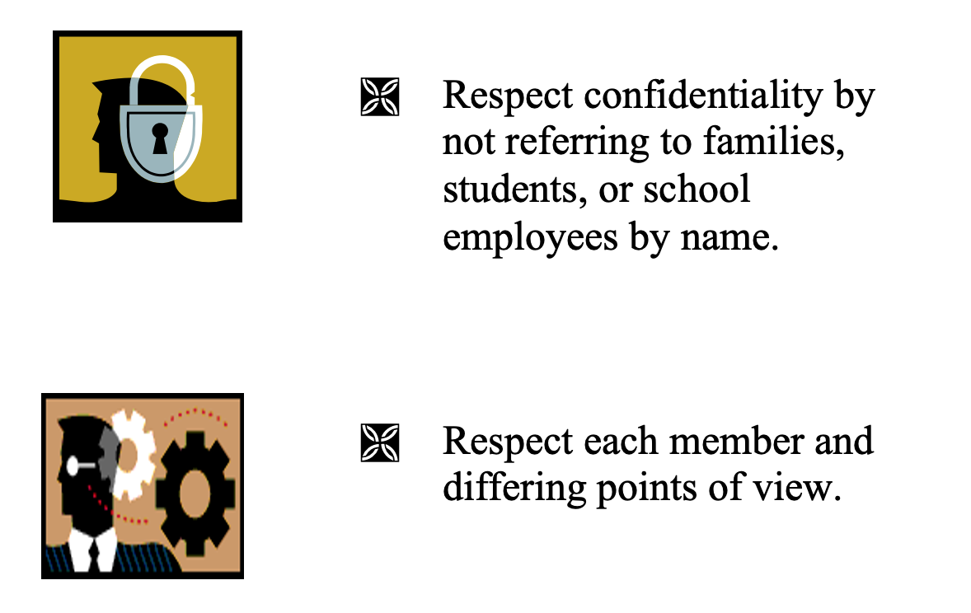
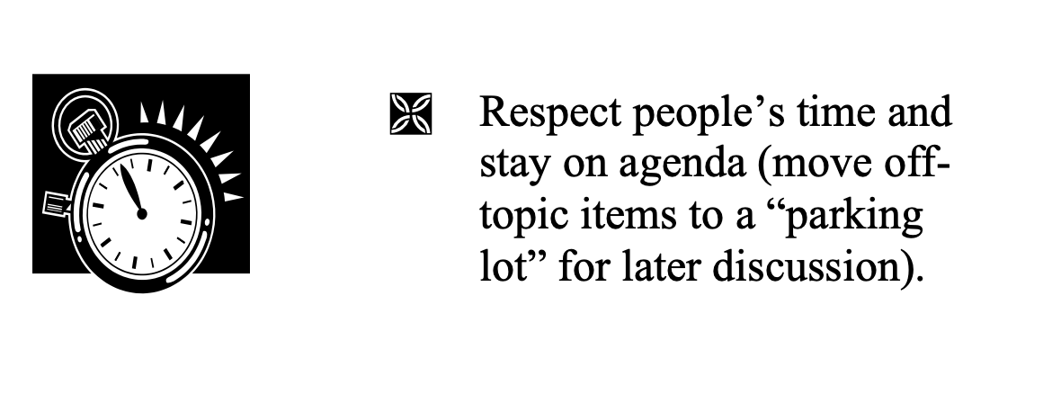
Team Rules

