Slide 1
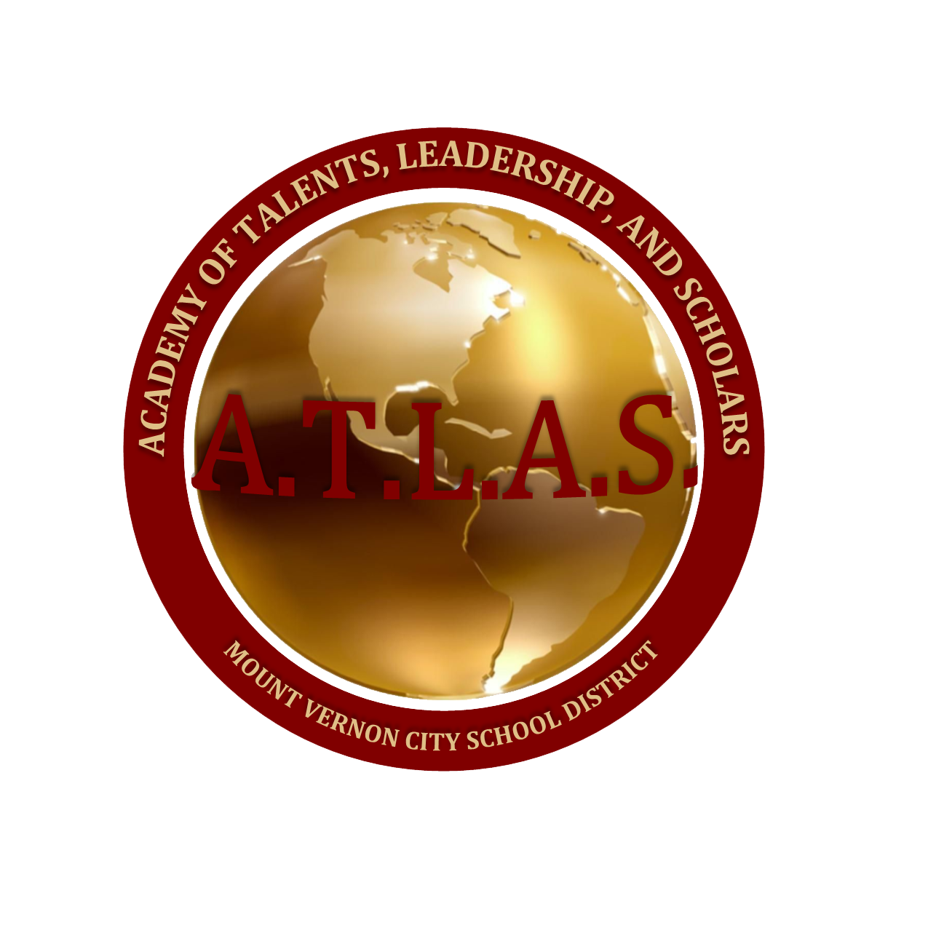
A.T.L.A.S. (Academy of Talents, Leadership and Scholars) Gifted and Talented

Slide 2
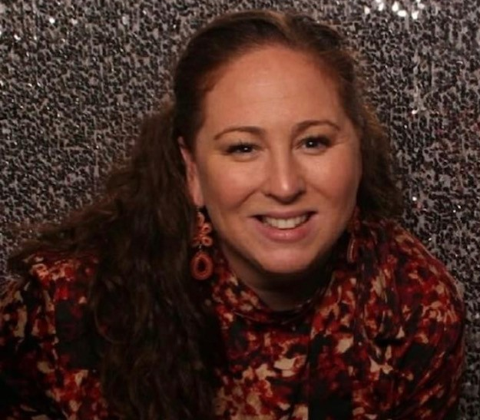
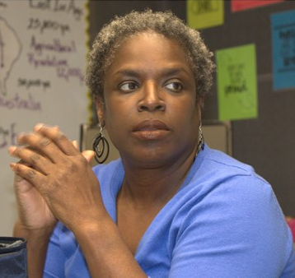
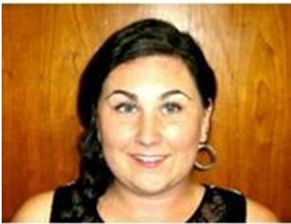
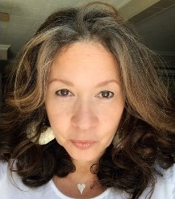
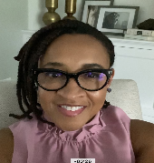
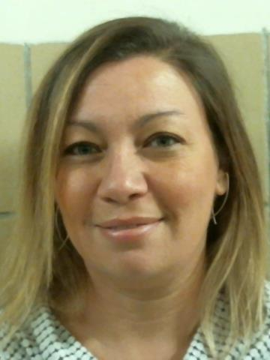
The Gifted and Talented Team
Stefanie Falk
Columbus
Benjamin and Rebecca Turner
Karen Wheeler
Lincoln /
Denzel Washington School of the Arts
Rachel Frederick
Pennington
Taryn Hill
Traphaghen/
Williams
Makenzie Rodgers
Grimes/Parker/
Hamilton
Allison Runicie-Smith
Lincoln /Mandela

Slide 3
What does it mean to be Gifted and Talented?
Gifted" children have been defined as those "who by nature of outstanding abilities are capable of high performance when compared with other children of their age, experience, or environment.” Federal definition includes areas of:
General intellectual ability
Specific aptitude (for example: math, science, language, etc)
Visual and performing arts
Creativity
Leadership
Advancement over same age peers- Friendships might be more related to mental age than chronological age.
Internal asynchronies - develop on a trajectory that is outside of norms, and at an uneven rate. Having areas of both strengths and weaknesses.
“Overexcitabilities” …they are "too"- (you fill in the blank...) too energetic, too talkative, have too much imagination, are too sensitive, think too much, etc.

Slide 4
Gifted and Talented Enrollment Data
7 Staff Members
15 Schools
272 Currently Enrolled from Grades 2-7
85 New Students Admitted for the 2022-2023 Academic Year

Slide 5
Mission and Vision
The Mount Vernon Academies of Talent, Leadership, and Scholars (ATLAS) program will provide a variety of research-based services that will give identified students the opportunity to address their unique needs. This will include curriculum that stresses higher-order thinking such as inquiry skills, problem solving, and creative thinking. In addition, development of self-direction, risk-taking, curiosity, imagination and interpersonal relations will be emphasized. The program framework will allow for individual projects and peer-group interaction.
Long-range goals for this program include the development of self-actualization for the highly able young person and the development of a sense of responsibility to self, school, and society.

Slide 6
Admissions Test: Raven's Progressive Matrices | Raven's 2
Nonverbal tests of observation skills and clear-thinking ability.
The Raven’s produces a single raw score and percentile rank to indicate educative ability or the ability to think clearly and extract meaning out of events, compared to a norm group in the general population.
Benefits:
Use in a variety of settings, such as testing culturally diverse populations, to minimize the impact of cultural or language bias.
Available in a variety of pre-packaged kits for easy purchase and a discounted price from the individual components.

Slide 7
Curriculum
In the Classroom
Out of the Classroom
3rd Grade: The Beginning of the Universe
Who am I? What is my place in the universe?
4th Grade :Life Comes to Earth
What are adaptations essential for living things?
5th Grade: Humans Come to Earth
How have humans evolved? How did civilizations develop?
6th Grade: Written Language
How does written language connect us?
7th Grade: Film/Photography
What impact does the visual arts have on the development of society ?
3rd Grade: The Beginning of the Universe
Hudson River Museum Planetarium
Pelham Arts Center: The Universe
4th Grade :Life Comes to Earth
Greenburgh Nature Center
5th Grade: Humans Come to Earth
Pelham Arts Center: Pottery and Civilization
6th Grade: Written Language
Japan Society Virtual Introduction to Sumi-e Calligraphy
7th Grade: Film/Photography
MVCSD Photography and Art Studio
Jacob Burns Intro to Film production

Slide 8
Curriculum Enhancements
Technology
Expert Support
The Gifted Guru- Lisa Van Gemert
Renzulli Learning
Students can engage in self-directed learning by exploring safe, fully-vetted resources that have been specifically matched to their individual profiles, and teachers can browse the database of resources to find activities that align to specific objectives, skills, or state and Next Generation Standards.
BirdseedTV
Byrdseed.TV is a library of video lessons, projects, and investigations that you can use directly with your gifted students.
Conference keynote speaker, facilitator of educational and business professional development, expert consult to television shows, and author of articles published in magazines and peer-reviewed journals. I’m also the author of the book Perfectionism: A Practical Guide to Managing “Never Good Enough.”

Slide 9
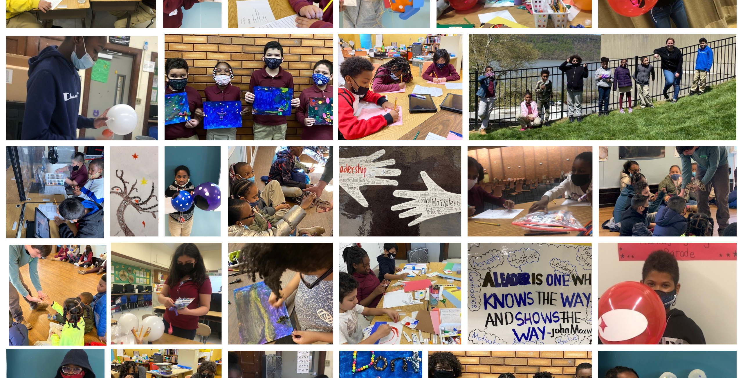

Slide 10
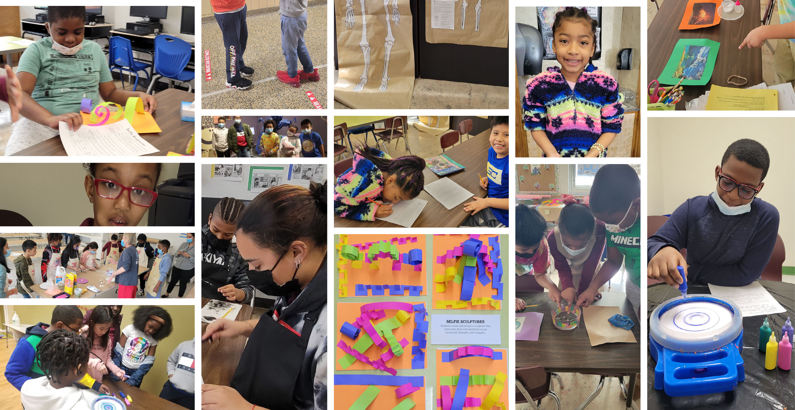

Slide 11
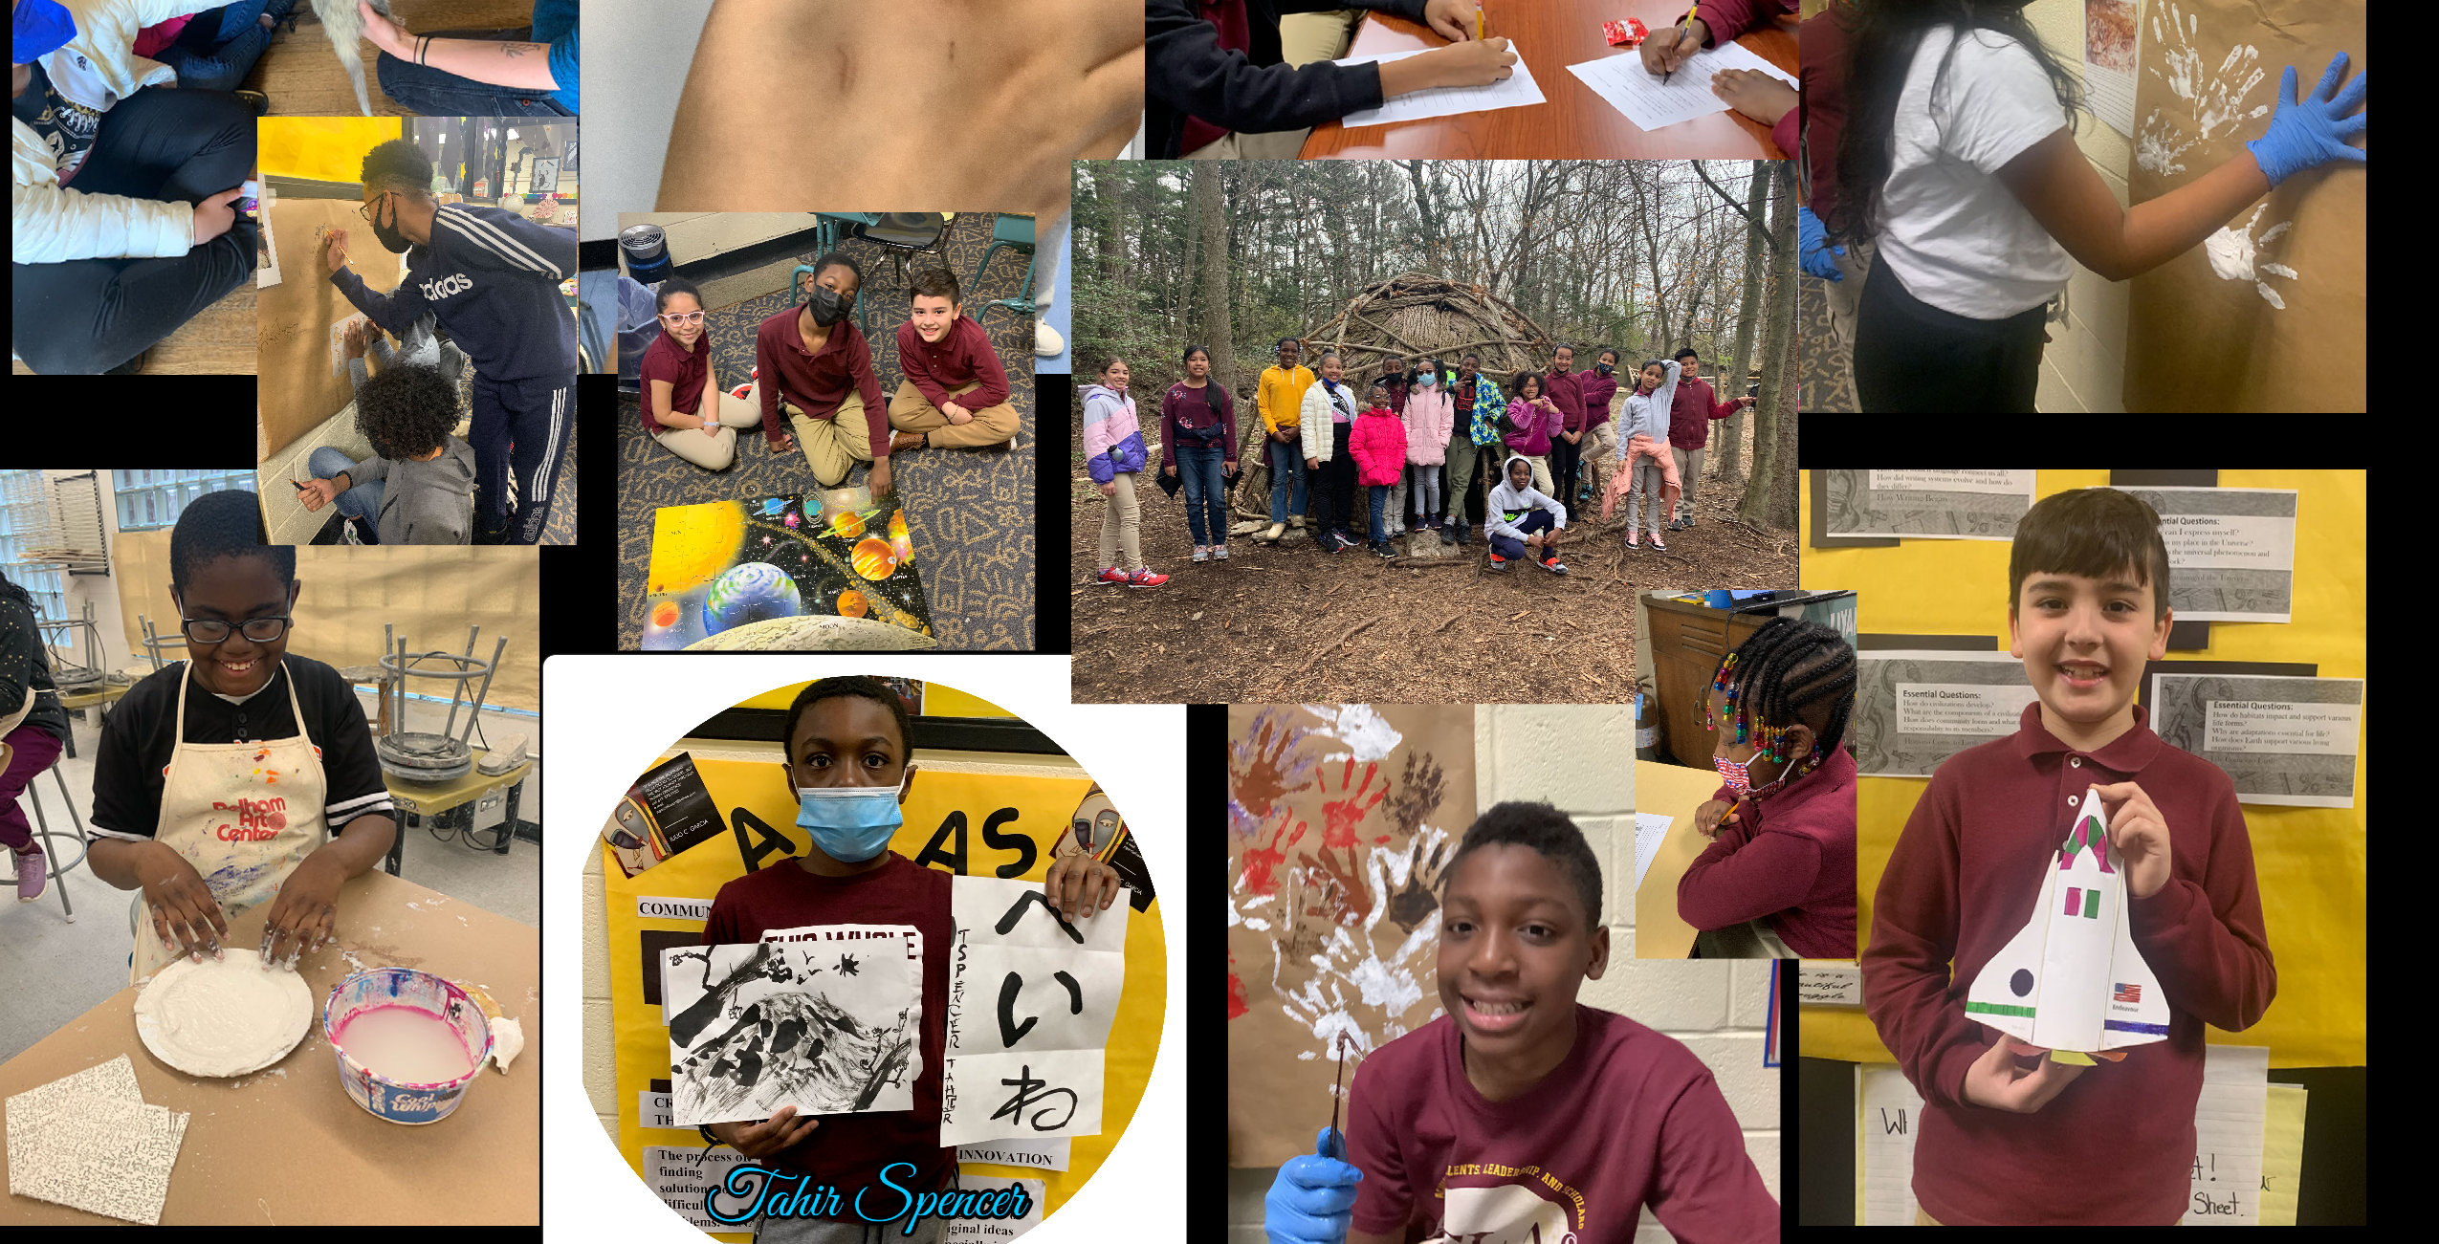

Slide 12
