Slide 1
2021 Enrollment and
Demographic Report
Notes:
Jake will start and introduce

Slide 2
Strategic Plan Areas
Improve learning for students of color, American Indian students, English learners, students receiving special education services, and pre-kindergarten learners
Provide a safe, challenging, and equitable learning environment
Provide curriculum that reflects the diverse cultures of families and students
Continue professional development for Culturally Responsive Competent Teaching
Strengthen relationships between staff and students of color and American Indian Students
Analyze English learner needs and develop an action plan for improving instruction
Improve communication and genuine engagement with families and communities, especially with our underrepresented communities
Strengthen outreach and effectiveness of communication to all families and communities
Recruit and retain more staff of color and American Indian staff
Create a comprehensive system to communicate with families around how they can help their student
Increase access to district and school information by providing interpreters and translations in multiple languages including Karen, Hmong, Somali, Spanish, and Nepali
Notes:
Jake- Updated 2021
This report covers multiple areas of our strategic plan, read bold areas

Slide 3
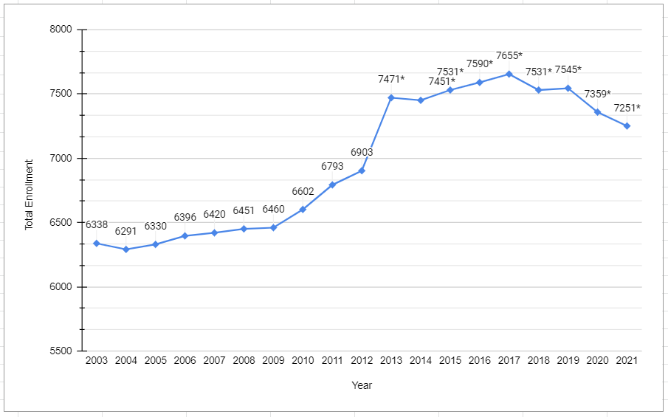
Total Enrollment Trend 2003-2021
* Data includes Harambee Elementary
Notes:
Melissa- Updated 2021
Use 10/1 monthly enrollment report from Jane Krause.
2021 notes:
Notes from Previous years: Down overall, mostly at elementary. Families enrolling in options that had full in person school, holding kindergarten student back, other options
Anticipated we would be down – large senior class, smaller K coming in. Max Capacity at RAHS 600 per grade level had us close open enrollment

Slide 4
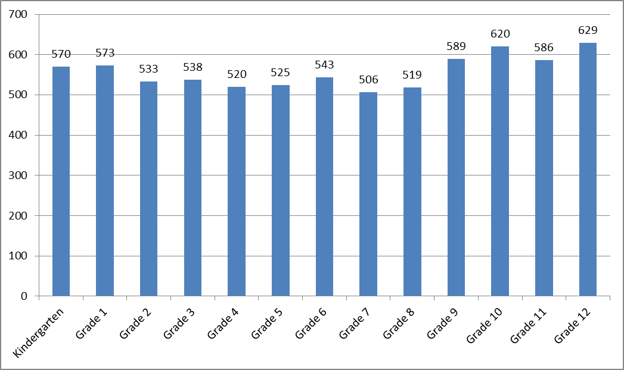
2021 Enrollment by Grade Level
Notes:
Melissa- Updated 2021
Use 10/1 monthly enrollment report from Jane Krause.
2021 Notes:
Previous Years Notes: Same situation next year with larger 12th grade and smaller K

Slide 5
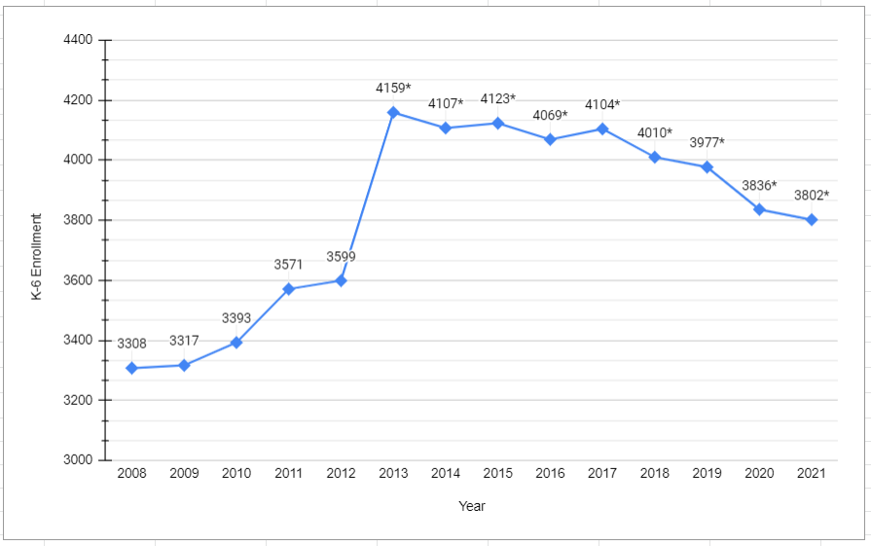
K-6 Enrollment 2008-2021
* Data includes Harambee Elementary
Notes:
Melissa- Updated 2021
Use 10/1 monthly enrollment report from Jane Krause.
2021 Notes:
Previous Years Notes: Down, again result of families seeking a full in-person option
Flat

Slide 6
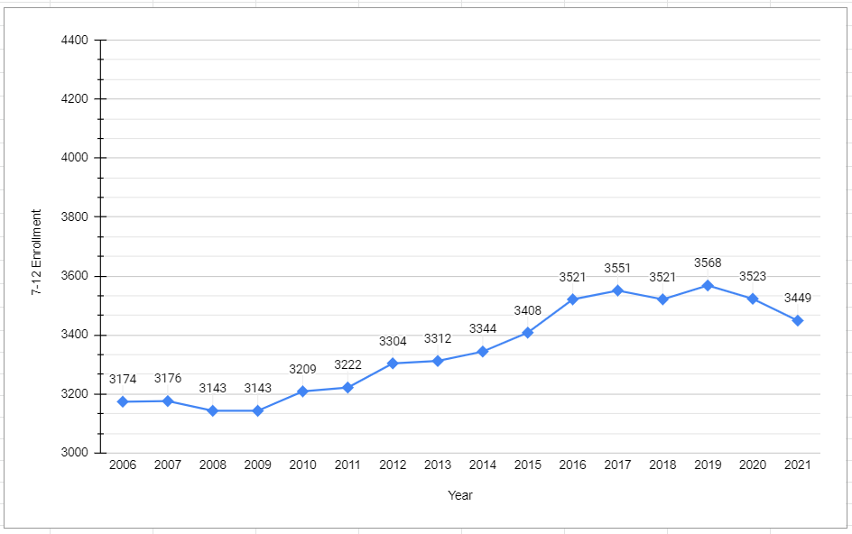
7-12 Enrollment 2006-2020
Notes:
Melissa- Updated 2021
Use 10/1 monthly enrollment report from Jane Krause.
2021 Notes:
Previous Years Notes:
Steady –

Slide 7
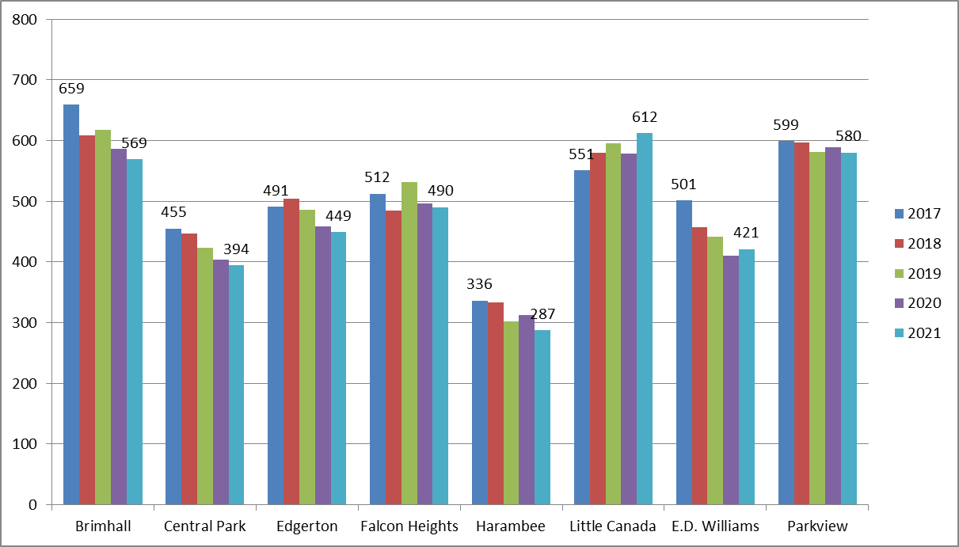
Elementary Building
Enrollment Trends
Notes:
Melissa- Updated 2021
2021 Notes:
Previous Years Notes:
2020 notes: Use 10/1 monthly enrollment report from Jane Krause.
Little Canada DLI has reached grade 6 so last year of increases – should be more steady

Slide 8
2021 Average Class Size - Elem
 | K | 1st | 2nd | 3rd | 4th | 5th | 6th | Building
Brimhall | 21.25 | 20.5 | 26.33 | 27 | 28 | 25 | 27.67 | 24.74 / 24.42
Central Park | 18.75 | 21.67 | 19.67 | 24.50 | 27 | 20.5 | 25.5 | 23.18 / 22.44
Edgerton | 18.33 | 18.33 | 18.67 | 23.67 | 22 | 23 | 25.67 | 23.63 / 23.31
Falcon Heights | 22.33 | 22 | 23.33 | 23.67 | 25 | 25.67 | 32 | 25.79 / 26.11
Harambee | 18.5 | 26 | 20.5 | 23.5 | 27 | 23 | 18.5 | 23.92 / 24.08
Little Canada | 17.67 | 20.4 | 23.75 | 14.33 | 13 | 11.5 | 12.67 | 23.54 / 23.03
E.D. Williams | 20.67 | 22.67 | 30.5 | 31.5 | 27 | 27.5 | 29 | 25.52 / 25.63
Parkview | 20.75 | 27.67 | 24 | 23.33 | 27.33 | 31 | 32.33 | 26.80 / 27.22
District | 20.36 | 21.62 | 22.68 | 25 | 24.8 | 25 | 26.488 | 24.67 / 24.52
Notes:
Melissa-
Use 10/1 monthly enrollment report from Jane Krause.
2021 Notes:
Previous Years Notes:
Far right column shows 2020-21 on top, and 2019-2020 on bottom for comparison
Building numbers change due to grade level enrollment, but overall the district is the same. This is on purpose by not touching class size in recent budget reductions
Bring attention to lower right hand corner

Slide 9
2021Average Class Size Grades 7-8
Class | # of Sections | Range | Average 2021 | Average 2020
Language Arts | 31 | 15-34 | 29.26 | 29.72
Math | 33 | 17-37 | 27.73 | 29.21
Science | 33 | 18-33 | 29.18 | 29.94
Social Studies | 37 | 17-33 | 28.92 | 29.68
Electives | 110 | 16-38 | 28.89 | 30.32
TOTAL | 244 |  | 28.82 | 29.93
Notes:
Melissa- Updated 2021
Use 10/1 monthly enrollment report from Jane Krause.
2021 Notes:
Previous Years Notes:

Slide 10
2021 Average Class Size Grades 9-12
Class | # of Sections | Range | Average 2021 | Average 2020
Language Arts | 44 | 20-38 | 31.02 | 31.15
Math | 48 | 19-37 | 31.42 | 30.89
Science | 48 | 17-36 | 29.63 | 31.02
Social Studies | 54 | 21-36 | 31.98 | 33.47
Electives | 103 | 8-40 | 31.01 | 30.01
TOTAL | 297 |  | 31.03 | 31.13
Notes:
Melissa- Updated 2021
Synergy reports RAMS & PCS 7-8
2021 Notes:
Previous Years Notes:
Slightly Lower Class sizes than 2017-18

Slide 11
Roseville vs. ECSU Class Size Elementary
 | 2016-17 |  | 2017-18 |  | 2018-19 |  | 2019-20 |  | 2020-21*
 | ECSU | Roseville | ECSU | Roseville | ECSU | Roseville | ECSU | Roseville | ECSU | Roseville
Kindergarten | 20.7 | 20.39 | 21.2 | 19.93 | 20.6 | 19.57 | 20.91 | 20.21 | No data | No data
1st Grade | 21.8 | 21.73 | 22.1 | 21.88 | 21.73 | 22.8 | 21.72 | 22.2 | No data | No data
2nd Grade | 23.3 | 23.83 | 23.4 | 23.71 | 23.46 | 23.05 | 22.97 | 23.7 | No data | No data
3rd Grade | 24.5 | 25.23 | 24.2 | 23.74 | 24.4 | 24.79 | 24.18 | 25.5 | No data | No data
4th Grade | 25.9 | 26.1 | 25.6 | 26.04 | 25.63 | 27.3 | 25.32 | 26.88 | No data | No data
5th Grade | 26.6 | 29.26 | 26.4 | 26.55 | 27.06 | 26.9 | 26.66 | 27 | No data | No data
6th Grade | 26.7 | 25.86 | 26.7 | 28.77 | 26.52 | 26.35 | 27.56 | 28.06 | No data | No data
Combo or Ungraded | 24.7 | 23.75 | 24.9 | 24 | 24.18 | 25.86 | 23.79 | 26 | No data | No data
*Due to the COVID-19 pandemic Metro ECSU did not conduct it’s class size survey.
Notes:
Melissa- Updated 2021
Metro ECSU class size report.
2021 Notes: *Due to the COVID-19 pandemic Metro ECSU did not conduct it’s class size survey.
Previous Years Notes:
Always a year behind in this data report collection
We haven’t lost ground with ECSU schools in the last 5 years

Slide 12
Roseville vs. ECSU Class Size
Middle School
 | 2016-17 |  | 2017-18 |  | 2018-19 |  | 2019-20 |  | 2020-21*
 | ECSU | Roseville | ECSU | Roseville | ECSU | Roseville | ECSU | Roseville | ECSU | Roseville
Art | 28.8 | 29.38 | 28.14 | 30.33 | 30.11 | 27.5 | 29.34 | 32.54 | No data | No data
FACS | 29.2 | 28.67 | 28.03 | 29.9 | 31.05 | 27.5 | 28.98 | 32.3 | No data | No data
Health Education | 27.7 | 27.64 | 28.38 | 29.83 | 30.12 | 30.31 | 29.43 | 32.82 | No data | No data
Language Arts/English | 25.9 | 29.62 | 26.64 | 30.66 | 27.26 | 28.97 | 26.9 | 31.21 | No data | No data
Math | 26.1 | 28.78 | 26.36 | 27.18 | 27.1 | 28.72 | 26.68 | 29.25 | No data | No data
Music | 32.3 | 23.86 | 32.41 | 25.33 | 31.47 | 23.2 | 29.96 | 36.44 | No data | No data
Physical Education | 30.2 | 33.51 | 30.22 | 33.45 | 31.12 | 31.36 | 30.31 | 33.24 | No data | No data
Science | 28.6 | 31.58 | 28.79 | 32 | 29.87 | 31.56 | 29.22 | 31.03 | No data | No data
Social Studies | 28.2 | 31.06 | 28.31 | 31.85 | 29.28 | 31.47 | 28.96 | 31.69 | No data | No data
Tech Ed/Comp Science | 27.9 | 27.46 | 27.2 | 28.85 | 28.63 | 28.64 | 29.12 | 30.54 | No data | No data
World Languages | 26.3 | 28.44 | 26.63 | 30.3 | 28.19 | 27.33 | 27.41 | 29.88 | No data | No data
*Due to the COVID-19 pandemic Metro ECSU did not conduct it’s class size survey.
Notes:
Melissa- Updated 2021
2021 Notes: *Due to the COVID-19 pandemic Metro ECSU did not conduct it’s class size survey.
Previous Years Notes:

Slide 13
Roseville vs. ECSU Class Size
High School
 | 2016-17 |  | 2017-18 |  | 2018-19 |  | 2019-20 |  | 2020-21*
 | ECSU | Roseville | ECSU | Roseville | ECSU | Roseville | ECSU | Roseville | ECSU | Roseville
Art | 27.1 | 27.6 | 27.03 | 31.75 | 27.87 | 31.56 | 26.99 | 29.75 | No data | No data
FACS | 26.3 | 28.13 | 25.72 | 30.29 | 27.44 | 27.11 | 27.4 | 31.33 | No data | No data
Health Education | 26.7 | 30 | 26.53 | 30.73 | 28.08 | 29 | 28.67 | 33.5 | No data | No data
Language Arts/English | 30.6 | 28.83 | 30.8 | 29.8 | 29.59 | 31.67 | 27.41 | 30.56 | No data | No data
Math | 27.9 | 30.08 | 27.82 | 28.44 | 28.43 | 30.42 | 27.5 | 30.74 | No data | No data
Music | 28.1 | 30.04 | 28.03 | 30.14 | 28.44 | 30.05 | 38.94 | 51.36 | No data | No data
Physical Education | 30.4 | 30.08 | 29.79 | 32.95 | 30.69 | 31.6 | 30.03 | 36.63 | No data | No data
Science | 28.3 | 30.39 | 27.8 | 29.64 | 28.72 | 29.13 | 29.74 | 27.56 | No data | No data
Social Studies | 29.7 | 31.83 | 29.18 | 31.75 | 30.54 | 32.04 | 29.18 | 30.83 | No data | No data
Tech Ed/Comp Science | 23.8 | 24.63 | 23.35 | 25.53 | 26.59 | 22.7 | 24.95 | 29.12 | No data | No data
World Languages | 25.8 | 26.09 | 26.09 | 25.14 | 27.5 | 29.7 | 26.41 | 31.3 | No data | No data
*Due to the COVID-19 pandemic Metro ECSU did not conduct it’s class size survey.
Notes:
Melissa- Updated 2021
2021 Notes: *Due to the COVID-19 pandemic Metro ECSU did not conduct it’s class size survey.
Previous Years Notes:

Slide 14
Demographic Report
Notes:
Jake Intro

Slide 15
Sections
Race/Ethnicity
English Learners
Educational Benefits Participation
(formerly Free/Reduced Price Meals)
Notes:
Jake Intro

Slide 16
Data Source Notes
Ethnicity and English Learner (EL) data comes from Synergy, our student information system. Further EL data comes from the Home Language Report in the Fall Minnesota Automated Reporting Student System (MARSS) submission.
Educational Benefits Participation data comes from the Compensatory Revenue Report.
Notes:
Jake Intro

Slide 17
Ethnicity
Notes:
Jake

Slide 18
Ethnic Composition
Synergy Data 10/2021
Notes:
Delon or Jake??- Updated 2021
2021 Notes:
Previous Years notes:

Slide 19
District Enrollment by Ethnicity
MARSS Fall Student Enrollment report *Includes Harambee for 2014-15 and beyond
Notes:
Delon or Jake??- Updated 2021
2021 Notes:
Previous Years notes:
We saw American Indian, black, asian and whites go down due to addition of multiracial category
Line break due to new category

Slide 20
Enrollment by Ethnicity
 | American Indian |  | Asian/Pacific Islander |  | Hispanic |  | Black |  | Multi-Racial |  | White |  | BIPOC Students |  | Total
Year | # | % | # | % | # | % | # | % | # | % | # | % | # | % | #
02-03 | 39 | 0.61% | 732 | 11.50% | 220 | 3.46% | 485 | 7.62% |  |  | 4887 | 76.80% | 1476 | 23.20% | 6363
03-04 | 54 | 0.80% | 727 | 11.45% | 275 | 4.92% | 495 | 7.54% |  |  | 4819 | 75.80% | 1541 | 24.20% | 6360
04-05 | 54 | 0.85% | 738 | 11.60% | 311 | 4.90% | 526 | 8.30% |  |  | 4716 | 74.30% | 1629 | 25.70% | 6345
05-06 | 59 | 0.93% | 780 | 12.30% | 359 | 5.60% | 627 | 9.90% |  |  | 4505 | 71.20% | 1825 | 28.80% | 6330
06-07 | 49 | 0.76% | 836 | 13.10% | 400 | 6.20% | 660 | 10.30% |  |  | 4459 | 69.60% | 1944 | 30.40% | 6404
07-08 | 55 | 0.85% | 968 | 15% | 462 | 7.30% | 716 | 11% |  |  | 4241 | 65.80% | 2201 | 34.20% | 6442
08-09 | 62 | 1% | 1034 | 15.90% | 490 | 7.50% | 755 | 11.50% |  |  | 4172 | 64.10% | 2341 | 35.90% | 6513
09-10 | 54 | 0.80% | 1047 | 16% | 538 | 8.20% | 792 | 12.10% |  |  | 4084 | 62.90% | 2431 | 37.10% | 6515
10-11 | 51 | 0.80% | 1149 | 17.30% | 590 | 8.90% | 864 | 13% |  |  | 3973 | 60% | 2654 | 40% | 6627
11-12 | 49 | 0.70% | 1270 | 18.80% | 667 | 9.80% | 905 | 13.40% |  |  | 3879 | 57.30% | 2891 | 42.70% | 6770
12-13 | 51 | 0.70% | 1365 | 19.90% | 669 | 9.80% | 964 | 14% |  |  | 3796 | 55.50% | 3049 | 44.50% | 6845
13-14 | 50 | 0.70% | 1461 | 20.60% | 783 | 11% | 1073 | 15.10% |  |  | 3728 | 52.50% | 3367 | 47.50% | 7095
14-15* | 51 | 0.70% | 1572 | 20.90% | 905 | 12% | 1229 | 16.30% |  |  | 3768 | 50.10% | 3757 | 49.90% | 7525
15-16* | 56 | 0.70% | 1623 | 21.50% | 953 | 12.60% | 1302 | 17.30% |  |  | 3613 | 47.90% | 3934 | 52.10% | 7547
16-17* | 108 | 1.40% | 1624 | 21.20% | 954 | 12.50% | 1399 | 18.30% |  |  | 3564 | 46.60% | 4085 | 53.40% | 7649
17-18* | 124 | 1.60% | 1635 | 21.20% | 1009 | 13.10% | 1501 | 19.50% |  |  | 3440 | 44.60% | 4269 | 55.40% | 7709
18-19* | 27 | <1% | 1473 | 19.60% | 1039 | 13.80% | 1195 | 15.90% | 516 | 6.90% | 3280 | 43.60% | 4250 | 56.40% | 7530
19-20* | 27 | <1% | 1440 | 19.10% | 1096 | 14.60% | 1254 | 16.70% | 519 | 6.90% | 3185 | 42.30% | 4336 | 57.70% | 7521
20-21* | 29 | <1% | 1412 | 18.70% | 1054 | 13.90% | 1373 | 18.20% | 624 | 8.30% | 3069 | 40.59% | 4492 | 59.41% | 7561
21-22* | 28 | <1% | 1303 | 18.0% | 1093 | 15.1% | 1308 | 18.1% | 598 | 8.3% | 2899 | 40.1% | 4330 | 59.9% | 7229
MARSS Fall Student Enrollment report
*Includes Harambee Elementary
Notes:
Delon or Jake??- Updated 2021
2021 Notes:
Previous Years notes:
Twenty year picture – 18% students of color in 99-2000 and 58% in 2019-20
Addition of multi-racial category

Slide 21
Ethnicity by Building
Building | American Indian |  | Asian |  | Hispanic |  | Black |  | Multi-Racial |  | White |  | Total Enrolled
 | # | % | # | % | # | % | # | % | # | % | # | %
Brimhall | 6 | 1.1% | 66 | 11.6% | 65 | 11.5% | 89 | 15.7% | 49 | 8.6% | 292 | 51.5% | 567
Central Park | 0 | 0.0% | 119 | 30.3% | 49 | 12.5% | 90 | 22.9% | 52 | 13.2% | 83 | 21.1% | 393
Edgerton | 0 | 0.0% | 212 | 48.0% | 62 | 14.0% | 67 | 15.2% | 28 | 6.3% | 73 | 16.5% | 442
Falcon Heights | 3 | 0.6% | 31 | 6.4% | 31 | 6.4% | 65 | 13.5% | 47 | 9.8% | 304 | 63.2% | 481
Harambee | 1 | 0.4% | 53 | 18.7% | 37 | 13.0% | 112 | 39.4% | 37 | 13.0% | 44 | 15.5% | 284
Little Canada | 3 | 0.5% | 93 | 15.2% | 231 | 37.7% | 90 | 14.7% | 40 | 6.5% | 156 | 25.4% | 613
E.D. Williams | 2 | 0.5% | 30 | 7.1% | 46 | 11.0% | 66 | 15.7% | 37 | 8.8% | 239 | 56.9% | 420
Parkview | 2 | 0.3% | 98 | 13.2% | 41 | 5.5% | 149 | 20.0% | 75 | 10.1% | 379 | 50.9% | 744
RAMS | 3 | 0.3% | 178 | 20.6% | 148 | 17.2% | 145 | 16.8% | 75 | 8.7% | 313 | 36.3% | 862
RAHS | 6 | 0.3% | 417 | 17.8% | 355 | 15.2% | 406 | 17.4% | 152 | 6.5% | 1004 | 42.9% | 2340
FAHS | 2 | 2.4% | 6 | 7.2% | 28 | 33.7% | 29 | 34.9% | 6 | 7.2% | 12 | 14.5% | 83
Total | 28 | 0.4% | 1303 | 18.0% | 1093 | 15.1% | 1308 | 18.1% | 598 | 8.3% | 2899 | 40.1% | 7229
MARSS Fall Student Enrollment report
Notes:
Delon or Jake??- Updated 2021
2021 Notes:
Previous Years notes:

Slide 22
BIPOC Students by Building
MARSS Fall Student Enrollment report
Notes:
Delon or Jake??- Updated 2021
2021 Notes:
Previous Years notes:
N very small on FAHS where 2-3 students can make a 10%-15% change

Slide 23
Surrounding Districts by Race/Ethnicity
District | American Indian |  | Asian |  | Hispanic |  | Black |  | White |  | Multiracial |  | Total Enrolled* | % of BIPOC Students
 | # | % | # | % | # | % | # | % | # | % | # | % | # | %
Centennial | 29 | 0.4 | 367 | 5.5 | 385 | 5.8 | 393 | 5.9 | 5109 | 76.7 | 370 | 5.6 | 6659 | 21.6
Mounds View | 34 | 0.3 | 1323 | 11.2 | 1150 | 9.7 | 1349 | 11.4 | 7058 | 59.8 | 889 | 7.5 | 11806 | 38.5
North St. Paul/ Maplewood/ Oakdale | 102 | 1 | 2494 | 24.1 | 1511 | 14.6 | 2016 | 19.5 | 3385 | 32.7 | 835 | 8.1 | 10352 | 65.5
Roseville | 26 | 0.3 | 1402 | 18.8 | 1125 | 15.1 | 1341 | 18 | 2989 | 40.1 | 576 | 7.7 | 7459 | 58.1
Spring Lake Park | 35 | 0.6 | 539 | 8.7 | 979 | 15.9 | 811 | 13.1 | 3309 | 53.6 | 482 | 7.8 | 6169 | 44.9
St. Paul | 338 | 1 | 10719 | 30.7 | 4835 | 13.8 | 8858 | 25.4 | 7318 | 21 | 2850 | 8.2 | 34928 | 78.7
White Bear Lake | 37 | 0.4 | 624 | 7.2 | 679 | 7.8 | 563 | 6.5 | 6234 | 71.6 | 559 | 6.4 | 8705 | 27.6
West. St. Paul/Mendota Heights/Eagan | 59 | 1.1 | 231 | 4.5 | 1382 | 26.9 | 647 | 12.6 | 2493 | 48.5 | 323 | 6.3 | 5140 | 50.7
*n too small for Native Hawaiian/Pacific Islander, so it is not included in the chart
Source: MDE Report Card 2021
Notes:
Delon or Jake??- Updated 2021
2021 Notes:
Previous Years notes:
Jake- UPDATE THIS SLIDE AND CHECK MDE SITE
Change in data source/timing – data is a year old

Slide 24
English Learners (ELs)
Notes:
Kristina- Updated 2021
2021 Notes:
Previous Years notes:
Doing better for us in reaching out to our families in other languages
Now there is a language line for families to call in to us- interpreter line- families can call in to our buildings with an interpreter if they have questions
FACEBOOK Live sessions- providing information and then they are interpreted

Slide 25
English Learners Enrollment
MARSS Fall Student Enrollment report
Notes:
Kristina Updated 2021
2021 Notes: This isn’t accurate – I don’t know how to change the 2021-2022 data. See slide 26…
Previous Years notes:

Slide 26
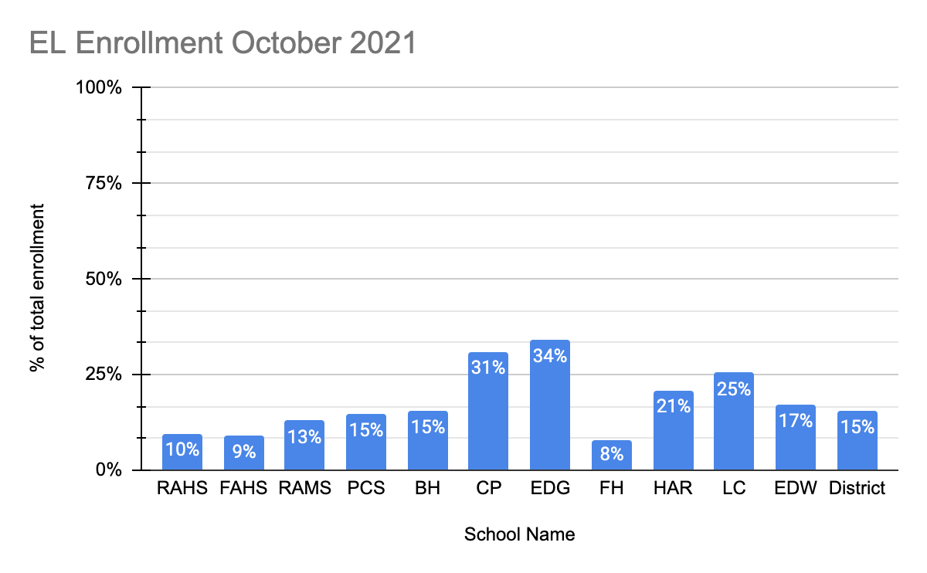
English Learners Enrollment
MARSS Fall Student Enrollment report
Notes:
Kristina Updated 2021
2021 Notes:
I don’t know how to make this comparative like slide 25.
EL enrollment tab in Google sheet - https://docs.google.com/spreadsheets/d/1d8X7mkp_OXGK26RSbbdUeS5XTBPAG8kiCqOTTPdPn4U/edit?usp=sharing
Previous Years notes:

Slide 27
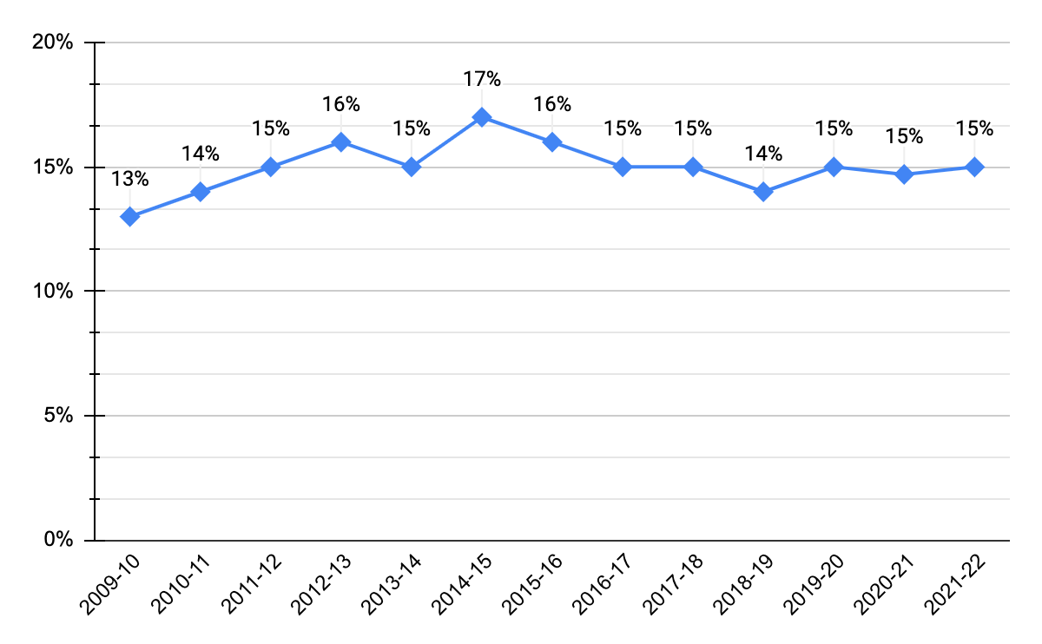
EL District Trend
MARSS Fall Student Enrollment report
Notes:
Kristina Updated 10.25.2021
2021 Notes: We are holding steady at 15% of total enrolled students qualifying for EL services – 1,119 K-12.
This reflects some newly enrolling students, and a lower exit rate from the program due to interrupted assessment and instruction.
Previous Years notes:
Higher numbers at secondary- more open enrollment at ML and HS
Fewer level 1 and 2s, with immigration policy – SLIFE- students with limited of interrupted formal education

Slide 28
EL School Trend
MARSS Fall Student Enrollment report
Notes:
Kristina Updated 2021
2021 Notes: Overall EL enrollment is stable. I believe the reduction in EL enrollment at Central Park is related to housing and minimal refugee arrivals.
Previous Years notes:
FAHS represents switch of SLIFE students to RAHS

Slide 29
Roseville Area Schools: Languages
All 7,545 Students
81 Languages other than English spoken at home: 2467 students
1119 EL students served
MARSS Home Primary Languages Report
Notes:
Kristina Updated 2021
2021 Notes:
Previous Years notes:
30% home language other than English
67% of multi-lingual students are in the top 5 languages

Slide 30
Top Languages Other Than English Spoken at Home
Top Ten Home Languages Other Than English
 | Spanish | Hmong | Somali | Nepali | S’Gaw | Oromo | Vietnamese | Karen | Arabic | Amharic
Total Students 2,152 | 768 (30.3%) | 381 (15.0%) | 318 (12.6%) | 192 (7.6%) | 142 (5.6%) | 91 (3.6%) | 82 (3.2%) | 75 (3.0%) | 54 (2.1%) | 49 (1.9%)
Top Ten Home Languages Among EL Students
 | Spanish | Hmong | Somali | Nepali | S’Gaw | Oromo | Karen | Vietnamese | Arabic | Amharic
EL 872 | 332 (38.1%) | 156 (15.7%) | 110 (12.6%) | 89 (10.2%) | 70 (8.0%) | 41 (4.7%) | 26 (2.48%) | 20 (2.3%) | 18 (2.1%) | 17 (1.9%)
MARSS Home Primary Languages
Notes:
Kristina Updated 2021
2021 Notes:
Previous Years notes:
S’Gaw is a Karen language- it is a dialect of Karen

Slide 31
Home Languages Spoken
 | 2021-22 | 2020-21 | 2019-20 | 2018-19 | 2017-18
English | 4985 | 5817 | 5158 | 5232 | 5391
Hmong | 381 | 426 | 382 | 396 | 404
Spanish | 768 | 832 | 733 | 667 | 659
Karen (including Karen, Pwo and Karen, S’gaw ) | 226 | 285 | 257 | 247 | 174
Chinese, Mandarin | 48 | 70 | 56 | 64 | 68
Vietnamese | 82 | 94 | 82 | 76 | 81
Korean | 21 | 29 | 22 | 32 | 39
Somali | 318 | 307 | 242 | 224 | 225
Arabic | 54 | 72 | 57 | 55 | 51
Burmese | 22 | 34 | 29 | 30 | 36
Japanese | 16 | 15 | 13 | 9 | 10
Hindi | 11 | 17 | 14 | 13 | 13
Nepali | 192 | 241 | 196 | 182 | 161
Cambodian, Khmer | 13 | 14 | 11 | 12 | 10
French | 11 | 14 | 12 | 9 | 11
Oromo (Ethiopia, Somalia) | 91 | 94 | 77 | 73 | 81
Swahili | 23 | 26 | 22 | 21 | 11
Amharic (Ethiopia) | 49 | 55 | 43 | 40 | 38
Tigrinya | 13 | <10 | <10 | <10 | <10
Afrikaans, Ainu, Albanian, Anuak, Bambara, Bantu, Bengali, Bosnian, Bulgarian, Catalan, Cebuano, Chaldean, Cheyenne, Dagari, Dakota, Dutch, English (Creolized), Fanti, Farsi, Filipino, Ganda, German, Gokana, Grebo, Ibibio, Igbo, Ilocano, Indonesian, Italian, Karenni, Khazakh, Krio, Kurdish, Kwanyama, Lao, Latvian, Lisu, Lithuanian, Maay, Macedonia, Malagasy, Mandingo, Marathi, Ojibwa, Pashto, Polish, Portuguese, Punjabi, Russian, Samoan, Shan, Sign Language, Slovak, Swati, Tagalog, Tamil, Telugu, Thai, Tibetan, Turkish, Twi, Ukrainian, Urdu, Wolaytta, Wolof, and Yoruba. (Bold are new languages in 2021) | <10 | <10 | <10 | <10
MARSS Data 10/2021
Notes:
Kristina Updated 2021
2021 Notes:
Previous Years notes:
Spanish is on the rise

Slide 32
Educational Benefits Participation
Notes:
Jake Intro

Slide 33
Educational Benefits District Trend
MARSS Compensatory Revenue
Notes:
Jake- Updated 2021
2021 Notes:
Previous Years Notes:

Slide 34
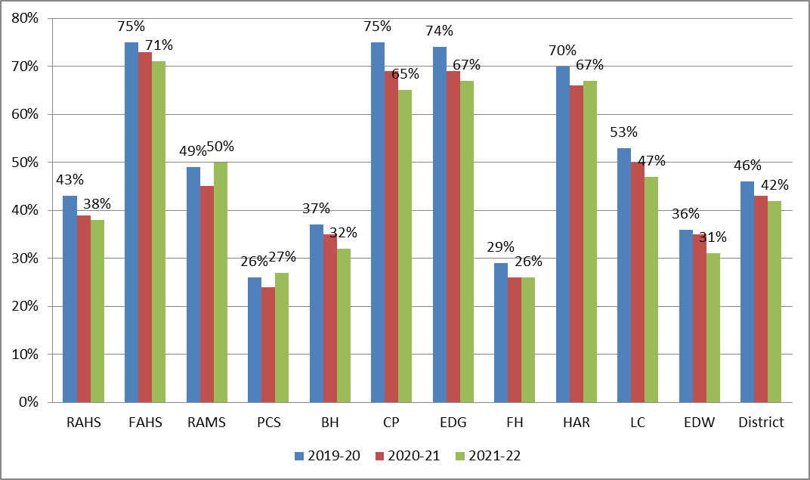
Educational Benefits 2020-2021
MARSS Compensatory Revenue
Notes:
Jake- Updated 2021
2021 Notes:
Previous Years Notes:

Slide 35
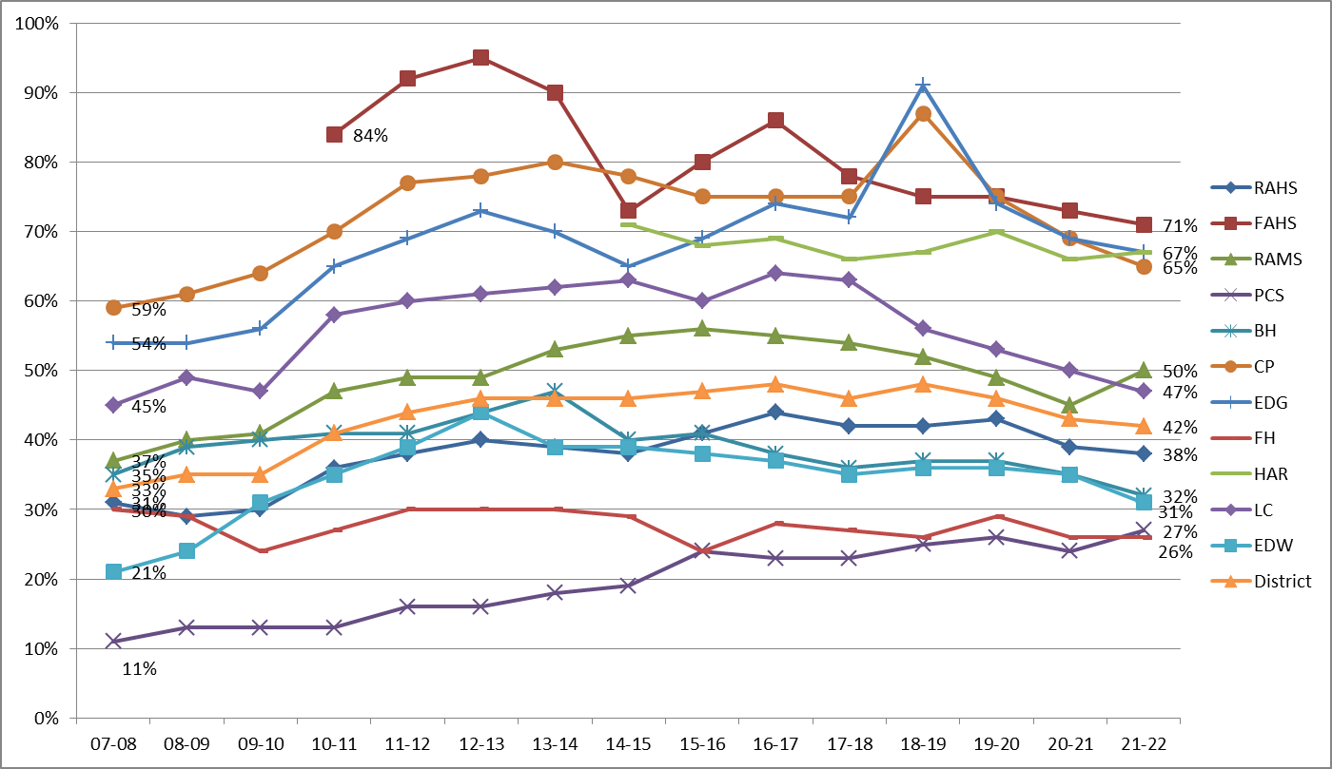
Educational Benefits School Trend
MARSS Compensatory Revenue
Notes:
Jake- Updated 2021
2021 Notes:
Previous Years Notes:

Slide 36
Questions
Notes:
Jake

